Slide 1
GUESSING GAME
Giáo viên soạn: Trần Thị Nhung

Slide 2
WARM-UP
RULES:
- 3 sets of pictures (3 pictures/set)
If you:
get the correct answer after the 1st picture
-> you get the biggest gift.
get the correct answer after the 2nd picture
-> you get smaller gift.
get the correct answer after the 3rd picture
-> you get the smallest gift.

Slide 3

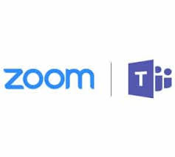
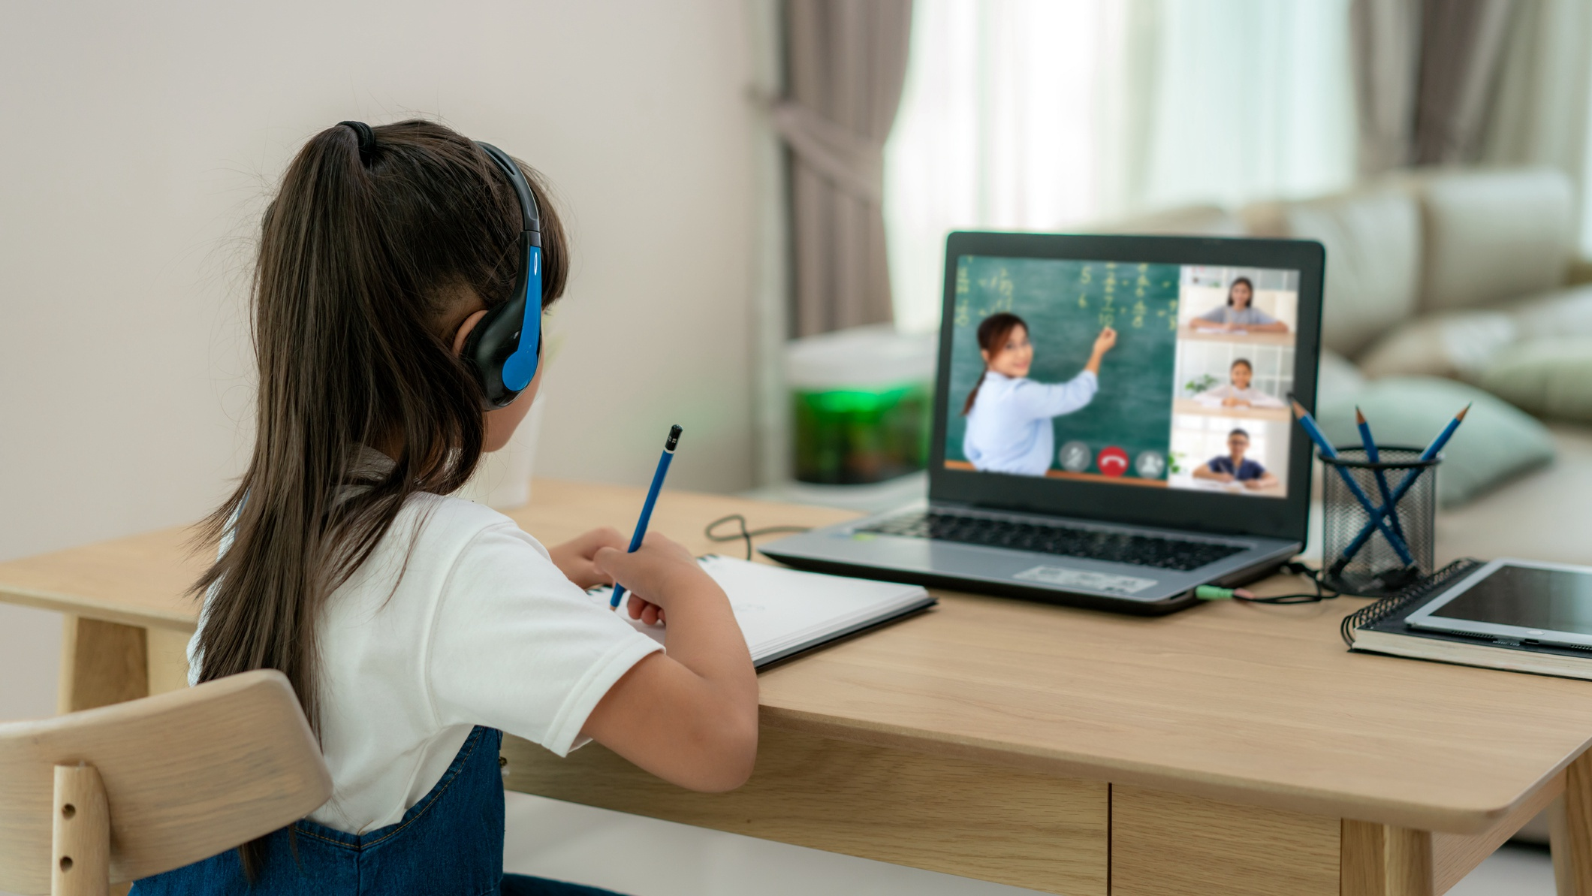
Online learning

Slide 4



Self-study

Slide 5
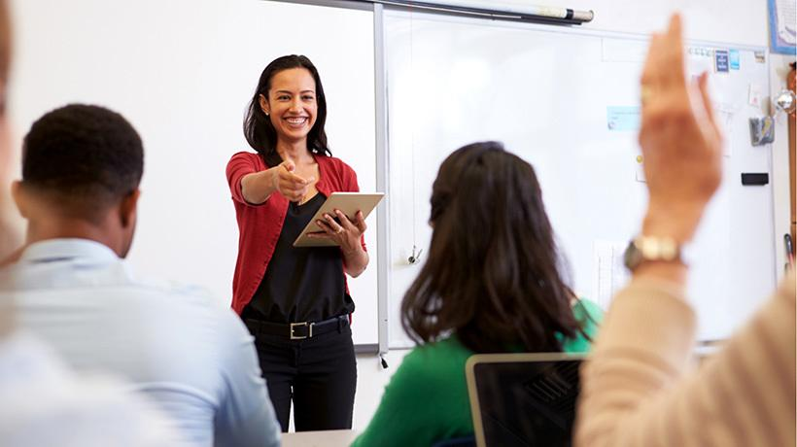
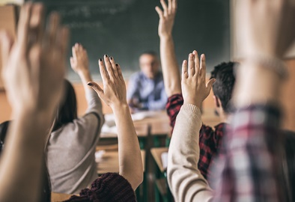

Face-to-face learning
Or traditional class

Slide 6
Unit 8:
NEW WAYS TO LEARN
LESSON 3: READING

Slide 7
01
Pre-reading

Slide 8
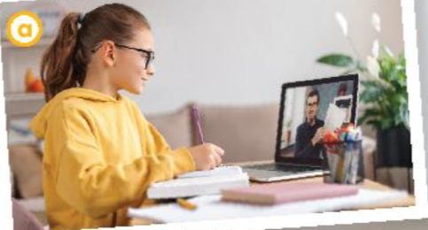
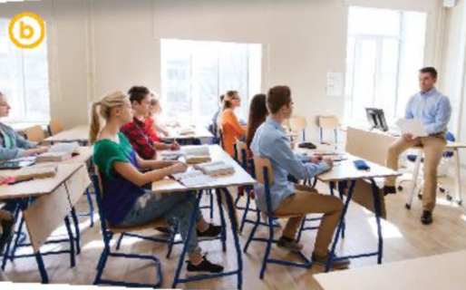
What are the way which people learn in each picture?
Online learning
Face-to-face learning or traditional class
Are you familiar with these ways of learning?

Slide 9
VOCABULARY

Slide 10


VOCABULARY
strategy (n) /ˈstrætədʒi/
Chiến lược
a way of doing something
or dealing with something

Slide 11
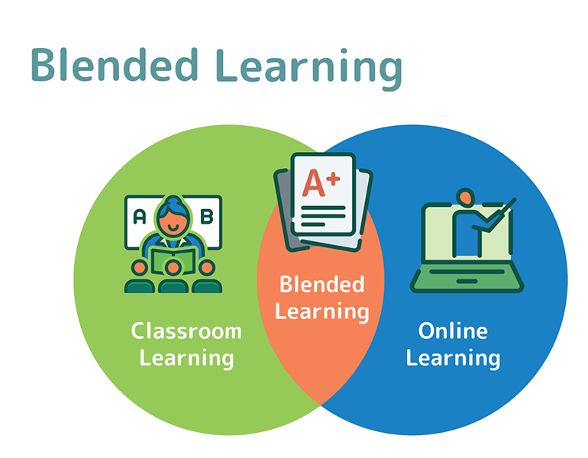
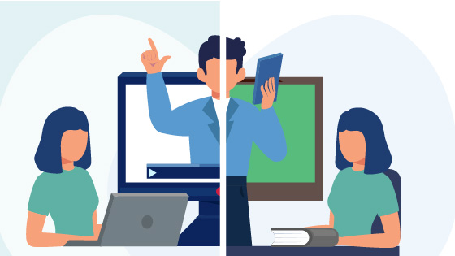
VOCABULARY
blended-learning (n)
/blendɪd ˈlɜːnɪŋ/
Học kết hợp

Slide 12
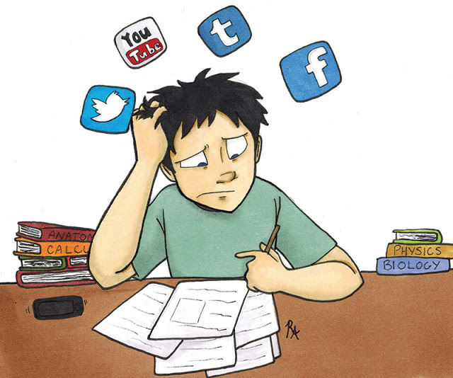
VOCABULARY
distraction (n)
/dɪˈstrækʃn/
Sự xao nhãng
a thing that takes your attention away from what you are doing or thinking about
Eg: There are a lot of distractions that drive me away from my focus like TV, mobile phones or traffic.

Slide 13
VOCABULARY
strategy (n) /ˈstrætədʒi/ | Chiến lược
blended-learning (n) /blendɪd ˈlɜːnɪŋ/ | Học kết hợp
distraction (n) /dɪˈstrækʃn/ | Sự xao nhãng

Slide 14
02
WHILE READING

Slide 15
Fill in the blanks with suitable words or phrases to complete the steps of finding the main idea of a passage.
repetition identify first and last summarize
How to find the main idea of a passage?
- (1) _____________ the topic.
- (2) _____________ the passage in your own words.
- Check the (3) _________________ sentences.
- Look for (4) _______________ of ideas.
Identify
Summarize
first and last
repetition

Slide 16

Exercise 2: (P.89)
Read the texts.
Choose the correct answer.

Slide 17
A. Ways of helping students
B. Ways of learning
C. How to enjoy learning
What are the two students talking about?
Kim
I think face-to-face learning is better than online learning because I can communicate with teachers and other classmates immediately and directly when I have questions.
Laura
I think online learning has more advantages than disadvantages. My school is trying to change from face-to-face to blended learning, so sometimes we have online classes. I don’t have to go to school, but I don’t feel I’m missing any lessons by taking online classes. Furthermore, I think I learn online as much as I learn in a traditional class. I can’t talk to my teacher and classmates, but I can email them at any time. I also have an online discussion
board where I can exchange comments and ideas about my projects with my classmates. The only disadvantage is I really need to have a fast Internet connection.
In class, I can work in groups and discuss with friends. This helps me understand the lessons better. When I have a problem, I can ask for answers or help immediately. I can’t do this in online classes. I have to email my teachers and wait for their reply.
Learning in a traditional classroom also has fewer distractions than learning online. My teachers have many strategies to keep us focused on the lessons. I really enjoy my lessons and learn a lot.

Slide 18
EXERCISE 3: (P.90)
Read the text again and decide who mentions the following sentences.

Slide 19
This person:
Kim | Laura
1. thinks that online learning isn’t as good as face-to-face learning.
2. gains the same knowledge in both ways of learning.
3. has more direct conversations and discussions.
4. uses emails to contact classmates.
5. can pay more attention in class.
6. needs to have access to high-speed Internet.

Slide 20
Laura
I think online learning has more advantages than disadvantages. My school is trying to change from face-to-face to blended learning, so sometimes we have online classes. I don’t have to go to school, but I don’t feel I’m missing any lessons by taking online classes. Furthermore, I think I learn online as much as I learn in a traditional class. I can’t talk to my teacher and classmates, but I can email them at any time. I also have an online discussion
board where I can exchange comments and ideas about my projects with my classmates. The only disadvantage is I really need to have a fast Internet connection.
Kim
I think face-to-face learning is better than online learning because I can communicate with teachers and other classmates
immediately and directly when I have questions.
In class, I can work in groups and discuss with friends. This helps me understand the lessons better. When I have a problem, I can ask for answers or help immediately. I can’t do this in online classes. I have to email my teachers and wait for their reply.
Learning in a traditional classroom also has fewer distractions than learning online. My teachers have many strategies to keep us focused on the lessons. I really enjoy my lessons and learn a lot.
isn’t as good as

Slide 21

This person:
Kim | Laura
1. thinks that online learning isn’t as good as face-to-face learning.
2. gains the same knowledge in both ways of learning.
3. has more direct conversations and discussions.
4. uses emails to contact classmates.
5. can pay more attention in class.
6. needs to have access to high-speed Internet.

Slide 22
Laura
I think online learning has more advantages than disadvantages. My school is trying to change from face-to-face to blended learning, so sometimes we have online classes. I don’t have to go to school, but I don’t feel I’m missing any lessons by taking online classes. Furthermore, I think I learn online as much as I learn in a traditional class. I can’t talk to my teacher and classmates, but I can email them at any time. I also have an online discussion
board where I can exchange comments and ideas about my projects with my classmates. The only disadvantage is I really need to have a fast Internet connection.
Kim
I think face-to-face learning is better than online learning because I can communicate with teachers and other classmates
immediately and directly when I have questions.
In class, I can work in groups and discuss with friends. This helps me understand the lessons better. When I have a problem, I can ask for answers or help immediately. I can’t do this in online classes. I have to email my teachers and wait for their reply.
Learning in a traditional classroom also has fewer distractions than learning online. My teachers have many strategies to keep us focused on the lessons. I really enjoy my lessons and learn a lot.
2. This person gains the same knowledge in both ways of learning.

Slide 23
This person:
Kim | Laura
1. thinks that online learning isn’t as good as face-to-face learning.
2. gains the same knowledge in both ways of learning.
3. has more direct conversations and discussions.
4. uses emails to contact classmates.
5. can pay more attention in class.
6. needs to have access to high-speed Internet.

Slide 24
3. This person has more direct conversations and discussions.
Laura
I think online learning has more advantages than disadvantages. My school is trying to change from face-to-face to blended learning, so sometimes we have online classes. I don’t have to go to school, but I don’t feel I’m missing any lessons by taking online classes. Furthermore, I think I learn online as much as I learn in a traditional class. I can’t talk to my teacher and classmates, but I can email them at any time. I also have an online discussion
board where I can exchange comments and ideas about my projects with my classmates. The only disadvantage is I really need to have a fast Internet connection.
Kim
I think face-to-face learning is better than online learning because I can communicate with teachers and other classmates
immediately and directly when I have questions.
In class, I can work in groups and discuss with friends. This helps me understand the lessons better. When I have a problem, I can ask for answers or help immediately. I can’t do this in online classes. I have to email my teachers and wait for their reply.
Learning in a traditional classroom also has fewer distractions than learning online. My teachers have many strategies to keep us focused on the lessons. I really enjoy my lessons and learn a lot.

Slide 25
This person:
Kim | Laura
1. thinks that online learning isn’t as good as face-to-face learning.
2. gains the same knowledge in both ways of learning.
3. has more direct conversations and discussions.
4. uses emails to contact classmates.
5. can pay more attention in class.
6. needs to have access to high-speed Internet.

Slide 26
Laura
I think online learning has more advantages than disadvantages. My school is trying to change from face-to-face to blended learning, so sometimes we have online classes. I don’t have to go to school, but I don’t feel I’m missing any lessons by taking online classes. Furthermore, I think I learn online as much as I learn in a traditional class. I can’t talk to my teacher and classmates, but I can email them at any time. I also have an online discussion
board where I can exchange comments and ideas about my projects with my classmates. The only disadvantage is I really need to have a fast Internet connection.
Kim
I think face-to-face learning is better than online learning because I can communicate with teachers and other classmates
immediately and directly when I have questions.
In class, I can work in groups and discuss with friends. This helps me understand the lessons better. When I have a problem, I can ask for answers or help immediately. I can’t do this in online classes. I have to email my teachers and wait for their reply.
Learning in a traditional classroom also has fewer distractions than learning online. My teachers have many strategies to keep us focused on the lessons. I really enjoy my lessons and learn a lot.
4. This person uses emails to contact classmates.

Slide 27
This person:
Kim | Laura
1. thinks that online learning isn’t as good as face-to-face learning.
2. gains the same knowledge in both ways of learning.
3. has more direct conversations and discussions.
4. uses emails to contact classmates.
5. can pay more attention in class.
6. needs to have access to high-speed Internet.

Slide 28
Laura
I think online learning has more advantages than disadvantages. My school is trying to change from face-to-face to blended learning, so sometimes we have online classes. I don’t have to go to school, but I don’t feel I’m missing any lessons by taking online classes. Furthermore, I think I learn online as much as I learn in a traditional class. I can’t talk to my teacher and classmates, but I can email them at any time. I also have an online discussion
board where I can exchange comments and ideas about my projects with my classmates. The only disadvantage is I really need to have a fast Internet connection.
Kim
I think face-to-face learning is better than online learning because I can communicate with teachers and other classmates
immediately and directly when I have questions.
In class, I can work in groups and discuss with friends. This helps me understand the lessons better. When I have a problem, I can ask for answers or help immediately. I can’t do this in online classes. I have to email my teachers and wait for their reply.
Learning in a traditional classroom also has fewer distractions than learning online. My teachers have many strategies to keep us focused on the lessons. I really enjoy my lessons and learn a lot.
5. This person can pay more attention in class.

Slide 29
This person:
Kim | Laura
1. thinks that online learning isn’t as good as face-to-face learning.
2. gains the same knowledge in both ways of learning.
3. has more direct conversations and discussions.
4. uses emails to contact classmates.
5. can pay more attention in class.
6. needs to have access to high-speed Internet.

Slide 30
Laura
I think online learning has more advantages than disadvantages. My school is trying to change from face-to-face to blended learning, so sometimes we have online classes. I don’t have to go to school, but I don’t feel I’m missing any lessons by taking online classes. Furthermore, I think I learn online as much as I learn in a traditional class. I can’t talk to my teacher and classmates, but I can email them at any time. I also have an online discussion
board where I can exchange comments and ideas about my projects with my classmates. The only disadvantage is I really need to have a fast Internet connection.
Kim
I think face-to-face learning is better than online learning because I can communicate with teachers and other classmates
immediately and directly when I have questions.
In class, I can work in groups and discuss with friends. This helps me understand the lessons better. When I have a problem, I can ask for answers or help immediately. I can’t do this in online classes. I have to email my teachers and wait for their reply.
Learning in a traditional classroom also has fewer distractions than learning online. My teachers have many strategies to keep us focused on the lessons. I really enjoy my lessons and learn a lot.
6. This person needs to have access to high-speed Internet.

Slide 31
This person:
Kim | Laura
1. thinks that online learning isn’t as good as face-to-face learning.
2. gains the same knowledge in both ways of learning.
3. has more direct conversations and discussions.
4. uses emails to contact classmates.
5. can pay more attention in class.
6. needs to have access to high-speed Internet.

Slide 32
03
Post- reading

Slide 33
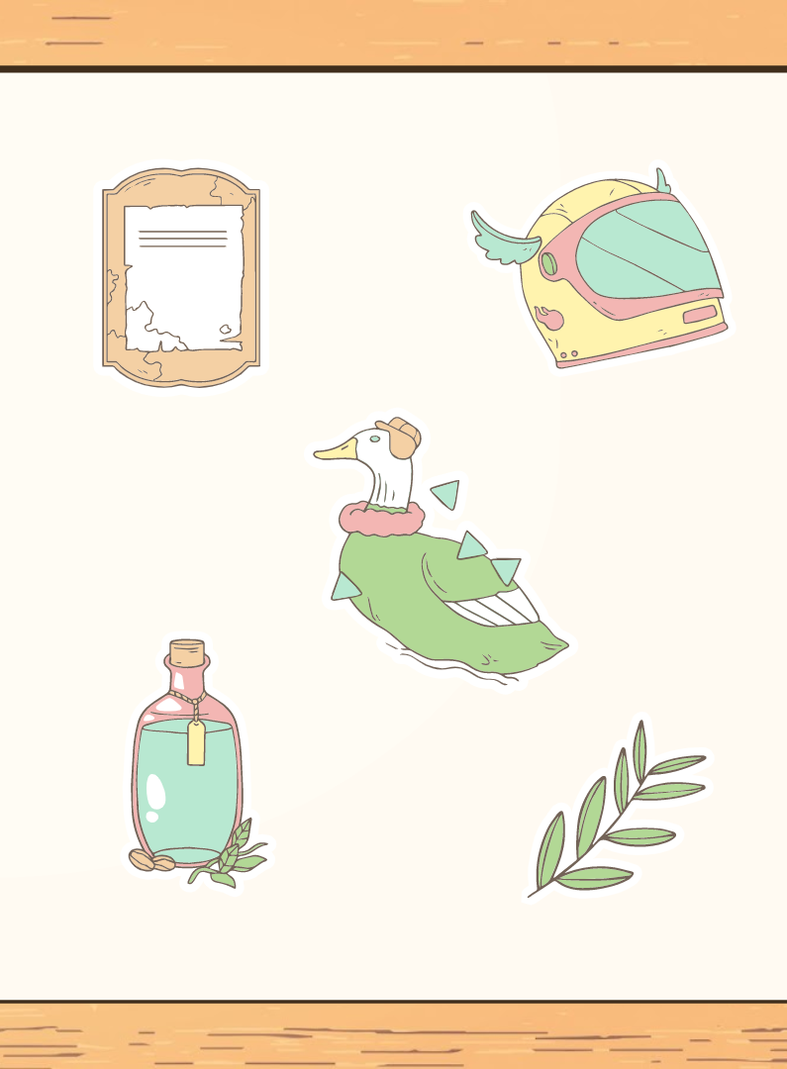
DEBATE
Which way of learning do you prefer?
ONLINE CLASS OR TRADITIONAL CLASS?
Give some reasons.

Slide 34
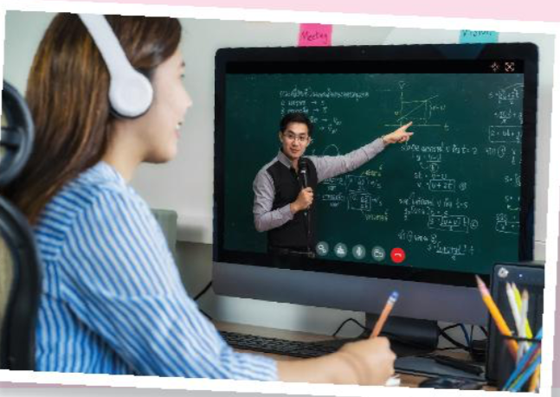
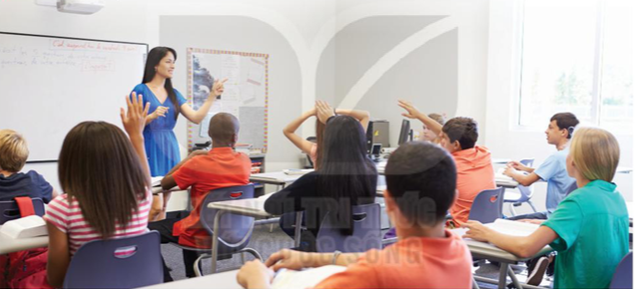
WRAP-UP

Slide 35
Homework
Write a short paragraph (about 100–120 words) about the disadvantages of online learning or face-to-face learning.

Slide 36
Thanks!

