Slide 1




Giáo viên soạn: Trần Thị Nhung

Slide 2

RULES:
Each team will take turns choosing 1 of gold or money and answering the corresponding picture (logo of international organisation).
Each correct answer gets the corresponding number of points.
The team with more points will be the winner.

Slide 3
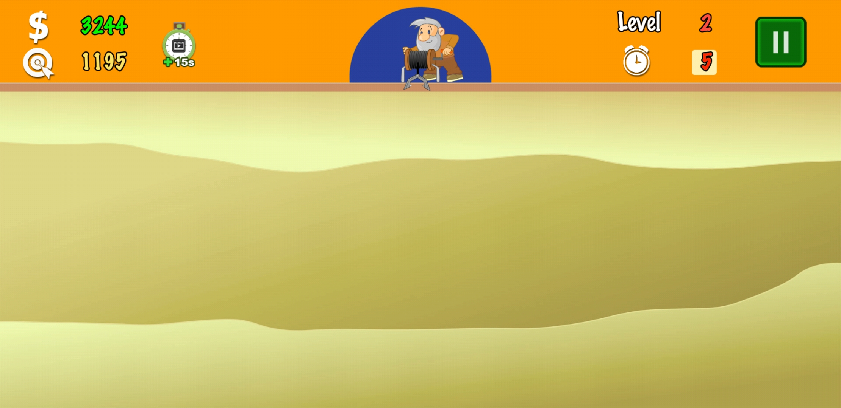


250
220
50
230
200
250
BÀI MỚI

Slide 4





START
12
Hint: “LHQ”
9
3
6
Hết Giờ
The United Nations

Slide 5

START
Hint: children
12
9
3
6
Hết Giờ
United Nations
Children’s Emergency Fund

Slide 6

START
12
Hint: WHO
9
3
6
Hết Giờ
World Health Organisation

Slide 7

START
12
9
3
6
Hết Giờ
Hint: development
United Nations
Development
Programme

Slide 8

START
12
9
3
6
Hết Giờ
World Trade Organisation

Slide 9

START
12
9
3
6
Hết Giờ
ASEAN

Slide 10

PRACTICE
What is the purpose of this organisation when it was founded?

Slide 11
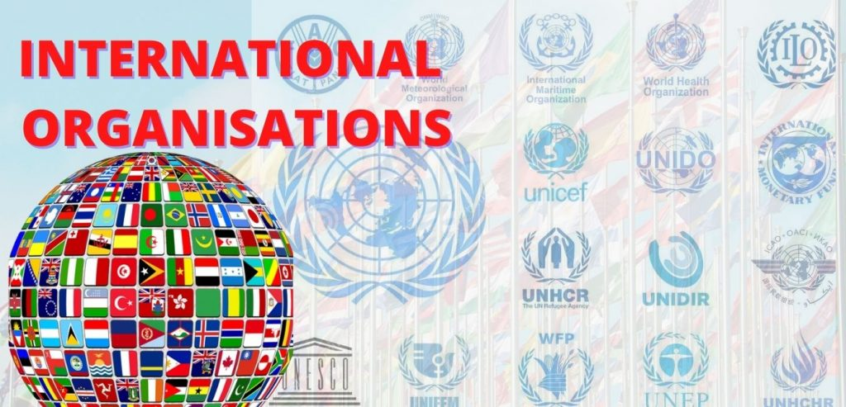
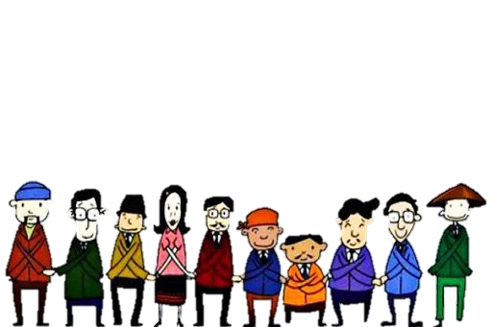
PRESENTATION
Unit 7:
VIETNAM AND INTERNATIONAL ORGANIZATIONS
Lesson 1: Getting started
December
Form | Pronunciation
peacekeeping (adj) | /ˈpiːskiːpɪŋ/
harm (n) | /hɑː(r)m/
expert (adj) | /ˈekspɜːrt/
investor (n) | /ɪnˈvestə(r)/
Meaning
damage or injury
people or organisations that invest money
helping stop people fighting
having great knowledge

Slide 12
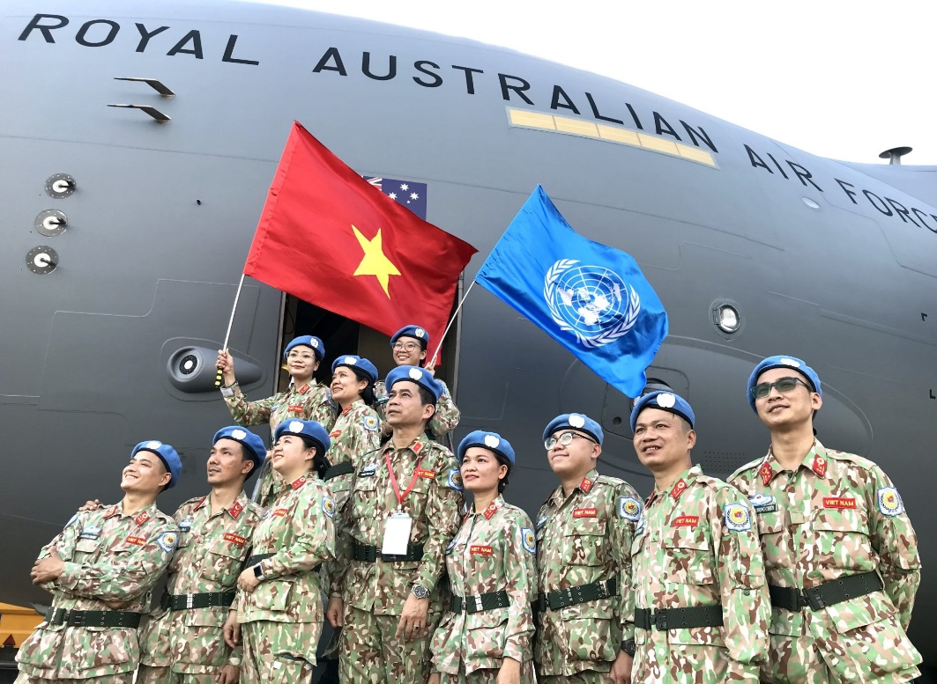
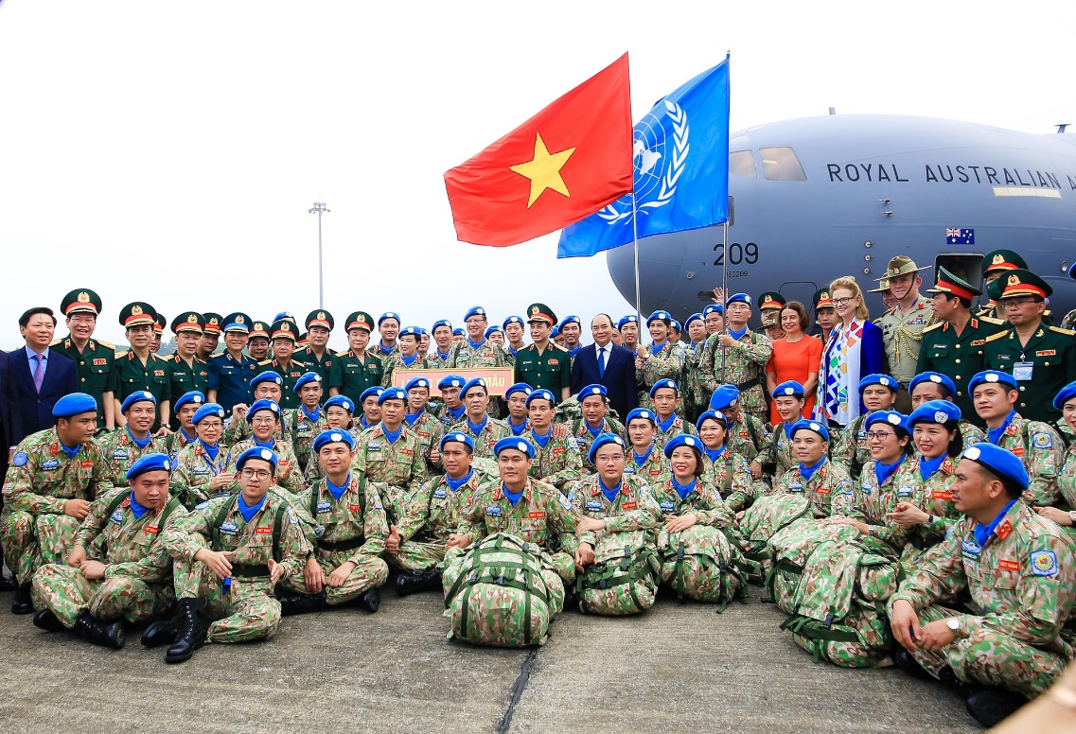
PRESENTATION
peacekeeping (adj)
/ˈpiːskiːpɪŋ/
intended to help stop people fighting and prevent war or violence in a place where this is likely
gìn giữ hòa bình

Slide 13

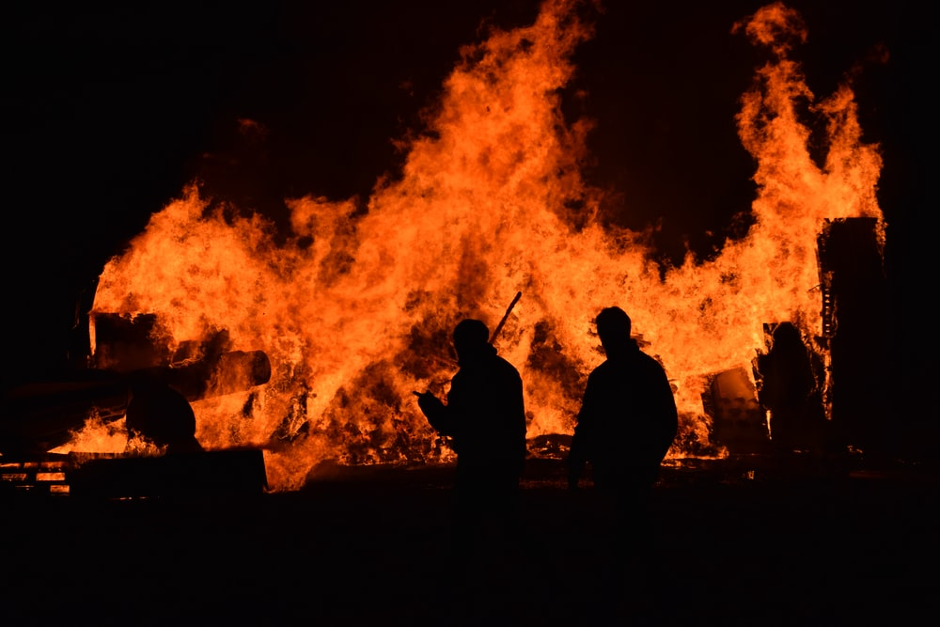
PRESENTATION
harm (n)
/hɑː(r)m/
damage or injury that is caused by a person or an event
tổn hại

Slide 14


PRESENTATION
expert (adj)
/ˈekspɜːrt/
having or involving great knowledge or skill
thuộc về chuyên môn

Slide 15


PRESENTATION
investor (n)
/ɪnˈvestə(r)/
a person or an organization that invests money in something
nhà đầu tư

Slide 16
PRESENTATION
Form | Pronunciation | Meaning
peacekeeping (adj) | /ˈpiːskiːpɪŋ/ | helping stop people fighting
harm (n) | /hɑː(r)m/ | damage or injury
expert (adj) | /ˈekspɜːrt/ | having great knowledge
investor (n) | /ɪnˈvestə(r)/ | people or organisations that invest money

Slide 17
PRACTICE
1
Listen and read.
Do You Know…?
A. The United Nations (UN) was created in 1945. It is an organisation of most of the world’s countries. Its main goal is world peace. It also works to reduce poverty and improve people’s lives in other ways. Viet Nam joined the organisation in 1977. Since then, our country has become more active and has participated in many UN activities including peacekeeping.
The United Nations
B. UNICEF was formed in 1946. It works in over 190 countries to help improve health and education of children. It particularly aims to support the most disadvantaged children all over the world. UNICEF’s aim in Viet Nam is to protect children and make sure they are healthy, educated and safe from harm.
United Nations
Children’s Emergency Fund

Slide 18
PRACTICE
1
Listen and read.
Do You Know…?
C. UNDP was formed in 1965 as part of the UN. It provides technical support, expert advice and training to help people in developing countries have a better life. In Viet Nam, UNDP works closely with the government to reduce poverty and improve people’s lives.
D. The WTO was formed in 1995. It is the world’s largest international economic organisation. VietNam became a WTO member in 2007. Since then, our economy has achieved a high growth level. Viet Nam has also become more attractive to foreign investors.

Slide 19
PRACTICE
2
Read the text again and choose the correct answers.
1. Which organisation was formed in 1945?
A. The UN B. UNICEF C. The WTO
2. Which organisation aims to help improve children’s health and education?
A. UNDP B. UNICEF C. The WTO
3. Which of the following is the largest international economic organisation?
A. The UN B. UNDP C. The WTO
4. Which year did Vietnam join The United Nations?
A. 1977 B. 1946 C. 1965
5. Which organization aims to reduce poverty and improve people’s lives in Viet Nam?
A. The WTO B. UNDP D. The UN

Slide 20
PRACTICE
4
Complete the sentences with the words and phrases from Task 1.
1. Which organisation was formed in 1945?
A. The UN B. UNICEF C. The WTO
A. The UN
A. The United Nations (UN) was created in 1945. It is an organisation of most of the world’s countries. Its main goal is world peace. It also works to reduce poverty and improve people’s lives in other ways. Viet Nam joined the organisation in 1977. Since then, our country has become more active and has participated in many UN activities including peacekeeping.
The United Nations

Slide 21
PRACTICE
4
Complete the sentences with the words and phrases from Task 1.
2. Which organisation aims to help improve children’s health and education?
A. UNDP B. UNICEF C. The WTO
B. UNICEF
B. UNICEF was formed in 1946. It works in over 190 countries to help improve health and education of children. It particularly aims to support the most disadvantaged children all over the world. UNICEF’s aim in Viet Nam is to protect children and make sure they are healthy, educated and safe from harm.
United Nations
Children’s Emergency Fund

Slide 22
PRACTICE
4
Complete the sentences with the words and phrases from Task 1.
3. Which of the following is the largest international economic organisation?
A. The UN B. UNDP C. The WTO
C. The WTO
D. The WTO was formed in 1995.
It is the world’s largest international economic organisation. VietNam became a WTO member in 2007. Since then, our economy has achieved a high growth level.
Viet Nam has also become more attractive to foreign investors.

Slide 23
PRACTICE
4
Complete the sentences with the words and phrases from Task 1.
4. Which year did Vietnam join The United Nations?
A. 1977 B. 1946 C. 1965
A. 1977
A. The United Nations (UN) was created in 1945. It is an organisation of most of the world’s countries. Its main goal is world peace. It also works to reduce poverty and improve people’s lives in other ways. Viet Nam joined the organisation in 1977. Since then, our country has become more active and has participated in many UN activities including peacekeeping.
The United Nations

Slide 24
PRACTICE
4
Complete the sentences with the words and phrases from Task 1.
5. Which organization aims to reduce poverty and improve people’s lives in Viet Nam?
A. The WTO B. UNDP D. The UN
B. UNDP
C. UNDP was formed in 1965 as part of the UN. It provides technical support, expert advice and training to help people in developing countries have
a better life. In Viet Nam, UNDP works closely with the government to reduce poverty and improve people’s lives.

Slide 25
PRACTICE
3
Find words in the texts (A, B, C, or D) that mean the following.
Words | Meanings
 | helping people stop fighting (A)
 | damage or injury (B)
 | having great knowledge (C)
 | people or organisations that invest money (D)
peacekeeping
harm
expert
investors

Slide 26
PRACTICE
4
Read the text again and complete the sentences with the words
and phrases from Task 1.
(comparative adjective)
1. Since joining the UN, Viet Nam has become _____________ and has participated in many UN activities including peacekeeping.
2. UNICEF particularly aims to support ___________ children all over the world.
3. UNDP helps people in developing countries have a __________ life.
4. The WTO is the world's _____________ international economic organisation.
5. Viet Nam has also become _____________ to foreign investors.
(superlative
adjectives)
(comparative adjective)
(superlative
adjectives)
(comparative adjective)

Slide 27
PRACTICE
4
Complete the sentences with the words and phrases from Task 1.
1. Since joining the UN, Viet Nam has become __________ and has participated in many UN activities including peacekeeping.
more active
A. The United Nations (UN) was created in 1945. It is an organisation of most of the world’s countries. Its main goal is world peace. It also works to reduce poverty and improve people’s lives in other ways. Viet Nam joined the organisation in 1977. Since then, our country has become more active and has participated in many UN activities including peacekeeping.
The United Nations

Slide 28
PRACTICE
4
Complete the sentences with the words and phrases from Task 1.
2. UNICEF particularly aims to support ________________ children all over the world.
the most disadvantaged
B. UNICEF was formed in 1946. It works in over 190 countries to help improve health and education of children. It particularly aims to support the most disadvantaged children all over the world. UNICEF’s aim in Viet Nam is to protect children and make sure they are healthy, educated and safe from harm.
United Nations
Children’s Emergency Fund

Slide 29
PRACTICE
4
Complete the sentences with the words and phrases from Task 1.
3. UNDP helps people in developing countries have a _______life.
better
C. UNDP was formed in 1965 as part of the UN. It provides technical support, expert advice and training to help people in developing countries have
a better life. In Viet Nam, UNDP works closely with the government to reduce poverty and improve people’s lives.

Slide 30
PRACTICE
4
Complete the sentences with the words and phrases from Task 1.
4. The WTO is the world’s _______international economic organisation.
largest
D. The WTO was formed in 1995.
It is the world’s largest international economic organisation. VietNam became a WTO member in 2007. Since then, our economy has achieved a high growth level.
Viet Nam has also become more attractive to foreign investors.

Slide 31
PRACTICE
4
Complete the sentences with the words and phrases from Task 1.
5. Viet Nam has also become ______________to foreign investors.
more attractive
D. The WTO was formed in 1995.
It is the world’s largest international economic organisation. VietNam became a WTO member in 2007. Since then, our economy has achieved a high growth level.
Viet Nam has also become more attractive to foreign investors.

Slide 32
CONSOLIDATION
1
What have we learnt today?
Some words and phrases related to International Organisations
Reading for specific information
2
Homework
Do exercises in the workbook

