Slide 1

Giáo viên soạn: Trần Thị Nhung

Slide 2
6TH GRADE
A SOCIAL AWARENESS CLUB MEETING
LESSON I – GETTING STARTED
Unit
9
SOCIAL ISSUES
FAMILY LIFE
Unit

Slide 3
LESSON I
GETTING STARTED
WARM-UP
Quiz
PRESENTATION
Vocabulary
Task 1: Listen and read.
Task 2: Tick (✓) the correct box.
Task 3: Find five social issues.
Task 4: Complete the summary.
PRACTICE
PRODUCTION
Discussion
CONSOLIDATION
Wrap-up
Homework

Slide 4

Students work in 4 groups.
There are some news headlines, pictures and short clips about social issues.
Raise your hands and give the correct names of the issues.

Slide 5

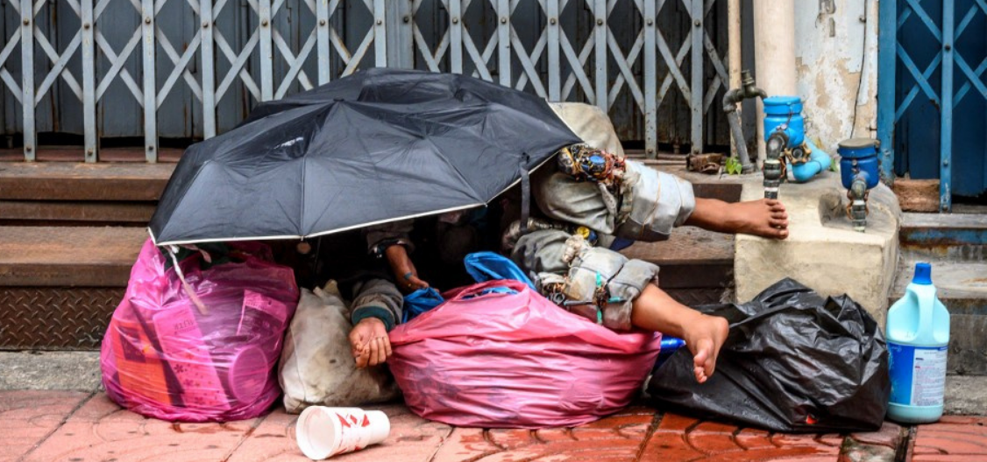
Find the correct name of the issue.
1
Gender inequality
Climate change
Childhood obesity
Homelessness

Slide 6
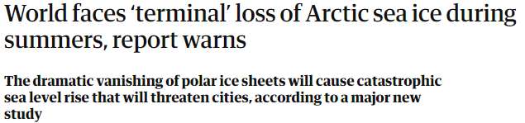
Find the correct name of the issue.
2
Civil rights
Bullying
Climate change
Gender inequality

Slide 7
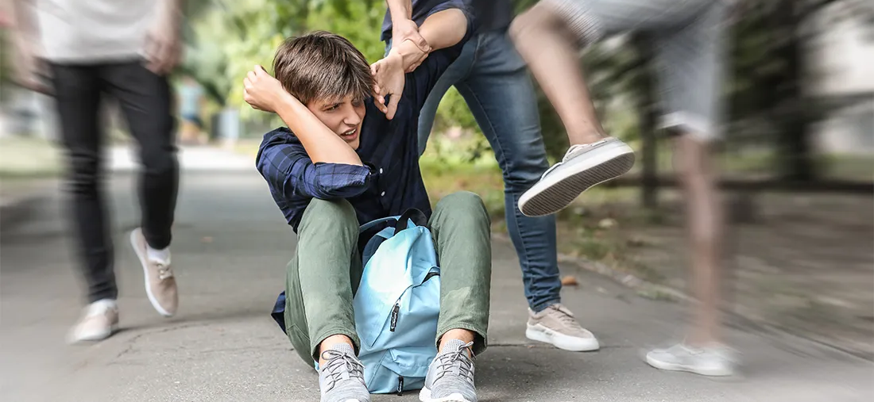
Find the correct name of the the issue.
3
School violence/ bullying
Health care availability
Gender inequality
Overpopulation

Slide 8
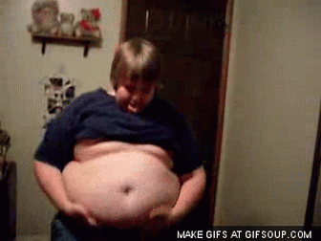
Find the correct name of the issue.
4
Climate change
Childhood obesity
Homelessness
Gender inequality

Slide 9
Answer the questions
What are some common social issues in your school?
Have you ever laughed at someone's appearance?
What will you do if your best friend looks down on your classmates?
Some common social issues in my school include bullying, discrimination, peer pressure, and academic stress. Many students also struggle with mental health problems and the pressure to fit in
No, I haven’t. I believe it is important to respect others and not judge people based on their looks. Everyone is unique in their own way.
I will talk to my best friend and explain that it is wrong to look down on others. I will try to help them understand that everyone deserves respect, regardless of their background or appearance.

Slide 10
VOCABULARY
1. Crime (n) : tội phạm
2. Overpopulation (n) : dân số quá đông
3. Bully (n) : bắt nạt
4. Peer pressure (n.phr) áp lực đồng trang lứa
5. Campaign (n) : chiến dịch
6. Struggle (n) : sự đấu tranh
7. Body shaming (n.phr) : miệt thị ngoại hình

Slide 11

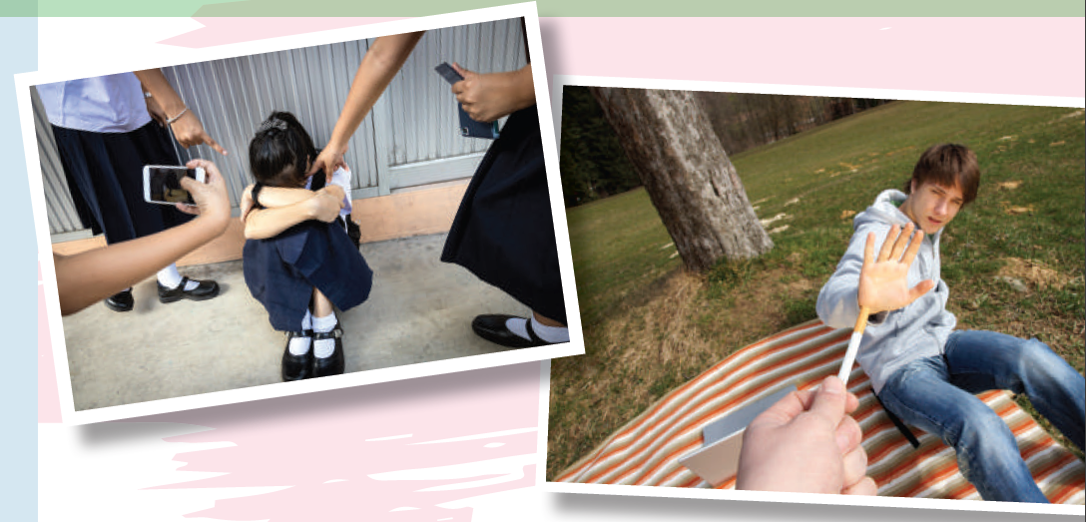
PRESENTATION
1
Listen and read.

Slide 12
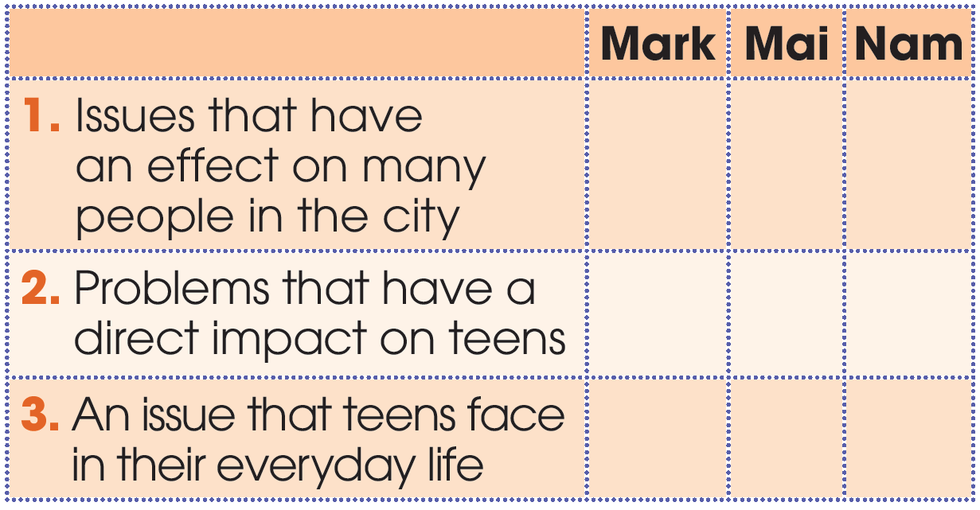
PRACTICE
2
Who suggests the following ideas? Tick (✓) the correct box.
✓
✓
✓
✓

Slide 13
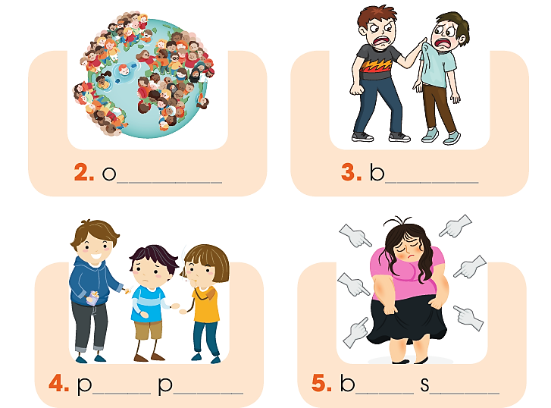
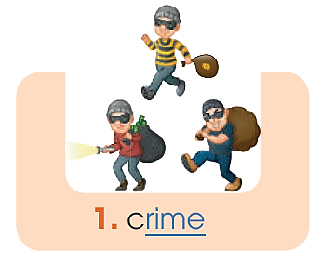
PRACTICE
3
Find five social issues in 1. Use the pictures and hints below to help you.
verpopulation
ullying
eer
ressure
ody
haming

Slide 14
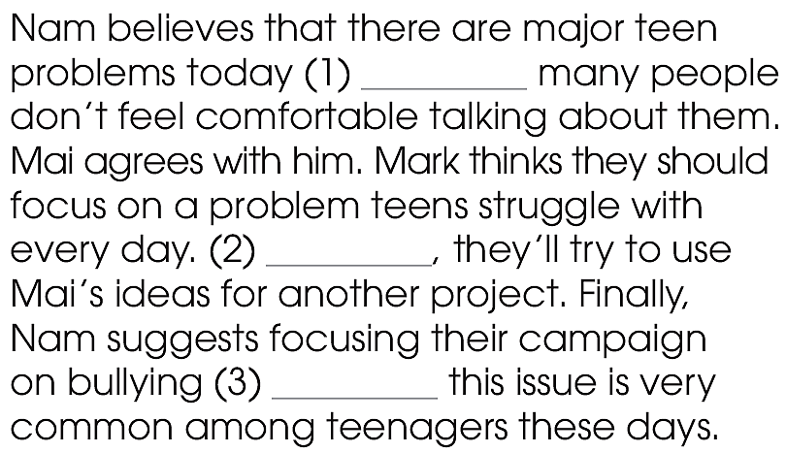
PRACTICE
4
Complete the summary with words from 1.
although
However
because

Slide 15

PRODUCTION
5
Discussion
Can you think of other social issues that directly affect teenagers?
What can we do to stop them or help the victims?

Slide 16
1. WRAP-UP
CONSOLIDATION
What have you learnt today?
A dialogue about a social awareness club meeting
Words and phrases related to social issues.

Slide 17
2. HOMEWORK
CONSOLIDATION
Do exercises in the workbook.
Prepare for Lesson 2 - Unit 9.
Prepare materials for the project in lesson 8

Slide 18

Website: hoclieu.vn
Fanpage: facebook.com/www.tienganhglobalsuccess.vn/

