Slide 1


Slide 2
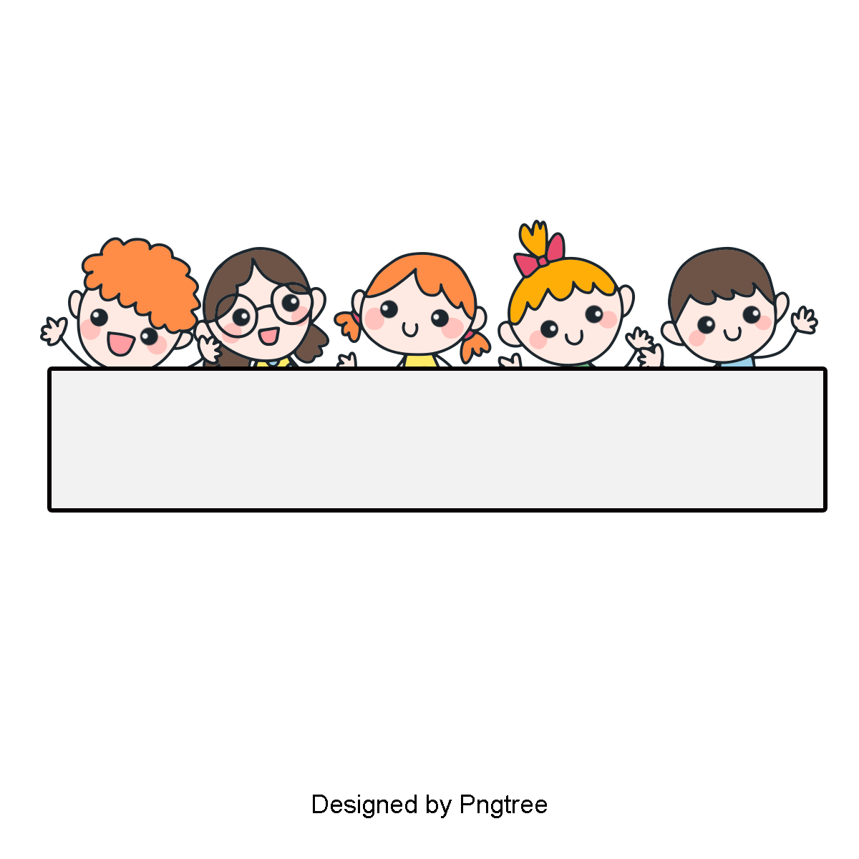
Warm-up

Slide 3

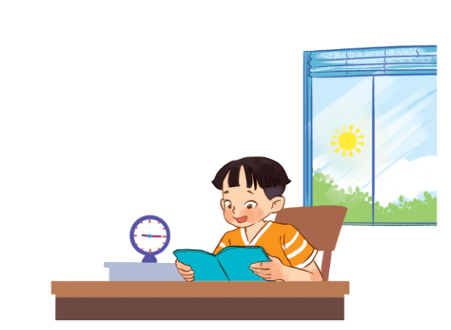
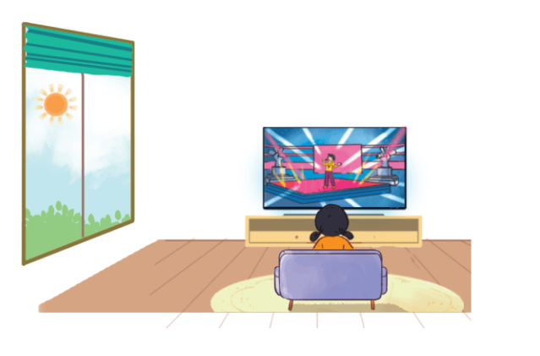
Let’s sing.
When do you watch TV and read books?
When do you watch TV?
When do you watch TV?
I watch TV in the afternoon.
I watch TV at noon.
When do you read books?
When do you read books?
I read books in the evening.
I read books in the morning.

Slide 4
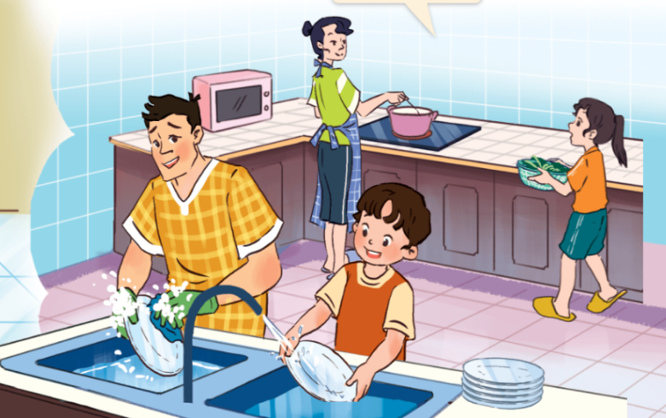
Tuesday, February 24th, 2026
Unit
14
DAILY ACTIVITIES
Lesson 2: 1,2,3

Slide 5



Contents
Look, listen and repeat.
Listen, point and say.
Let’s talk.

Slide 6

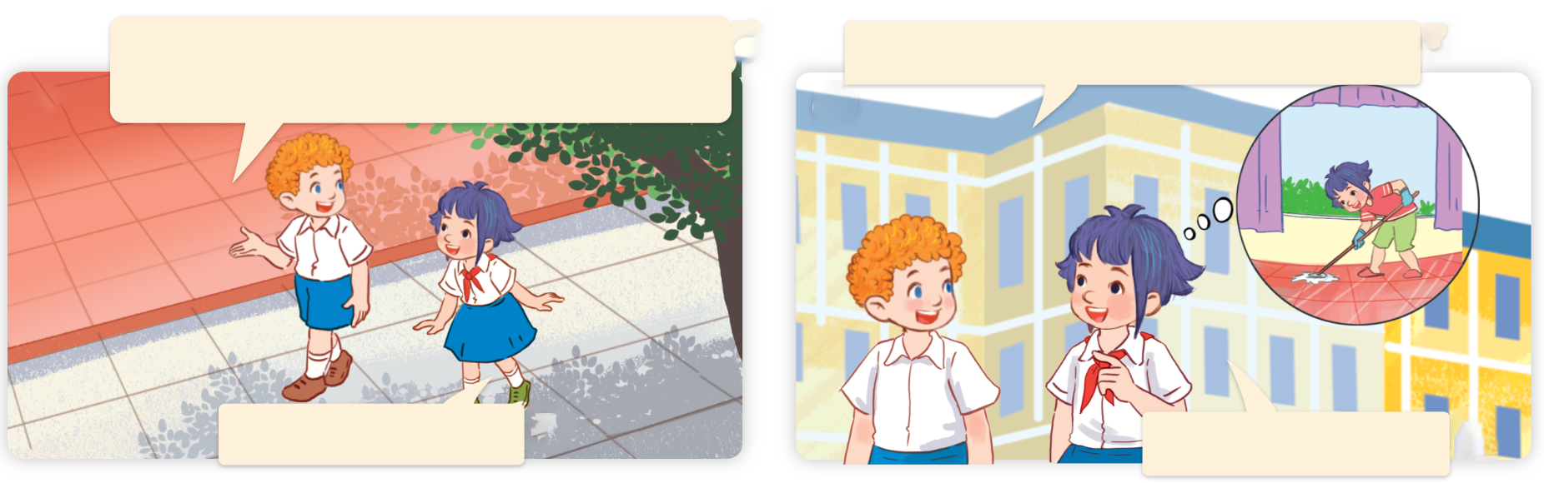
1. Look, listen and repeat.
What do you do in the morning?
What do you do on Sundays, Linh?
a
b
I do housework.
I clean the floor.
What are they talking about?
Where are they?
Who are they?
Click on the speaker / sentences to listen.

Slide 7
Vocabulary

Slide 8
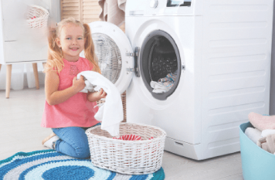
Vocabulary
wash the clothes
/wɒʃ ðə ˈkləʊðz /
giặt quần áo

Slide 9
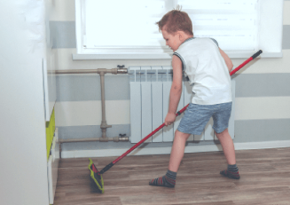
clean the floor
/kli:n ðə flɔː/
lau sàn nhà

Slide 10
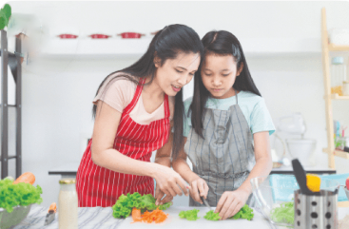
help with the cooking
/help wɪð ðə ˈkʊkɪŋ/
giúp đỡ việc nấu ăn

Slide 11
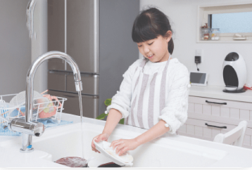
wash the dishes
/wɒʃ ðə ˈdɪʃɪz/
rửa bát đĩa

Slide 12
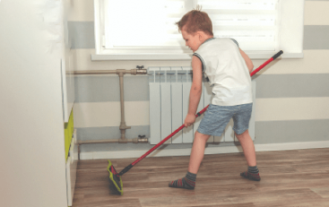
Review
wash the clothes
clean the floor
help with the cooking
wash the dishes

Slide 13


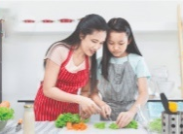

Vocabulary
1. wash the clothes
: giặt quần áo
2. clean the floor
: lau nhà sàn
3. help with the cooking
: giúp đỡ việc nấu ăn
4. wash the dishes
: rửa bát đĩa
Click on the English words to listen again.

Slide 14

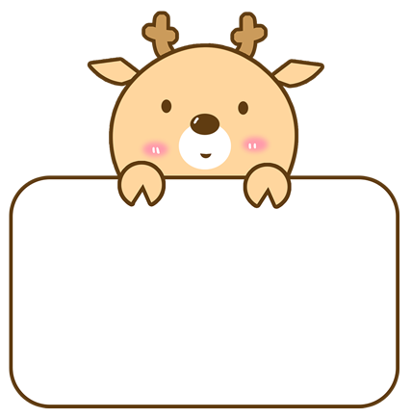
Checking vocabulary

Slide 15


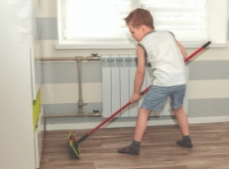

What is missing?
Notes:
What is missing?

Slide 16
What is missing?
Notes:
What is missing?

Slide 17
What is missing?
Notes:
What is missing?

Slide 18
What is missing?
Notes:
What is missing?

Slide 19
What is missing?
Notes:
What is missing?

Slide 20
Well done!

Slide 21
Structures

Slide 22




Cách hỏi bạn làm gì vào buổi sáng:
What do you do in the morning?
( Bạn làm gì vào buổi sáng?)
I _______.
(Tôi _______.)
Ex:
What do you do in the morning?
I wash the clothes.

Slide 23
2. Listen, point and say.
a
b
What do you do in the morning?
wash the clothes
clean the floor
I _________.
c
d
help with the cooking
wash the dishes

Slide 24


2. Listen, point and say.
a
What do you do in the morning?
I _________.
wash the clothes
What do you do in the morning?
I wash the clothes.

Slide 25

2. Listen, point and say.
b
What do you do in the morning?
I _________.
clean the floor
What do you do in the morning?
I clean the floor.

Slide 26
2. Listen, point and say.
c
What do you do in the morning?
I _________.
help with the cooking
What do you do in the morning?
I help with the cooking.

Slide 27
2. Listen, point and say.
d
What do you do in the morning?
I _________.
wash the dishes
What do you do in the morning?
I wash the dishes.

Slide 28

3. Let’s talk.

Slide 29
Let’s play

Slide 30
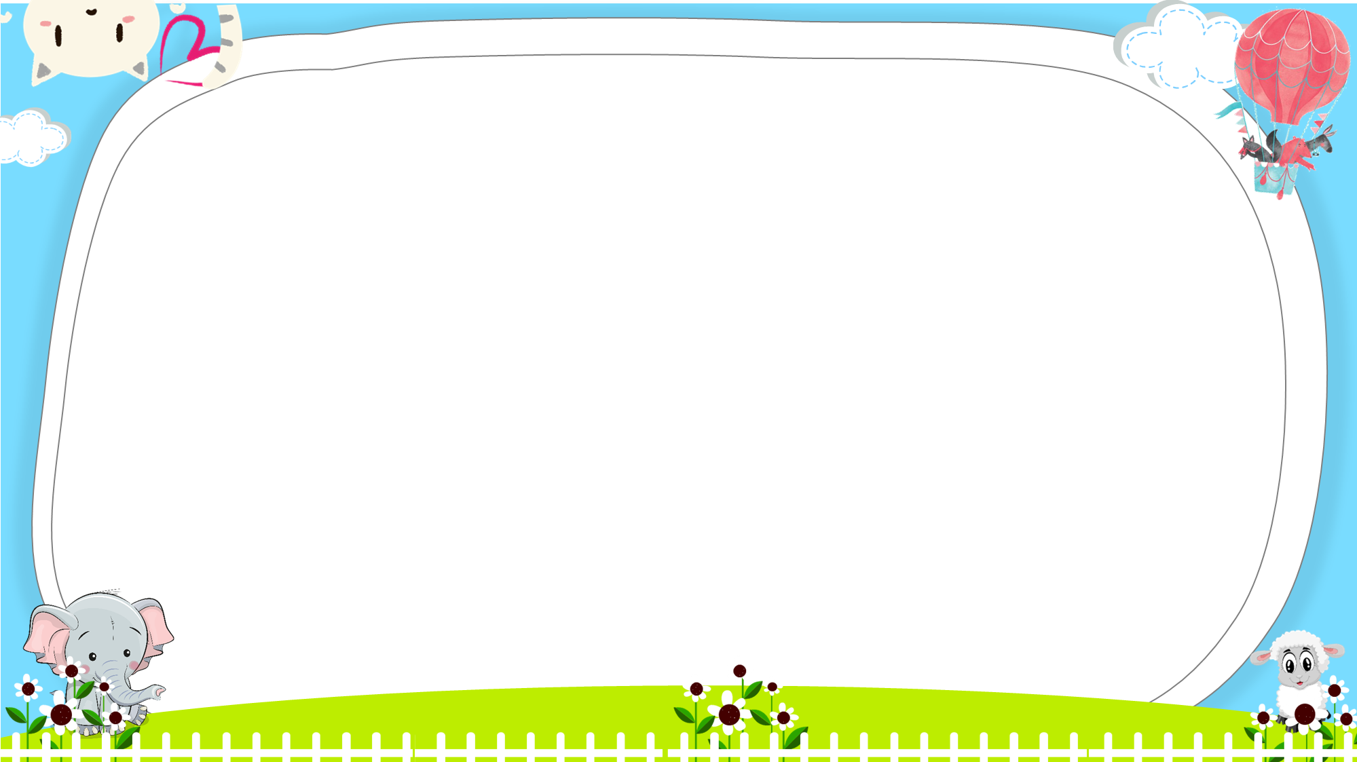




Slide 31





A. clean the floor
B. wash the clothes

Slide 32
A. wash the clothes
B. wash the dishes

Slide 33
A. help with the cooking
B. clean the floor

Slide 34
A. clean the floor
B. wash the clothes

Slide 35



A.
B.

Slide 36

A.
B.

Slide 37
_____ the clothes
A. clean
B. wash

Slide 38
_____ the floor
A. clean
B. wash

Slide 39
Lucy: What do you do in the morning?
Linh: I help with the cooking.
A.
B.

Slide 40


Bill: What do you do in the evening?
Mai: I wash the clothes.
A.
B.

Slide 41
A. False
B. True

Slide 42
A. False
B. True

Slide 43


Slide 44
Wrap up

Slide 45
Review
What do you do in the morning?
I ________.
wash the clothes
wash the dishes
clean the floor
help with the cooking

Slide 46
Homework
Learn by heart all the new words.
Read again the dialogue in part 1.

Slide 47

Thank you!

