Slide 1



Tuesday, November 25th, 2025
Unit
7
Our timetables
Lesson 1: 4,5,6

Slide 2
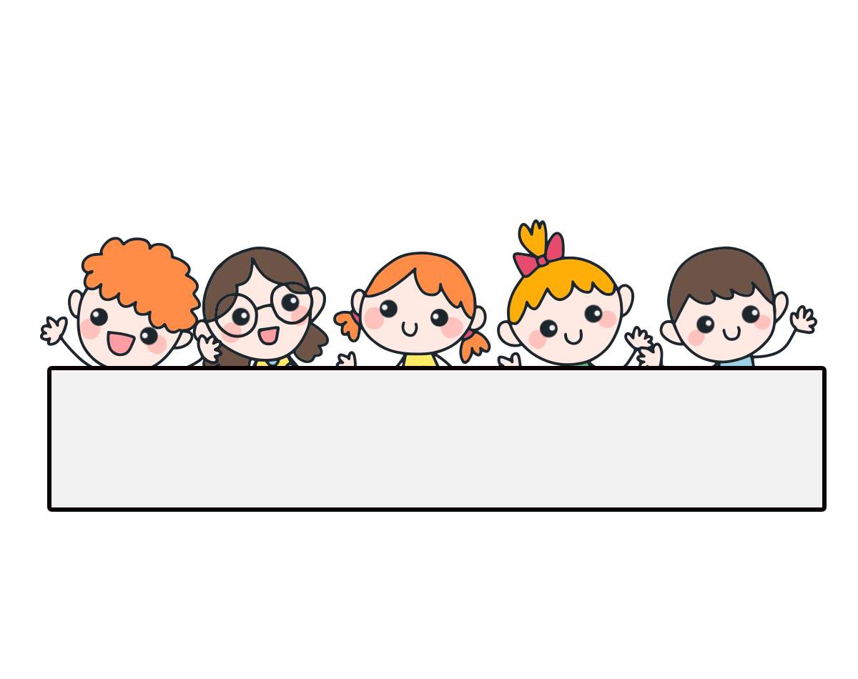
Warm-up

Slide 3











Find Pikachu

Slide 4








A. English
B. Vietnamese
C. science

Slide 5



A. science
B. maths
C. Vietnamese

Slide 6



A. maths
B. science
C. English

Slide 7



A.timetables
B. subjects
C. science

Slide 8
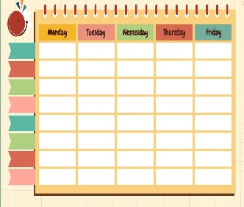




a
b
c

Slide 9



a
b
c

Slide 10



a
b
c

Slide 11



a
b
c

Slide 12

What subjects do you have today?
A. I have maths.
B. I have English.
C. I have science.

Slide 13


A. I have maths and English.
What subjects do you have today?
B. I have science and maths.
C. I have English and science.

Slide 14



Excellent!

Slide 15
Tuesday, November 25th, 2025
Unit
7
Our timetables
Lesson 1: 4,5,6

Slide 16



Contents
Listen and tick or cross.
Look, complete and read.
Let’s play.

Slide 17



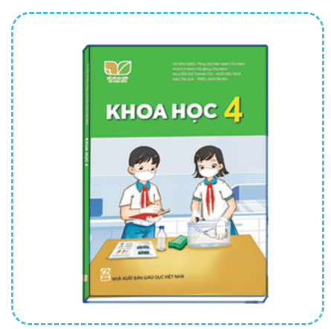






4. Listen and tick or cross.
1.
2.
3.
4.

Slide 18




5. Look, complete and read.
1.
A: What subjects do you have today?
B: I have ___________.
Vietnamese
2.
A: What subjects do you have today?
B: I ________________.
have maths
3.
A: _____________ do you have today?
B: I have English and _________.
What subjects
science
4.
A: What subjects ___________ today?
B: I have ________and ________.
do you have
English
maths

Slide 19
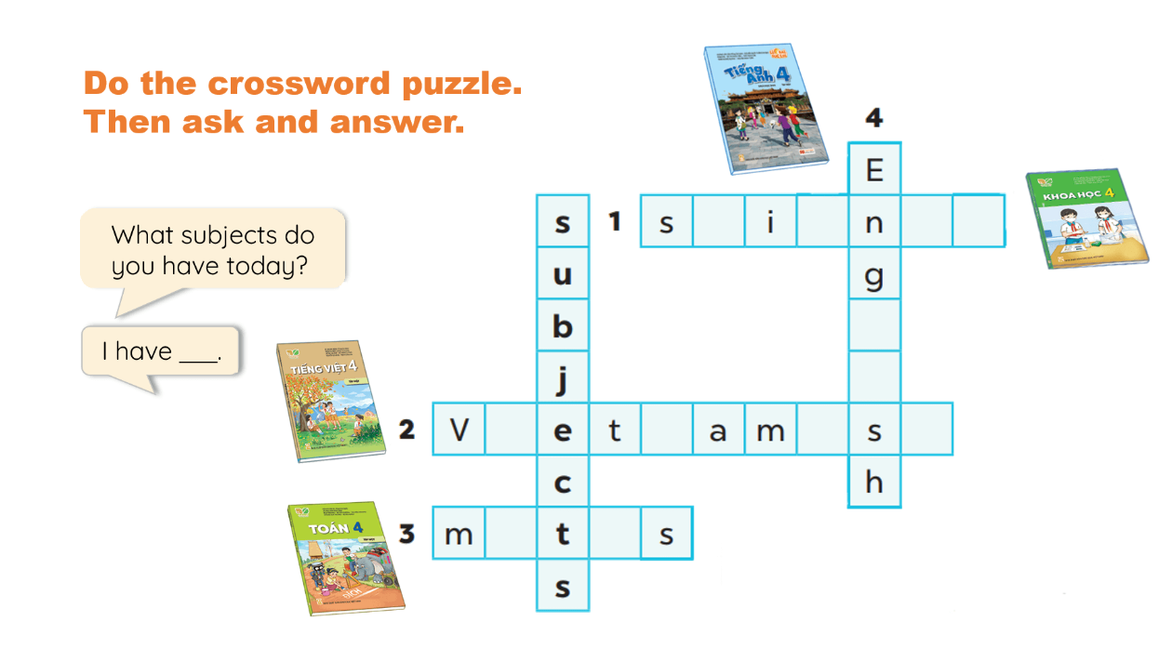
6. Let’s play.

Slide 20
Wrap up

Slide 21

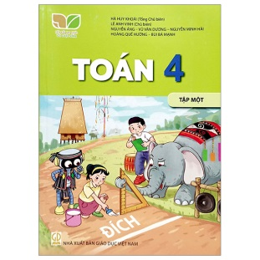


Unit 7.1
What subjects do you have today?
I have______.
Vietnamese
maths
science
English

Slide 22
Homework
Learn by heart all the new words.
Read again the dialogue in part 1.

Slide 23

Facebook : Bùi Liễu
Thank you!

