Slide 1
WARMLY WELCOME
TEACHERS TO OUR CLASS

Slide 2
Monday, September 30th 2024
English
Unit 2: Our names
Lesson 2: 1, 2, 3

Slide 3
GUESSING

Slide 14
Let’s count together!

Slide 15
Activity 3
Activity 2
Activity 1
CONTENT
Let’s talk
Listen, point and say
Look, listen and repeat

Slide 16
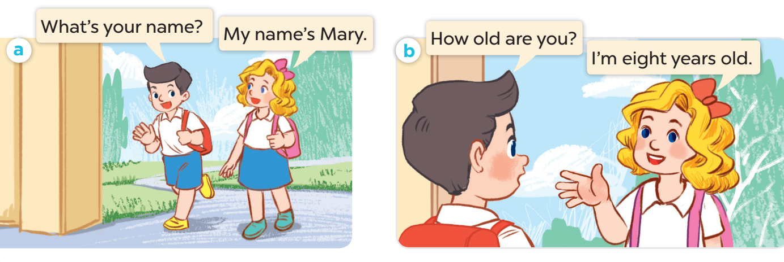

Slide 17
New words:
How old:
Model sentences:
How old are you?
I’m eight years old.

Slide 18
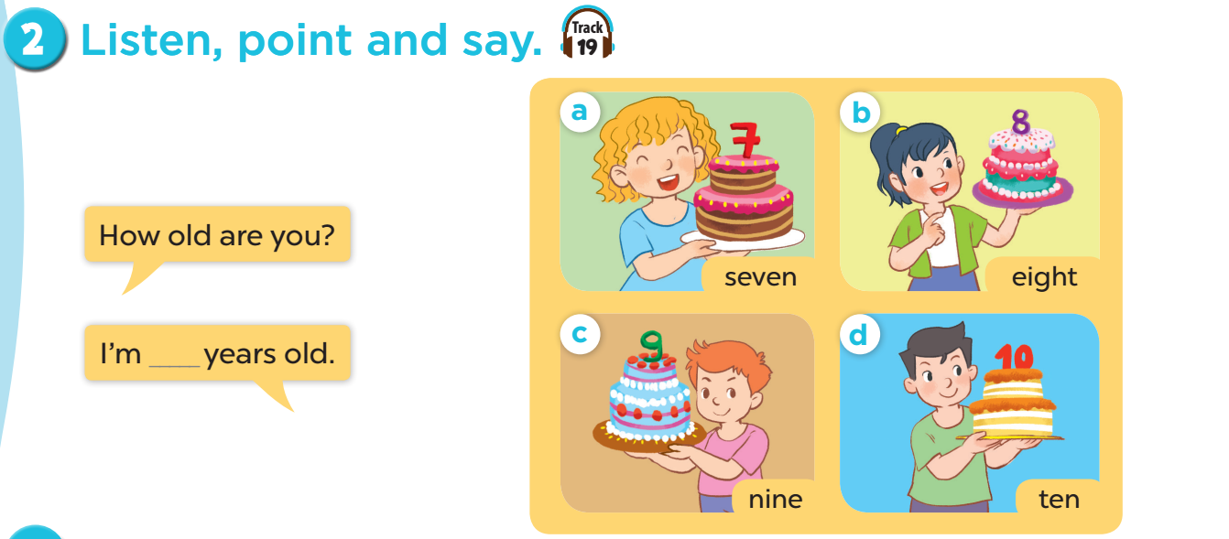

Slide 20
LET’S TALK!
Activity 3

