Slide 1

WARMLY WELCOME
TEACHERS TO OUR CLASS

Slide 2


Slide 3

Friday, October 4th 2024
English
Unit 2: Our names
Lesson 3: 1, 2, 3

Slide 4
Activity 3
Activity 2
Activity 1
CONTENT
Let’s chant
Listen and circle
Listen and repeat

Slide 5
ACTIVITY 1
Listen and repeat

Slide 6
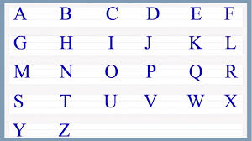


Slide 7
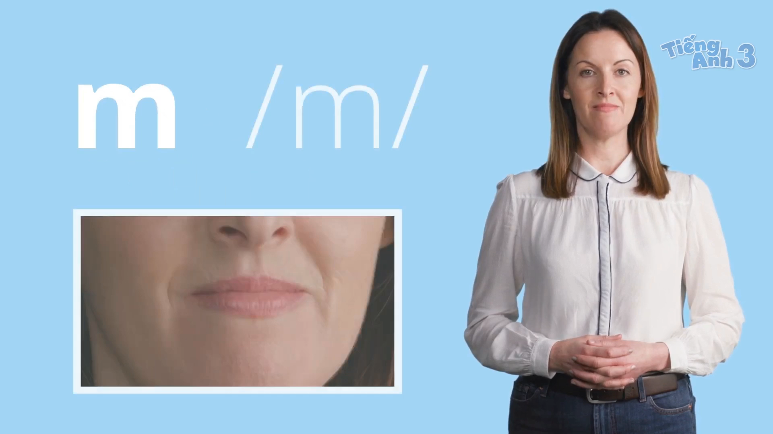

Slide 8
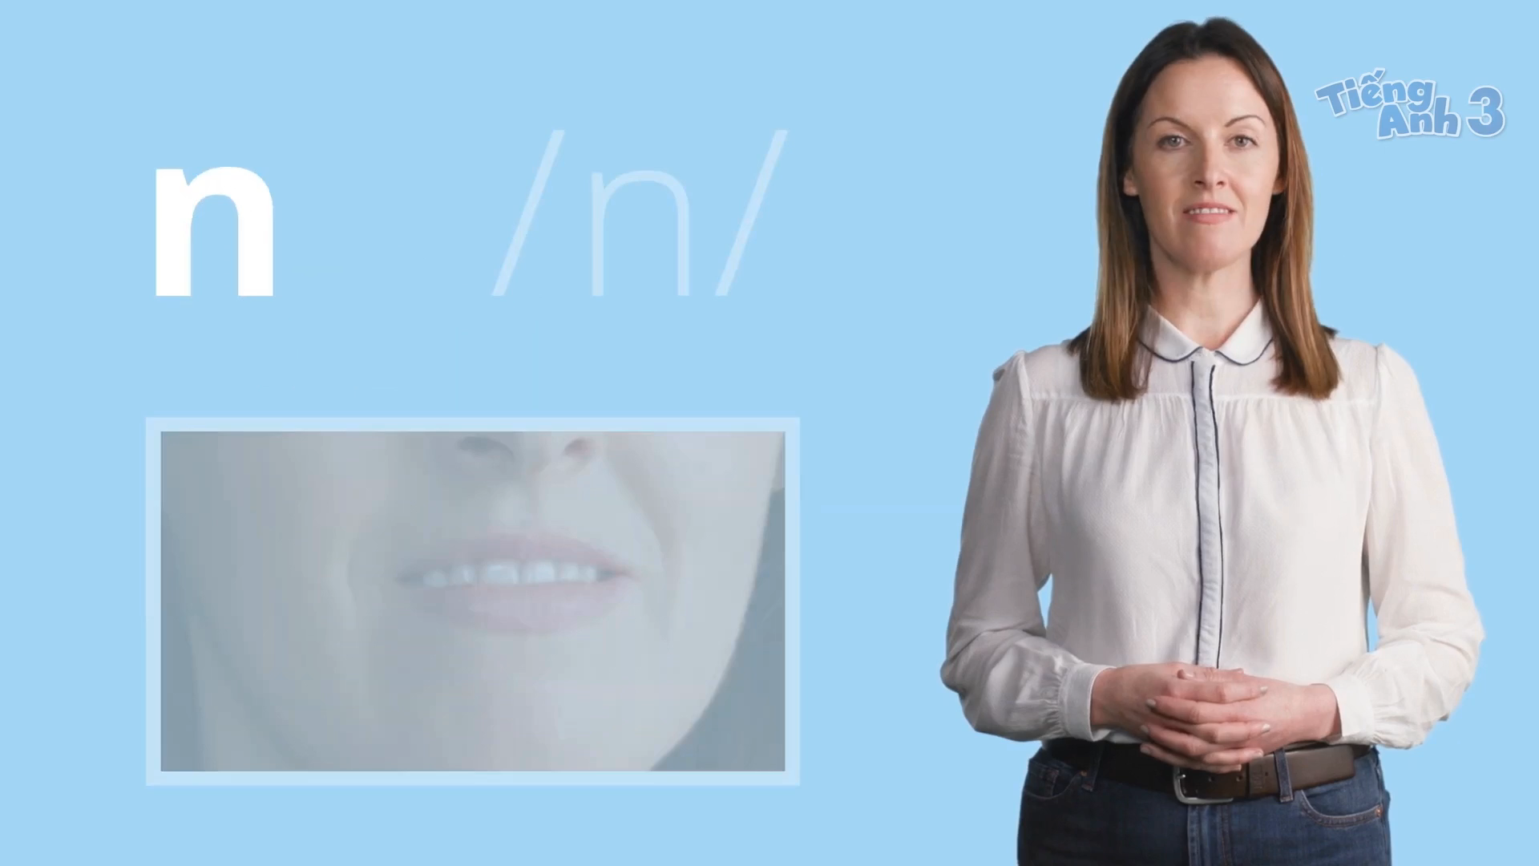

Slide 9
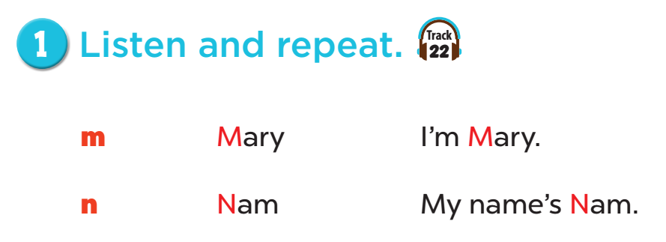


Slide 10
ACTIVITY 2
Listen and circle

Slide 11
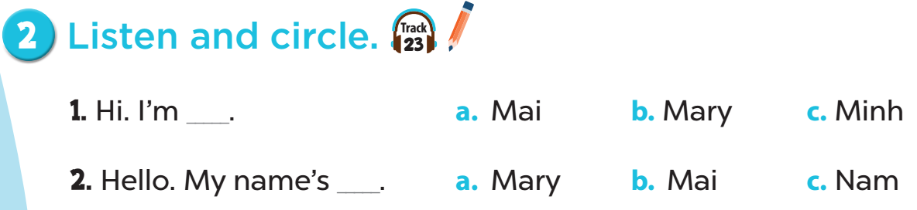

Slide 12
ACTIVITY 3
Let’s chant

Slide 13
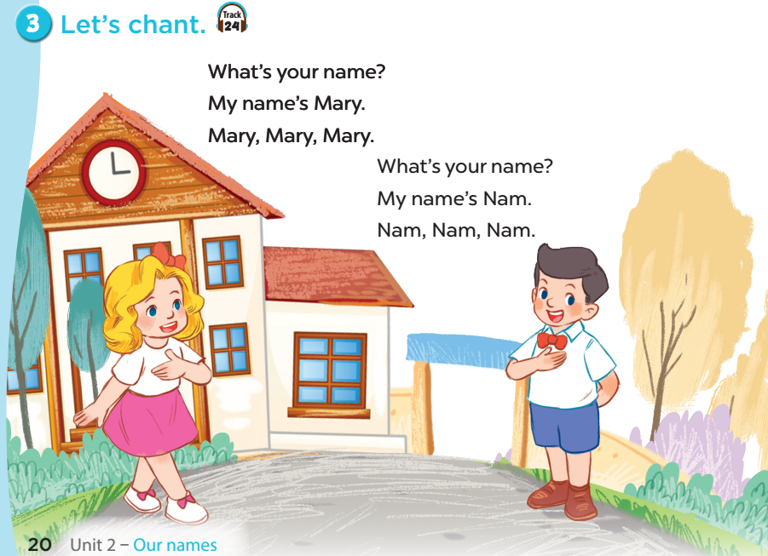

Slide 14


