Slide 1






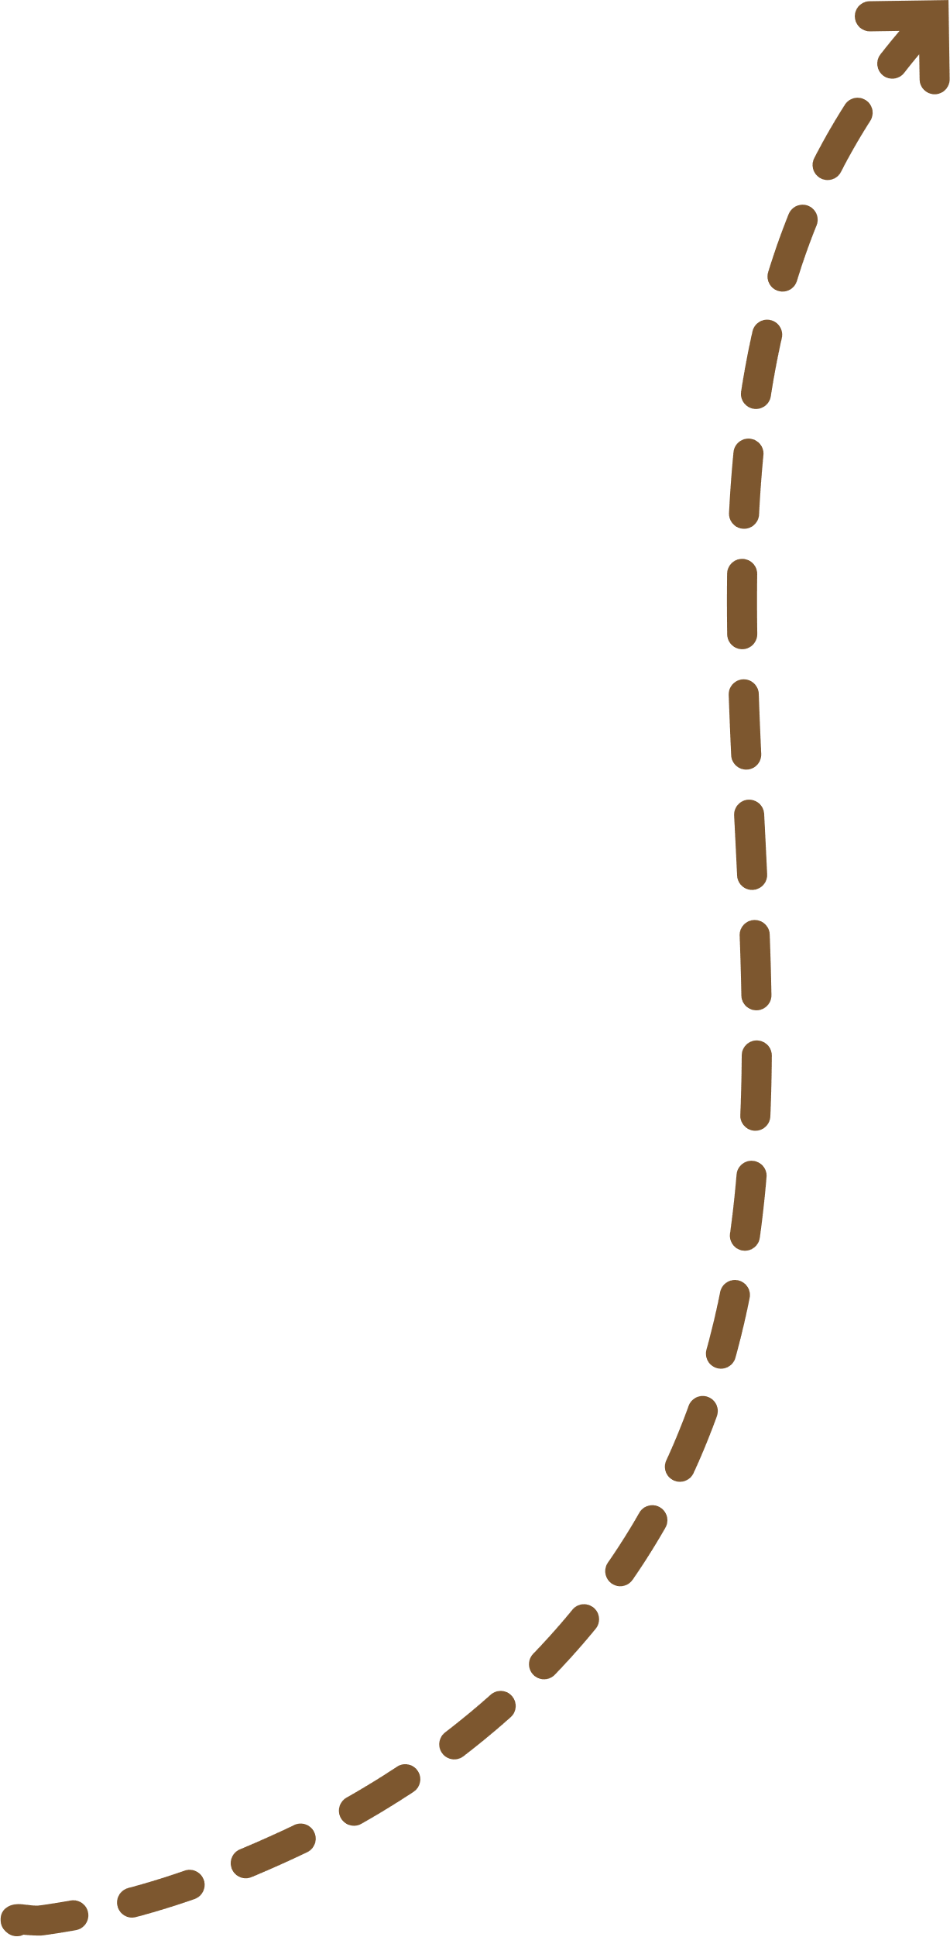





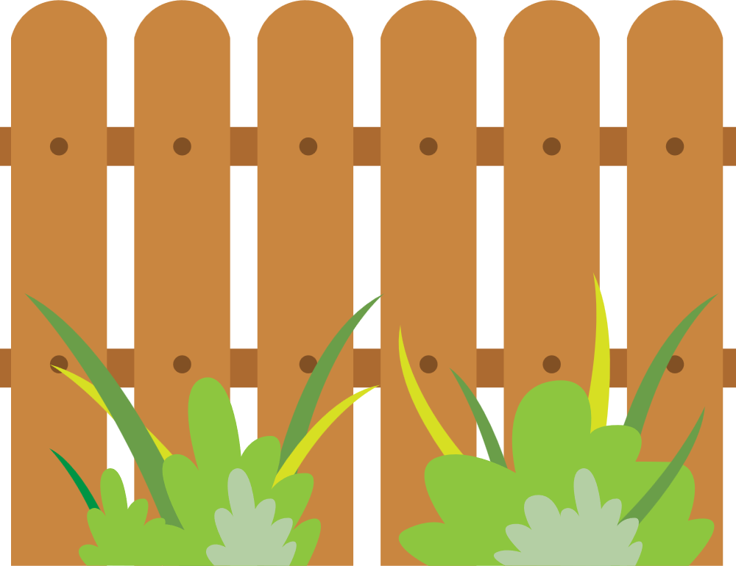


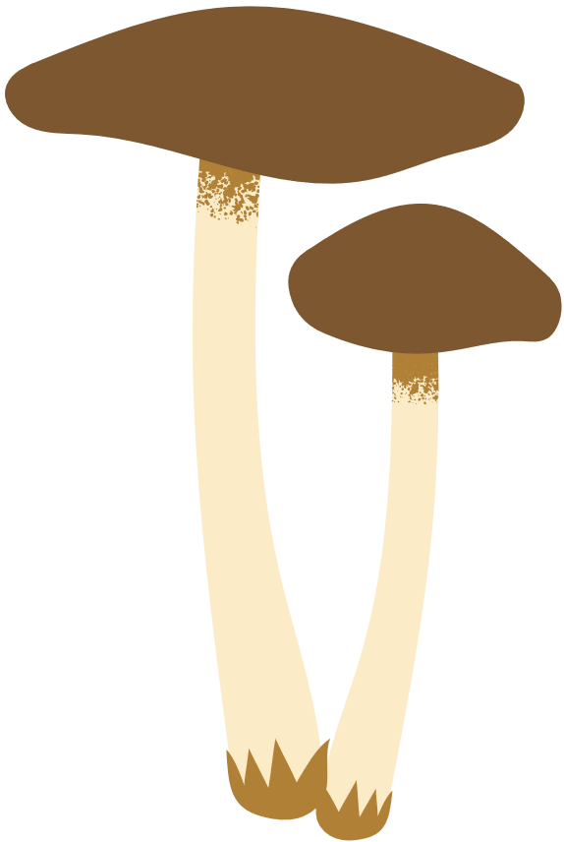


unit 7
in the garden
Lesson 1 (1,2)
Teacher: Ngô Thu Quyên
Class: 1A3

Slide 2
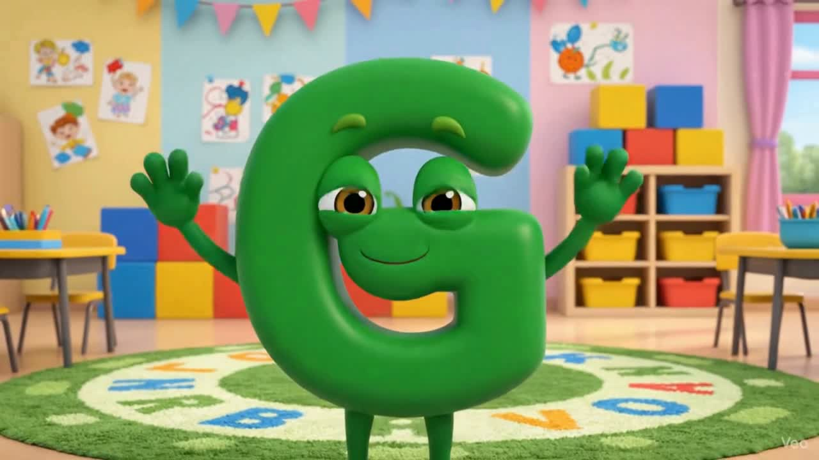

Slide 3
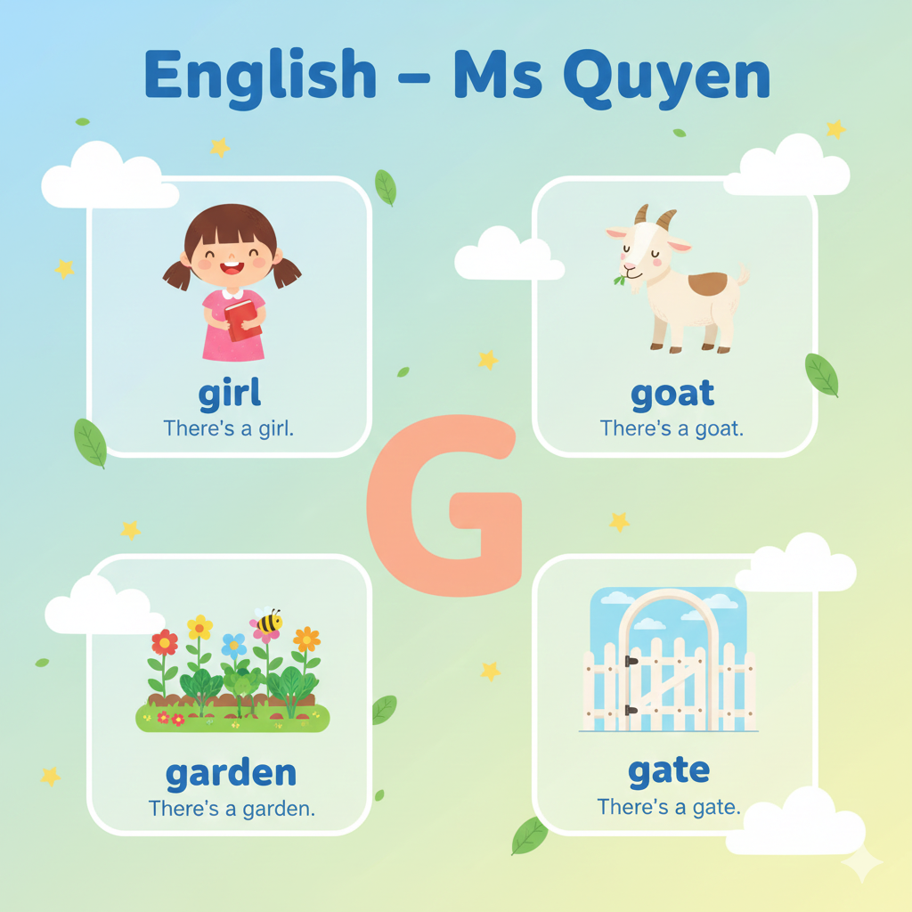

Slide 4



G
goat
garden
girl
gate

