Slide 1
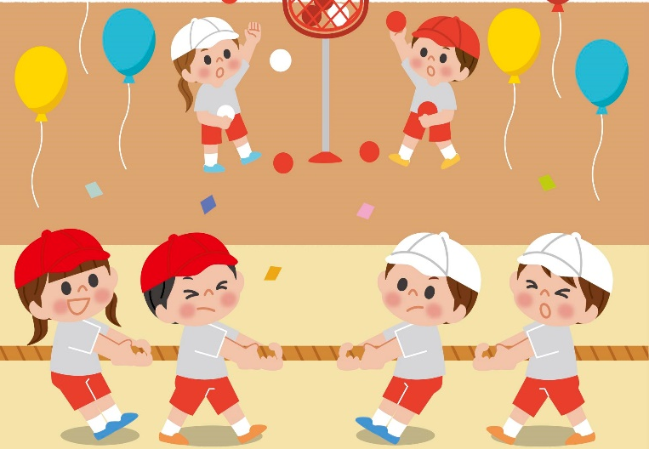
Monday, December 15th 2025
Unit
9
Our sports day
Lesson 1 (4+5+6)

Slide 2
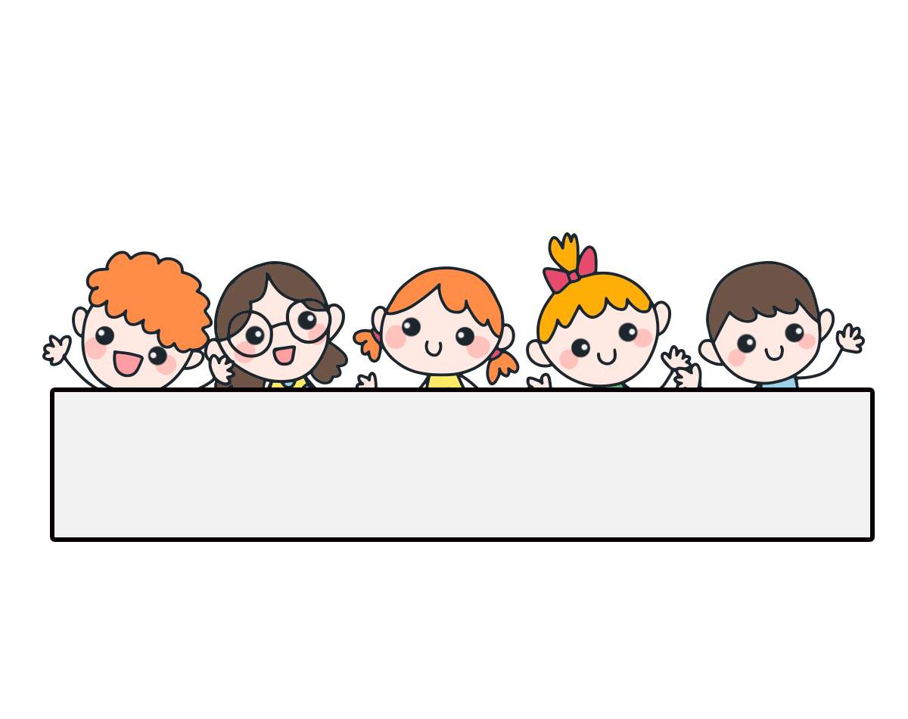
Warm-up

Slide 3
Let’s play!

Slide 4




Slide 5


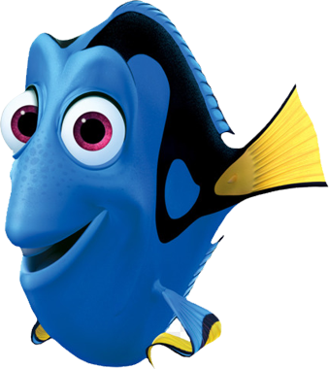




A. sports day
B. game
C. May

Slide 6
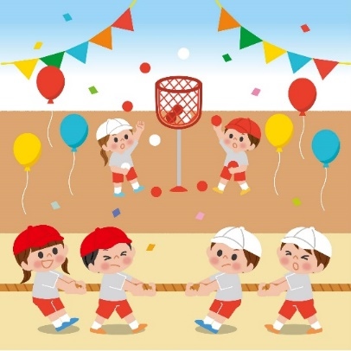
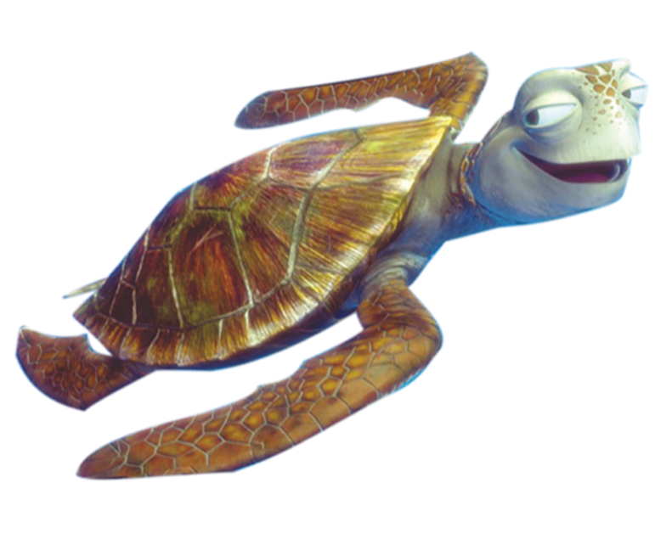
A. game
B. June
C. sports day

Slide 7


A: Is your sports day in July?
B: Yes, it is.
A. False
B. True

Slide 8
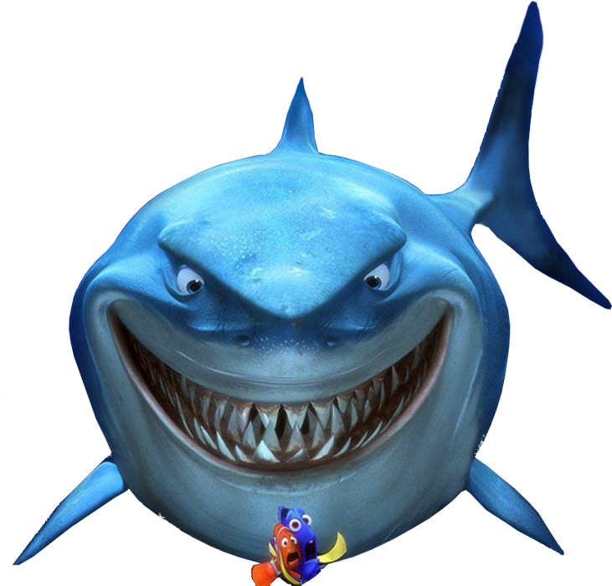
A: Is your sports day in May?
B: Yes, it is.
A. True
B. False

Slide 9
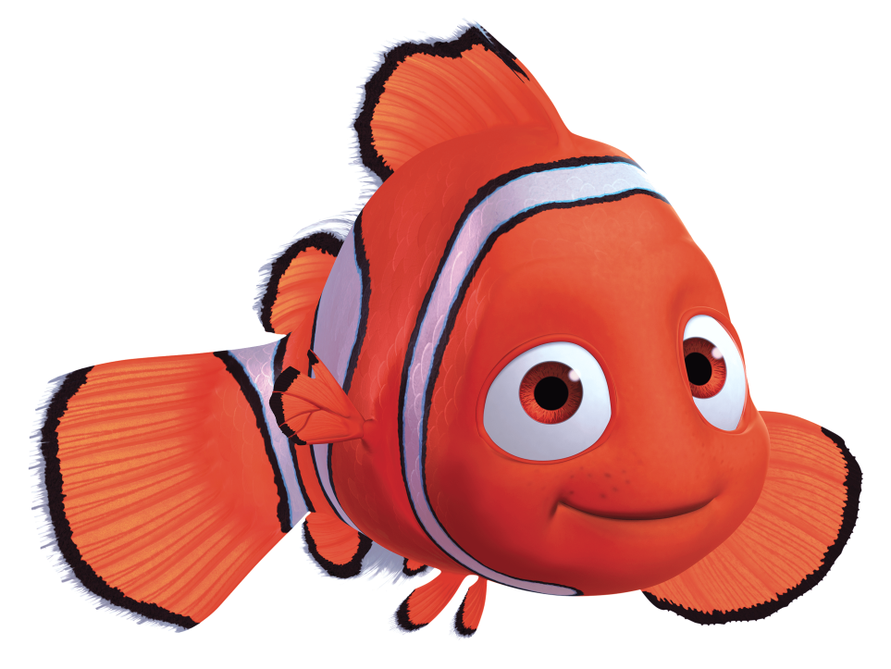
A: Is your sports day in June?
B: ___, it isn’t. It’s in May.
A. No
B. Yes

Slide 10
A: Is your sports day in August?
B: _____, it is.
A. No
B. Yes

Slide 11
__gust
A. Aw
B. Ou
C. Au

Slide 12
sports _____
A. month
B. day
C. year

Slide 13
__ly
A. gu
B. Ju
C. Ji

Slide 14
g___
A. ain
B. ane
C. ame

Slide 15

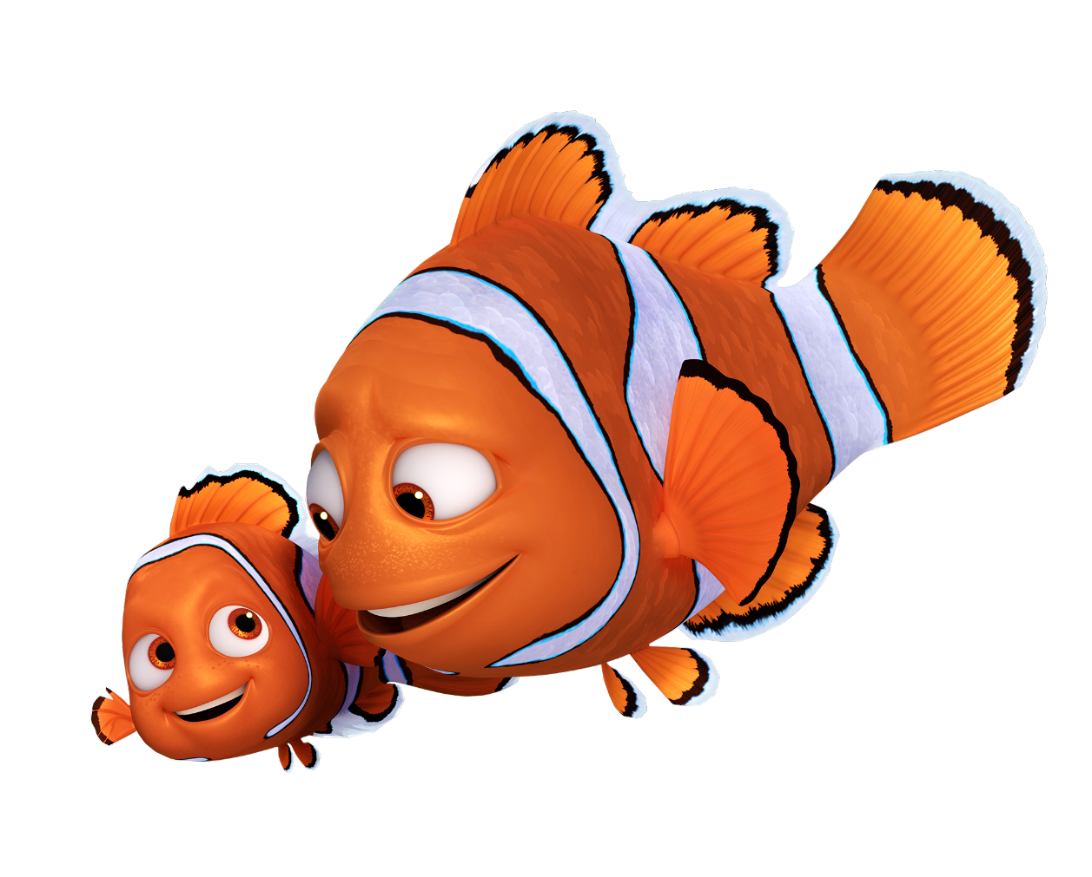

Slide 16
Contents
4
Listen and match.
Look, complete and read.
5
Let’s sing.
6

Slide 17


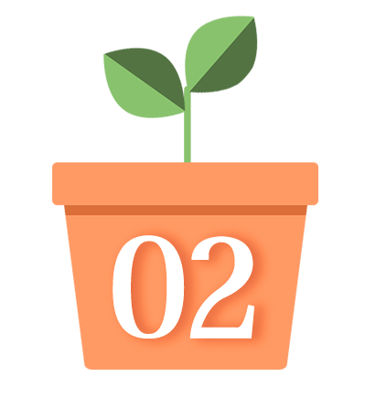



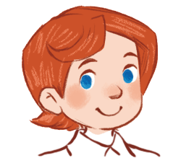
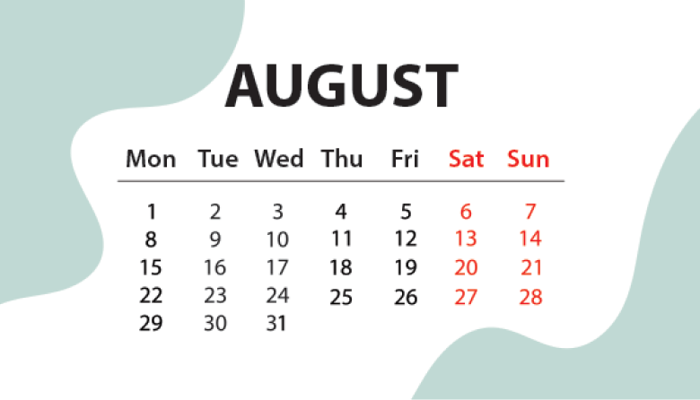
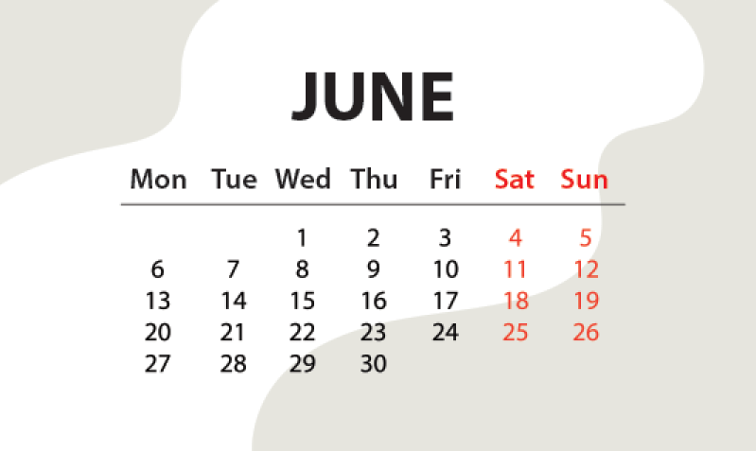
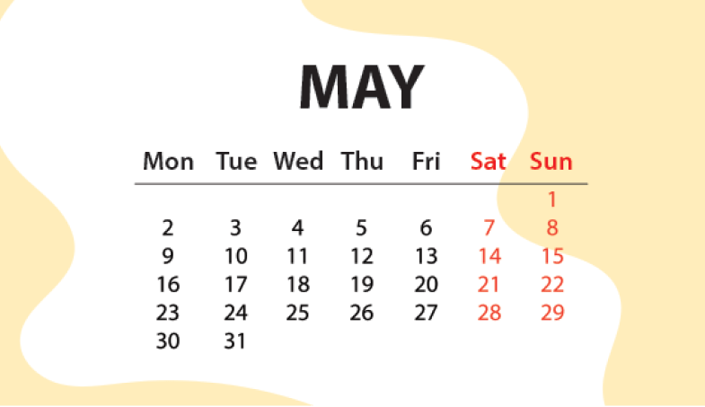
4. Listen and match.
1.
2.
3.
a
b
c

Slide 18

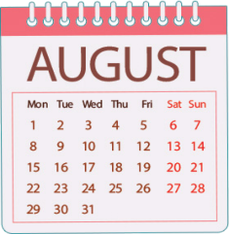
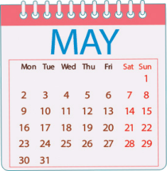
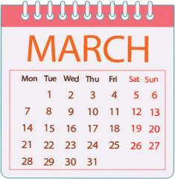
5. Look, complete and read.
1.
A: Is your sports day in June?
B: Yes, ________.
2.
A: Is your sports day in _______?
B: Yes, it is.
August
it is
3.
A: ___ your sports day in February?
B: No, it isn’t. It’s in ______.
A: Is your sports day ___ July?
B: _________. It’s in March.
Is
4.
in
May
No, it isn’t

Slide 19









6. Let’s sing.
Our sports day
Sports day,
sports day.
Is your sports day in May?
Yes, it is.
Yes, it is.
It’s in May.
Sports day,
sports day.
Is your sports day in June?
No, it isn’t.
No, it isn’t.
It’s in July.

Slide 20

6. Let’s sing.
Our sports day
Sports day,
sports day.
Is your sports day in May?
Yes, it is.
Yes, it is.
It’s in May.
Sports day,
sports day.
Is your sports day in June?
No, it isn’t.
No, it isn’t.
It’s in July.

Slide 21
Wrap up

Slide 22
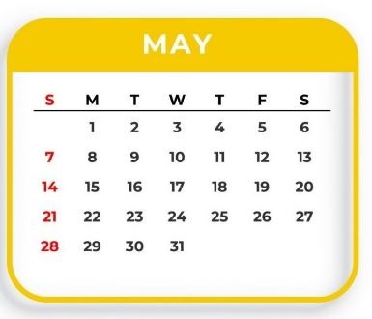
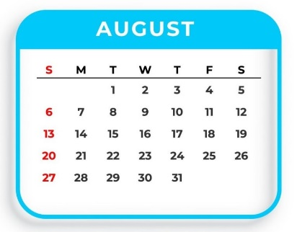
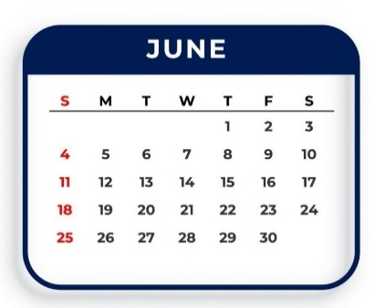
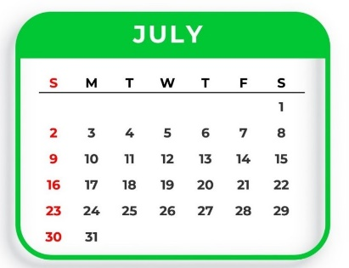
Unit 9.1
Yes, it is.
Is your sports day in ____?
No, it isn’t.
It’s in ____.
May
August
June
July

Slide 23
Homework
Learn by heart all the new words.
Read again the dialogue in part 1.

Slide 24

Thank you!

