Slide 1
Unit 13
Appearance
Lesson 3 (1,2,3)

Slide 2
Table of contents
01
Warm-up and review
04
02
03
Let's chant.
Listen and repeat.
05
Fun corner and wrap-up
Listen and circle.

Slide 3
Warm-up
01
Drawing Game
Notes:
- Divide SS into groups, Have them line up.
- Teacher gives the student at the back one piece of paper describing a person (He is slim / She has long hair / He has a round face ...)
- Ss whisper the sentence to the next student until they reach the student at the front, who comes to the board a draw the sentence and say the sentence out loud.
- The correct answer gets a point. Quick time is a bonus.

Slide 4
02
Activity 1
Listen and repeat.

Slide 5
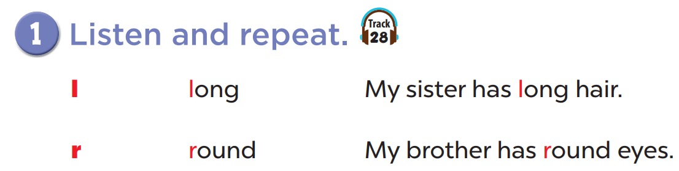


Slide 6
03
Look, listen and repeat.

Slide 7
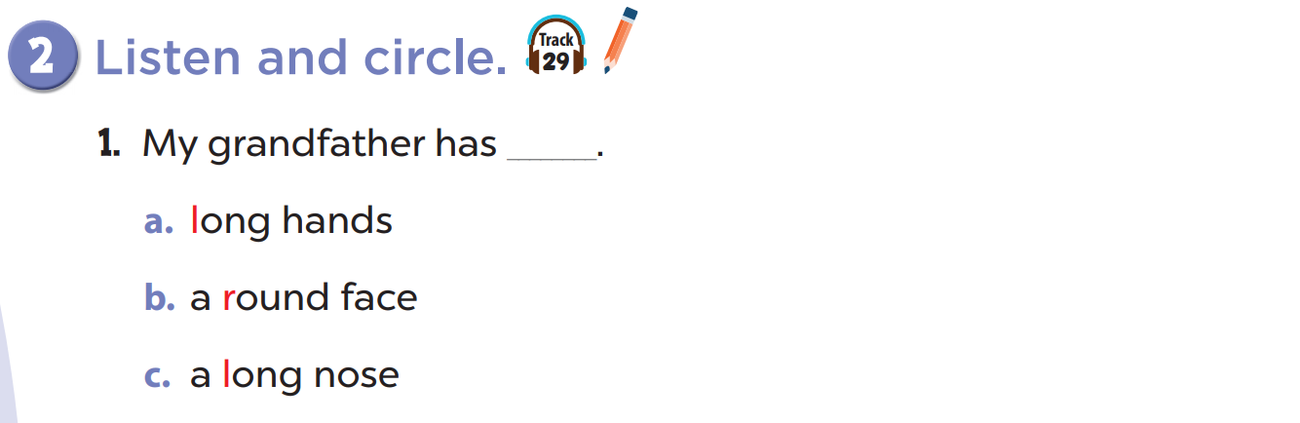
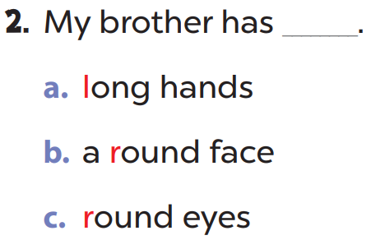

Slide 8
04
Activity 3
Let's chant.

Slide 9
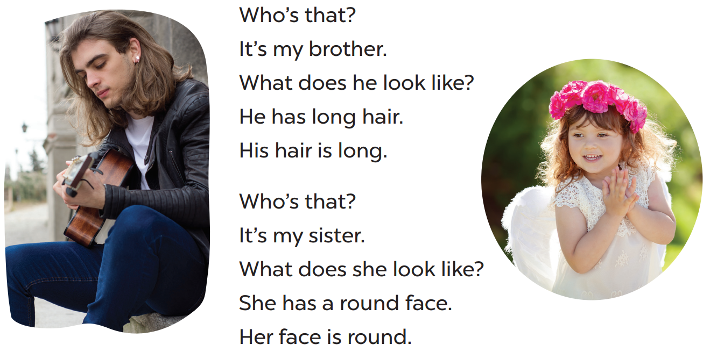
Read the lyrics.

Slide 10
Listen.

Slide 11
05
Fun corner and wrap-up
Listen and find the word with the given sounds.
Notes:
- Teacher plays the audio. Student listens and choose the number with the word containing the given sound.
- Teacher click on play / stop button to choose the point for that question.

Slide 12


Which word has the "L" sound?
He's
got
long
hair.
1
2
3
4



Slide 13
Which word has the "R" sound?
She's
got
a
round
face.
1
2
3
4
5



Slide 14
Which word has the "L" sound?
What
does
he
look
like?
1
2
3
4
5



Slide 15
Which word has the "L" sound?
He's
got
long
legs.
1
2
3
4



Slide 16
Which word has the "R" sound?
Ron
has
round
eyes.
1
2
3
4



Slide 17
Which word has the "R" sound?
Lucy
rides
a
bike.
1
2
3
4



Slide 18
Which word has the "L" sound?
It
looks
like
a
robot.
1
2
3
4
5



Slide 19
Which word has the "R" sound?
The
robot
has
round
eyes.
1
2
3
4
5



