Slide 1
Warm-up
Let’s play a game.

Slide 3
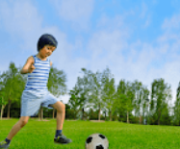
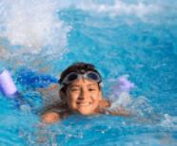
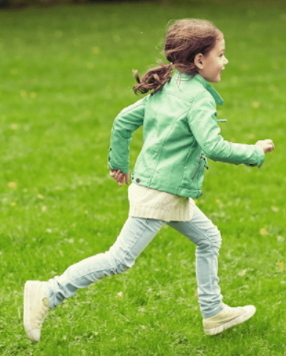
Unit 5:My hobbies
LESSON 1: 1,2,3

Slide 4
Notes:
Step 1: Ask pupils to look at context a. Play the recording for them to listen. Play the recording again, sentence by sentence, for them to listen and repeat. Correct pronunciation if necessary.
Step 2: Do the same with context b.
Step 4: Work in pair - role play.
Step 5: Invite few pairs to the front of the class and act.

Slide 5
2. Look, listen and repeat
Notes:
Step 1: Have pupils look at the pictures and elicit the names of the pupils. Have the class repeat the words a few time.
Step 2: Ask 2 pupils to do as an example.
Step 4: Ask pupils to work in pairs, pointing to the questions and pictures and giving the answers.
Step 5: Invite few pairs to the front of the class and make questions and answers.

Slide 6
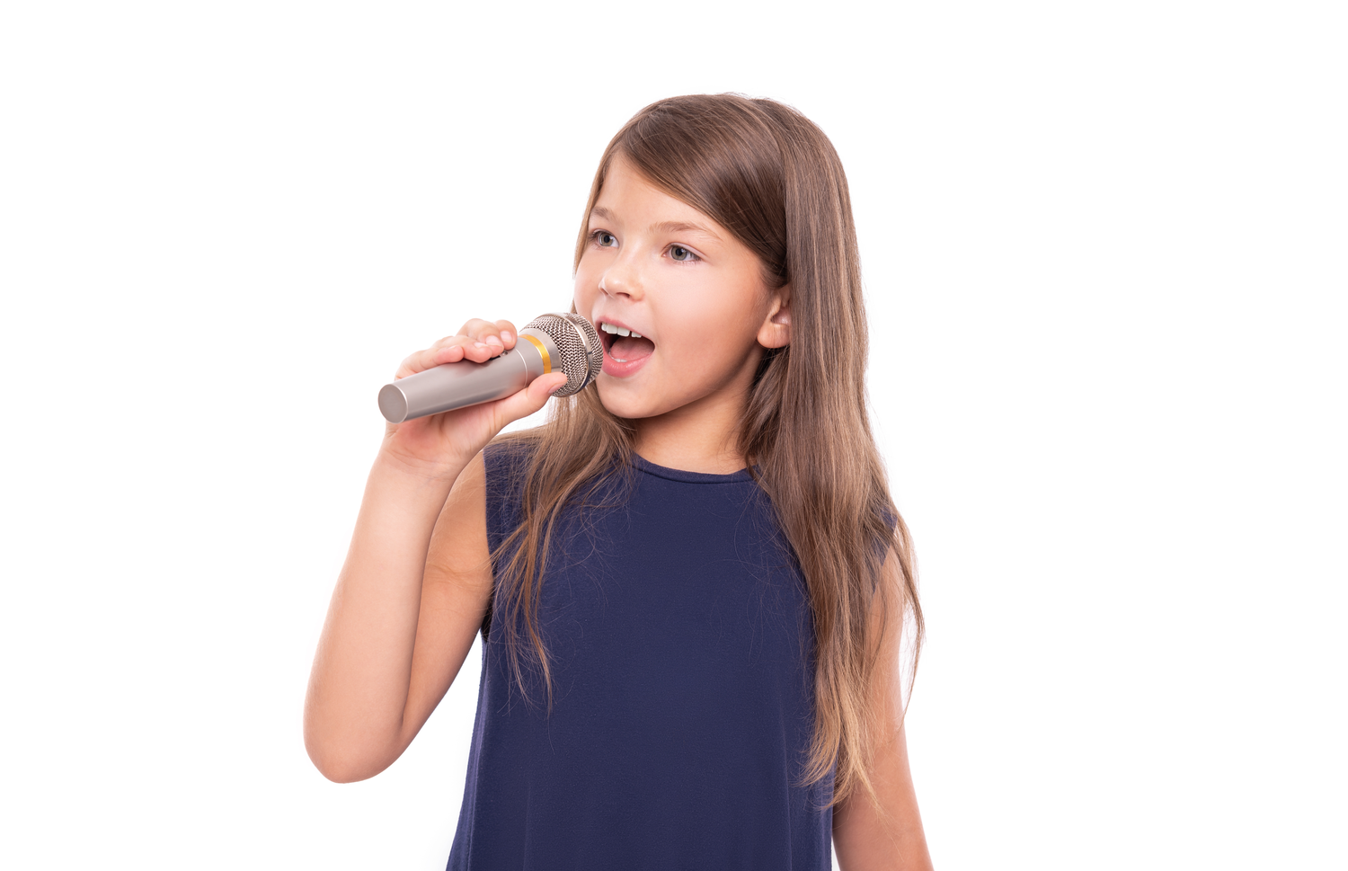
singing

Slide 7
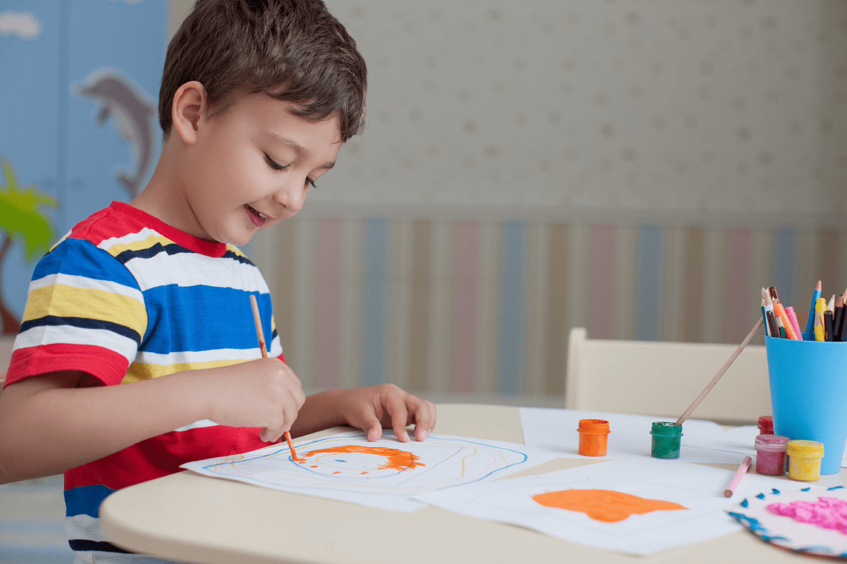
drawing

Slide 8
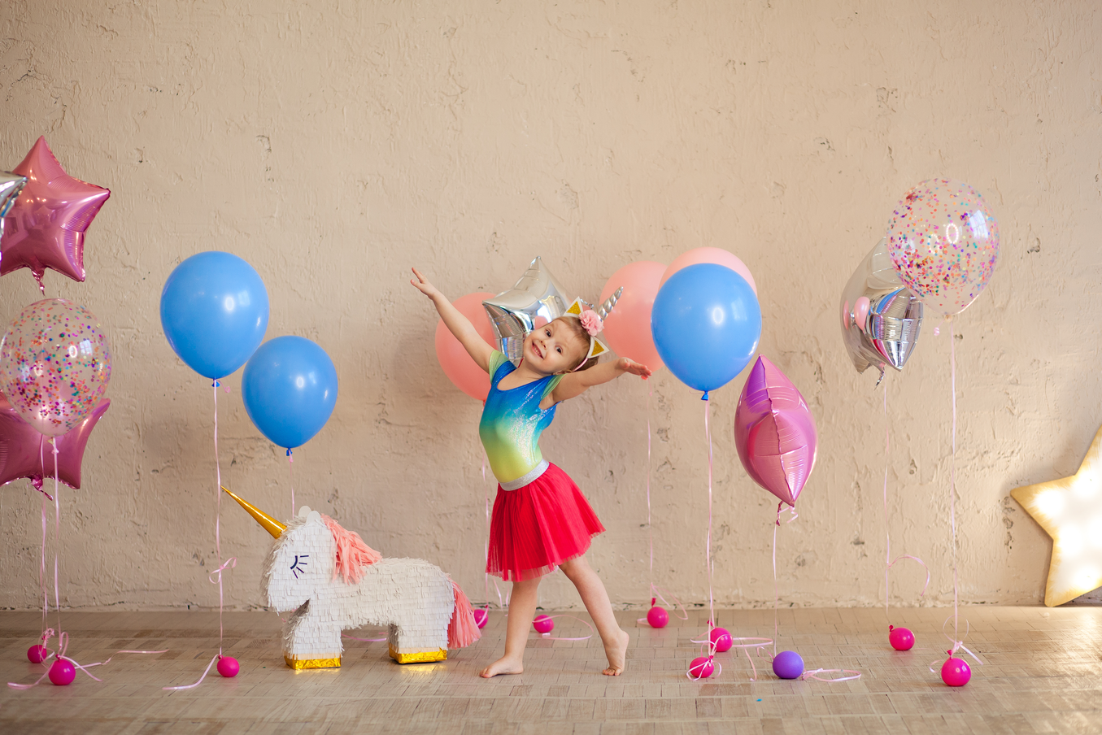
dancing

Slide 9
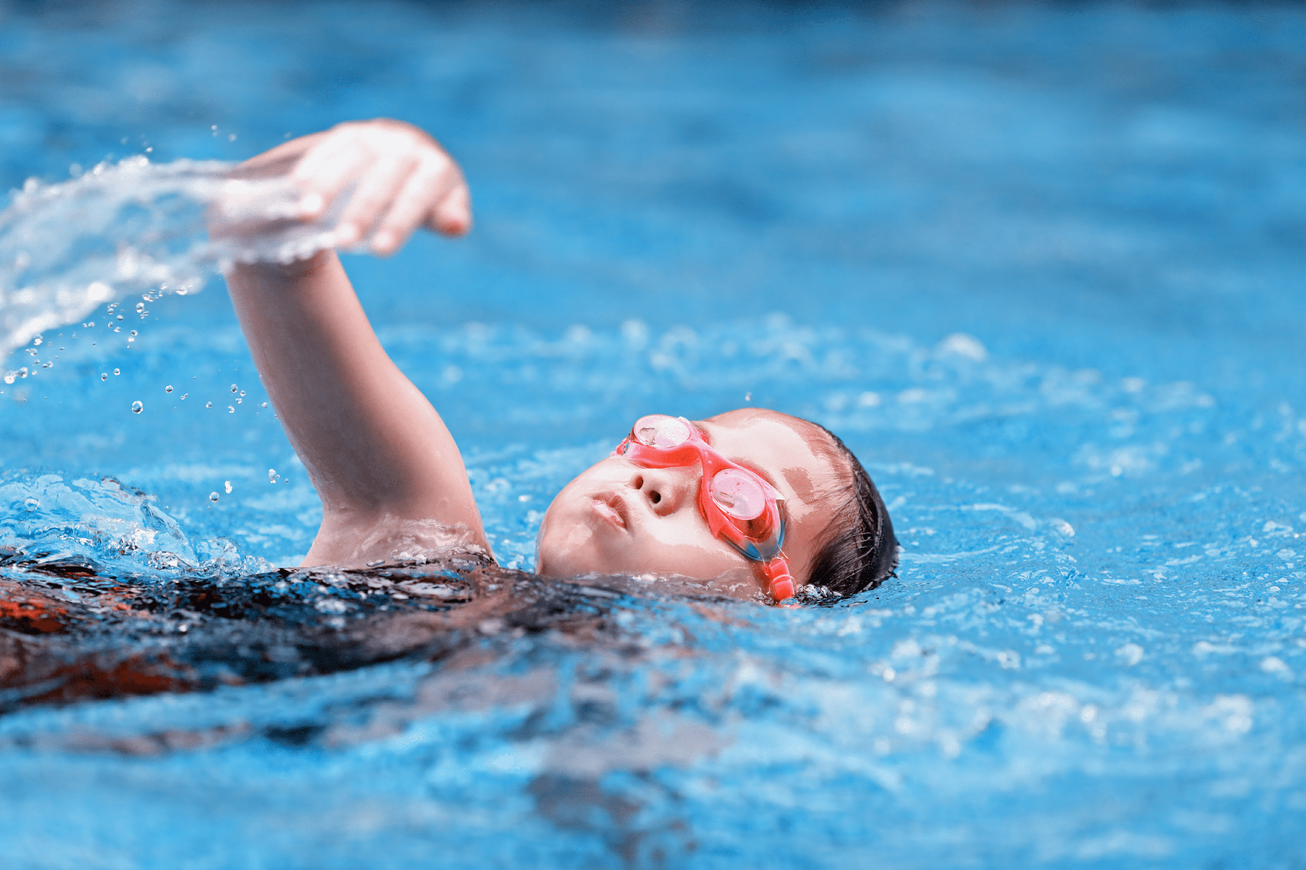
swimming

Slide 10
Practise
Notes:
Step 1: Have pupils look at the pictures and elicit the names of the pupils. Have the class repeat the words a few time.
Step 2: Ask 2 pupils to do as an example.
Step 4: Ask pupils to work in pairs, pointing to the questions and pictures and giving the answers.
Step 5: Invite few pairs to the front of the class and make questions and answers.

Slide 11
What’s missing?
Notes:
Game: What’s missing?
Divide the class into 4 groups.
A pupil from each group comes to the front, look at the pictures and say which is missing.
Who say it fast will get points.

Slide 12
What’s missing?

Slide 13
What’s missing?

Slide 14
What’s missing?

Slide 15
What’s missing?

Slide 17
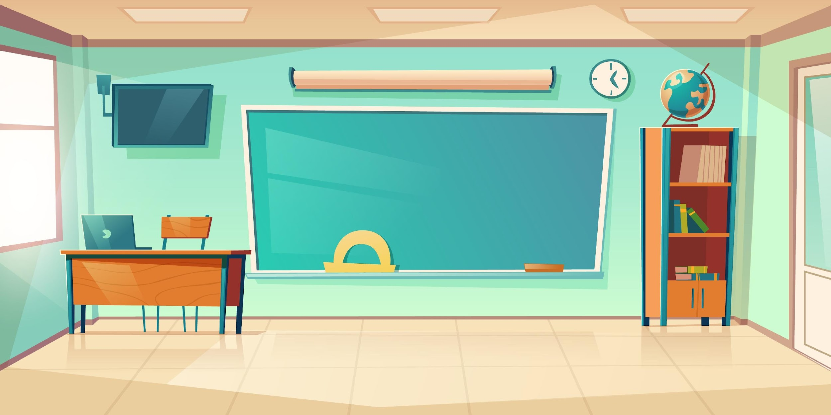
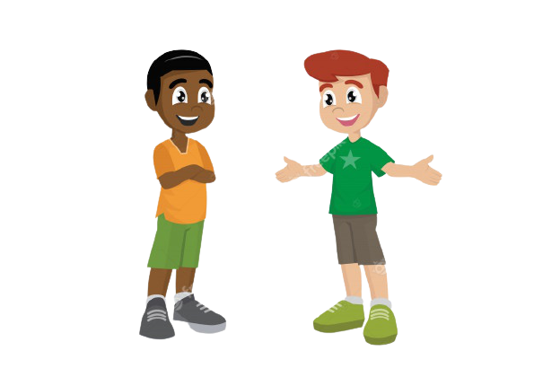
It’s ____.
What’s your hobby?
Notes:
- T asks pupils to practise in pairs asking and answering.
- T asks some pairs to present in front of class.

Slide 18
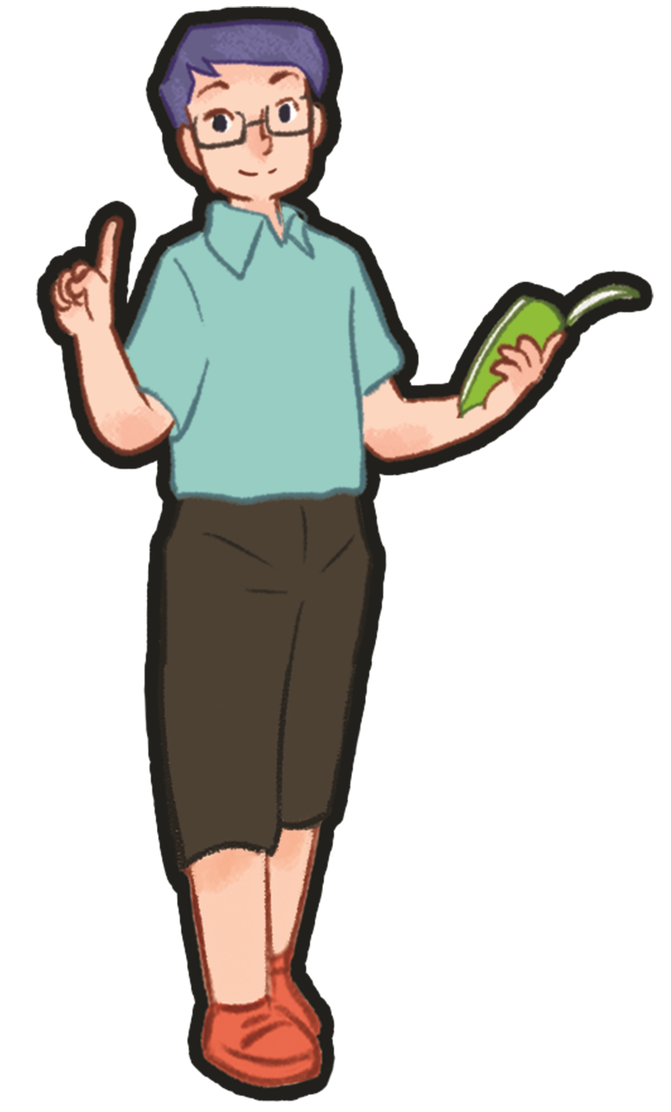
Matching game

Slide 19
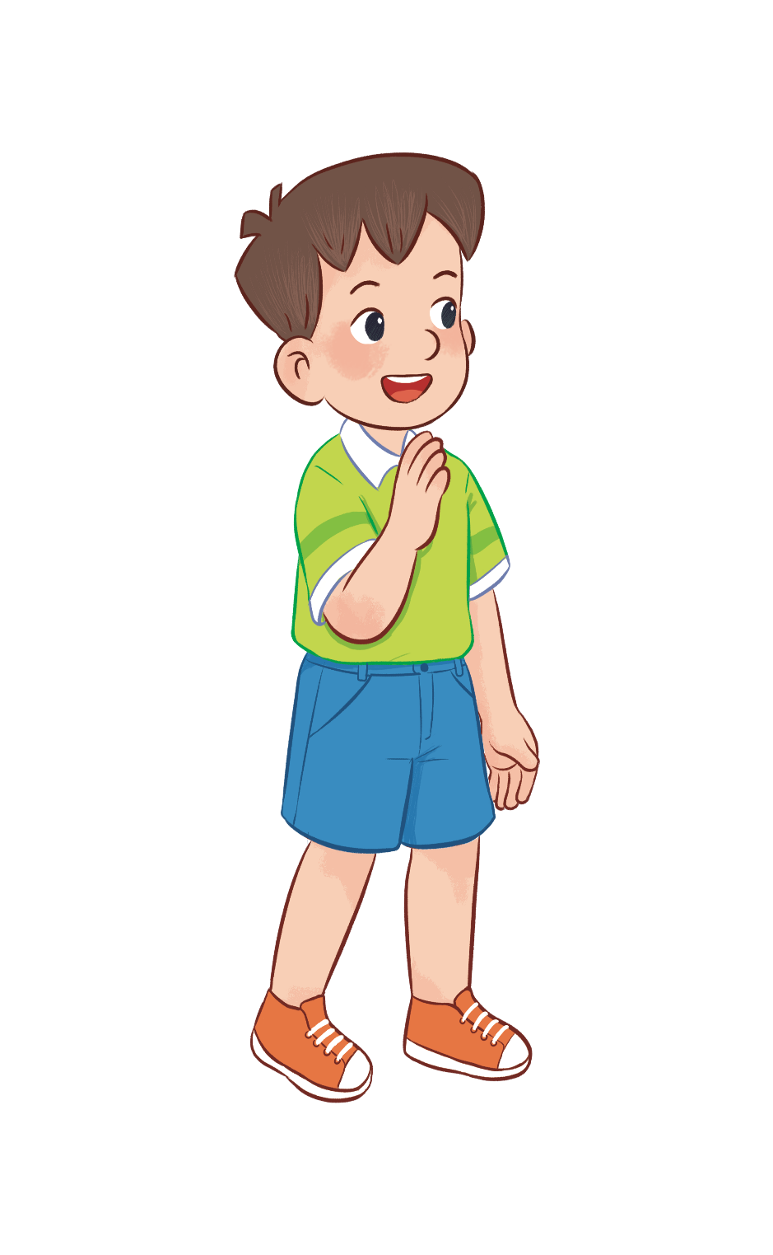
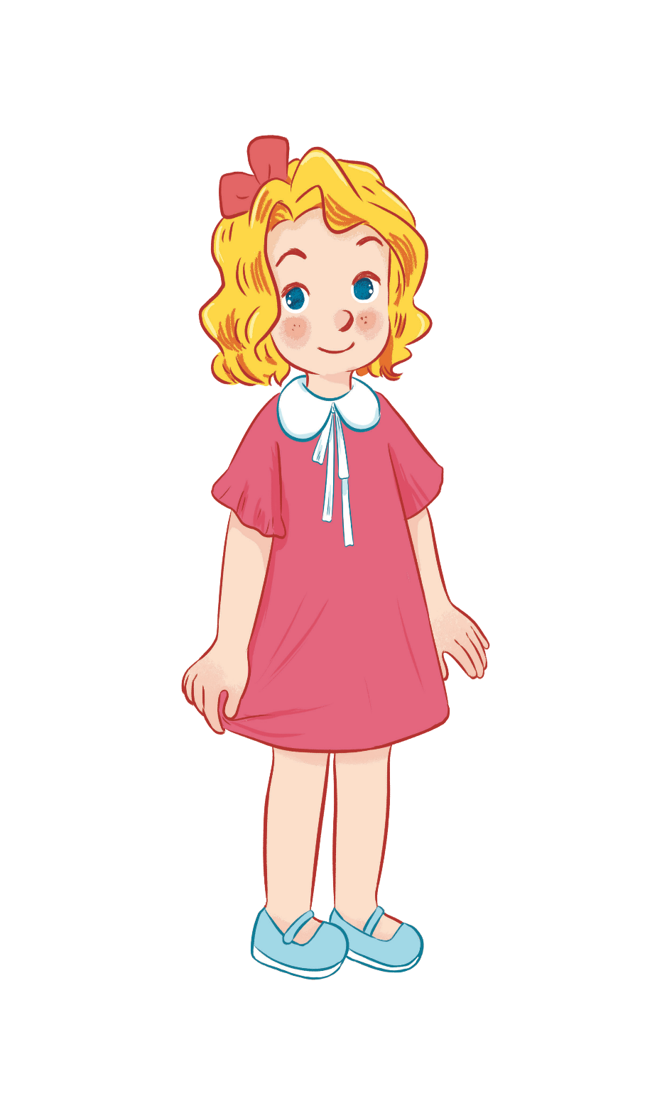
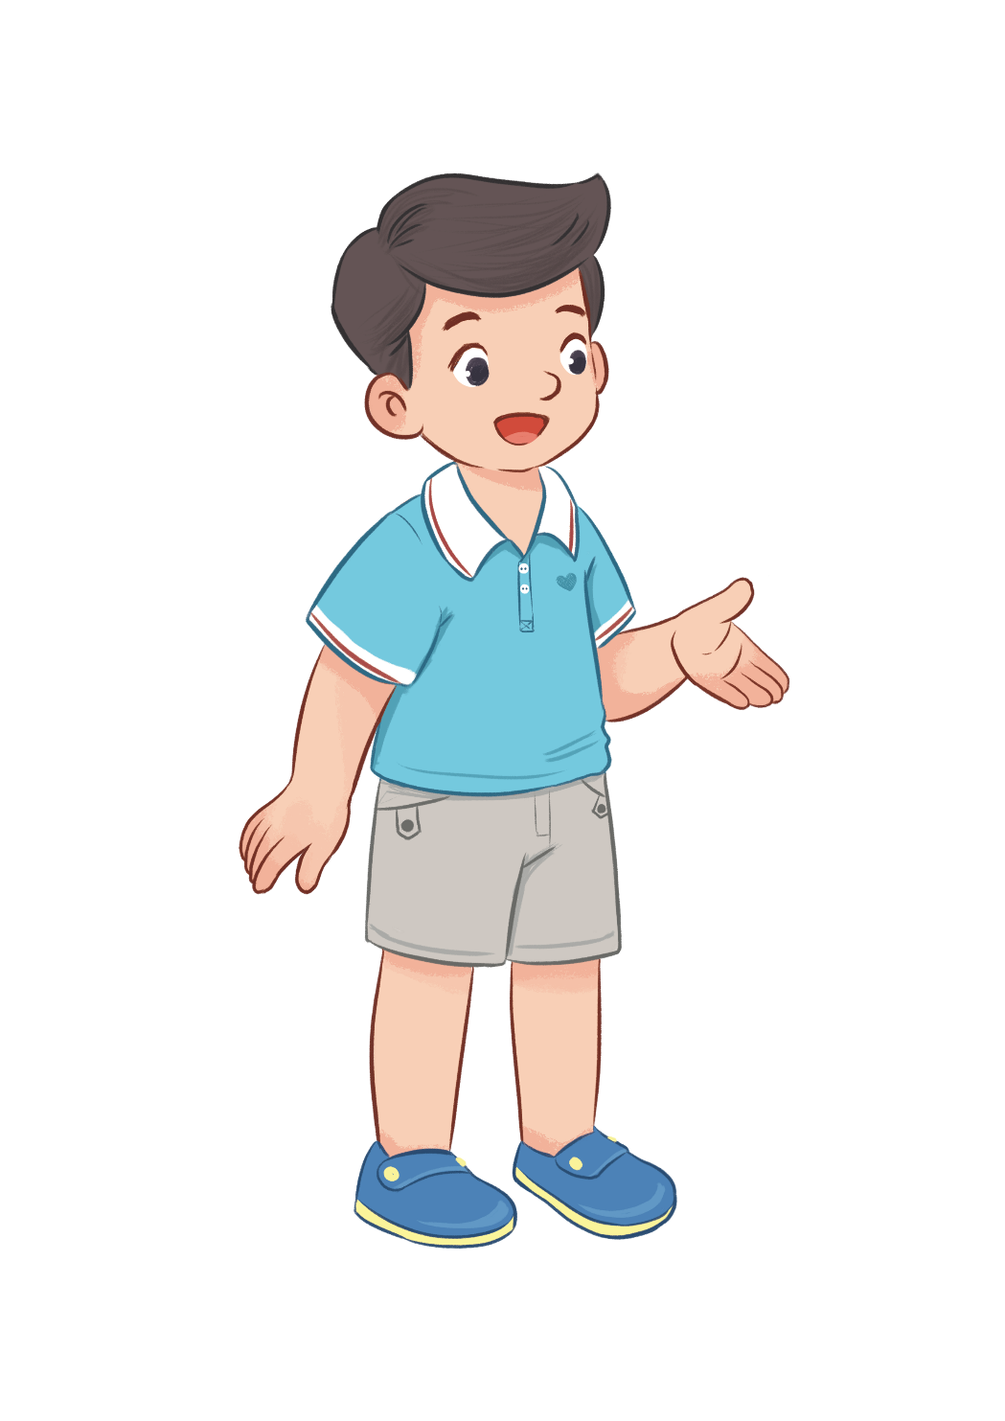
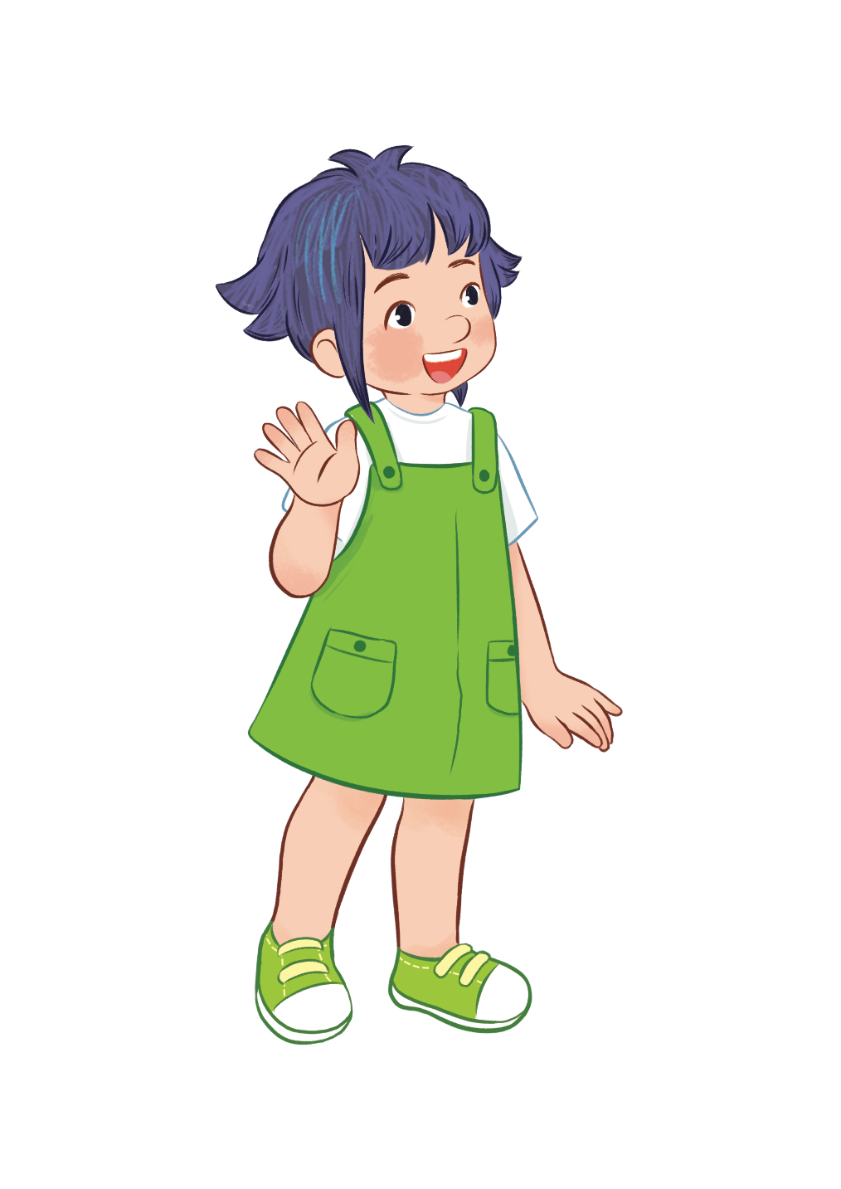
HOBBIES
drawing
swimming
dancing
singing
Notes:
- T writes 4 new words on the board and asks pupils to read (whole class).
- T asks 4 pupils to come to the board and write their hobbies in the pieces of paper and keep them in secret.

Slide 20
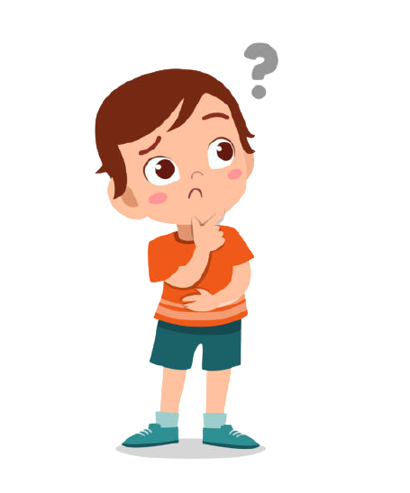
swimming/ drawing, ..?
dancing/ singing, ..?
dancing/ singing, ...?
swimming/ drawing, ...?
HOBBIES
drawing
swimming
dancing
singing
Notes:
T asks 1 pupil come to the board and guess their hobbies written in the paper (He has to write the answers in the small pieces of paper and stick to 4 pupils).

Slide 21
It’s swimming.
HOBBIES
drawing
swimming
dancing
singing
What’s your hobby?
swimming
singing
dancing
drawing
Notes:
T asks the pupil to ask the question to find the answers and gives him or her point if correct (repeat the activities depending the time).

Slide 22
Notes:
- T asks 1 student come to the board and face to the class.
- T shows 1 picture of 4 hobbies and lets the others act so that the pupil on the board can guess the name of the hobby in the picture (1 pupil will guess 3 pictures).

