Slide 1
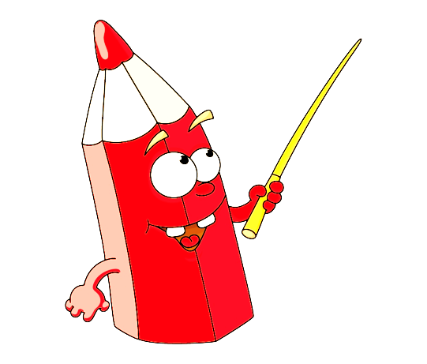
Warm-up and review

Slide 2
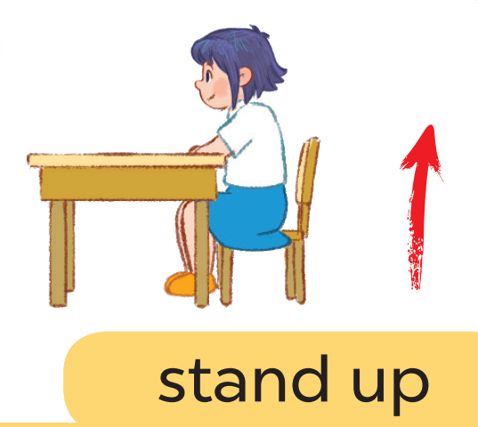
Game: Listen and choose

Slide 3
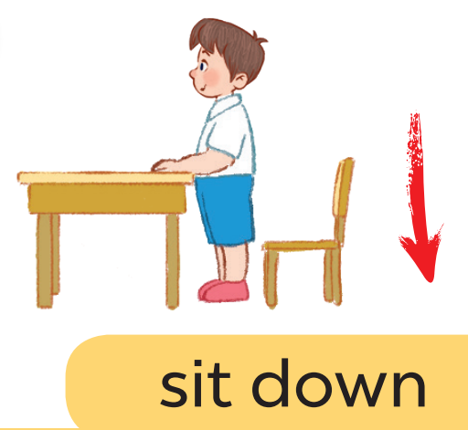
Game: Listen and choose

Slide 4
Game: Listen and choose

Slide 5
Game: Listen and choose

Slide 6
Game: Listen and choose

Slide 7
Game: Listen and choose

Slide 8
Game: Listen and choose

Slide 9
Game: Listen and choose

Slide 10
8
: 1, 2, 3

Slide 11
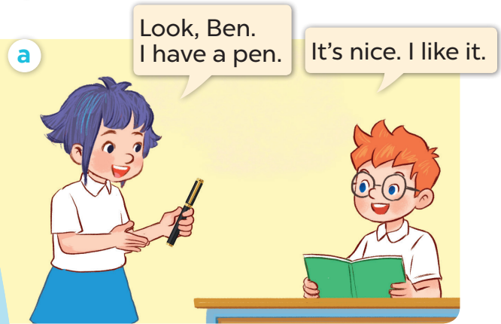
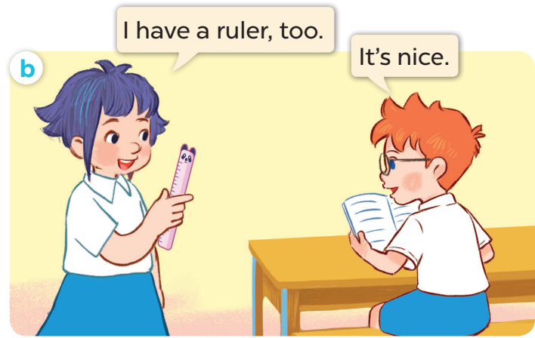
1. Look, Listen and repeat

Slide 14
Game:
Notes:
Game: Slap the board.
- Divide the class into four teams.
- Stick the pictures of activities on the board.
- T says a sentence, a pupil from each team has to point/slap the right picture and says the sentence again. The faster pupil will get points for their team.

Slide 15
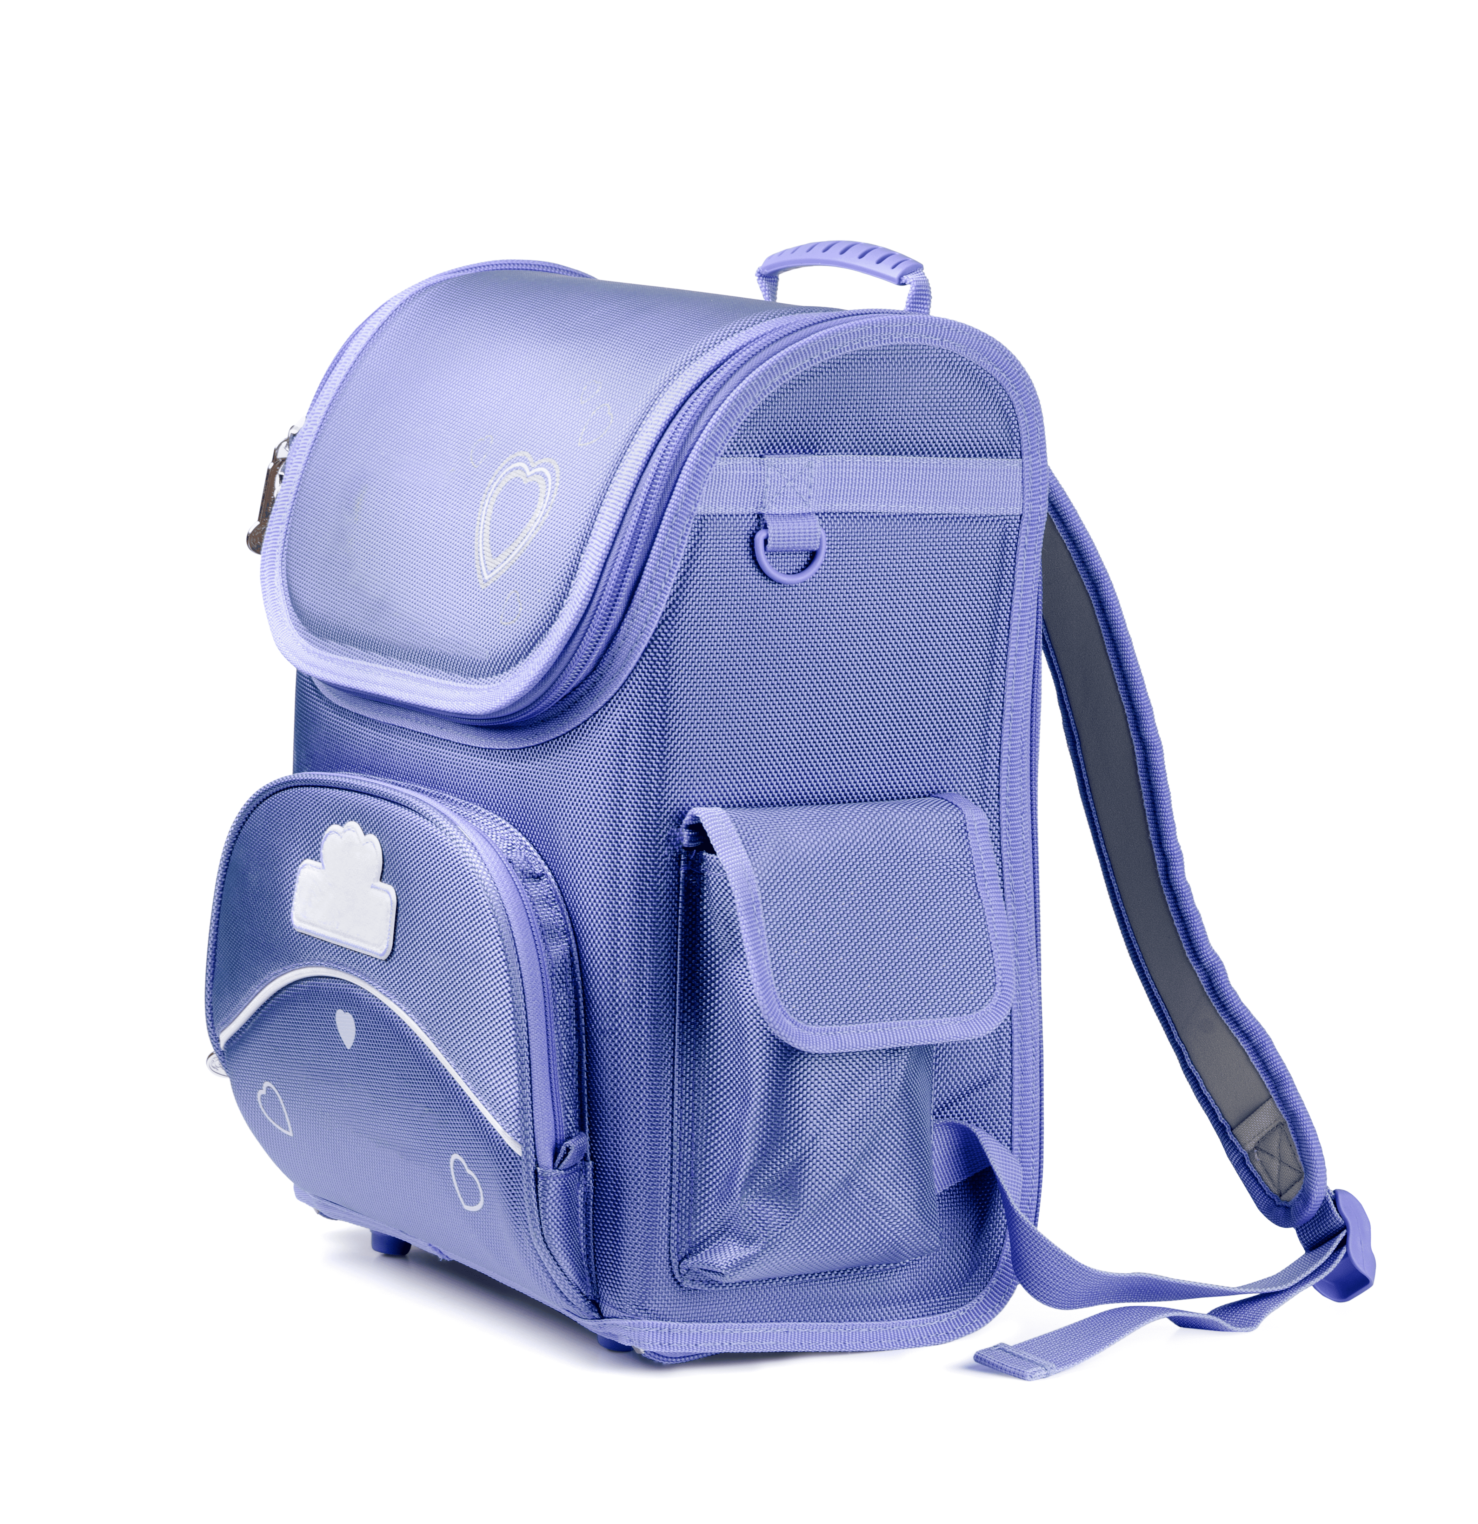
I have a ruler!
I have a ruler!
Notes:
Game: Slap the board.
- Divide the class into four teams.
- Stick the pictures of school things on the board.
- T says a sentence, a pupil from each team has to point/slap the right picture and says the sentence again. The faster pupil will get points for their team.

Slide 16
I have a book!
I have a school bag!

Slide 17
Game: Let’s move and say!

Slide 18
I have a pencil!
Go back 1 space
Go back 1 space
Go forward 1 space
Back to
start!
Notes:
Let’s move and say!
- Get 2-3 pupils to play at the same time.
- Each pupil tosses a dice then moves accordingly.
- When he/she gets to the space, they have to do the requirements. Whoever gets to the last place first is the winner.

