Slide 1
14
My bedroom
Lesson 1 – 1,2,3

Slide 2
①
Warm-up and review
②
Look, listen and repeat.
③
Listen, point and say.
④
Let’s talk.
⑤
Fun corner and wrap-up

Slide 3
Lesson 1
Period 1
①
Warm-up and review

Slide 4
Game: What room is this?
Look and guess
Notes:
Open the coloured squares and guess the room behind.

Slide 5
living room
SHOW

Slide 6
bathroom
SHOW

Slide 7
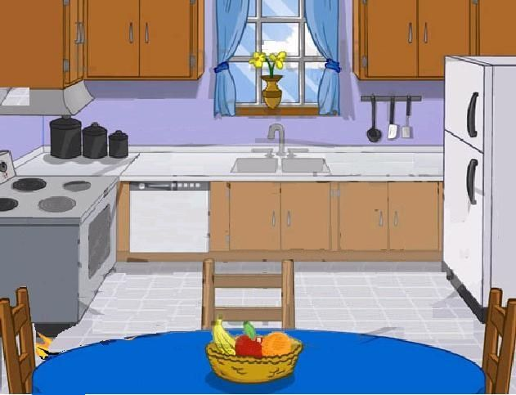
kitchen
SHOW

Slide 8
bedroom
SHOW

Slide 9
Lesson 1
Period 1
②
Look, listen and repeat.

Slide 12
Lesson 1
Period 1
③
Listen, point and say.

Slide 13
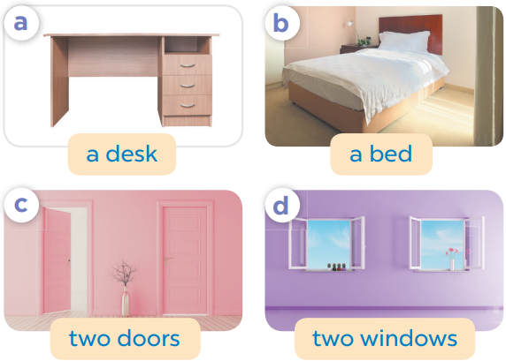
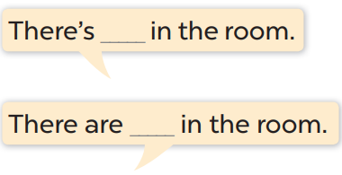

Slide 15
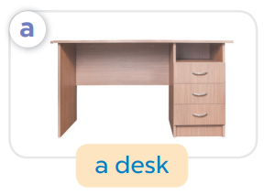
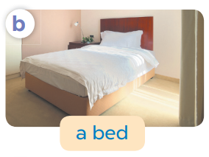
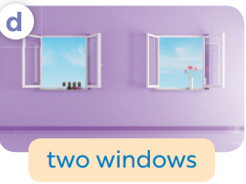
Game: What’s missing?
Notes:
Game: What’s missing?
T divides the class into 2 teams: BOYS and GIRLS.
T shows 4 pictures on the board. Take out 1, then 2 pictures then ask pupils to find out what is/ are missing.
Members of each team try to say out loud the missing room as fast as possible.

Slide 16
What’s missing?

Slide 17
What’s missing?

Slide 18
What’s missing?

Slide 19
What’s missing?

Slide 20
What’s missing?
What’s missing?

Slide 21
What’s missing?
What’s missing?

Slide 22
What’s missing?
What’s missing?

Slide 23
What’s missing?
What’s missing?

Slide 24
What’s missing?
What’s missing?

Slide 25
What’s missing?
What’s missing?

Slide 26
Lesson 1
Period 1
④
Let’s talk.

Slide 27
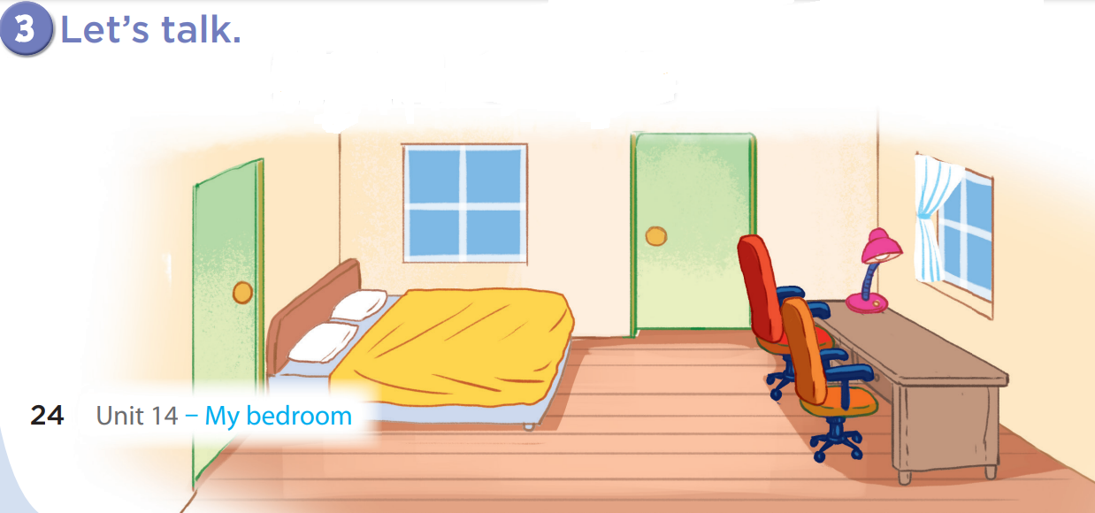
There are
two windows.
There is a bed.

Slide 28
There are
two doors.
There is a desk.

Slide 29
There are
two chairs.
There is a lamp.

Slide 30
Game: Look and say!
Notes:
Game: Look and say
- Divide the class into 2-4 teams.
- Have the pupils look at the arrows and say the sentences.

Slide 31
There are two windows.
5

Slide 32
There are two doors.
3

Slide 33
There is a bed.
2

Slide 34
There is a desk.
3

Slide 35
There are two doors.
5

Slide 36
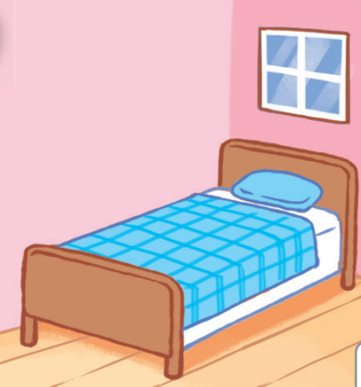
There is a bed.
2

Slide 37
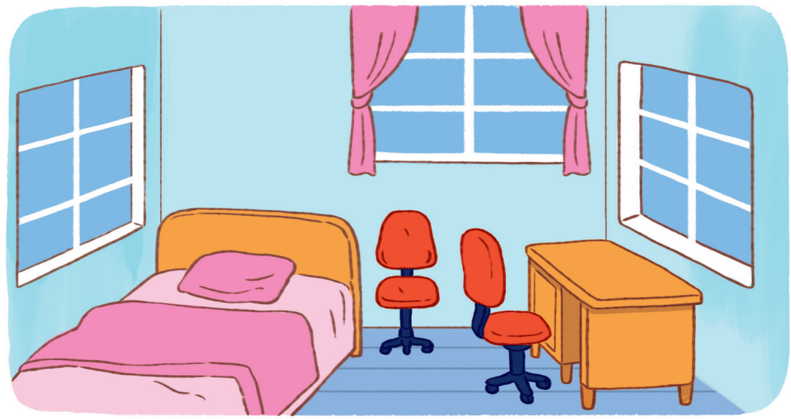
There is a desk.
3

Slide 38
There are three windows.
3

Slide 39
There are two chairs.
3

Slide 40
Lesson 1
Period 1
⑤
Fun corner and wrap-up

Slide 41
What can you see in the room?
Notes:
Teacher asks pupils some questions about the picture and has them answer, e.g.:
+ What can you see in the picture?
+ How many…..?

Slide 42
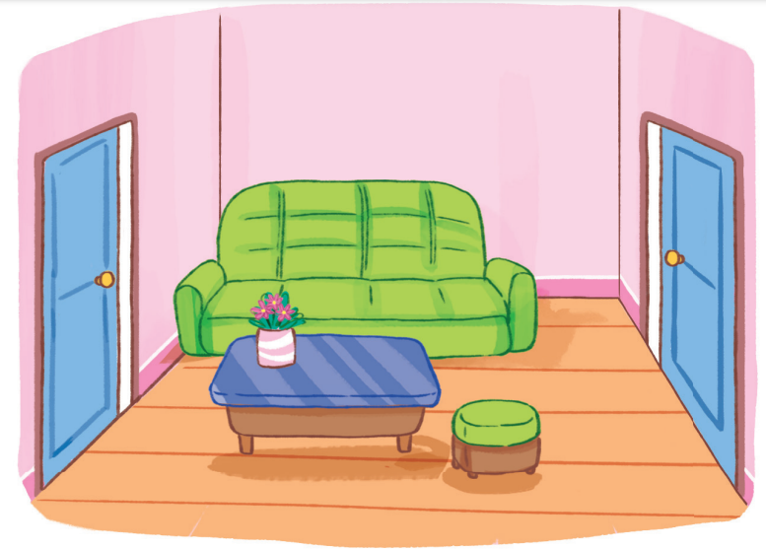
What can you see in the room?

Slide 43
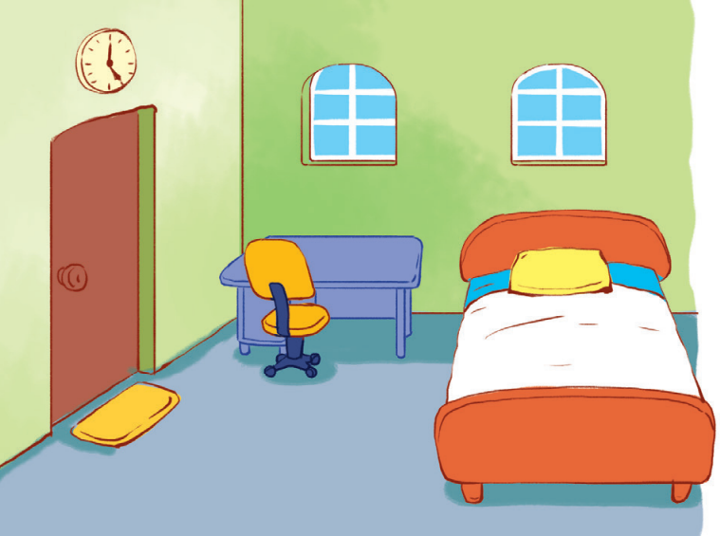
What can you see in the room?

