Slide 1
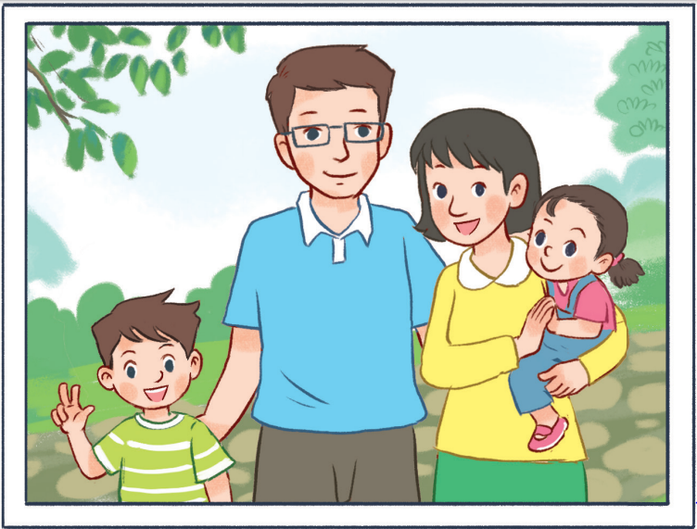
11
Part 1,2,3

Slide 2
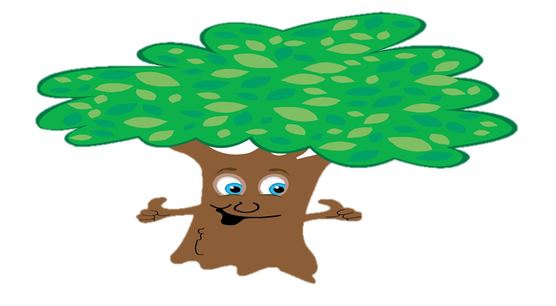
My family
Listen, point
and say.
Let’s talk.
Look, listen
and repeat.
Warm-up
and review
Fun corner
and wrap-up

Slide 3
Warm-up
and review
GIRLS
0
1
2
3
4
5
6
7
8
0
9
1
2
3
4
5
6
7
8
0
9
1
2
3
4
5
6
7
8
9
BOYS
0
1
2
3
4
5
6
7
8
0
9
1
2
3
4
5
6
7
8
0
9
1
2
3
4
5
6
7
8
9
A
B
C
D
E
F
G
H
Notes:
- Divide the class into 2 teams. Each team choose one letter to go to the question.
- Have pupils look, read and choose the right options.
- Back to the menu for pupils to choose another question.
- Pupils continue their turns until there are no letters left.
- The team with the most points wins.

Slide 4
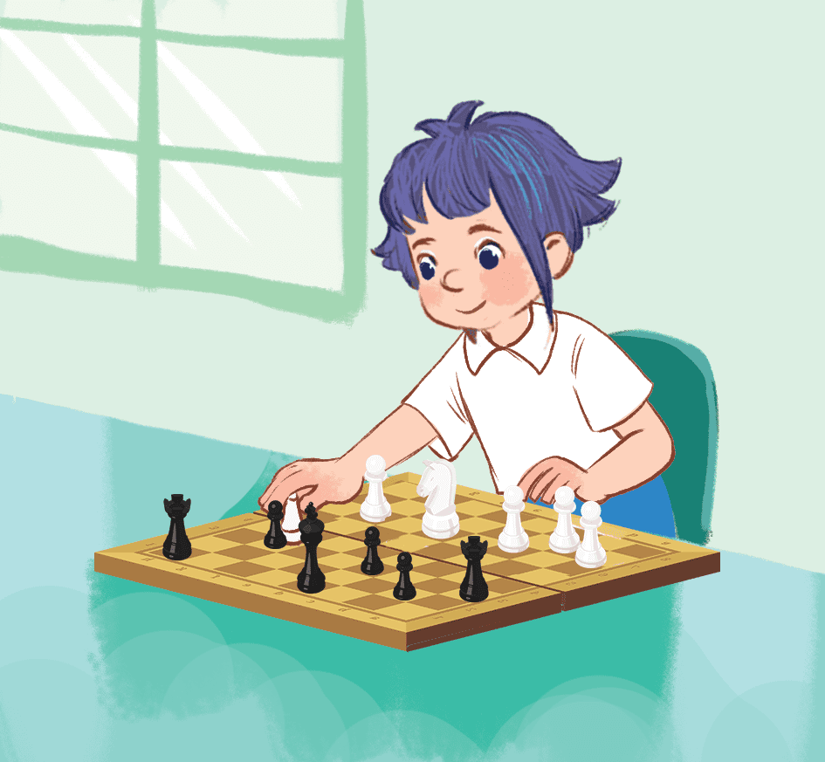
What do you do
at break time?
10
I play chess.
I play badminton.
I play basketball.
Notes:
- Click the flower at the top left cornet to go back.

Slide 5
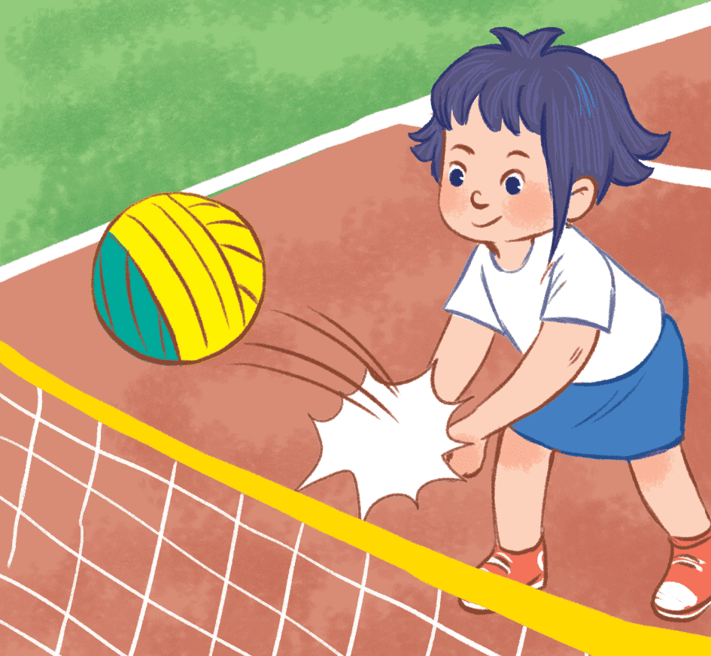
What do you do
at break time?
20
I play football.
I play volleyball.
I play basketball.
Notes:
- Click the flower at the top left cornet to go back.

Slide 6
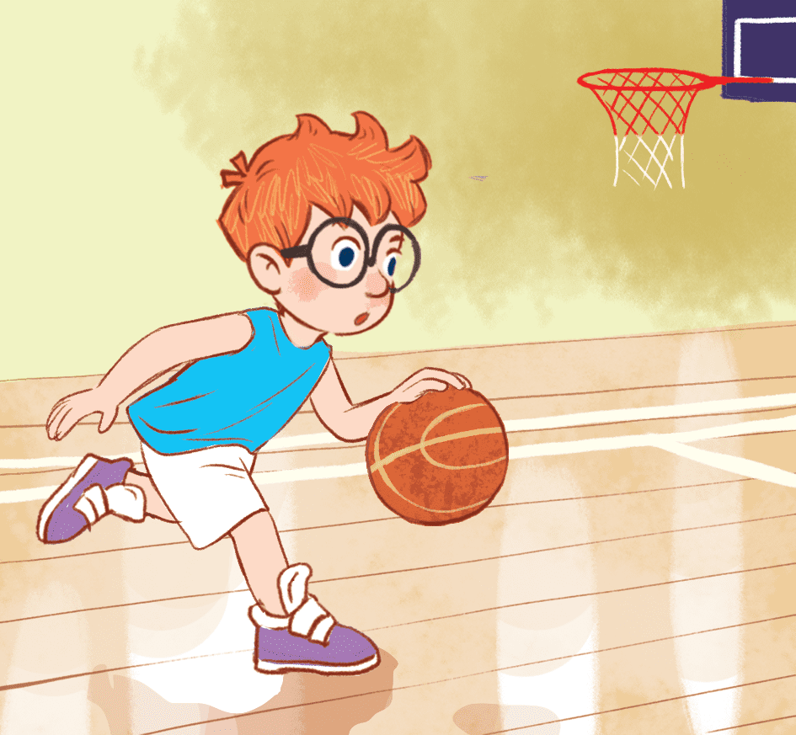
What do you do
at break time?
30
I play volleyball.
I play badminton.
I play basketball.
Notes:
- Click the flower at the top left cornet to go back.

Slide 7
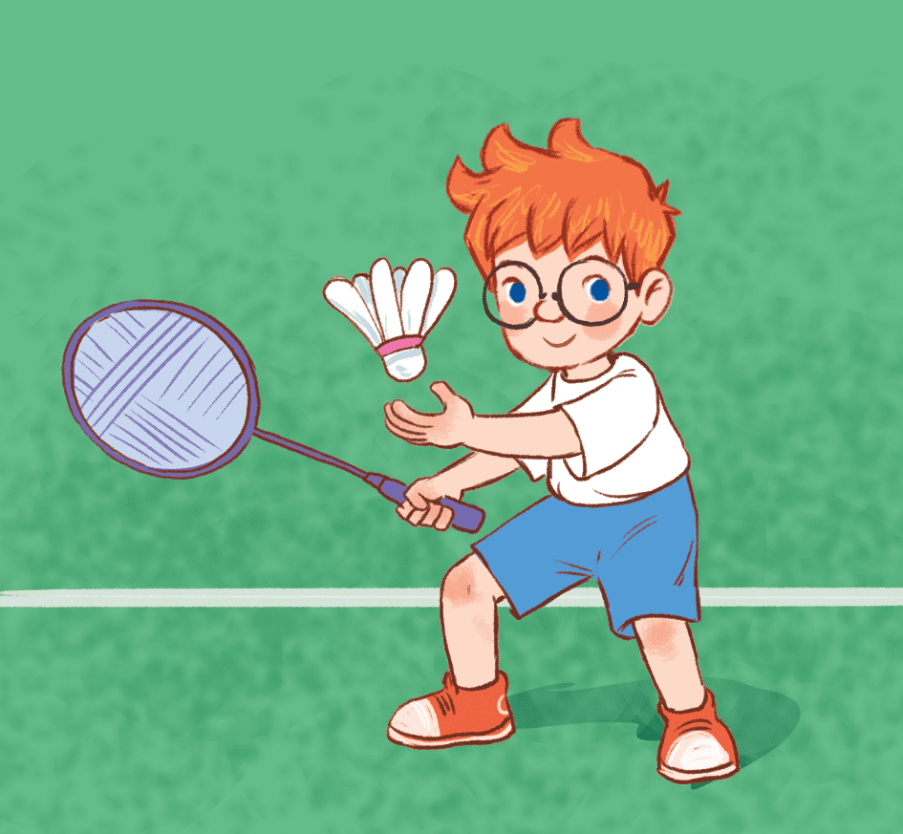
What do you do
at break time?
40
I play badminton.
I play volleyball.
I play table tennis.
Notes:
- Click the flower at the top left cornet to go back.

Slide 8
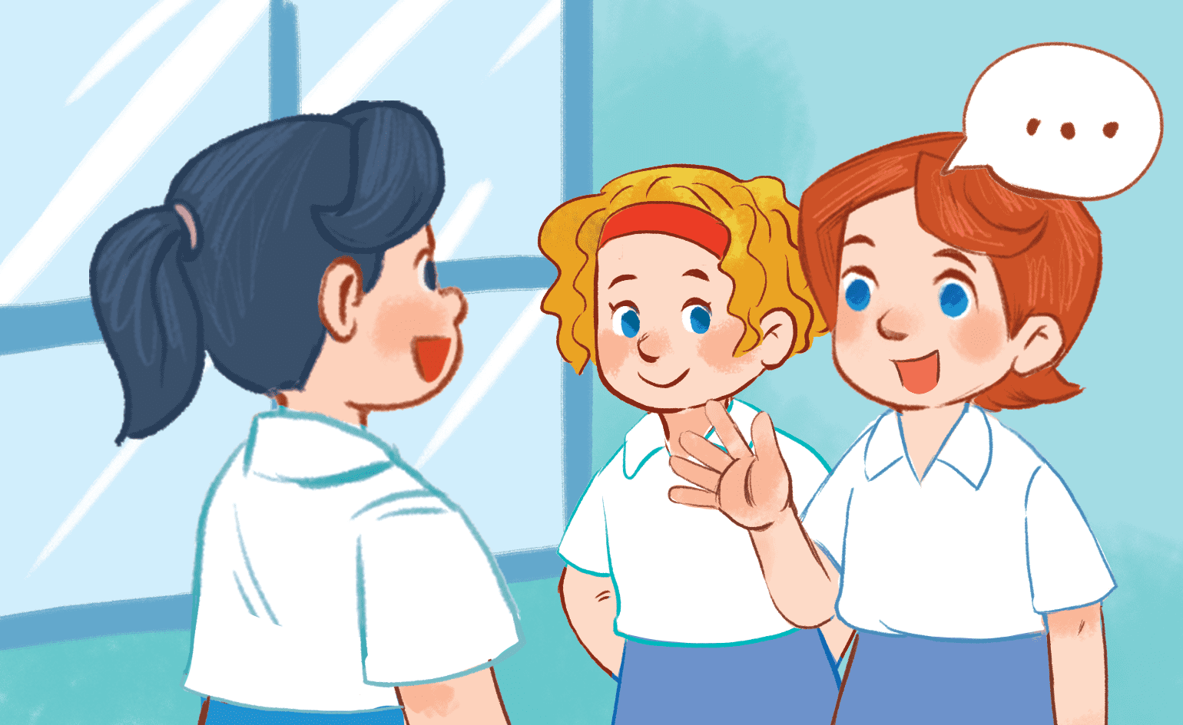
What do you do
at break time?
50
I play chess.
I chat with my friends.
I play table tennis.
Notes:
- Click the flower at the top left cornet to go back.

Slide 9
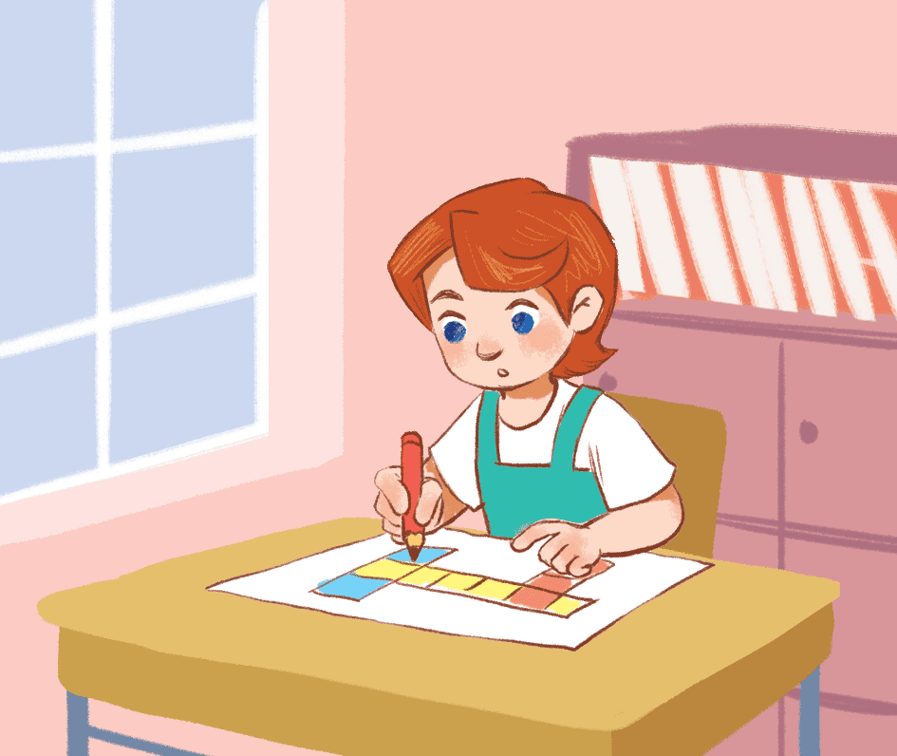
What do you do
at break time?
40
I play basketball.
I play volleyball.
I do word puzzles.
Notes:
- Click the flower at the top left cornet to go back.

Slide 10
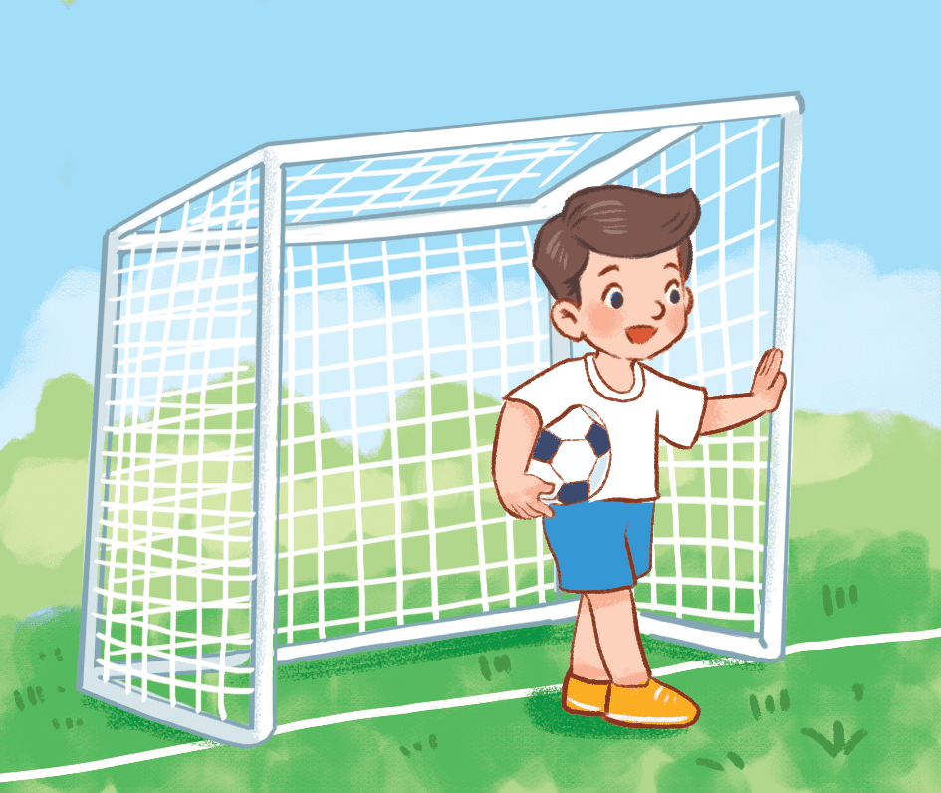
What do you do
at break time?
10
I play volleyball.
I play football.
I play chess.
Notes:
- Click the flower at the top left cornet to go back.

Slide 11
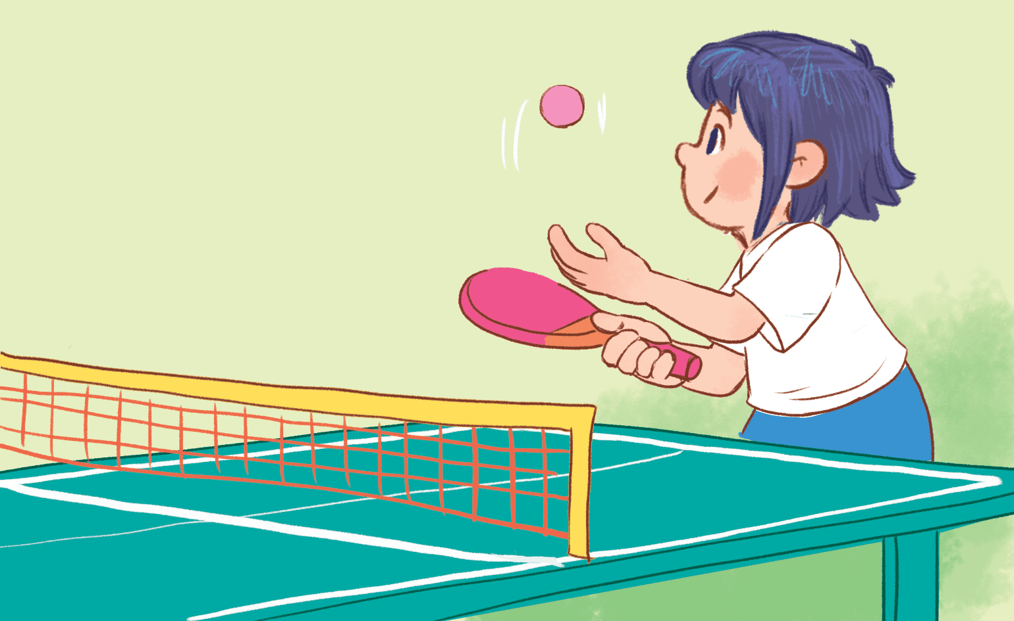
What do you do
at break time?
20
I play volleyball.
I play badminton.
I play table tennis.
Notes:
- Click the flower at the top left cornet to go back.

Slide 12
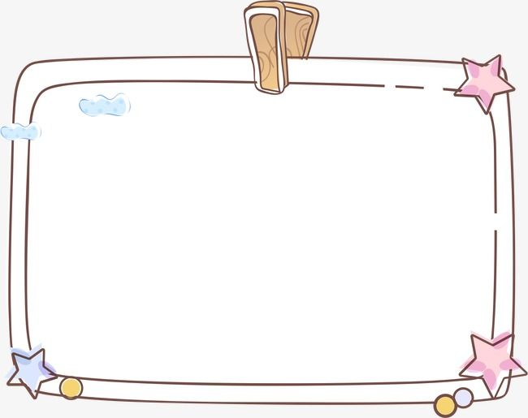
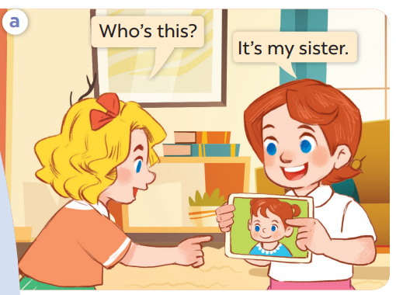
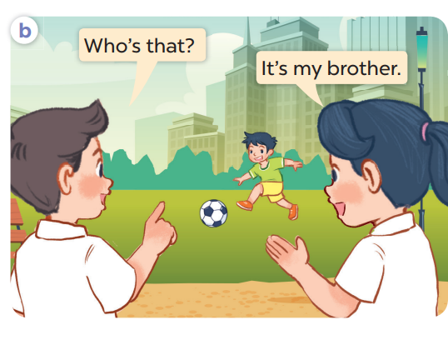
Look, listen and repeat.

Slide 13
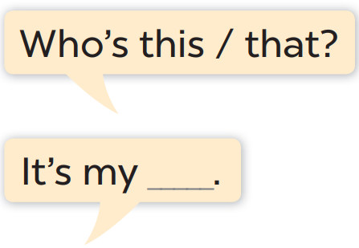
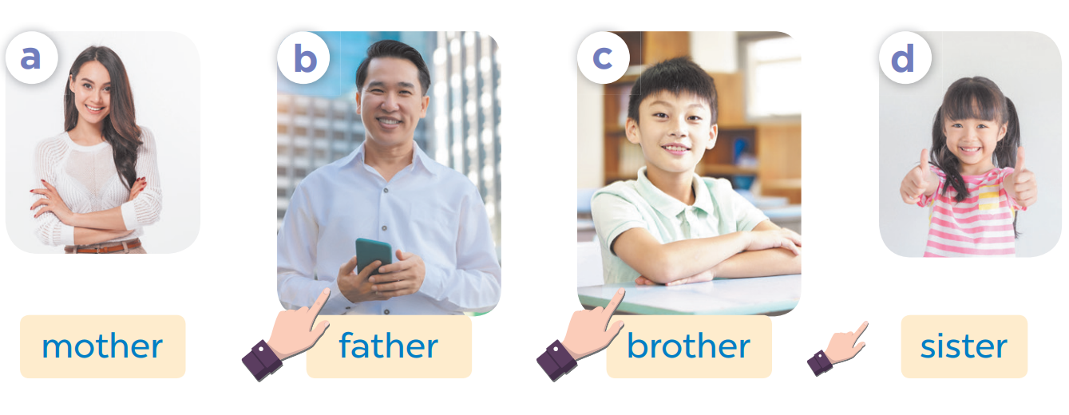

Slide 14
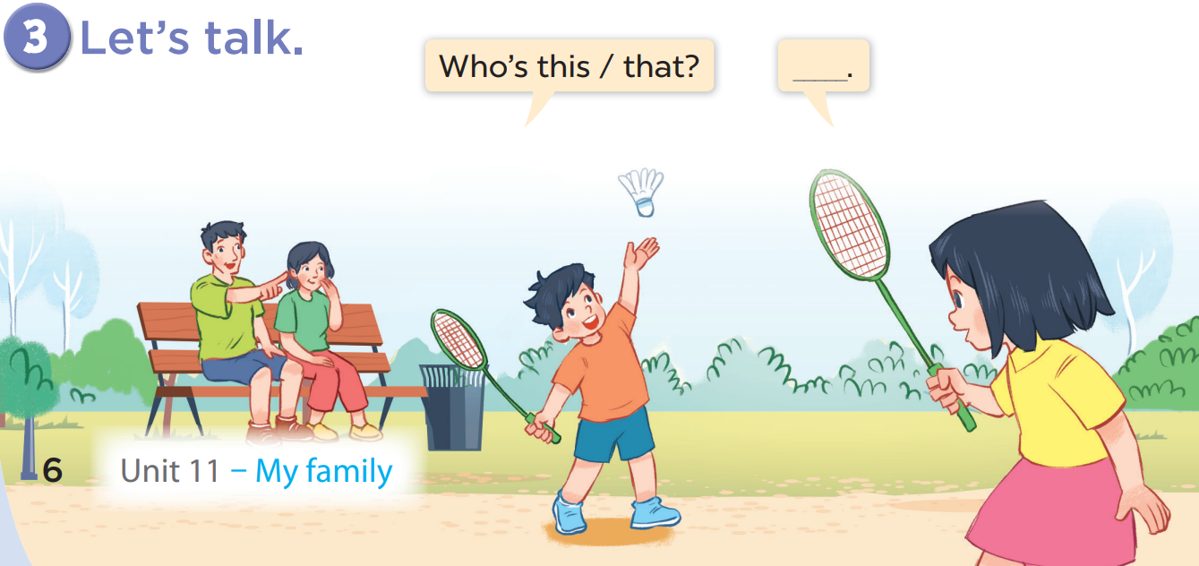

Slide 15
LEVEL 2
Fun corner
and wrap-up
GIRLS
0
1
2
3
4
5
6
7
8
0
9
1
2
3
4
5
6
7
8
0
9
1
2
3
4
5
6
7
8
9
BOYS
0
1
2
3
4
5
6
7
8
0
9
1
2
3
4
5
6
7
8
0
9
1
2
3
4
5
6
7
8
9
A
B
C
D
E
F
G
H
Notes:
- Each team choose a letter to go to the question.
- Have pupils look, read and answer the questions.
- Back to the menu for pupils another question.
- Pupils continue their turns until there are no letters left.
- The team with the most points wins.

Slide 16
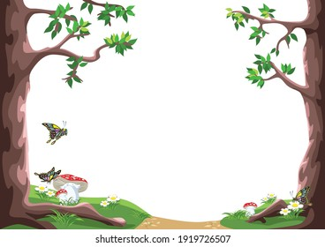
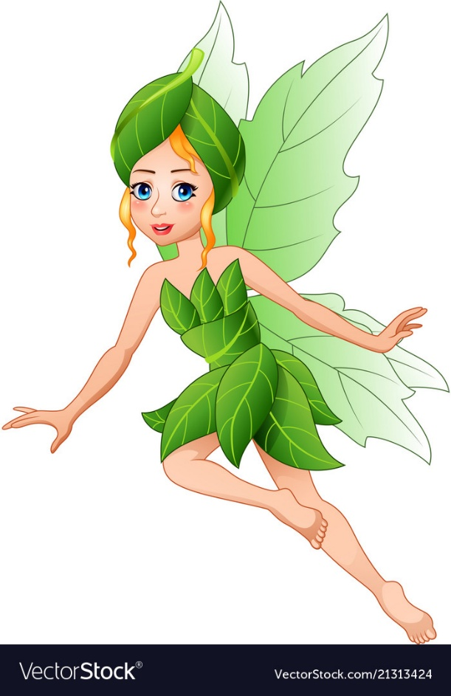
Who’s that?
home
10
It’s my father.
Notes:
Click the answer box to show how many points the students get.
- Click the flower on top left to go back.

Slide 17
Who’s this?
home
20
It’s my sister.
Notes:
Click the answer box to show how many points the students get.
- Click the flower on top left to go back.

Slide 18
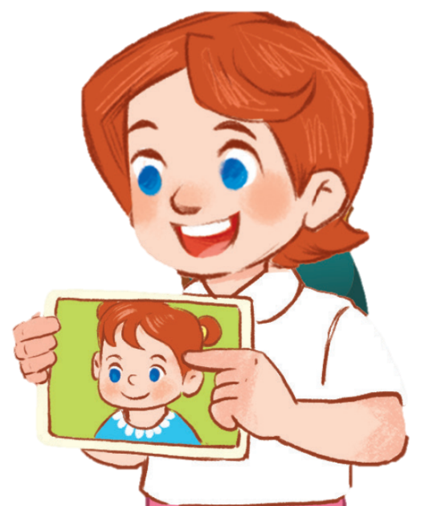
Who’s this?
home
10
It’s my sister.
Notes:
Click the answer box to show how many points the students get.
- Click the flower on top left to go back.

Slide 19
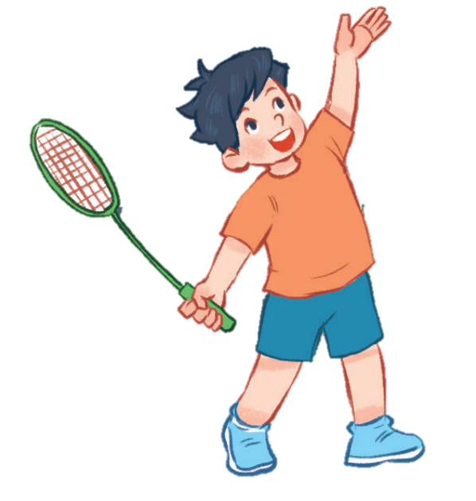
Who’s that?
home
20
It’s my brother.
Notes:
Click the answer box to show how many points the students get.
- Click the flower on top left to go back.

Slide 20
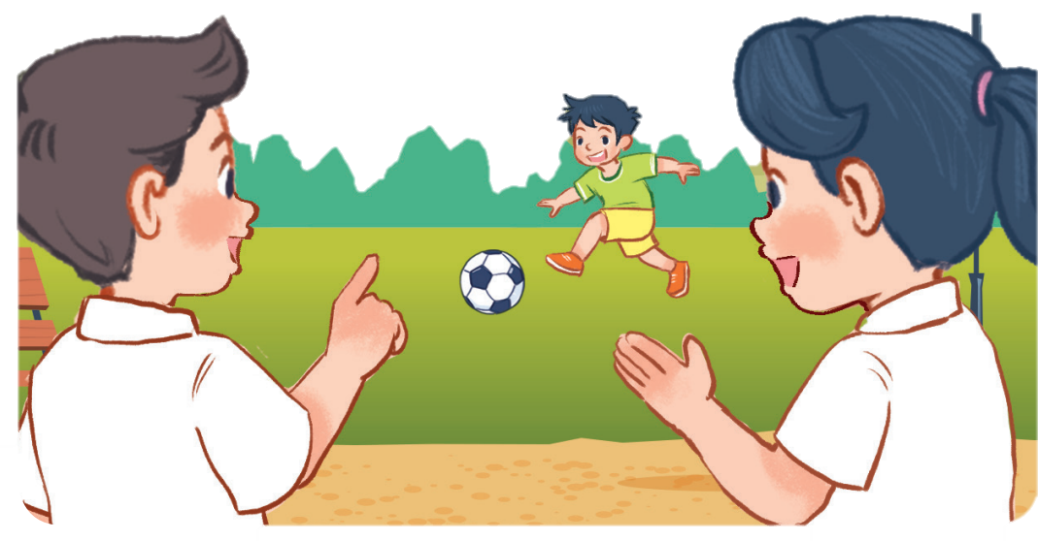
Who’s that?
home
30
It’s my brother.
Notes:
Click the answer box to show how many points the students get.
- Click the flower on top left to go back.

Slide 21
Who’s that?
home
20
It’s my mother.
Notes:
Click the answer box to show how many points the students get.
- Click the flower on top left to go back.

Slide 22
Who’s this?
home
30
It’s my father.
Notes:
Click the answer box to show how many points the students get.
- Click the flower on top left to go back.

Slide 23
Who’s this?
home
20
It’s my brother.
Notes:
Click the answer box to show how many points the students get.
- Click the flower on top left to go back.

