Slide 1
6
Our school
LESSON 1-1,2,3

Slide 2
Warm-up

Slide 4
1. Look, listen and repeat.

Slide 9
2. Listen, point and say.

Slide 10
New words

Slide 11
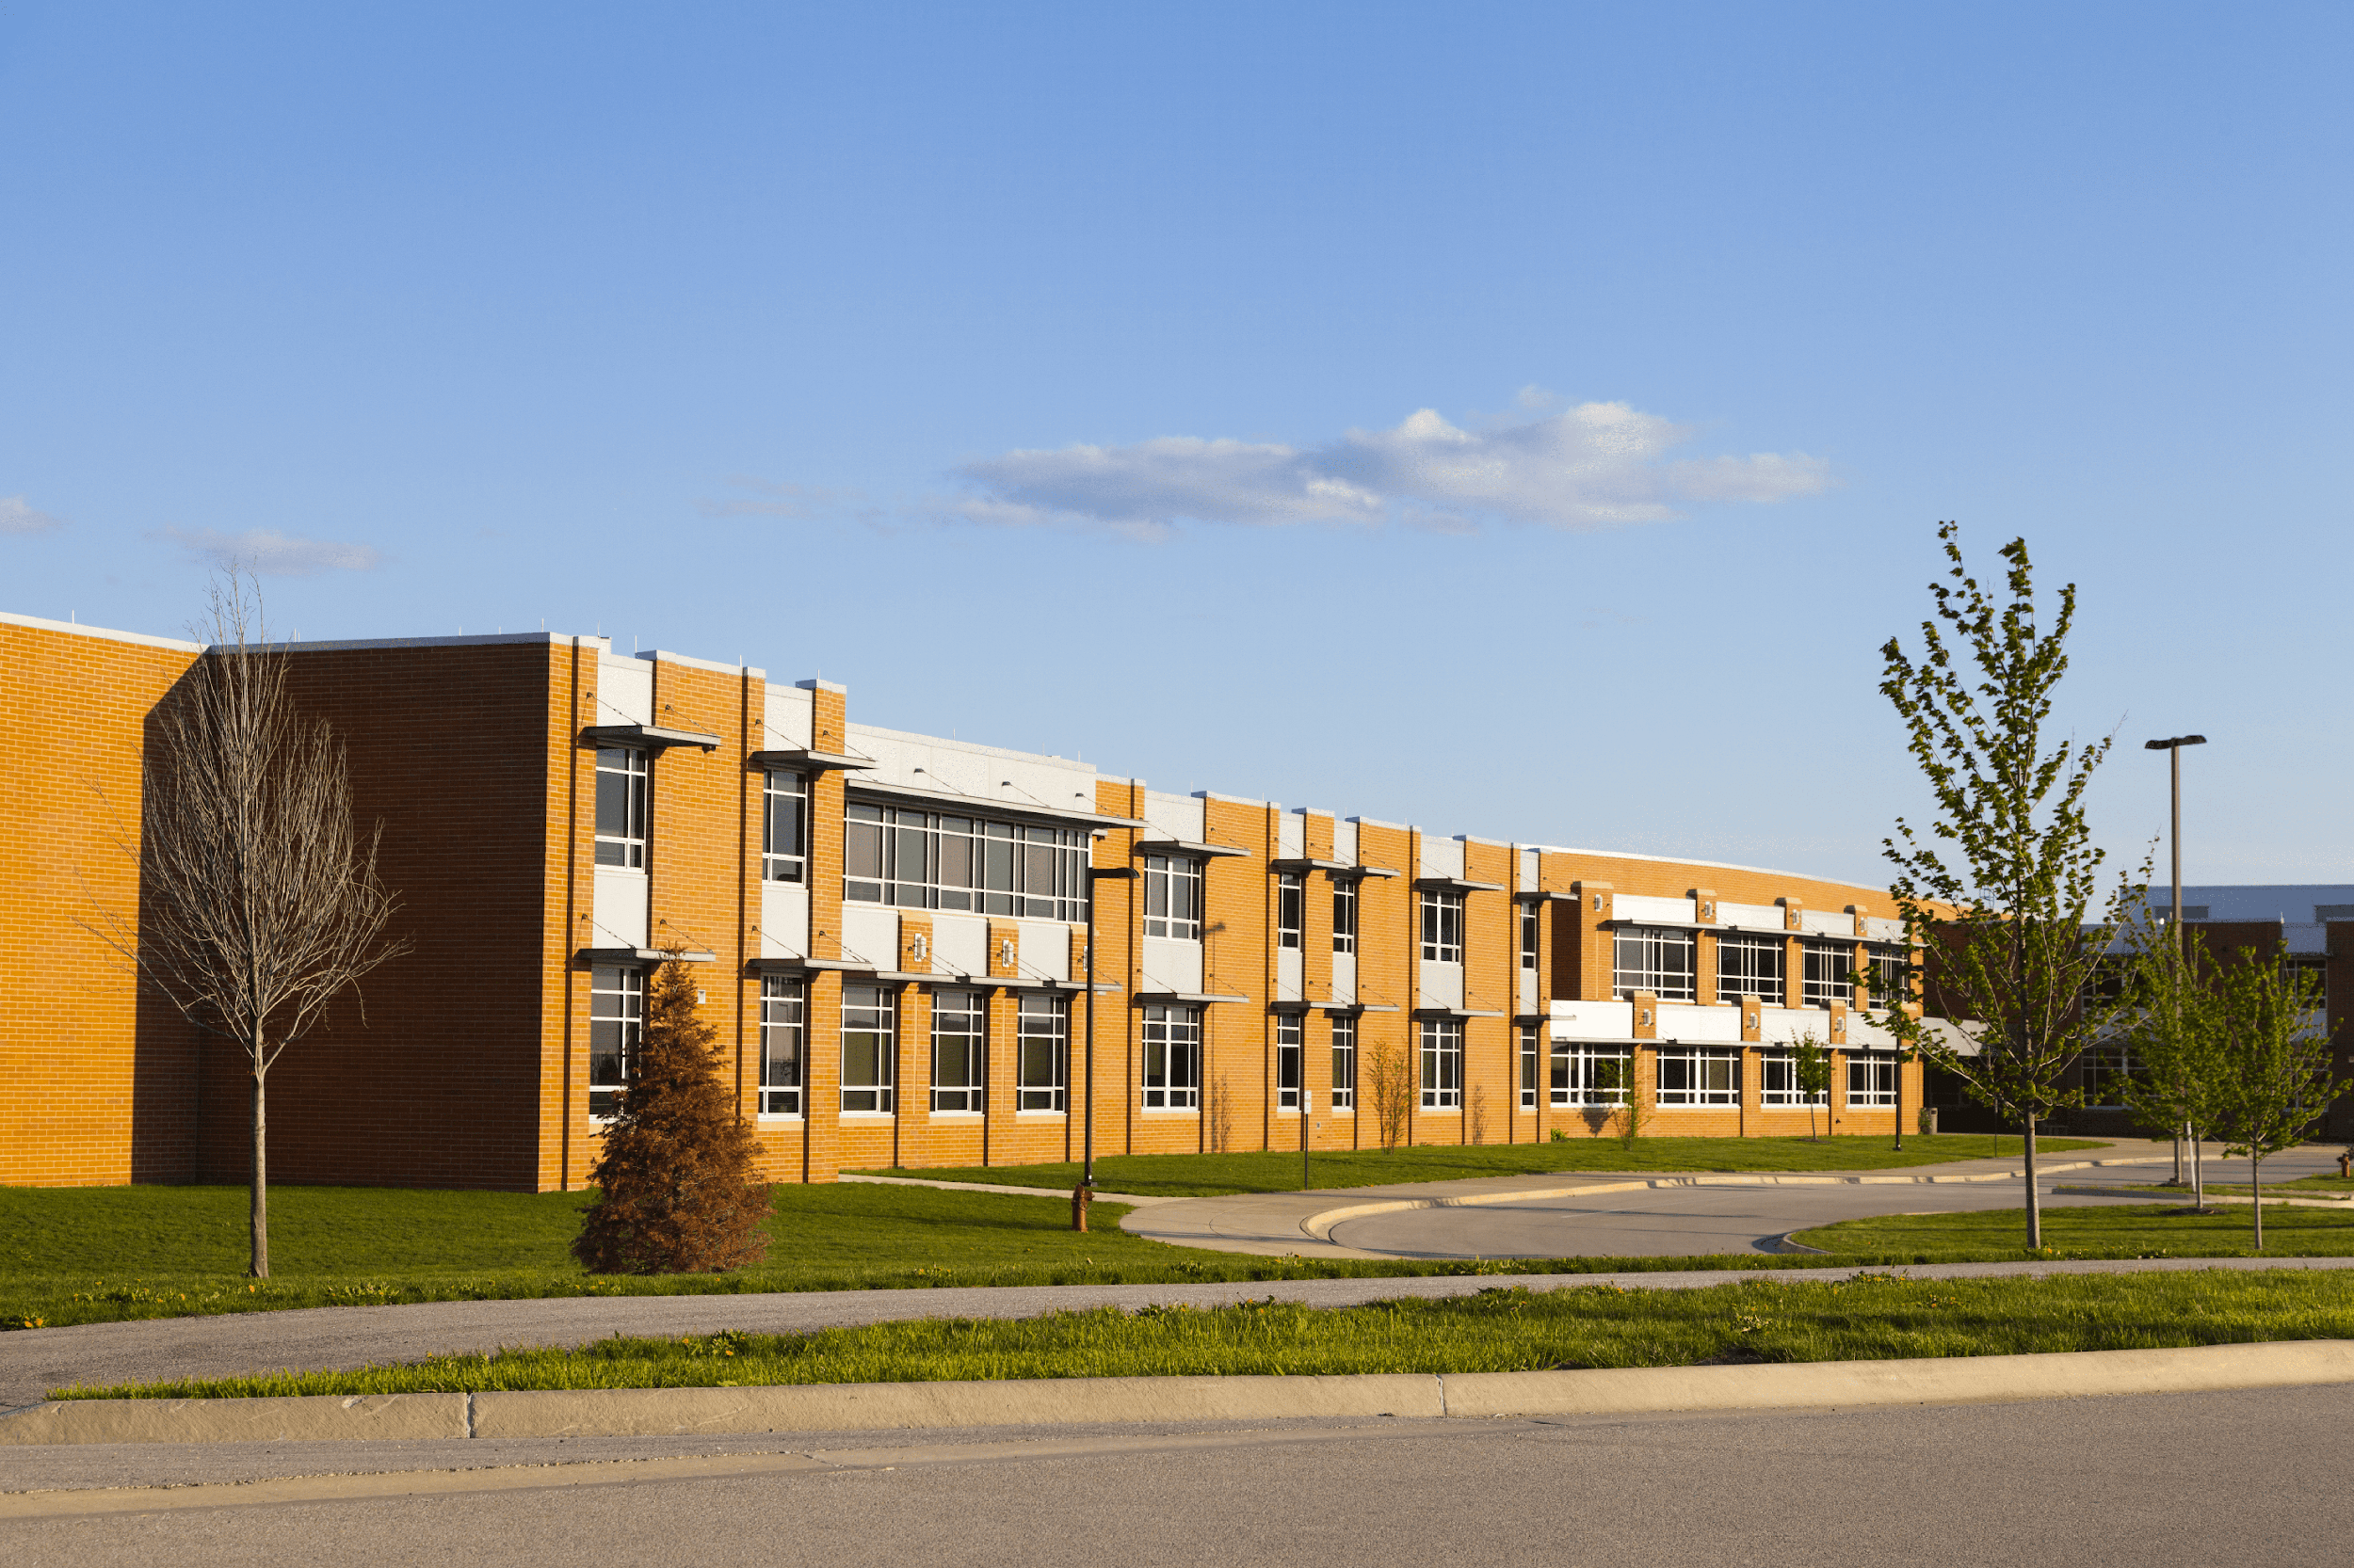
school

Slide 12
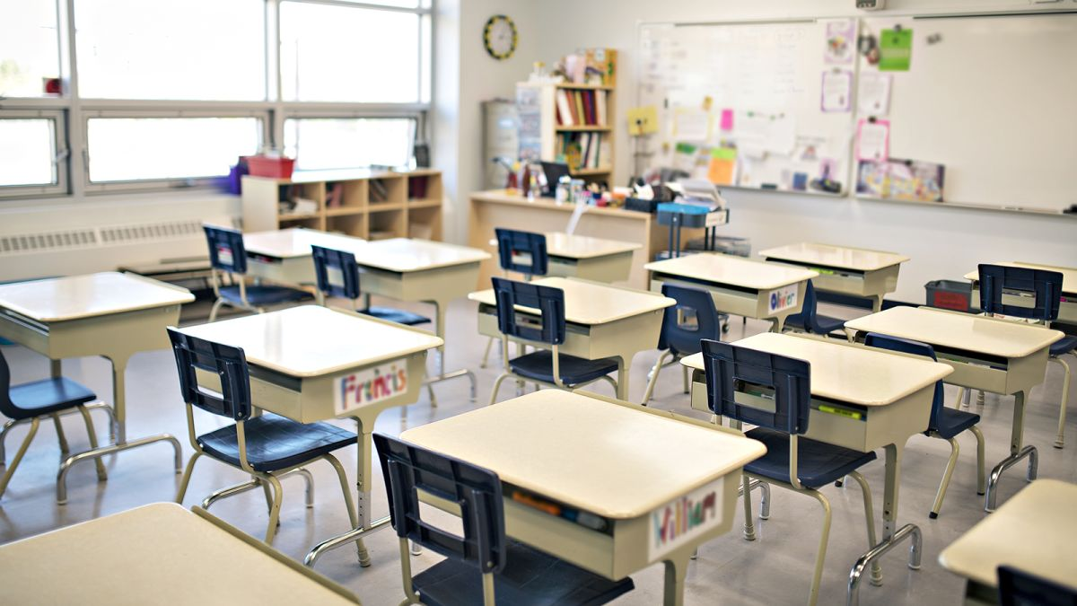
classroom

Slide 13
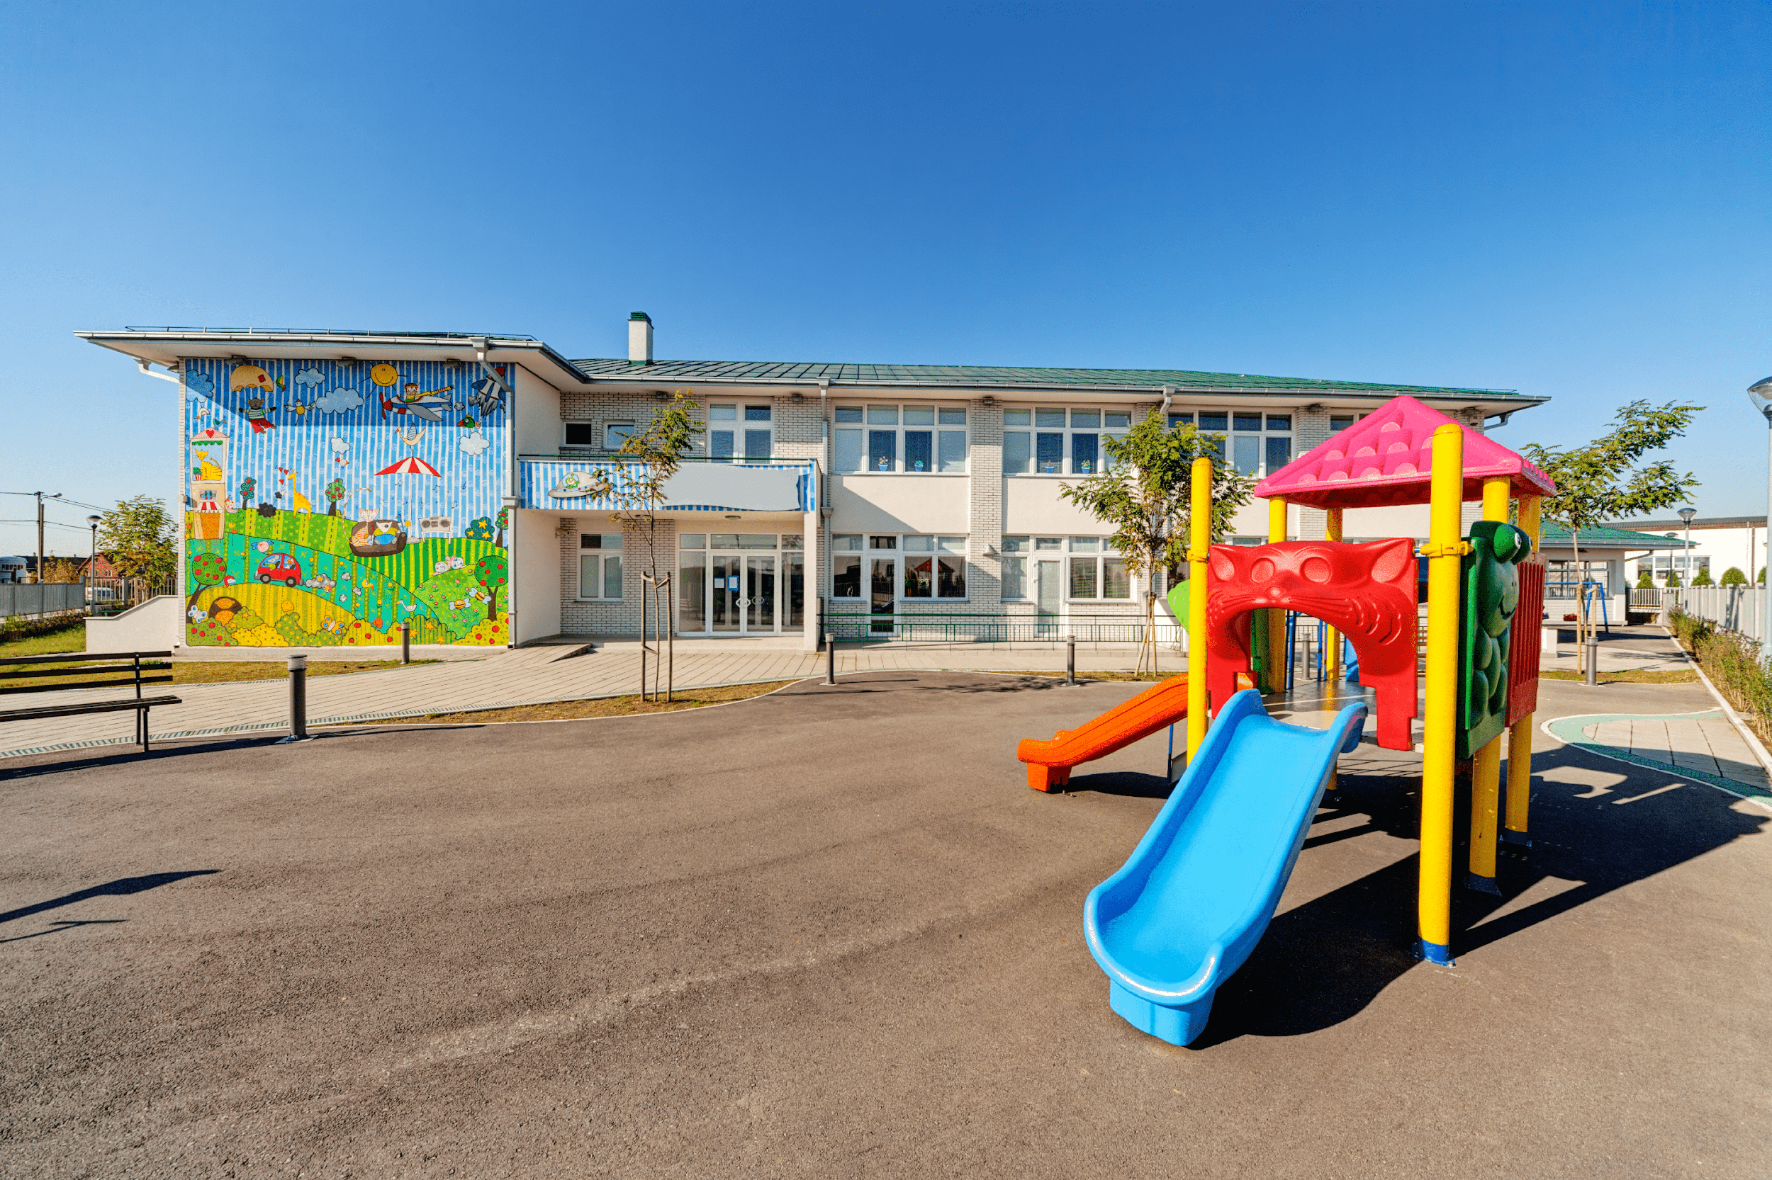
playground

Slide 14
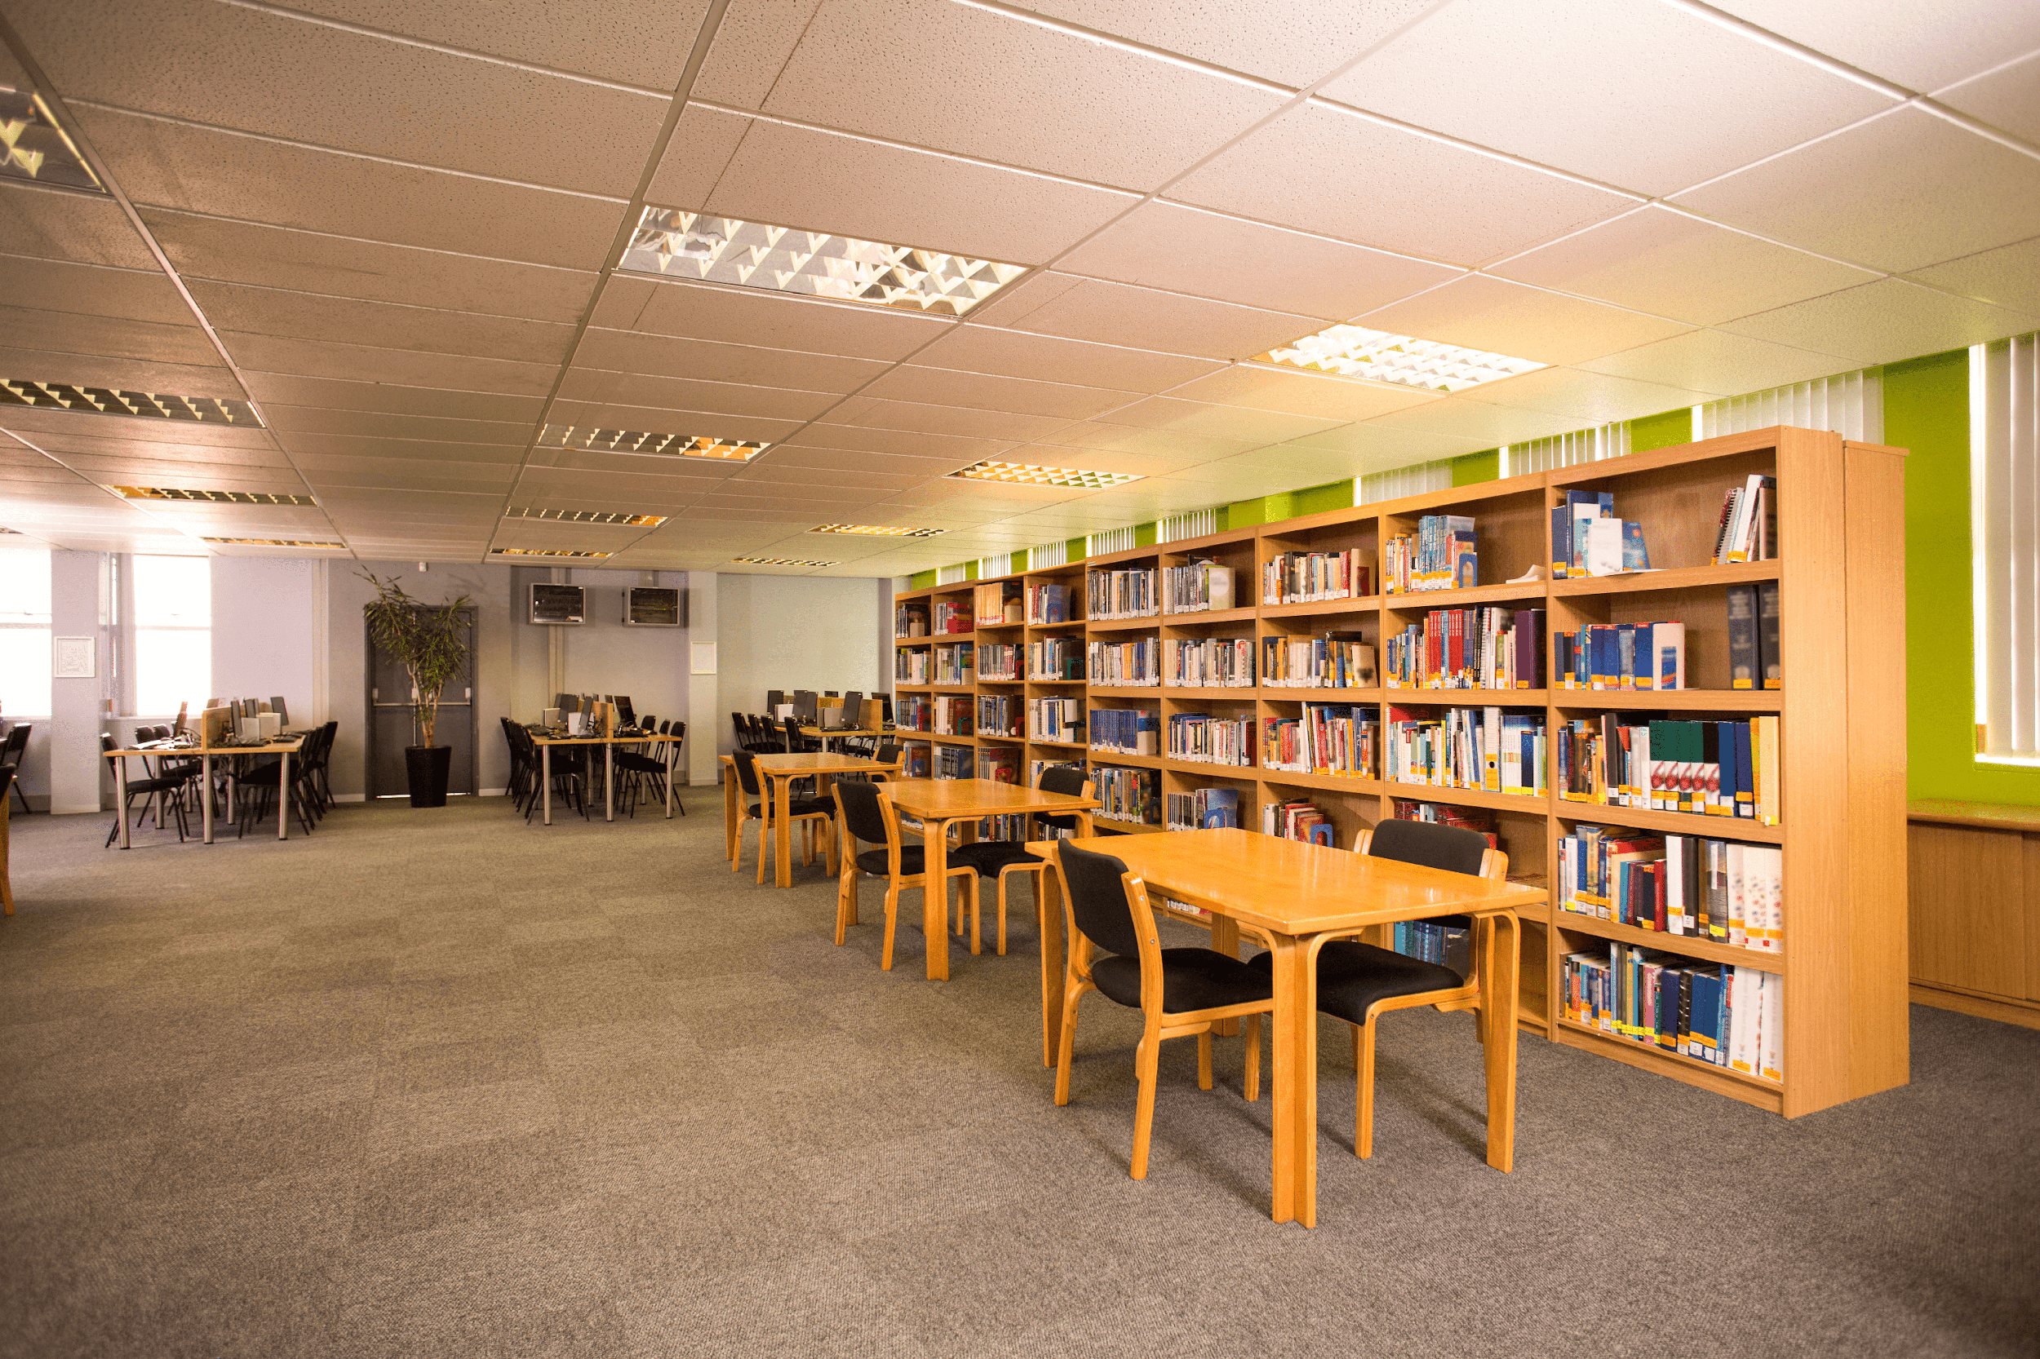
library

Slide 15
Look and guess.

Slide 16
playground

Slide 17
classroom

Slide 18
library

Slide 19
school

Slide 20
Is this our classroom?
No, it isn’t.
Yes, it is.

Slide 21
Is this our library?
Yes, it is.
No, it isn’t.

Slide 22
Is this our playground?
Yes, it is.
No, it isn’t.

Slide 23
Work in pairs. Practise.

Slide 24
3. Let’s talk.

Slide 26
Fun corner

Slide 27
Let’s play a game!
3 points
10 points
No
Yes
classroom
library
4
bomb
playground
No
school
3
2
1
Yes
5
10 points
8
school
library
7
school
- 3 points
6
Yes
Yes
playground
1 point
No
Yes
4 points
Notes:
Gv chia 2 đội.
Hs chọn số, 1 bạn đặt câu hỏi, 1 bạn trả lời với từ cho sẵn và nhận điểm

