Slide 1
1
Hello
LESSON 3-1,2,3

Slide 2
Contents
1
2
Listen and repeat.
Warm-up
Listen and circle.
3
4
Let’s chant.
5
Fun corner and wrap-up

Slide 3
1
Warm-up
Game

Slide 4
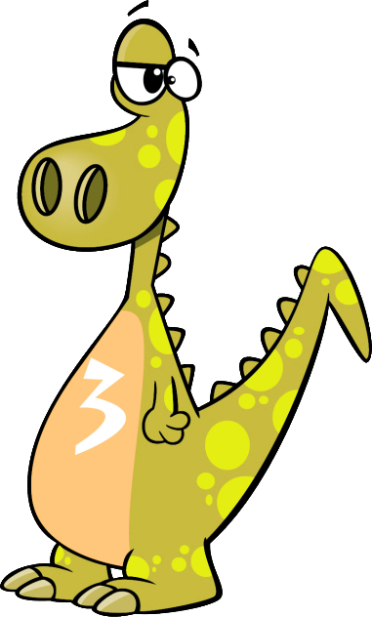
Notes:
Review the numbers.
Divide class into 4 teams. Invite pupils go to the monitor and choose the correct answer. If correct, one point for the team.
- Give points for the teams and encourage pupils.

Slide 5
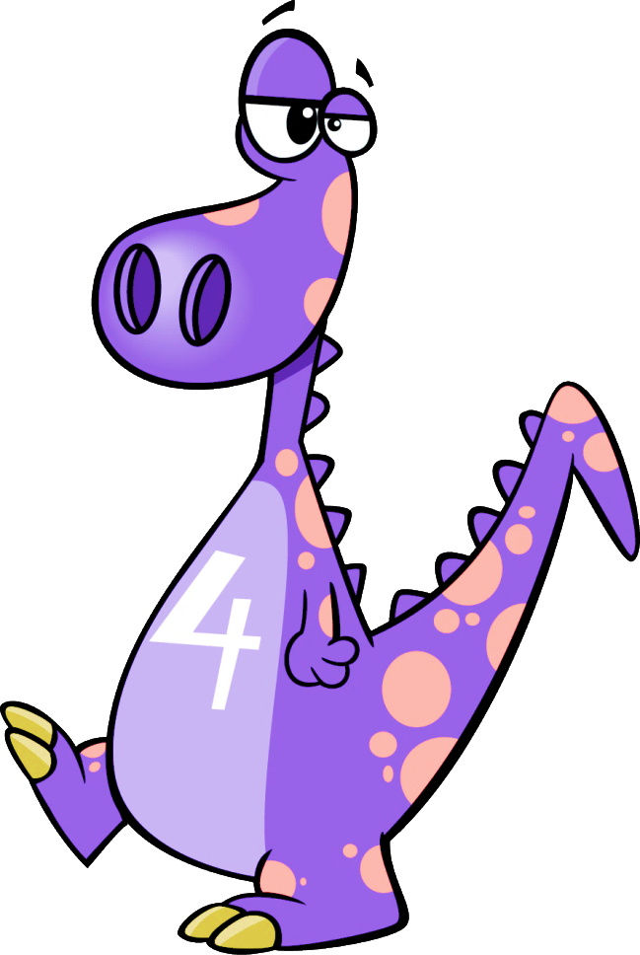
I’m dino number _______
four
one
ten
four
NEXT
Notes:
Divide the class into 4 groups. Invite pupils to go to the monitor and touch to choose the numbers. Pupils will get points for their teams if their answers are correct.
Give points to the groups and encourage them.

Slide 6
I’m dino number _______
one
one
ten
two
NEXT
Notes:
Review the numbers.
Divide class into 4 teams. Invite pupils go to the monitor and choose the correct answer. If correct, one point for the team.
- Give points for the teams and encourage pupils.

Slide 7
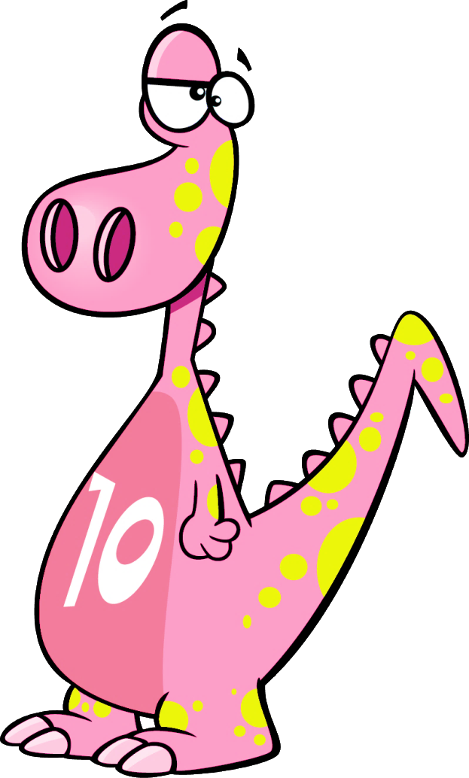
I’m dino number _______
ten
nine
ten
eight
NEXT
Notes:
Review the numbers.
Divide class into 4 teams. Invite pupils go to the monitor and choose the correct answer. If correct, one point for the team.
- Give points for the teams and encourage pupils.

Slide 8
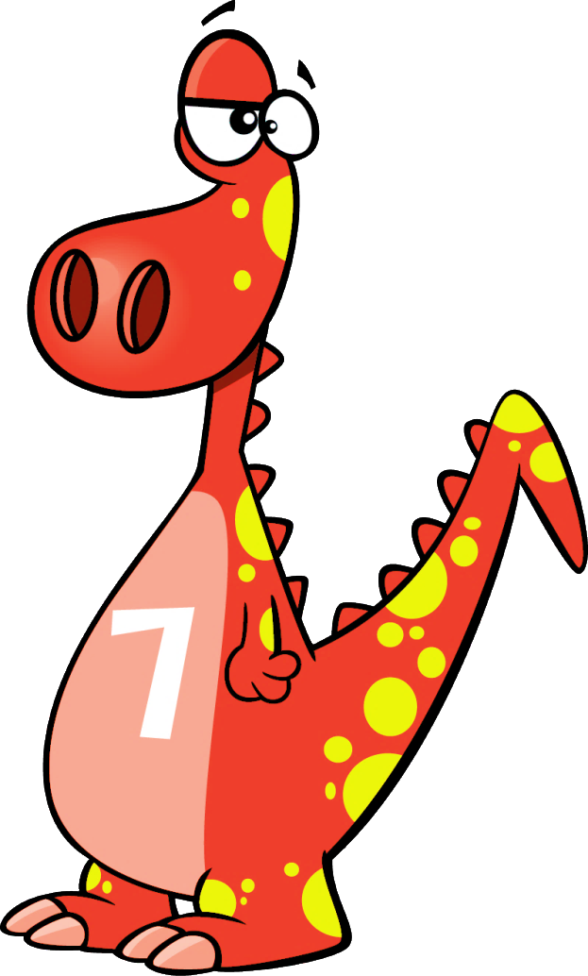
I’m dino number _______
seven
one
ten
seven
NEXT
Notes:
Review the numbers.
Divide class into 4 teams. Invite pupils go to the monitor and choose the correct answer. If correct, one point for the team.
- Give points for the teams and encourage pupils.

Slide 9
2
Listen and repeat.

Slide 11
3
Listen and circle.

Slide 13
4
Let’s chant.

Slide 14
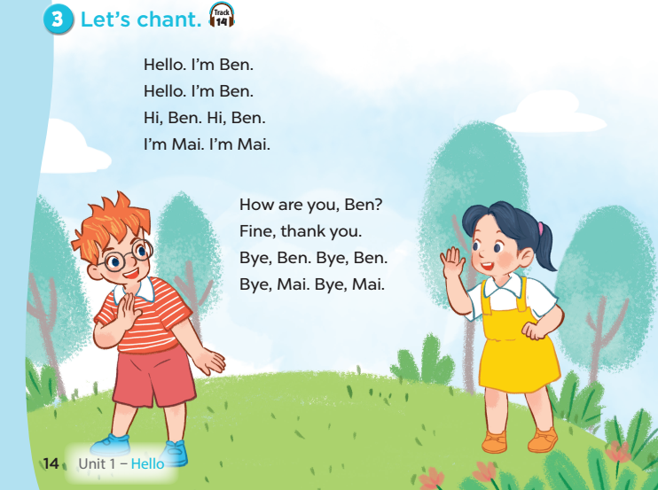

Slide 15
Fun corner and wrap-up
5

Slide 16
Sing, do actions, then stop!
Game time!!!
Notes:
Step 1: Divide the class into 4 teams.
Step 2: Have pupils sing and dance with the lyrics and rhythm of the chant.
Step 3: Invite each team to sing and do actions. When the music stops, all of them have to stop doing actions (freeze). Who can freeze longer will win.
Step 4: Encourage pupils to join the game. Give point to teams.

