Slide 1

Teacher: Vu Thu Thuy.
Dong Kinh Primary School
Unit 6-Our school facilities.
Lesson 1.part 1,2,3

Slide 2
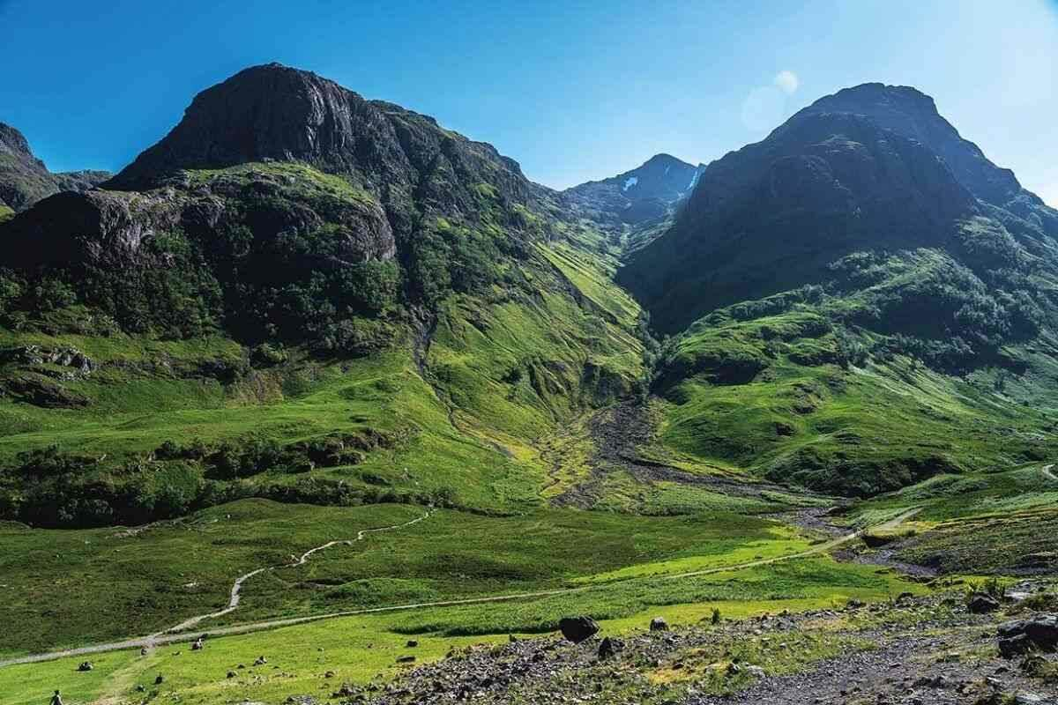

Mountain
City
Village

Slide 3
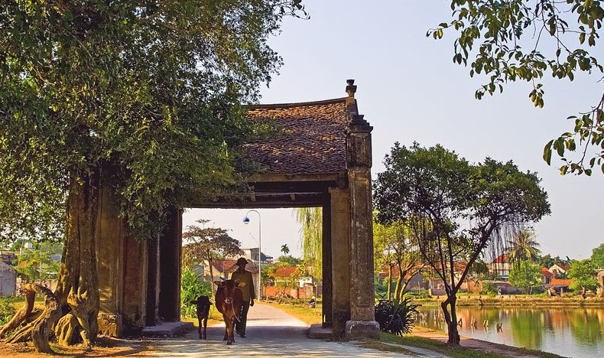
Town
City
Village

Slide 4
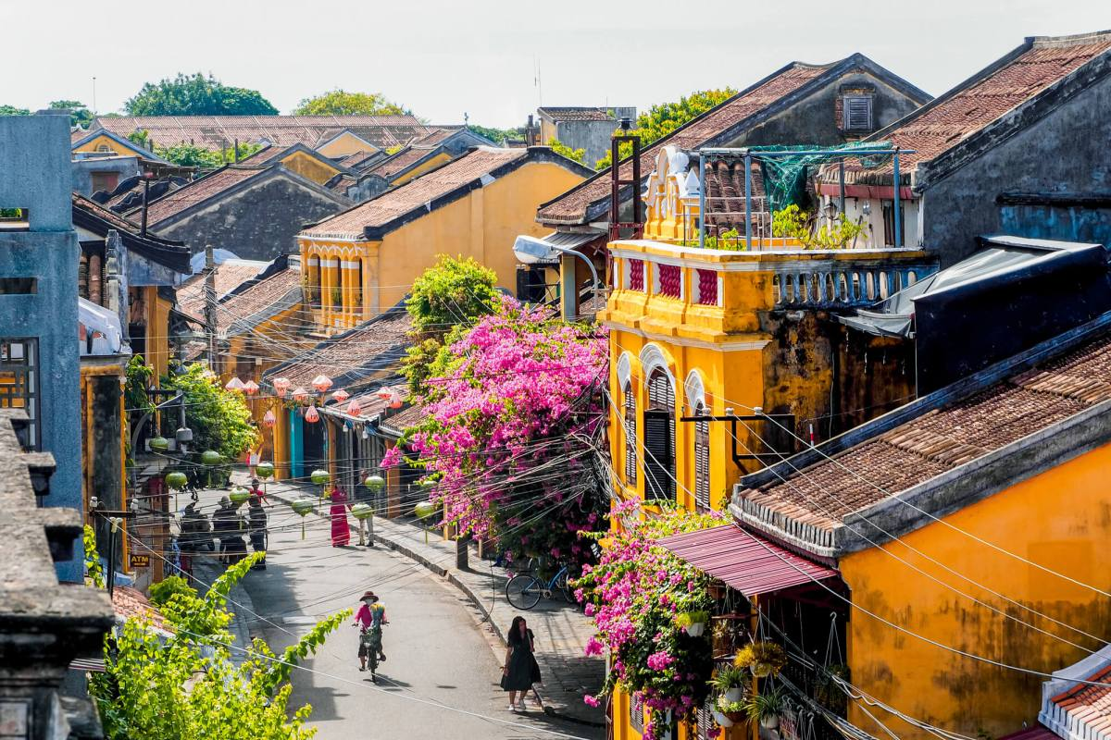
City
Town
Mountain

Slide 5
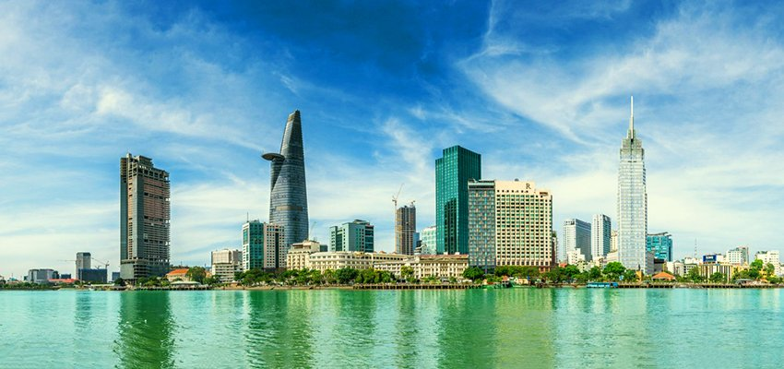
Village
Town
City

Slide 6
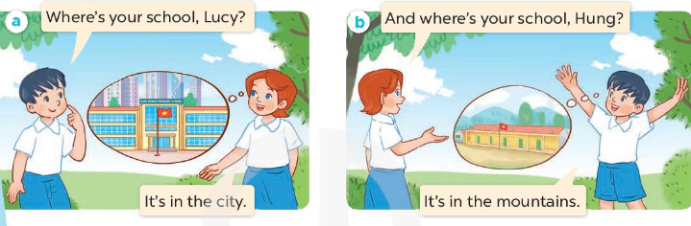

1.Look,listen and repeat.

Slide 7
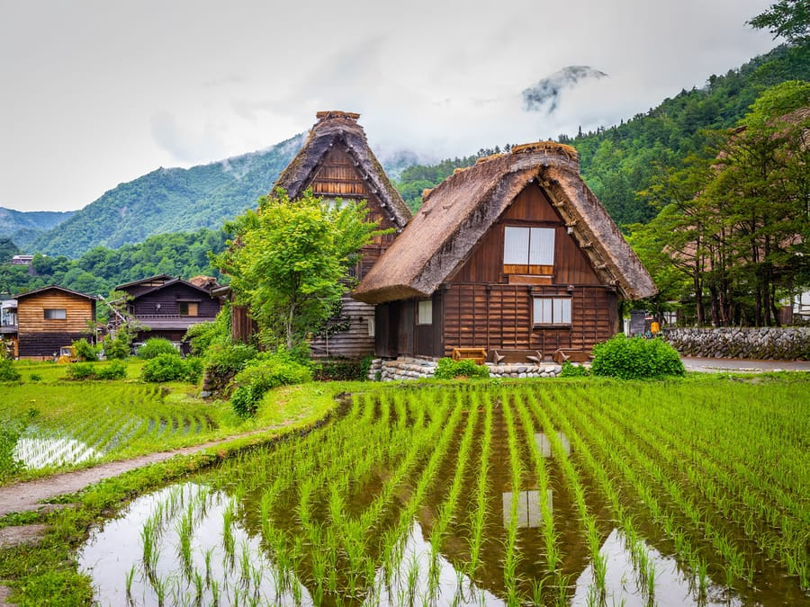



Where’s your school?
A. It’s in the city
B. It’s in the mountains
C. It’s in the village

Slide 8
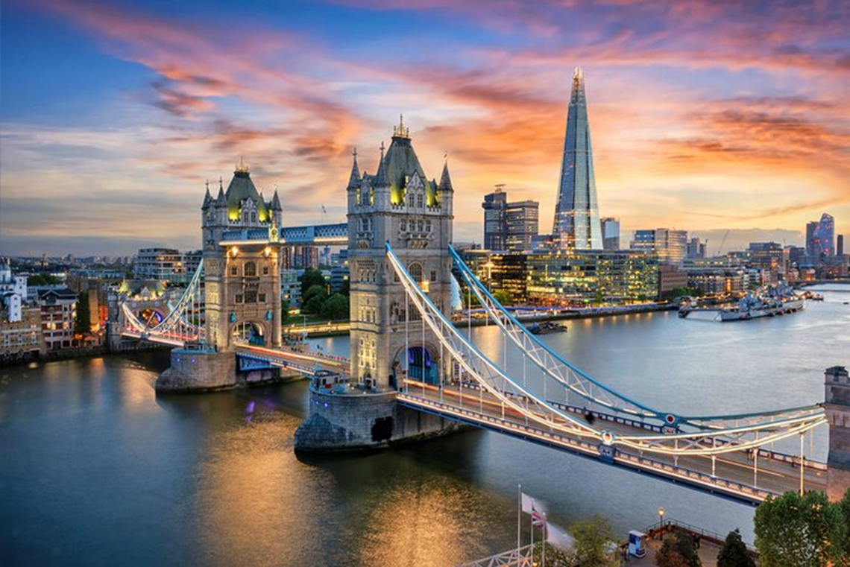
Where’s your school?
A.It’s in the city.
B.It’s in the town
C. It’s in the village

Slide 9
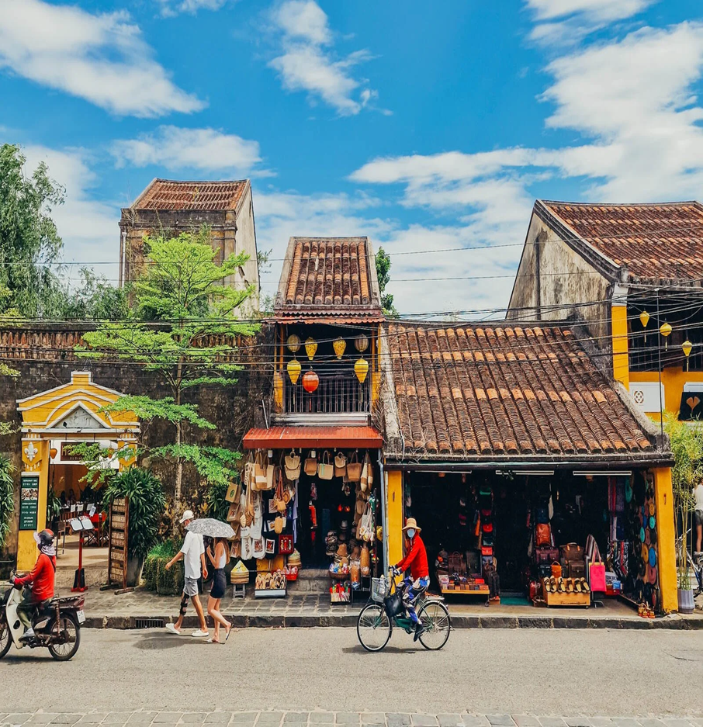
Where’s your school?
A. It’s in the city
B. It’s in the mountains
C. It’s in the town

Slide 10
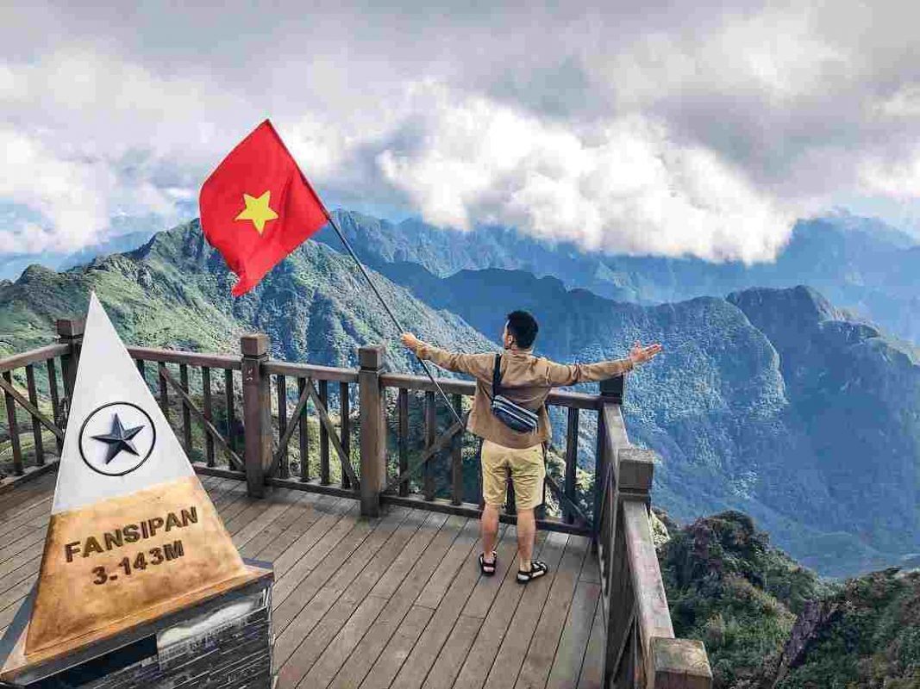
Where’s your school?
A.It’s in the mountains.
B.It’s in the town
C. It’s in the village.

Slide 11




Where is your school?
Trường của bạn ở đâu?
It’s in the_____(địa điểm)
It is in the_____(địa điểm)

Slide 12
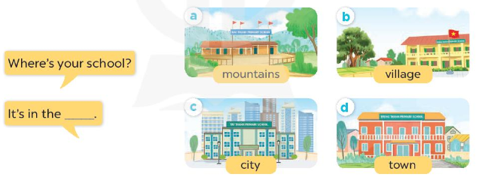
2.Listen, point and say.

Slide 13
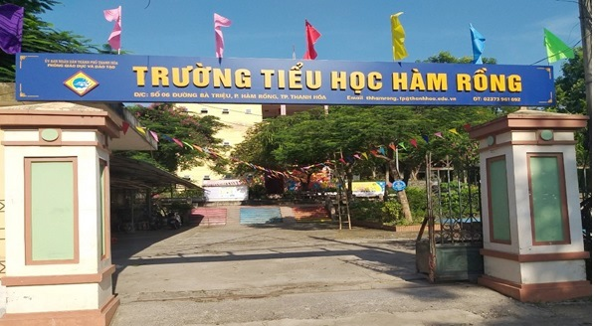
Where is your ________?
school

Slide 14
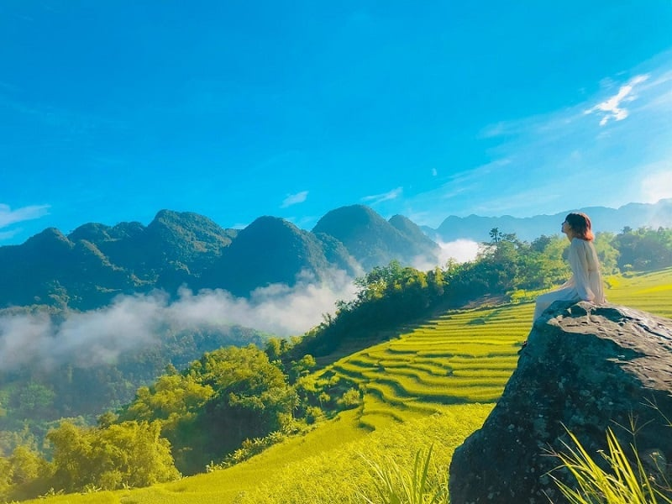
It is in the ___________.
mountains

Slide 15
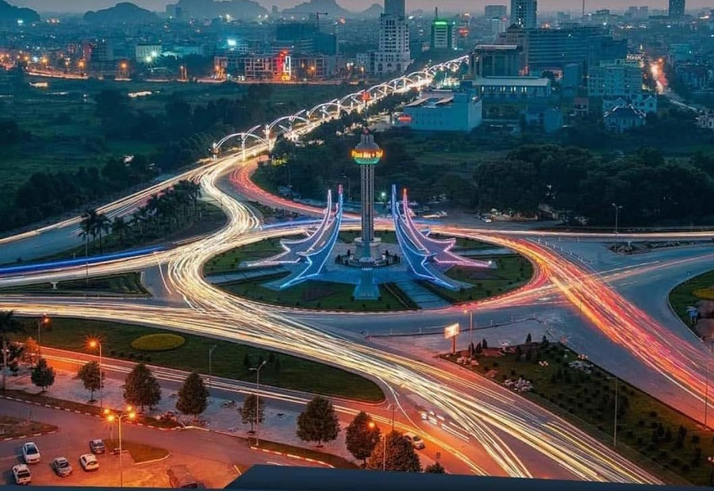
It is in the _______.
city

Slide 16
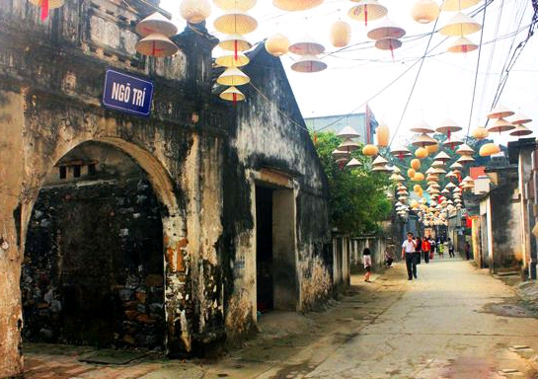
It is in the _________.
village

Slide 17

Where’s your school?
3.Let’s talk.
It’s in the village.

Slide 18

Where’s your school?
It’s in the city.

Slide 19

Where’s your school?
It’s in the mountains.

Slide 20

Where’s your school?
It’s in the town.

Slide 21



Look and complete.
school
1.Where is your ________?
city
2.It is in the ________.
village
3.It is in the ________.

