Slide 1
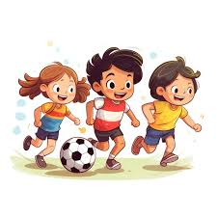

b
a
c
d
I can swim.

Slide 2
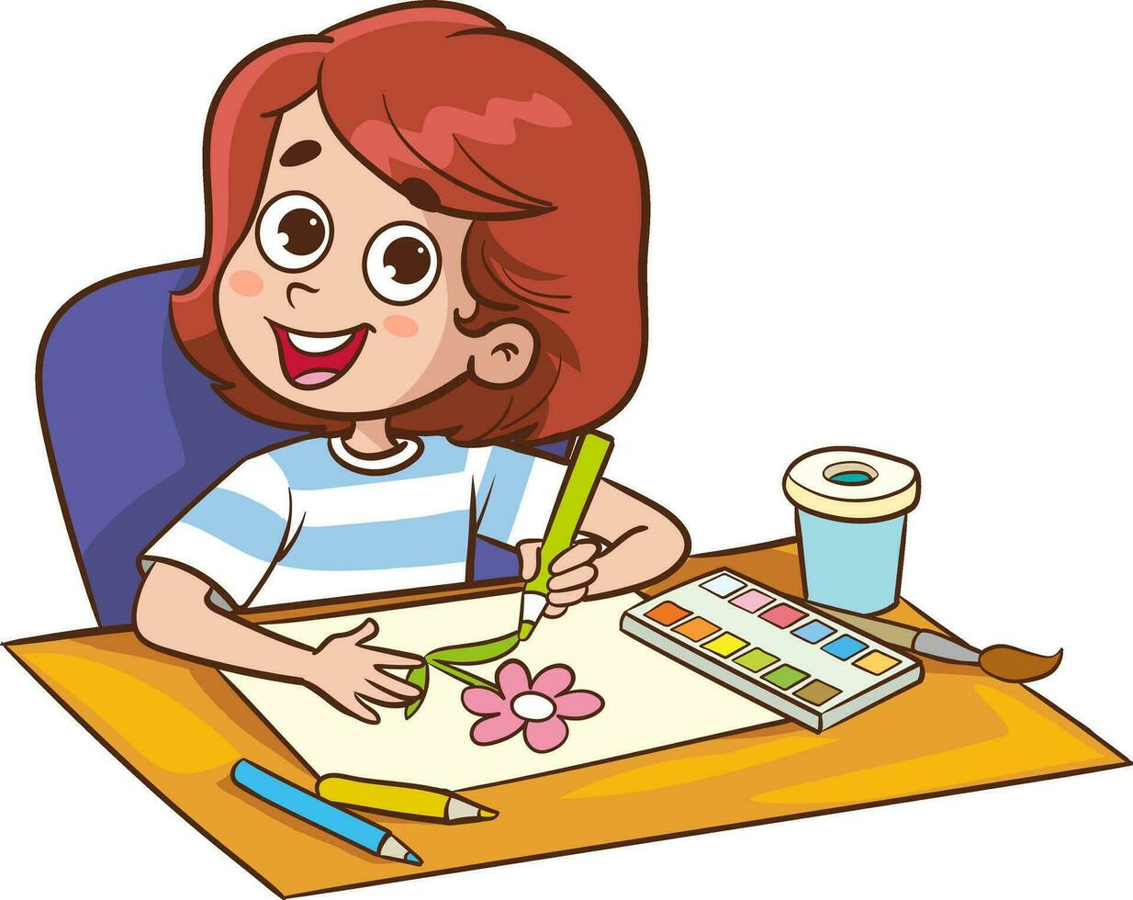
a
b
c
d
I can ride a horse.

Slide 3
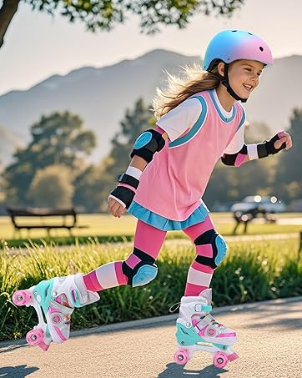
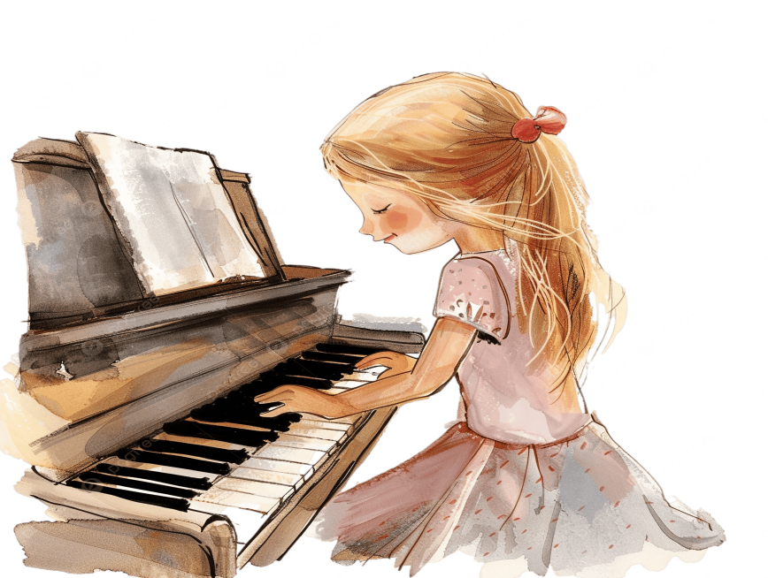
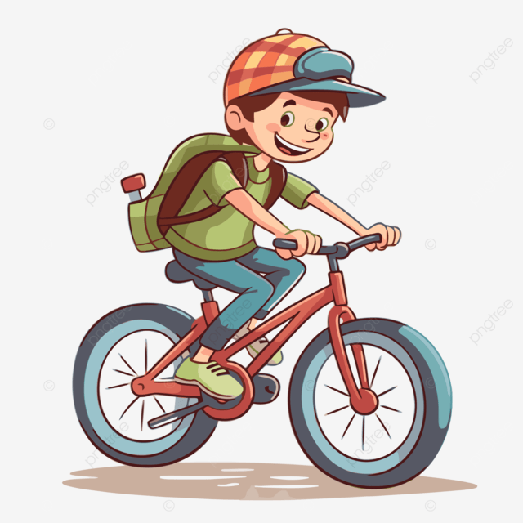
a
b
c
d
I can draw.

Slide 4

a
b
c
d
I can play the piano.

Slide 5

Dong Kinh Primary school
Unit 5 Things we can do
(Lesson 3: 1,2,3)
Teacher: Vu Thu Thuy

Slide 6
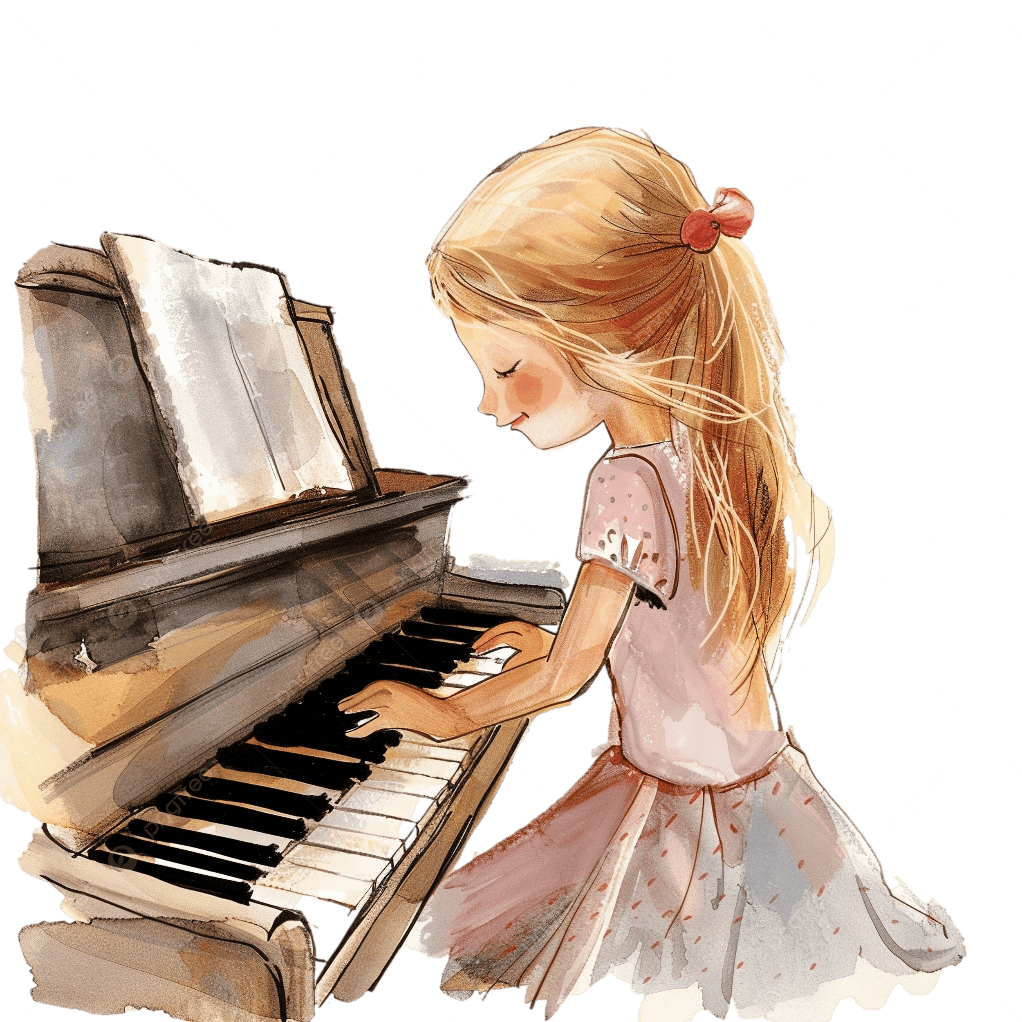
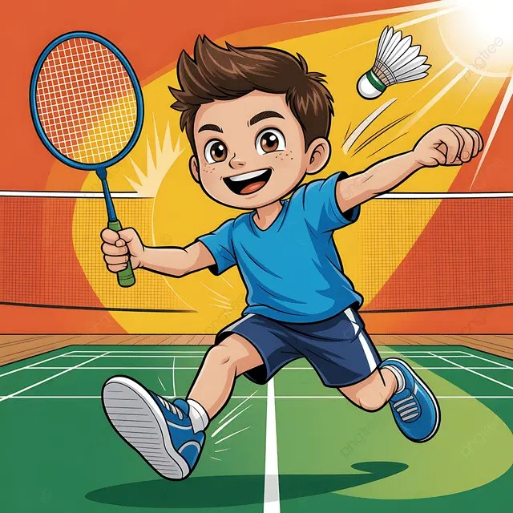
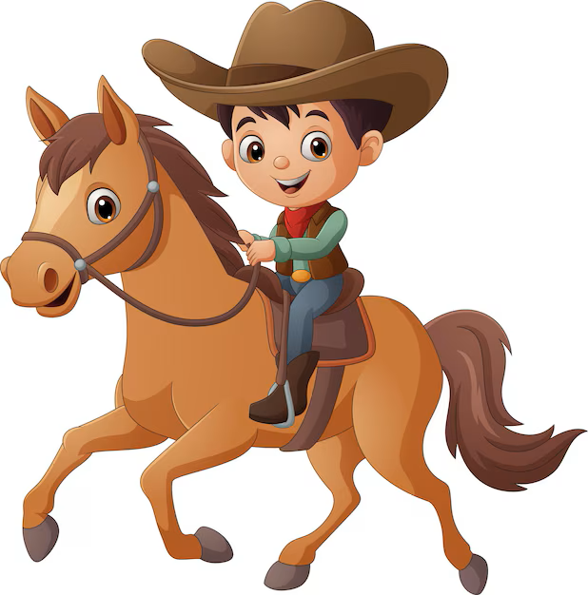
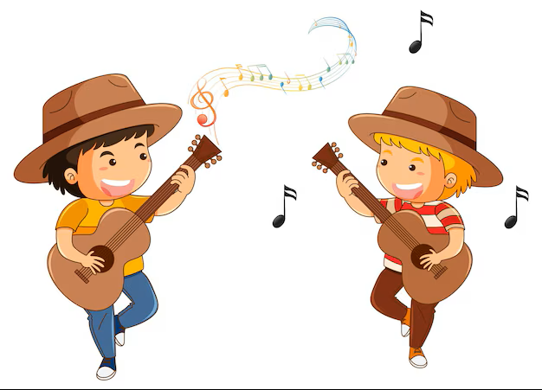
Keep silent/Repeat

Slide 7


1.Listen and repeat.
y Yes Can you draw?
Yes,I can.
n No Can she swim?
No,she can’t.

Slide 8

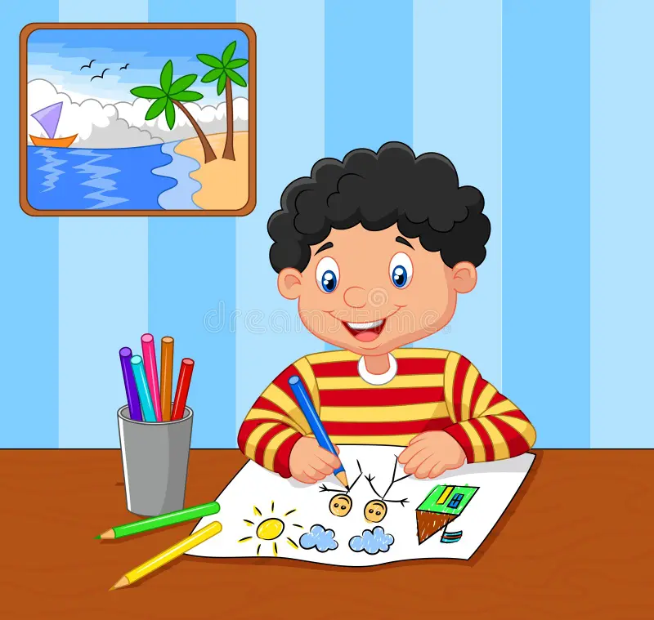
I can _________________.
sing
play the piano
draw
ride a bike
ride a horse
play badminton

Slide 9
2.Listen and circle.
1. Can he swim?
a. Yes, he can. b.No, he can’t.
a
2. Can they draw?
a. Yes, they can.
b. No, they can’t
b

Slide 10
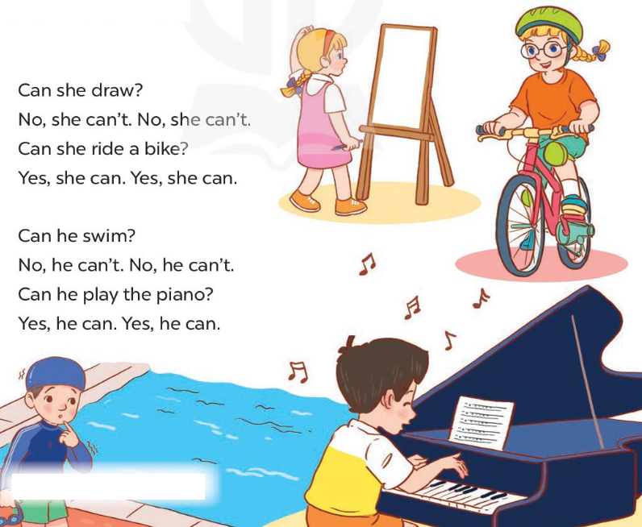
Let’s chant.

Slide 11
Can she draw?
No, she can’t. No, she can’t.
Can she ride a bike?
Yes, she can. Yes, she can.
Can he swim?
No, he can’t. No, he can’t.
Can he play the piano?
Yes, he can. Yes, he can.

Slide 12
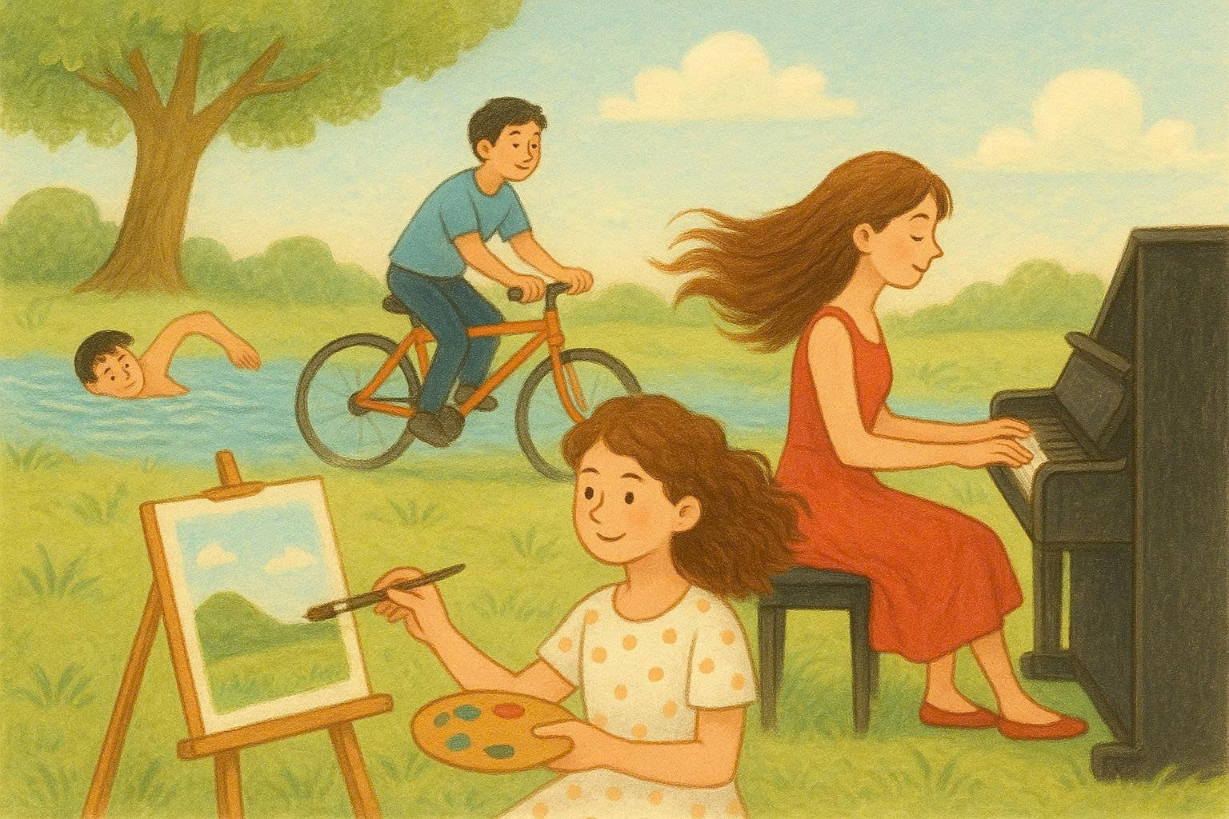
Can she draw? No, she can’t. No, she can’t.
Can she ride a bike?
Yes, she can. Yes, she can.
Can he swim?
No, he can’t. No, he can’t.
Can he play the piano?
Yes, he can. Yes, he can.

Slide 13
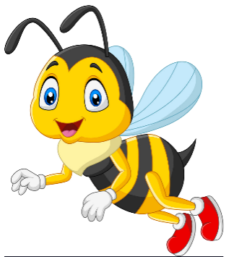





He can_____________.
Next
ride a bike.
draw.
ride a horse.
Notes:
Ms Huyền Phạm - 0936.082.789 – YOUTUBE: MsPham. Facebook: Dạy và học cùng công nghệ.

Slide 14
Can she play the piano?
Next
No, I can’t.
Yes, she can.
Yes, I can.
Notes:
Ms Huyền Phạm - 0936.082.789 – YOUTUBE: MsPham. Facebook: Dạy và học cùng công nghệ.

Slide 15
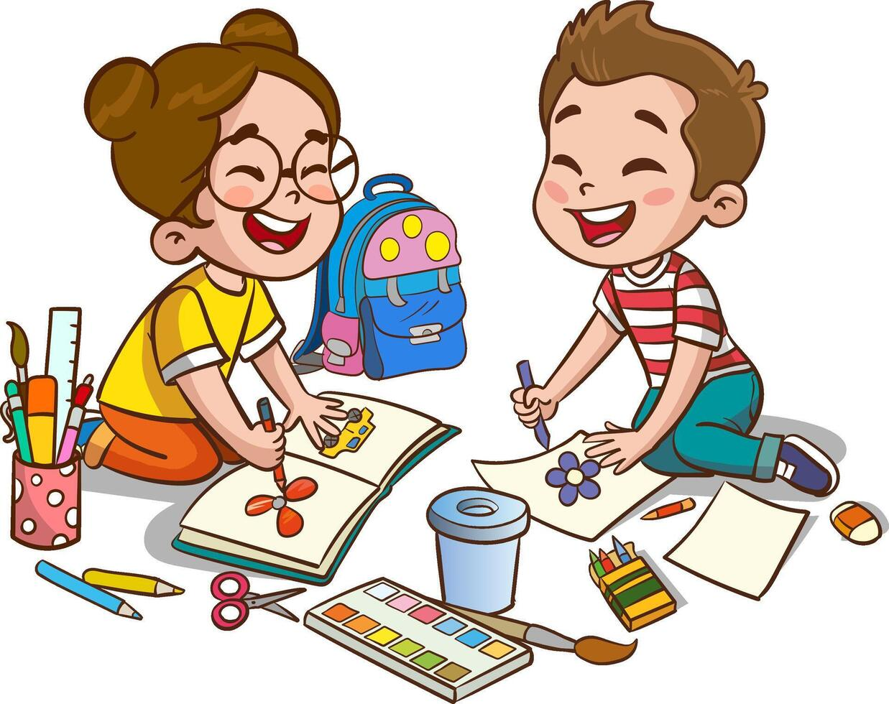
They can _________.
Next
skate.
draw.
dance.
Notes:
Ms Huyền Phạm - 0936.082.789 – YOUTUBE: MsPham. Facebook: Dạy và học cùng công nghệ.

Slide 16
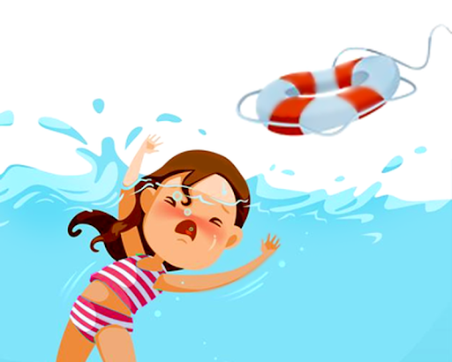
Can she swim?
Next
No, I can’t.
Yes, she can.
No, she can’t.
Notes:
Ms Huyền Phạm - 0936.082.789 – YOUTUBE: MsPham. Facebook: Dạy và học cùng công nghệ.

Slide 17
Can you swim?
Can you draw?
No, I can’t.
Yes, I can.
Yes/No question.

Slide 18
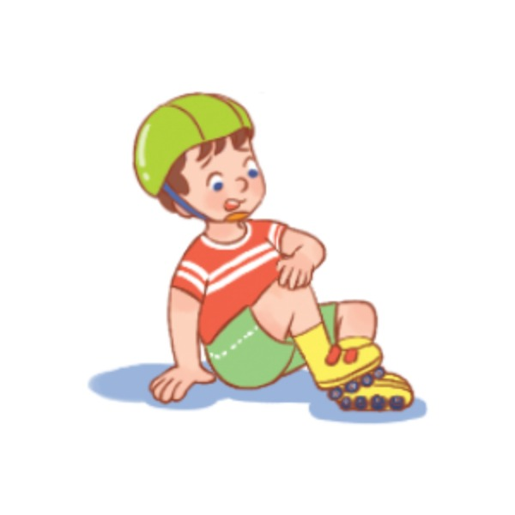
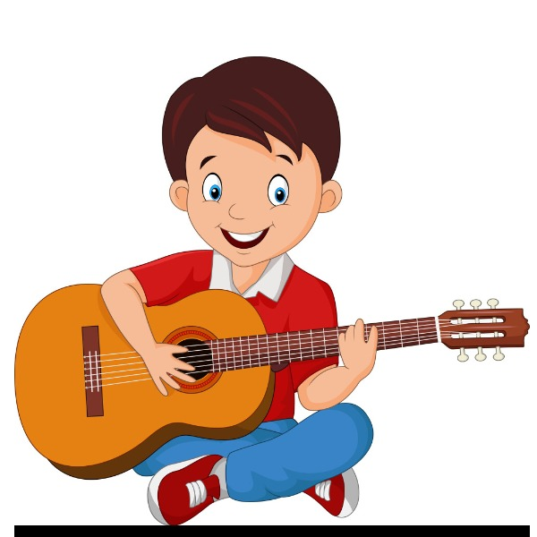
Can he play the guitar?
Yes, he can.
Can he roller skate?
No, he can’t.

Slide 19
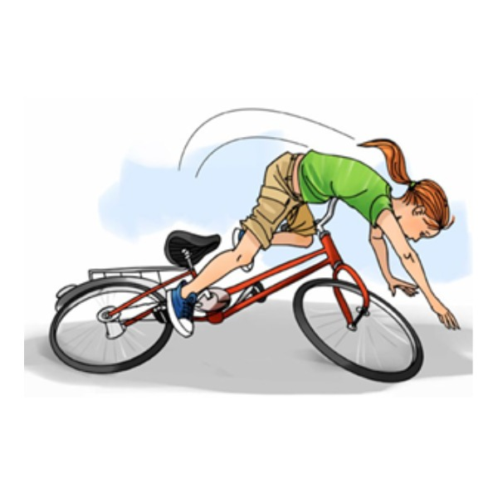

Can she play the piano?
Yes, she can.
Can she ride a bike?
No, she can’t.
Can she sing?
Yes, she can.

Slide 20
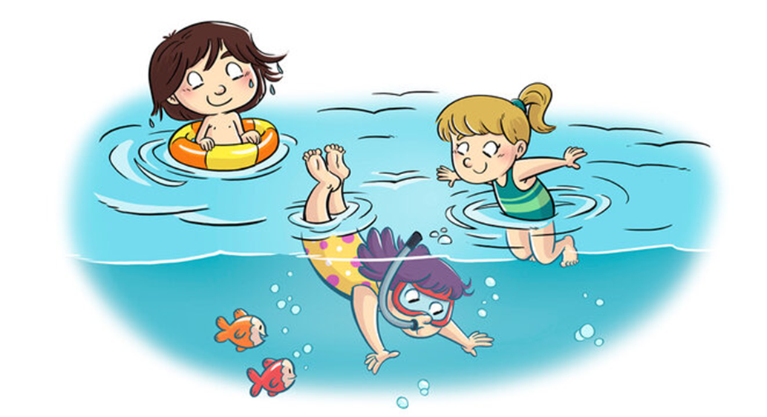

What can you do?
I can fly a kite.
I can swim.

Slide 21

Thanks for your attention!

