Slide 1
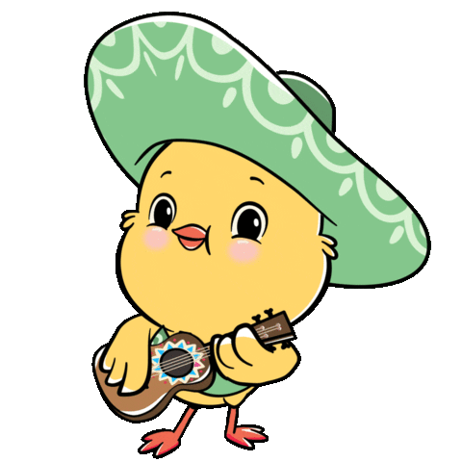
Welcome to our class!

Slide 2
Warm-up

Slide 3
Let’s sing.

Slide 4
Monday, October 10th 2024
Unit 1

Slide 5
Contents
Listen and repeat.
Point and say.

Slide 6
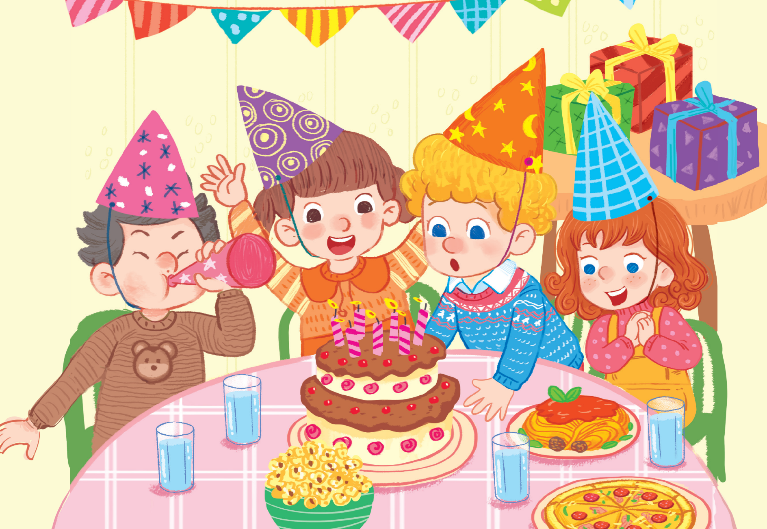
1
Listen and repeat.
pasta
pizza
popcorn

Slide 7
Phonic

Slide 9
Vocabulary
popcorn
bỏng ngô
Click on the word to listen again.

Slide 10
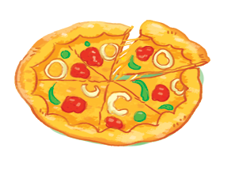
pizza
bánh pizza

Slide 11
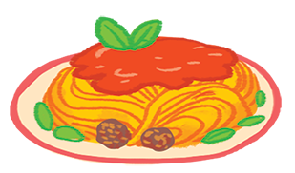
pasta
mì ống, mì sợi

Slide 12
Review
popcorn
pizza
pasta

Slide 13
Vocabulary
1. popcorn:
bỏng ngô
2. pizza:
bánh pizza
3. pasta:
mì ống, mì sợi
Click on the words to listen again.

Slide 14
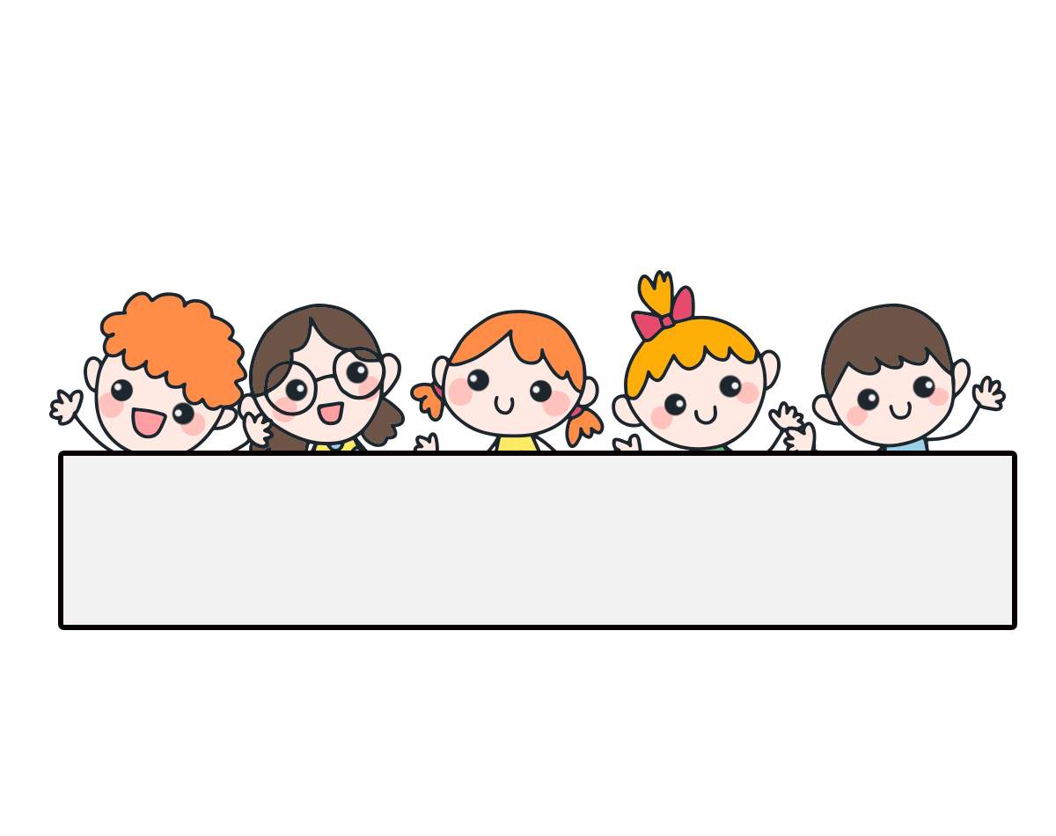
Let’s check!

Slide 15
Can you guess?
popcorn

Slide 16
Can you guess?
pizza

Slide 17
Can you guess?
pasta

Slide 18
Well done!

Slide 19
2
Point and say.
pasta
pizza
popcorn

Slide 20
Let’s play!

Slide 21
START

Slide 22
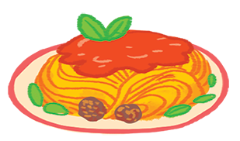
Click on the red button to show the picture.
pasta
check
next

Slide 23
popcorn
check
next

Slide 24
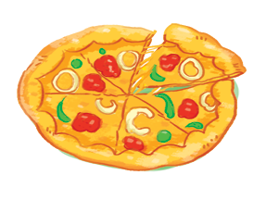
pizza
check
next

Slide 25
popcorn
check
next

Slide 26
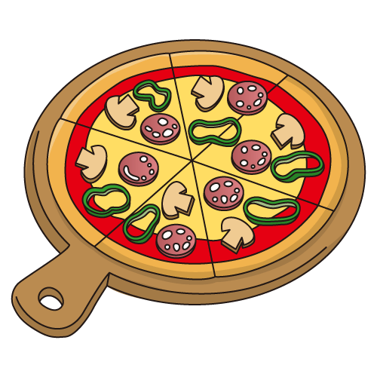
pizza
check
next

Slide 27
pasta
check

Slide 28
Good job!

Slide 29
Review
popcorn
pizza
pasta

Slide 30
Homework
.....................................................
.....................................................

Slide 31
Goodbye!

