Slide 1



Unit 12: Our Tet holiday
Lesson 2 - Period 3

Slide 2
Table of contents
1
2
3
Activity
Activity
4
5
Game time
Activity
Warm-up
Look, listen and repeat.
Listen, point and say.
Let’s talk.

Slide 3
1
Warm-up
What are the missing letters?

Slide 4
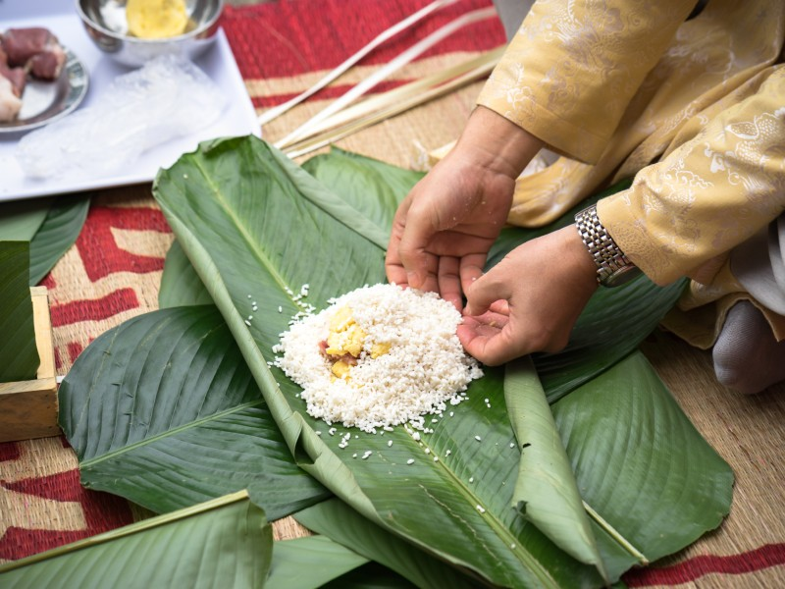
k
_ake chung ca_e
m

Slide 5
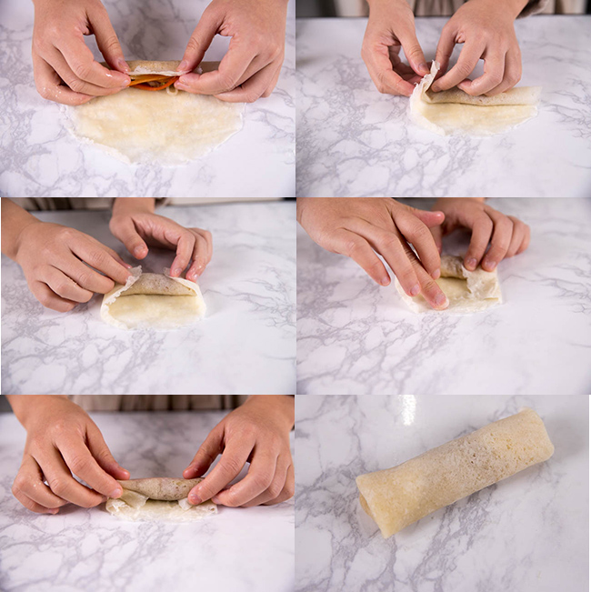
a
p
l
m_ke s_ring ro_ls

Slide 6
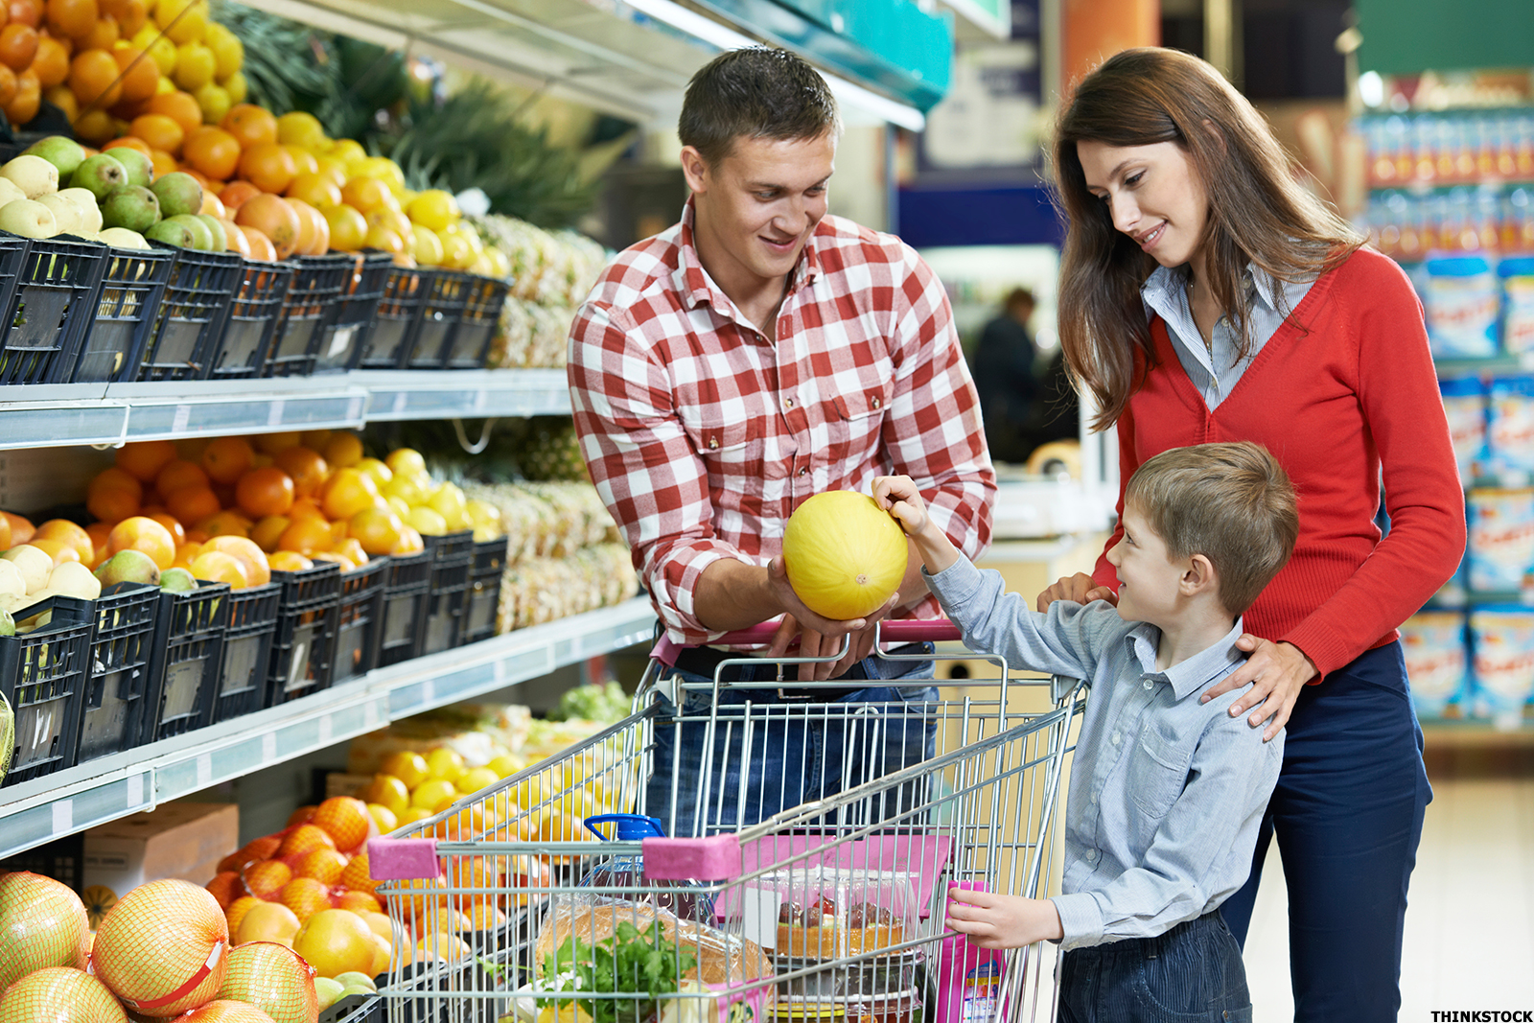
d_ the s_op_ing
o
h
p

Slide 7
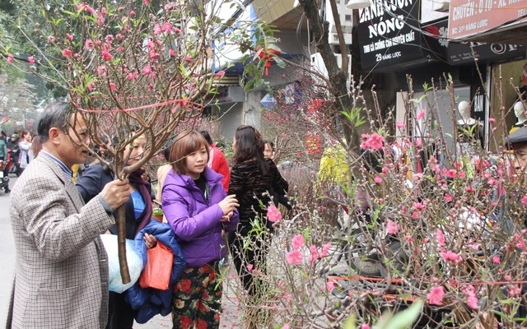
r
bu_ a b_anch of
pe_ch blo_soms
y
a
s

Slide 8
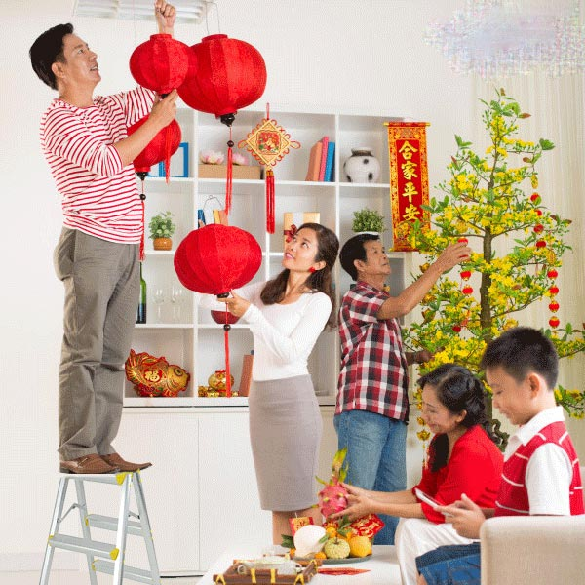
s
d_co_ate the hou_e
e
r

Slide 9
Awesome words

Slide 10
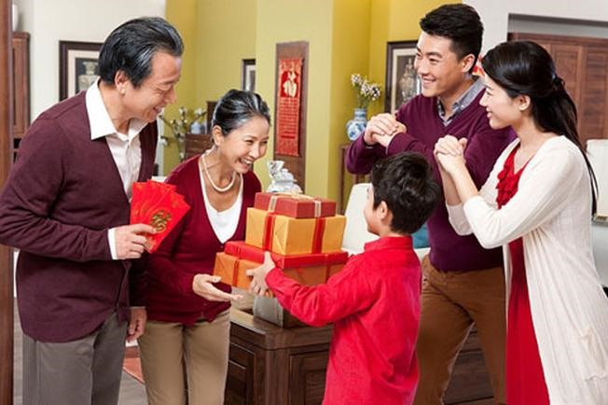
our grandparents’ house

Slide 11
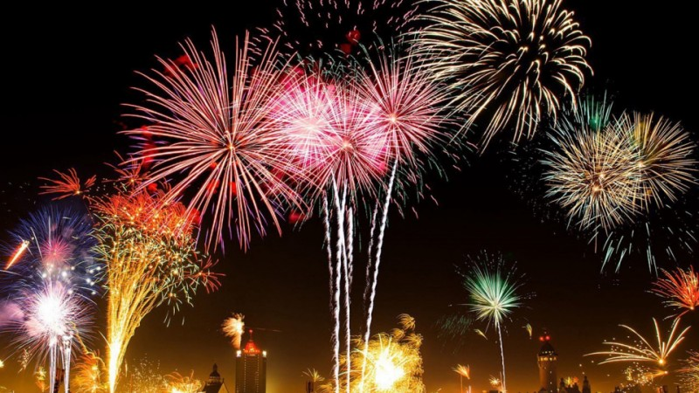
a fireworks show

Slide 12
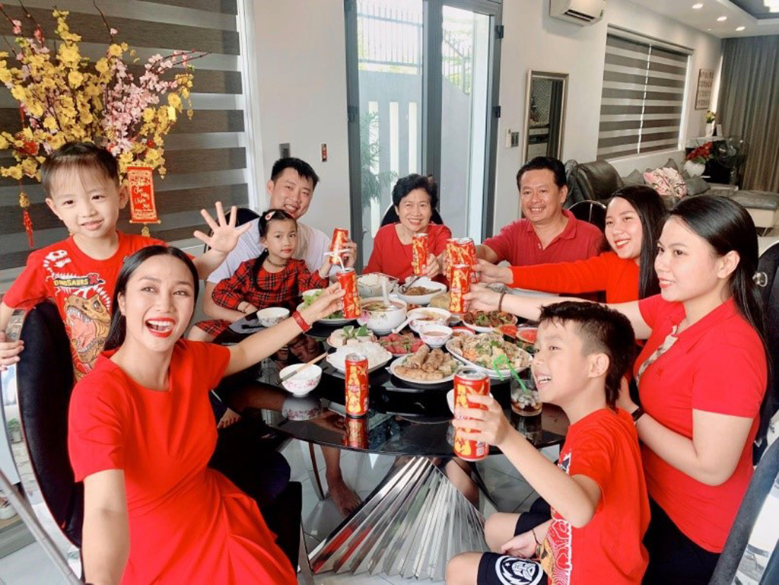
a New Year party

Slide 13
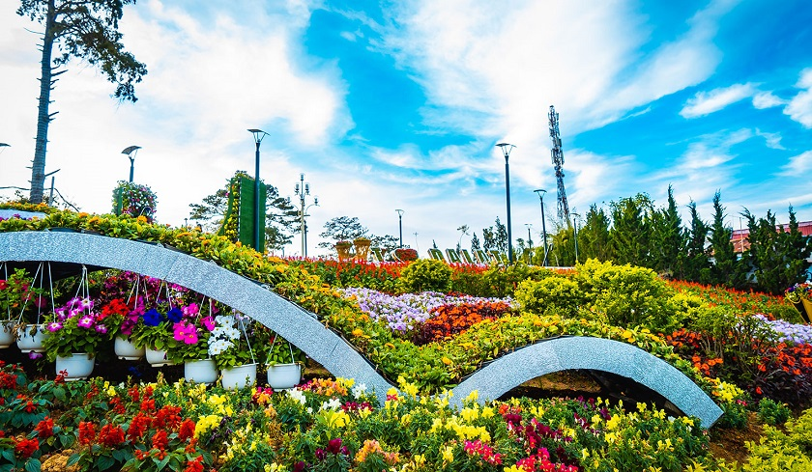
a flower festival

Slide 14
2
Look, listen and repeat.
Activity 1

Slide 15
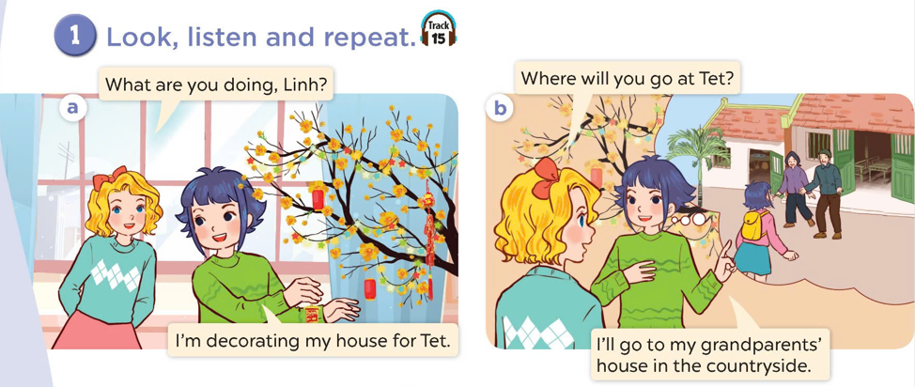
Look at the pictures.
Where are they?
What are they doing?

Slide 16

Look, listen and repeat.

Slide 17
3
Listen, point and say.
Activity 2

Slide 18

Where will you go at Tet?
I will go to my grandparents’ house.

Slide 19

Where will you go at Tet?
I will go to a fireworks show.

Slide 20
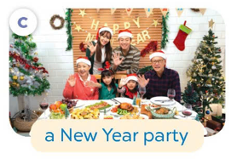
Where will you go at Tet?
Where will you go at Tet?
I will go to a New Year party.

Slide 21

Where will you go at Tet?
I will go to a flower festival.

Slide 22
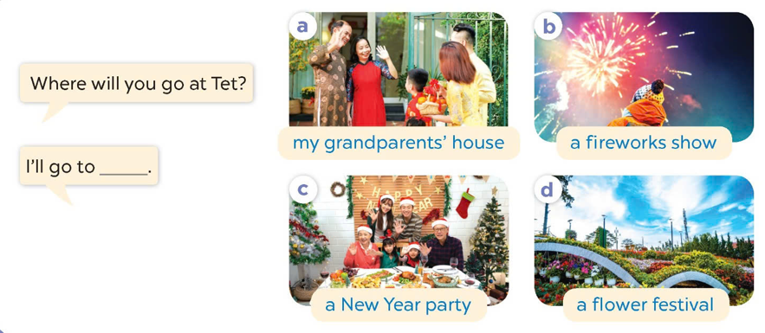
Listen and repeat.
Look and repeat the phrases.
Work in pairs. Ask and answer.

Slide 23
4
Let’s talk.
Activity 3

Slide 24
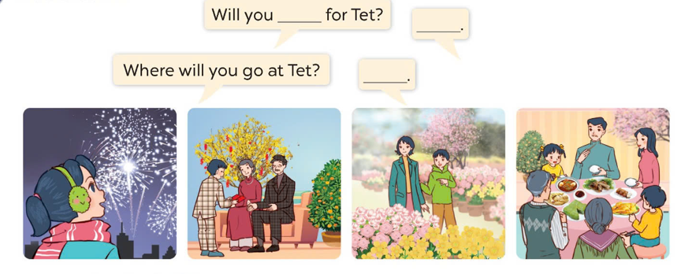
Look and say.
a fireworks show
my grandparents’ house
a flower festival
a New Year party

Slide 25
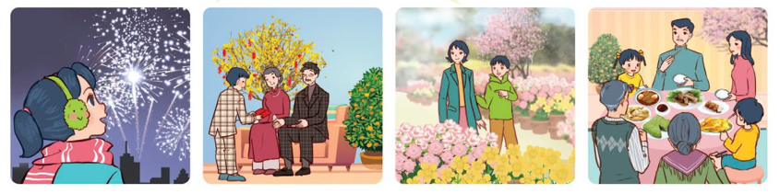
Work in pairs. Ask and answer.
Where will you go at Tet?
I’ll go to ________.
a fireworks show
my grandparents’ house
a flower festival
a New Year party

Slide 26
5
Game time
Lucky number

Slide 27
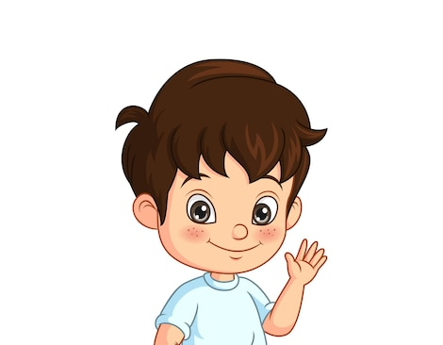







2

Slide 28


I will go to ……………………… .
my grandparents’ house.

Slide 29
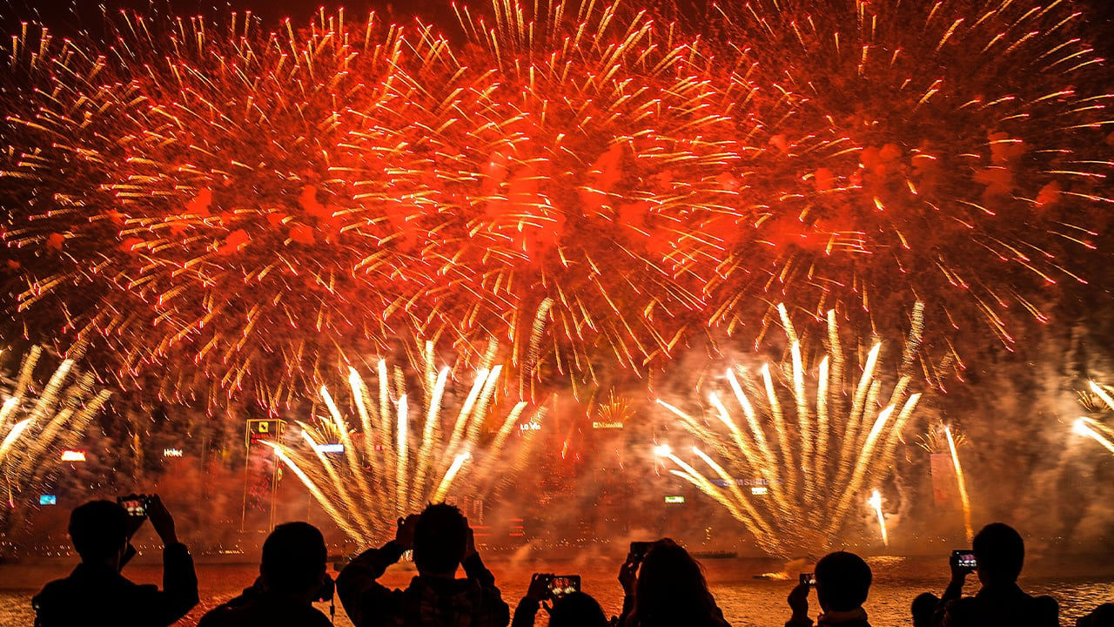
I will go to ……………………… .
a firework show.

Slide 30
a New Year party.
I will go to ……………………… .

Slide 31
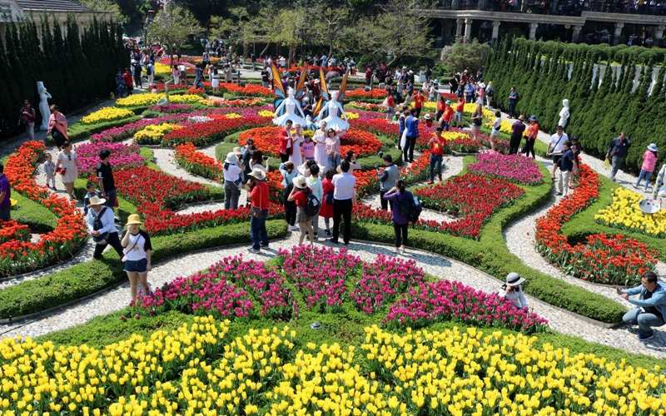
a flower festival.
I will go to ……………………… .

Slide 32

at/ Where/ will/ go/ Tet?/ you/
.…..?
Where will you go at Tet?

Slide 33
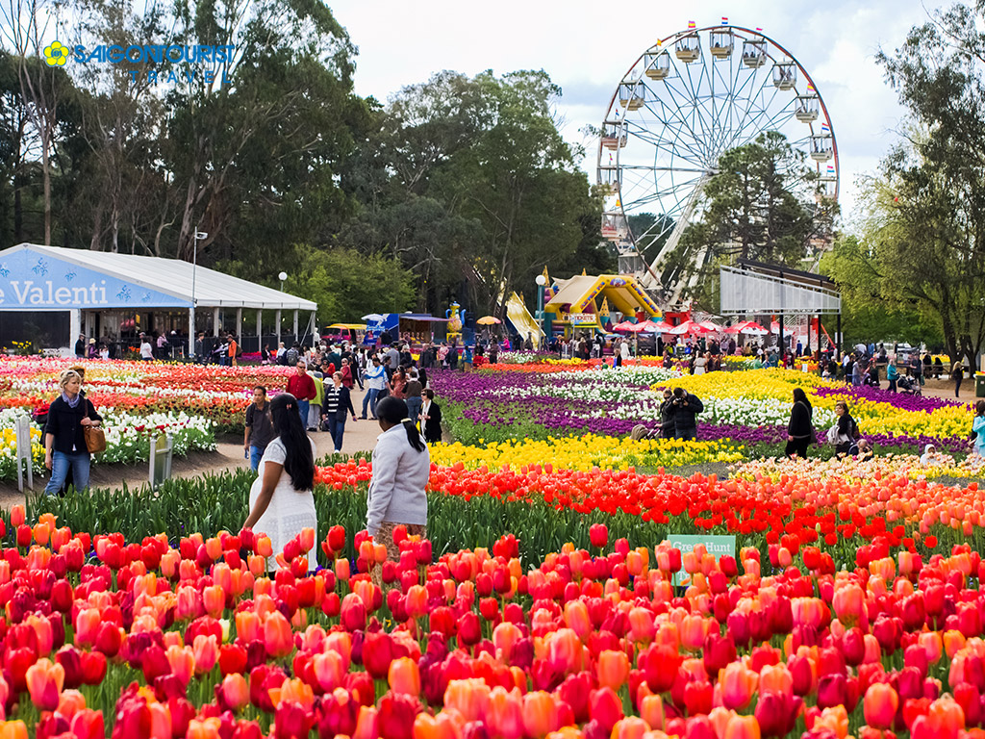
will/ I/ to / festival./ a / go/ flower/
I will go to a flower festival.

