Slide 1
Warm-up

Slide 4
Revise

Slide 5
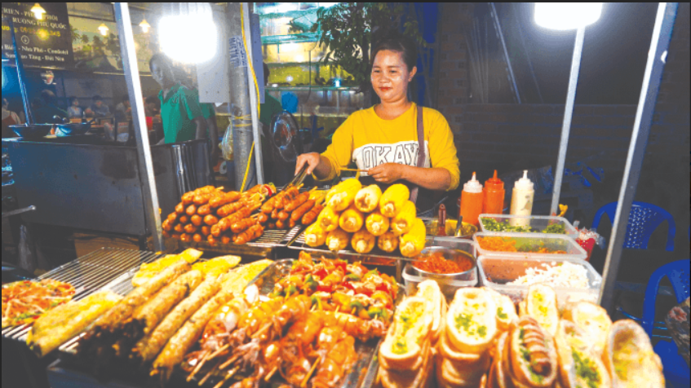
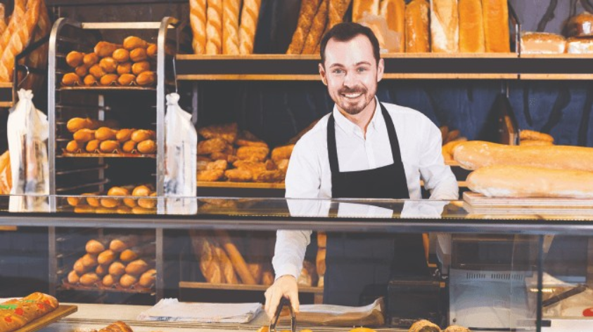
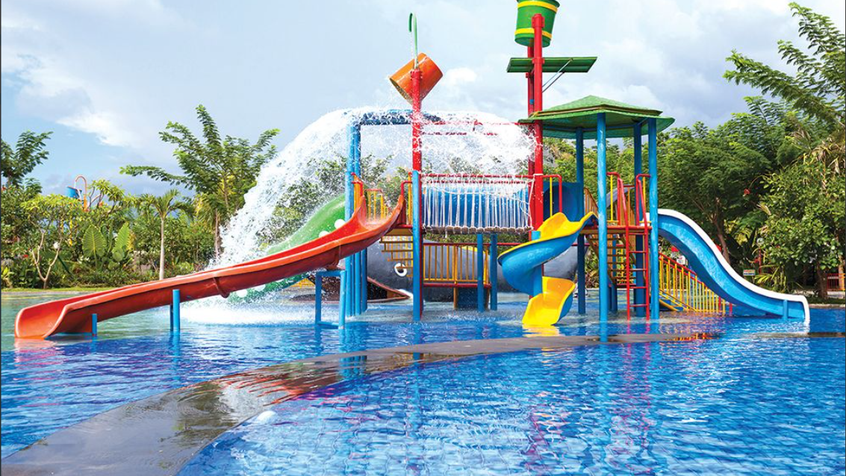
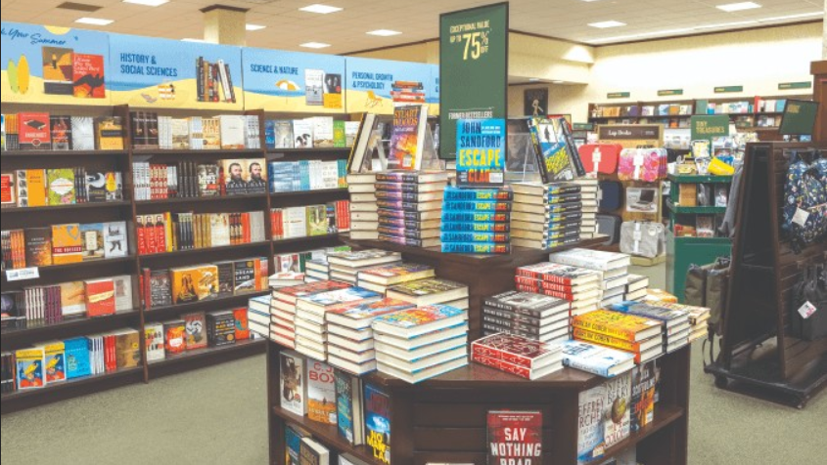

Slide 6
food stall

Slide 7
bakery

Slide 8
supermarket

Slide 9
water park

Slide 10
bookshop

Slide 11
Do you want to go to the ___________?
Great! Let’s go.
Sorry, I can’t.

Slide 12
Do you want to go to the ___________?
food stall
Great! Let’s go.
Sorry, I can’t.

Slide 13
New lesson

Slide 14
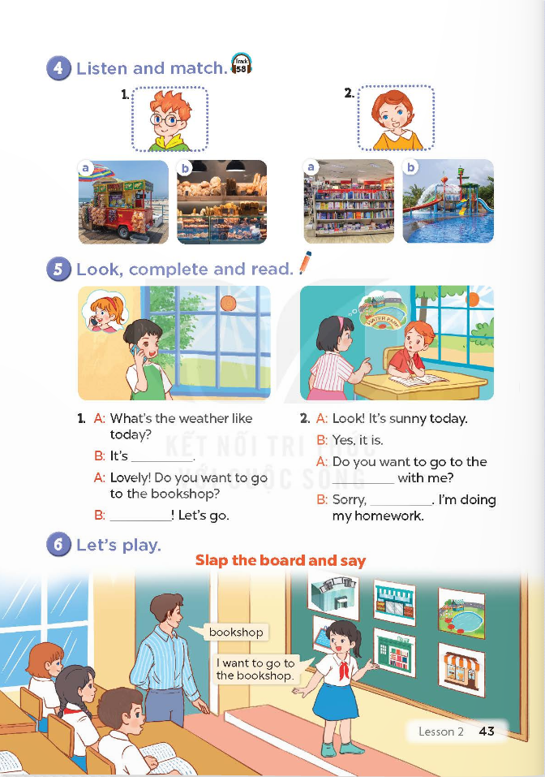
Unit 16: Weather
Lesson 2 (4-5-6)

Slide 15
Listen and match

Slide 16
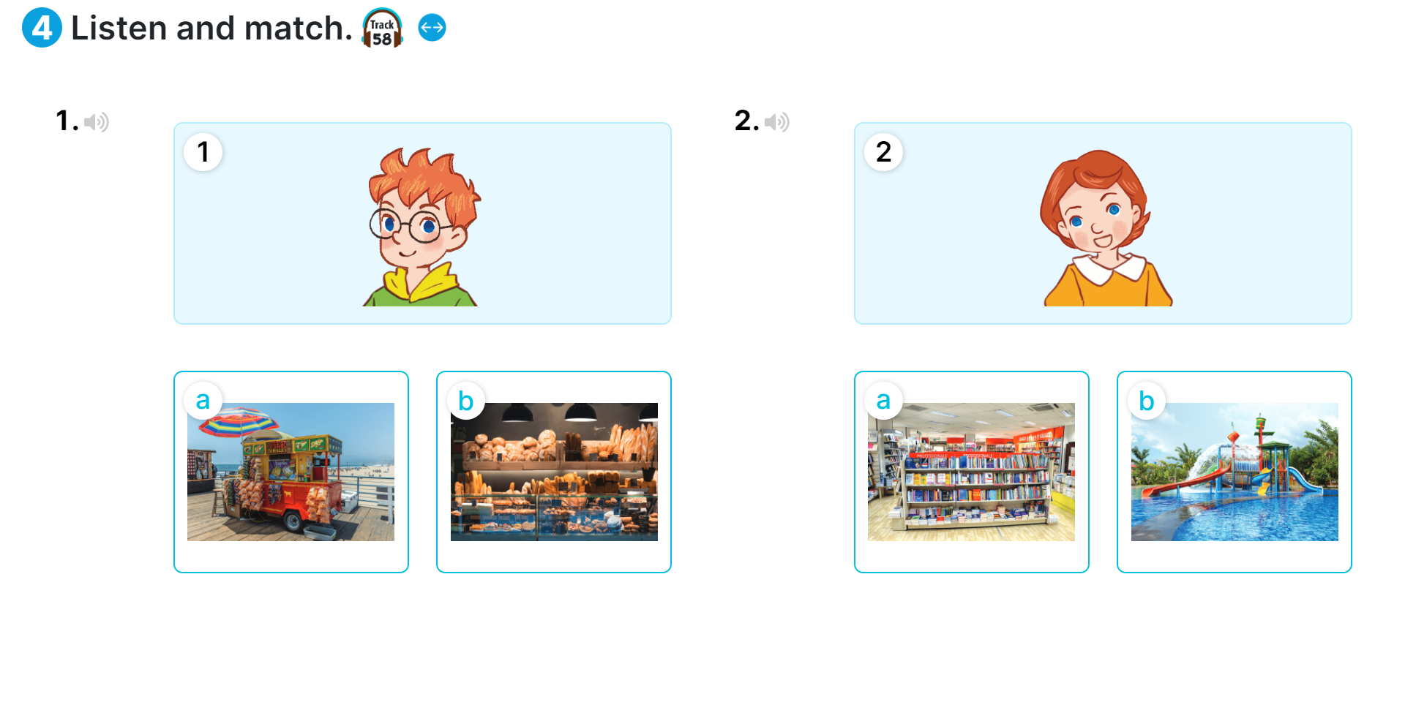

Slide 17
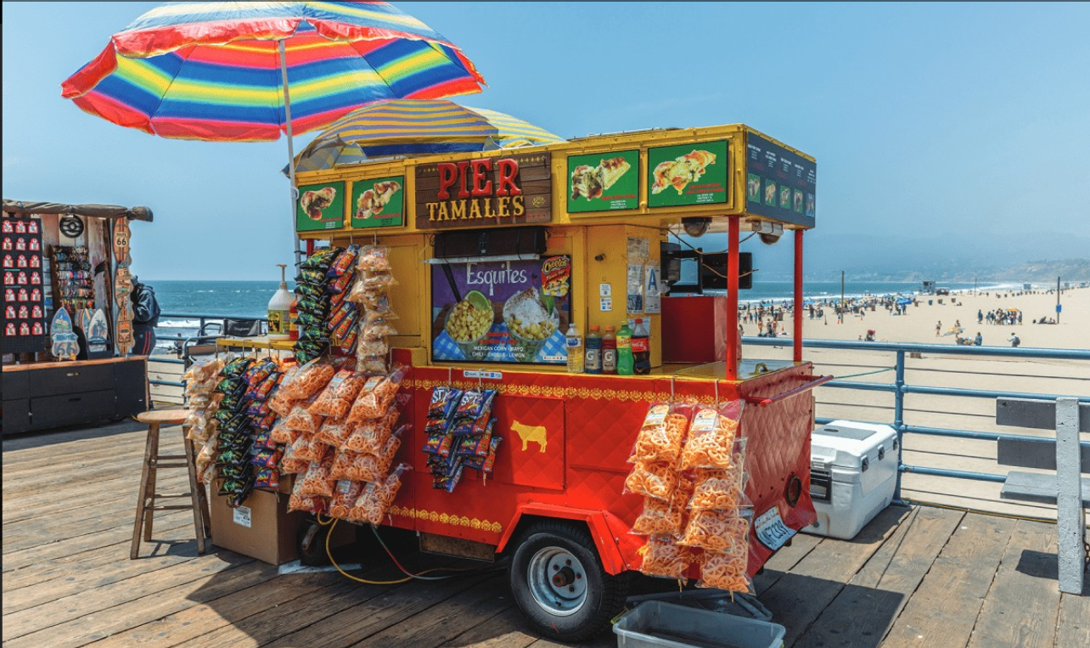
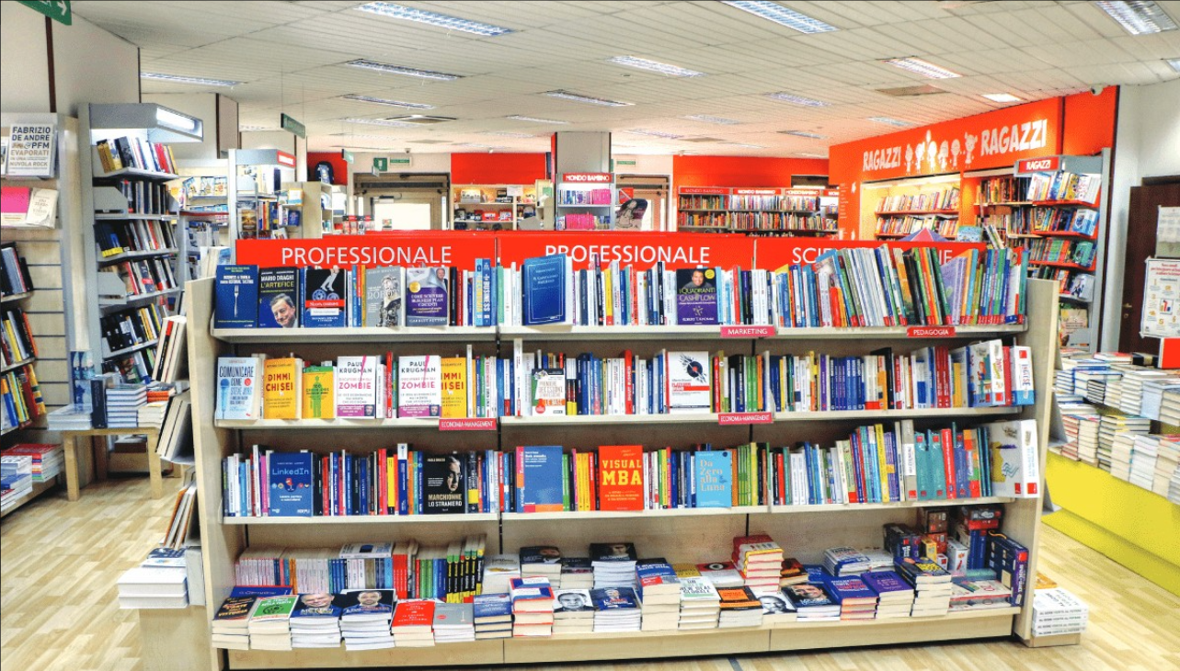
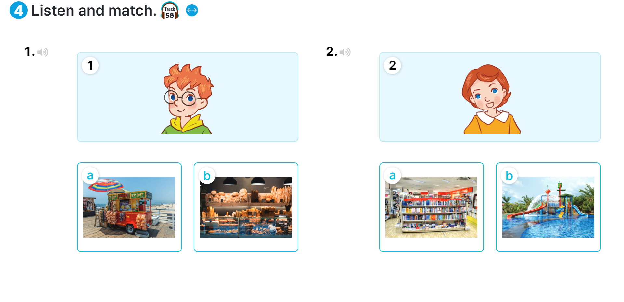
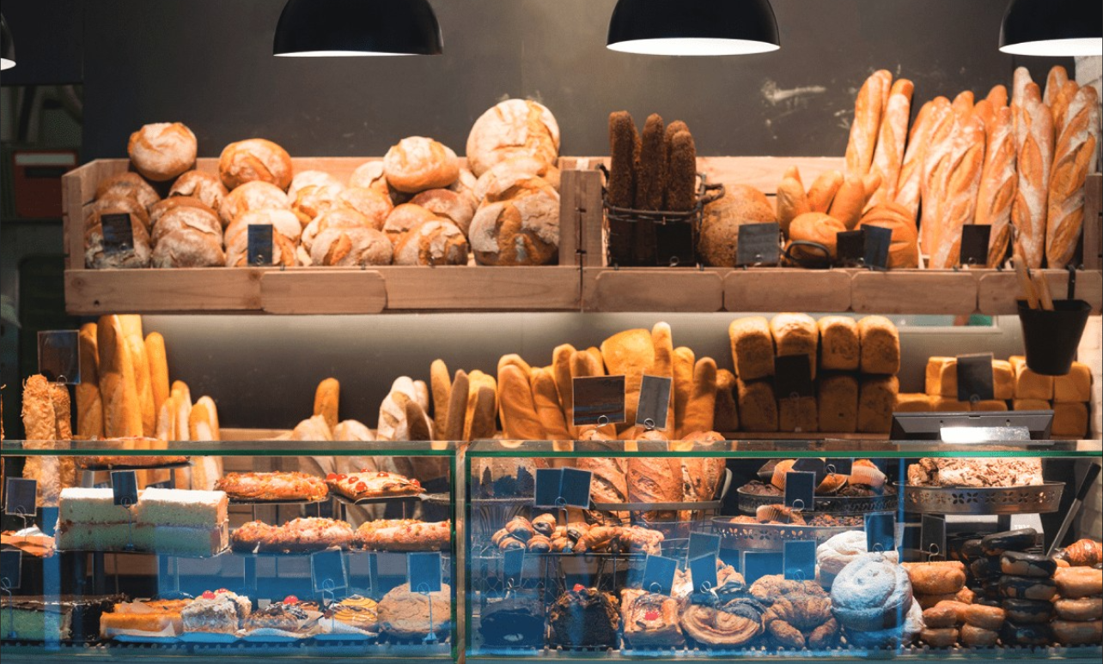
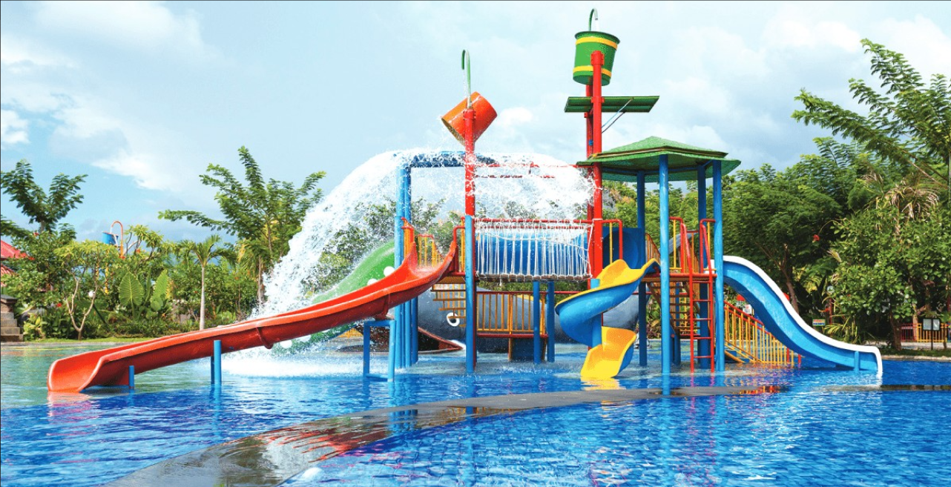
Ben
water park
food stall
Lucy
bookshop
bakery

Slide 19
Look, complete
and read

Slide 20
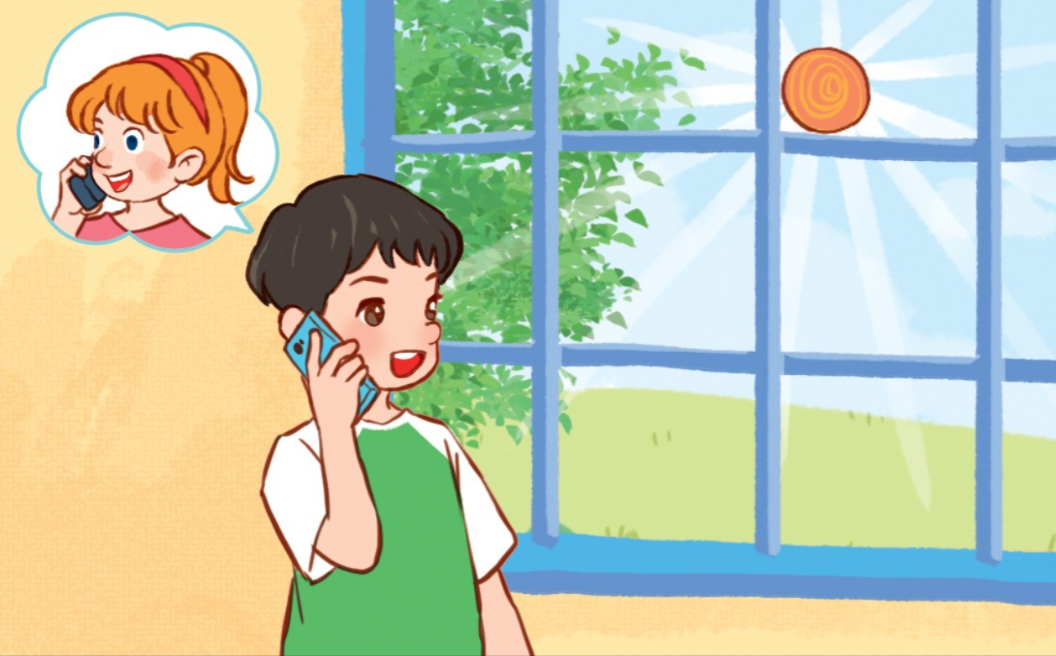
1
What’s the weather like today?
a. It’s sunny.
b. It’s rainy.
c. It’s windy.

Slide 21
2
Do you want to go to the bookshop?
a. OK! I can’t.
b. Sorry. Let’s go.
c. Great! Let’s go.

Slide 22
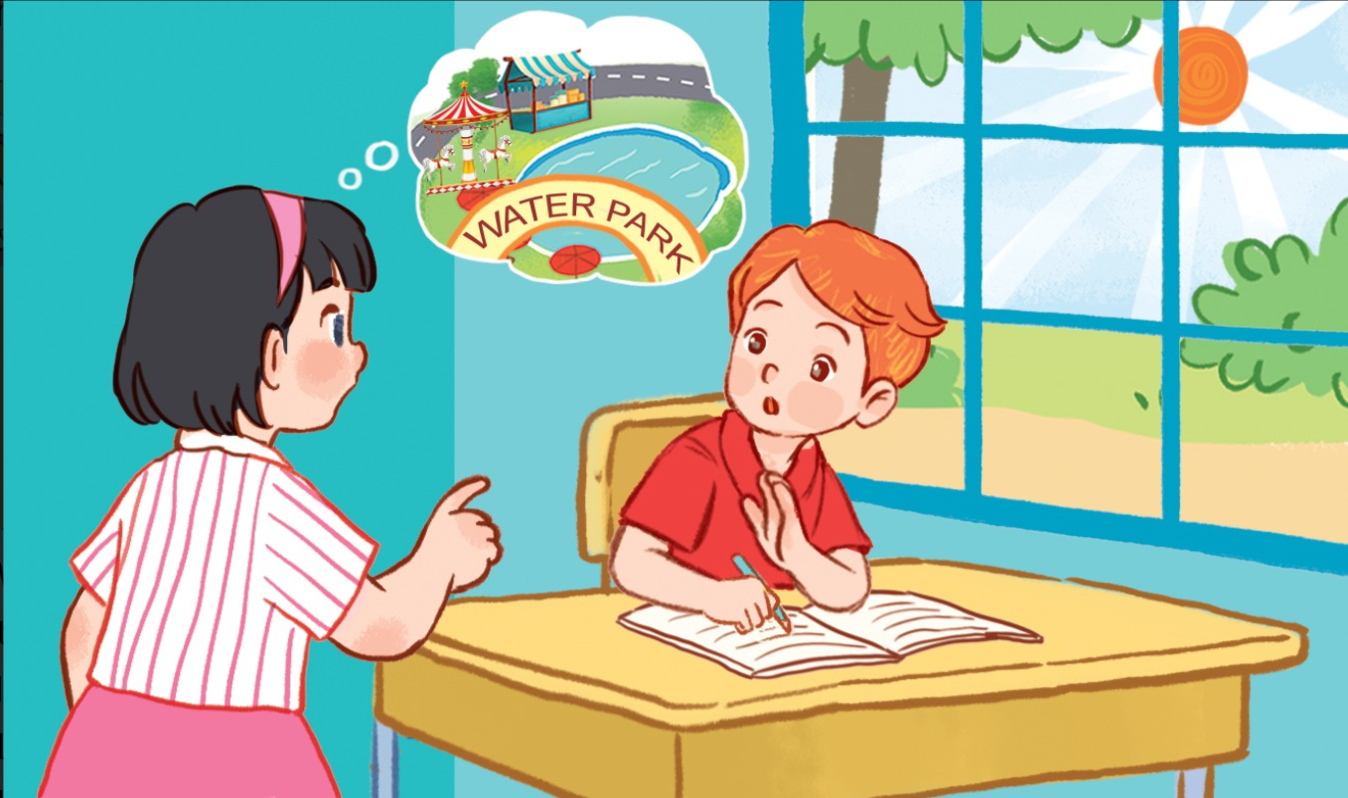
3
Do you want to go to the ______________?
a. swimming pool
b.water park
c. park

Slide 23
4
Do you want to go to the water park? Sorry, __.
a. I can
b. I do
c. I can’t

Slide 24
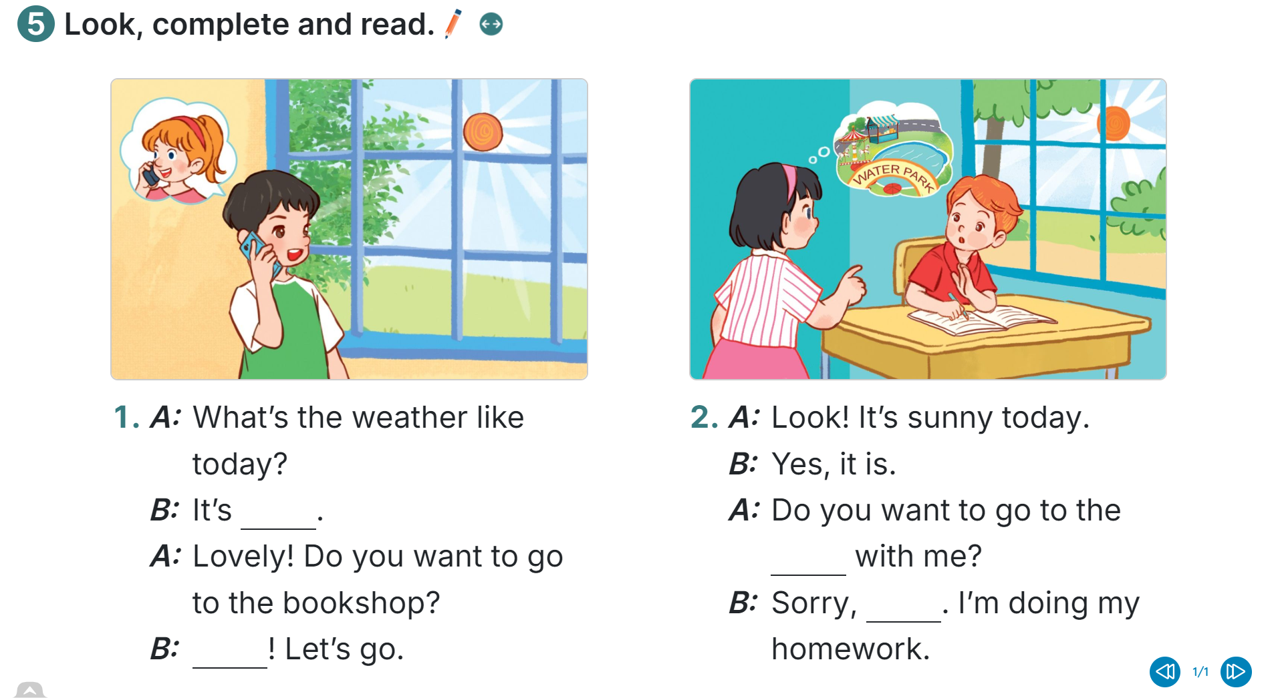
sunny
water park
I can’t
Great

Slide 26
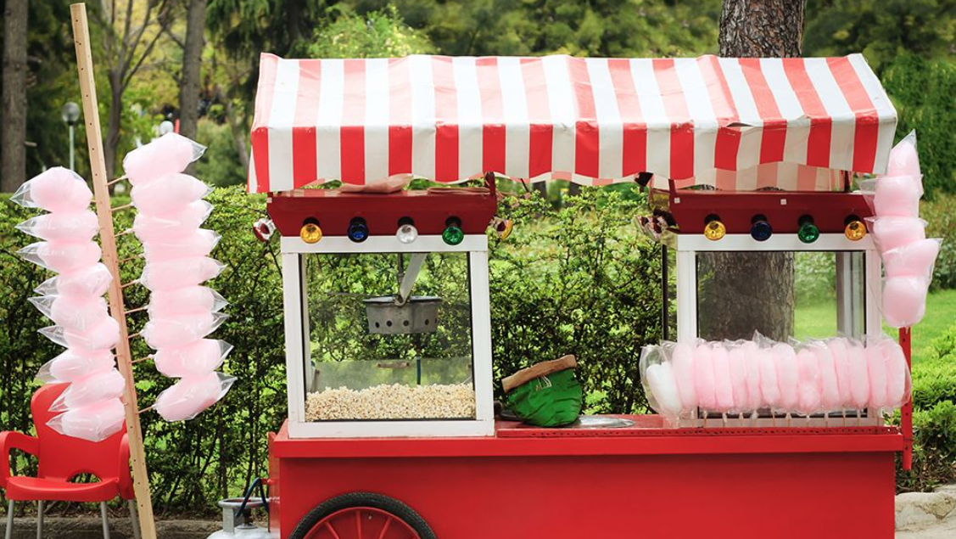
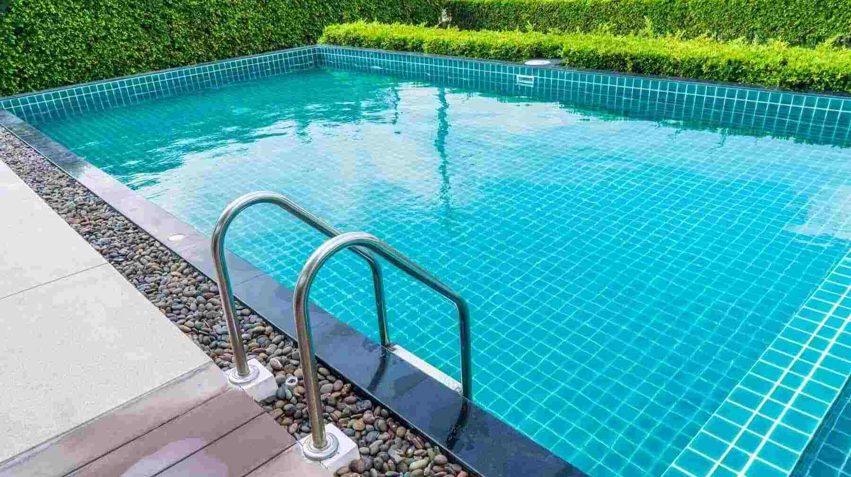
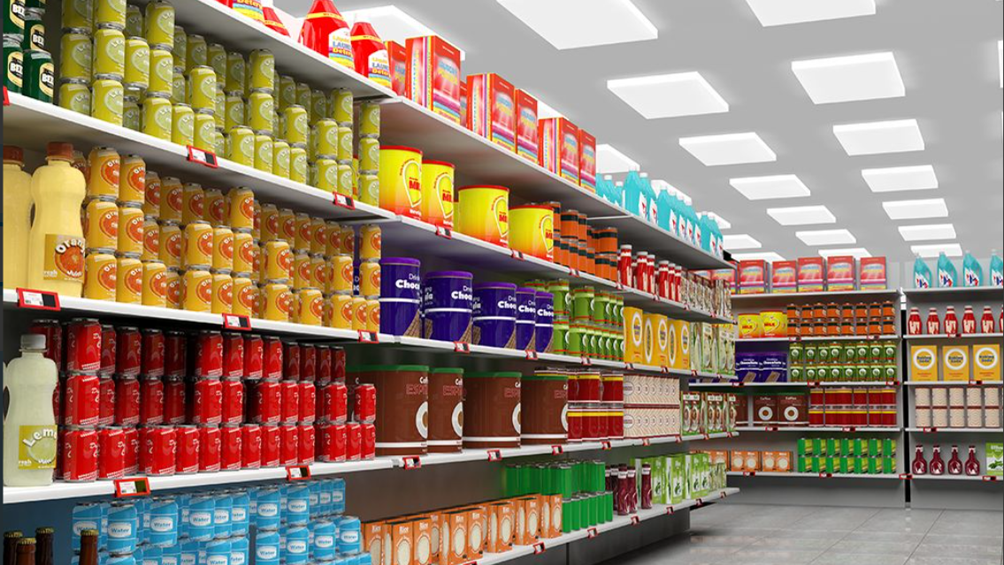
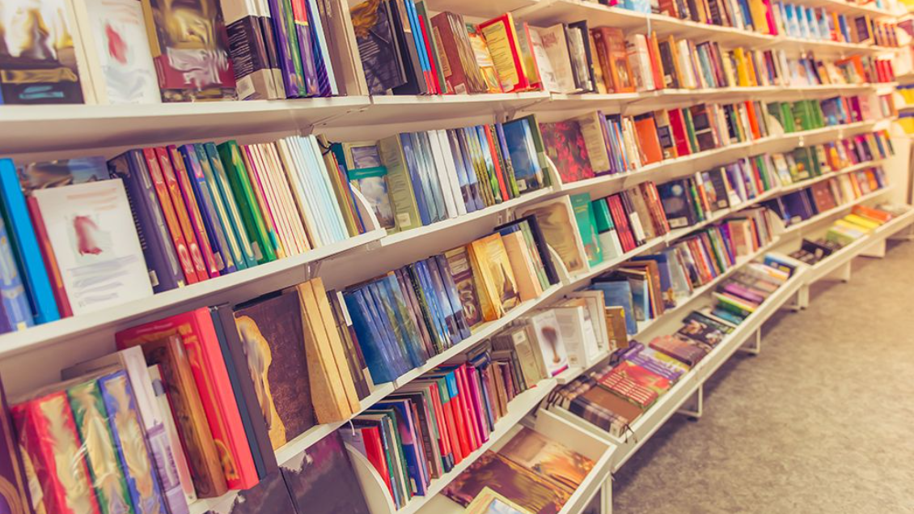

Slide 27
I want to go to the bookshop.

Slide 28
I want to go to the supermarket.

Slide 29
I want to go to the bakery.

Slide 30
I want to go to the food stall.

Slide 31
I want to go to the water park.

Slide 32
I want to go to the swimming pool.

Slide 34
Wrap-up

Slide 35
Great! Let’s go.
Sorry, I can’t.

Slide 36
Great! Let’s go.
Sorry, I can’t.
food stall
bakery
bookshop.
supermarket
water park

Slide 37
Unit 16: Weather
Lesson 2 (4-5-6)

