Slide 1
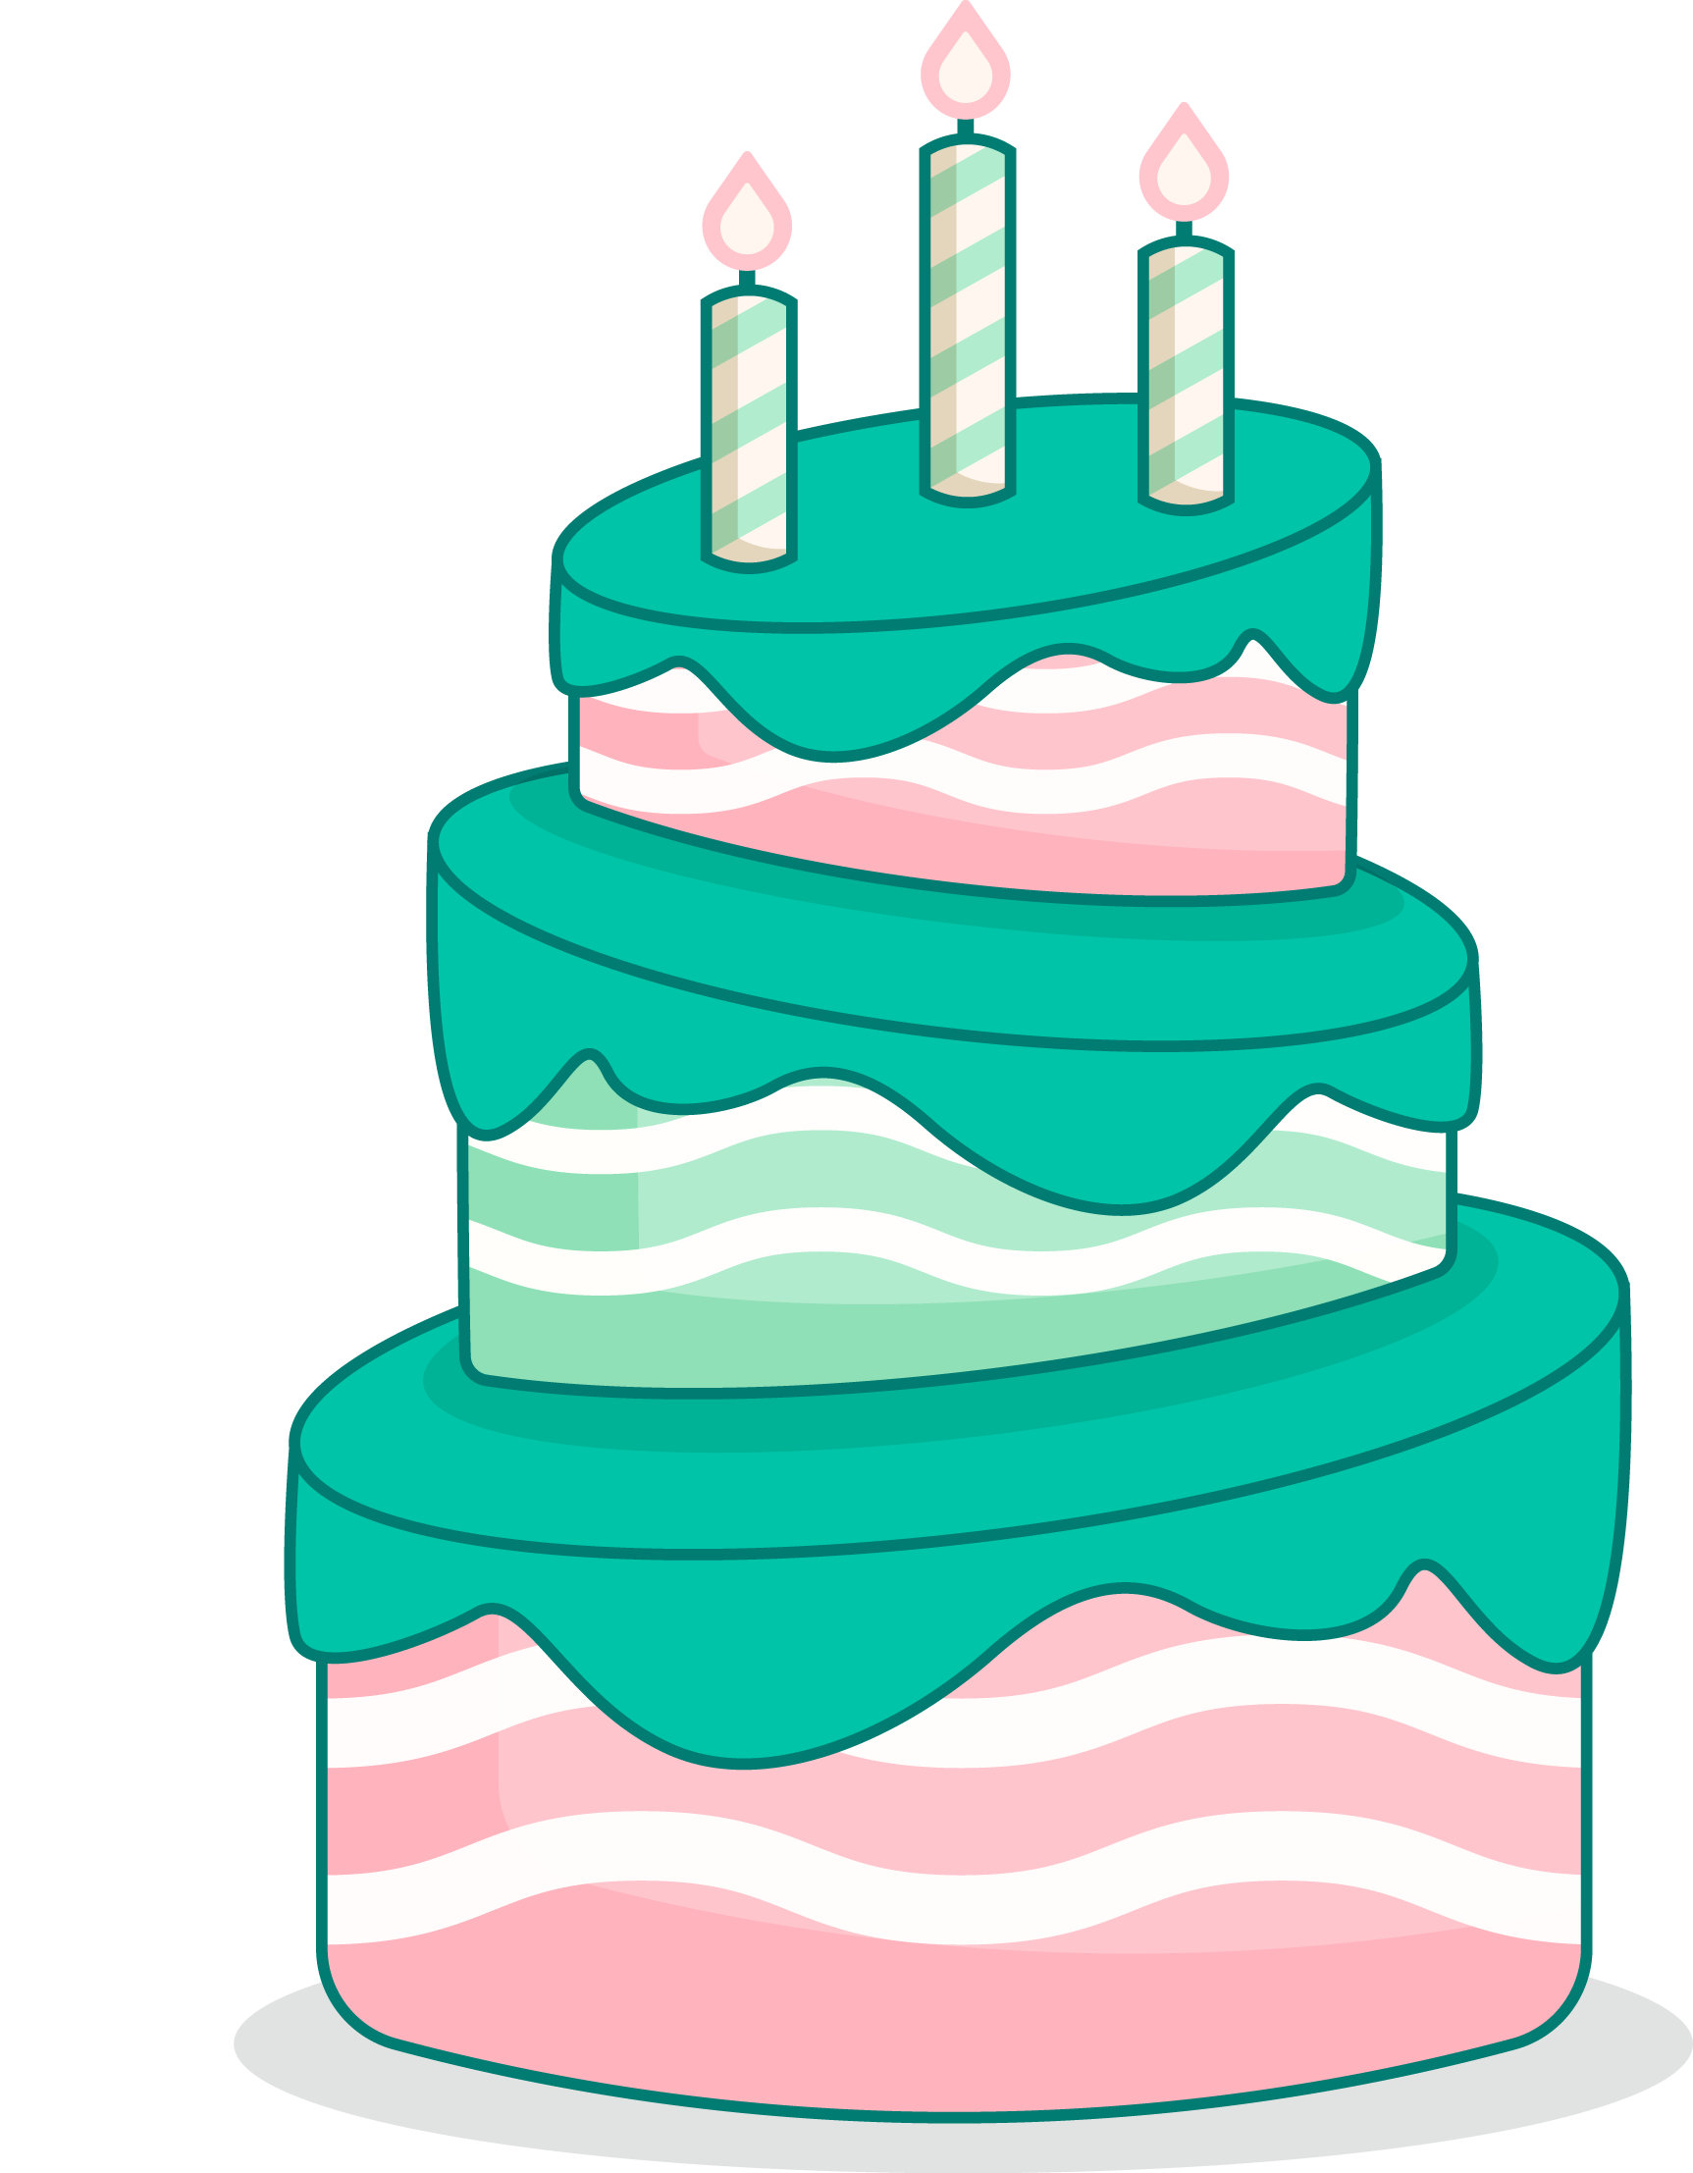
Unit 4
My Birthday
Party
Lesson 1 - Period 1

Slide 2
MsPham
0936082789
Warm-up

Slide 3
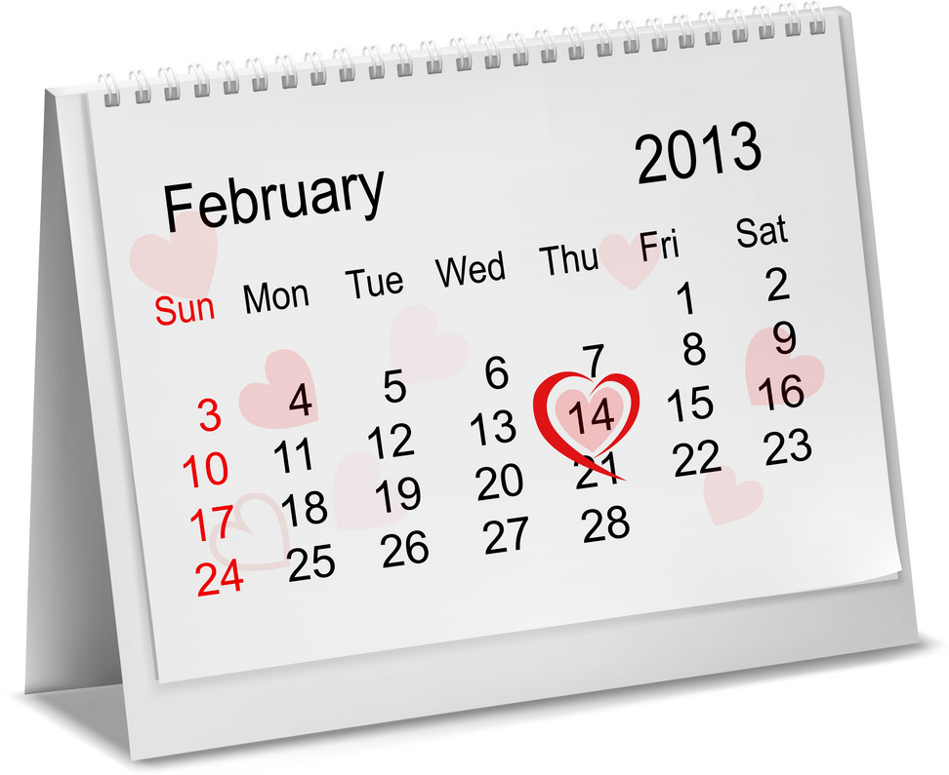
Calendar
Month
Days of the week
1. How many months in a years?
2. Can you say the name of months?
MsPham
0936082789

Slide 5
MsPham
0936082789
Vocabulary

Slide 6
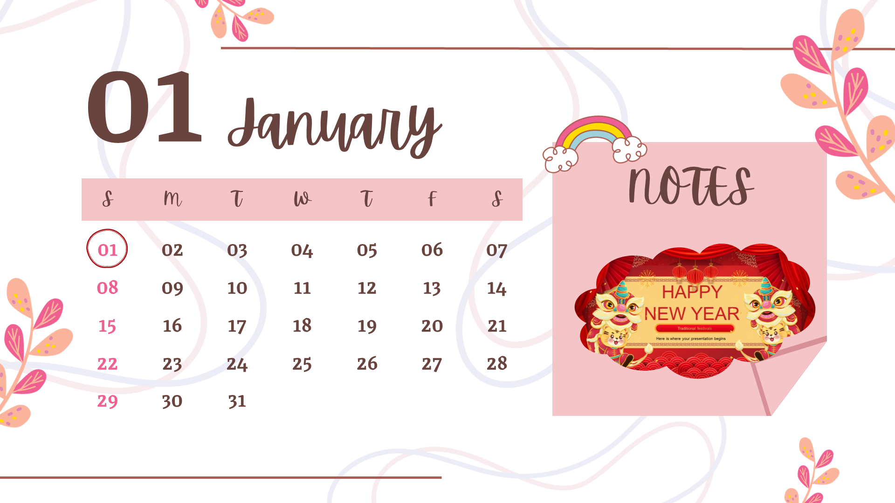
MsPham
0936082789
January
/ˈdʒænjuəri/

Slide 7
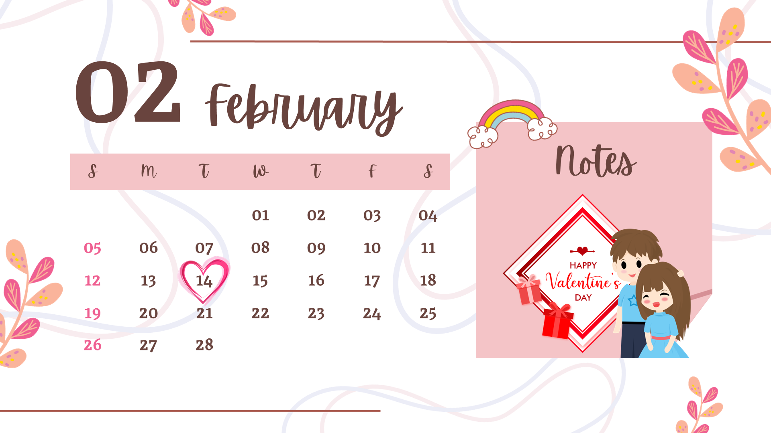
MsPham
0936082789
February
/ˈfebruəri/

Slide 8
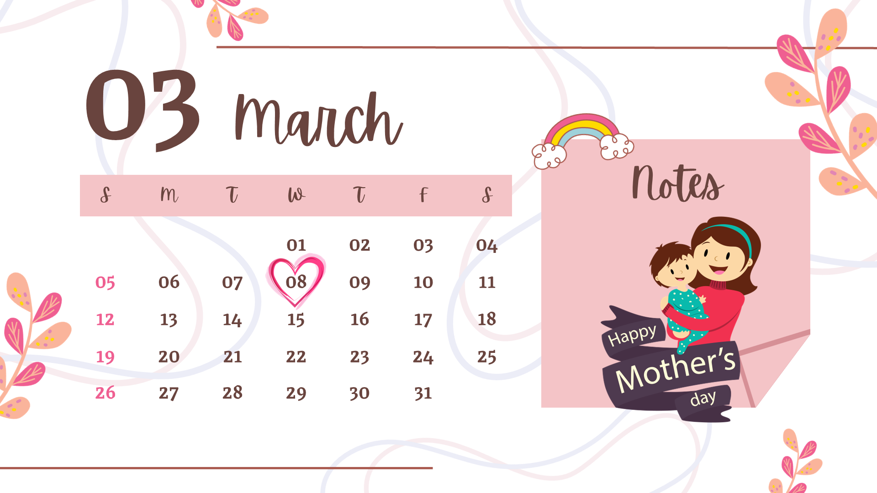
MsPham
0936082789
March
/mɑːtʃ/

Slide 9
MsPham
0936082789
April
/ˈeɪprəl/

Slide 10
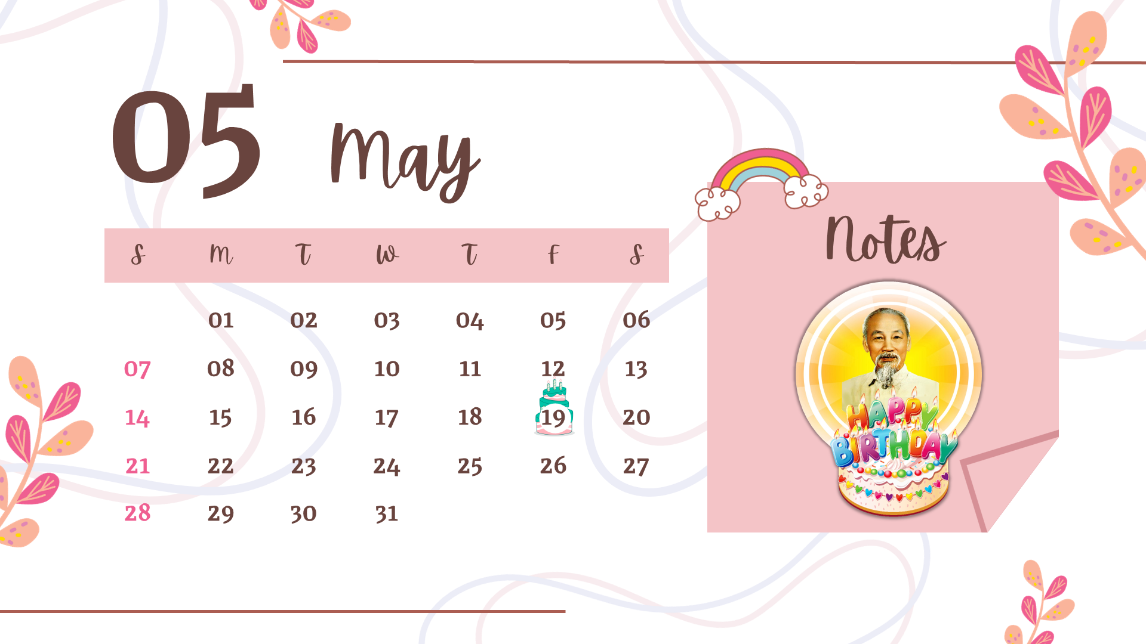
MsPham
0936082789
May
/meɪ/

Slide 11
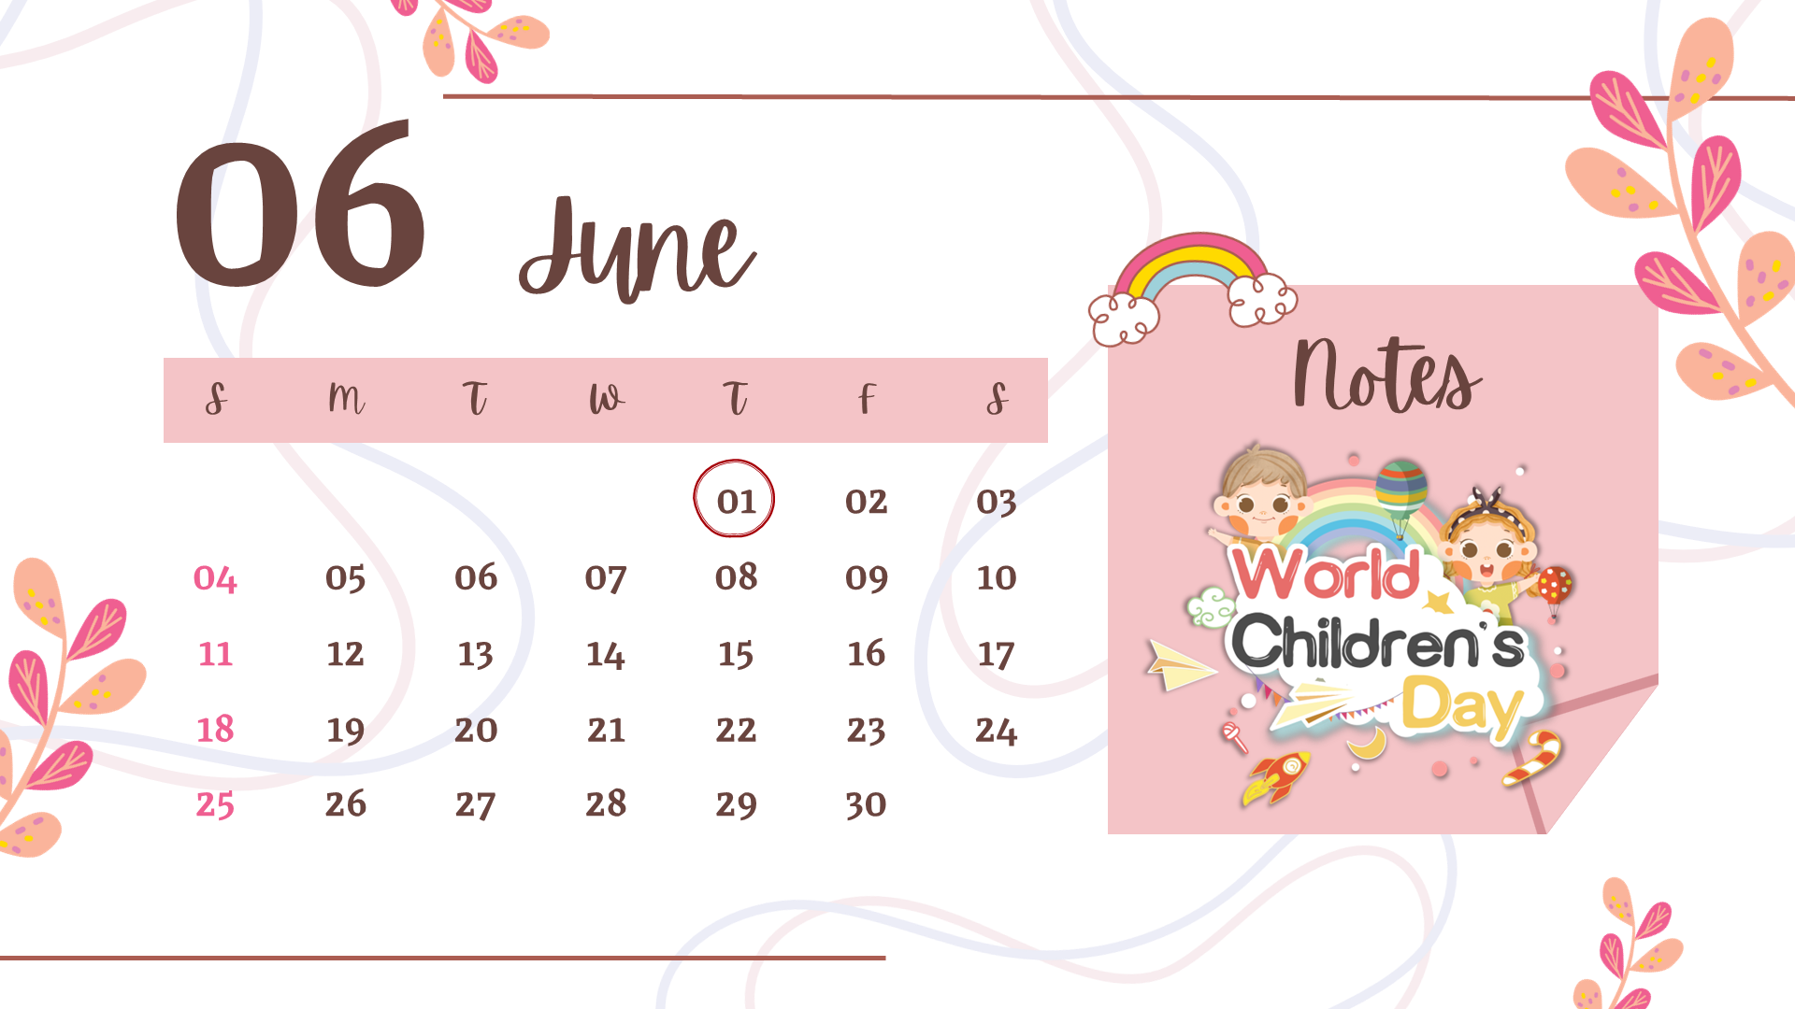
MsPham
0936082789
June
/dʒuːn/

Slide 12
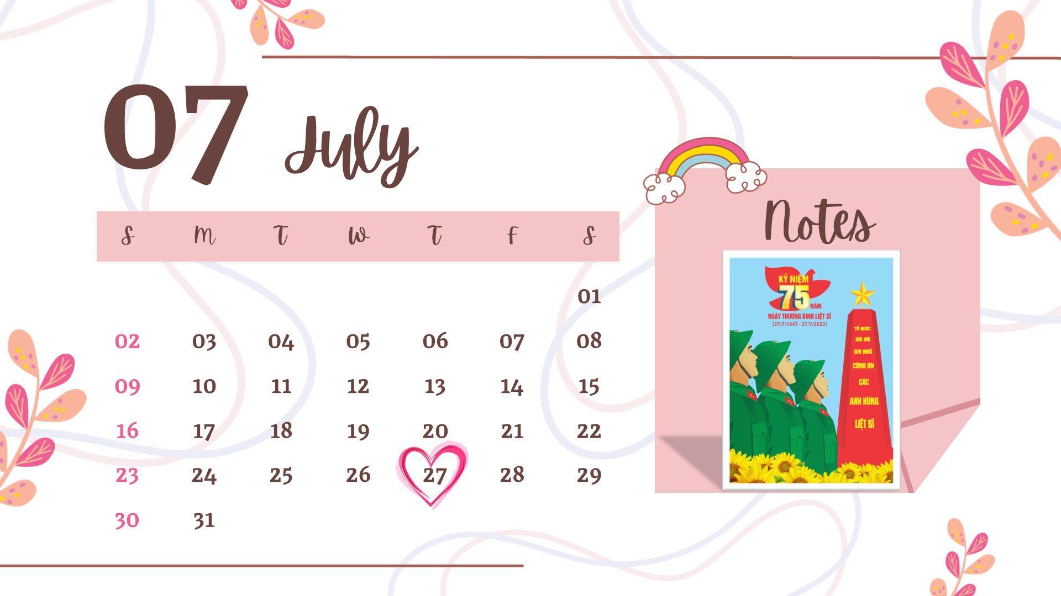
MsPham
0936082789
July
/dʒuˈlaɪ/

Slide 13
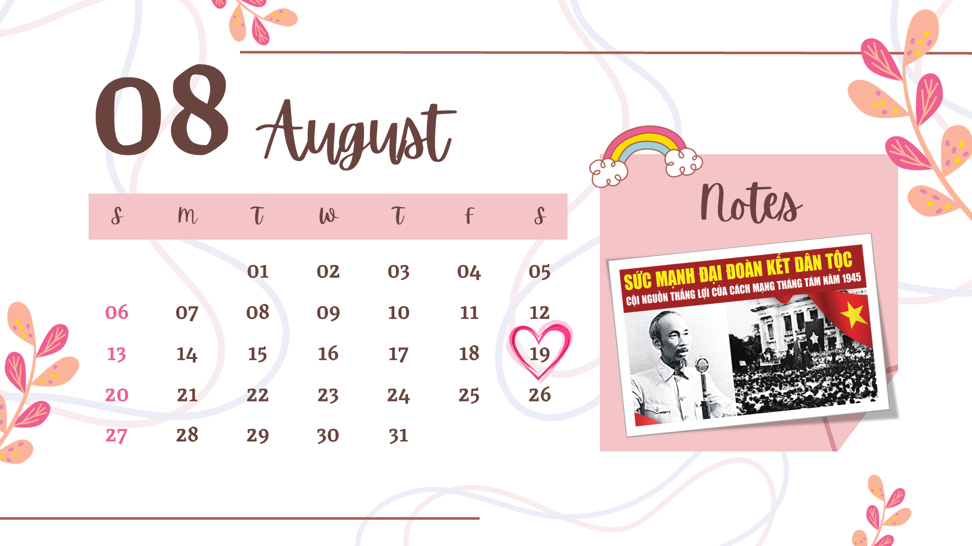
MsPham
0936082789
August
/ɔːˈɡʌst/

Slide 14
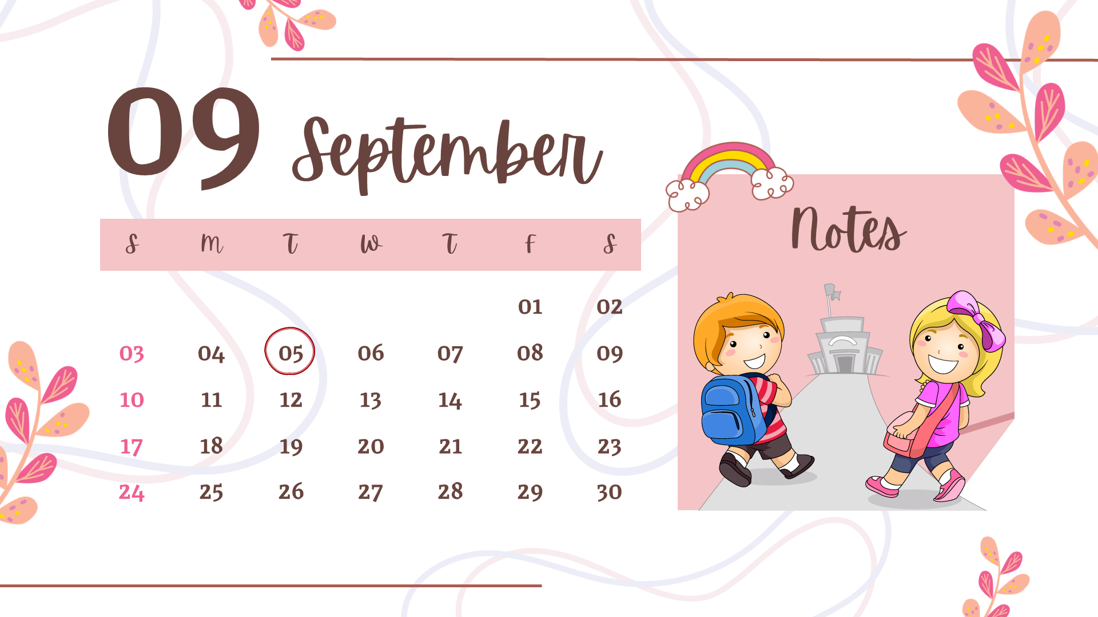
MsPham
0936082789
September
/sepˈtembər/

Slide 15
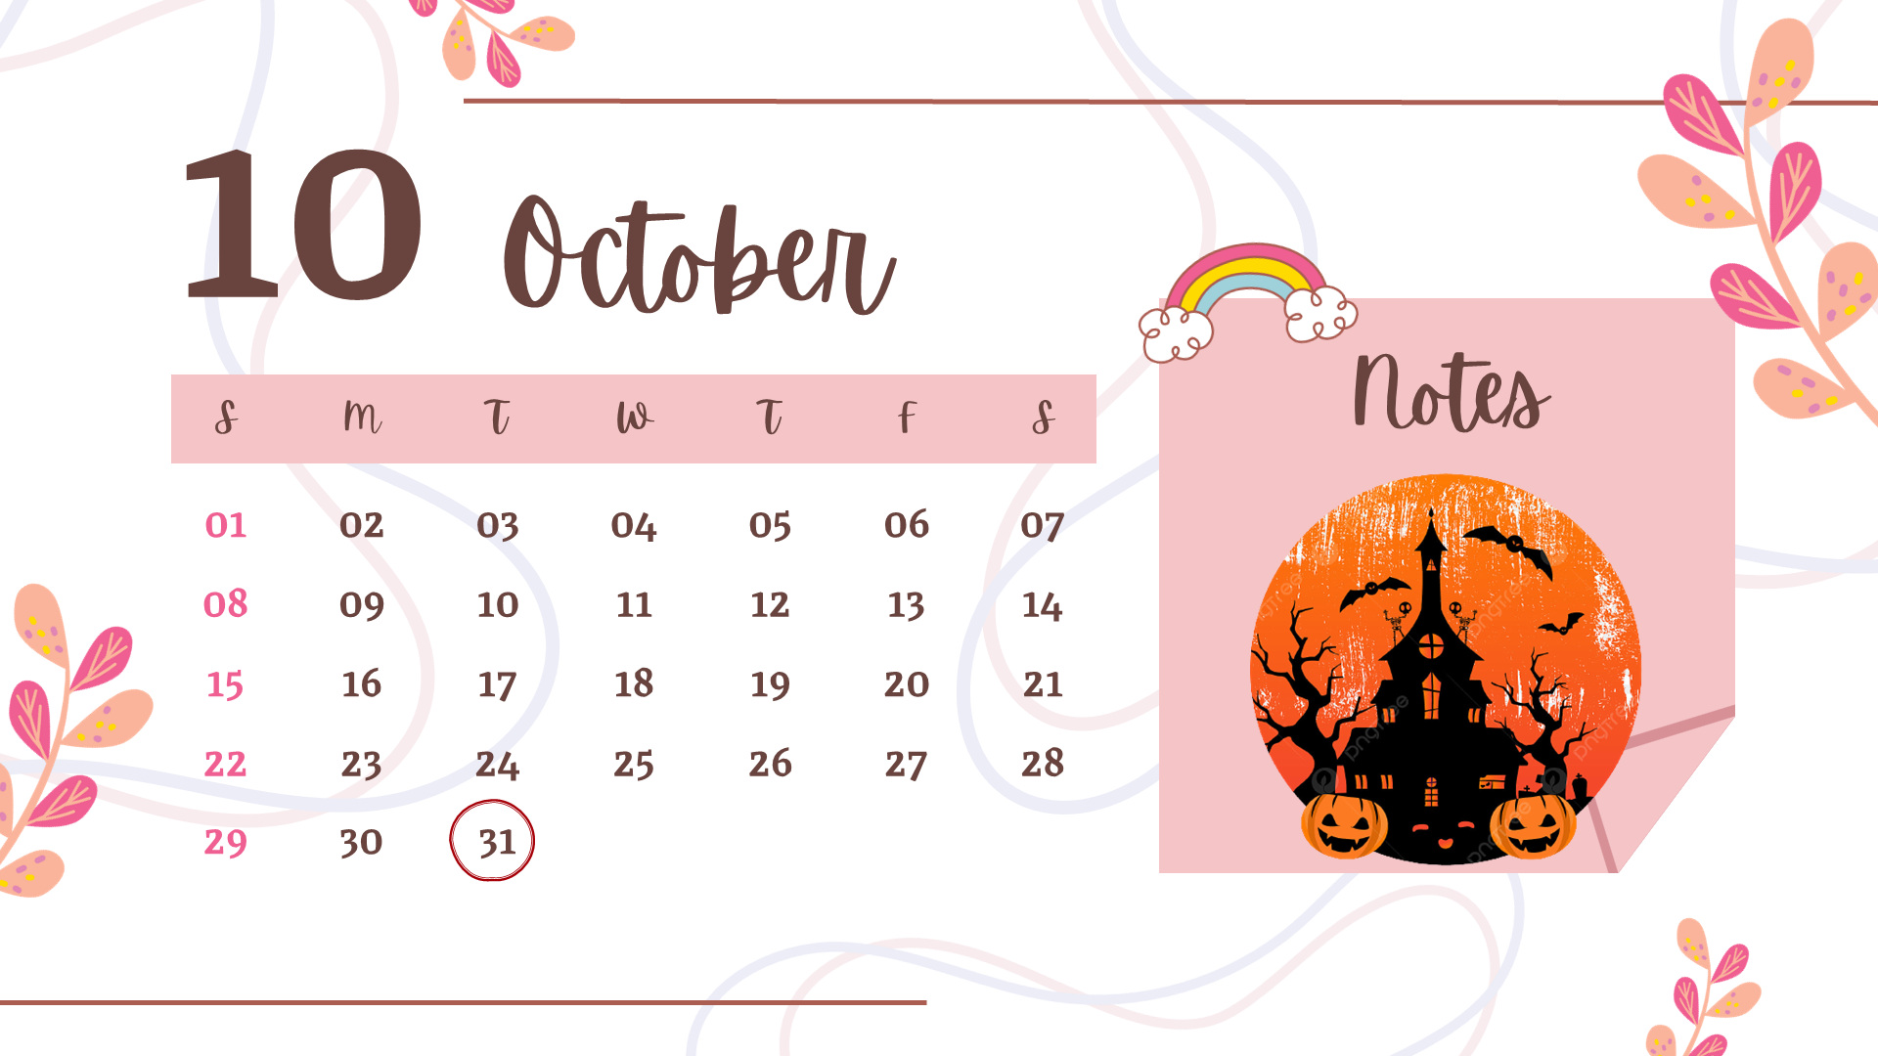
MsPham
0936082789
October
/ɒkˈtəʊbə(r)/

Slide 16
MsPham
0936082789
November
/nəʊˈvembə(r)/

Slide 17
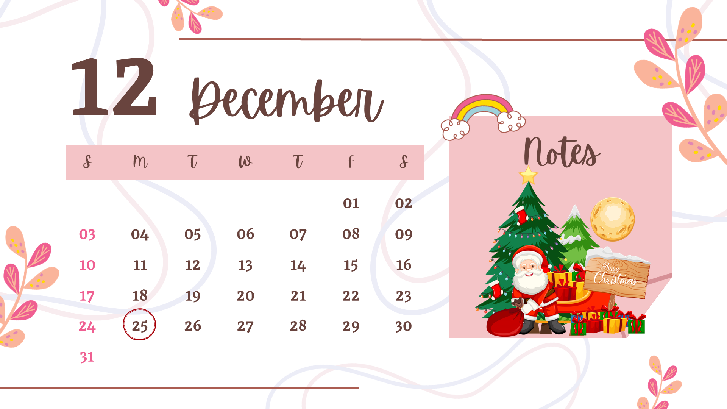
MsPham
0936082789
December
/dɪˈsembə(r)/

Slide 18
I. Vocabulary
January
: Tháng 1
February
: Tháng 2
MsPham
0936082789
March
: Tháng 3
April
: Tháng 4
May
: Tháng 5
June
: Tháng 6

Slide 19
I. Vocabulary
July
: Tháng 7
August
: Tháng 8
MsPham
0936082789
September
: Tháng 9
October
: Tháng 10
November
: Tháng 11
December
: Tháng 12

Slide 20
1
Look, listen and read.

Slide 21
MsPham
0936082789
Structure

Slide 22
1
Cách hỏi sinh nhật của bạn:
When’s your birthday?
It’s in _________.
(+ month)
Ex:
When’s your birthday?
MsPham
0936082789
It’s in June.

Slide 23
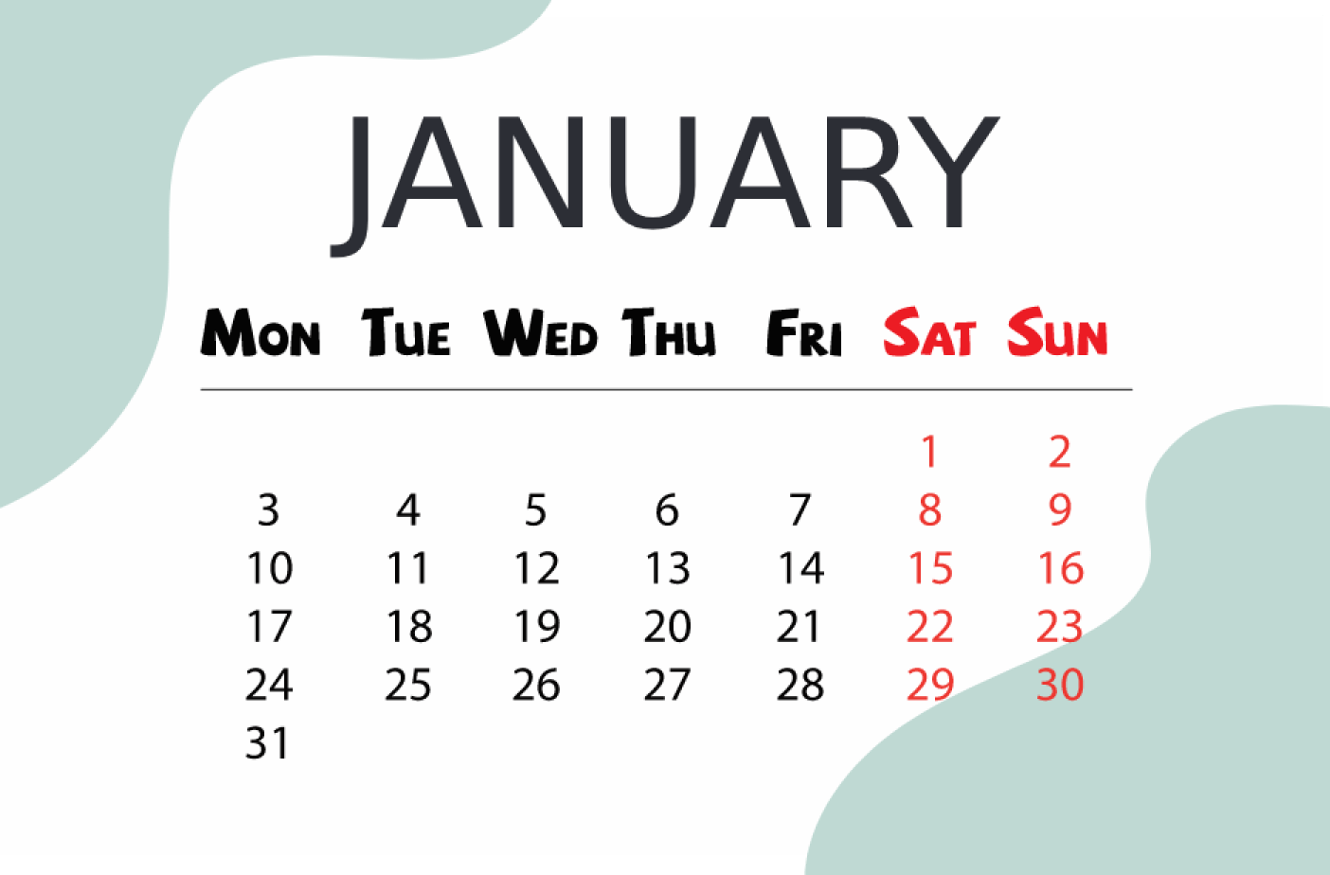
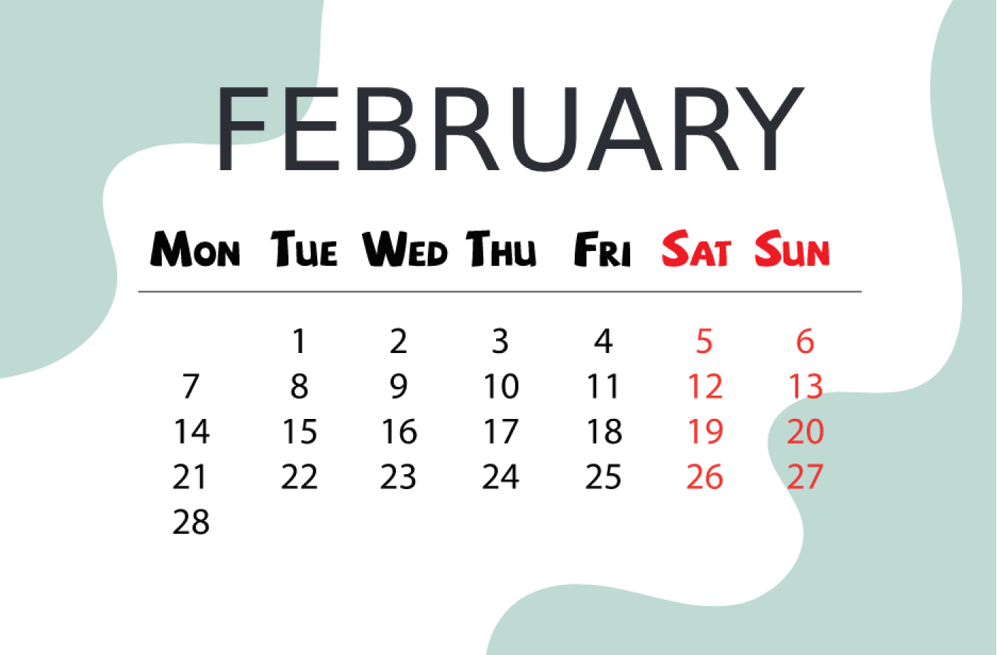
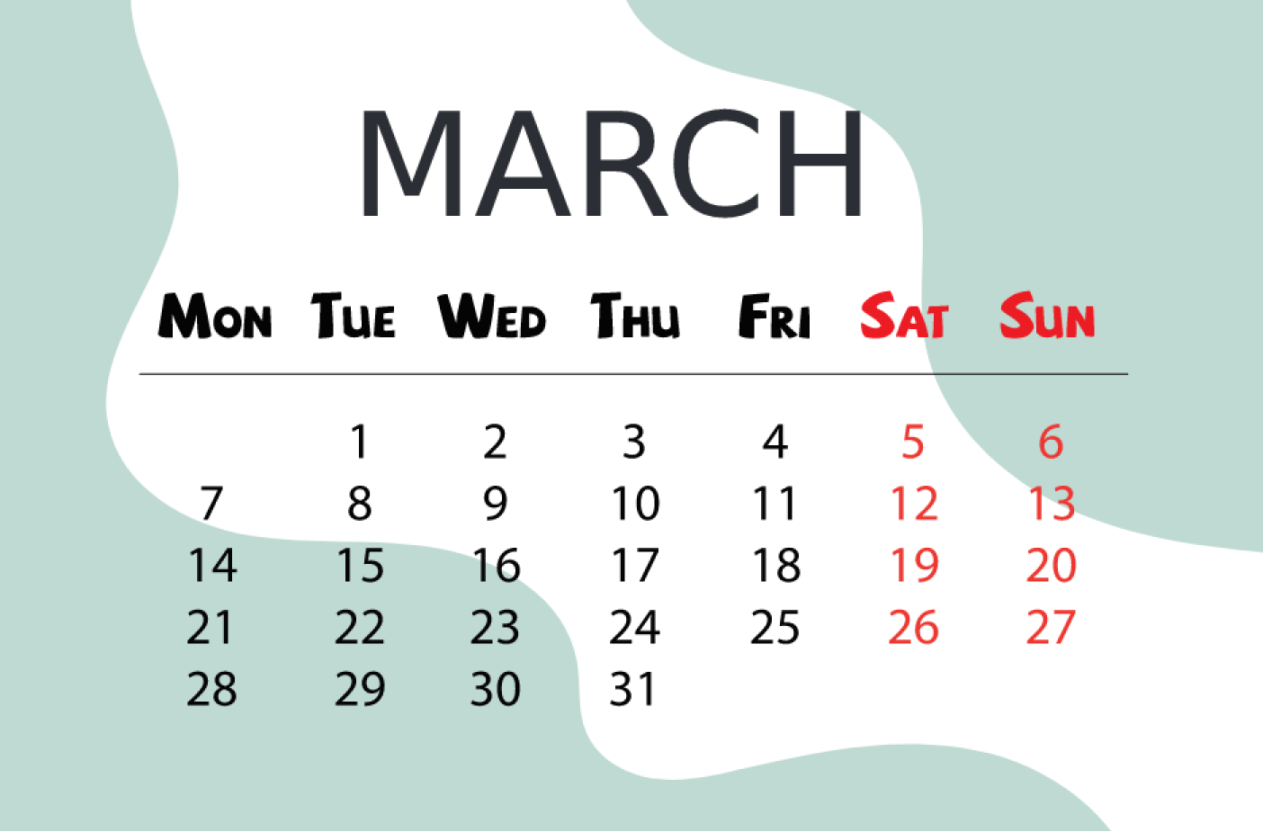
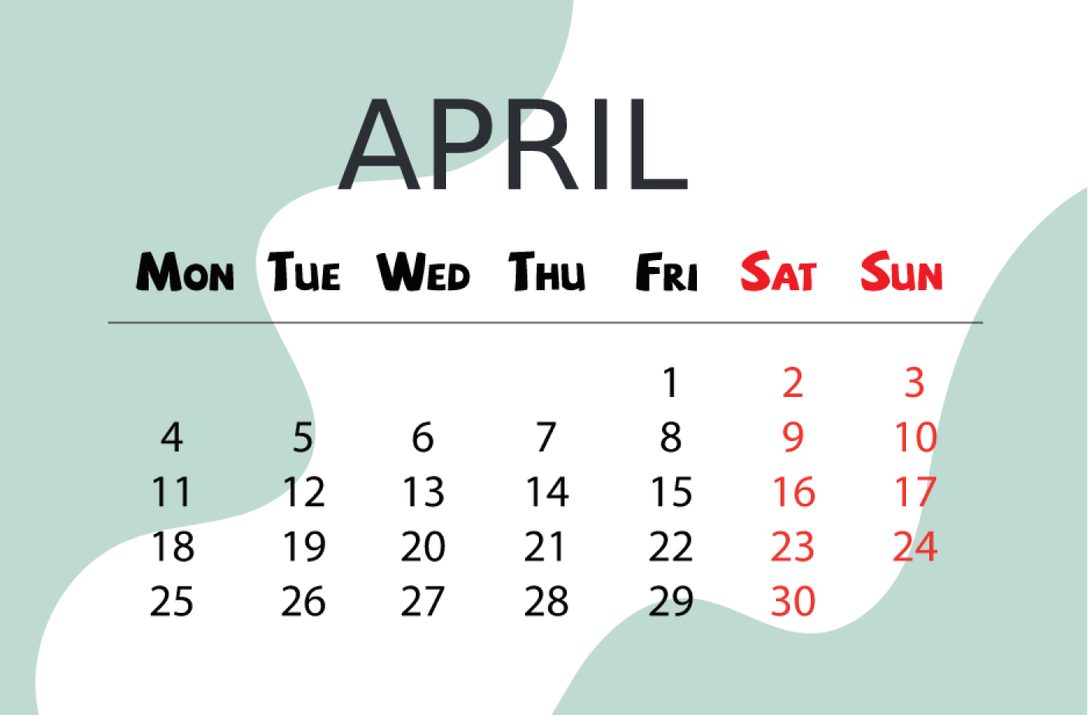
2
Listen, point and say.
When’s your birthday?
It’s _________.
a
b
January
February
MsPham
0936082789
c
d
March
April

Slide 24
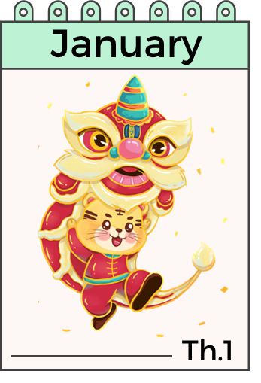
2
Listen, point and say.
MsPham
0936082789
When’s your birthday?
It’s in January.

Slide 25
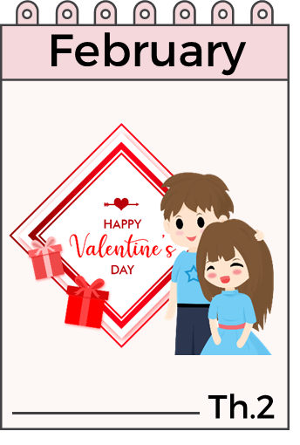
2
Listen, point and say.
MsPham
0936082789
When’s your birthday?
It’s in February.

Slide 26
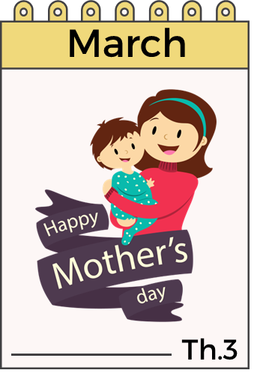
2
Listen, point and say.
MsPham
0936082789
When’s your birthday?
It’s in March.

Slide 27
2
Listen, point and say.
MsPham
0936082789
When’s your birthday?
It’s in April.

Slide 28
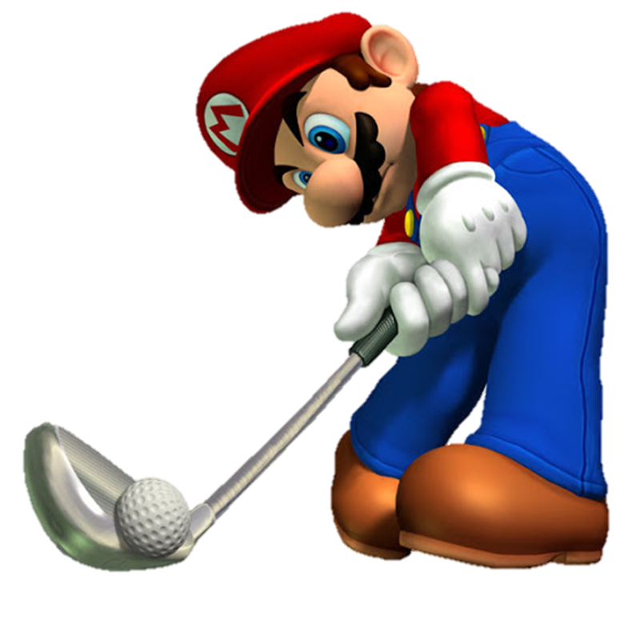
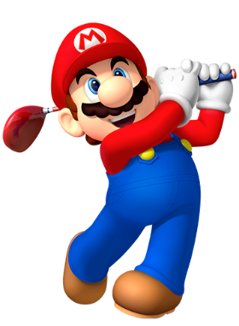
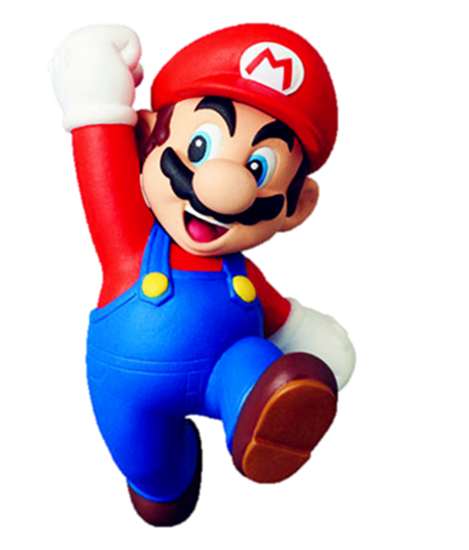

Slide 29
When’s your birthday?
It’s in
February
It’s in
March
It’s in
August

Slide 30
When’s your birthday?
It’s in
April
It’s in
July
It’s in
March

Slide 31
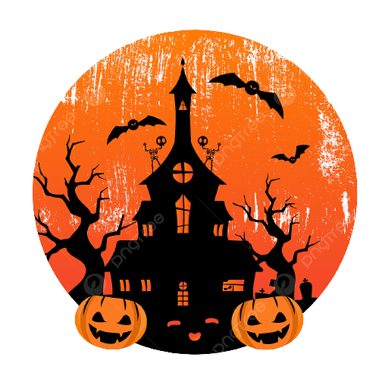
When’s your birthday?
It’s in
November
It’s in
October
It’s in
May

Slide 32
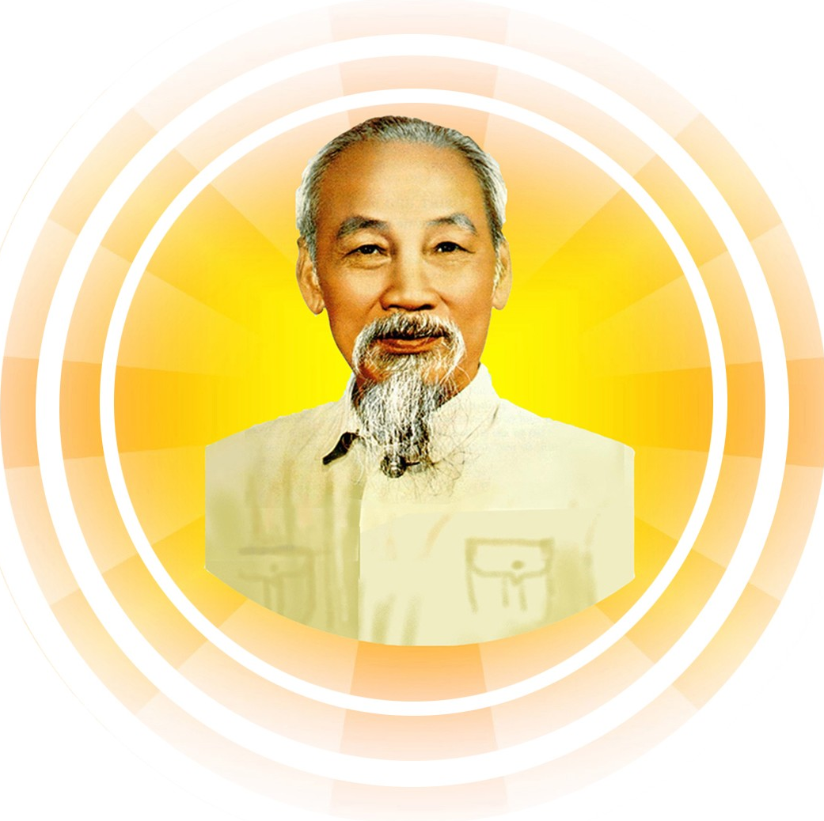
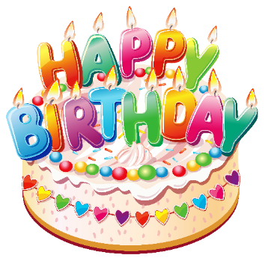
When’s your birthday?
It’s in
May
It’s in
June
It’s in
September

Slide 33
When’s your birthday?
It’s in
May
It’s in
September
It’s in
April

Slide 34
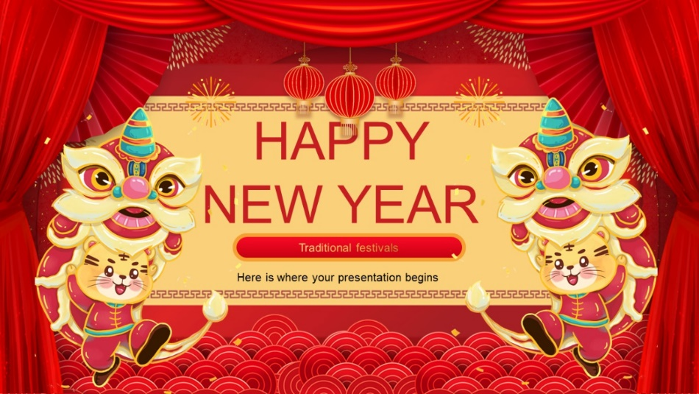
When’s your birthday?
It’s in
February
It’s in
January
It’s in
April

Slide 35
When’s your birthday?
It’s in
October
It’s in
July
It’s in
August

Slide 36
When’s your birthday?
It’s in
October
It’s in
June
It’s in
September

Slide 37
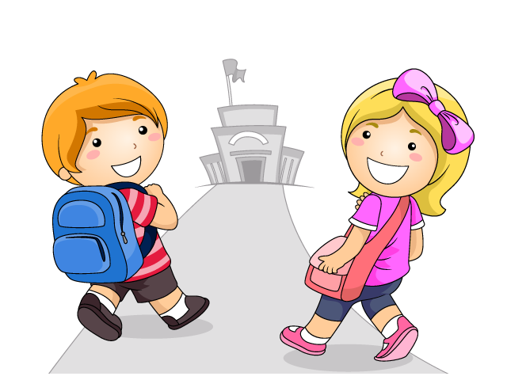
When’s your birthday?
It’s in
December
It’s in
January
It’s in
September

Slide 38
When’s your birthday?
It’s in
August
It’s in
February
It’s in
September

Slide 39
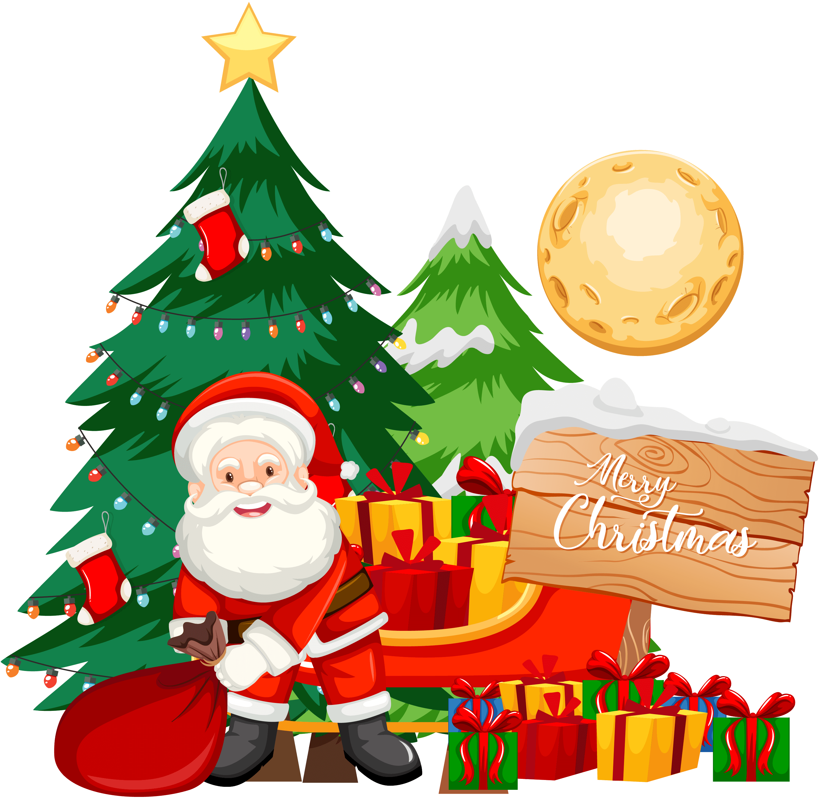
When’s your birthday?
It’s in
December
It’s in
January
It’s in
November

Slide 40
When’s your birthday?
It’s in
March
It’s in
November
It’s in
July

Slide 41
GOOD JOB!

Slide 42
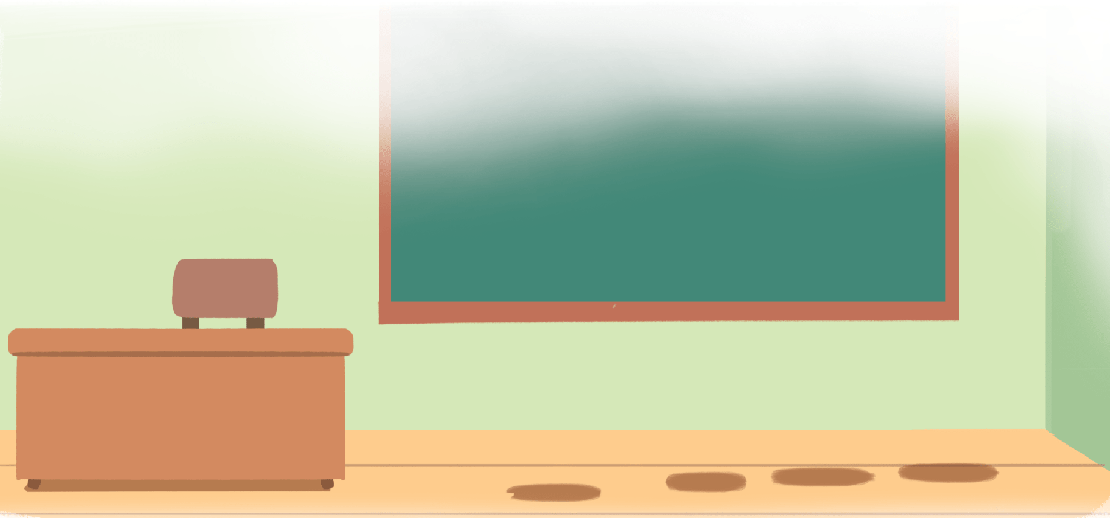
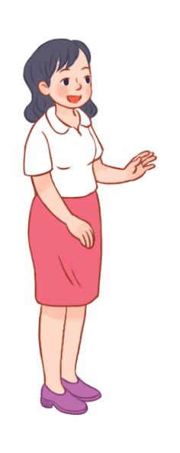
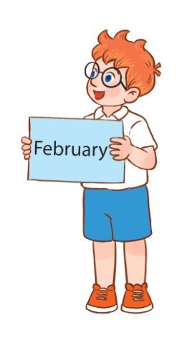
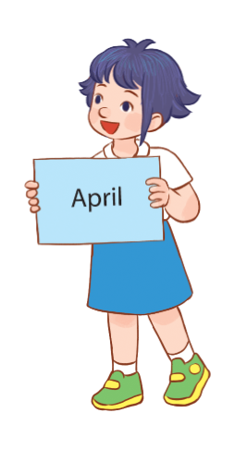
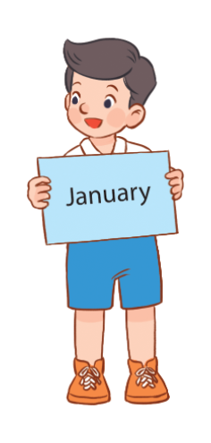
3
Let’s talk.
It’s in ___________.
When’s your birthday?

Slide 43
MsPham
0936082789
Review

Slide 44
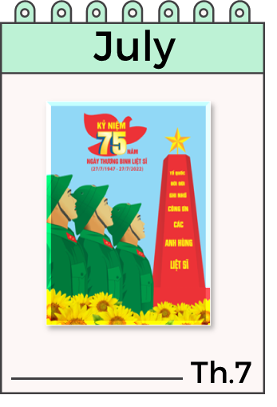
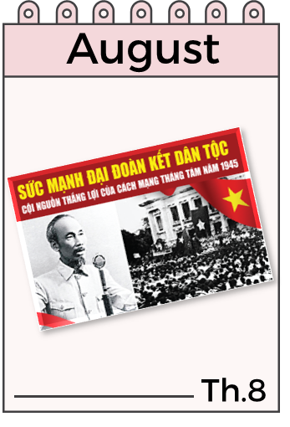
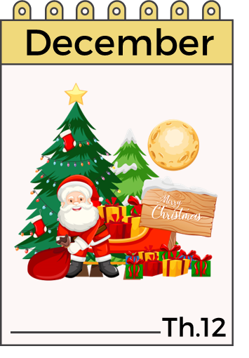
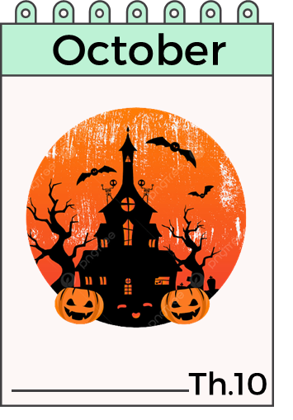
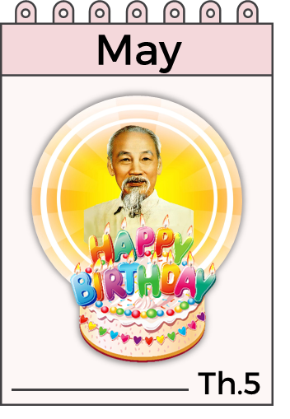
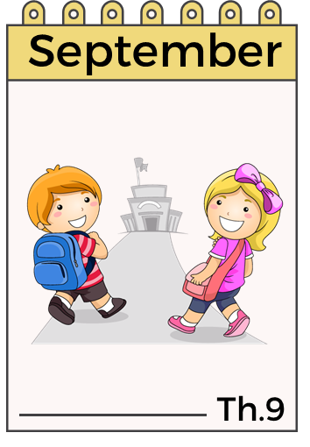
When’s your birthday?
It’s in ___________.
MsPham
0936082789

Slide 45
Thank you
for joining!

