Slide 1
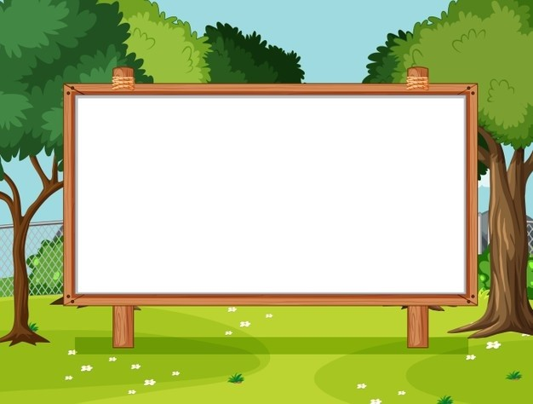
Welcome to our class!
ENGLISH 5
Teacher: Cao Minh Ngoc

Slide 2

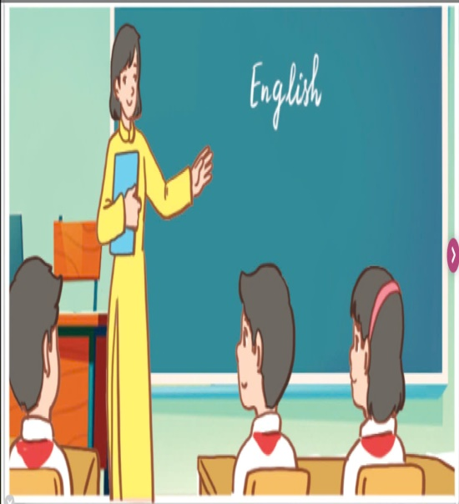
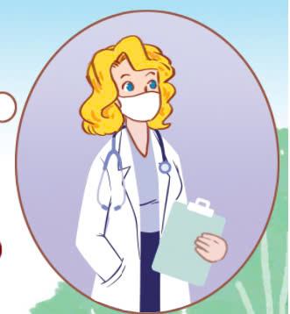
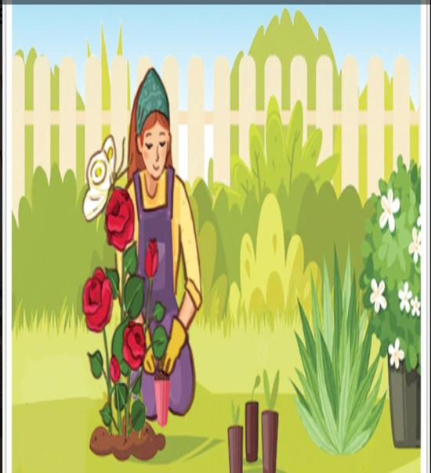
1
I’d like to teach children.
teacher
I’d like to be a ___________.
A. teacher
B. doctor
C. gardener

Slide 3

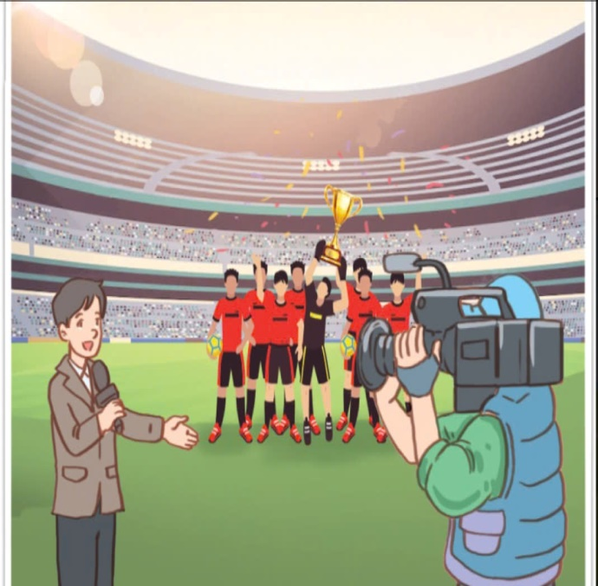
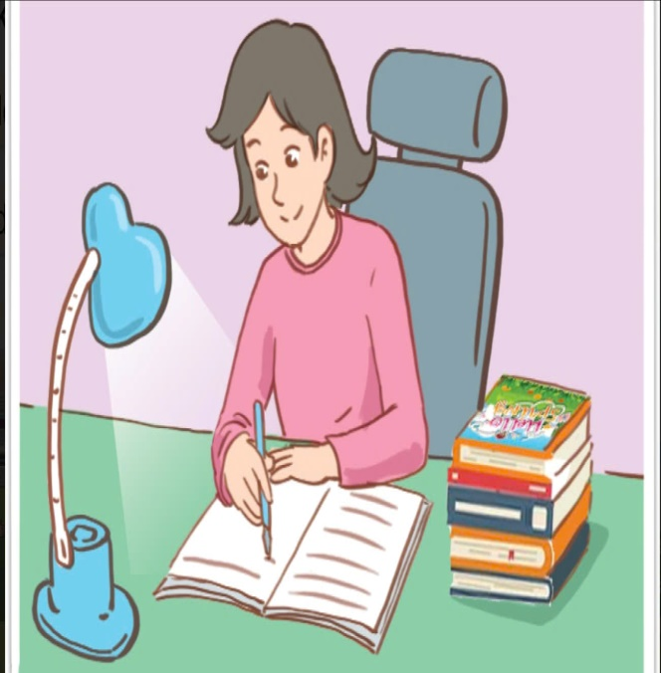
2
I’d like to report the news.
I’d like to be a ___________.
reporter
A. teacher
B. reporter
C. writer

Slide 4


3
I’d like to grow flowers.
I’d like to be a _______________.
gardener
A. doctor
B. writer
C. gardener

Slide 5


4
I’d like to write stories.
I’d like to be a ____________.
writer
A. writer
B. doctor
C. teacher

Slide 6
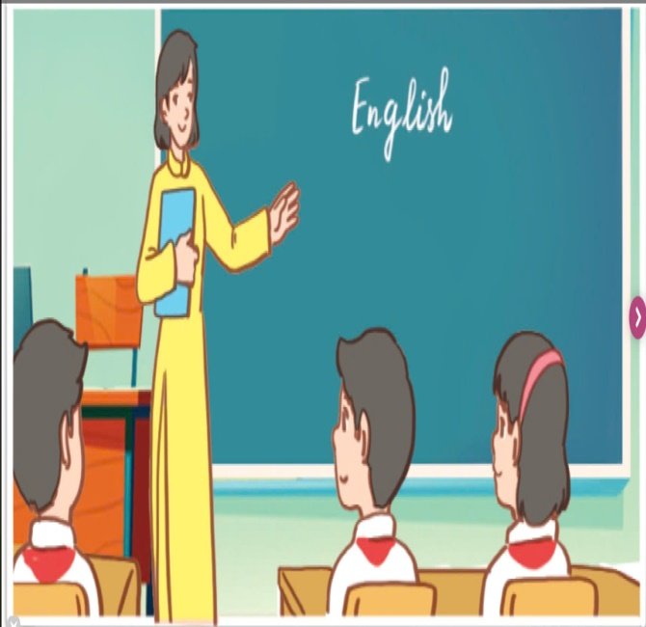

5
I’d like to help people.
I’d like to be a _________________.
doctor
A. teacher
B. doctor
C. reporter

Slide 7
Unit 5. My future job!
Lesson 2: 4,5,6

Slide 8



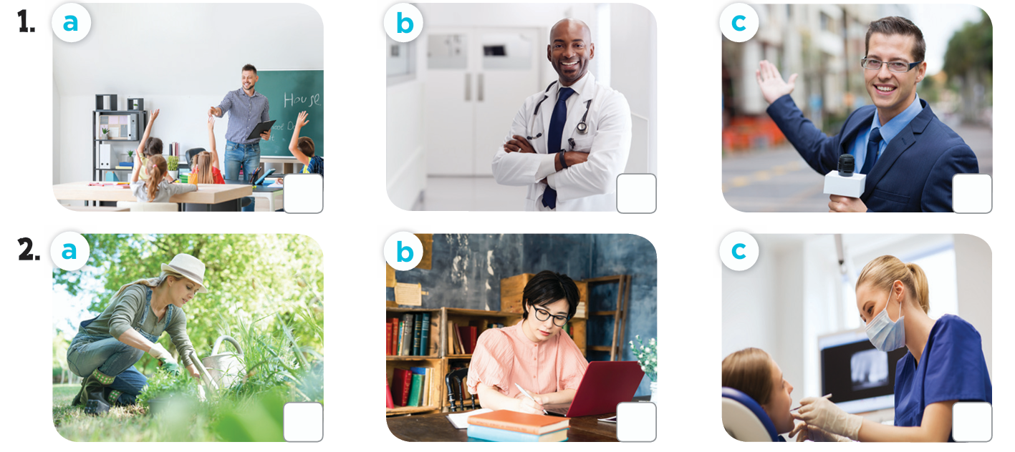




4. Listen and tick

Slide 9
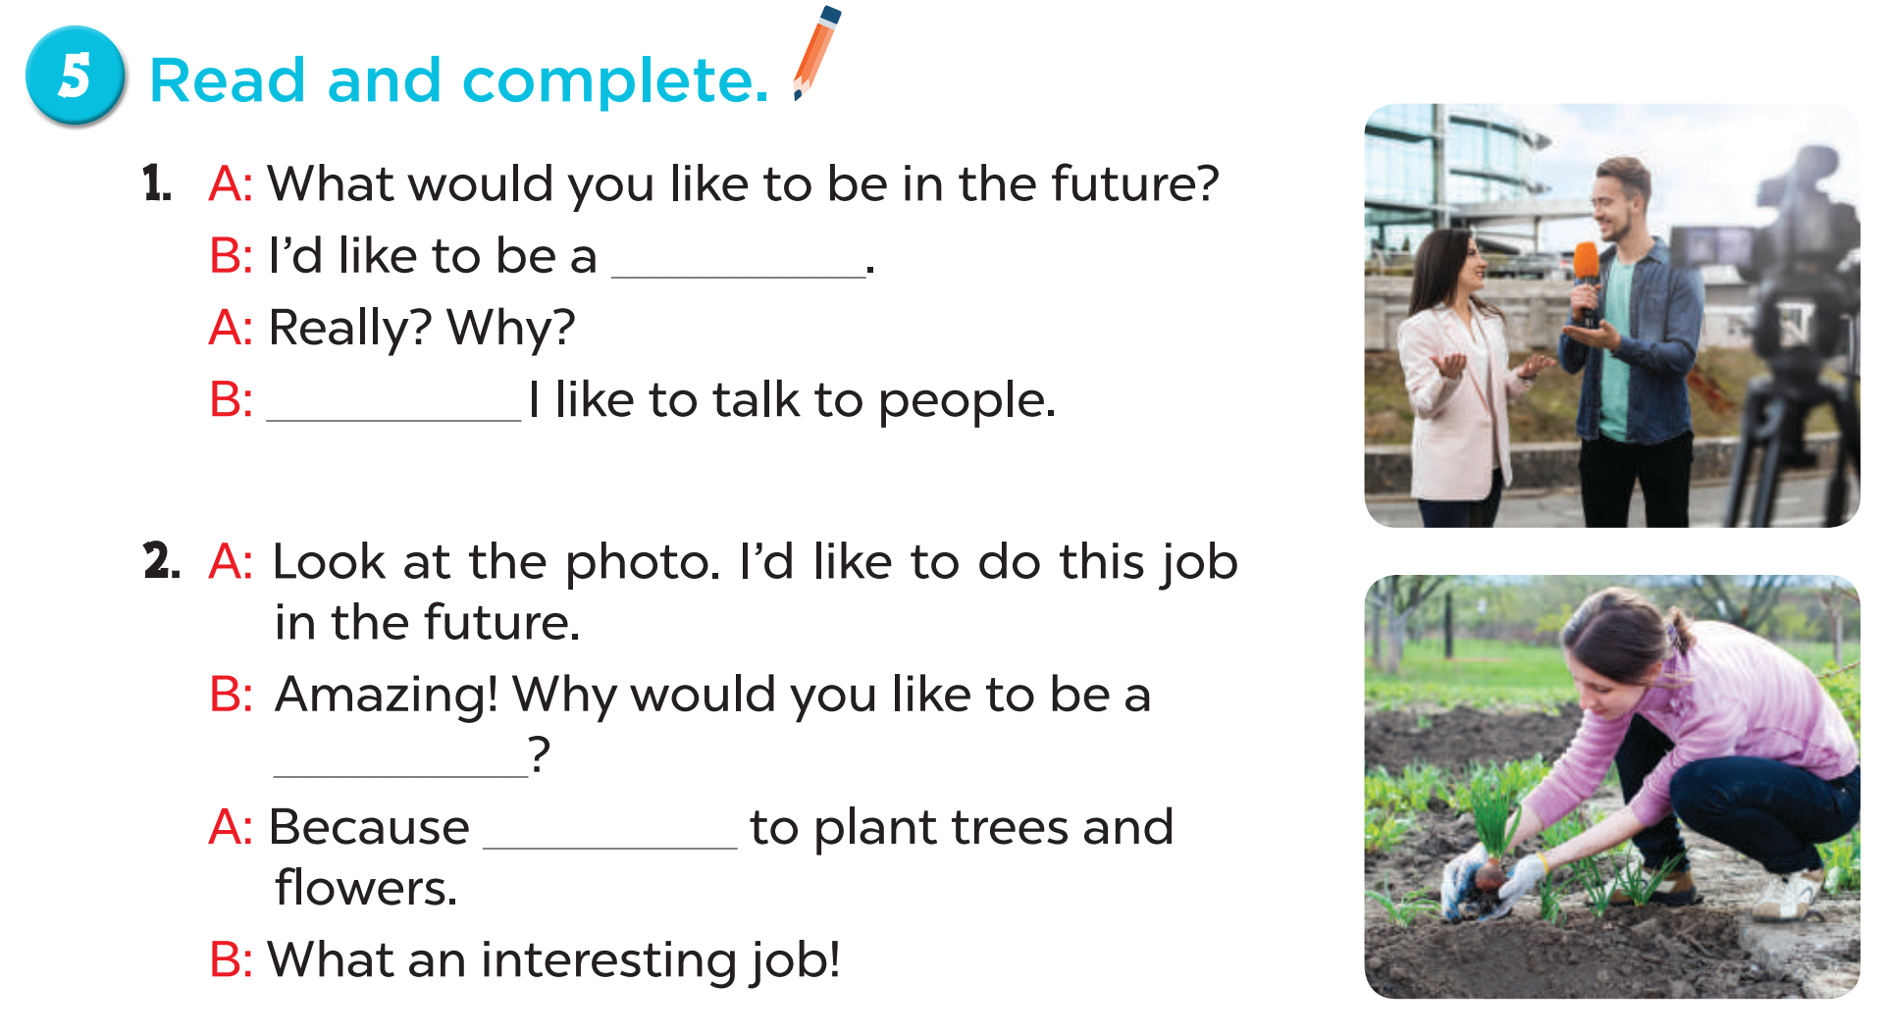
reporter
Because
gardener
I’d like

Slide 10
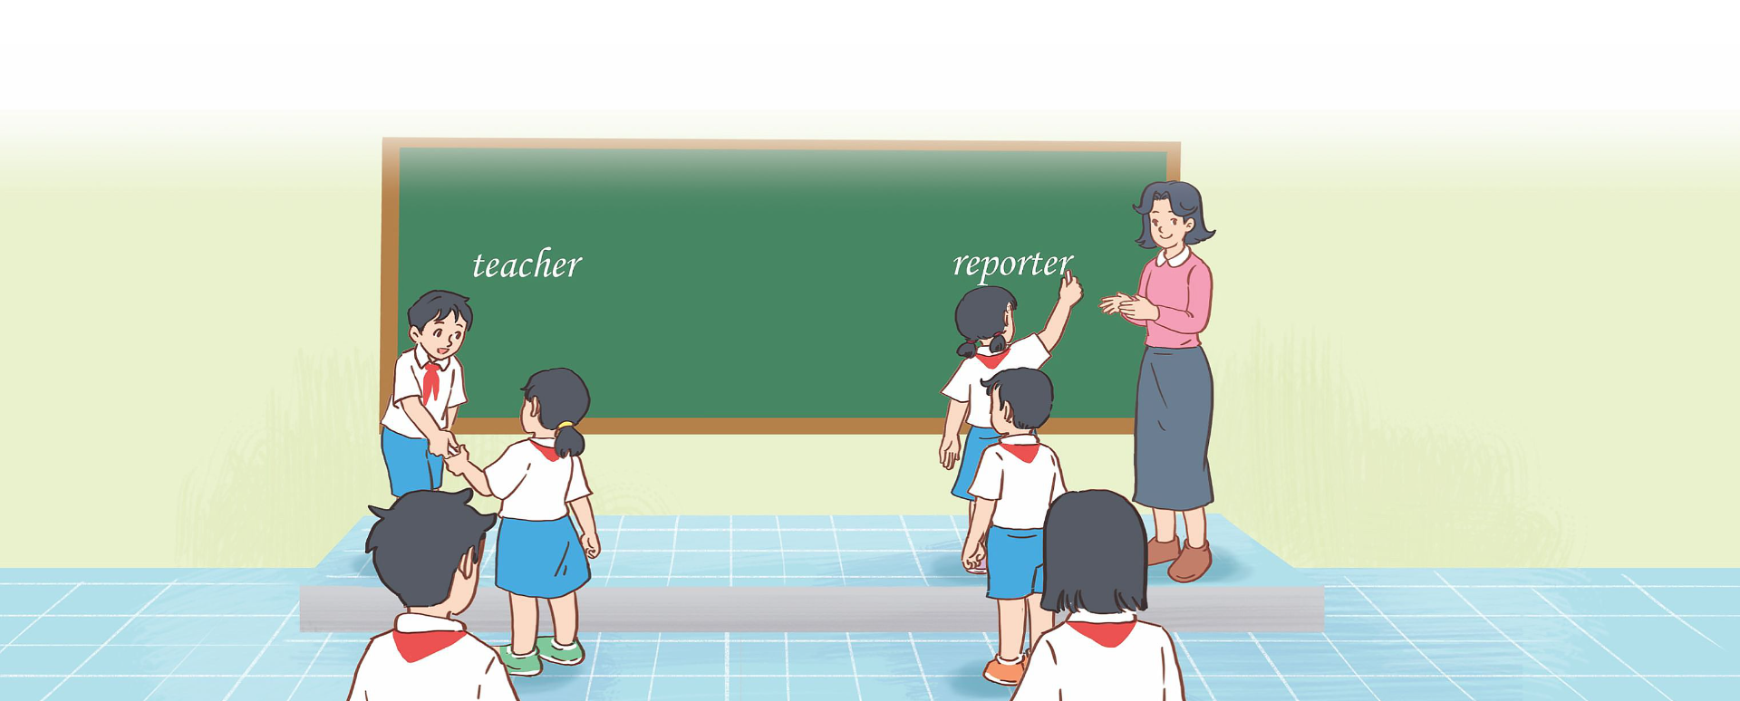
6. Let’s play.
Jobs word bank

