Slide 1

WELCOME TO OUR CLASS

Slide 2
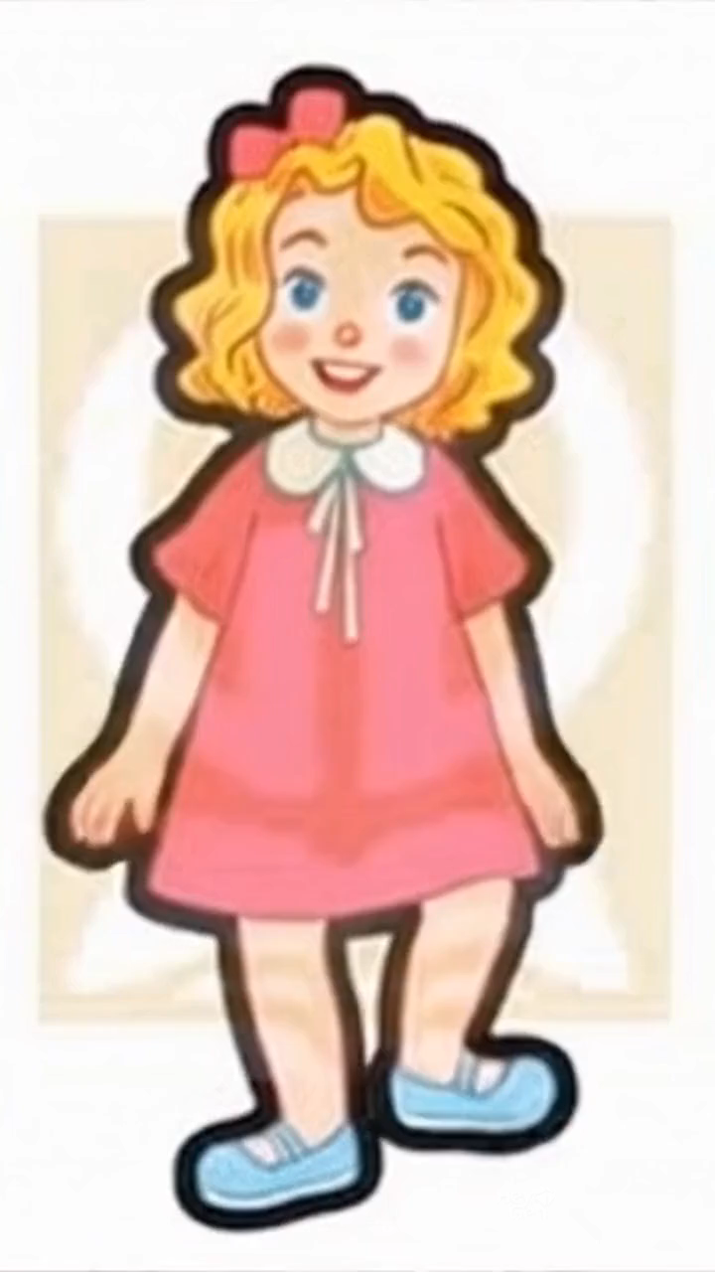

Slide 3


Slide 4



Things we can do
5
LESSON 1: 1,2,3

Slide 5
Games

Slide 6
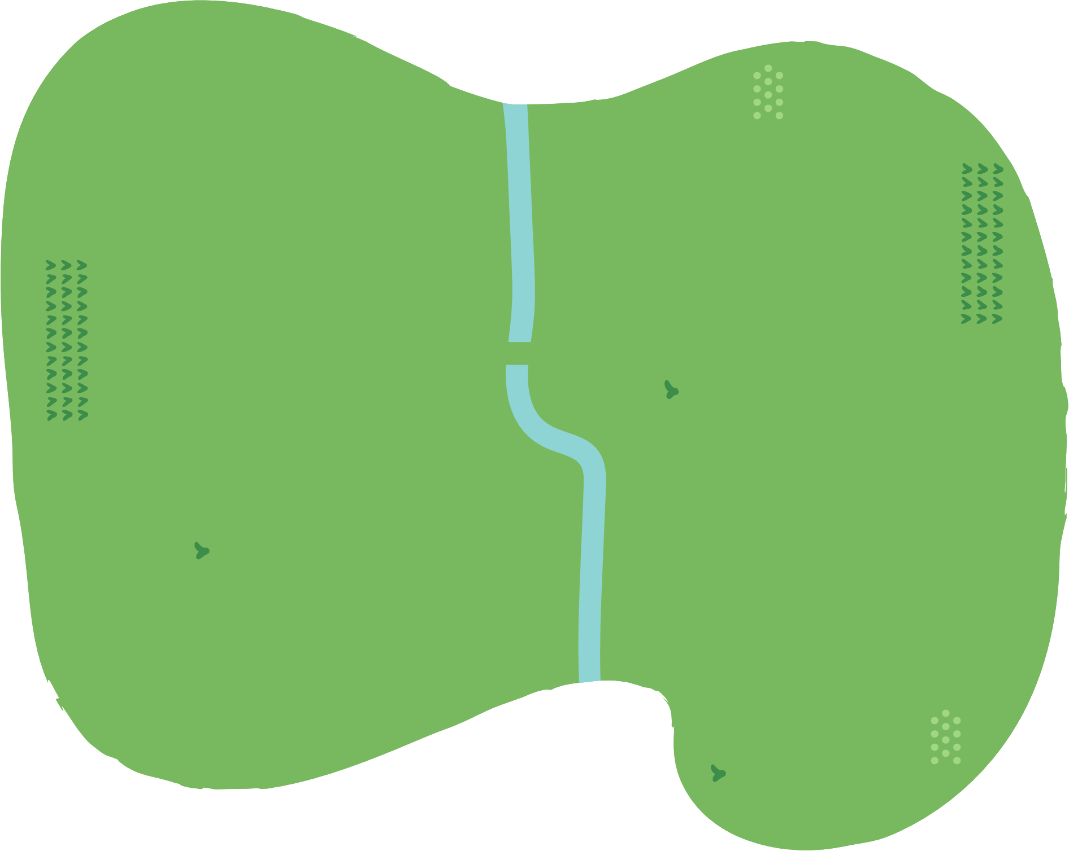


























Slide 7
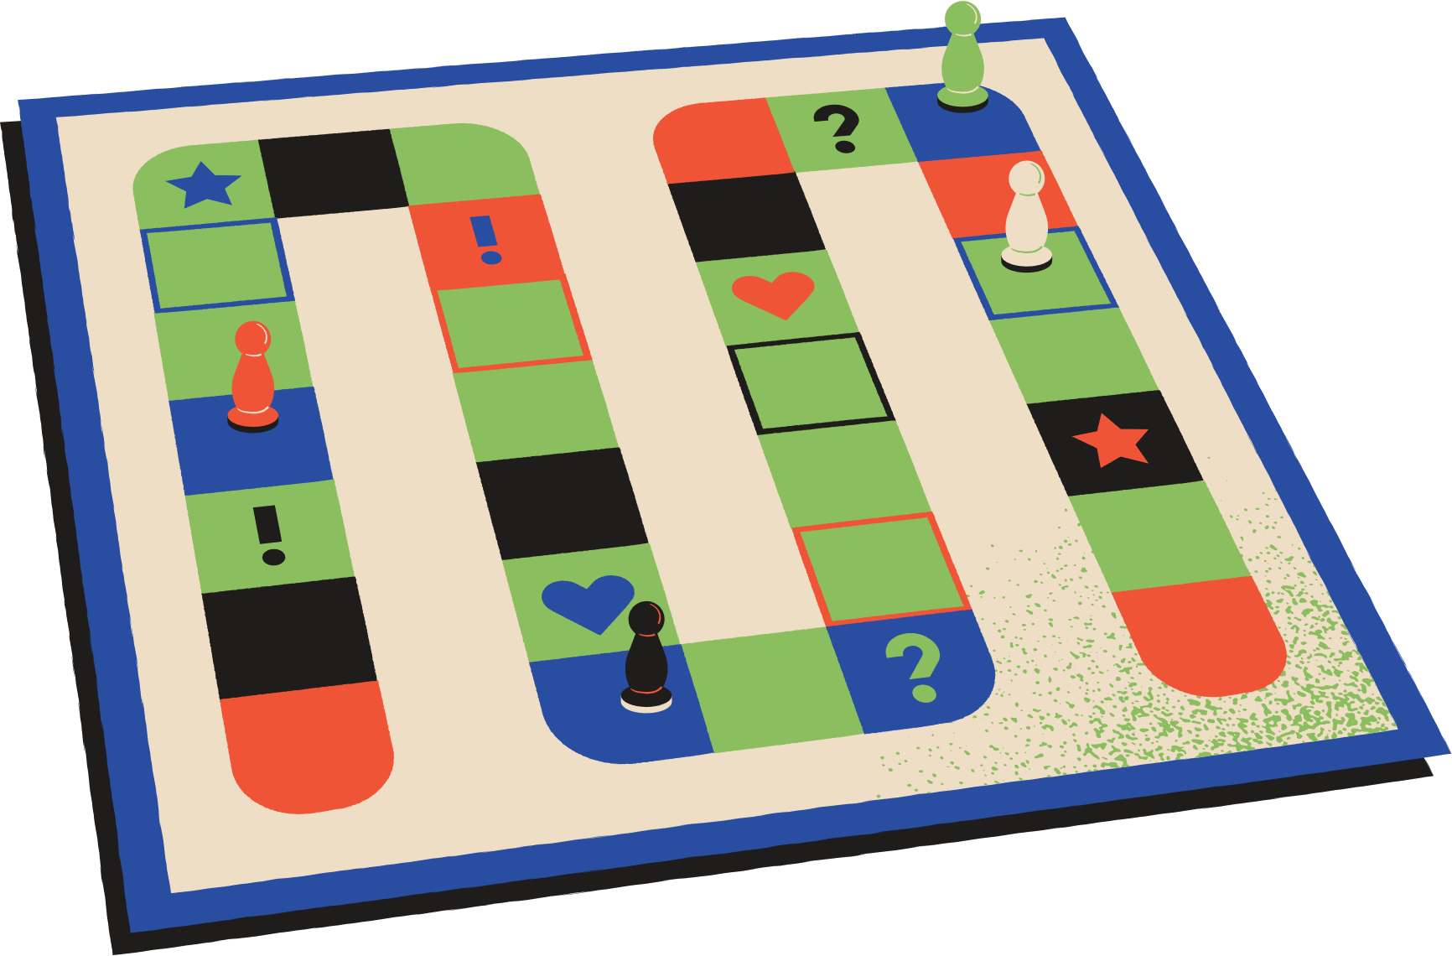




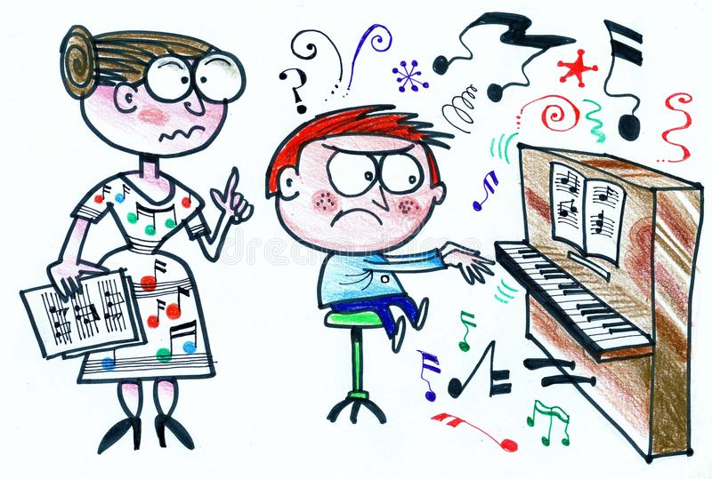

Can you play the piano?
Insert one question here
No, I can’t.

Slide 8
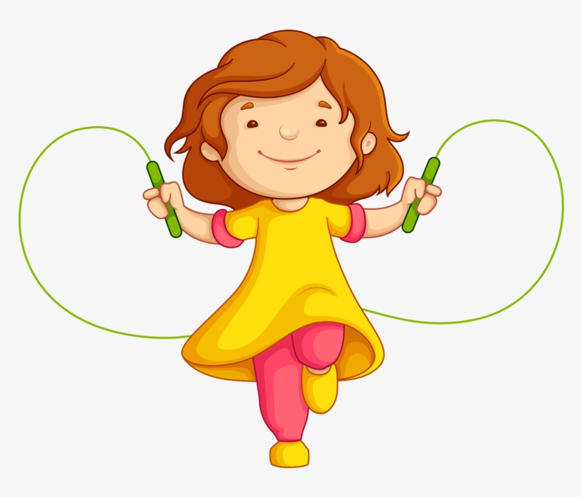
Can you skip?
Insert one question here
Insert one question here
Insert one question here
Yes, I can.

Slide 9
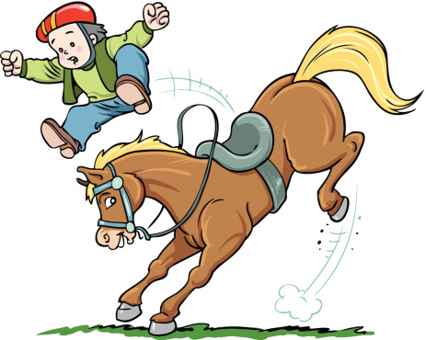
Can you ride a horse?
Insert one question here
Insert one question here
Insert one question here
No, I can’t.

Slide 10
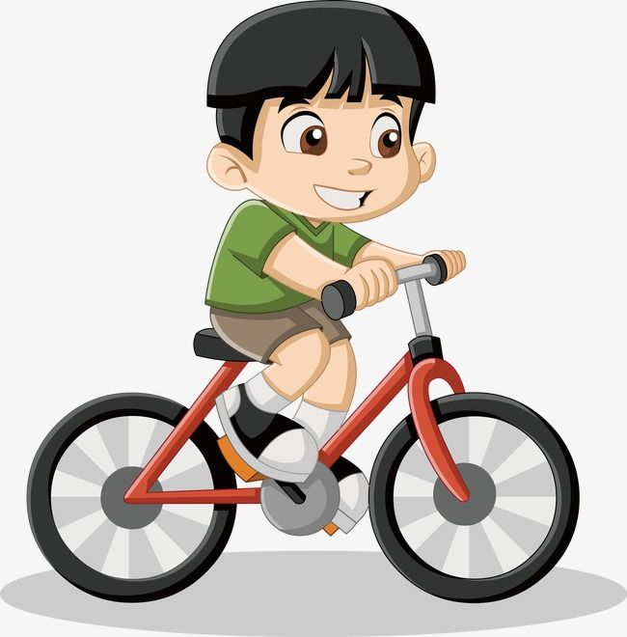
Can you ride a bike?
Insert one question here
Insert one question here
Insert one question here
Yes, I can.

Slide 11



Slide 12

Goodbye !

