Slide 1
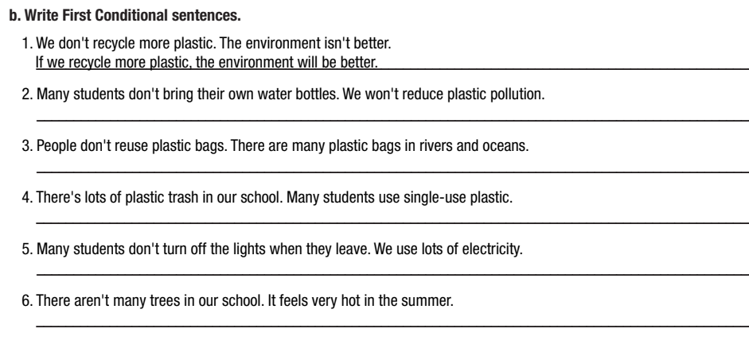

Slide 2
More Practice
WB, P. 45
b. Write First Conditional sentences.
2. Many students don't bring their own water bottles. We won't reduce plastic pollution.
→
If students bring their own water bottles, we will reduce plastic pollution
3. People don't reuse plastic bags. There are many plastic bags in rivers and oceans. →
If people reuse plastic bags, there will be fewer plastic bags in rivers and oceans./there won't be many plastic bags in rivers and oceans.
Notes:
Taken from TA 10 i-Learn Smart World WB, page 45, activity b

Slide 3
More Practice
WB, P. 45
b. Write First Conditional sentences.
4. There's lots of plastic trash in our school. Many students use single-use plastic.
→
If students stop using single-use plastic, there will be less plastic trash in our school./there won't be much plastic trash in our school.
5. Many students don't turn off the lights when they leave. We use lots of electricity. →
If students turn off the lights when they leave, we will use less/save electricity./we won't use much electricity
Notes:
Taken from TA 10 i-Learn Smart World WB, page 45, activity b

Slide 4
More Practice
WB, P. 45
b. Write First Conditional sentences.
6. There aren't many trees in our school. It feels very hot in the summer.
→
If there are more trees in our school,/If we plant more trees in our school, it won’t feel very hot in the summer.
Notes:
Taken from TA 10 i-Learn Smart World WB, page 45, activity b

Slide 5
UNIT 8: ECOLOGY AND THE ENVIRONMENT
Lesson 1.3 – Pronunciation & Speaking
Page 66

Slide 6
By the end of this lesson,
students will be able to:
practice Intonation for the First conditional sentences.
talk about making the school green.
develop environmentally-friendly awareness.

Slide 7
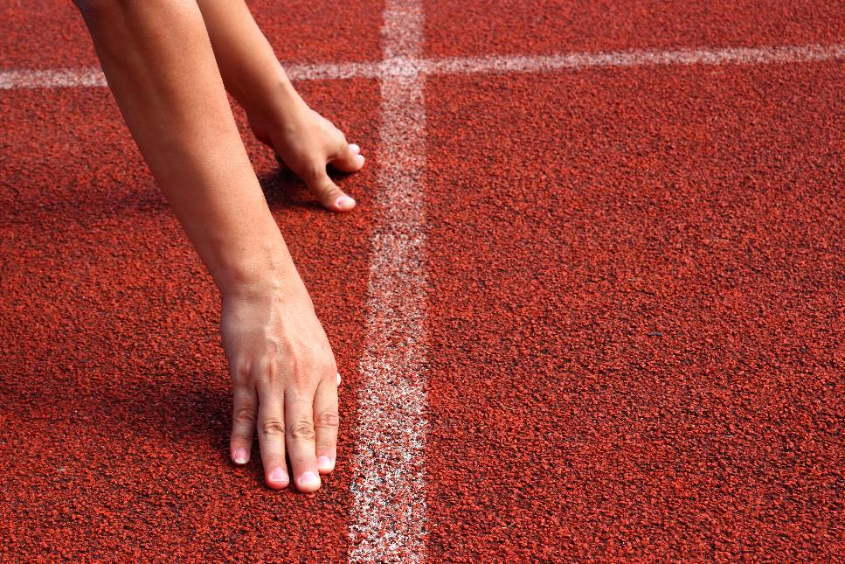

Slide 8
Choose the word whose main stress is placed
differently from the others.
Work in pairs.
A. Mercury B. telescope C. recycle D. heritage
2. A. measure B. rocket C. cable D. delay
3. A. thermometer B. registration C. interaction D. education
/ˈmɜ:kjəri/
/ˈteləskoʊp/
/ˌri:ˈsaɪkəl/
/ˈherɪtɪdʒ/
/ˈmeʒə/
/ˈrɑ:kɪt/
/ˈkeɪbəl/
/dɪˈleɪ/
/θəˈmɑ:mətə/
/ˌredʒəˈstreɪʃən/
/ˌɪntəˈrækʃən/
/ˌedʒəˈkeɪʃən/

Slide 9
Work in pairs.
Choose the word whose underlined part is
pronounced differently from that of the other words.
A. affect B. release C. become D. deny
2. A. sick B. nice C. tight D. kind
3. A. vehicle B. handwriting C. humorist D. habitant
/əˈfekt/
/rɪˈli:s/
/bɪˈkʌm/
/dɪˈnaɪ/
/sɪk/
/naɪs/
/taɪt/
/kaɪnd/
/ˈvi:əkəl/
/ˈhændˌraɪtɪŋ/
/ˈhju:mərɪst/
/ˈhæbɪtənt/

Slide 10
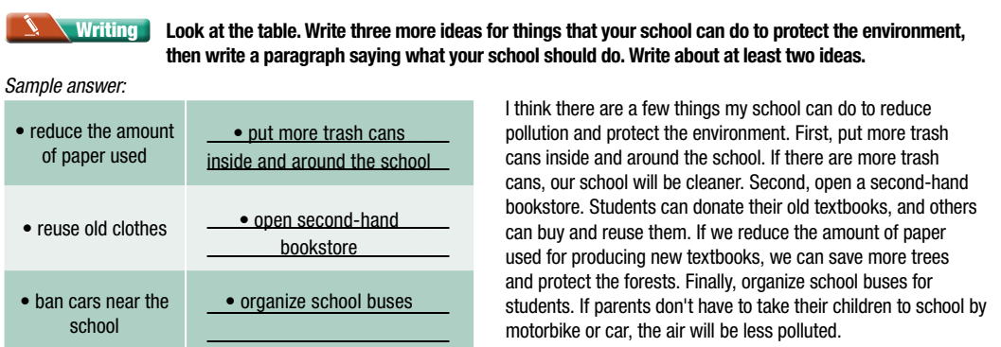
Checking homework
Suggested answers/ product
Notes:
Choose some student’s products to stick on the board, ask the others to move around to read and give comments (check the grammar mistakes related to the first conditional sentence)

Slide 11
Listen to the sentence and notice how the intonation change
If we use electric hand dryers, we will save tissues

Slide 12
Read that sentences with the correct intonation to a partner

Slide 13
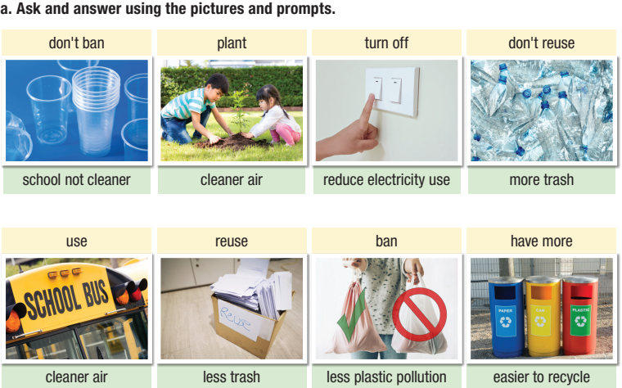

Slide 14
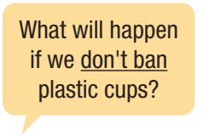
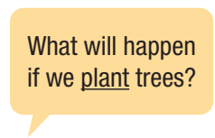
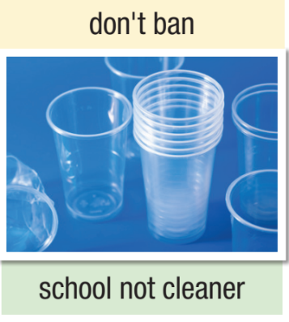
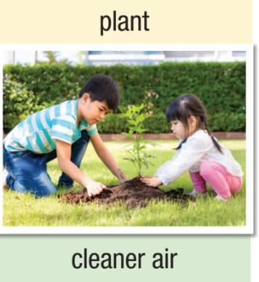
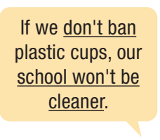
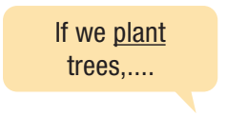
Example:

Slide 15
turn off the light when going out
save electricity
plan trees
clean the air

Slide 16
Suggested conversation
A: Do you have any ideas for our presentation?
B: We should put recycling bins around our school.
A: Why?
B: If we put recycling bins around our school, we’ll reduce trash.
A: What else can we do?
B: We should turn off the light when we go out.
A: Yes, If we turn off the light when we go out, we can save electricity.
B: And we can plan more trees in our school garden.
A: That’s a good ideas. The air will be cleaner if we plan more trees in our school garden.

Slide 17
Post Speaking
Suggested presentation

Slide 18
Consolidation

Slide 19
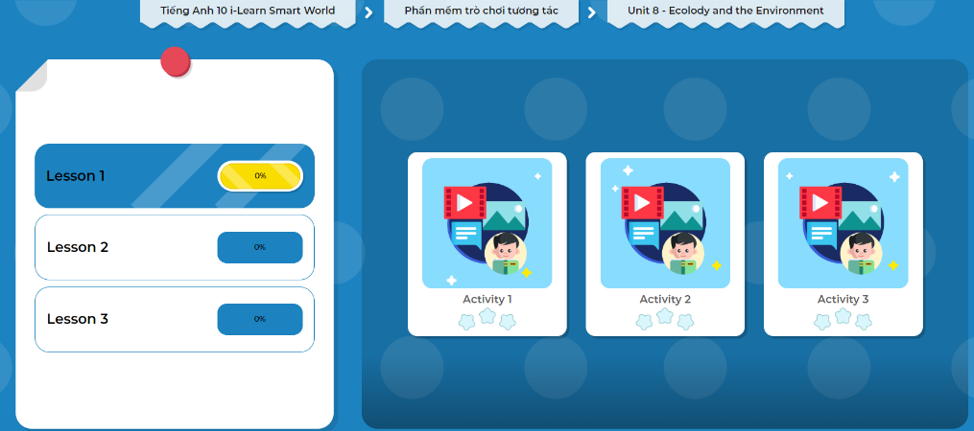
Let’s Play!
Click here to play the games

Slide 20
Today’s lesson
Wrap-up
Pronunciation: falling at the end of the clauses
Speaking: Presentation about to protect the environment in your school

Slide 21
- Make a short clip to advise your friends to make your school greener.
Prepare the next lesson: Lesson 2.1 Reading, (page 67).
Play the consolidation games in Tiếng Anh 10 i-Learn Smart World DHA App on www.eduhome.com.vn

