Slide 1
UNIT 7: INVENTIONS
Lesson 2.2 – Grammar
Page 60

Slide 2
By the end of this lesson,
students will be able to …
practice and use defining relative clause correctly.

Slide 4
Quiz
Who invented the light bulb?
Thomas Edison.
Who invented the fridge in 1835?
Jacob Perkins.
Which was invented in 1885 by John Starley?
The modern bicycle.

Slide 5
PRESENTATION
Defining relative clause

Slide 6
Lead in:
Thomas is the person who invented the light bulb.
Jacob Perkins is the person who invented the fridge in 1835.
The modern bicycle is the thing which was invented in 1885
by John Starley.
Defining relative clause

Slide 7
Defining relative clause
We use defining relative clauses to give important information about a person or thing. This is the karaoke machine which I bought in Japan.

Slide 8
We usually start the defining clause with a relative pronoun: who or that (for people), which or that (for things), or where (for places). That is less formal than who or which. We do not use commas to separate the defining clause from the rest of the sentence.

Slide 9
Example
This invention is for people who want to save time when they travel to school. You can use this invention in the mountains where there isn't any electricity. This invention is something that will help a lot of people.

Slide 10
PRACTICE

Slide 11
b. Fill in the blanks with who, which, that, or where.
1. The grocery hoody is for people ________ don't buy many things and don't want to get a cart.
who/that
which/that
2. They're umbrellas ________ are attached to your shoes so your shoes don't get wet.
3. You can use it in your garden ________ there are lots of bugs.
where

Slide 12
4. It's for people ________ like to read but are tired of holding heavy books.
who/that
5. You can use it to make smoothies in places ________ there isn't electricity.
where
6. They're high heeled roller skates ________ let you skate while looking very fashionable.
which/that

Slide 13
7. The pet petter is a machine ___________ will automatically pet your dogs for you.
which/that
8. It's a portable table top __________ you can strap on your bike.
which/that

Slide 14
Extra Practice
WB, page 41
a. Fill in the blanks with the correct relative pronouns
1. People ______________ like hiking will find this invention very useful. 2. It's a tiny purse ______________ can be strapped to your arm. 3. It's an umbrella ______________ can follow you automatically, and you don't need to hold it.
4. Is this the store ______________ you bought that cool jacket? 5. People ______________ travel a lot can sleep comfortably with this special pillow. 6. This is a cooker ______________ is specially designed for cooking perfect eggs.
Notes:
Taken from TA 10 i-Learn Smart World WB, page 2

Slide 15
Extra Practice
WB, page 41
a. Fill in the blanks with the correct relative pronouns
1. People ______________ like hiking will find this invention very useful. 2. It's a tiny purse ______________ can be strapped to your arm. 3. It's an umbrella ______________ can follow you automatically, and you don't need to hold it.
who/that
which/that
which/that
Notes:
Taken from TA 10 i-Learn Smart World WB, page 2

Slide 16
Extra Practice
WB, page 41
4. Is this the store ______________ you bought that cool jacket? 5. People ______________ travel a lot can sleep comfortably with this special pillow. 6. This is a cooker ______________ is specially designed for cooking perfect eggs.
where
who/that
which/that

Slide 17
c. Combine sentences. Use the second sentence as a defining relative clause.
1. The invention is for busy people. It helps cook dinner.
The invention which helps cook dinner is for busy people.
2. The Fone-Fan is a small portable fan. You attach it to your phone.
The Fone-Fan is a small portable fan which/that you attach to your phone.

Slide 18
3. People will love this ice cream maker. They like to have ice cream on picnics.
People who/that like to have ice cream on picnics will love this ice cream maker.
4. We want to go to a beach and have a barbecue. Dogs are allowed on the beach.
We want to go to a beach where dogs are allowed and have a barbecue.
5. This cake-cutter is a special knife. It helps you cut perfect cake slices.
This cake-cutter is a special knife that/which helps you cut perfect cake slices.

Slide 19
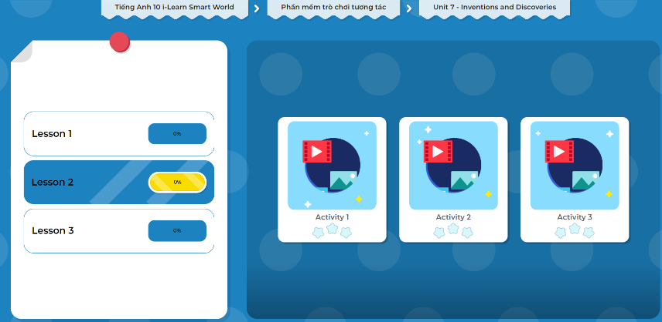
Extra Practice
DHA on Eduhome
Let’s Play!
Click here to play the games.

Slide 20
PRODUCTION

Slide 21
d. In pairs: Take turns making sentences about the things and people around you for your friend to guess.
This is the thing which you use to get information.
It’s a computer.
It’s a teacher.
This is the person who teaches you.

Slide 22
CONSOLIDATION

Slide 23
b. Combine the sentences using defining relative clauses.
1. The noodle fan is a portable fan. It can be attached to chopsticks to cool noodles for you.
2. This invention is a cup. The cup has a phone holder built into its lid.
The noodle fan is a portable fan that/which can be attached to chopsticks to cool noodles for you.
This invention is a cup which/that has a phone holder built into its lid.
Extra Practice
WB, page 41

Slide 24
3. The sleeping hoody is a special hoody. It can be turned to a pillow.
4. People will love this invention. They like to walk on grass.
5. You can use the napping pillow in the office. There isn't room to lay down in the office.
The sleeping hoody is a special hoody which/that can be turned to a pillow.
People who like to walk on grass will love this invention.
You can use the napping pillow in the office where there isn't room to lay down.
Extra Practice
WB, page 41

Slide 25
Consolidation

Slide 26
Extra Practice
DHA on Eduhome
Let’s Play!
Click here to play the games.

Slide 27
WRAP-UP

Slide 28
Today’s lesson
Grammar: Defining relative clause
Speaking: Practice asking and answering about things and people around using Defining relative clause

Slide 29
Practice making sentences using Defining relative clause
Do the exercises in WB on page 41 (Writing ).
Complete the grammar notes in Tiếng Anh 10 i-Learn Smart World Notebook on page 41.
Prepare the next lesson - Pronunciation & Speaking on page 61 in SB.
Play the consolidation games in Tiếng Anh 10 i-Learn Smart World DHA App on www.eduhome.com.vn

