Slide 1

UNIT 4: INTERNATIONAL ORGANIZATIONS AND CHARITIES
Lesson 2.1 – Vocabulary & Reading
Page 33

Slide 2

By the end of this lesson,
students will be able to …
- practice and learn vocabulary related to charity.
- practice reading for gist and specific information.

Slide 3
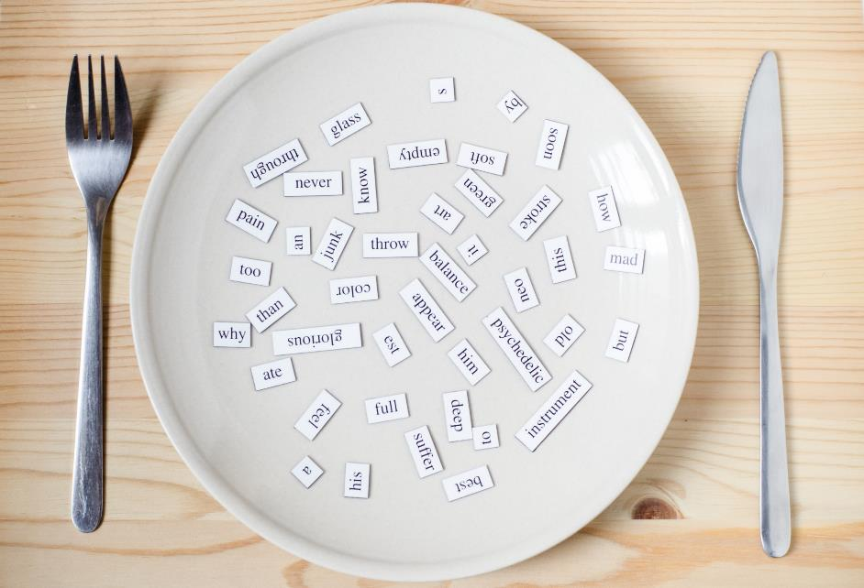
New words
organize
awareness
set up
conservation
aim

Slide 4



Slide 5

Work in pairs.
Can you name any international organizations or charities? What do they do?
- WHO (World Health Organization). It promotes health, keeps the world safe.
- …

Slide 6
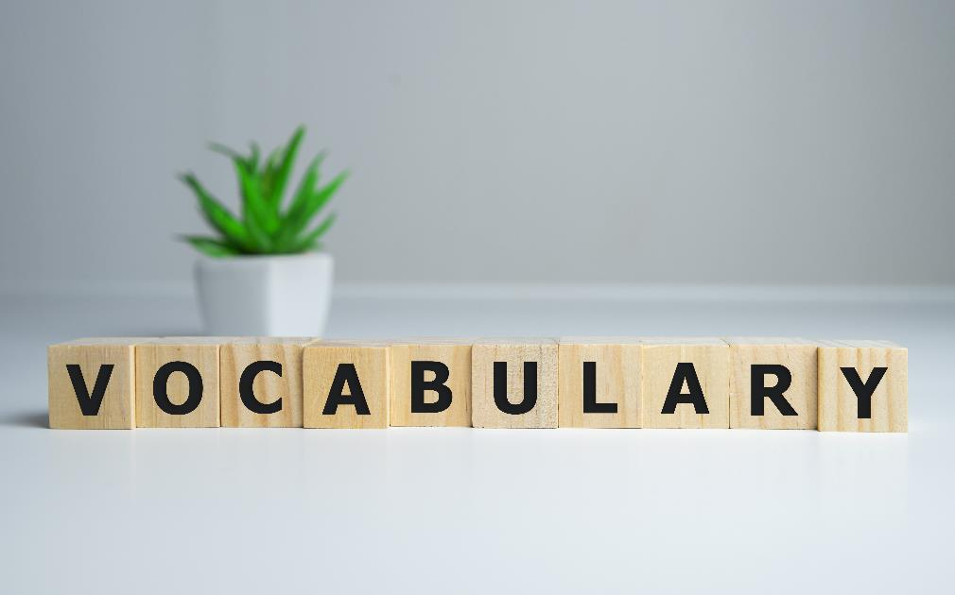


Slide 7

Listen and repeat. Click each phrase to hear the sound
organize (v) /ˈɔːrɡənaɪz/ tổ chức
awareness (n) /əˈwernəs/ sự nhận thức
set up (v) /set ʌp/ thành lập
conservation (n) /kɑːnsərˈveɪʃn/ sự giữ gìn, sự bảo tồn
aim (n) / eɪm / mục đích, mục tiêu
Notes:
GV click vào từng cụm nghe âm thanh

Slide 8

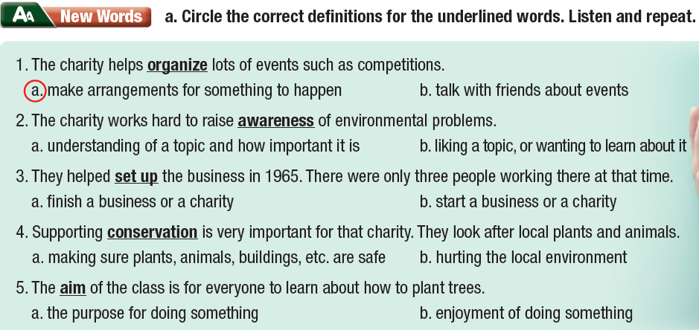

Slide 9
b. Fill in the blanks with the words from Task a.
Our main _________ is to help children receive good education.
The charity works to raise ____________ of the importance of a healthy diet.
According to our research, ___________ efforts have helped increase the number of turtles by 20% since 2009.
We helped Ms. Jones to __________ her business back in 2004.
We're going to ____________ an event to raise money for the charity.
aim
+ N
+ N / Adj
+ V
+ V

Slide 10
b. Fill in the blanks with the words from Task a.
Our main _________ is to help children receive good education.
The charity works to raise ____________ of the importance of a healthy diet.
According to our research, ___________ efforts have helped increase the number of turtles by 20% since 2009.
We helped Ms. Jones to __________ her business back in 2004.
We're going to ____________ an event to raise money for the charity.
aim
awareness
conservation
set up
organize

Slide 11



Slide 12
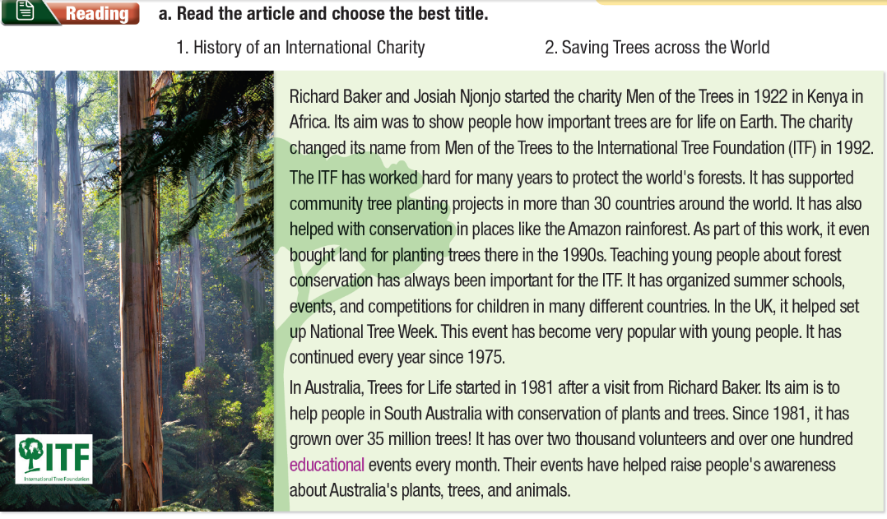

Slide 13

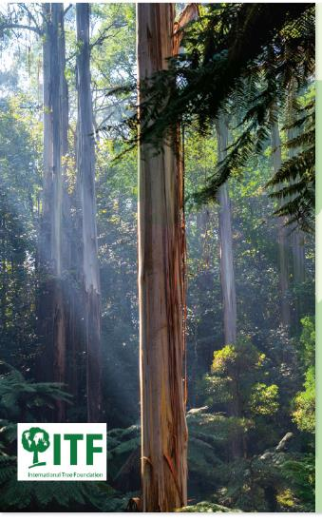
Richard Baker and Josiah Njonjo started the charity Men of the Trees in 1922 in Kenya in Africa. Its aim was to show people how important trees are for life on Earth. The charity changed its name from Men of the Trees to the International Tree Foundation (ITF) in 1992.

Slide 14
The ITF has worked hard for many years to protect the world's forests. It has supported community tree planting projects in more than 30 countries around the world. It has also helped with conservation in places like the Amazon rainforest. As part of this work, it even bought land for planting trees there in the 1990s. Teaching young people about forest conservation has always been important for the ITF. It has organized summer schools, events, and competitions for children in many different countries. In the UK, it helped set up National Tree Week. This event has become very popular with young people. It has continued every year since 1975.

Slide 15
In Australia, Trees for Life started in 1981 after a visit from Richard Baker. Its aim is to help people in South Australia with conservation of plants and trees. Since 1981, it has grown over 35 million trees! It has over two thousand volunteers and over one hundred educational events every month. Their events have helped raise people's awareness about Australia's plants, trees, and animals.

Slide 16
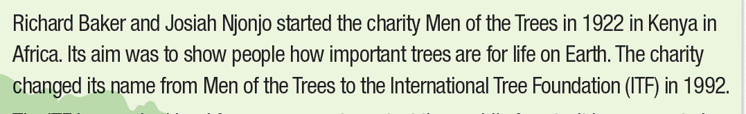
Pre-reading
Teaching notes: Reading for general information: SKIMMING
Skimming is reading rapidly in order to get a general overview of the material.
Part a. Choose the title of the text → Skim for the main idea.
Read the first part of the article, underline the keywords and choose the best title for the text.

Slide 17
Pre-reading
Teaching notes: Reading for specific information: SCANNING
Scanning is reading a text quickly in order to find specific information, e.g. figures or names.
Tips: Read the questions, underline keywords and guess what kind of information is asked.
Ex: Question 1. asks about the year.
Key word: “Men of the Trees”, “new name”, “1992”
Related sentence in the article:
The charity changed its name from Men of the Trees to the International Tree Foundation (ITF) in 1992.
The correct choice is b. 1992
Do the same with other questions.

Slide 18
While-reading
a. Read the article and choose the best title.
History of an International Charity
Saving Trees across the World

Slide 19
b. Now, read and circle the answers.
Men of the Trees was given a new name in...
a. 1975 b. 1981 c. 1992
The ITF has helped to protect trees in...
a. the Amazon b. Kenya c. Australia
National Tree Week started in…
a. 1981 b. the 1990s c. 1975
Trees for Life has grown...
a. two thousand trees. b. over one hundred trees.
c. 35 million trees.

Slide 20
Extra Practice
WB, page 40
The Howard Hughes Medical Institute (HHMI) is one of the biggest charities in the world. It was set up by Howard Hughes in 1953. He was a famous and successful businessman, pilot, engineer, and film director.

Slide 21
HHMI is a health charity. Its aim is to promote human knowledge of science, especially biology and medicine. Their main research program, called Investigators, chooses scientists they believe can make a difference and support them. Every year, they organize a competition, and the winners will receive money for their research for seven years. Through their research, HHMI scientists have increased our understanding of our body. HHMI has also provided money for other scientists' research at universities and hospitals. It has spent 653 million dollars on supporting research and since 1978, more than 30 scientists whom HHMI supported have won the Nobel Prize.

Slide 22
The institute also works to bring science knowledge to everyone. It provides free resources for teachers and students on its website and gives scholarships to both students and professors. It has spent more than 66 million dollars to support science education. To make science more interesting to the public, the institute has worked with filmmakers to create science films that bring science to life. One of its movies won the Emmy Award for Outstanding Science and Technology Documentary in 2018.

Slide 23
The Howard Hughes Medical Institute (HHMI)...
1. helps scientists make discoveries in biology and medicine.
2. researches new medicines for diseases.
3. makes science more accessible to everyone.
4. builds a network of the best scientists.

Slide 24

Work in pairs.
How can we stop people and companies from cutting down trees in our rainforests?
We can …
I think we should …
It’s good to …
It’s a good idea to …

Slide 25

Consolidation

Slide 26
Game: Guessing the words
Work in groups
Each student takes turn to describe/ give definition of a word in today’s lesson. The other will listen and guess the word.
Who can guess the most correct words will win the game.
The result you want to have when you do something.
Is it “AIM”?

Slide 27
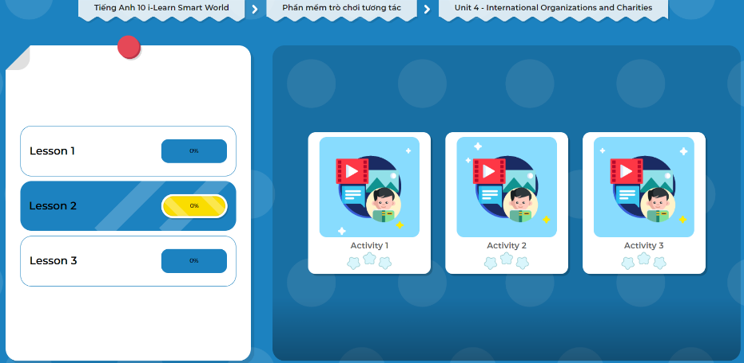
LET’S PLAY!
Click here to play the games.

Slide 28

WRAP-UP

Slide 29
Today’s lesson
Vocabulary: related to charities
Reading: for gist and specific information

Slide 30
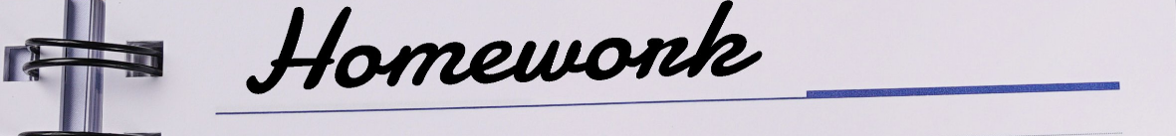
Learn by heart vocabularies and make sentences using them.
Do the exercises in WB on page 22
Do the exercises in Tiếng Anh 10 i-Learn Smart World Notebook ( page 22)
Prepare the next lesson - Grammar on page 34 in SB.

Slide 31
Work in pairs.
Check the answer with your partner.
A: What do you think “conservation” mean?
B: I think it means making sure plants, building and animals are safe.
A: Why?
B: Because I see the word “look after” in the next sentence.

Slide 32

b. In pairs: If you set up a charity, who or what will you help, and why?
I will set up a charity to help animals. There are lots of stray dogs in my town.

Slide 34
