Slide 2
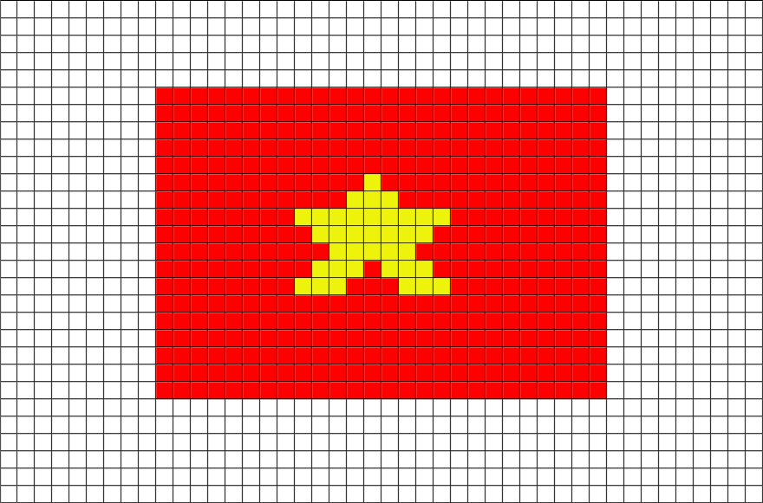
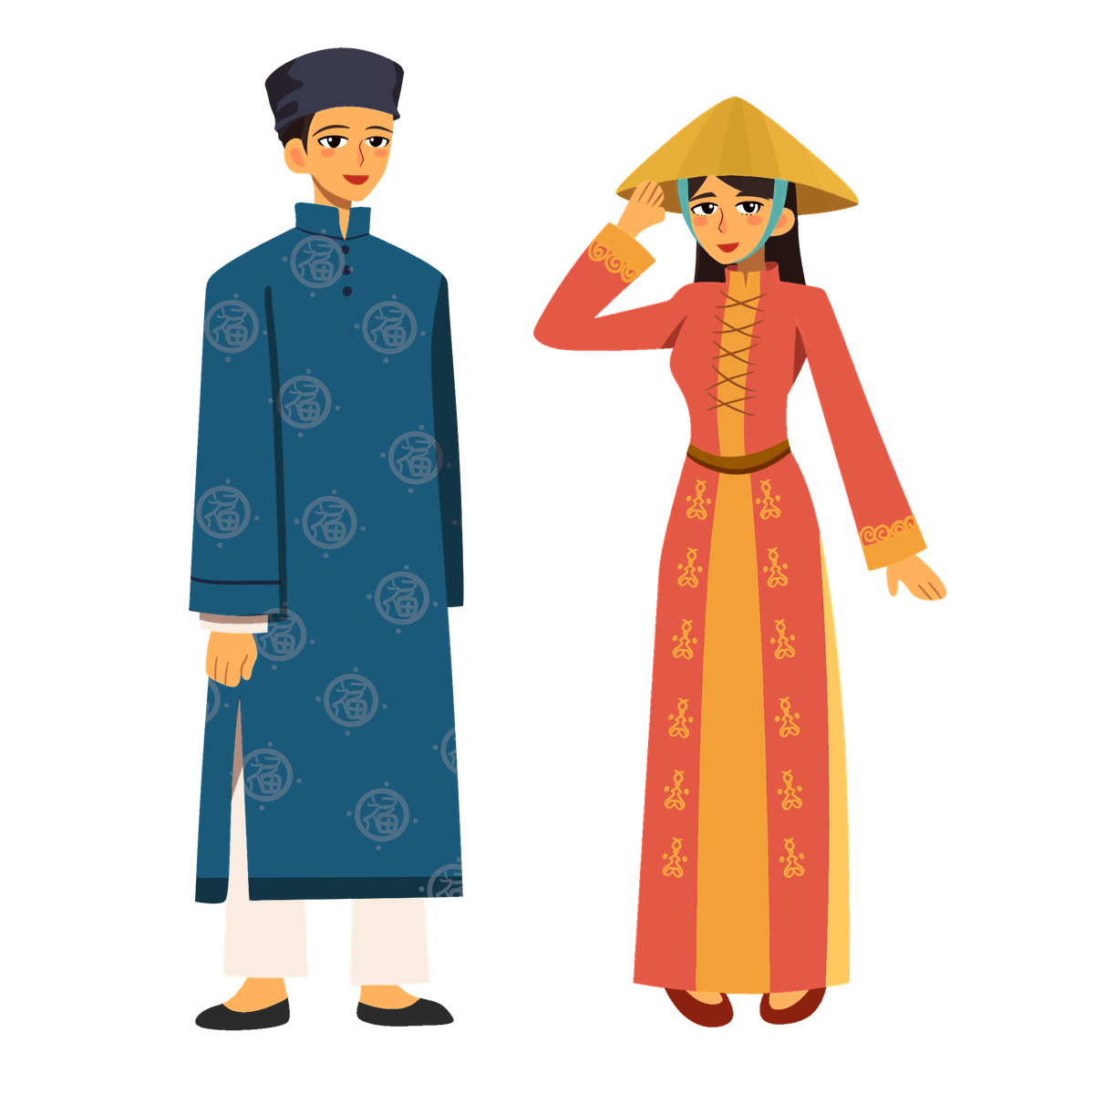
Unit
6
VIETNAMESE LIFESTYLE:
THEN AND NOW
LESSON 6: SKILLS 2

Slide 3
LESSON 6: SKILLS 2
LESSON 1: GETTING STARTED
WARM-UP
Option 1: Brainstorm
Option 2: Family Tree Brainstorm
Task 1: You are going to listen to a talk about family life. Work in pairs. Choose the aspect(s) that you think will be mentioned in the talk.
Task 2: Listen to the talk and tick (√) the correct column.
Task 3: Listen again and fill in the blank with a word or number.
LISTENING
Task 4: Read the list and tick the thing(s) that has/have changed in your family in the past five years. Make notes of those which have changed.
Task 5: Write an email (100 - 120 words) to your penfriend about the changes in your family. Use the ideas in 4.
WRITING
CONSOLIDATION
Wrap-up
Homework

Slide 4
WARM-UP
OPTION 1
BRAINSTORMING

Slide 5
WARM-UP
OPTION 1
- List some aspects which you think are related to family life.
Examples:
Family Relationships, Family roles, ....
BRAINSTORMING

Slide 6
WARM-UP
OPTION 2
Family Tree Brainstorm

Slide 7
WARM-UP
OPTION 2
- Create a family tree diagram, starting with yourself as the center and extending outwards to include your parents, grandparents, siblings, ….
PETER
- Add details to each branch of their family tree, including names, relationships, occupations, memorable events, and any unique traditions or customs associated with your families.

Slide 8
WARM-UP
OPTION 2
Father: Ben
Age: 50
He has taught me many things.
Mother: Mary
Age: 45
She always takes care of me.
PETER
Brother: _______
Sister: _______
___________
___________

Slide 9
WARM-UP
OPTION 2
- How family dynamics and traditions have evolved over time, and how these changes have impacted your family life?

Slide 10
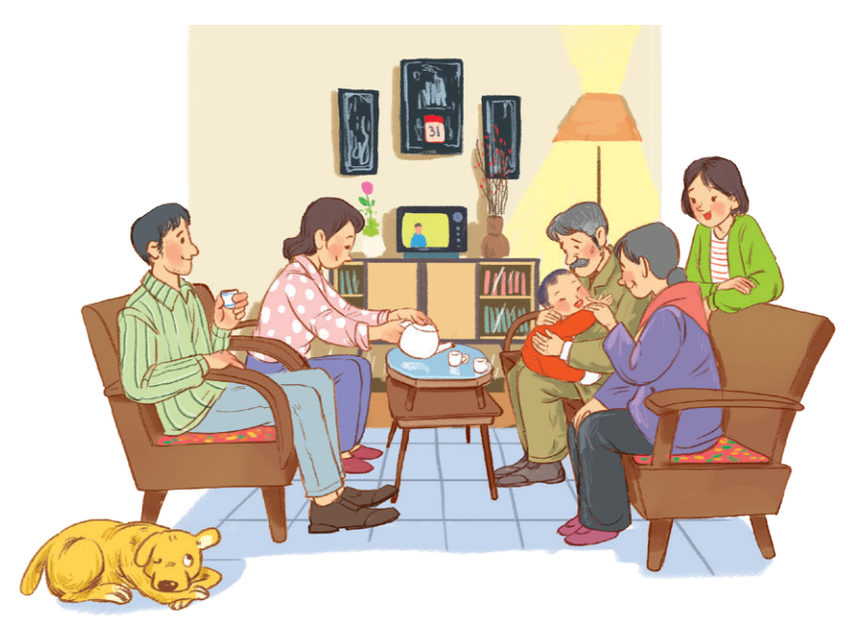
LISTENING
1
You are going to listen to a talk about family life. Work in pairs. Choose the aspect(s) that you think will be mentioned in the talk.
a. Family types
b. Parents’ working places
c. Family holidays
d. Birthday parties
e. Parents-children relations

Slide 11
LISTENING
2
Listen to the talk and tick (√) the correct column.
Facts | The past | The present
1. Popularity of extended families
2. More holidays away from home
3. More time spent doing things together
4. More sources to learn from
5. More democratic parent-children relationships

Slide 12
LISTENING
3
Listen again and fill in the blank with one word or number.
1. The speaker mentions _____ types of families.
two
three
2. In an extended family, there is / are _______ generation(s) living together.
3. The speaker describes Vietnamese people as ________________.
family-oriented
4. Children in the past usually came to their ________ to share their experiences.
elders
5. Today’s children want their parents to respect their independence and _________.
privacy

Slide 13
WRITING
4
Read the list and tick the thing(s) that has / have changed in your family in the past five years. Make notes of those which have changed.
List | Change
1. Family type / Members | Still nuclear. One more member: my brother
2. Home facilities
3. Ways of spending free time
4. Relationships among members
better, air conditioner, washing machines, ...
eat out, go on holiday, do chores, …
respect each other

Slide 14
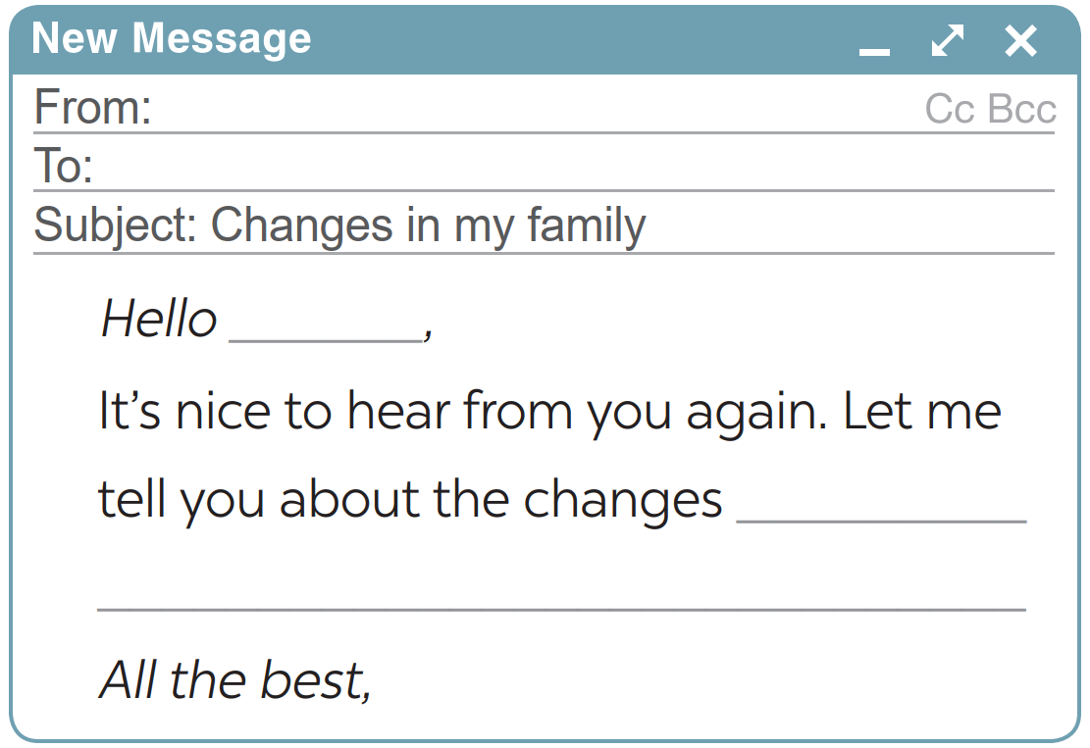
WRITING
5
Write an email (100 - 120 words) to your penfriend about the changes in your family. Use the ideas in 4.
From: Hoa
To: Tom
Subject: Changes in my family
Hello Tom,
It’s nice to hear from you again. Let me tell you about the changes in my family over the past five years. It’s still a nuclear family with two generations. But our living conditions are much better. Two years ago, my father found another job and he earns more money now. We now have an air conditioner and a washing machine. Sometimes we can eat out or go on holiday. My father also spends more time with my brother and me. He teaches us how to do the chores that adult men should be able to do. We act more like friends. My parents respect our independence and privacy. It’s good news, isn’t it?
All the best,
Hoa

Slide 15
From: Hoa
To: Tom
Subject: Changes in my family
Hello Tom,
It’s nice to hear from you again. Let me tell you about the changes in my family over the past five years. It’s still a nuclear family with two generations. But our living conditions are much better. Two years ago, my father found another job and he earns more money now. We now have an air conditioner and a washing machine. Sometimes we can eat out or go on holiday. My father also spends more time with my brother and me. He teaches us how to do the chores that adult men should be able to do. We act more like friends. My parents respect our independence and privacy. It’s good news, isn’t it?
All the best,
Hoa
5

Slide 16
EXTRA ACTIVITY
Write your opinion about the role of children nowadays in the family based on the following suggestions:
1. The number of children in a household.
2. The amount of housework they share with their parents.
3. The amount of time they spend on family activities.
4. How much they are obedient to / independent of their parents.
5. If they are obliged to take care of their parents when their parents get old.
5

Slide 17
EXTRA ACTIVITY
Nowadays families tend to have fewer children than in the past: just one or two per family. Therefore, parents have more time to take care of their children, resulting in their children doing less housework and having fewer responsibilities in the family. Most parents encourage their children to spend more time on their studies, so they may have less time with families. The internet is also a factor to distract children from engaging with family activities. Children become more independent. However, when their parents get old, most children are willing to take care of them.
5

Slide 18
CONSOLIDATION
1
Wrap-up
What have we learnt in this lesson?
Listen for general and specific information to talk about changes in family life;
Write about the changes in one’s family.Write about old school days.

Slide 19
CONSOLIDATION
2
Homework
- Rewrite the paragraph in the notebooks;
- Do exercises in the workbook.

Slide 20
Website: hoclieu.vn
Fanpage: facebook.com/tienganhglobalsuccess.vn/

