Slide 2

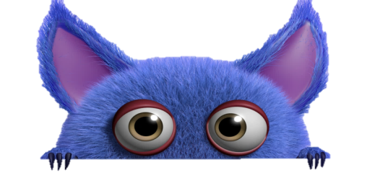


WARM - UP
book
School things

Slide 3
WARM - UP
book
rubber
ruler
School things
chalk
paper
pen
notebook
School bag

Slide 4
UNIT 1
English 6
MY NEW SCHOOL
LESSON 1:
GETTING STARTED

Slide 5
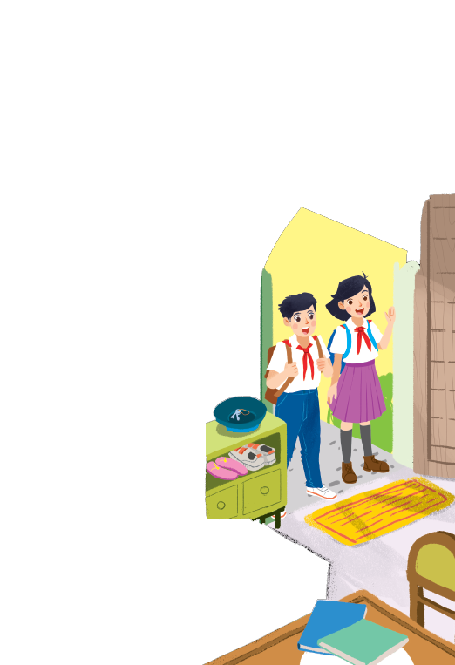
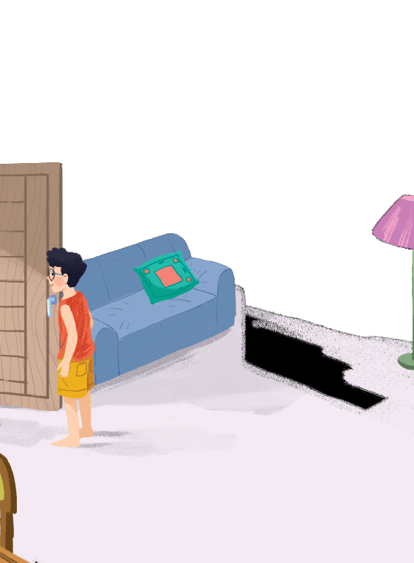




Listen and read.
A special day
Notes:
Thiếu tên bài đọc.

Slide 6
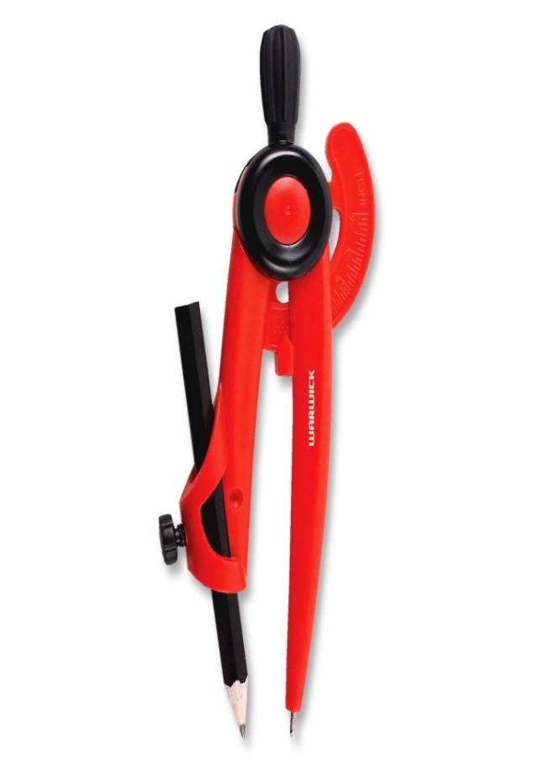
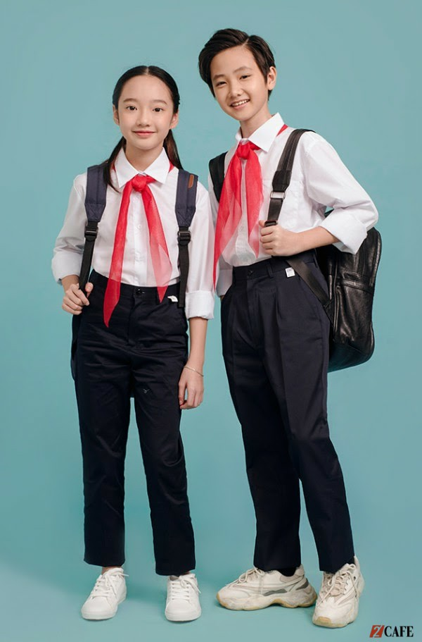
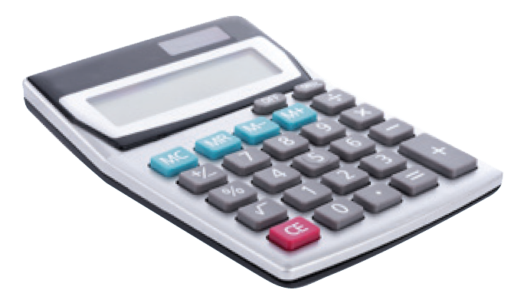
Listen and read.
A special day
* Vocabulary:
1. calculator (n): /ˈkæl.kjə.leɪ.tər/
máy tính
2. uniform (n) : /ˈjuː.nɪ.fɔːm/
đồng phục
3. smart (a) : /smɑːt/
gọn gàng, bảnh bao
4. put on >< take off ( phr .v ) :/ˈpʊt.ɒn/ ɔ:f/
mặc >< cởi
5. wear ( v ): /weər/
mặc , đội
6. compass (n) /ˈkʌm.pəs/
compa
7. heavy ( adj): /ˈhev.i/
nặng

Slide 7



Checking Vocabulary:
Rub out and remember
1. calculator (n):
2. uniform (n) :
3. smart (a) :
4. classmate (n)
5. wear ( v ):
6. compass (n)
7. heavy ( adj):
➲ đồng phục
➲ máy tính
➲ mặc , đội
➲ gọn gàng, bảnh bao
➲ Compa
➲ nặng
➲ bạn cùng lớp

Slide 8
(Loud knock)
A special day
Phong: Hi, Vy.
Vy: Hi, Phong. Are you ready?
Phong: Just a minute.
Vy: Oh, this is Duy, my new friend.
Phong: Hi, Duy. Nice to meet you.
Duy: Hi, Phong. I live near here, and we go to the same school!
Phong: Good. Hmm, your school bag looks heavy.
Duy: Yes! I have new books, and we have new subjects to study.
Phong: And a new uniform, Duy! You look smart!
Duy: Thanks, Phong. We always look smart in our uniforms.
Phong: Let me put on my uniform. Then we can go.

Slide 9

Read the conversation again and tick () T (True) or F (False).
 |  | T | F
1. | Vy, Phong, and Duy go to the same school.
2. | Duy is Phong’s friend.
3. | Phong says Duy looks smart in his uniform.
4. | They have new subjects to study
5. | Phong is wearing a school uniform.

Slide 10
Read the conversation again and tick () T (True) or F (False).
A special day
Phong: Hi, Vy.
Vy: Hi, Phong. Are you ready?
Phong: Just a minute.
Vy: Oh, this is Duy, my new friend.
Phong: Hi, Duy. Nice to meet you.
Duy: Hi, Phong. I live near here, and we go to the same school!
Phong: Good. Hmm, your school bag looks heavy.
Duy: Yes! I have new books, and we have new subjects to study.
Phong: And a new uniform, Duy! You look smart!
Duy: Thanks, Phong. We always look smart in our uniforms.
Phong: Let me put on my uniform. Then we can go.
1. Vie, Phong, and Duy go to the same school.
T

Slide 11
Read the conversation again and tick () T (True) or F (False).
A special day
Phong: Hi, Vy.
Vy: Hi, Phong. Are you ready?
Phong: Just a minute.
Vy: Oh, this is Duy, my new friend.
Phong: Hi, Duy. Nice to meet you.
Duy: Hi, Phong. I live near here, and we go to the same school!
Phong: Good. Hmm, your school bag looks heavy.
Duy: Yes! I have new books, and we have new subjects to study.
Phong: And a new uniform, Duy! You look smart!
Duy: Thanks, Phong. We always look smart in our uniforms.
Phong: Let me put on my uniform. Then we can go.
2. Duy is Phong’s friend.
F
Vy’s friend

Slide 12
Read the conversation again and tick () T (True) or F (False).
A special day
Phong: Hi, Vy.
Vy: Hi, Phong. Are you ready?
Phong: Just a minute.
Vy: Oh, this is Duy, my new friend.
Phong: Hi, Duy. Nice to meet you.
Duy: Hi, Phong. I live near here, and we go to the same school!
Phong: Good. Hmm, your school bag looks heavy.
Duy: Yes! I have new books, and we have new subjects to study.
Phong: And a new uniform, Duy! You look smart!
Duy: Thanks, Phong. We always look smart in our uniforms.
Phong: Let me put on my uniform. Then we can go.
3. Phong says Duy looks smart in his uniform.
T

Slide 13
Read the conversation again and tick () T (True) or F (False).
Phong: Hi, Vy.
Vy: Hi, Phong. Are you ready?
Phong: Just a minute.
Vy: Oh, this is Duy, my new friend.
Phong: Hi, Duy. Nice to meet you.
Duy: Hi, Phong. I live near here, and we go to the same school!
Phong: Good. Hmm, your school bag looks heavy.
Duy: Yes! I have new books, and we have new subjects to study.
Phong: And a new uniform, Duy! You look smart!
Duy: Thanks, Phong. We always look smart in our uniforms.
Phong: Let me put on my uniform. Then we can go.
4. They have new subjects to study
T

Slide 14
Read the conversation again and tick () T (True) or F (False).
Phong: Hi, Vy.
Vy: Hi, Phong. Are you ready?
Phong: Just a minute.
Vy: Oh, this is Duy, my new friend.
Phong: Hi, Duy. Nice to meet you.
Duy: Hi, Phong. I live near here, and we go to the same school!
Phong: Good. Hmm, your school bag looks heavy.
Duy: Yes! I have new books, and we have new subjects to study.
Phong: And a new uniform, Duy! You look smart!
Duy: Thanks, Phong. We always look smart in our uniforms.
Phong: Let me put on my uniform. Then we can go.
5. Phong is wearing a school uniform.
F

Slide 15
Read the conversation again and tick () T (True) or F (False).
 |  | T | F
1. | Vie, Phong, and Duy go to the same school.
2. | Duy is Phong’s friend.
3. | Phong says Duy looks smart in his uniform.
4. | They have new subjects to study
5. | Phong is wearing a school uniform.
✓
✓
✓
✓
✓

Slide 16

Write ONE word from the box in each gap.
go
subjects
has
wear
uniforms
wear
1.
Students their uniforms on Monday.
has
2.
Vy a new friend, Duy.
go
3.
- Do Phong, Vy, and Duy to the same school?
- Yes, they do.
4.
Students always look smart in their .
uniforms
5.
- What do you like to study?
subjects
- I like to study English and history.

Slide 17

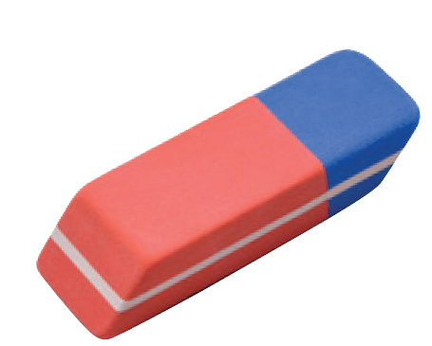
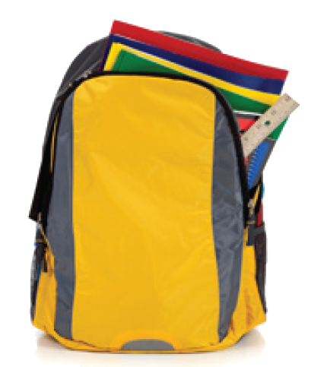
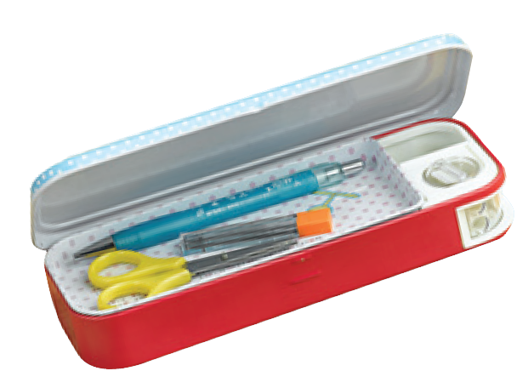
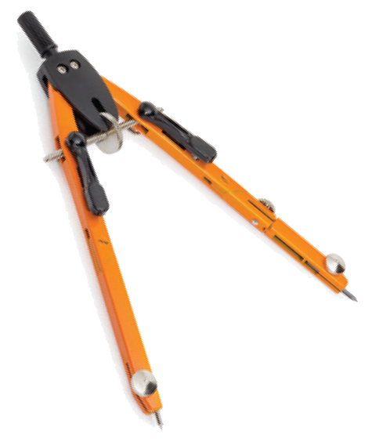
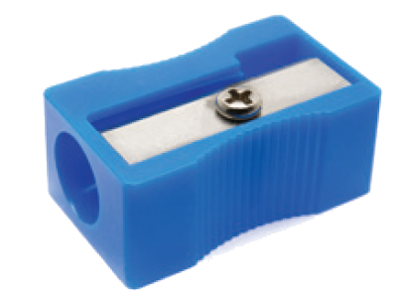
Match the word with the school things. Then listen and repeat.
1
4
pencil sharpener
compass
school bag
2
5
calculator
rubber
3
6
pencil case

Slide 18

Look around the class. Write the names of the things you see in your notebook.

Slide 19







Slide 20
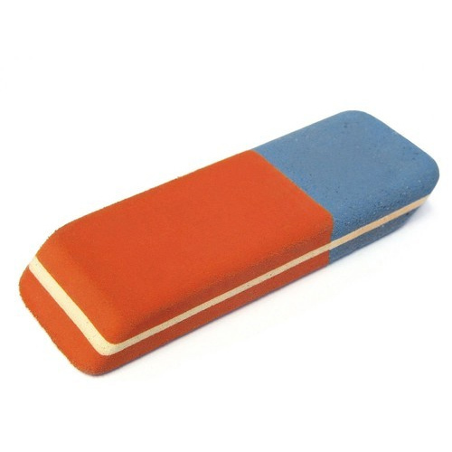

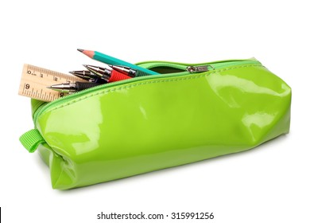
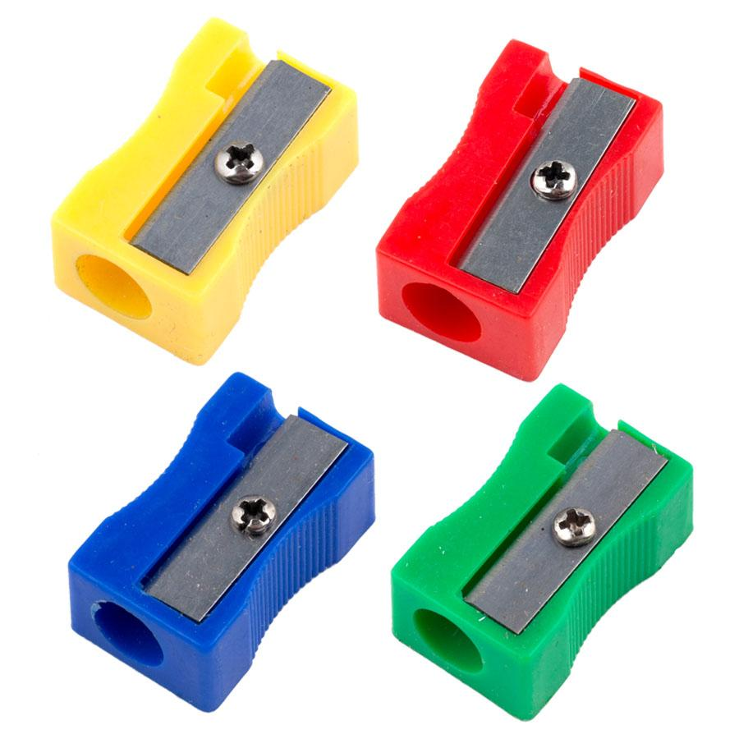
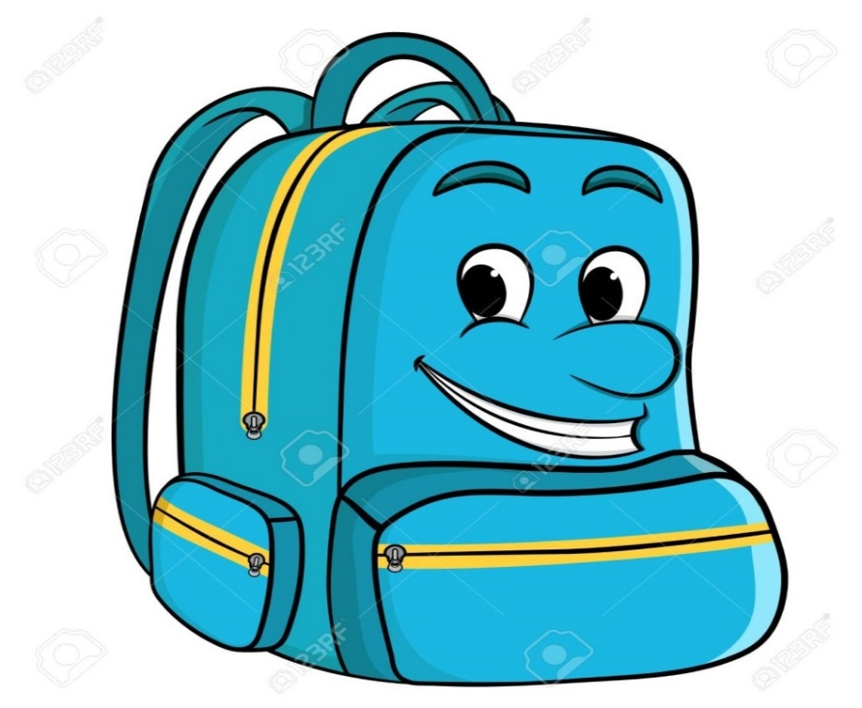

Listen and read.
LESSON 1: Gettingstarted
A special day
* Vocabulary:
- Classmate (n) /ˈklɑːs.meɪt/
Bạn cùng lớp
- Rubber (n) /ˈrʌb.ər/
Cục tẩy
- Pencil case (n) /ˈpen.səl ˌkeɪs/
Hộp đựng bút
- Pencil sharpener (n) /ˈpen.səl ˌʃɑː.pən.ər/
Đồ chuốt bút chì
- Schoolbag (n) /ˈskuːl.bæɡ/
Cặp sách
- Knock at /nɒk/
Gõ cửa

