Slide 1
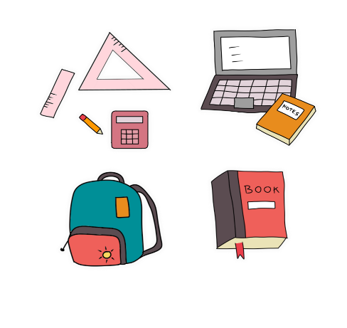
My school things
Unit
8
Lesson 2

Slide 2
Warm-up

Slide 3
Let’s play!

Slide 4
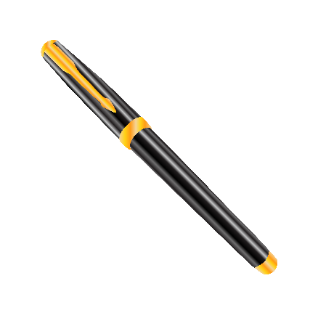
Game: Sentence puzzle
(Reorder the words)
pen.
have
I
a
I
have
a
pen.
Notes:
Sentence Puzzle
Divide the class into groups of four. Give each group a sentence that is broken/cut in to pieces. Ask them to arrange them to make a complete sentence, then read it aloud.
The group makes it first will be the winner.

Slide 5
book.
have
a
I
I
have
a
book.
Notes:
Sentence Puzzle
Divide the class into groups of four. Give each group a sentence that is broken/cut in to pieces. Ask them to arrange them to make a complete sentence, then read it aloud.
The group makes it first will be the winner.

Slide 6
I
have
a
pencil.
I
have
a
pencil.
Notes:
Sentence Puzzle
Divide the class into groups of four. Give each group a sentence that is broken/cut in to pieces. Ask them to arrange them to make a complete sentence, then read it aloud.
The group makes it first will be the winner.

Slide 7
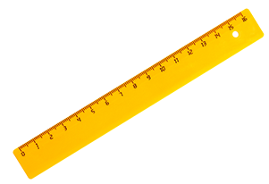
I
have
a
ruler.
I
have
a
ruler.
Notes:
Sentence Puzzle
Divide the class into groups of four. Give each group a sentence that is broken/cut in to pieces. Ask them to arrange them to make a complete sentence, then read it aloud.
The group makes it first will be the winner.

Slide 8
Well done!

Slide 9
Contents
Look, listen
and repeat.
Let’s talk.
Read and
match.
Listen, point
and say.
Listen
and number.
Let’s play.

Slide 10
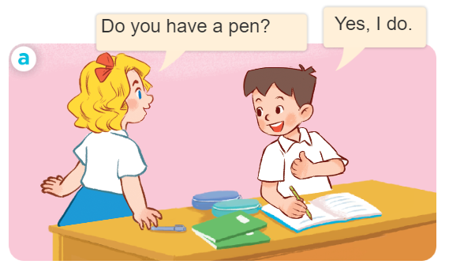
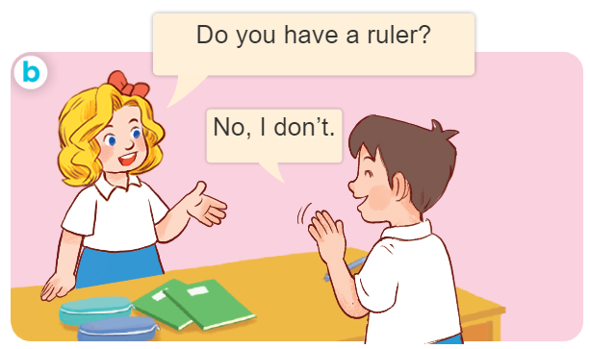
1. Look, listen and repeat.
What are they doing?
Where are they?
Who are they?

Slide 11
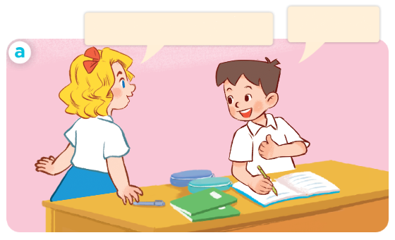
1. Look, listen and repeat.
Click on the sentences to hear the sound.
Facebook : Bùi Liễu
0968142780
Yes, I do.
Do you have a pen?
Facebook : Bùi Liễu
0968142780
Notes:
Facebook : Bùi Liễu
Mobile phone: 0968142780

Slide 12
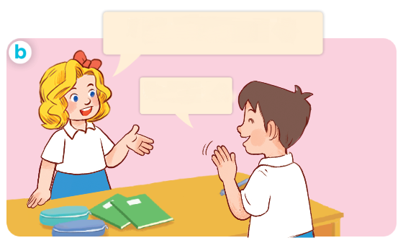
1. Look, listen and repeat.
Click on the sentences to hear the sound.
Do you have a ruler?
Facebook : Bùi Liễu
0968142780
No, I don’t.
Notes:
Facebook : Bùi Liễu
Mobile phone: 0968142780

Slide 13
Facebook : Bùi Liễu
0968142780
Vocabulary

Slide 14
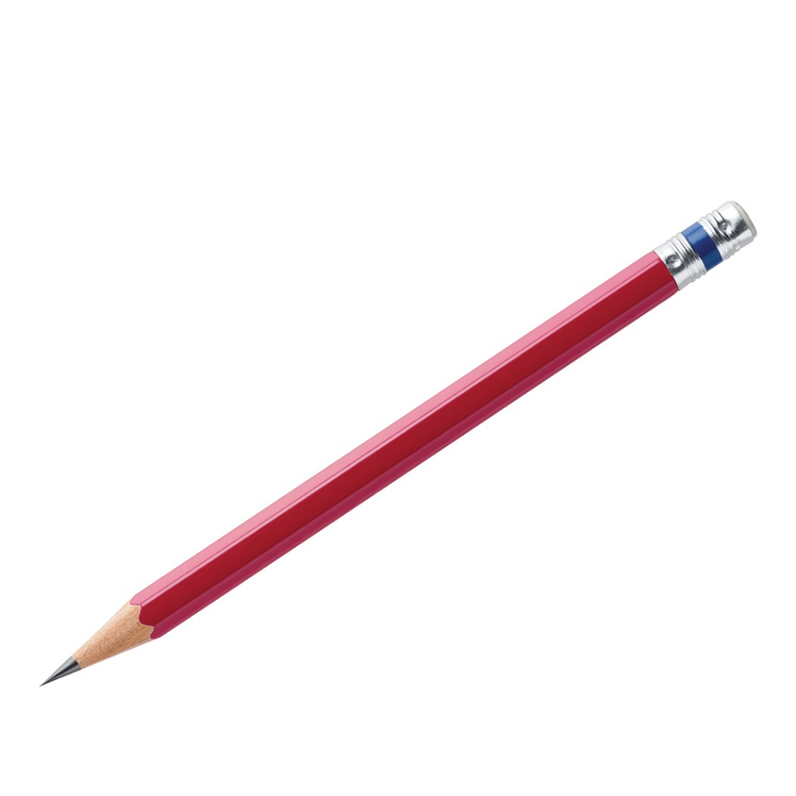
Vocabulary
Facebook : Bùi Liễu
0968142780
pencil
/ˈpen.səl/
bút chì

Slide 15
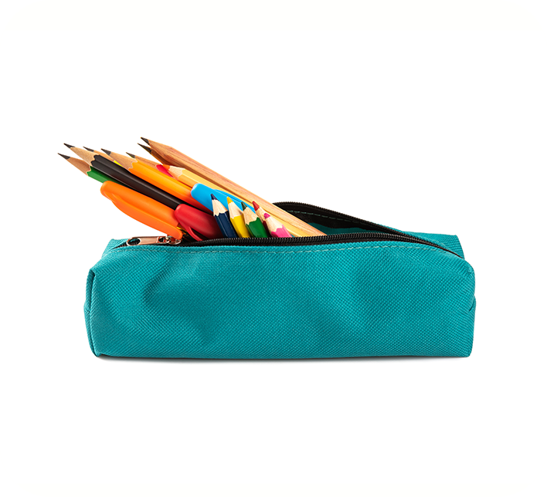
Vocabulary
pencil case
/ˈpen.səl ˌkeɪs/
hộp bút

Slide 16
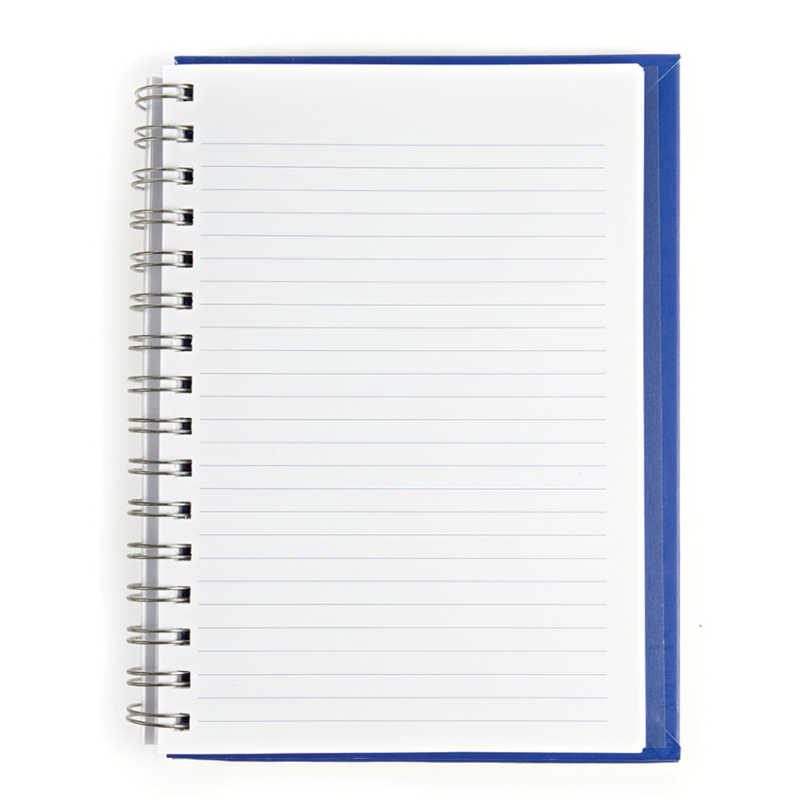
Vocabulary
Facebook : Bùi Liễu
0968142780
notebook
/ˈnəʊt.bʊk/
vở viết

Slide 17
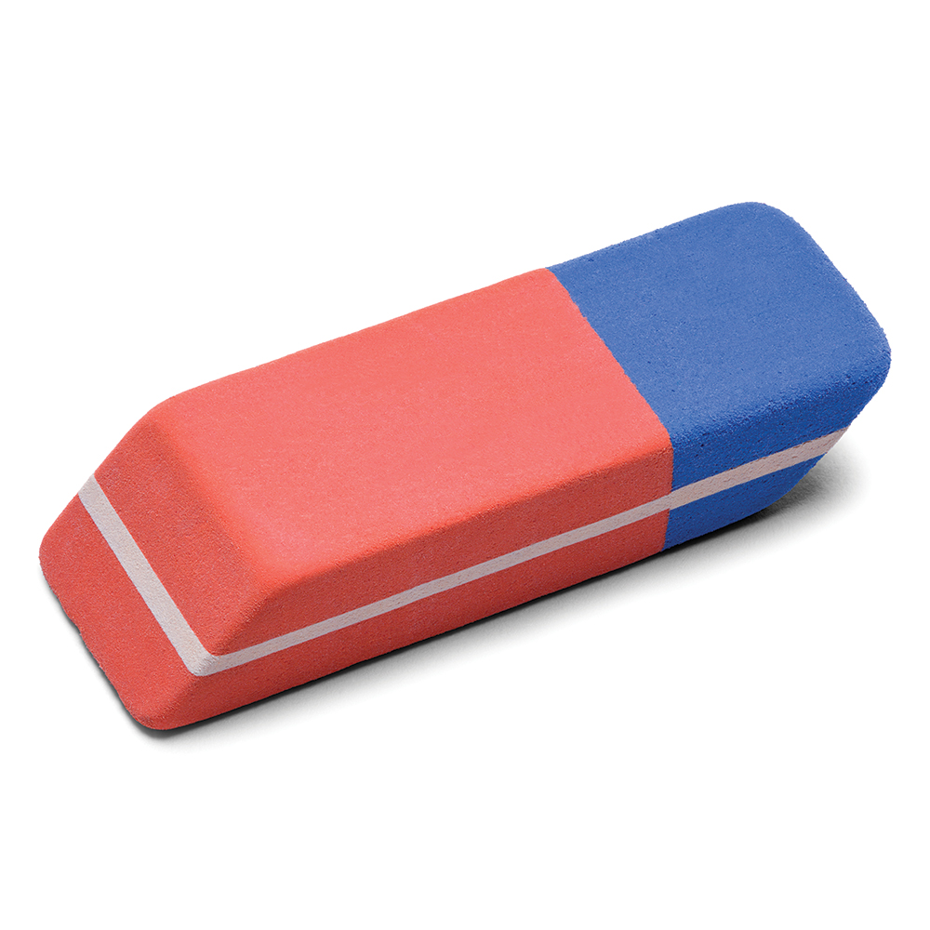
Vocabulary
Facebook : Bùi Liễu
0968142780
eraser
/ɪˈreɪ.zər/
cục tẩy

Slide 18
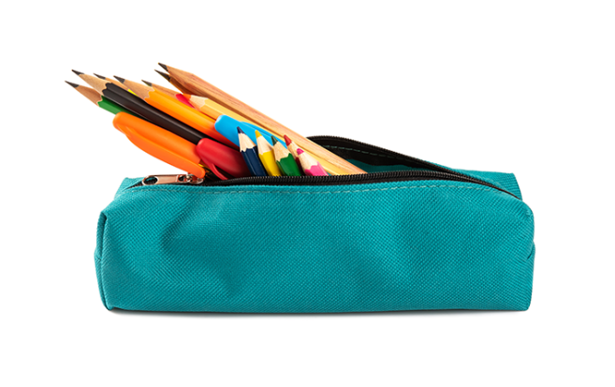
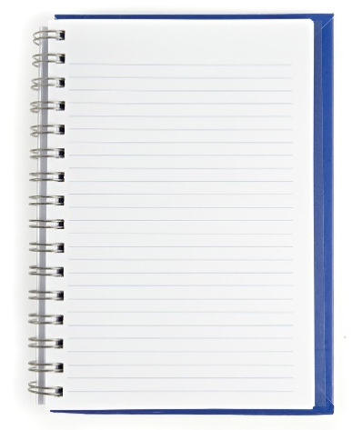
Review
pencil
pencil case
notebook
eraser

Slide 19
Vocabulary
- pencil: bút chì
- pencil case: hộp bút
- notebook: vở viết
- eraser: cục tẩy

Slide 20
Facebook : Bùi Liễu
0968142780
Structures

Slide 21
* Hỏi và trả lời ai đó có cái gì không?.
- Do you have _______?
+ Yes, I do.
+ No, I don’t.
- Bạn có ______ không?
+ Ừ, tớ có.
+ Không, tớ không có.

Slide 22
Let’s play!

Slide 23
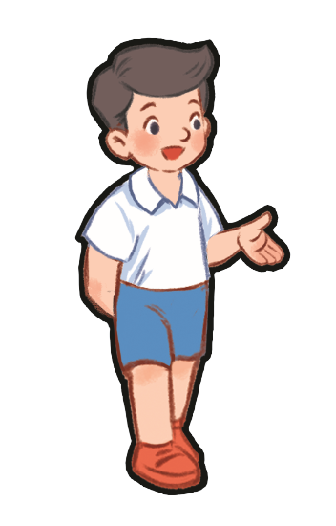
Do you have a pencil?
A. Yes, I do.
B. No, I don’t.

Slide 24
Do you have a ruler?
A. Yes, I do.
B. No, I don’t.

Slide 25
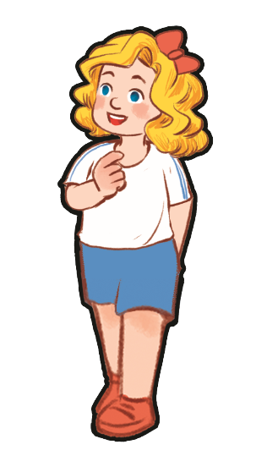
Do you have a book?
A. Yes, I do.
B. No, I don’t.

Slide 26
Do you have an eraser?
A. Yes, I do.
B. No, I don’t.

Slide 27
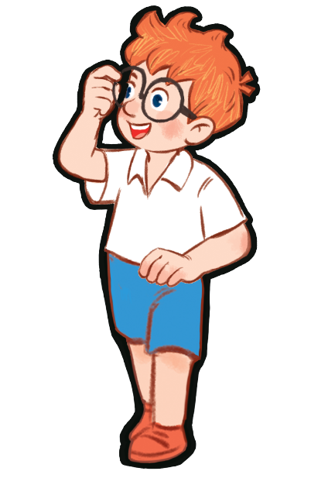
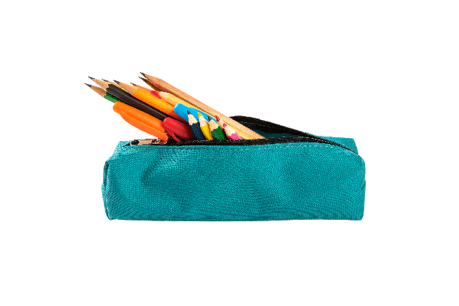
Do you have a pencil case?
A. Yes, I do.
B. No, I don’t.

Slide 28
Do you have a pencil case?
A. Yes, I do.
B. No, I don’t.

Slide 29
Do you have a ruler?
A. Yes, I do.
B. No, I don’t.

Slide 30
Do you have a pen?
A. Yes, I do.
B. No, I don’t.

Slide 31
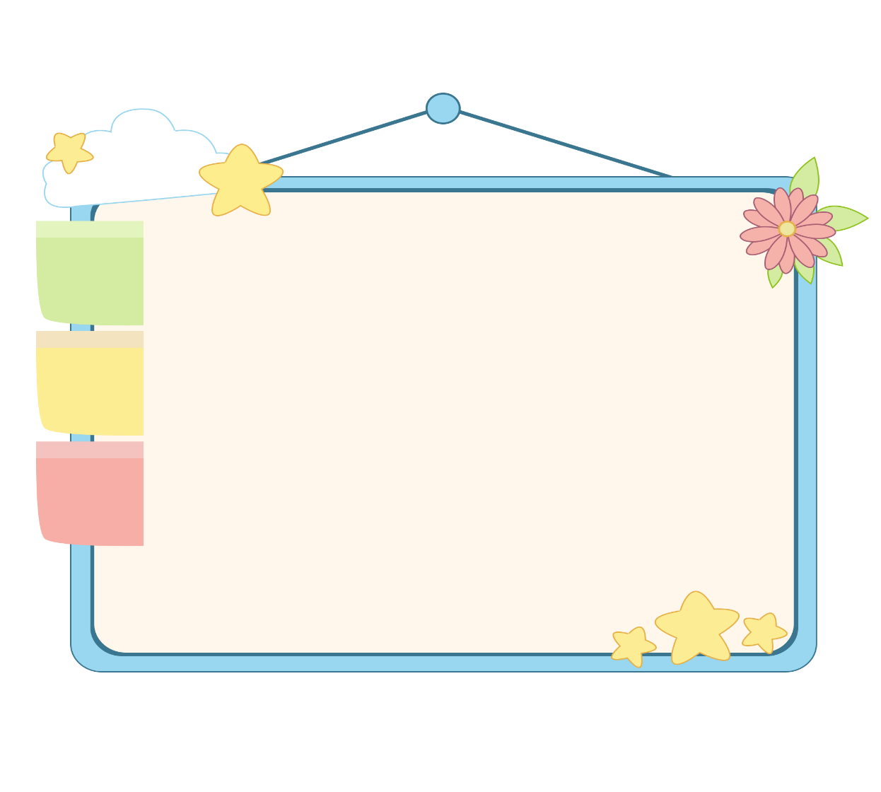
WELL DONE!

Slide 32
2. Listen, point and say.
a
b
Do you have _____?
Yes, I do.
a pencil / yes
a pencil case / no
No, I don’t.
c
d
don’t = do not
a notebook / yes
an eraser / no

Slide 33
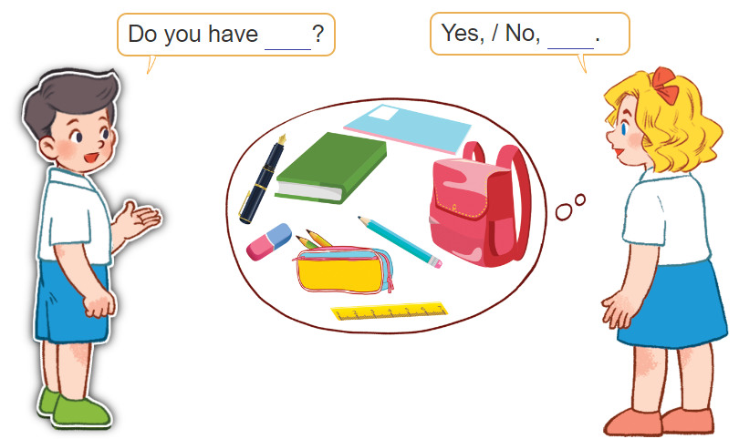
3. Let’s talk.

Slide 34
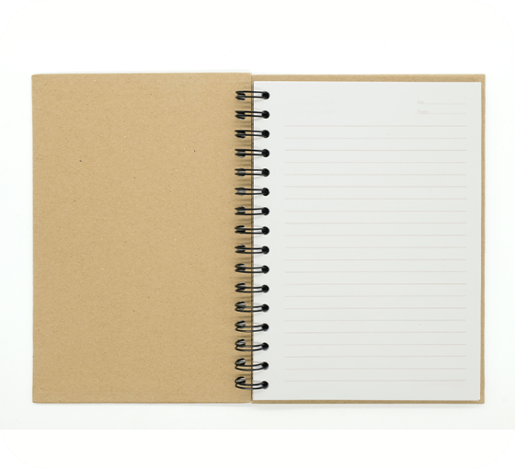
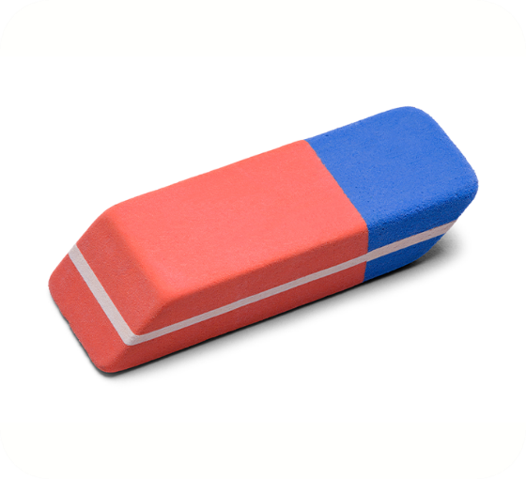
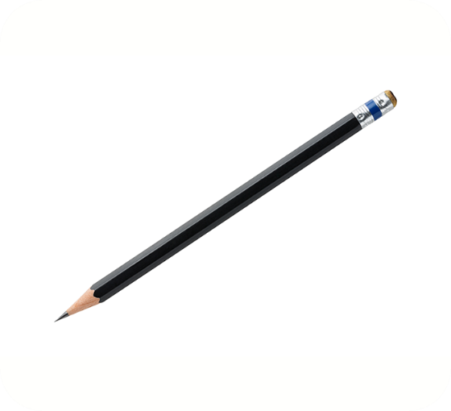
4. Listen and number.
3
4
1
2
a
b
c
d

Slide 35
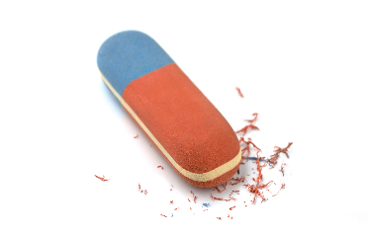
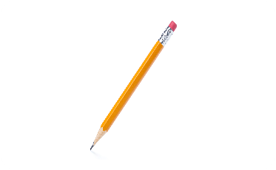
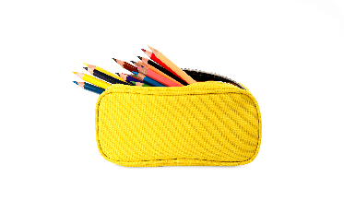
5. Read and match.
a
1. A: Do you have a notebook?
B: Yes, I do.
b
2. A: Do you have a school bag?
B: No, I don’t. I have a pencil case.
3. A: Do you have an eraser?
B: Yes, I do.
c
4. A: Do you have a pen?
B: No, I don’t. I have a pencil.
d
1 - d
2 - c
3 - a
4 - b

Slide 36
6. Let’s play.
Notes:
d

Slide 37
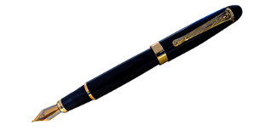
Matching game
pencil
pencil case
pen
Notes:
Click the card to show the words/picture. Click again to close it.

Slide 38
Matching game
book
eraser
pen
Notes:
Click the card to show the words/picture. Click again to close it.

Slide 39
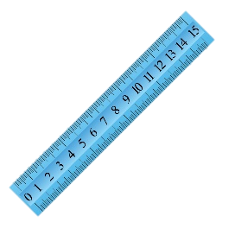
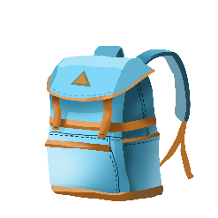
Matching game
notebook
school bag
ruler
Notes:
Click the card to show the words/picture. Click again to close it.

Slide 40
Wrap up
Notes:
Facebook : Bùi Liễu
0968142780

Slide 41
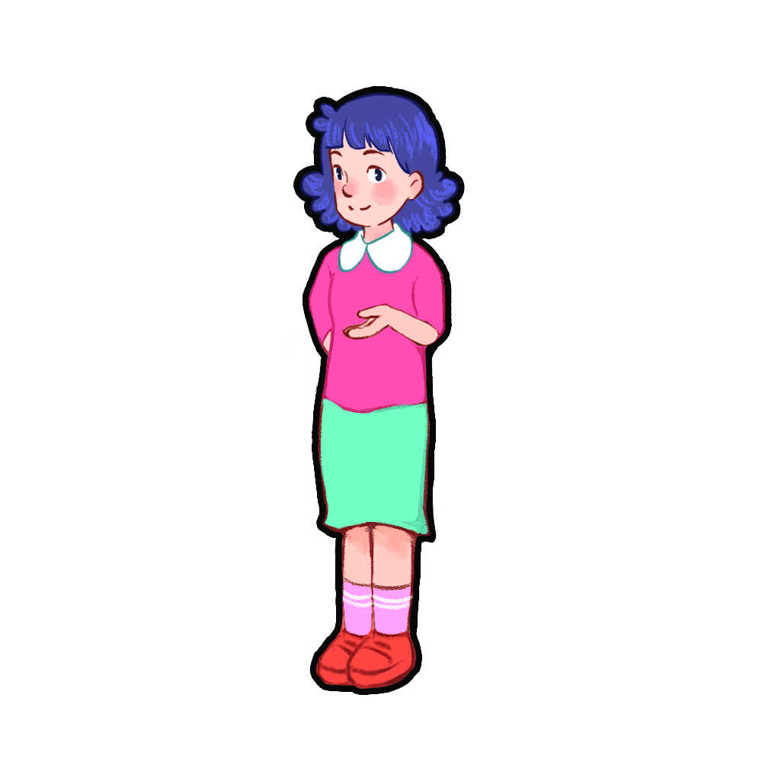
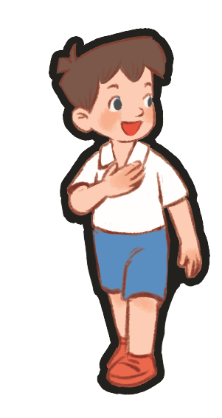
Show me: pencil, eraser, pen!
pencil, eraser, pen!
pencil, eraser, pen!
pencil, eraser, pen!
Notes:
Teacher tells pupils to put out their school things on the desk.
Ask them to show the school things with the correct order. (example: Show me: pencil, eraser, pen). Who can make it fastest is the winner.
Ask pupils to show those school things and repeat.

Slide 42
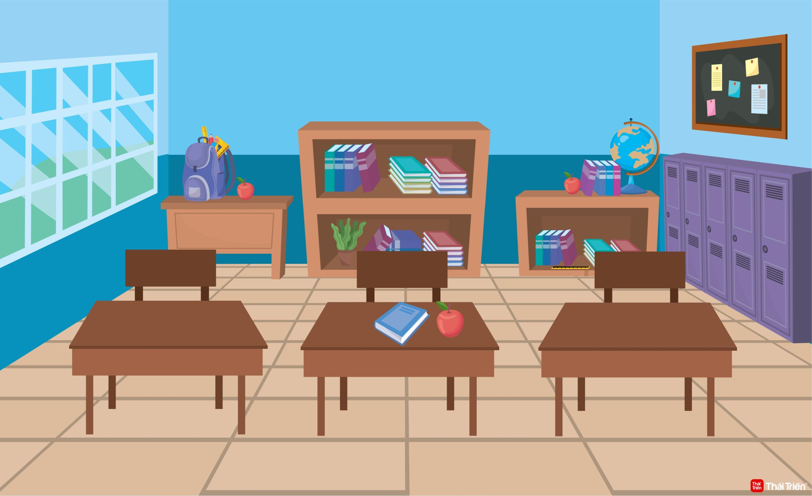
Do you have a ruler?
No, I don’t.
Yes, I do.
Yes, I do.
Notes:
Teacher tells pupils to put out their school things on the desk.
Ask them: Do you have a pen/book/ruler…?
Ask pupils if they have, say: Yes, I do. / if not: No, I don’t.

Slide 43
Homework
Learn by heart all the new words.
Read again the dialogue in part 1.
Notes:
Facebook : Bùi Liễu
0968142780

Slide 44
Thank you!
Facebook : Bùi Liễu
0968142780
Notes:
Facebook : Bùi Liễu
0968142780

