Slide 1
Classroom
instruction
Unit
7
Lesson 1

Slide 2






Contents
Facebook : Bùi Liễu
0968142780
Look, listen and repeat.
Listen, point and say.
Let’s talk.
Listen and tick.
Look, complete and read.
Let’s play.
Notes:
Facebook : Bùi Liễu
Mobile phone: 0968142780

Slide 3
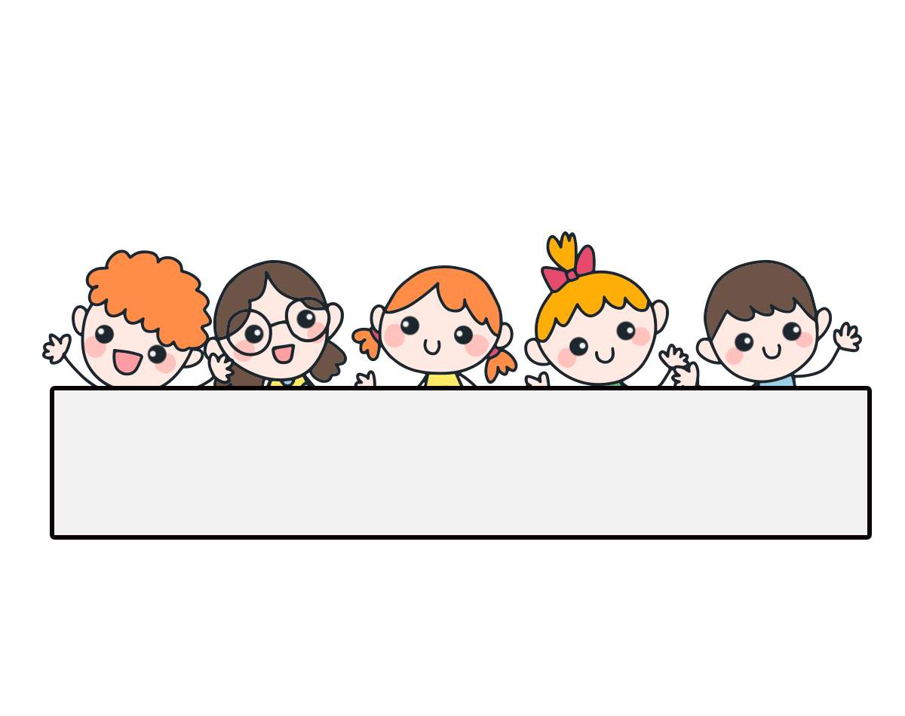
Warm-up

Slide 4

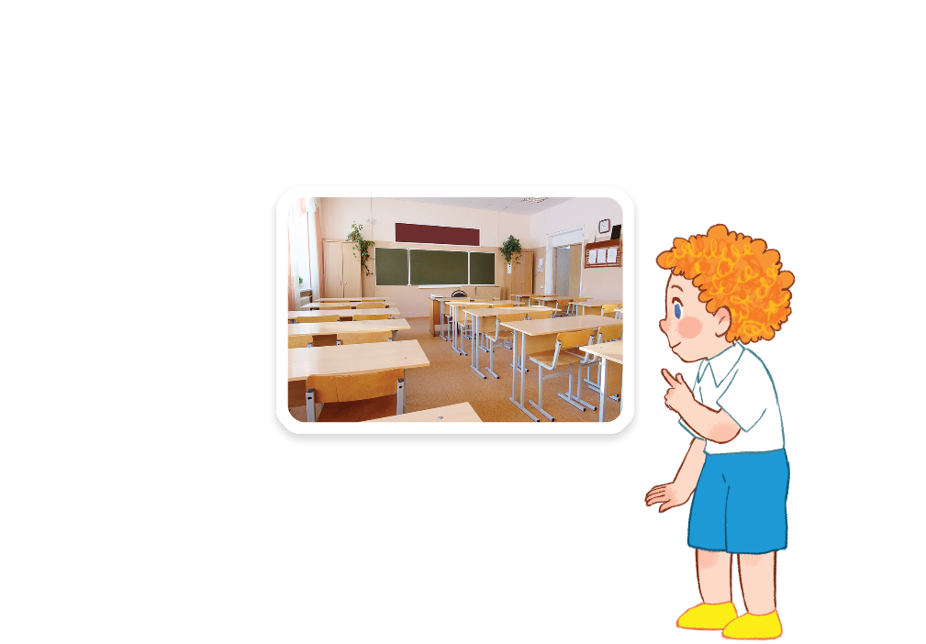
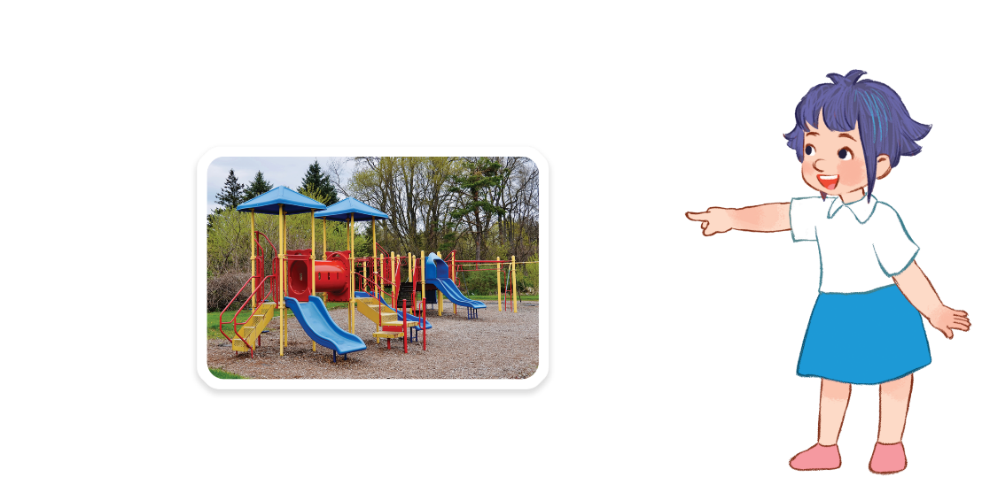
Facebook : Bùi Liễu
Let’s chant.
Classroom,
classroom.
Is that your classroom?
Yes, it is. Yes, it is.
Let’s go to your classroom.
Playground, playground.
Facebook : Bùi Liễu
Is that our playground?
Yes, it is. Yes, it is.
Let’s go to our playground.

Slide 5
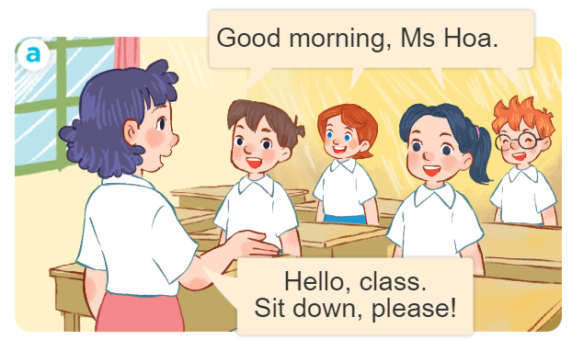
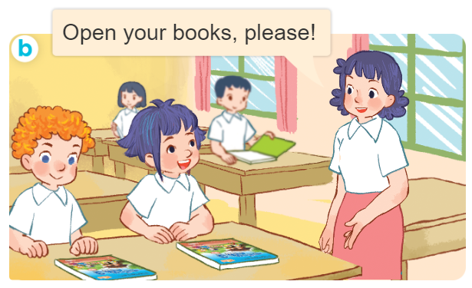
1. Look, listen and repeat.
Slide hội thoại đầu tiên là giới thiệu.
What are they doing?
Where are they?
Who are they?

Slide 6
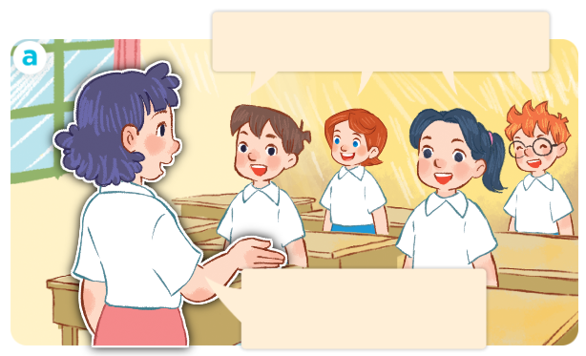
1. Look, listen and repeat.
Click on the sentences to hear.
Good morning, Ms Hoa.
Hello, class.
Sit down, please!

Slide 7
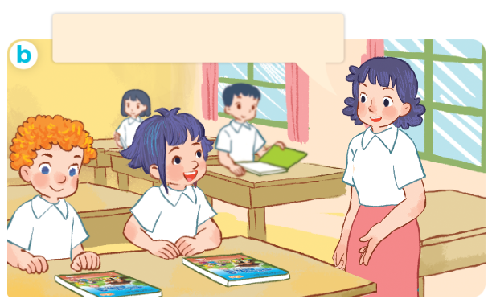
1. Look, listen and repeat.
Click on the sentences to hear.
Open your books, please!
Facebook : Bùi Liễu
0968142780
Notes:
Facebook : Bùi Liễu
Mobile phone: 0968142780

Slide 8
Vocabulary
Notes:
Facebook : Bùi Liễu
Mobile phone: 0968142780

Slide 9


Vocabulary
Facebook : Bùi Liễu
0968142780
open your book
/ˈəʊpən jɔː bʊk/
mở, giở sách

Slide 10

Vocabulary
Facebook : Bùi Liễu
0968142780
close your book
/kləʊz jɔː bʊk/
gập sách

Slide 11
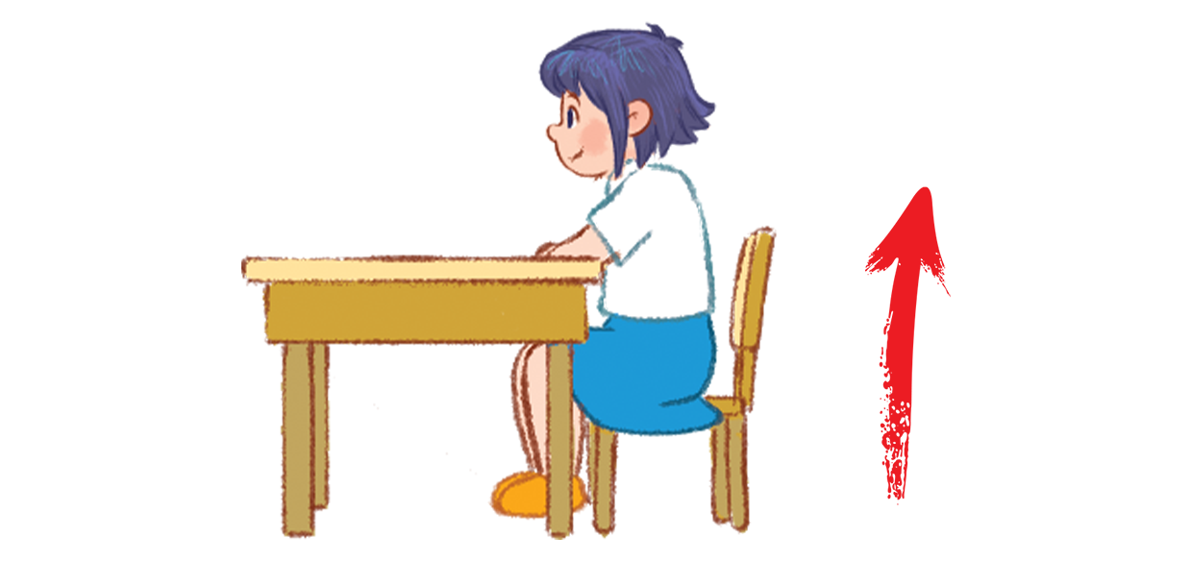
Vocabulary
Facebook : Bùi Liễu
0968142780
stand up
/stænd ʌp/
đứng lên

Slide 12
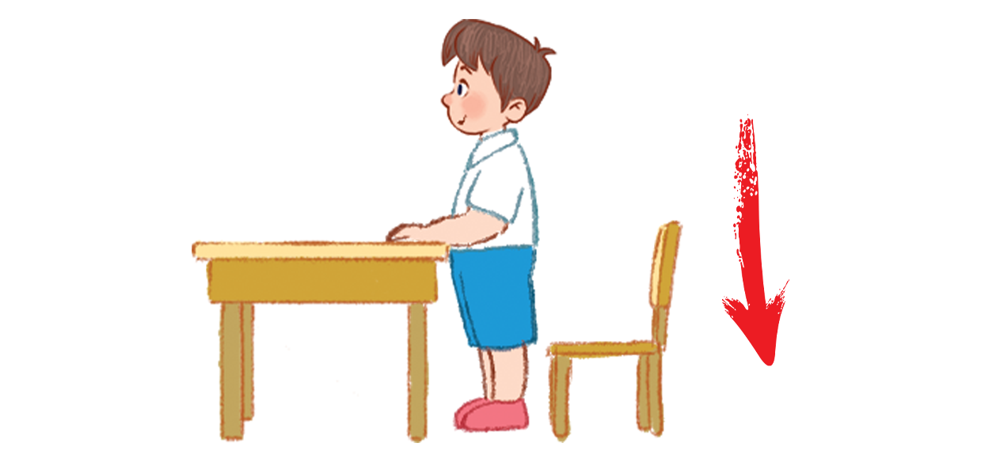
Vocabulary
Facebook : Bùi Liễu
0968142780
sit down
/sɪt daʊn/
ngồi xuống

Slide 13




Review
open your book
close your book
stand up
sit down
Notes:
Facebook : Bùi Liễu
Mobile phone: 0968142780

Slide 14
Vocabulary
open your book: mở, giở sách
close your book: gập sách
stand up: đứng lên
sit down: ngồi xuống
Notes:
Facebook : Bùi Liễu
Mobile phone: 0968142780

Slide 15
1. Look, listen and repeat.
Slide hội thoại đầu tiên là giới thiệu.
What are they doing?
Where are they?
Who are they?

Slide 16


Let’s play!

Slide 17

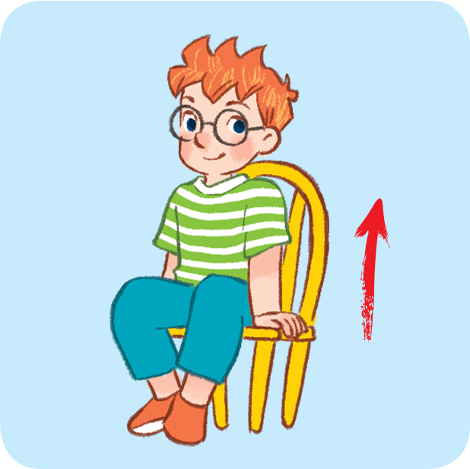
Can you guess?
Nhấn vào ống nhòm lần thứ nhất để chuyển động.
Nhấn lần thứ 2 để hiển thị đáp án.
stand up
Notes:
Facebook : Bùi Liễu
Mobile phone: 0968142780

Slide 18
Can you guess?
Nhấn vào ống nhòm lần thứ nhất để chuyển động.
Nhấn lần thứ 2 để hiển thị đáp án.
open your book
Notes:
Facebook : Bùi Liễu
Mobile phone: 0968142780

Slide 19
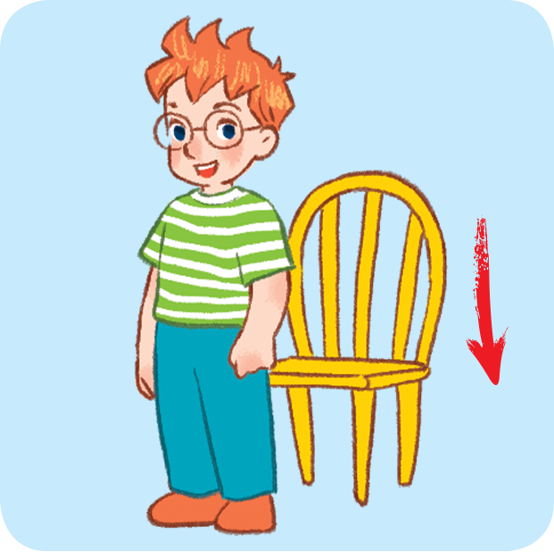
Can you guess?
Nhấn vào ống nhòm lần thứ nhất để chuyển động.
Nhấn lần thứ 2 để hiển thị đáp án.
sit down
Notes:
Facebook : Bùi Liễu
Mobile phone: 0968142780

Slide 20
Can you guess?
Nhấn vào ống nhòm lần thứ nhất để chuyển động.
Nhấn lần thứ 2 để hiển thị đáp án.
close your book
Notes:
Facebook : Bùi Liễu
Mobile phone: 0968142780

Slide 21
Well done!

Slide 22
Structures

Slide 23
Structures
Câu mệnh lệnh/yêu cầu.
______, please!
Ví dụ:
Sit down, please!
Open your book, please!

Slide 24




2. Listen, point and say.
____, please!
a
b
open your book
close your book
c
d
stand up
sit down

Slide 25
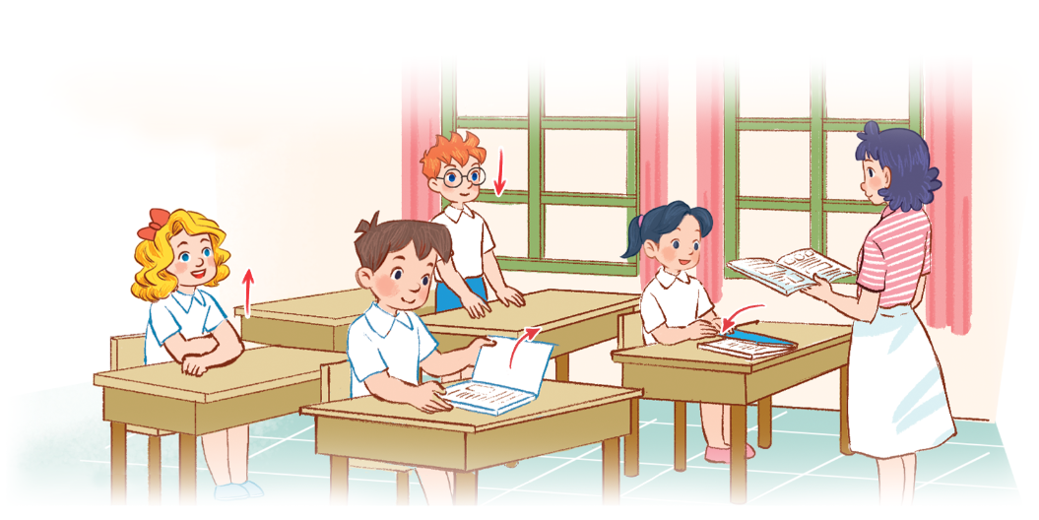
3. Let’s talk.
________, please!

Slide 26



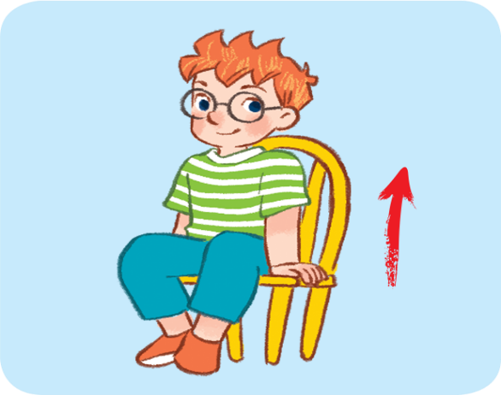
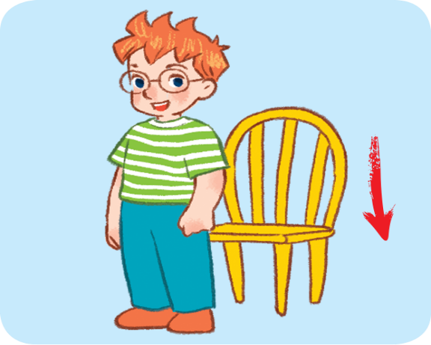
4. Listen and tick.
1
a
b
2
a
b

Slide 27
Facebook : Bùi Liễu
0968142780
Let’s play!
Notes:
Facebook : Bùi Liễu
Mobile phone: 0968142780

Slide 28
Look, say
and do!
10
20
Open your book, please!
Close your books, please!
30
70
Stand up, please!
Open your books, please!
A
Spin &
Stop
40
Sit down, please!
Close your book, please!
B
60
Hello, class.
Sit down, please!
80
50
Good morning, teacher!

Slide 29

Good job!
Notes:
Facebook : Bùi Liễu
Mobile phone: 0968142780

Slide 30

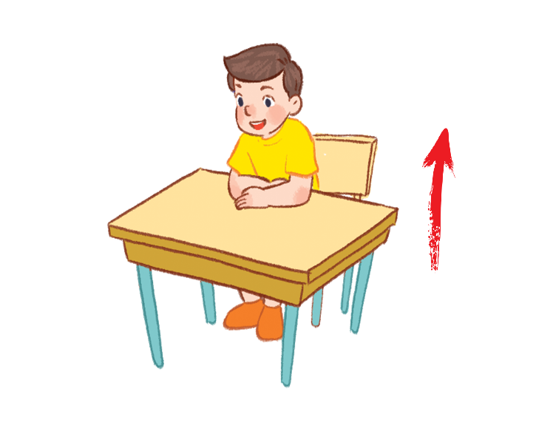
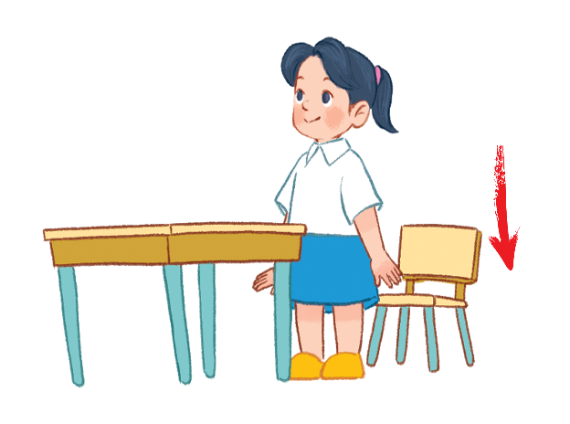
5. Look, complete and read.
1. ______your book, please!
2. ______your book, please!
3. ________, please!
4. ________, please!
Notes:
Facebook : Bùi Liễu
Mobile phone: 0968142780

Slide 31
Open
5. Look, complete and read.
1. ______your book, please!
Notes:
Facebook : Bùi Liễu
Mobile phone: 0968142780

Slide 32
Close
5. Look, complete and read.
2. ______your book, please!

Slide 33

Stand up
5. Look, complete and read.
3. ________, please!
Notes:
Facebook : Bùi Liễu
Mobile phone: 0968142780

Slide 34

Sit down
5. Look, complete and read.
4. ________, please!

Slide 35
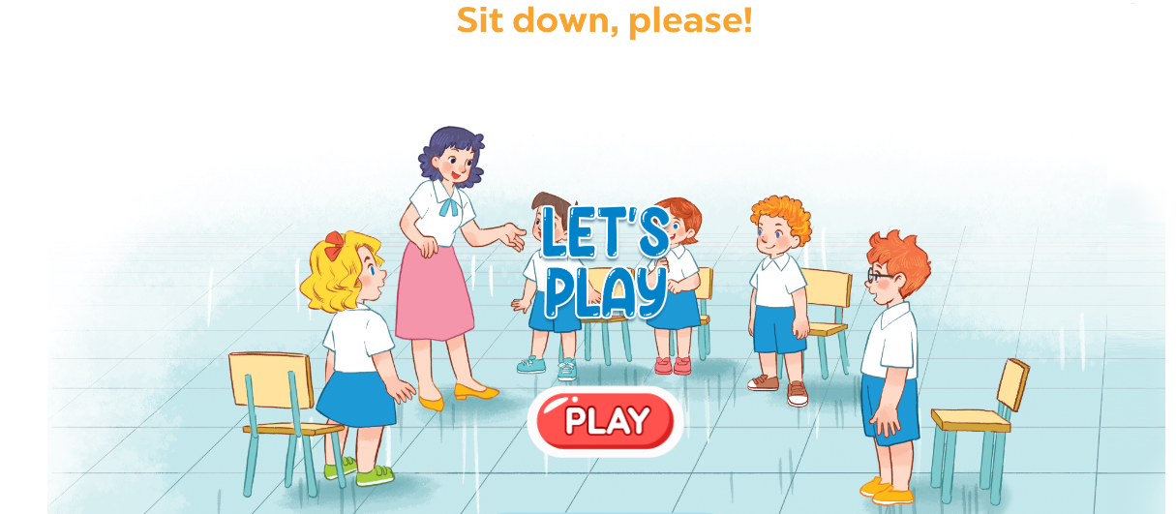
6. Let’s play.

Slide 36

Wrap up

Slide 37
Vocabulary
open your book
close your book
stand up
sit down
Notes:
Facebook : Bùi Liễu
Mobile phone: 0968142780

Slide 38
Structures
Câu mệnh lệnh/yêu cầu.
______, please!
Ví dụ:
Sit down, please!
Open your book, please!

Slide 39
Homework
Learn by heart all the new words.
Read again the dialogue in part 1.

Slide 40

Facebook : Bùi Liễu
0968142780
Thank you!
Notes:
Facebook : Bùi Liễu
0968142780

