Slide 1
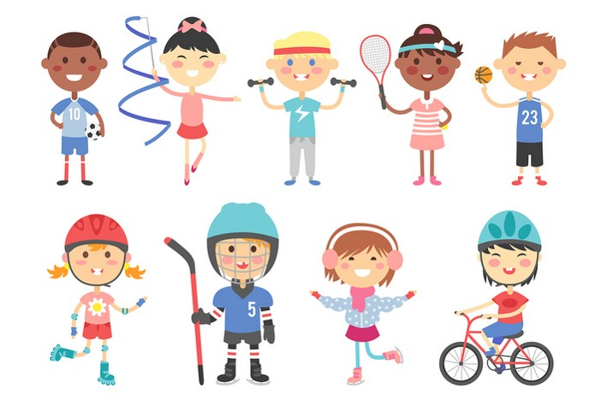
My hobbies
Unit
5
Lesson 3

Slide 2
Warm-up

Slide 3
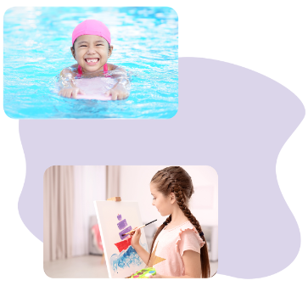
Let’s sing.
My hobby
What’s your hobby?
It’s dancing.
What’s your hobby?
It’s swimming.
What’s your hobby?
I like cooking.
What’s your hobby?
I like painting.
Dancing, swimming,
cooking,
and painting.
Notes:
Facebook : Bùi Liễu
Mobile phone: 0968142780

Slide 4
Contents
Facebook : Bùi Liễu
0968142780
Listen and repeat.
Listen and circle.
Let’s chant.
Read and tick.
Let’s write.
Project.
Notes:
Facebook : Bùi Liễu
Mobile phone: 0968142780

Slide 5
1. Listen and repeat.
Notes:
Facebook : Bùi Liễu
Mobile phone: 0968142780

Slide 6
2. Listen and circle.

Slide 7
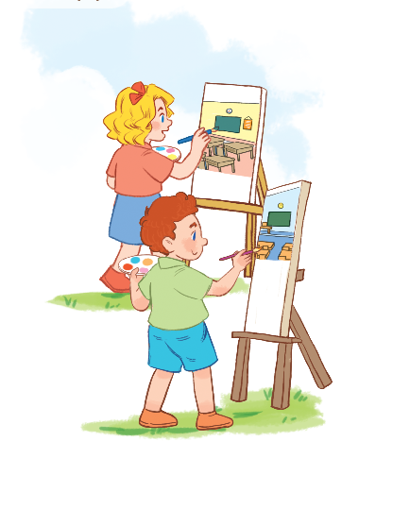
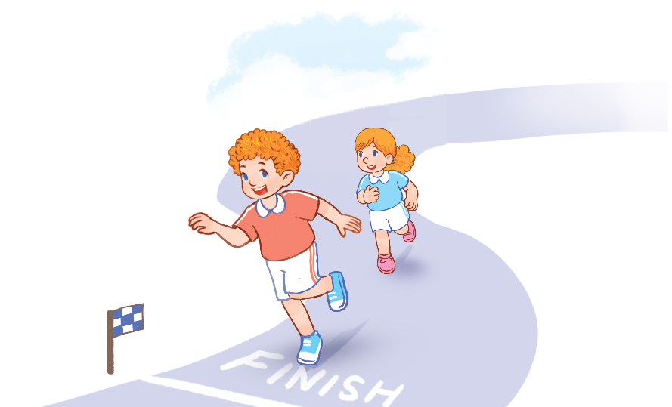
3. Let’s chant.
Painting.
Painting.
I like painting.
Running.
Running.
I like running.
Painting?
Running?
I like painting.
I like running.

Slide 8
3. Let’s chant.
Painting.
Painting.
I like painting.
Running.
Running.
I like running.
Painting?
Running?
I like painting.
I like running.

Slide 9
Let’s play!

Slide 10
GO FISHING
Game
PLAY

Slide 11
EXIT
7
6
8
2
4
9
1
5
3
13
Click vào con cá có số để chuyển tới câu hỏi
12
11
14
15

Slide 12
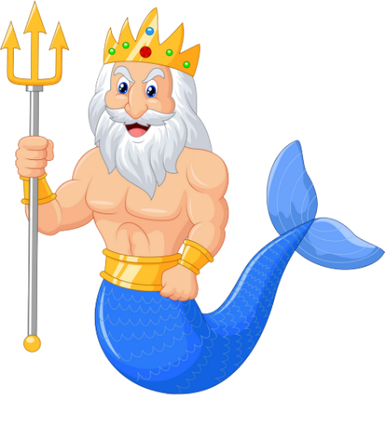
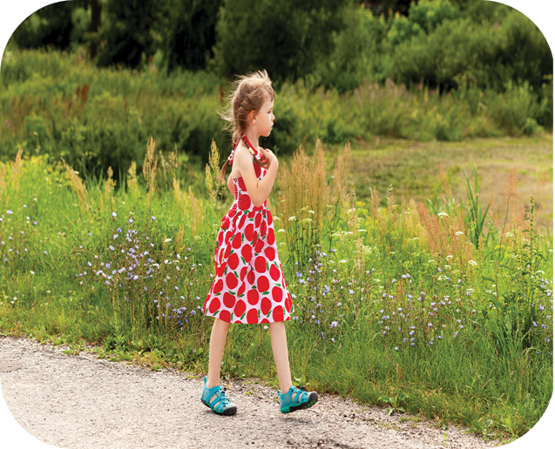
trả lời xong thì nhấn click mũi tên để quay lại chọn con cá
A
It’s walking.
B
It’s running.
C
It’s swimming.
D
STOVE
What’s your hobby?

Slide 13
A
I like painting.
B
I like cooking.
C
I like walking.
D
Climb
What’s your hobby?

Slide 14
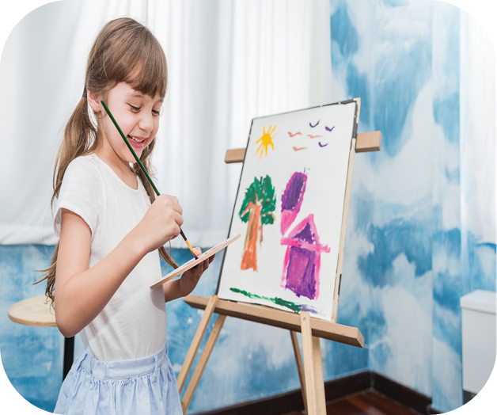
A
hobby
B
name
C
old
What’s your ________?
It is painting.
D
May

Slide 15
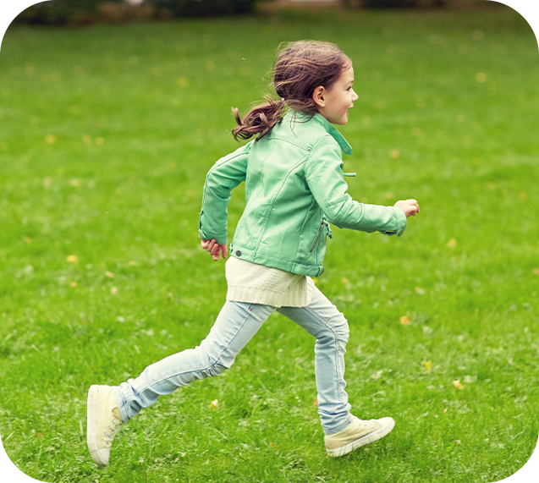
A
I play football.
B
I like running.
C
It is dancing.
D
Watch
What’s your hobby?

Slide 16
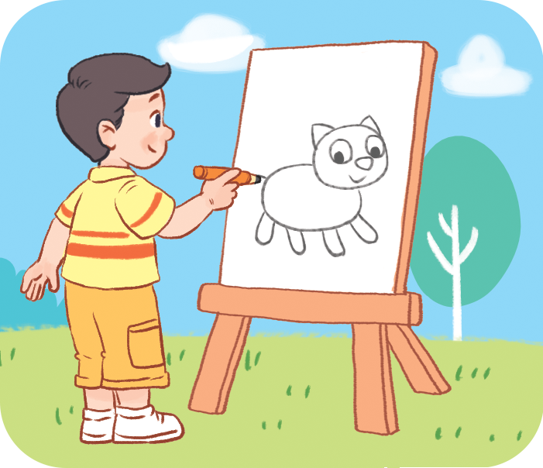
A
No, it isn’t.
B
Yes, it is.
C
I like drawing.
D
Next to
What’s your hobby?

Slide 17
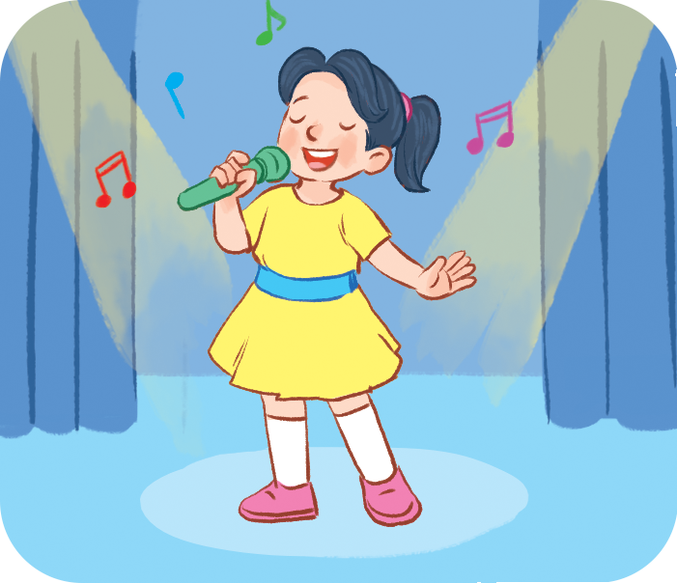
A
I like singing.
B
It is running.
C
I like walking.
D
Next to
What’s your hobby?

Slide 18
A
I like cooking.
B
It is swimming..
C
I like painting.
D
She plays chess
in his free time.
What’s your hobby?

Slide 19
A
his
B
my
What’s ___ hobby?
C
your
D
They likes sport.

Slide 20
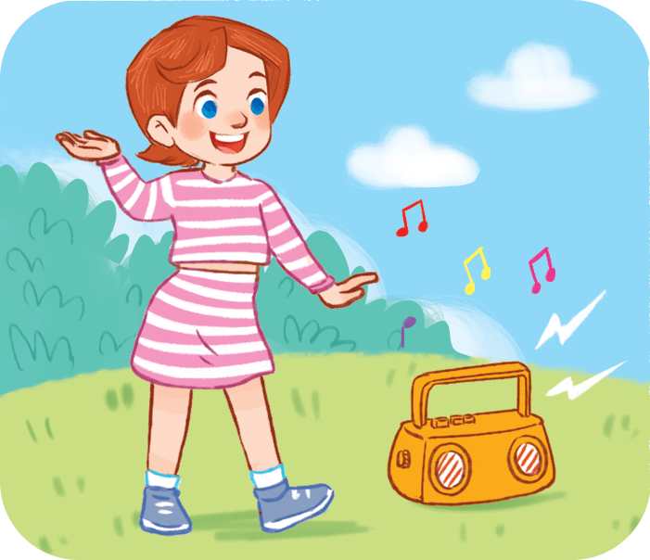
A
What’s your hobby?
B
What’s your name?
C
What’s this?
_____________?
I like dancing.
D
She should take some warm water.

Slide 21
Thank you!

Slide 22
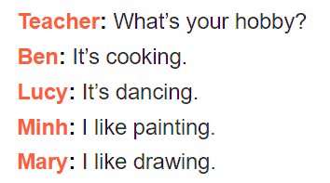
4. Read and tick.

Slide 23
5. Let’s write.
Hello. My name is _____.
I like _________.
I like _________.
What’s your hobby?
Lieu
singing
cooking

Slide 24
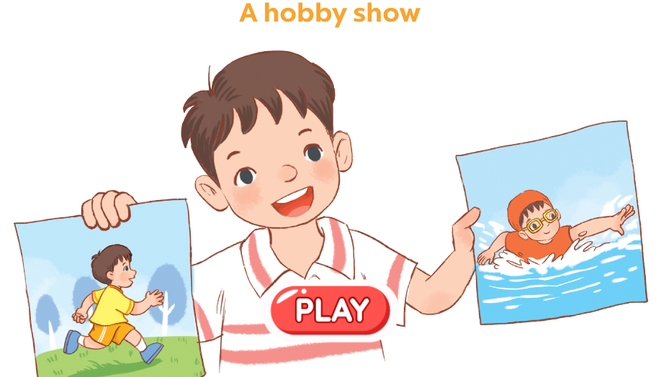
6. Project.

Slide 25
Wrap up

Slide 26
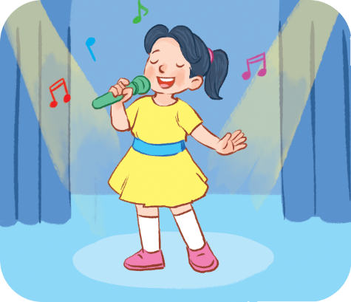
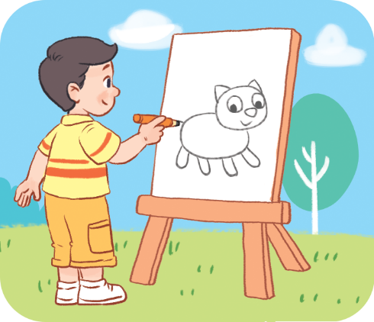
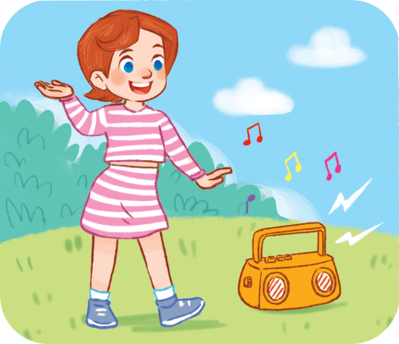
Vocabulary
hobby
singing
drawing
dancing
swimming

Slide 27
Structures
Hỏi và trả lời về sở thích.
- What’s your hobby?
It’s _______.
(Sở thích của bạn là gì?)
What’s = what is
It’s = it is
(Đó là ________)

Slide 28
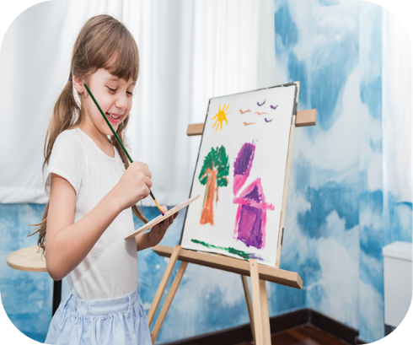
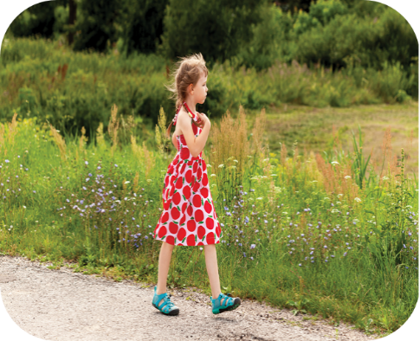
Vocabulary
running
painting
walking
cooking
Notes:
Facebook : Bùi Liễu
Mobile phone: 0968142780

Slide 29
Structures
Hỏi và trả lời về sở thích.
- What’s your hobby?
I like _______.
(Sở thích của bạn là gì?)
What’s = what is
(Tớ thích ________)

Slide 30
Homework
Learn by heart all the new words.
Do your homework.

Slide 31
Facebook : Bùi Liễu
0968142780
Thank you!
Notes:
Facebook : Bùi Liễu
0968142780

