Slide 1
My hobbies
Unit
5
Lesson 1
Facebook : Bùi Liễu
0968142780

Slide 4
Warm-up

Slide 5
Let’s sing.
Ears,,
ears,
ears.
Hair,
hair,
hair.
Touch your ears!
Touch your hair!
Touch your ears!
Touch your hair!

Slide 6
Contents
Facebook : Bùi Liễu
0968142780
Look, listen and repeat.
Listen, point and say.
Let’s talk.
Listen and number.
Read and match.
Let’s play.
Notes:
Facebook : Bùi Liễu
Mobile phone: 0968142780

Slide 7
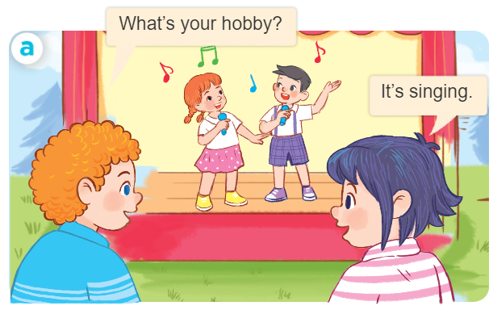
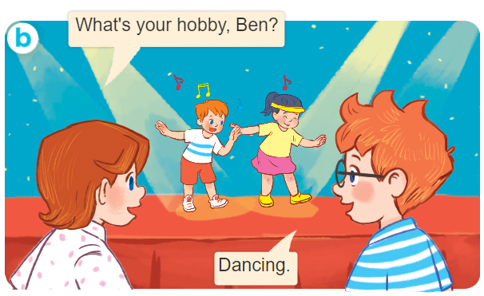
1. Look, listen and repeat.
Notes:
Facebook : Bùi Liễu
Mobile phone: 0968142780

Slide 8
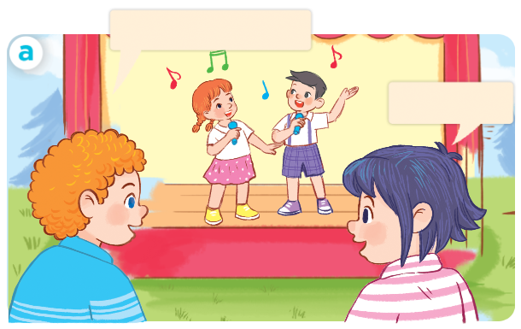
1. Look, listen and repeat.
What’s your hobby?
Facebook : Bùi Liễu
0968142780
It’s singing.

Slide 9
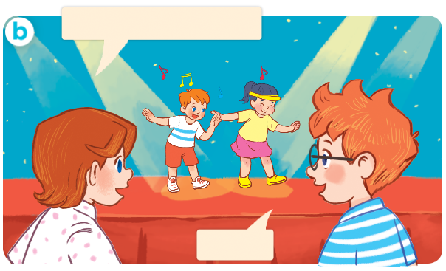
1. Look, listen and repeat.
What’s your hobby, Ben?
Facebook : Bùi Liễu
0968142780
Dancing.
Notes:
Facebook : Bùi Liễu
Mobile phone: 0968142780

Slide 10
Vocabulary
Notes:
Facebook : Bùi Liễu
Mobile phone: 0968142780

Slide 11
Vocabulary
hobby
/ˈhɒb.i/
sở thích
Notes:
Facebook : Bùi Liễu
Mobile phone: 0968142780

Slide 12
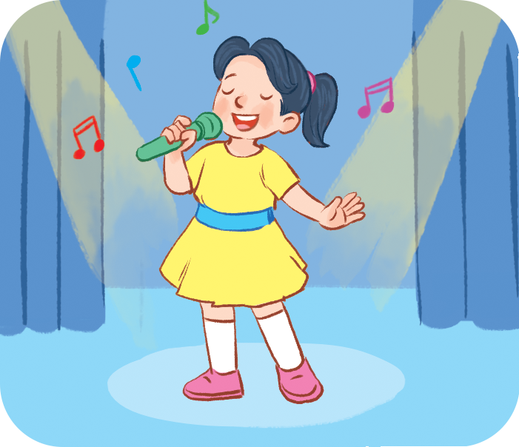
Vocabulary
singing
/ˈsɪŋ.ɪŋ/
hát
Notes:
Facebook : Bùi Liễu
Mobile phone: 0968142780

Slide 13
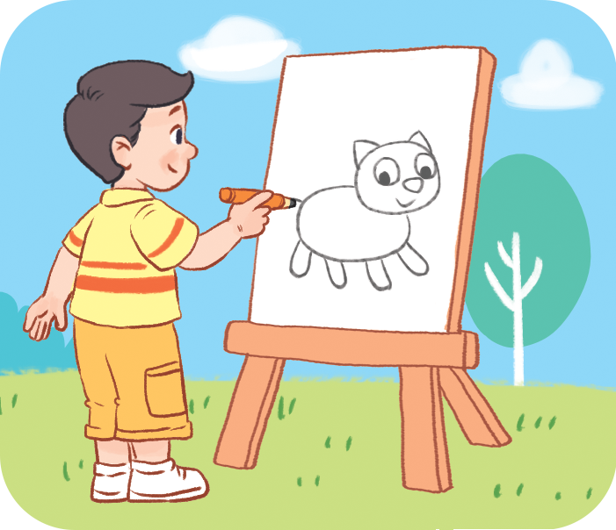
Vocabulary
drawing
/ˈdrɔː.ɪŋ/
vẽ
Notes:
Facebook : Bùi Liễu
Mobile phone: 0968142780

Slide 14
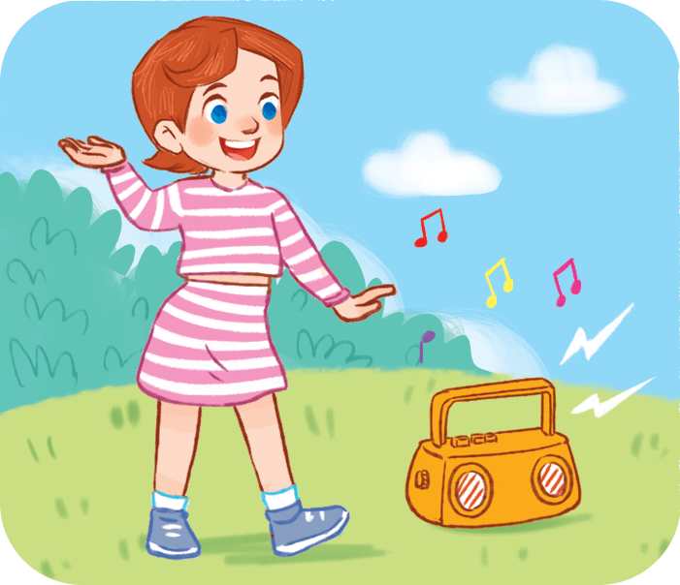
Vocabulary
dancing
/dɑːnsɪŋ/
khiêu vũ
Notes:
Facebook : Bùi Liễu
Mobile phone: 0968142780

Slide 15
Vocabulary
swimming
/ˈswɪm.ɪŋ/
bơi
Notes:
Facebook : Bùi Liễu
Mobile phone: 0968142780

Slide 16
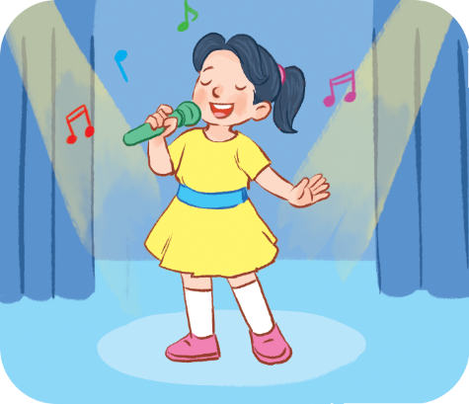
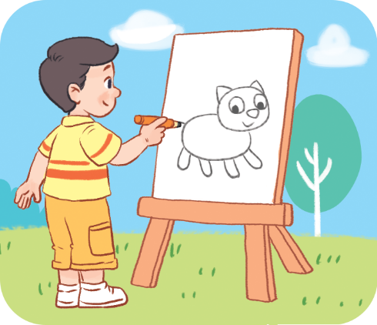
Review
hobby
singing
drawing
dancing
swimming
Notes:
Facebook : Bùi Liễu
Mobile phone: 0968142780

Slide 17
Vocabulary
hobby: sở thích
singing: hát
drawing: vẽ
dancing: khiêu vũ
swimming: bơi
Notes:
Facebook : Bùi Liễu
Mobile phone: 0968142780

Slide 18
Structures
Notes:
Facebook : Bùi Liễu
Mobile phone: 0968142780

Slide 19
Structures
Hỏi và trả lời về sở thích.
- What’s your hobby?
It’s _______.
(Sở thích của bạn là gì?)
What’s = what is
It’s = it is
(Đó là ________)

Slide 20
Facebook : Bùi Liễu
0968142780
Let’s play!
Notes:
Facebook : Bùi Liễu
Mobile phone: 0968142780

Slide 21
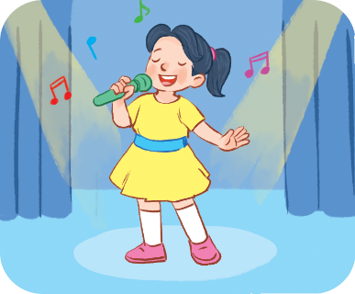
Choose the right answer.
Click on the picture to choose the right answer.
swimming
a
b
c

Slide 22
Click on the picture to choose the right answer.
Choose the right answer.
singing
a
b
c

Slide 23
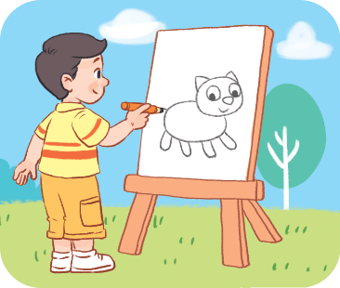
Click on the picture to choose the right answer.
Choose the right answer.
dancing
a
b
c

Slide 24
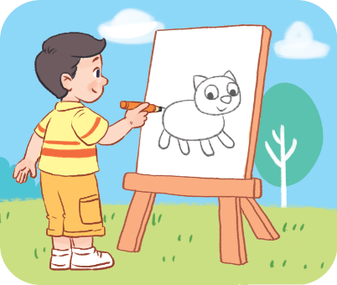
Click on the picture to choose the right answer.
Choose the right answer.
drawing
a
b
c

Slide 25
Choose the right answer.
Click on the picture to choose the right answer.
a
b
c

Slide 26
Click on the picture to choose the right answer.
Choose the right answer.
a
b
c

Slide 27
Click on the picture to choose the right answer.
Choose the right answer.
a
b
c

Slide 28
Choose the right answer.
Click on the picture to choose the right answer.
a
b
c

Slide 29
Facebook : Bùi Liễu
0968142780
Thank you!
Notes:
Facebook : Bùi Liễu
Mobile phone: 0968142780

Slide 30
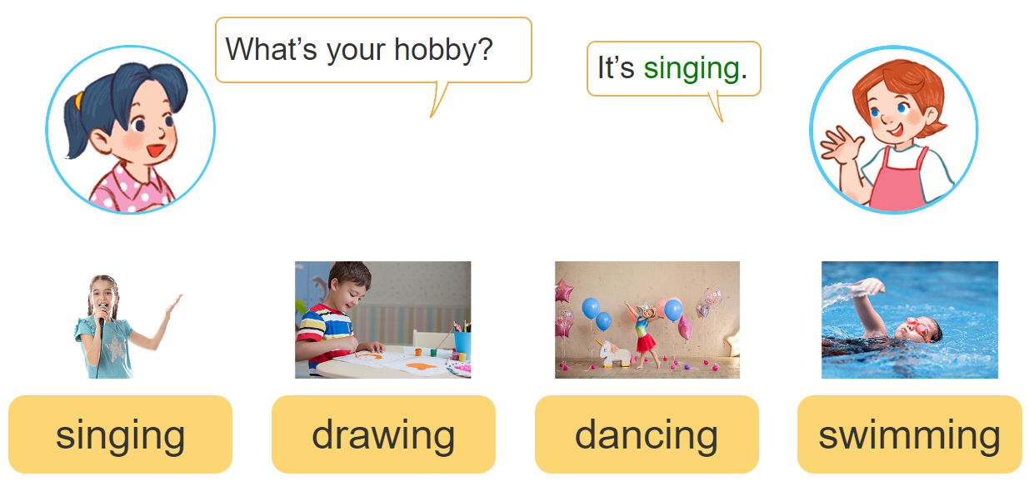
2. Listen, point and say.
a
b
c
d

Slide 31
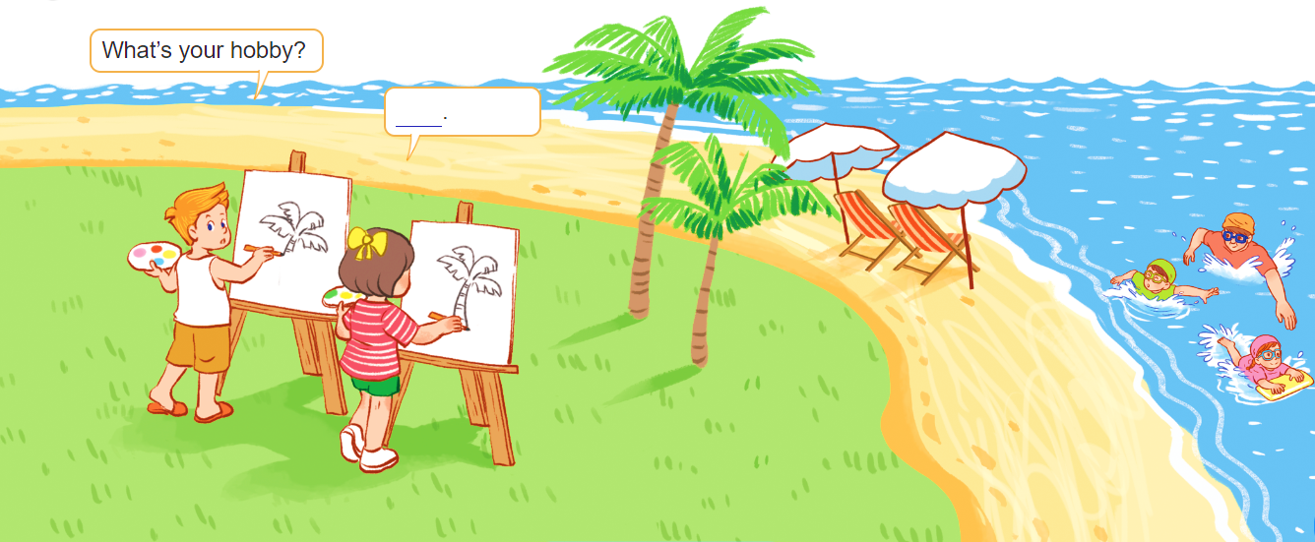
3. Let’s talk.

Slide 32
4. Listen and number.
4
3
2
1
a
b
c
d

Slide 33
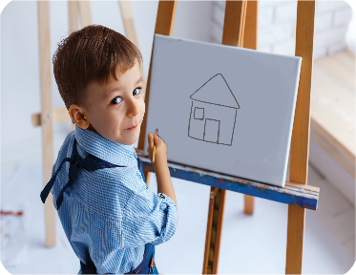
5. Read and match.
What’s your hobby?
a
1. It’s dancing.
b
2. It’s drawing.
c
3. It’s swimming.
4. It’s singing.
d
1 - c
2 - d
3 - a
4 - b

Slide 34
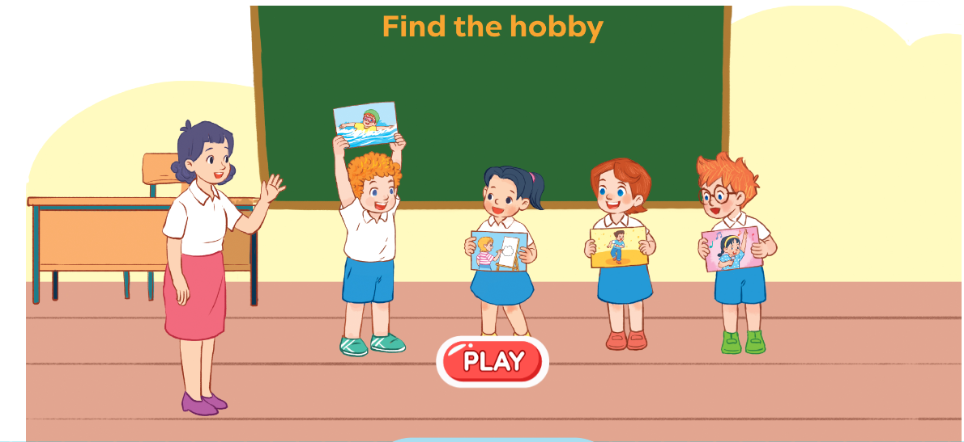
6. Let’s play.
Notes:
Facebook : Bùi Liễu
Mobile phone: 0968142780

Slide 35
Wrap up

Slide 36
Vocabulary
hobby
singing
drawing
dancing
swimming
Notes:
Facebook : Bùi Liễu
Mobile phone: 0968142780

Slide 37
Structures
Hỏi và trả lời về sở thích.
- What’s your hobby?
It’s _______.
(Sở thích của bạn là gì?)
What’s = what is
It’s = it is
(Đó là ________)

Slide 38
Homework
Learn by heart all the new words.
Read again the dialogue in part 1.

Slide 39
Facebook : Bùi Liễu
0968142780
Thank you!
Notes:
Facebook : Bùi Liễu
0968142780

