Slide 1
Our bodies
Unit
4
Lesson 1

Slide 2
Warm-up

Slide 3
Let’s sing.

Slide 4
Contents
Look, listen and repeat.
Listen, point and say.
Let’s talk.
Listen and tick.
Look, complete and read.
Let’s sing.

Slide 5
1. Look, listen and repeat.

Slide 6
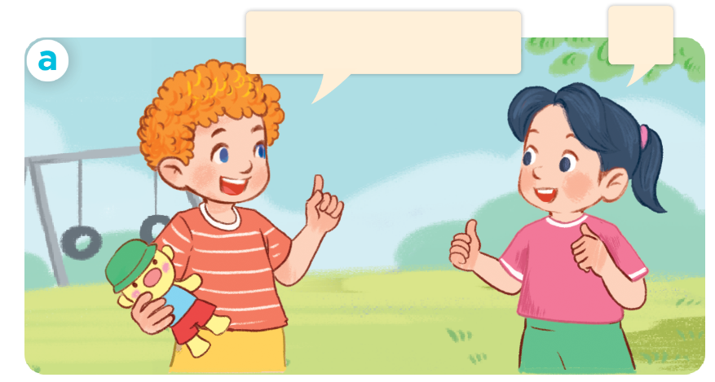
1. Look, listen and repeat.
Let’s play a game!
OK.

Slide 7
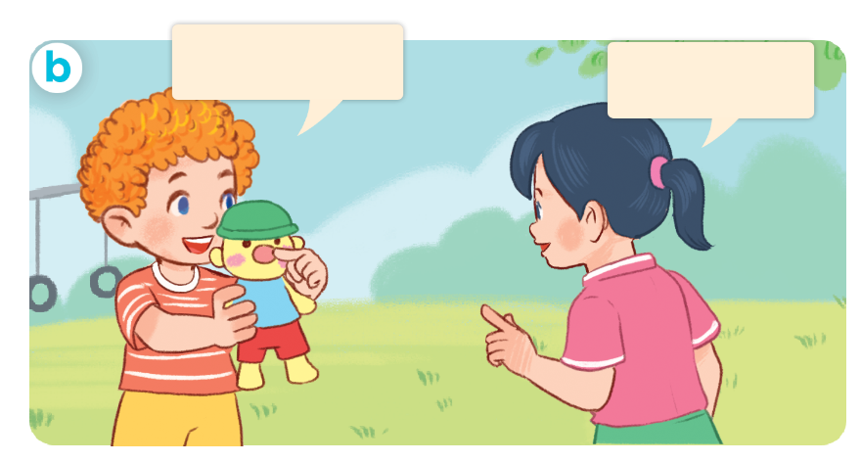
1. Look, listen and repeat.
What’s this.
It’s a nose.

Slide 8
Vocabulary
Notes:
Facebook : Bùi Liễu
Mobile phone: 0968142780

Slide 9
Vocabulary
body
/ˈbɒd.i/
cơ thể

Slide 10
Vocabulary
face
/feɪs/
mặt

Slide 11
Vocabulary
hand
/hænd/
bàn tay

Slide 12
Vocabulary
ear
/ɪə/
tai
Notes:
Facebook : Bùi Liễu
Mobile phone: 0968142780

Slide 13
Vocabulary
eye
/aɪ/
mắt

Slide 14
Review
body
face
hand
ear
eye

Slide 15
Vocabulary
body: cơ thể
face: mặt
hand: bàn tay
ear: tai
eye: mắt

Slide 16
1. Look, listen and repeat.

Slide 17
Structures

Slide 18
Structures
Hỏi và trả lời về bộ phận cơ thể.
- What’s this?
It’s _______.
(Đây là gì?)
(Đó là ….)
It’s = it is

Slide 19
Let’s play!

Slide 21
A. eye
B. ear
C. hand
D. hair
It’s an ear.

Slide 22
A. ear
B. eye
C. face
D. hand
It’s a hand.

Slide 23
A. eye
B. hand
C. face
D. ear
It’s a face.

Slide 24
A. hand
B. eye
C. ear
D. face
It’s an eye.

Slide 25
Thank you!

Slide 26
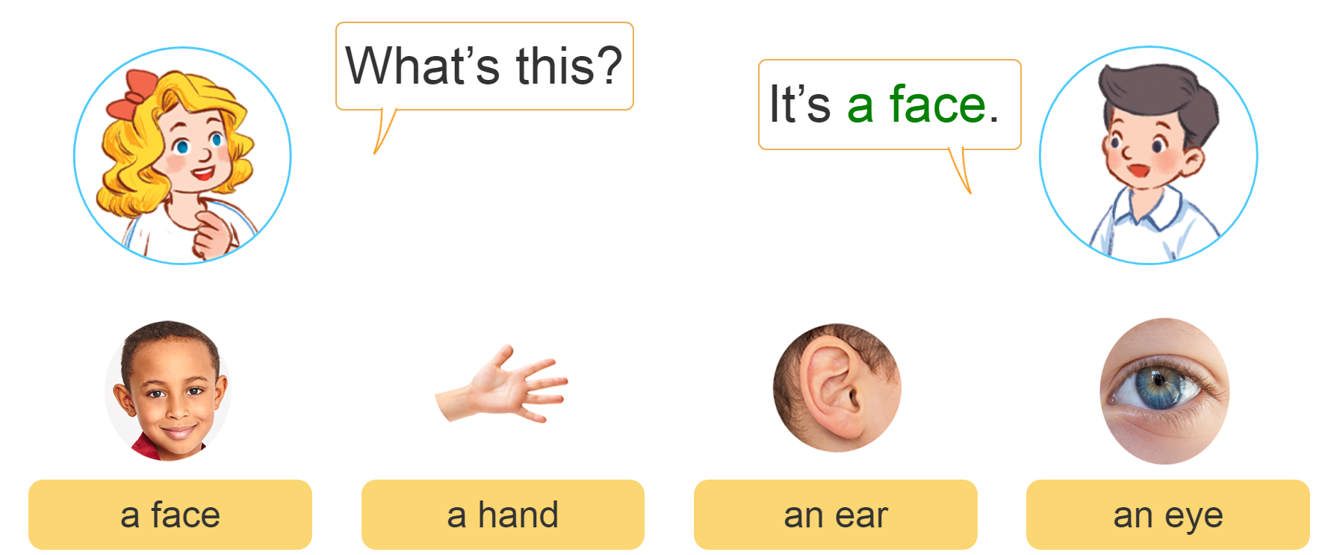
2. Listen, point and say.
a
b
c
d

Slide 27
3. Let’s talk.
1
What’s this?
1
5
5
2
2
4
4
It’s an ear
3
_________.
3
It’s a nose
It’s an eye
It’s a face
It’s a hand

Slide 28
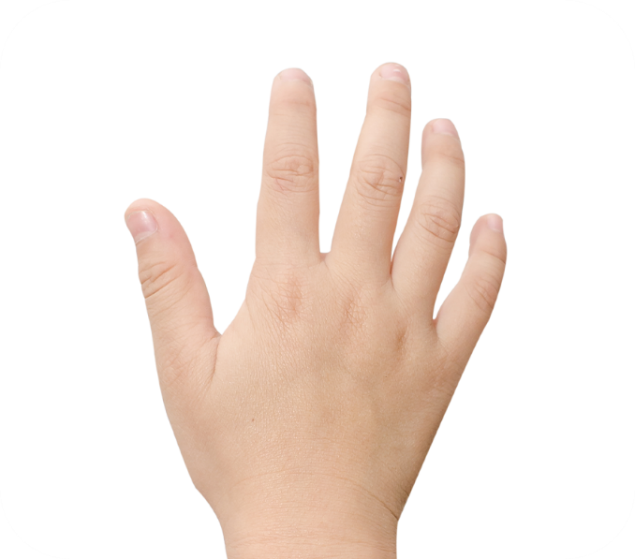
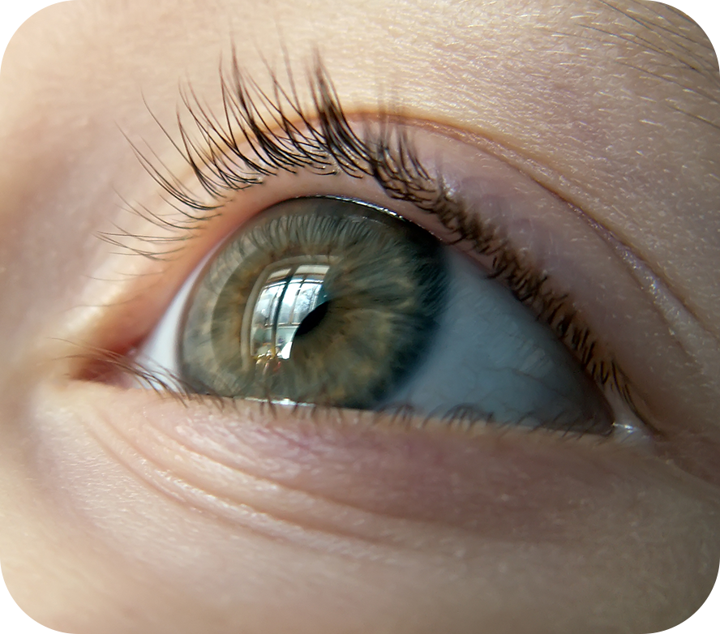
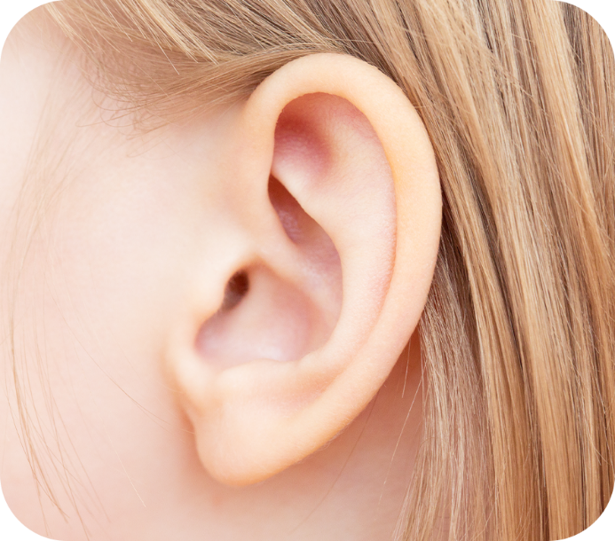
4. Listen and tick.
1
a
b
2
c
d

Slide 29
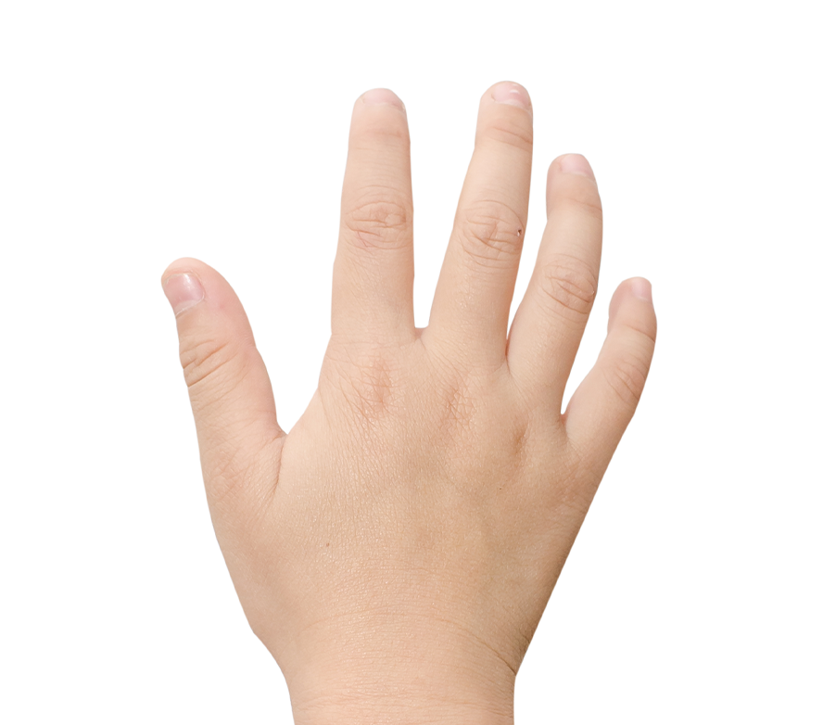
4. Listen and tick.
a
1
b

Slide 30
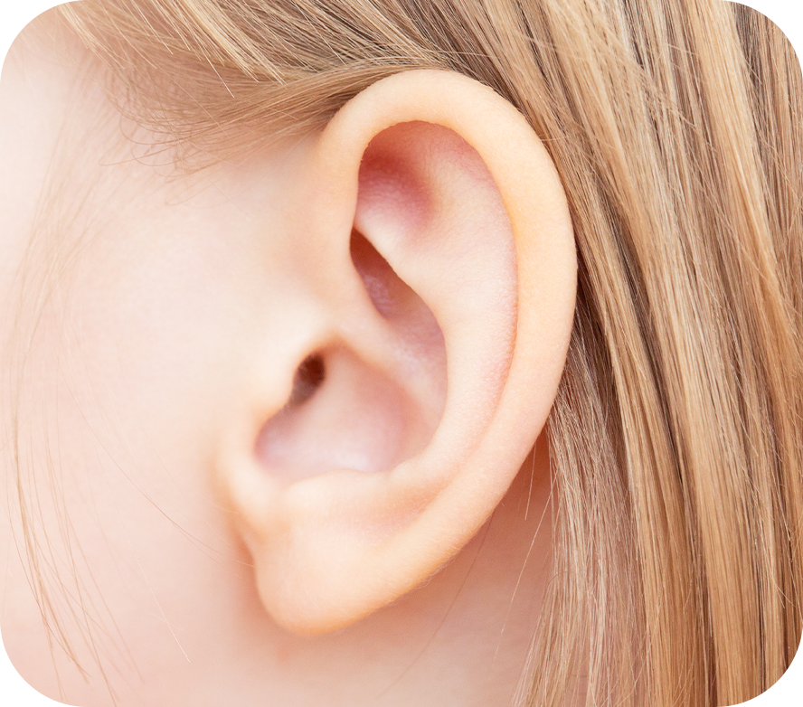
4. Listen and tick.
a
2
b

Slide 31
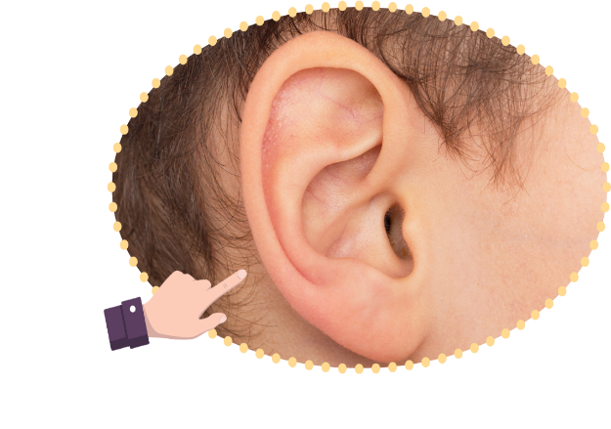
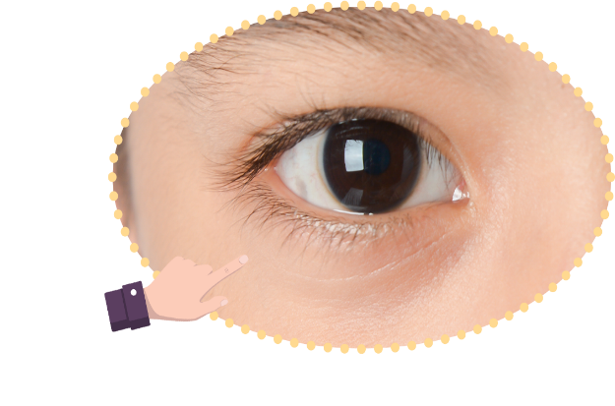
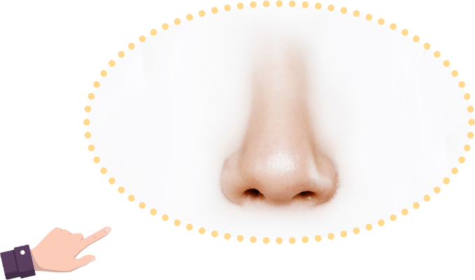
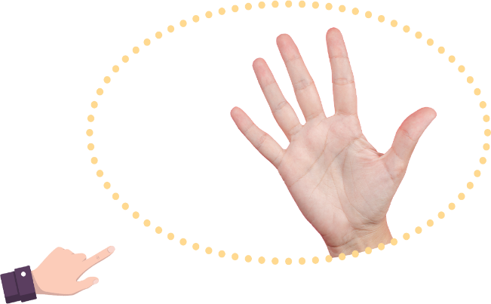
5. Look, complete and read.
1. What’s this?
It’s ________.
2. What’s this?
It’s ________.
3. What’s this?
It’s ________.
4. What’s this?
It’s ________.

Slide 32
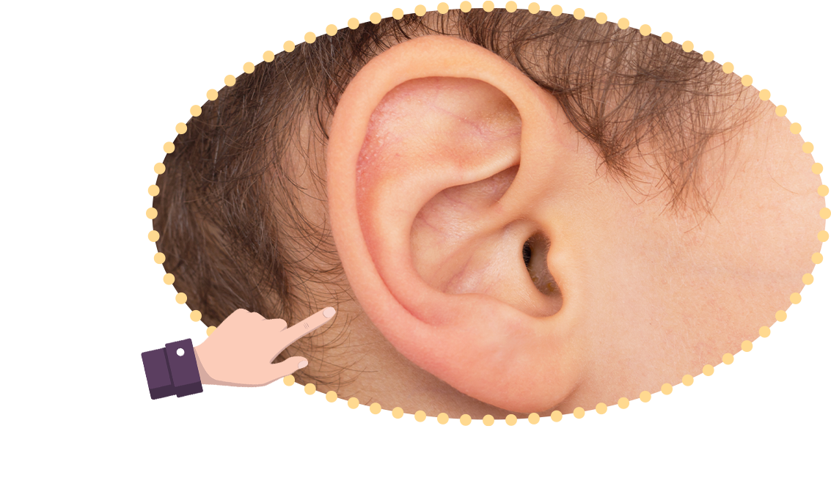
5. Look, complete and read.
1. What’s this?
It’s ________.
an ear
Notes:
Facebook : Bùi Liễu
Mobile phone: 0968142780

Slide 33
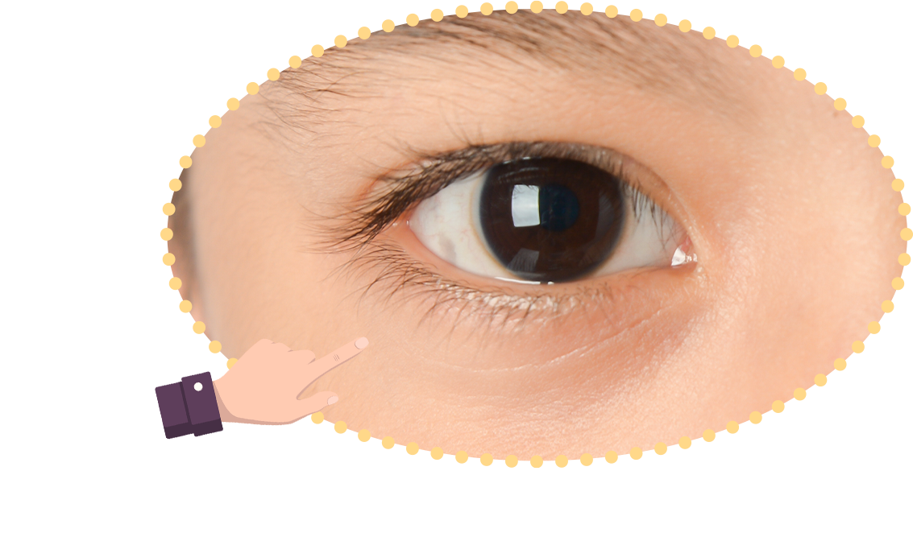
5. Look, complete and read.
2. What’s this?
It’s ________.
an eye
Notes:
Facebook : Bùi Liễu
Mobile phone: 0968142780

Slide 34
5. Look, complete and read.
3. What’s this?
It’s ________.
a nose

Slide 35
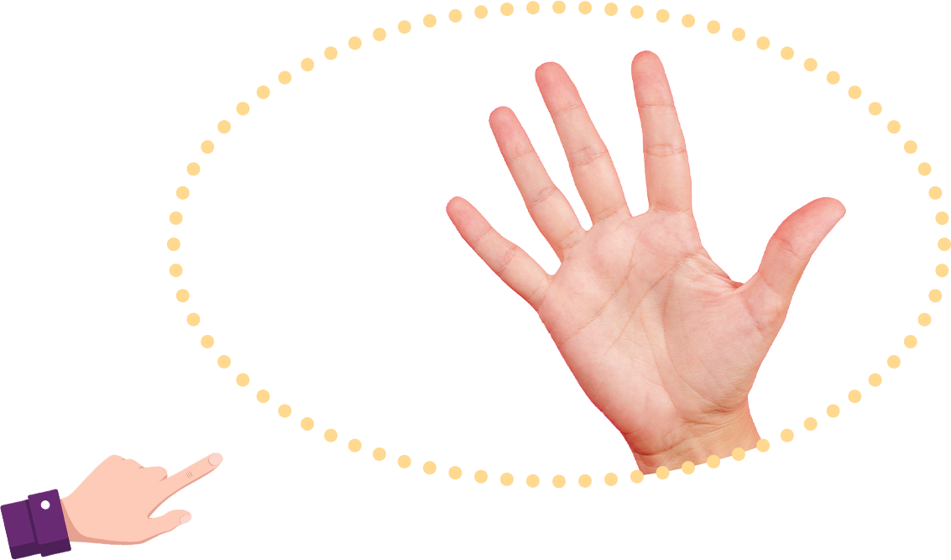
5. Look, complete and read.
4. What’s this?
It’s ________.
a hand
Notes:
Facebook : Bùi Liễu
Mobile phone: 0968142780

Slide 36
6. Let’s sing.
Parts of the body
What’s this? It’s an eye
What’s this? It’s an ear.
An eye and an ear.
What’s that? It’s a face.
What’s that? It’s a hand.
A face and a hand.
Notes:
Facebook : Bùi Liễu
Mobile phone: 0968142780

Slide 37
6. Let’s sing.
Parts of the body
What’s this? It’s an eye
What’s this? It’s an ear.
An eye and an ear.
What’s that? It’s a face.
What’s that? It’s a hand.
A face and a hand.

Slide 38
Wrap up

Slide 39
Review
body
face
hand
ear
eye
Notes:
Facebook : Bùi Liễu
Mobile phone: 0968142780

Slide 40
Structures
Hỏi và trả lời về bộ phận cơ thể.
- What’s this?
It’s _______.
(Đây là gì?)
(Đó là ….)
It’s = it is

Slide 41
Homework
Learn by heart all the new words.
Read again the dialogue in part 1.

Slide 42
Thank you!

