Slide 1
Our friends
Unit
3
Lesson 3

Slide 2
Contents
Listen and repeat.
Listen and tick.
Let’s chant.
Read and match.
Let’s write.
Project.
.

Slide 3
Warm-up

Slide 4
Let’s play!

Slide 5
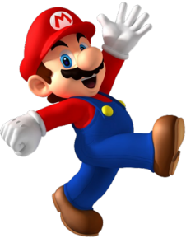
PLAY

Slide 6
Ms Huyền Phạm
0936.082.789

Slide 7
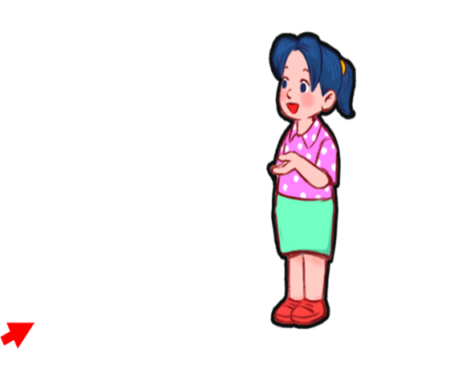
B. That is
A. This is
C. Is this
________ Mai.

Slide 8
B. That is
A. Is that
C. This is
________ Linh.

Slide 9
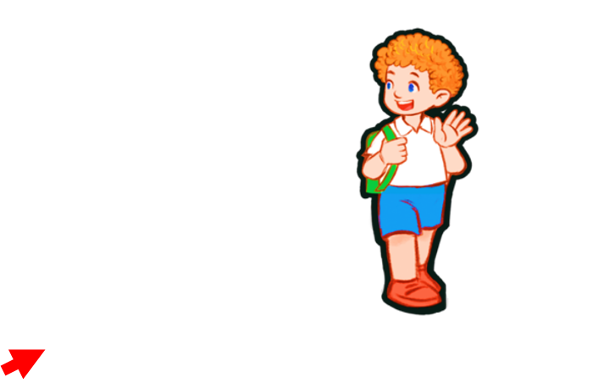
B. This is
A. That’s
C. Is this
________ Bill.

Slide 10
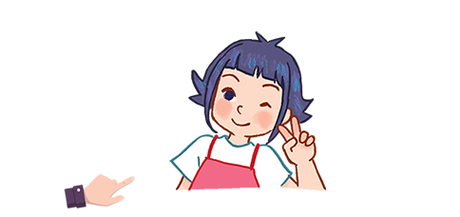
B. Is this
A. This is
C. Is that
________ Linh?

Slide 11
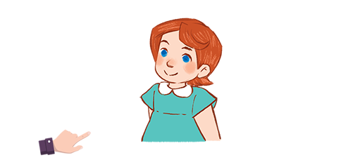
B. That is
A. Is that
C. Is this
________ Lucy?

Slide 12
B. Is that Ben?
A. Is this Bill?
C. Is that Minh?
_______________?
No, it isn’t. It’s Ben.

Slide 13
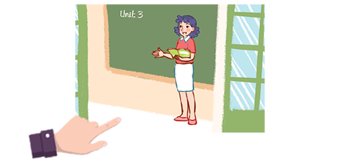
B. Is that Ms Lien?
A. This is Ms Loan.
C. Is this Ms Loan.
__________________?
No, it isn’t. It’s Ms Hoa.

Slide 14
A. False
B. True
Is this Ben?

Slide 15
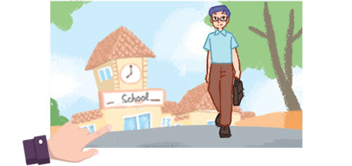
A. False
B . True
Is this Mr Long?

Slide 16
EXIT

Slide 17
1. Listen and repeat.
https://youtu.be/dngrxphHjRw?si=yzql712nLWKLtn20
Link phát âm
Notes:
Facebook : Bùi Liễu
Mobile phone: 0968142780

Slide 18
2. Listen and tick.
2. a. That’s Lucy.
b. Thank you, Lucy
c. Thank you, Bill.
1. a. That’s Bill.
b. Thank you, Bill
c. That’s Lucy.
Tick the squares to show answer.
Notes:
Facebook : Bùi Liễu
Mobile phone: 0968142780

Slide 19
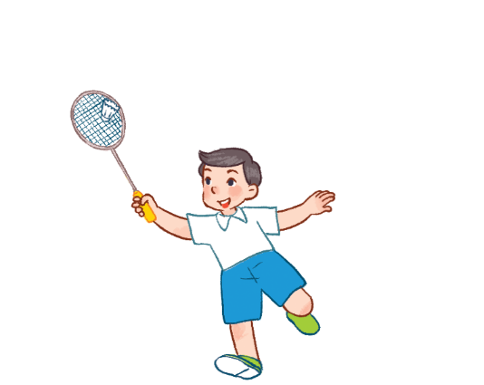
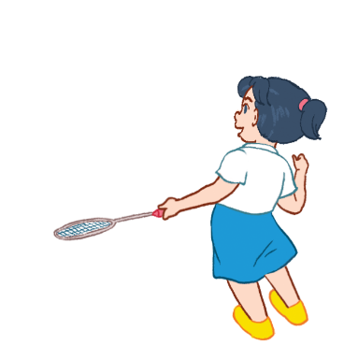
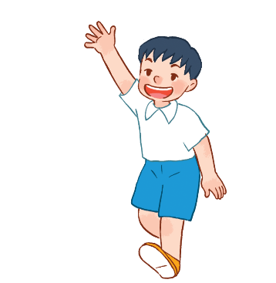
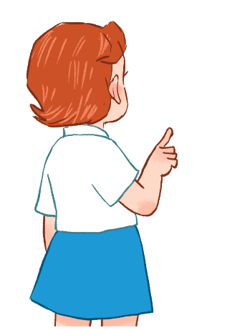
3. Let’s chant.
Is that Mai?
Hello, Mary.
Yes, it is.
Hello, Mary.
Is that Minh?
How are you?
No, it isn’t.
I’m fine, thank you.
It’s Nam. It’s Nam.
I’m fine, thank you.

Slide 20
3. Let’s chant.
Is that Mai?
Hello, Mary.
Yes, it is.
Hello, Mary.
Is that Minh?
How are you?
No, it isn’t.
I’m fine, thank you.
It’s Nam. It’s Nam.
I’m fine, thank you.

Slide 21
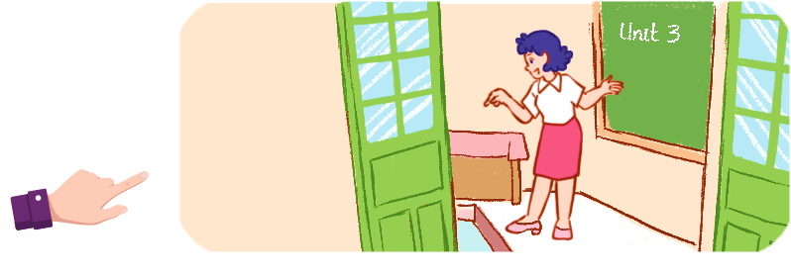
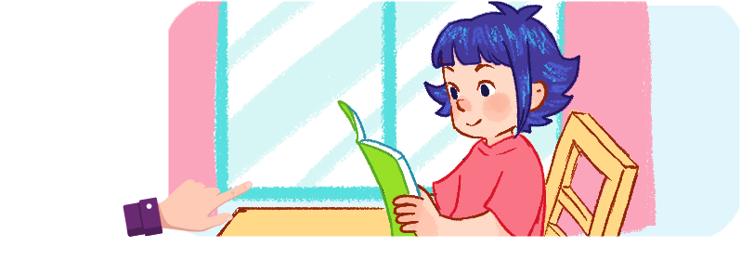
4. Read and match.
1. My name’s Nam.
a
2. This is my teacher, Mr. Long.
b
3. That’s my teacher, Ms. Hoa.
c
4. This is my friend, Linh.
1 - d
2 - c
3 - a
4 - d
D

Slide 22
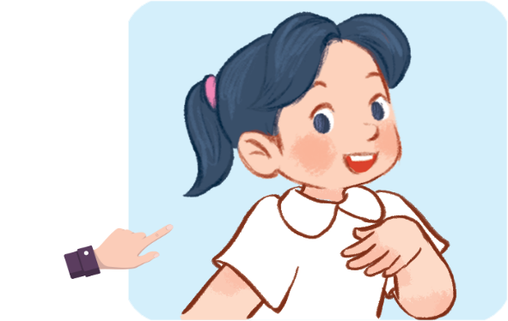
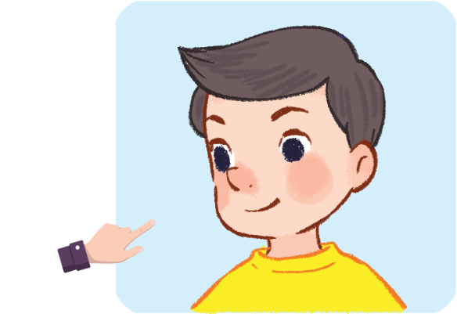
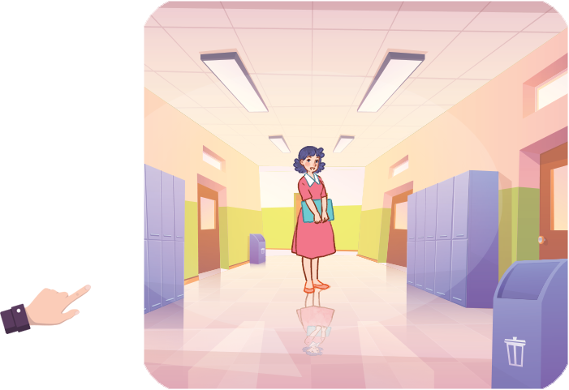
5. Let’s write.
1. This ___ my friend, Mai.
is
2. _________friend, Nam.
This is my
3. ____________________, Ms Hoa.
That’s/that is my teacher

Slide 23
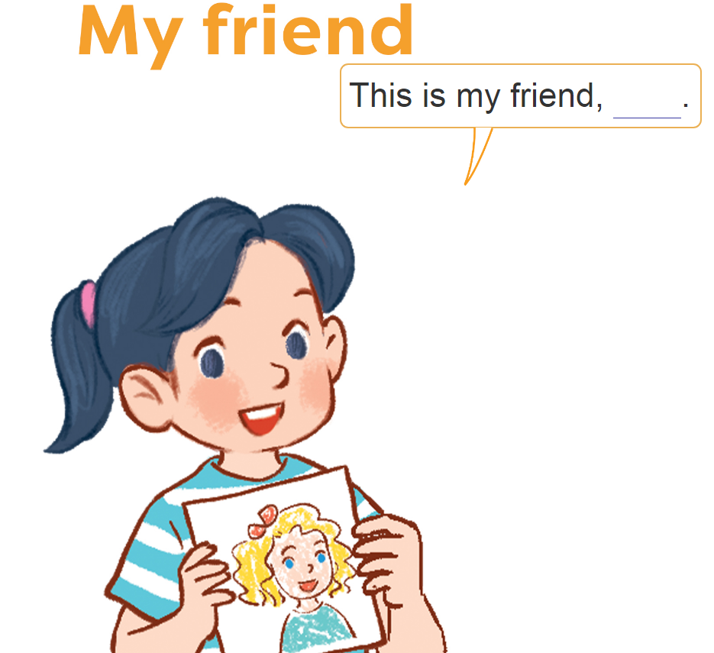
6. Project.

Slide 24
Facebook : Bùi Liễu
0968142780
Wrap up unit 3

Slide 25
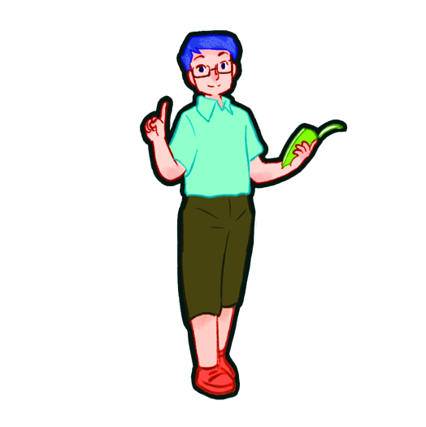
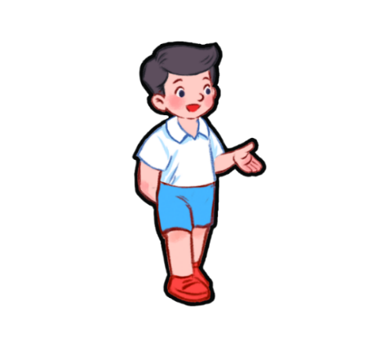
Vocabulary
Mr Long
Ms
Hoa
Mr
Miss
this
it
that
friend
it
teacher

Slide 26
Structures
1. Giới thiệu một người đang ở gần mình.
This is ______.
2. Giới thiệu một người đang ở xa mình.
That’s ______.
Ví dụ:
(that’s = that is)
This is Mai. (Đây là Mai.)
That’s Lucy. (Kia/đó là Lucy.)
Notes:
Facebook : Bùi Liễu
0968142780

Slide 27
Vocabulary
Facebook : Bùi Liễu
0968142780
- Yes : vâng, ừ
- No : không

Slide 28
* Hỏi đây/kia là ai đó phải không.
Is this/ that + ______?
(Đây/kia là ___ có phải không?)
Yes, it is.
(Vâng, đúng vậy)
No, it isn’t.
It’s _____.
(Không, không phải).
Đó là _______/.

Slide 29
Homework
Do exercises in your workbooks.

Slide 30
Facebook : Bùi Liễu
0968142780
Thank you!
Notes:
Facebook : Bùi Liễu
0968142780

