Slide 1
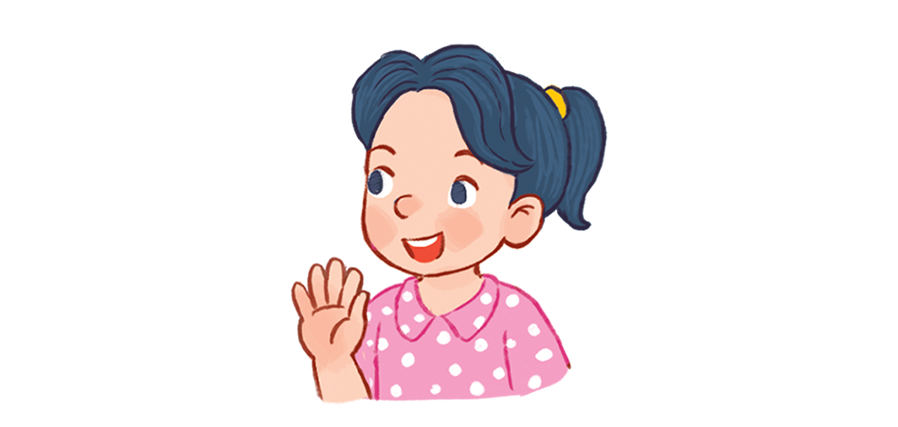

Hello
Unit
1
Lesson 3

Slide 2
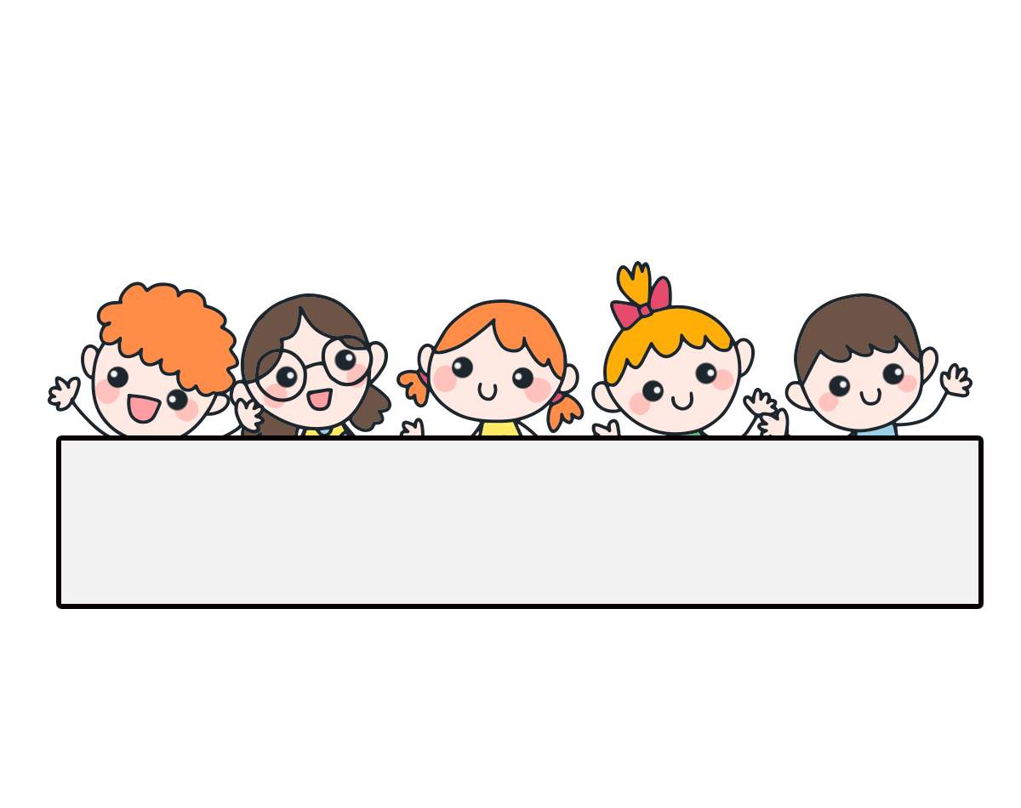
Warm-up

Slide 3

Let’s play!

Slide 4
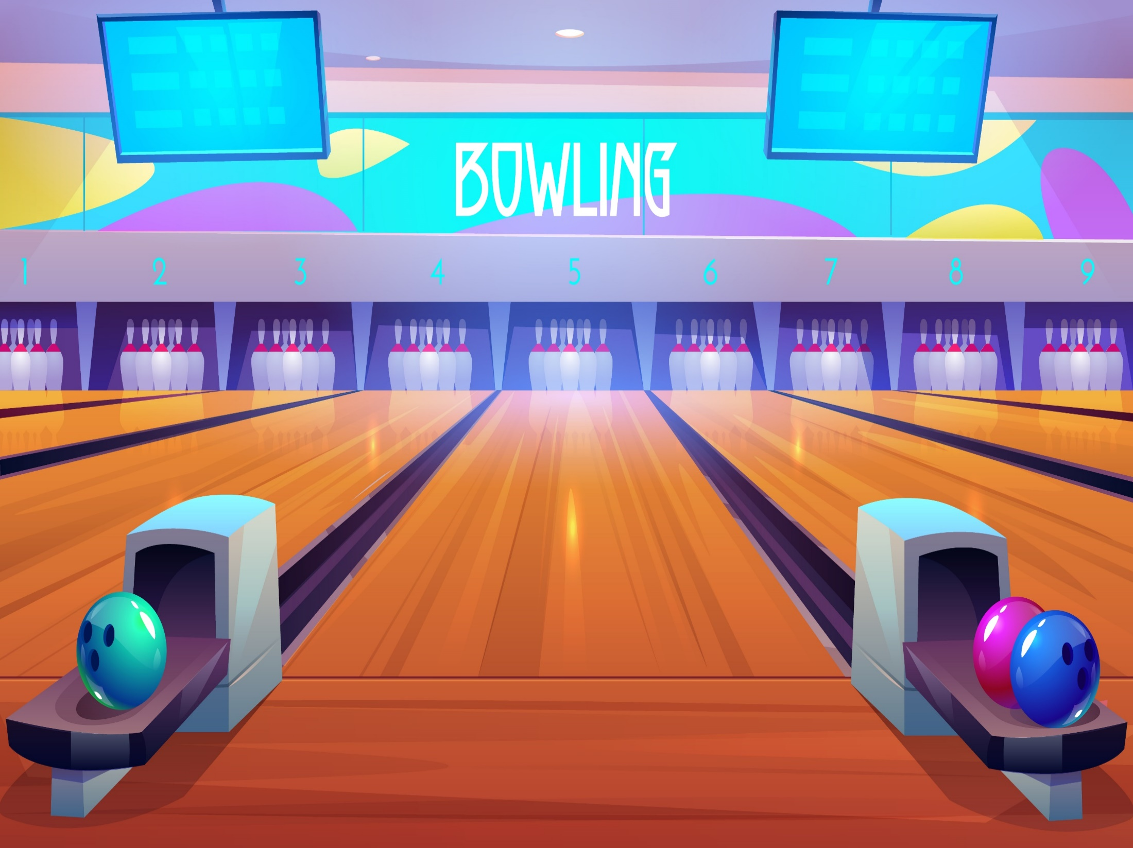

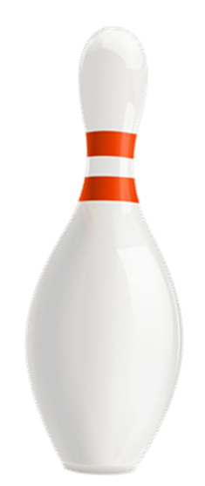


Facebook : Bùi Liễu
0968142780
Notes:
Facebook : Bùi Liễu Mobile phone: 0968142780

Slide 5
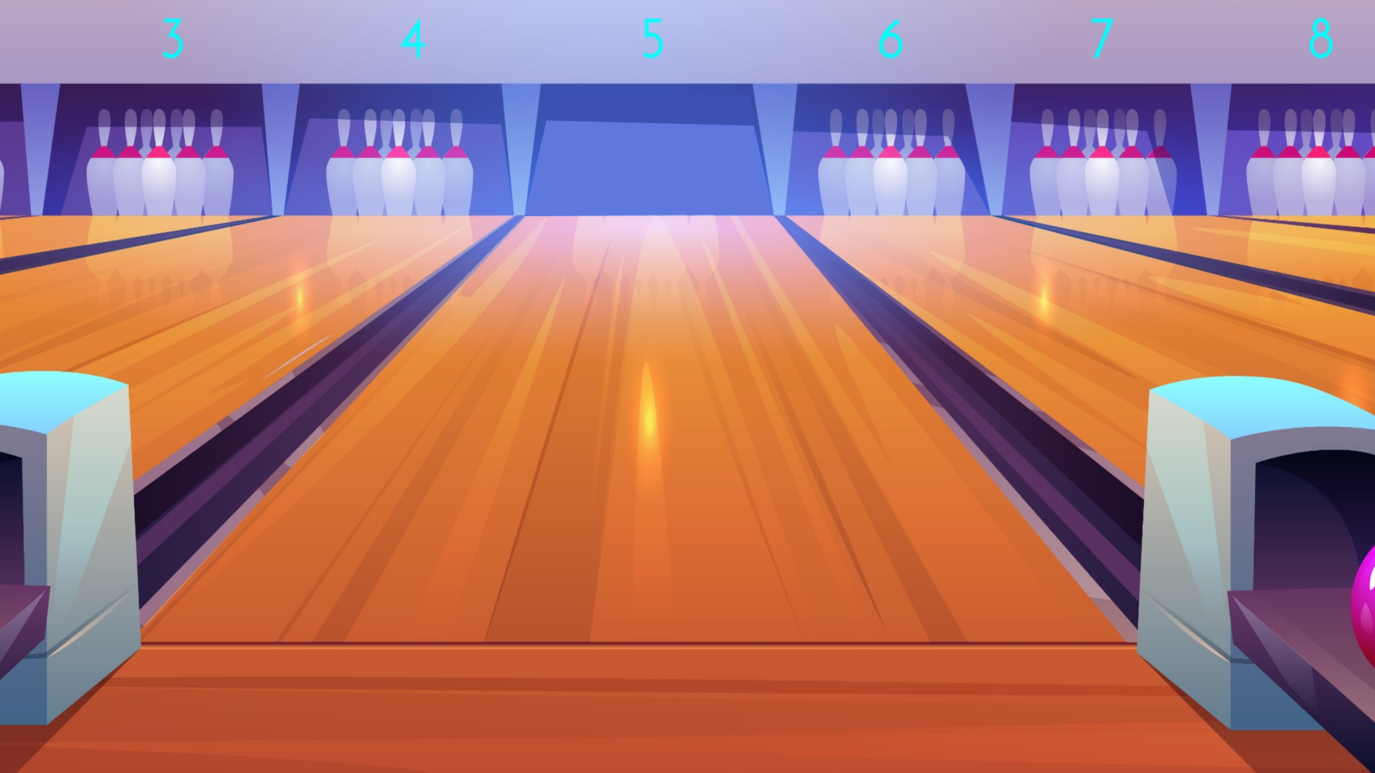





A. bye
Facebook : Bùi Liễu
0968142780
B. Hi
Linh: Hi.
Lucy: _____.
C. goodbye
Next
Notes:
Facebook : Bùi Liễu Mobile phone: 0968142780

Slide 6
A. Hello
Facebook : Bùi Liễu
0968142780
Bill: Hello
Ben: ______.
B. Goodbye
C. Fine.
Next
Notes:
Facebook : Bùi Liễu Mobile phone: 0968142780

Slide 7
A. Goodbye.
Facebook : Bùi Liễu
0968142780
Linh: How are you?
Mary: _____________.
B. Hi. I’m Linh.
C. Fine. Thank you.
Next
Notes:
Facebook : Bùi Liễu Mobile phone: 0968142780

Slide 8
A. Nice to meet you.
Facebook : Bùi Liễu
0968142780
meet-to-nice-you
B. Nice meet you too.
C. Nice to you meet.
Next
Notes:
Facebook : Bùi Liễu Mobile phone: 0968142780

Slide 9
A. How you are?
Facebook : Bùi Liễu
0968142780
Nam: ___________.
Minh: Fine. Thanks
B. How are you?
C. How old are you?
Next
Notes:
Facebook : Bùi Liễu Mobile phone: 0968142780

Slide 10
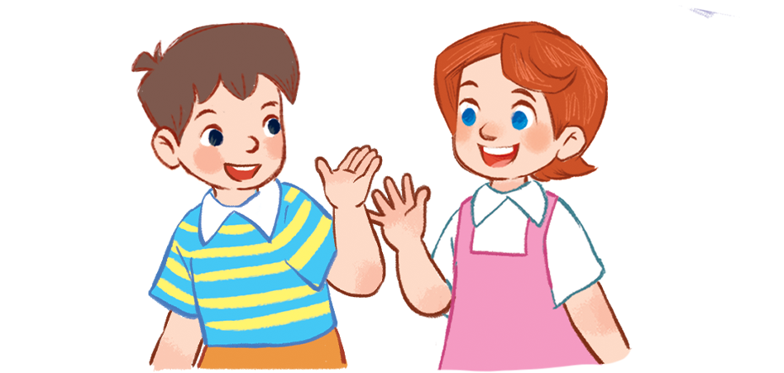
A. Thanks.
Facebook : Bùi Liễu
0968142780
B. Bye.
C. Thank you.
Next
Notes:
Facebook : Bùi Liễu Mobile phone: 0968142780

Slide 11
A. Goodbye, teacher.
Facebook : Bùi Liễu
0968142780
Ms Hoa: Goodbye, class.
Students: ____________.
B. Hello, teacher.
C. Goodbye, class.
Next
Notes:
Facebook : Bùi Liễu Mobile phone: 0968142780

Slide 12
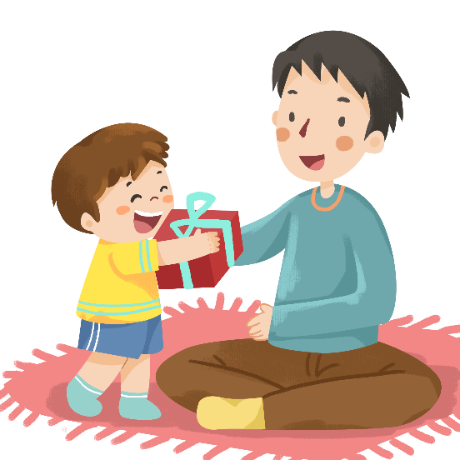
A. Goodbye
Facebook : Bùi Liễu
0968142780
B. How are you?
C. Thank you.
Next
Notes:
Facebook : Bùi Liễu Mobile phone: 0968142780

Slide 13

A. Goodbye.
Facebook : Bùi Liễu
0968142780
B. Bye.
C. Fine.
Next
Notes:
Facebook : Bùi Liễu Mobile phone: 0968142780

Slide 14

WELL DONE!
Facebook : Bùi Liễu
0968142780
Notes:
Facebook : Bùi Liễu Mobile phone: 0968142780

Slide 15






Contents
Facebook : Bùi Liễu
0968142780
Listen and repeat.
Listen and circle.
Let’s chant.
Read and circle.
Let’s write.
Project.
Notes:
Facebook : Bùi Liễu
Mobile phone: 0968142780

Slide 16
Vocabulary

Slide 17
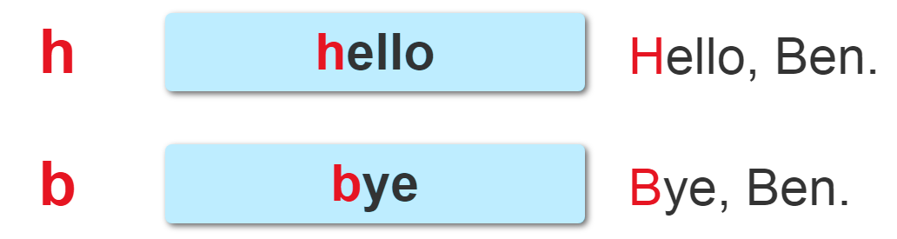

1. Listen and repeat.

Slide 18
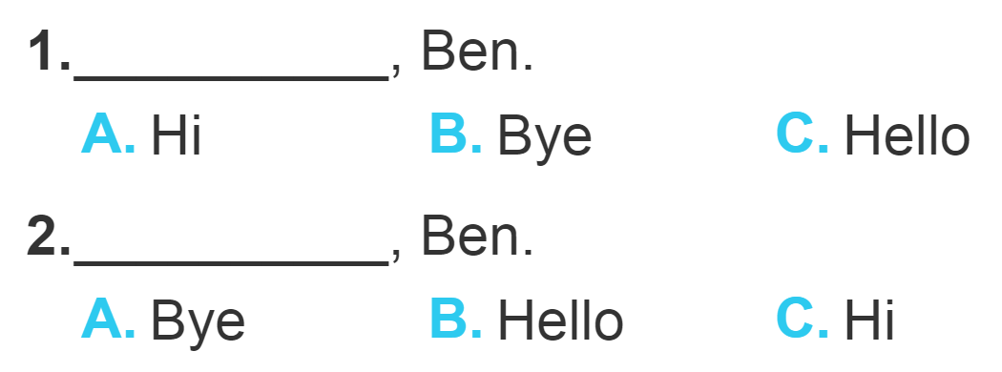
2. Listen and circle.

Slide 19
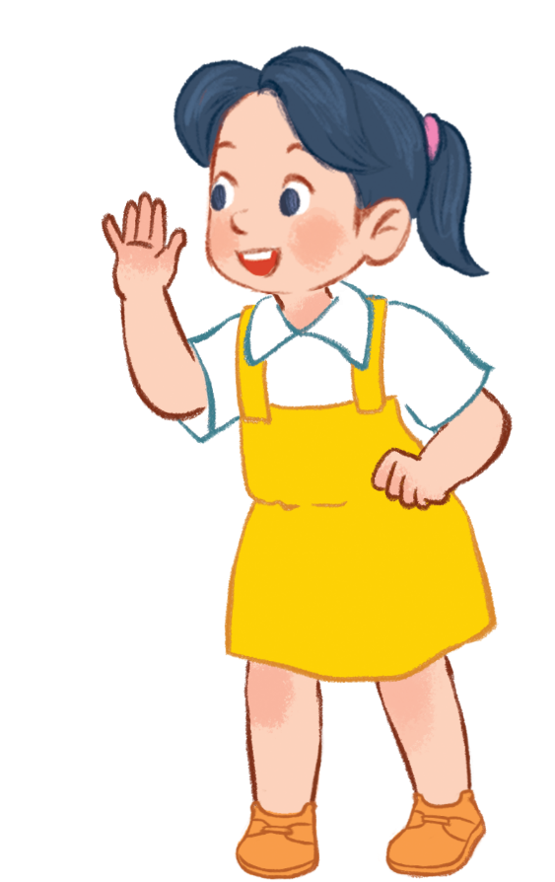
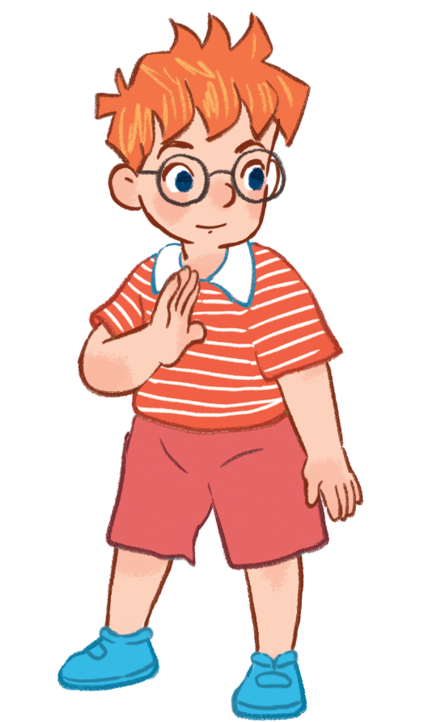
3. Let’s chant.
Hello.
I’m Ben.
Hello.
I’m Ben.
Hi, Ben.
Hi, Ben.
I’m Mai.
I’m Mai.
How are you, Ben?
Fine, thank you.
Bye, Ben.
Bye, Ben.
Bye, Mai.
Bye, Mai.

Slide 20

3. Let’s chant.
Hello.
I’m Ben.
Hello.
I’m Ben.
Hi, Ben.
Hi, Ben.
I’m Mai.
I’m Mai.
How are you, Ben?
Fine, thank you.
Bye, Ben.
Bye, Ben.
Bye, Mai.
Bye, Mai.

Slide 21
4. Listen and tick.
1. Hi. I’m Ben.
A. Bye, Ben. B. Hello, Ben. I’m Lucy.
2. Hello, Mai.
A. Hi, Ben. B. Goodbye, Ben.
3. Goodbye, Ben.
A. Bye, Mai. B. How are you?
4. How are you?
A. Hi, Ben. B. Fine, thank you.

Slide 22
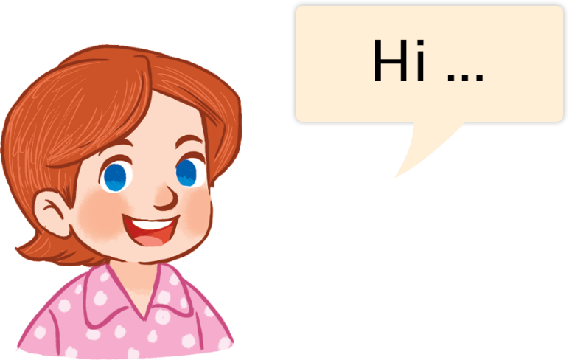
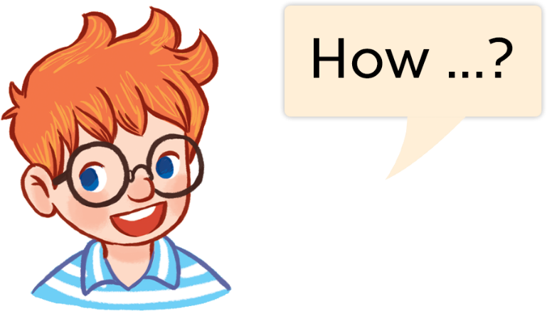
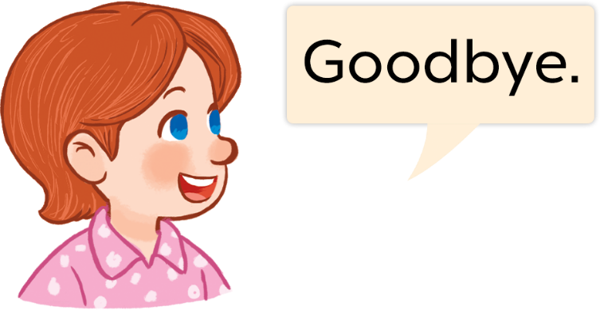
5. Look, complete and read.
Lucy: Hi. I’m Lucy.
You: Hello, Lucy. I’m _____.
Mai
Ben: How are you?
You: Fine, _________ .
thank you
Lucy: Goodbye.
You: __________.
Goodbye

Slide 23
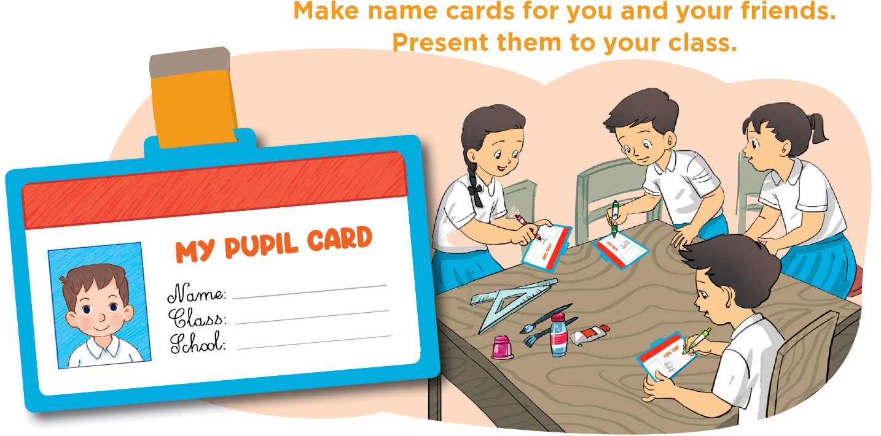
6. Let’s play.
Notes:
Facebook : Bùi Liễu
Mobile phone: 0968142780

Slide 24
6. Let’s play.
Pupil’s photo/
picture
Name: _____________
Class: _____________
School: ____________

Slide 25

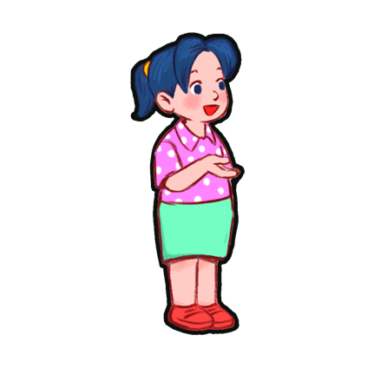


Vocabulary
Facebook : Bùi Liễu
0968142780
Ben
Lucy
Mai
Minh

Slide 26




Vocabulary
Hello
Hi
hello
= hi
/heˈləʊ/
/haɪ/
xin chào
I
/aɪ/
tôi, tớ

Slide 27
Grammar
1. Chào khi gặp nhau.
Hello/Hi
2. Giới thiệu tên mình.
I’m + name
(I am = I’m)
Ví dụ:
I'm Mai. (Mình tên là Mai.)
Hi, I'm Mai. (Xin chào, mình tên là Mai.)

Slide 28
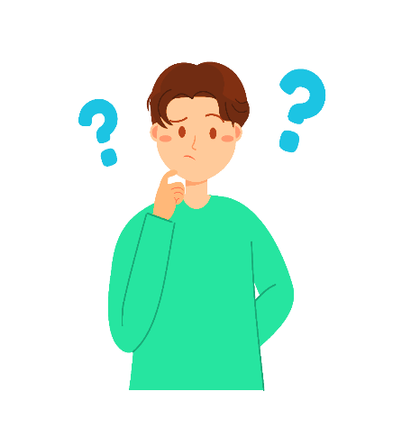


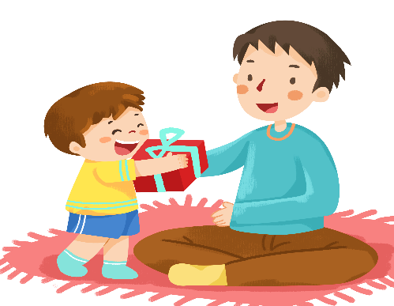
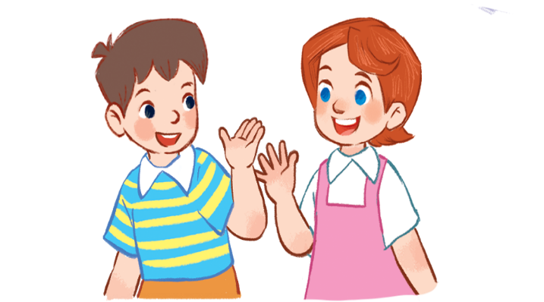

Vocabulary
Facebook : Bùi Liễu
0968142780
you
you
how
How are you
fine
Thank you= thanks
Goodbye = bye

Slide 29
Grammar
Facebook : Bùi Liễu
0968142780
1. Chào và hỏi sức khỏe.
Question: Hello/Hi. How are you?
(Xin chào. Bạn có khỏe không?)
Answer: Fine. Thank you.
(Mình khỏe. Mình cảm ơn.)
2. Chào tạm biệt.
Goodbye / bye.
(Tạm biệt.)

Slide 30

Facebook : Bùi Liễu
0968142780
Thank you!
Notes:
Facebook : Bùi Liễu
0968142780

