Slide 1
Hello
Unit
1
Lesson 2

Slide 2
Warm-up

Slide 3
Let’s sing.
Hello
Hello.
Hello.
I’m Ben.
Hi, Ben.
Hi, Ben.
I’m Mai.
Hello.
Hello.
I’m Minh.
Hi, Minh.
Hi, Minh.
I’m Lucy.
Notes:
Facebook : Bùi Liễu
Mobile phone: 0968142780

Slide 4
Contents
Look, listen and repeat.
Listen, point and say.
Let’s talk.
Listen and number.
Read and match.
Let’s play.
Notes:
Facebook : Bùi Liễu
Mobile phone: 0968142780

Slide 5
1. Look, listen and repeat.

Slide 6
1. Look, listen and repeat.
Fine, thank you.
Hi, Mai. How are you?
Notes:
Facebook : Bùi Liễu
Mobile phone: 0968142780

Slide 7
1. Look, listen and repeat.
Goodbye, Mai.
Bye, Ben.

Slide 8
Vocabulary

Slide 9
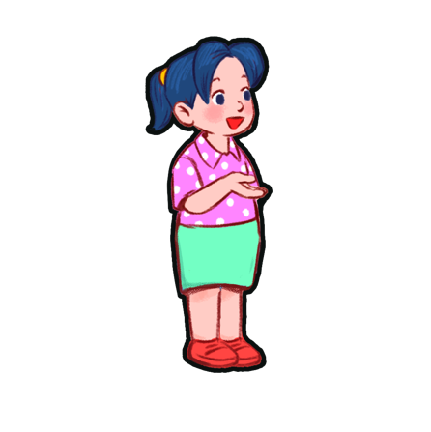
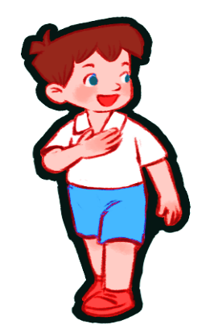
Vocabulary
you
you
/juː/
bạn

Slide 10
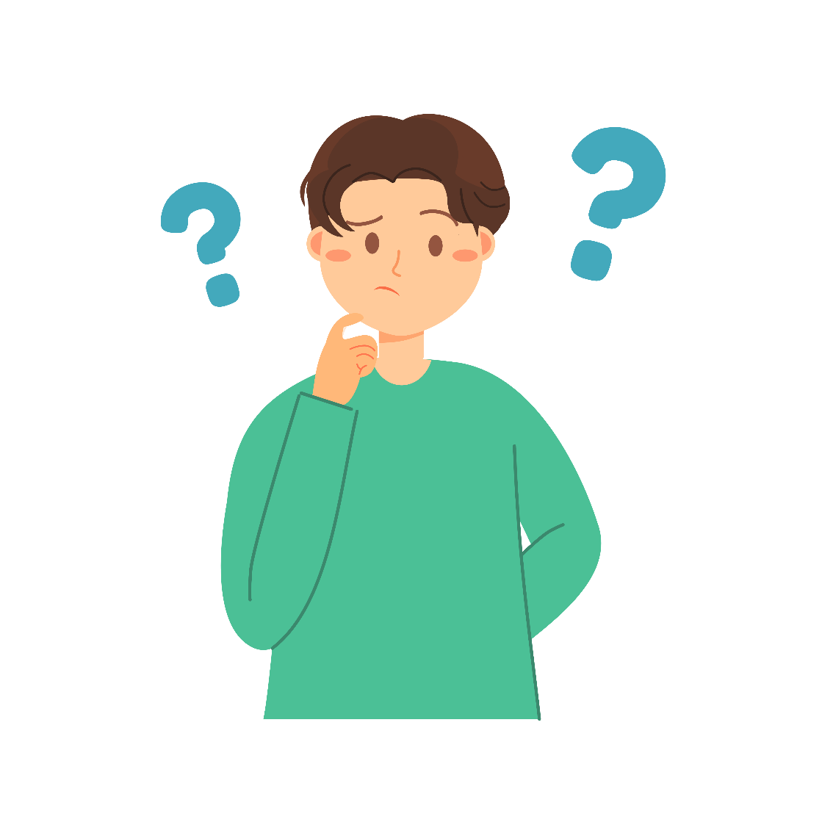
Vocabulary
How
/ haʊ /
như thế nào

Slide 11
Vocabulary
How are you?
/haʊ ɑː juː/
Bạn có khỏe không?

Slide 12
Vocabulary
fine
/faɪn/
khỏe, tốt

Slide 13
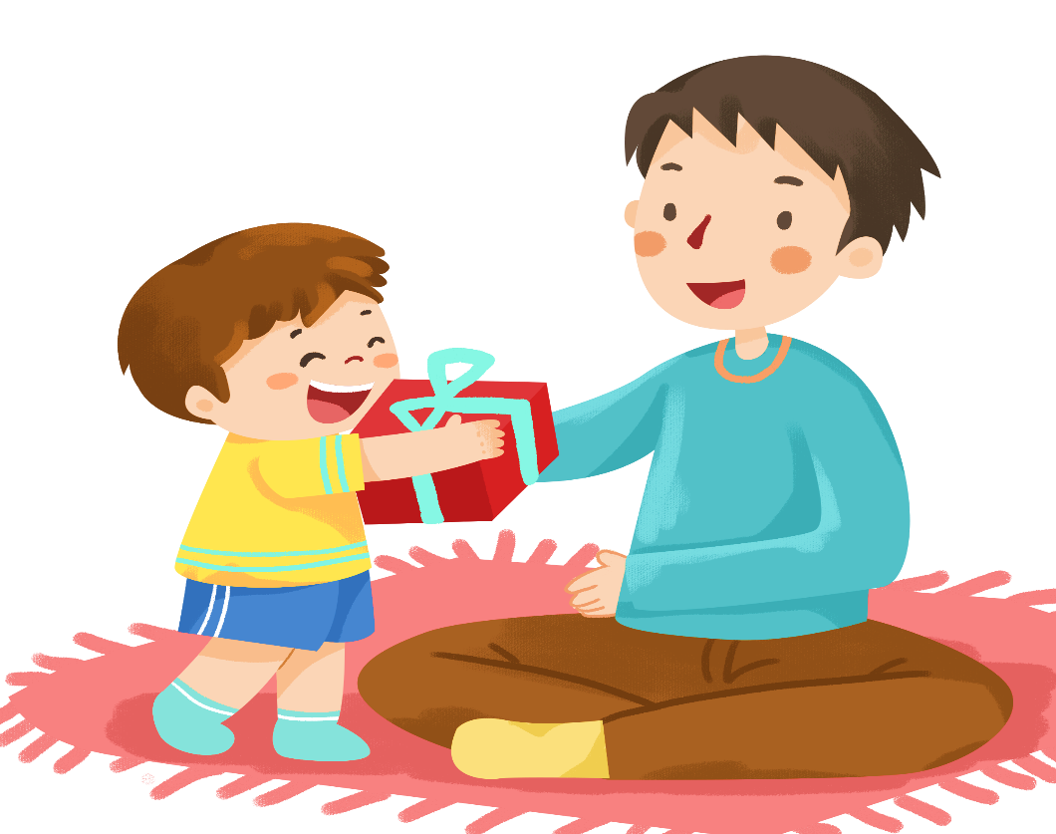
Vocabulary
Thank you
= Thanks
/θæŋk juː/
/θæŋks/
Cảm ơn bạn
Cảm ơn

Slide 14
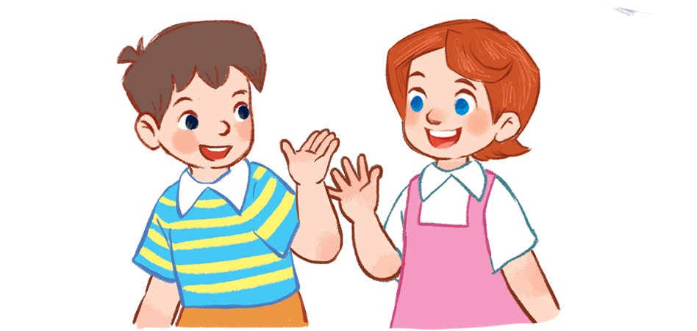
Vocabulary
Goodbye
= Bye
/ˌɡʊdˈbaɪ/
/baɪ/
Tạm biệt
Tạm biệt

Slide 15
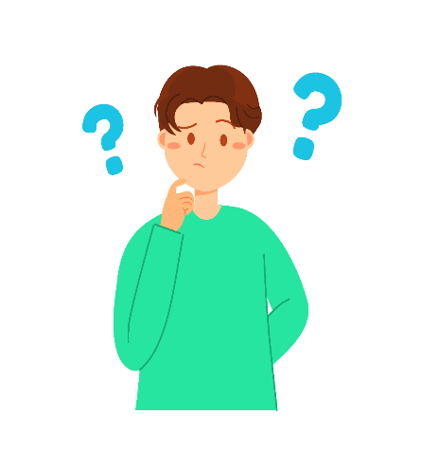
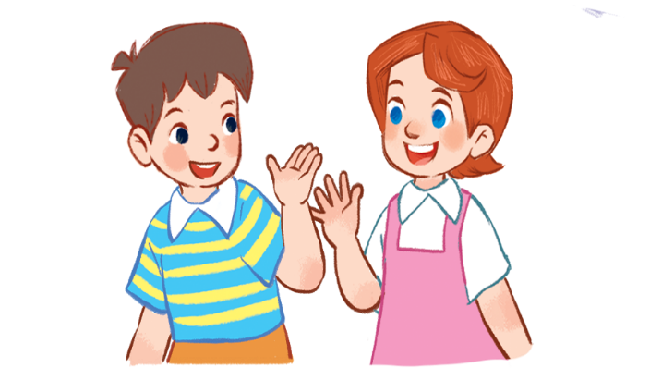
Review
you
you
how
How are you
fine
Thank you= thanks
Goodbye = bye

Slide 16
Vocabulary
- you
bạn
- how
như thế nào
- How are you?
Bạn có khỏe không?
- fine
khỏe, tốt
- Thank you
Cảm ơn bạn.
- Thanks
Cảm ơn.
- Goodbye
Tạm biệt.
- Bye
Tạm biệt.

Slide 17
Let’s play!

Slide 18
Can you guess?
Notes:
Facebook : Bùi Liễu
Mobile phone: 0968142780

Slide 19
1
2
3
Facebook : Bùi Liễu
0968142780
4
5
6
7
8
9
next
neb
Ben

Slide 20
1
2
3
4
5
6
7
8
9
next
Mai
ima

Slide 21
1
2
3
Facebook : Bùi Liễu
0968142780
4
5
6
7
8
9
next
inhm
Minh

Slide 22
1
2
3
4
5
6
7
8
9
next
cylu
Lucy

Slide 23
1
2
3
4
5
6
7
8
9
next
beydgoo
goodbye

Slide 24
1
2
3
you
4
5
6
Facebook : Bùi Liễu
0968142780
7
8
9
next
you
uyo

Slide 25
1
2
3
4
5
6
7
8
9
next
hwo aer ouy
How are you?

Slide 26
1
2
3
4
5
6
7
8
9
next
how
hwo

Slide 27
1
2
3
4
5
6
7
8
9
Facebook : Bùi Liễu
0968142780
next
oodg bey
Goodbye

Slide 28
1
2
3
Facebook : Bùi Liễu
0968142780
4
5
6
7
8
9
end
fine
ifne

Slide 29
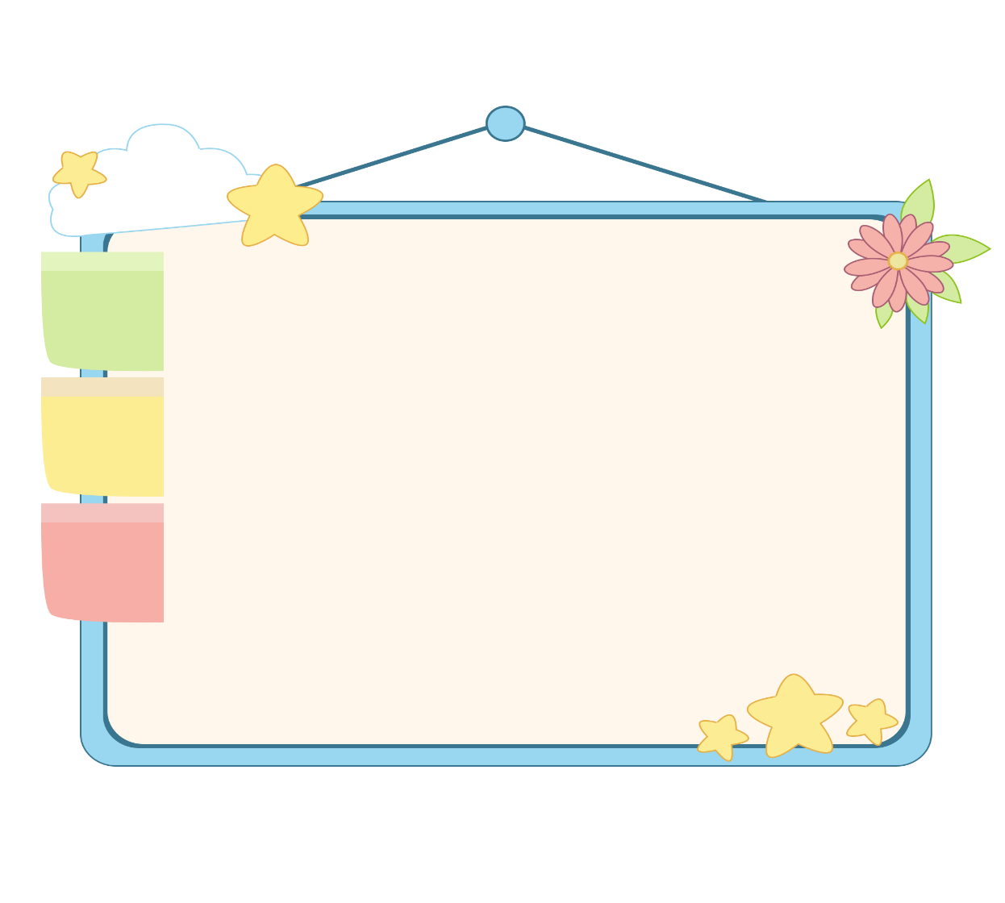
WELL DONE!

Slide 30
Structures

Slide 31
Grammar
1. Chào và hỏi sức khỏe.
Question: Hello/Hi. How are you?
(Xin chào. Bạn có khỏe không?)
Answer: Fine. Thank you.
(Mình khỏe. Mình cảm ơn.)
2. Chào tạm biệt.
Goodbye / bye.
(Tạm biệt.)

Slide 32
2. Listen, point and say.
Hi. How are you?
Good bye.
______, _________.
_________.
a
b

Slide 33
2. Listen, point and say.
Hi. How are you?
_____, __________.
Fine thank you
a

Slide 34
2. Listen, point and say.
Facebook : Bùi Liễu
0968142780
Good bye.
Bye
____.
b

Slide 35
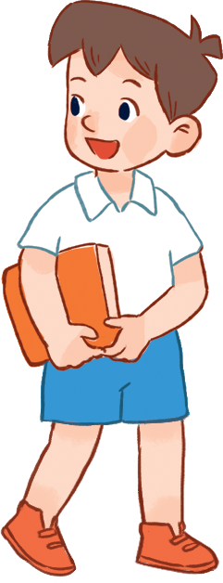
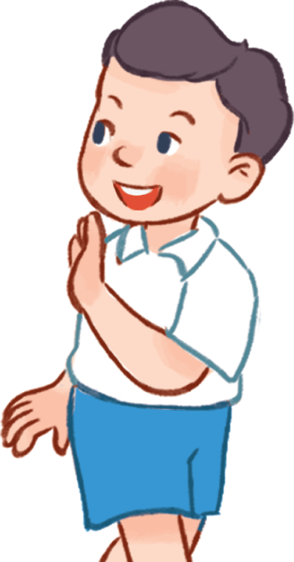
3. Let’s talk.
Hi. How are you?
Good bye / bye.
______, _________.
_________.
a
b

Slide 36
3. Let’s talk.
Hi. How are you?
_____, __________.
Fine thank you
a

Slide 37
3. Let’s talk.
Good bye / bye.
_____________.
Goodbye / Bye
b

Slide 38
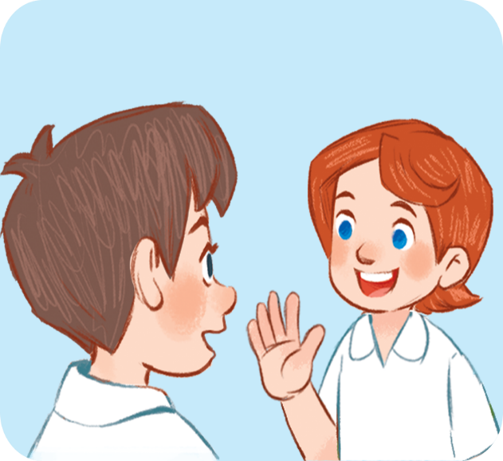
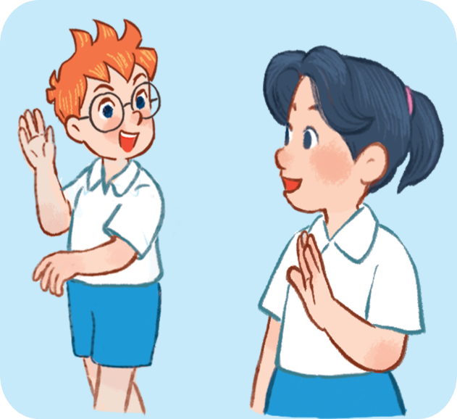
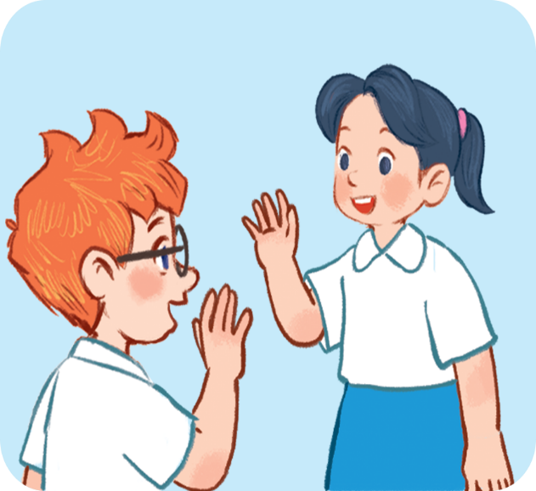
4. Listen and number.
3
4
2
1
a
b
c
d

Slide 39
5. Look, complete and read.
1. Hi. I’m Mai.
a. Fine, thank you.
2. Goodbye, Mai.
b. Hello, Mai. I’m Ben.
3. How are you, Mai?
c. Bye, Ben.
Facebook : Bùi Liễu
0968142780
1 - b
2 - c
3 - a
Notes:
Facebook : Bùi Liễu
Mobile phone: 0968142780

Slide 40
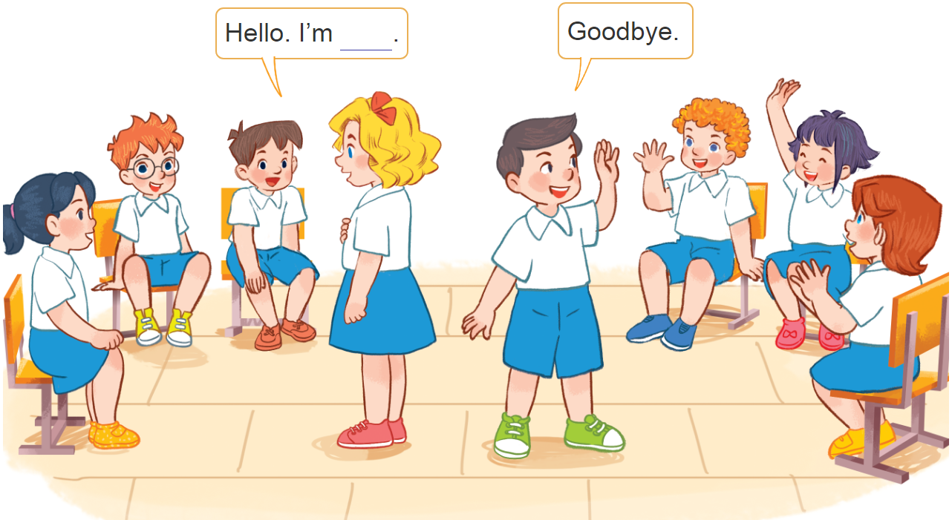
6. Let’s play.
Hello and goodbye

Slide 41
Wrap up

Slide 42
Wrap up
Facebook : Bùi Liễu
0968142780
you
you
how
How are you
fine
Thank you= thanks
Goodbye = bye

Slide 43
Grammar
1. Chào và hỏi sức khỏe.
Question: Hello/Hi. How are you?
(Xin chào. Bạn có khỏe không?)
Answer: Fine. Thank you.
(Mình khỏe. Mình cảm ơn.)
2. Chào tạm biệt.
Goodbye / bye.
(Tạm biệt.)

Slide 44
Homework
Learn by heart all the new words.
Read again the dialogue in part 1.

Slide 45
Thank you!

