Slide 1
Welcome to our class!

Slide 2
Warm-up

Slide 3
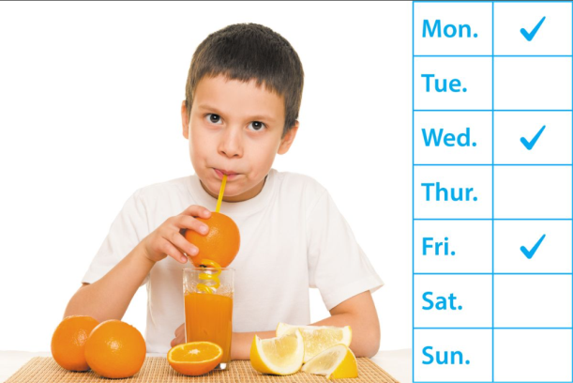
1/8
Read and guess.
+1
A: How often does he drink orange juice?
B: ___________________
Three times a week.
Check
Next

Slide 4
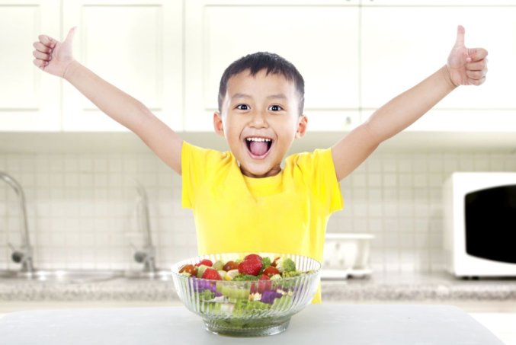
2/8
+2
A: How does he stay healthy?
B: __________________
He eats healthy food.
Check
Next

Slide 5
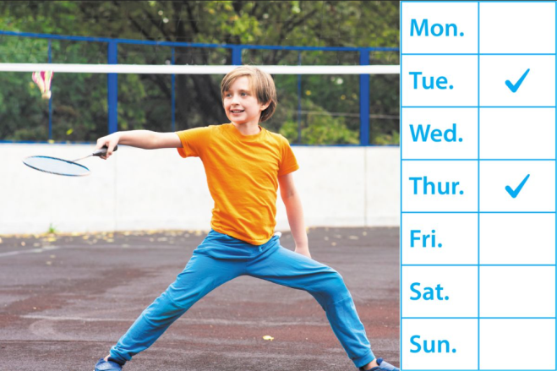
3/8
+2
How often does he play badminton?
A: ______________________________
B: Twice a week.
Check
Next

Slide 6
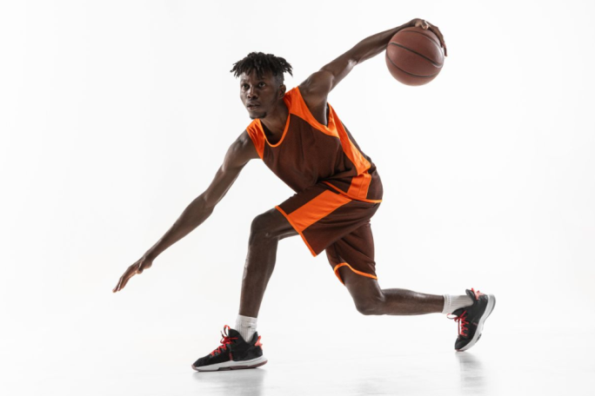
4/8
+2
How does he stay healthy?
He plays sports.
A: ________________________
B: ________________________
Check
Next

Slide 7
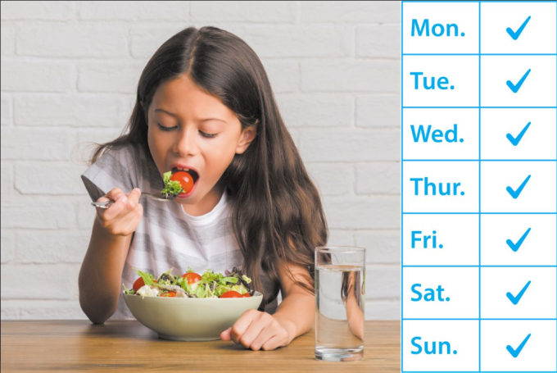
5/8
+1
A: How often does she eat vegetables?
B: ____________
Every day.
Check
Next

Slide 8
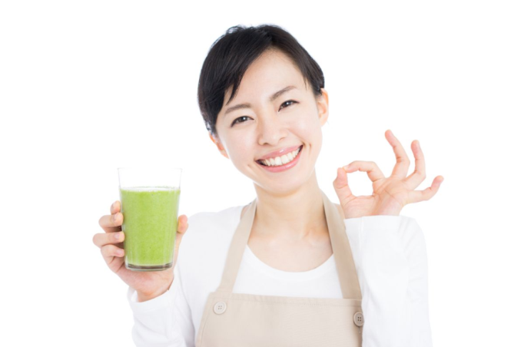
+1
6/8
A: How does she stay healthy?
B: __________________
She drinks fresh juice.
Check
Next

Slide 9
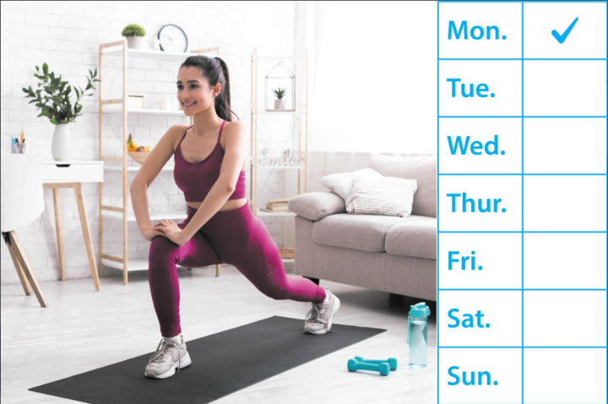
7/8
+2
A: ________________________
B: ______________
How often does she do yoga?
Once a week.
Check
Next

Slide 10
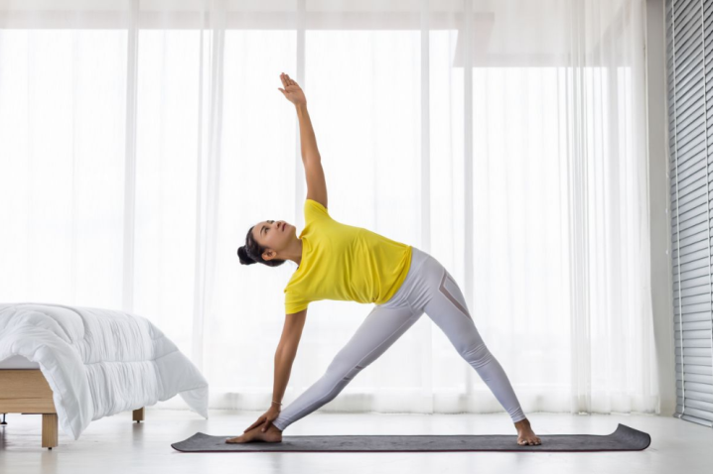
8/8
+2
A: __________________________
B: __________________________
How does she stay healthy?
She does morning exercise.
Check

Slide 11
Great!

Slide 12
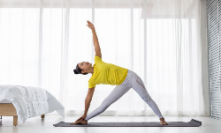
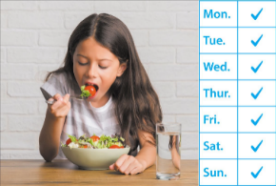
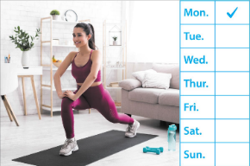
Monday, December 6th 2024
Unit 14
Staying healthy
Lesson 3 (4+5+6)

Slide 13
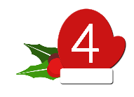
Contents
Read and circle.
Let’s write.
Project

Slide 14
4. Read and circle.
Peter’s healthy lifestyle
Peter loves staying healthy. He eats healthy food every day. For breakfast, he usually eats an egg sandwich and some fresh fruit. For lunch and dinner, he likes fish and vegetables. Peter drinks lots of water and fresh juice. He really enjoys apple juice. He gets up early and never goes to bed late. He exercises every morning. He does judo on Tuesdays and Thursdays. He is very strong and active. Peter is a super healthy kid, and he sets a great example for all of us.
1
2
1. Peter eats healthy food like fish and ________.
a. vegetables
b. ice cream
c. chips
2. Peter drinks ______ water and fresh juice.
a. some
b. lots of
c. little

Slide 15
4. Read and circle.
Peter’s healthy lifestyle
Peter loves staying healthy. He eats healthy food every day. For breakfast, he usually eats an egg sandwich and some fresh fruit. For lunch and dinner, he likes fish and vegetables. Peter drinks lots of water and fresh juice. He really enjoys apple juice. He gets up early and never goes to bed late. He exercises every morning. He does judo on Tuesdays and Thursdays. He is very strong and active. Peter is a super healthy kid, and he sets a great example for all of us.
1
2
3
4
3. He exercises ____________.
a. every week
b. every Saturday
c. every day
4. He does judo _________.
a. Once a week
b. Twice a week
c. three times a week

Slide 16
5. Let’s write.
Complete the table and write about your healthy habits. (40 words)
I have some healthy habits. _____ _________________________________________________________________________________________________________________________________________________________________.
I eat
vegetables every day.
My favourite
My healthy habits | Frequency
eat vegetables | (1) _________
(2) _________ _________ | (3) _________ _________
(4) _________ _________ | (5) _________ _________
vegetables are carrots and tomatoes.
every day
I like drinking fresh juice.
I drink
orange juice twice a week.
drink
orange juice
twice
a week
I play
basketball three times a week.
play basketball
three times
a week
I want to stay healthy.

Slide 17
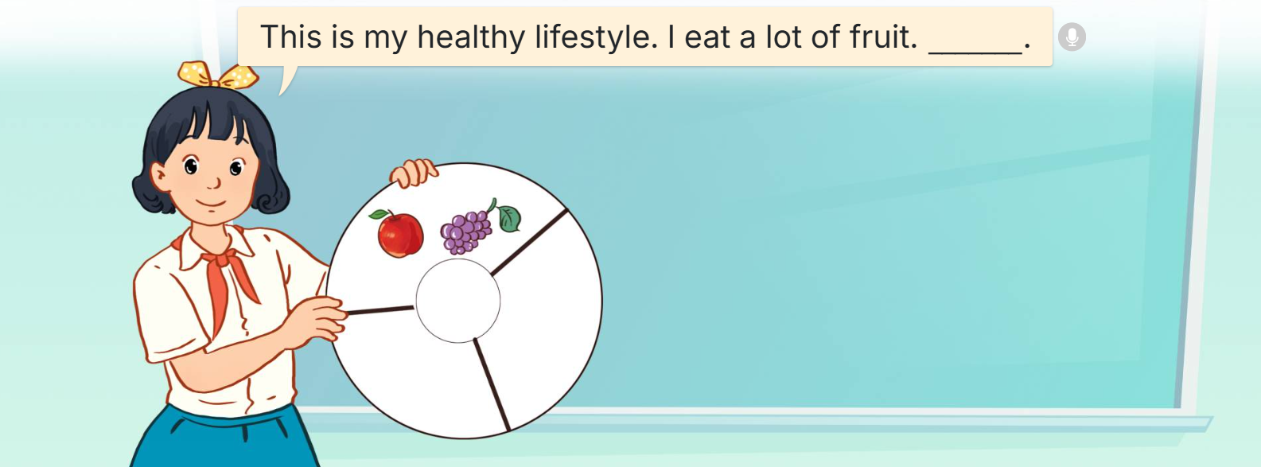
6. Project.
My healthy lifestyle
This is my healthy lifestyle. I eat a lot of fruit. _____.

Slide 18
Fun corner
& wrap - up

Slide 19
Listen and choose.
1/8
A
B
C
Click on the square to choose the answer.

Slide 20
Listen and choose.
2/8
A
B
C

Slide 21
Listen and choose.
3/8
A
B
C

Slide 22
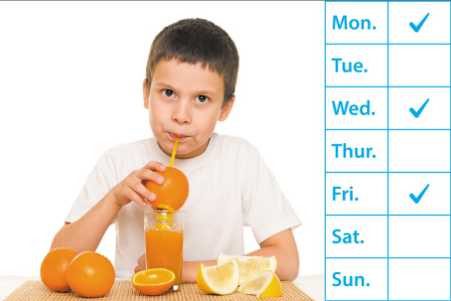
Listen and choose.
4/8
A
B
C

Slide 23
Listen and choose.
5/8
A
B
C

Slide 24
Listen and choose.
6/8
A
B
C

Slide 25
Listen and choose.
7/8
A
B
C

Slide 26
Listen and choose.
8/8
A
B
C

Slide 27
Good job!

Slide 28
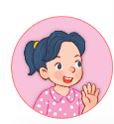
Review
How does he / she stay healthy?
He / She ________.
does morning exercise
plays sports
drinks fresh juice
eats healthy food

Slide 29
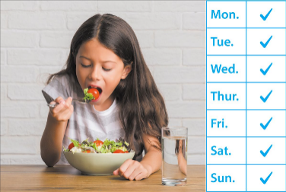
Review
How often does he / she ______?
______________.
eats vegetables / every day
drinks orange juice / three times a week
does yoga / once a week
plays badminton / twice a week

Slide 30
Homework
……………………………………. Prepare for unit 15 (1+2+3).

Slide 31
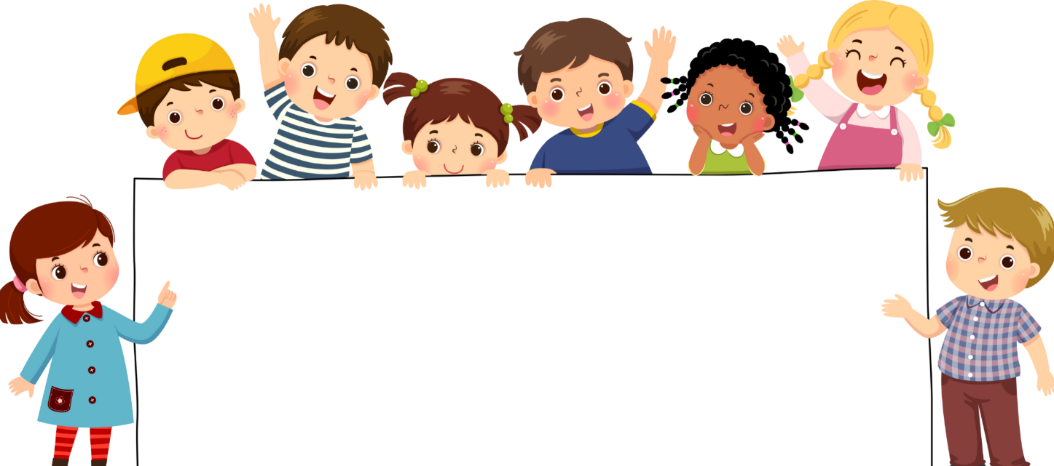
Goodbye!

