Slide 1
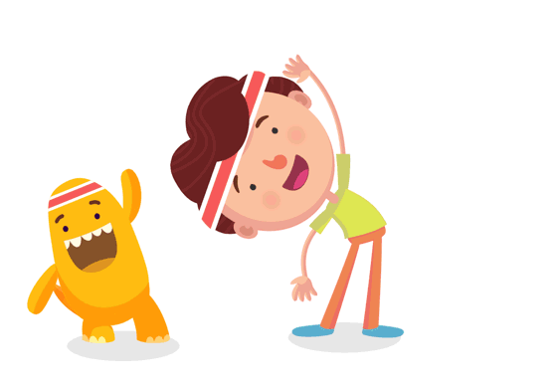
Welcome to our class!

Slide 2
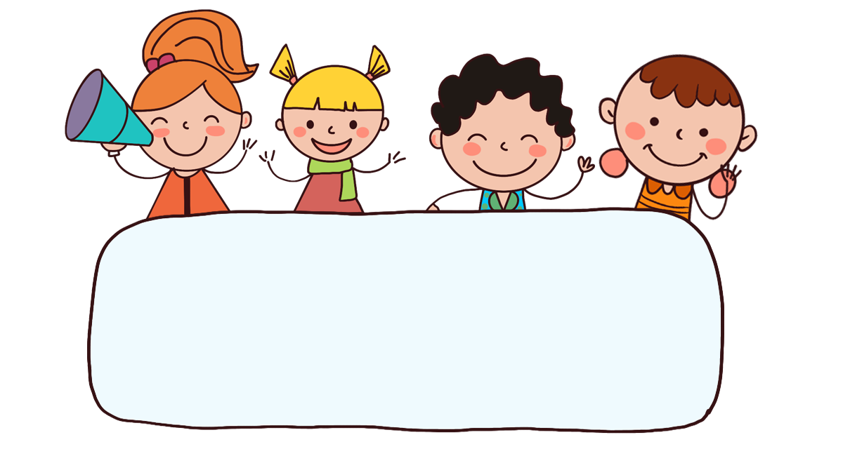
Warm-up

Slide 3



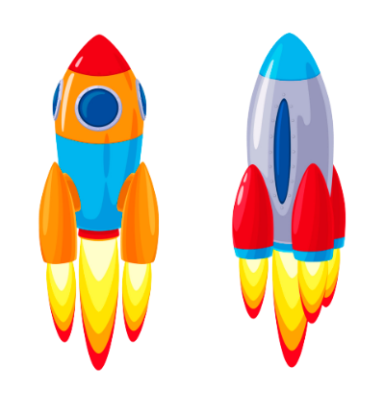
Go to the Moon
Start

Slide 4
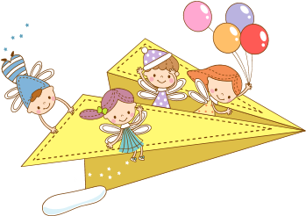
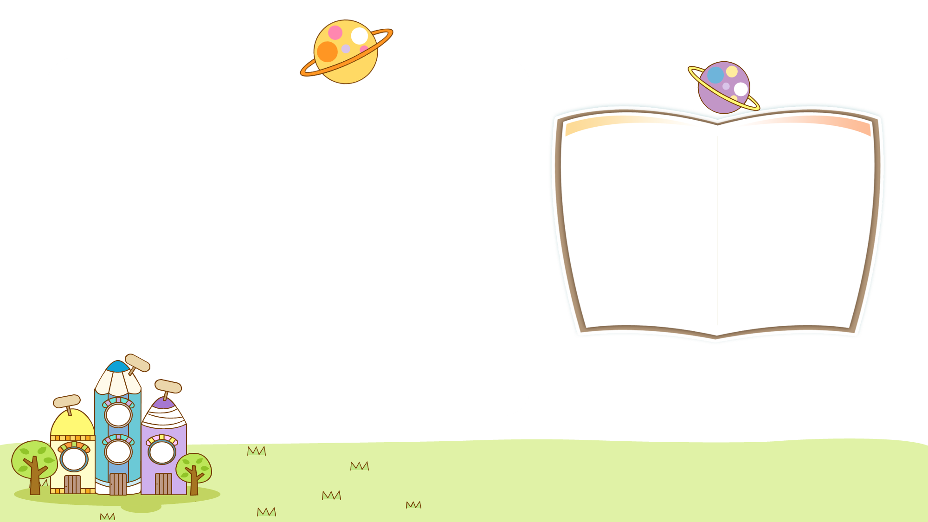
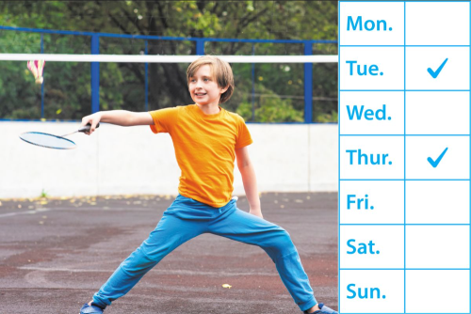
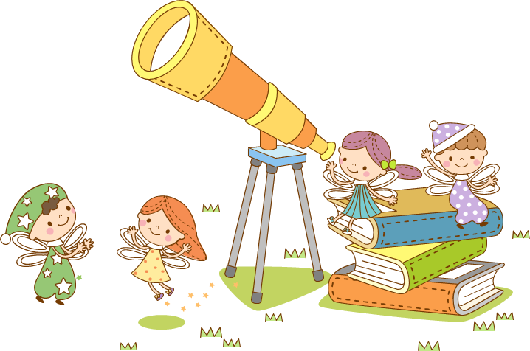
1/8
Next
Click the clock to start the timer.
A: How often does he play badminton?
B: _____________
Twice a week.
Answer
Click on the binoculars to show answer.

Slide 5
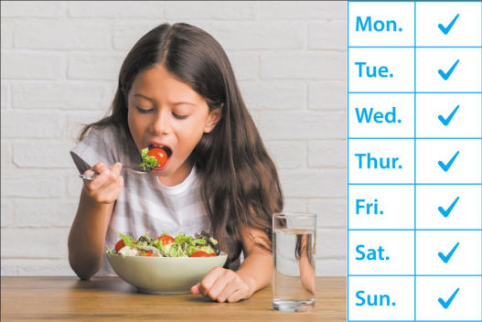
2/8
Next
Click the clock to start the timer.
A: How often does she eat vegetables?
B: _______________
Every day.
Answer
Click on the binoculars to show answer.

Slide 6
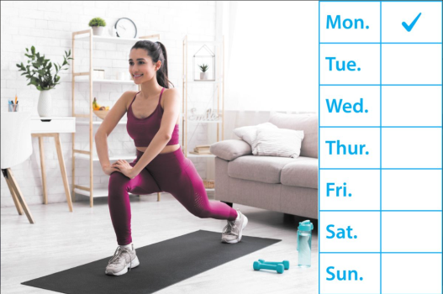
Next
3/8
A: How often does she do yoga?
B: ______________
Once a week.
Answer
Click on the binoculars to show answer.

Slide 7
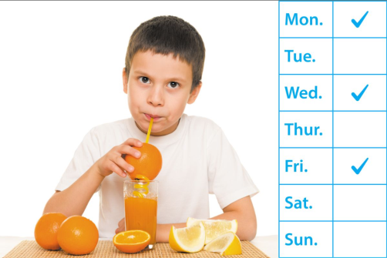
4/8
Next
A How often does he drink orange juice?
B: _____________
Three times a week.
Answer

Slide 8

5/8
Next
A: ___________________
B: Twice a week.
How often does he play badminton?
Answer

Slide 9

6/8
Next
A: ___________________
B: Every day.
How often does she eat vegetables?
Answer

Slide 10

7/8
Next
A: ___________________
B: ___________________
- How often does she do yoga?
- Once a week.
Answer

Slide 11

8/8
End
A: ___________________
B: ___________________
- How often does he drink orange juice?
- Three times a week.
Answer

Slide 12

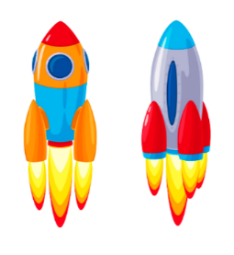
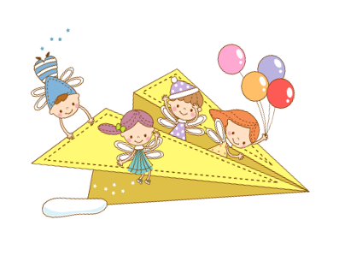
Next
Thử thách
QUYẾT ĐỊNH

Slide 13

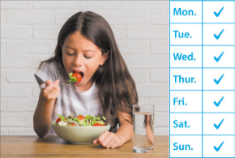

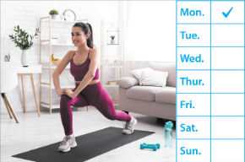

Monday, December 5th 2024
Unit 14
Staying healthy
Lesson 2 (4+5+6)

Slide 14
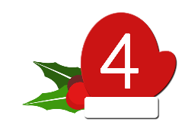


Contents
Listen and circle.
Read and complete.
Let’s play.

Slide 15




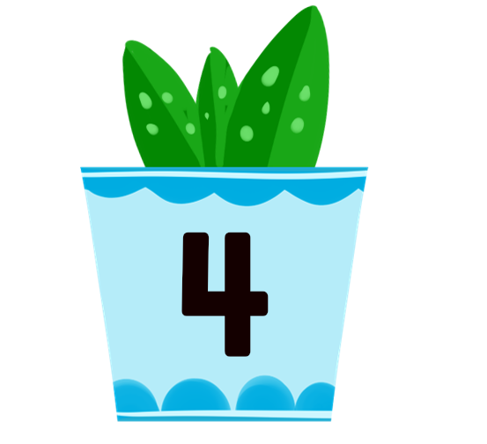
4. Listen and circle.
1. What’s Tony doing?
a. He’s doing yoga.
b. He’s doing a project.
2. How does Tony stay healthy?
a. He eats fish and vegetables.
b. He eats sausages and chips.
3. How often does Tony drink lemonade?
a. Every day.
b. Twice a week.
4. How often does Tony play basketball?
a. Three times a week.
b. Once a week.
Click on the speaker / pots to listen.

Slide 16
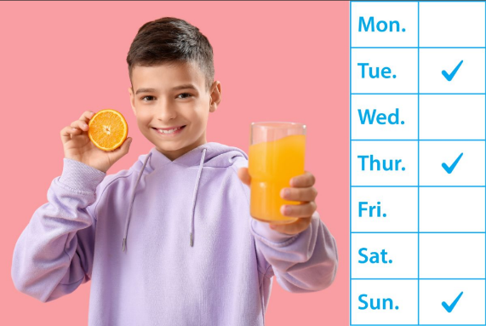
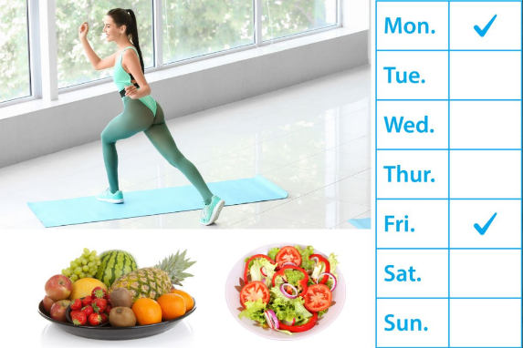
5. Read and complete.
1.
A: How does your brother stay healthy?
B: He drinks _____________.
A: How often does he drink it?
B: ____________ a week.
orange juice
Three times
2.
A: My sister is a member of the aerobics club.
B: Oh, really? _________ does she do aerobics?
A: Twice a _______ after class.
B: Does your sister eat healthy food?
A: Yes, she does. She eats fruit and
___________ regularly.
How often
week
vegetables

Slide 17
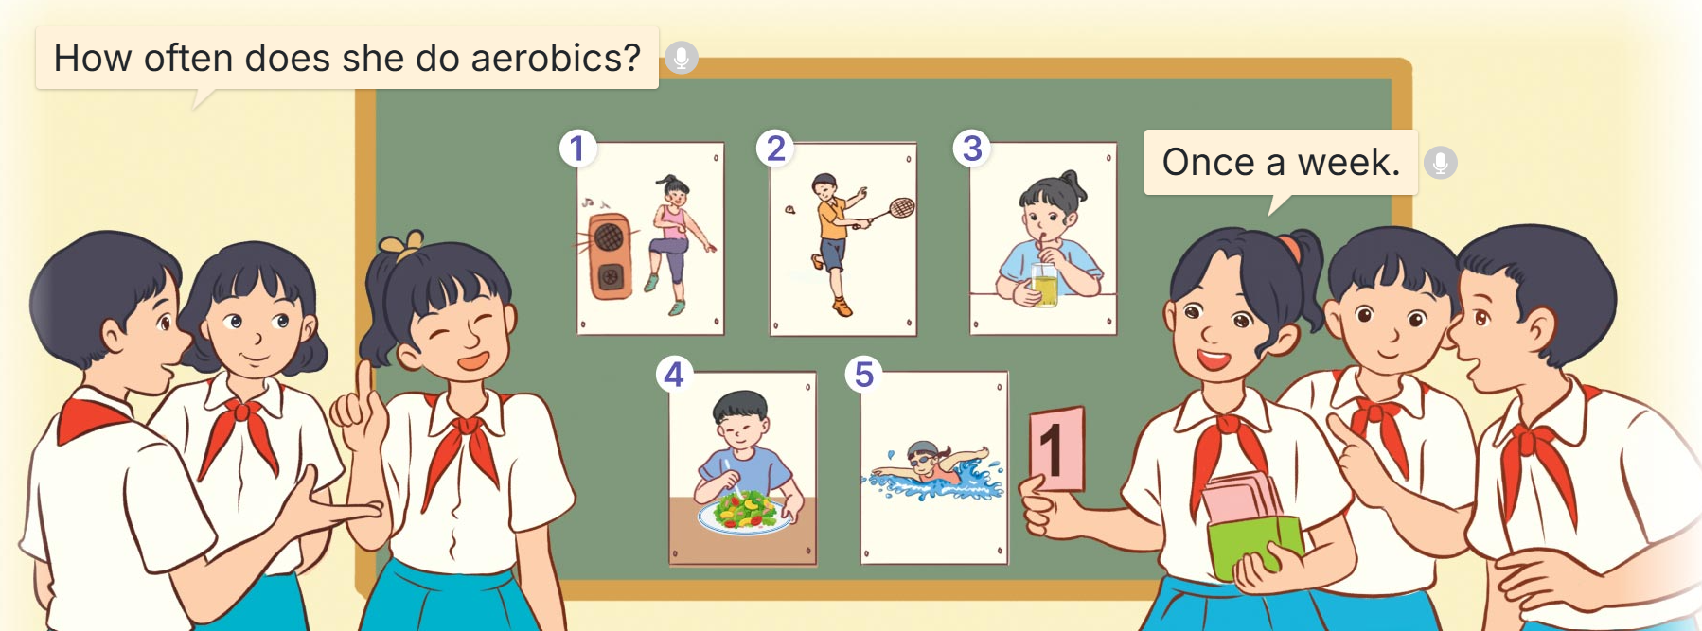
6. Let’s play.
Frequency Game
How often does she do aerobics?
Once a week.

Slide 18
Fun corner
& wrap - up

Slide 19

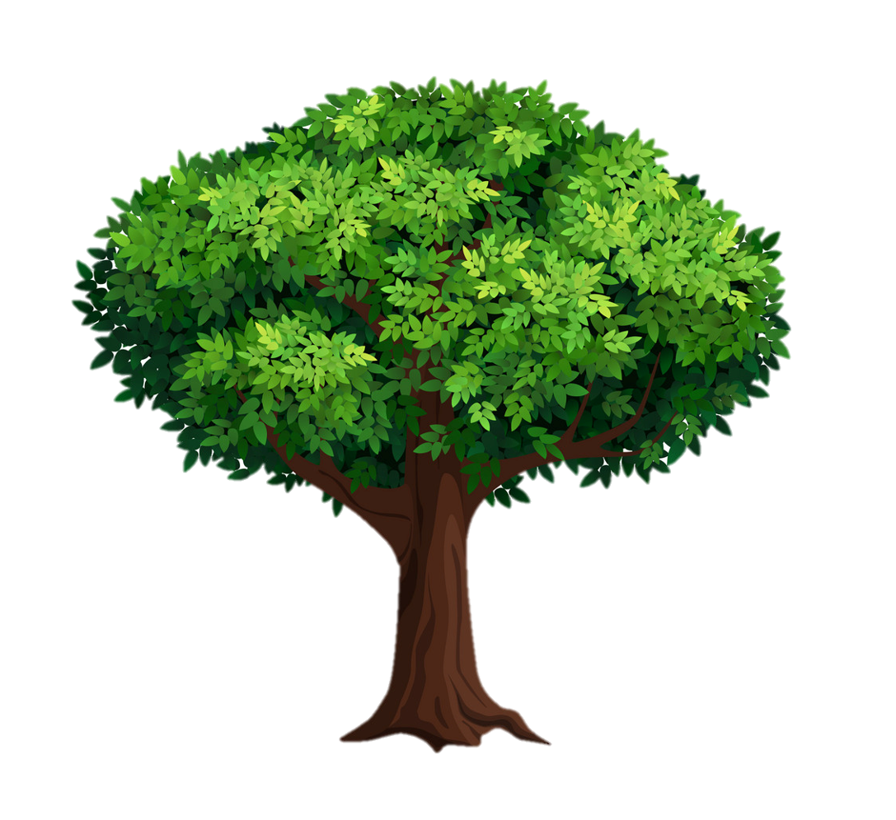














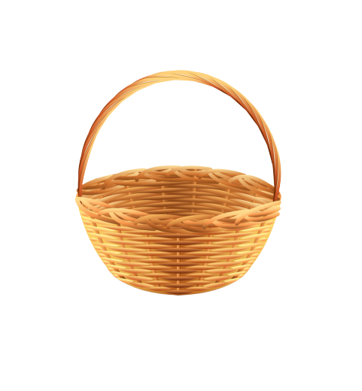
Picking
apples
Chia lớp thành 3 đội, mỗi giỏ táo tượng trưng cho 1 đội. Nhấn vào giỏ táo để thưởng cho đội đó 1 trái táo.

Slide 20


A: How often does he play badminton?
B: Twice a week.
True
A
False
B

Slide 21

A: How often does he drink orange juice?
B: Three times a week.
True
A
False
B

Slide 22

A: _______________
B: ______________
- How often does she eat vegetables?
- Every day.
A
- How often does she do yoga?
- Once a week.
B
- How often does he play badminton?
- Twice a week.
C

Slide 23
What food will you have at the party?
A
A: _______________?
B: Twice a week.
Will you make banh chung for Tet?
B
How often does he play badminton?
C

Slide 24
When - do
A
A: _____ often ____ she eat vegetables?
B: Every day.
How - does
B
Where - does
C

Slide 25



A
Listen and choose.
B

Slide 26

A
Listen and choose.
B

Slide 27



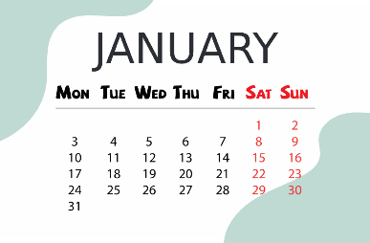
A
Listen and choose.
B
C

Slide 28

A
Listen and choose.
B
C

Slide 29

Thank you!

Slide 30


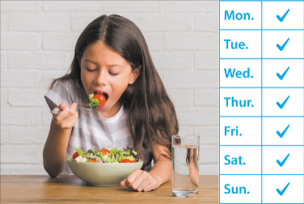



Review
How often does he / she ______?
______________.
eats vegetables / every day
drinks orange juice / three times a week
does yoga / once a week
plays badminton / twice a week

Slide 31
Homework
………………………………………….
Prepare for lesson 3 (1+2+3).

Slide 32
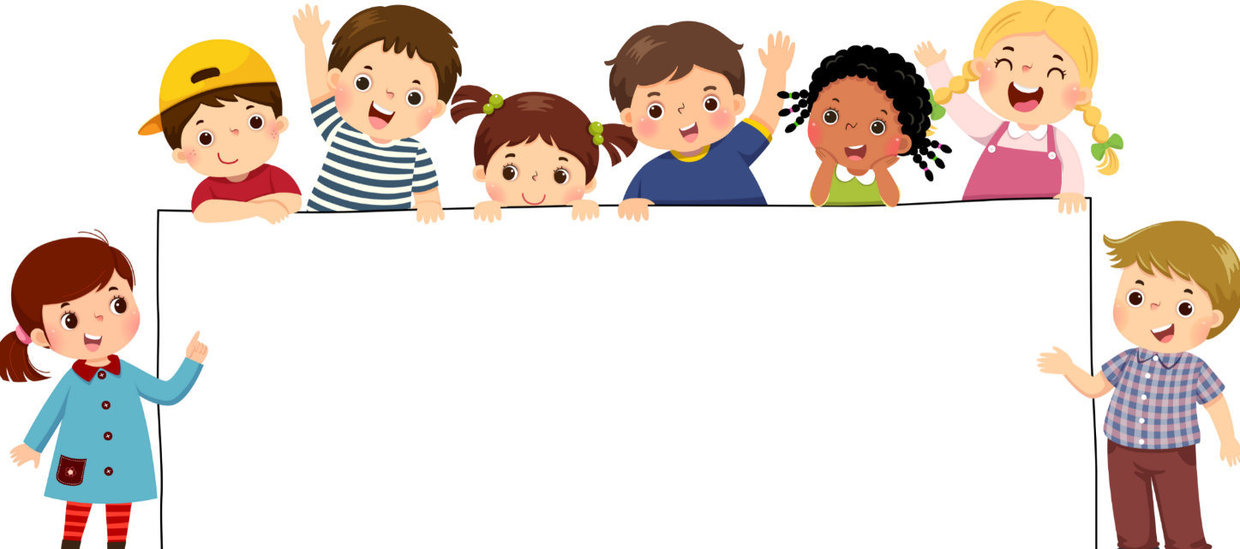
Goodbye!

