Slide 1
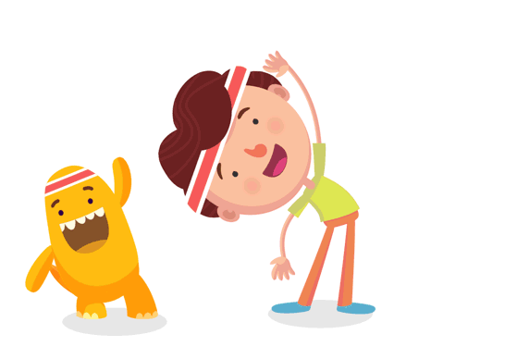
Welcome to our class!

Slide 2
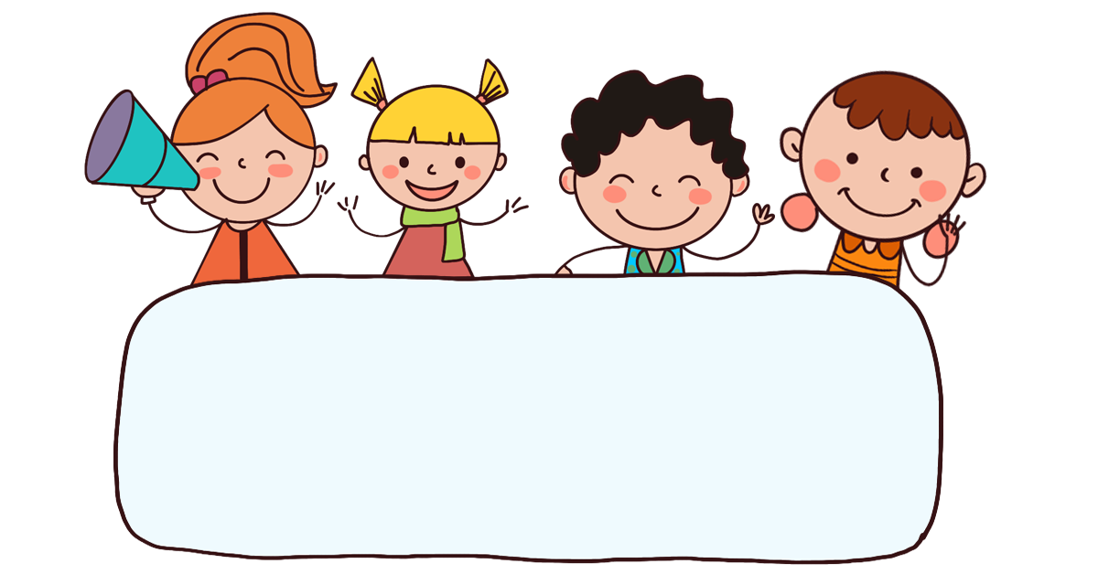
Warm-up

Slide 3


Slide 4


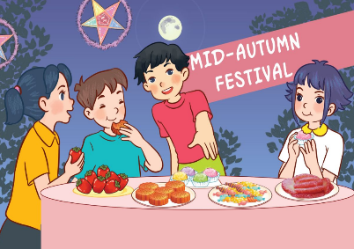



Review
What will you do _____?
we’ll = we will
We’ll _____.
at Mid-Autumn Festival / have a party
on Sports Day / play badminton
on Children’s Day / dance
on Teachers’ Day / sing

Slide 5
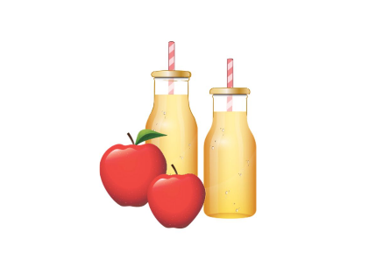
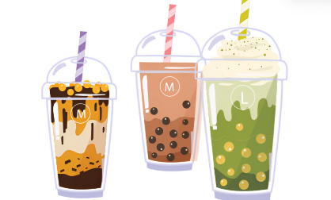
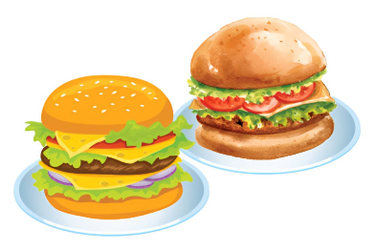
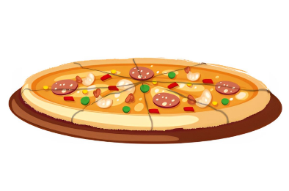
Review
What food / drinks will you have at the party?
We’ll have ______.
apple juice
milk tea
burgers
pizza

Slide 6

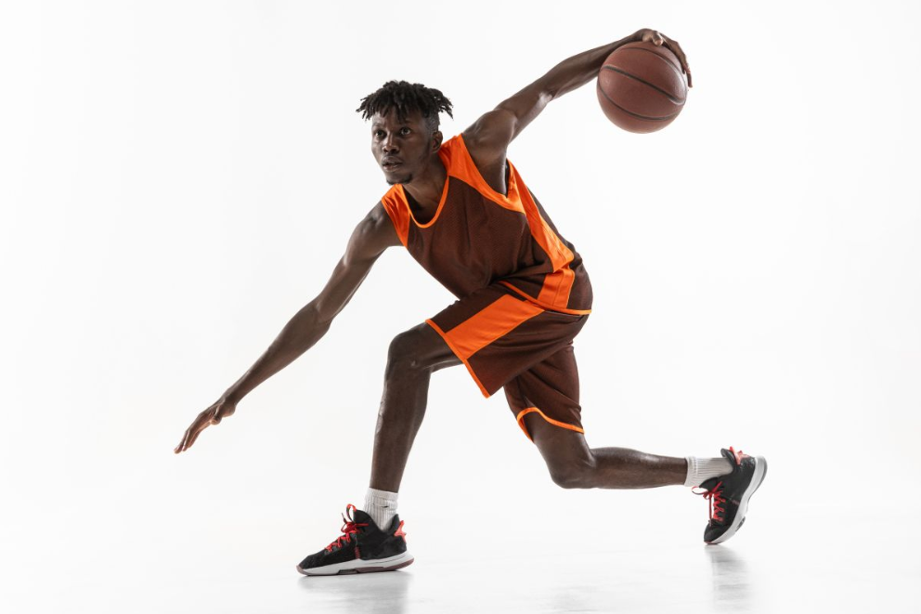
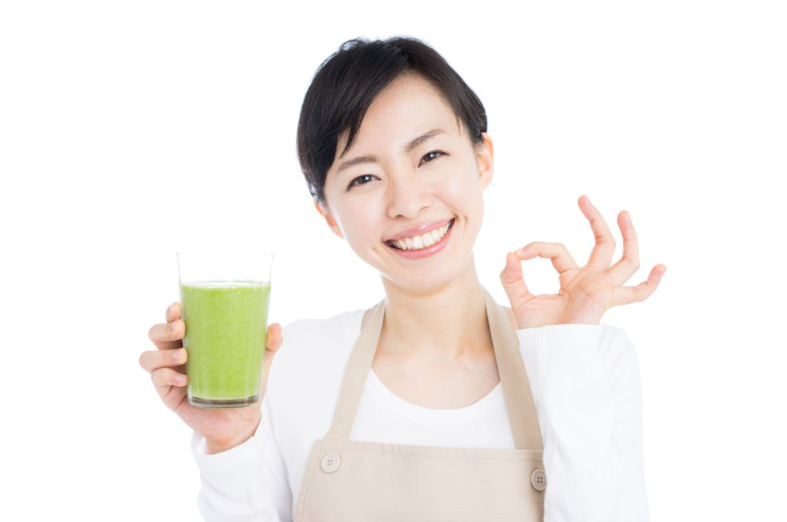
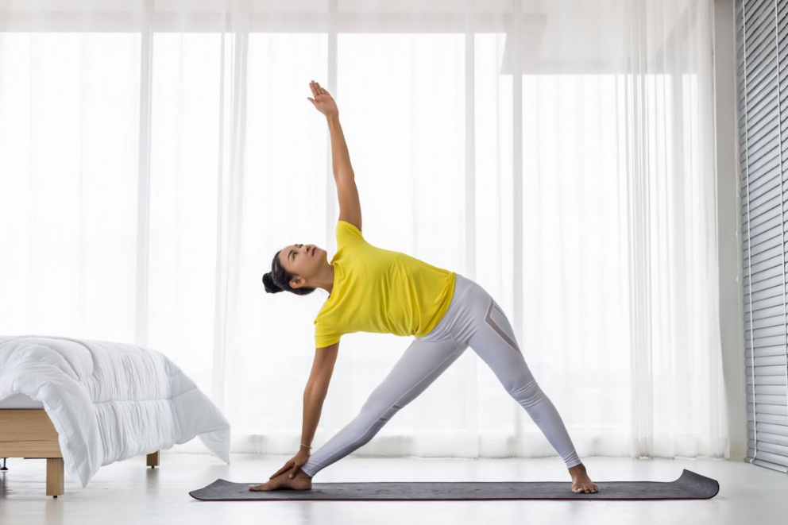
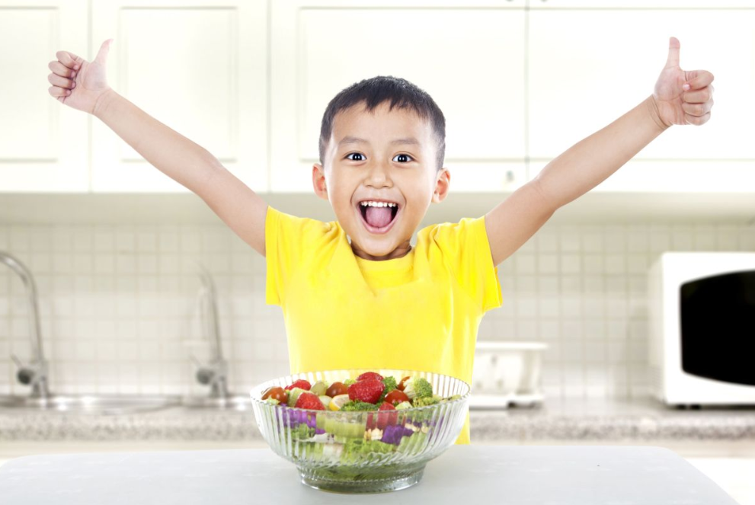
Monday, December 1st 2024
Unit 14
Staying healthy
Lesson 1 (1+2+3)

Slide 7



Contents
Look, listen and repeat.
Listen, point and say.
Let’s talk.

Slide 8


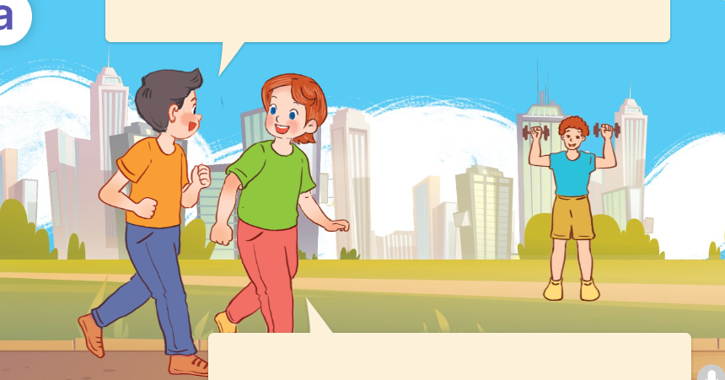
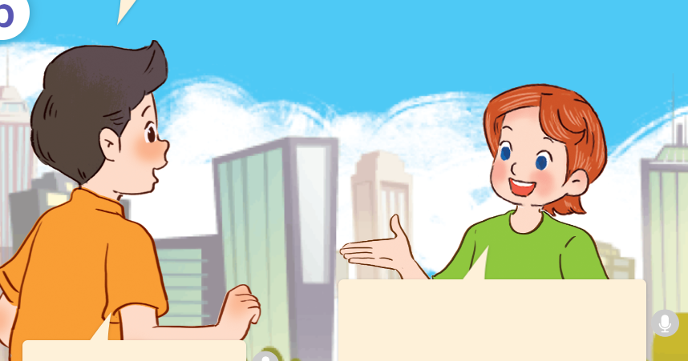
1. Look, listen and repeat.
I want to stay healthy, Lucy.
I eat vegetables and drink a lot of water.
How does he stay healthy?
a
b
Is that your brother over there?
Yes, that’s my brother, Tom.
He does morning exercise every day.
He also wants to stay healthy.
Yeah, me too.
What are they doing?
Who are they?
They’re in the park.
They’re doing morning exercise.
They are Nam, Lucy and her brother.
Where are they?
Click on the speaker / sentences to listen.

Slide 9
Vocabulary

Slide 10
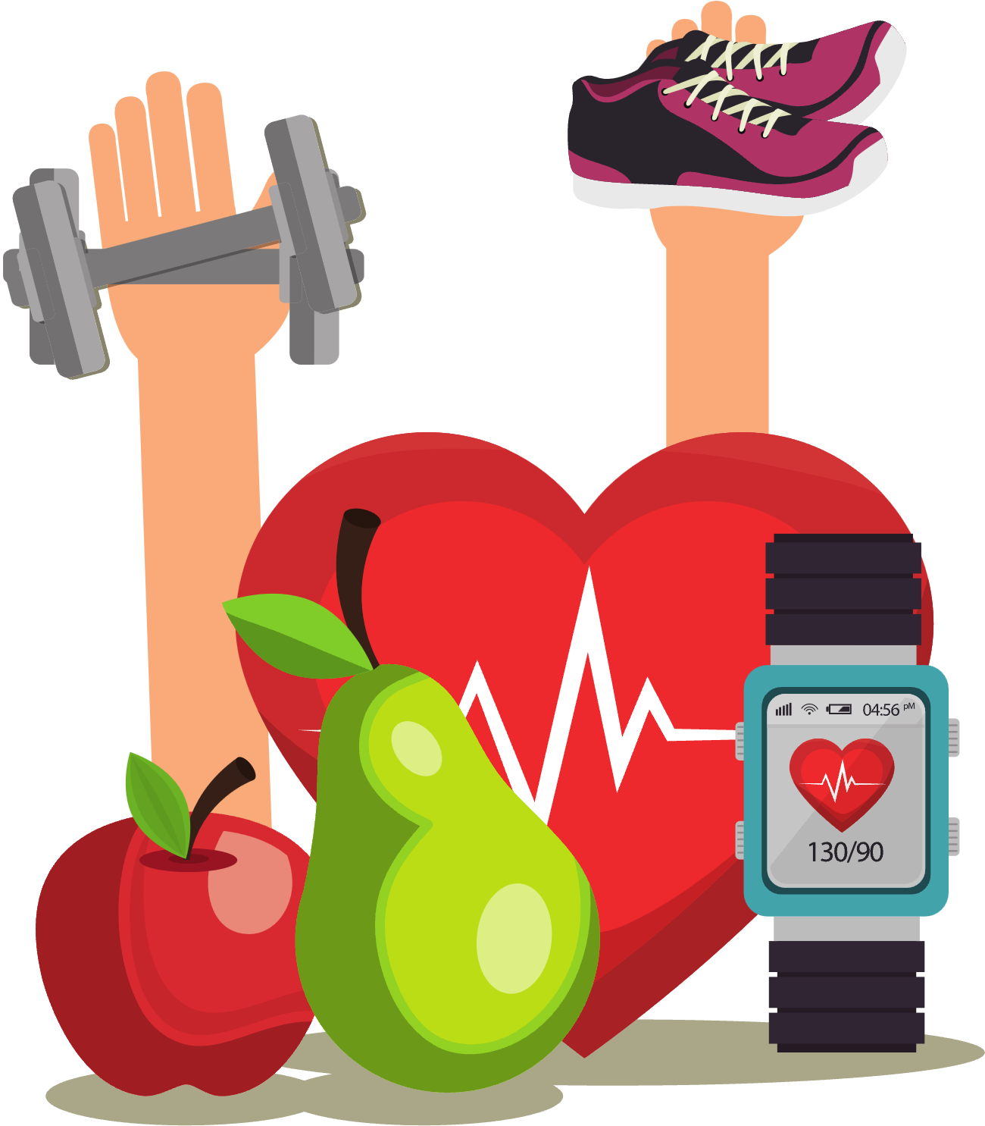
Vocabulary
stay healthy
/steɪ ˈhelθɪ/
giữ gìn sức khỏe
Click on the English words to listen.

Slide 11
do morning exercise
/duː ˈmɔːnɪŋ ˈeksəsaɪz/
tập thể dục buổi sáng

Slide 12
drink fresh juice
/ drɪŋk freʃ dʒuːs/
uống nước ép trái cây tươi

Slide 13
eat healthy food
/iːt ˈhelθɪ fuːd/
ăn thức ăn có lợi cho sức khỏe

Slide 14
play sports
/ˌpleɪ ˈspɔːts/
chơi thể thao

Slide 15
Review
stay healthy
do morning exercise
drink fresh juice
eat healthy food
play sports
Click on the English words to listen again.

Slide 16
Vocabulary
1. stay healthy
: giữ gìn sức khỏe
2. do morning exercise
: tập thể dục buổi sáng
3. drink fresh juice
: uống nước ép trái cây tươi
4. eat healthy food
: ăn thức ăn tốt cho sức khỏe
5. play sports
: chơi thể thao
Click on the English words to listen again.

Slide 17

Checking vocabulary

Slide 18

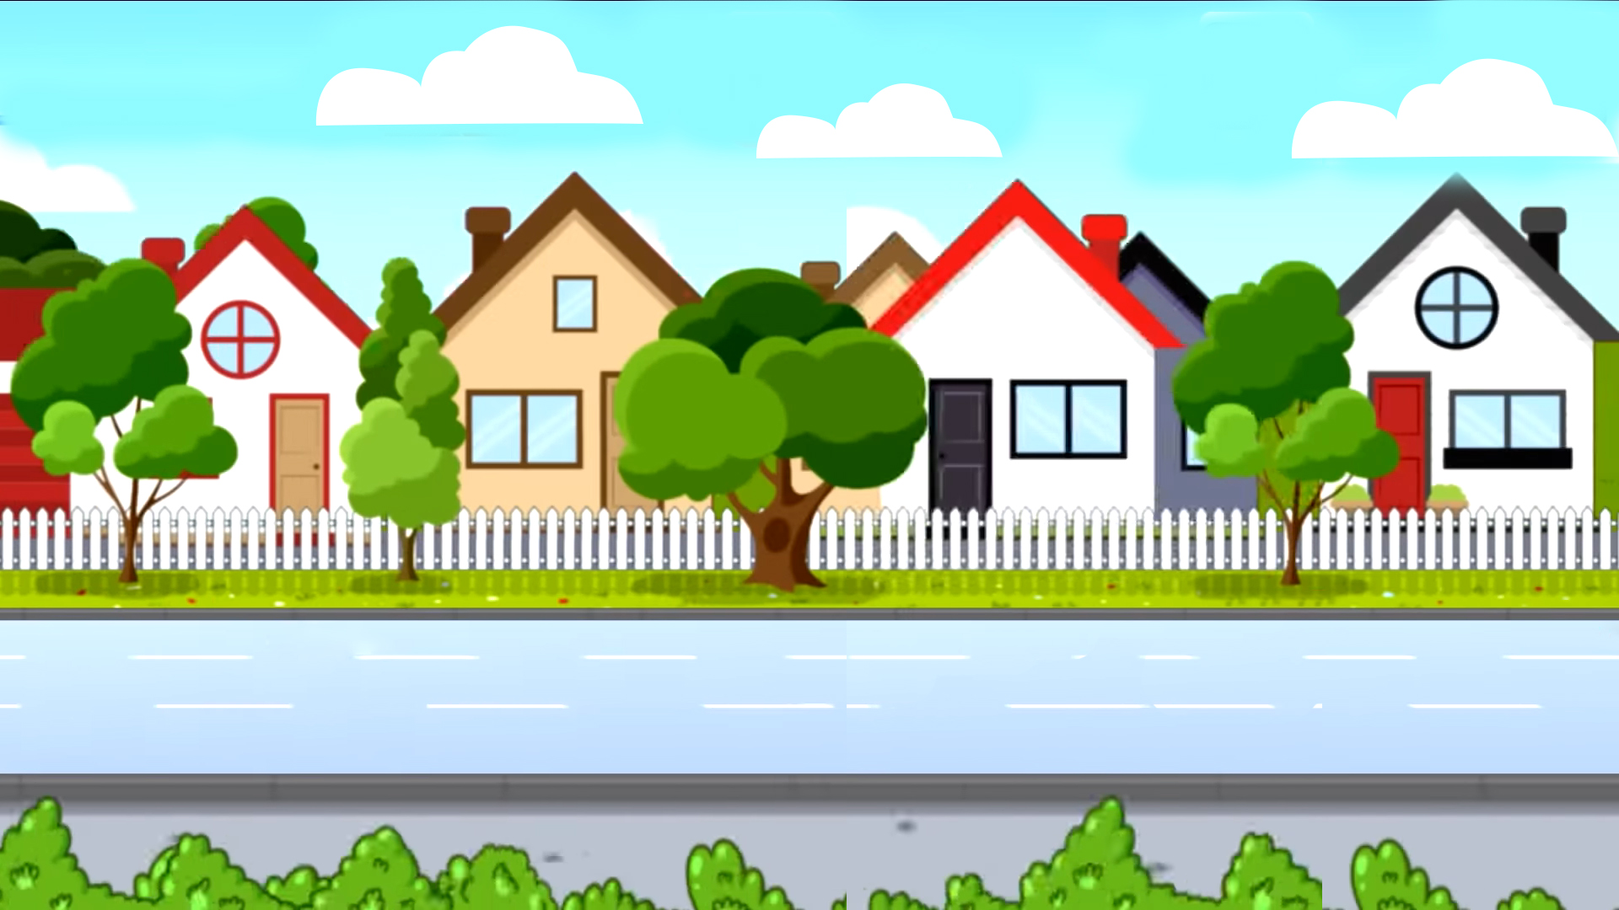

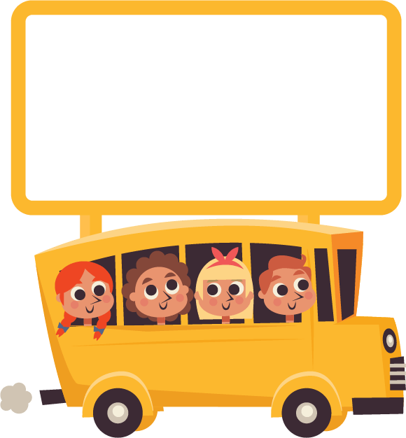




School bus
Play

Slide 19

H/s nhìn hình và nói, cô giáo nhấn “check” để hiển thị đáp án.
drink fresh juice
Check
Next

Slide 20
do morning exercise
Check
Next

Slide 21
eat healthy food
Check
Next

Slide 22
play sports
Check
Next

Slide 23

Well done!

Slide 24
Structures

Slide 25
Dạng số ít của động từ
Động từ | Động từ ở dạng số ít
do
/du/
does
/dʌz/
drink
/drɪŋk/
drinks
/drɪŋks/
eat
/iːt/
eats
/iːts/
play
/pleɪ/
plays
/pleɪz/
want
/wɒnt/
wants
/wɒnts/
Click on the words to listen again.

Slide 26



Cách hỏi và đáp về việc ai đó làm gì để giữ cơ thể khỏe mạnh.
How does he / she stay healthy?
(Cậu ấy / cô ấy giữ sức khỏe như thế nào?)
He / she ___________.
( Cậu ấy / cô ấy ______________
Example:
How does she stay healthy?
She does morning exercise.

Slide 27
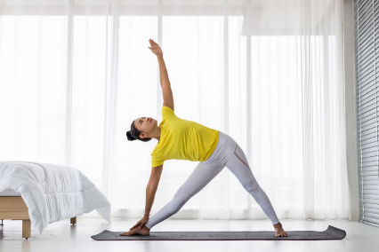



Unit 14 lesson 1 (1+2+3)
How does he / she stay healthy?
He / She ____________.
does morning exercise
plays sports
drinks fresh juice
eats healthy food

Slide 28
2. Listen, point and say.
a
b
How does he / she stay healthy?
do morning exercise
play sports
c
d
He / She _________.
drink fresh juice
eat healthy food
Click on the words / phrases to listen again.

Slide 29


2. Listen, point and say.
a
do morning exercise
How does she stay healthy?
She does morning exercise.
Click on the sentences to listen.

Slide 30
2. Listen, point and say.
b
play sports
How does he stay healthy?
He plays sports.

Slide 31
2. Listen, point and say.
c
drink fresh juice
How does she stay healthy?
She drinks fresh juice.
Click on the sentences to listen.

Slide 32
2. Listen, point and say.
d
eat healthy food
How does he stay healthy?
He eats healthy food.

Slide 33

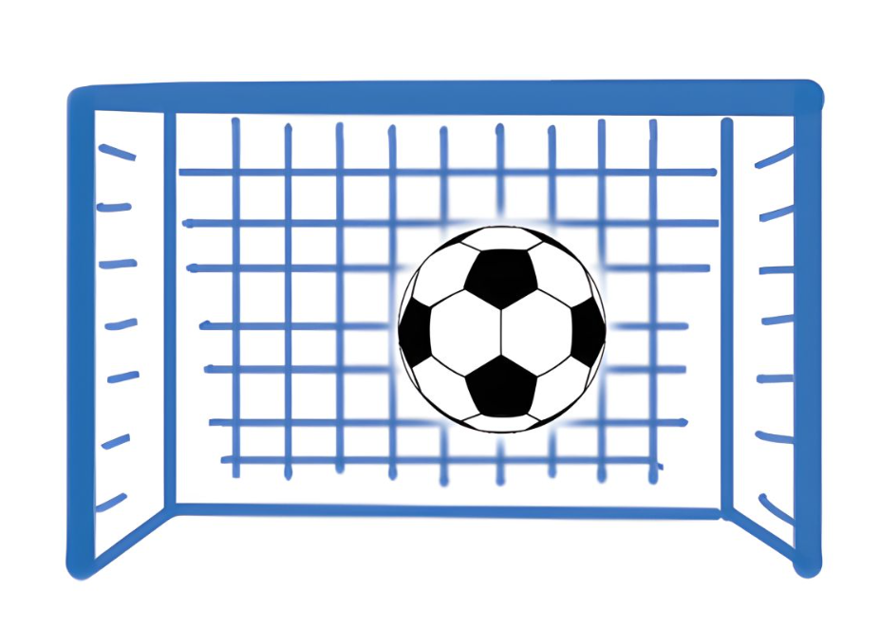
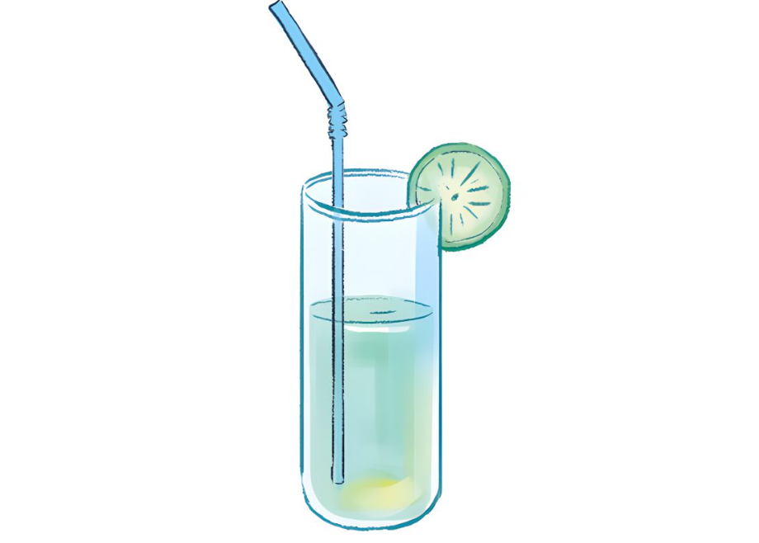
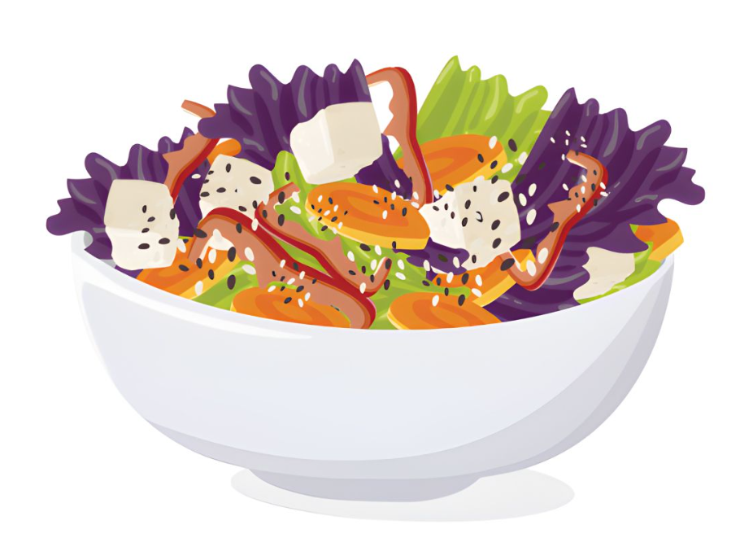
3. Let’s talk.
How does your _____ stay healthy?
______________.

Slide 34

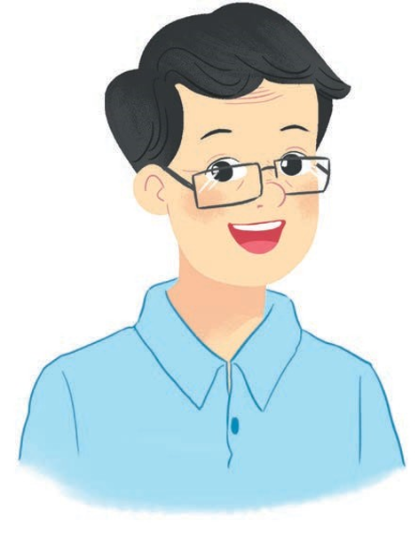
3. Let’s talk.
father
How does your _____ stay healthy?
______________________________.
He does morning exercise every day

Slide 35
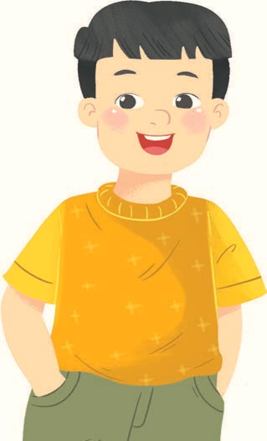
3. Let’s talk.
brother
How does your ______ stay healthy?
He plays sports every day
______________________.

Slide 36
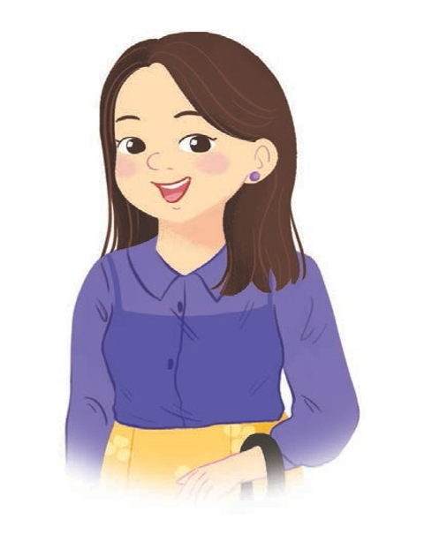
3. Let’s talk.
mother
How does your ______ stay healthy?
She drinks fresh juice every day
___________________________.

Slide 37
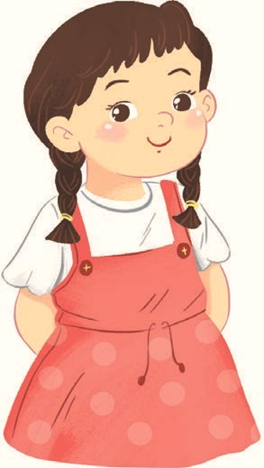
3. Let’s talk.
sister
How does your ______ stay healthy?
She eats healthy food every day
___________________________.

Slide 38
Fun corner
& wrap - up

Slide 39

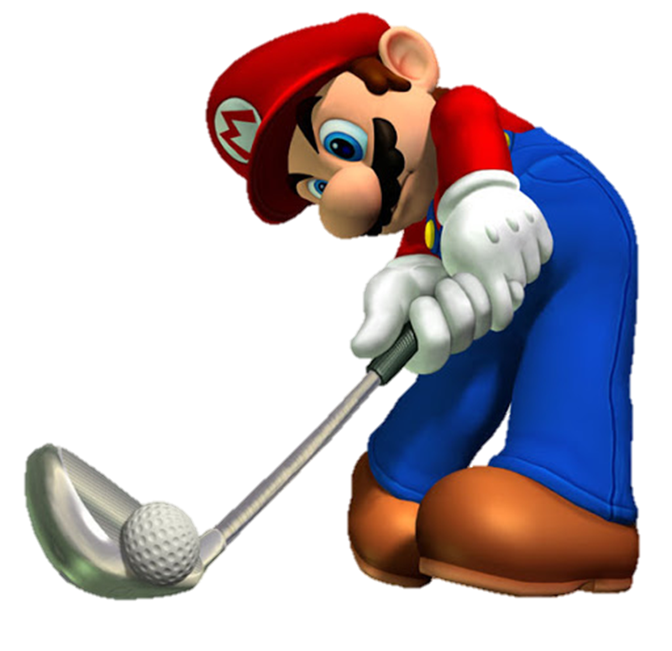
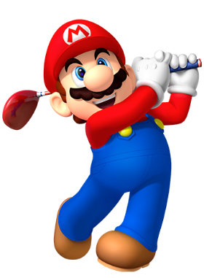

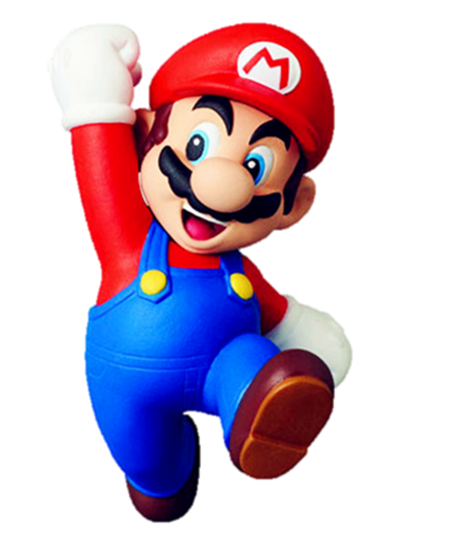


Slide 40







A: How does she stay healthy?
B: She _______.
1/8
A. does morning exercise
B. drinks fresh juice
C. plays sports

Slide 41

2/8
A: How does he stay healthy?
B: He ________.
A. plays sports
B. eats healthy food
C. drinks fresh juice

Slide 42

A: How does she stay healthy?
B: She ______.
3/8
A. eats healthy food
B. plays sports
C. does morning exercise

Slide 43

4/8
A: How does he stay healthy?
B: He ______.
A. plays sports
B. drinks fresh juice
C. eats healthy food

Slide 44

A: ___ does she stay healthy?
B: She _____ fresh juice.
5/8
A. When - drinks
B. How - drinks
C. What - eat

Slide 45
A: How ___ she stay healthy?
B: She ___ morning exercise.
6/8
A. does - do
B. does - does
C. do - does

Slide 46



7/8
A: How does he stay healthy?
B: He plays sports.
A.
B.
C.

Slide 47




8/8
A: How does he stay healthy?
B: He eats healthy food.
A.
B.
C.

Slide 48


Slide 49
Review
How does he / she stay healthy?
He / She ____________.
does morning exercise
plays sports
drinks fresh juice
eats healthy food

Slide 50
Homework
Learn by heart all the new words and the model sentences.
Read again the dialogue in part 1.
Prepare for lesson 1 (4+5+6).

Slide 51

Goodbye!

