Slide 1
Welcome to our class!

Slide 2
Warm-up

Slide 3
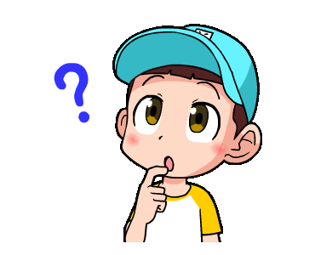
Look and guess!
Start

Slide 4
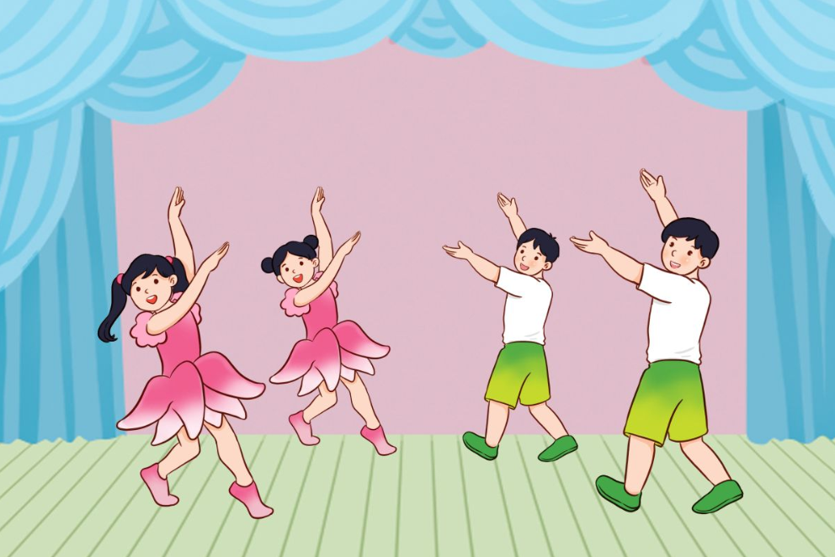
1
2
3
1/8
4
5
6
Bùi Liễu Powerpoint
0968142780
7
8
9
What will you do on Children’s Day?
_____________
We’ll dance.
Check
Next

Slide 5
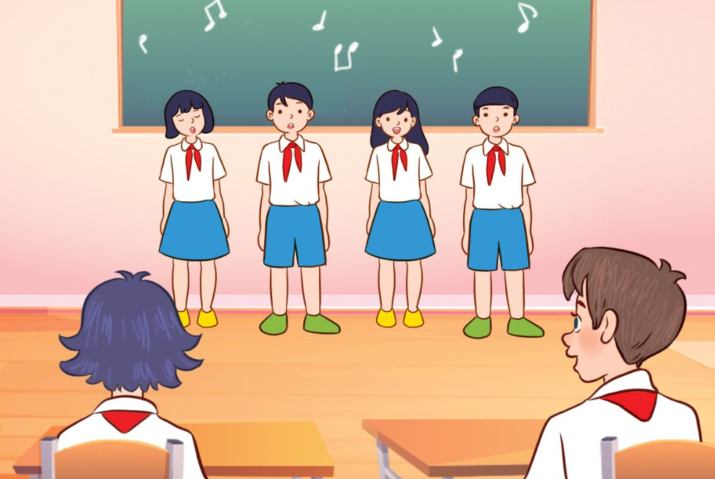
1
2
3
2/8
4
5
6
Bùi Liễu Powerpoint
0968142780
7
8
9
What will you do on Teachers’ Day?
___________.
We’ll sing
Check
Next

Slide 6
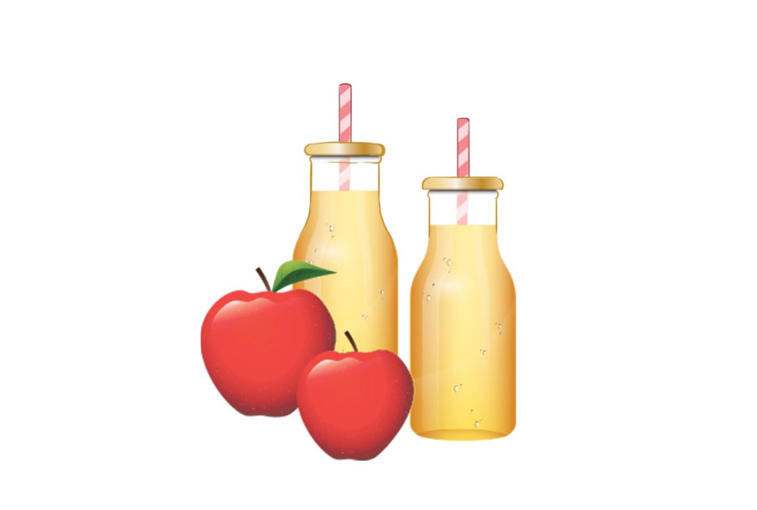
1
2
3
3/8
4
5
6
Bùi Liễu Powerpoint
0968142780
7
8
9
We’ll have apple juice
What drinks will you have at the party?
______________________.
Check
Next

Slide 7
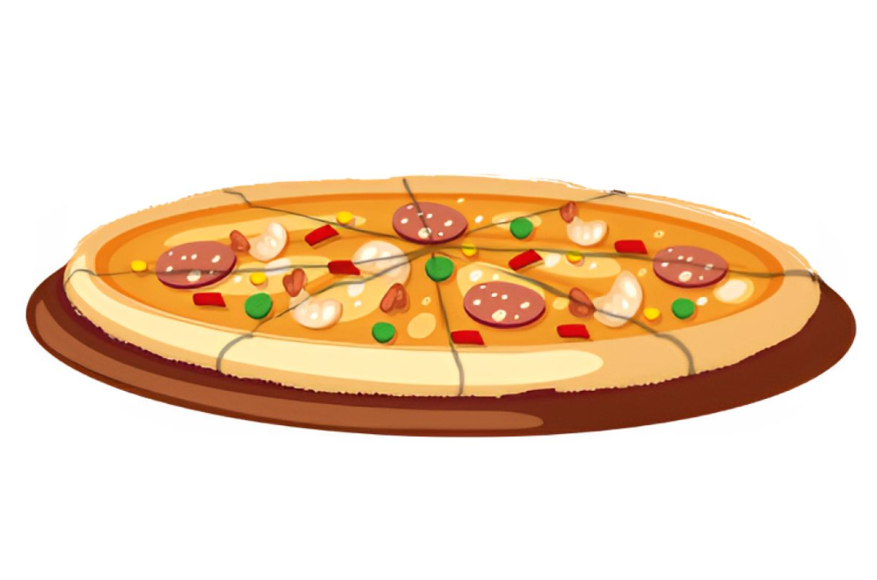
1
2
3
4/8
4
5
6
Bùi Liễu Powerpoint
0968142780
7
8
9
What food will you have at the party?
______________.
We’ll have pizza
Check
Next

Slide 8
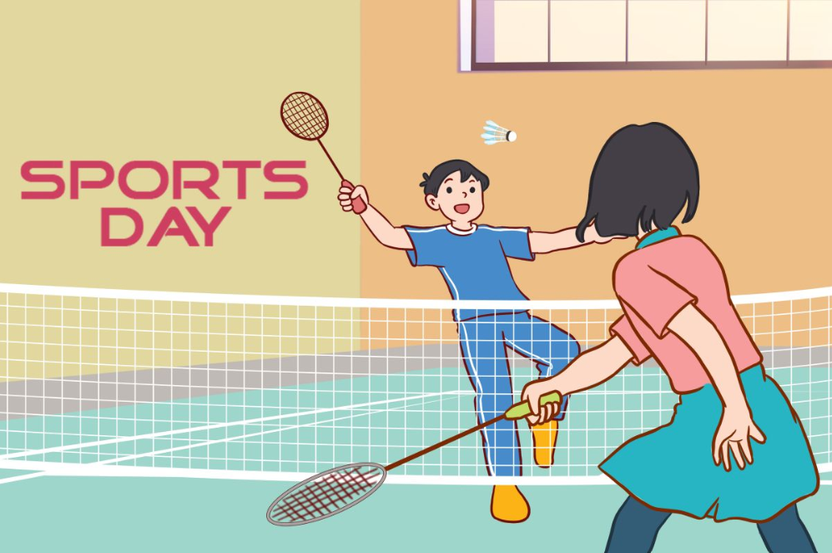
1
2
3
5/8
4
5
6
Bùi Liễu Powerpoint
0968142780
7
8
9
What will you do on Sports Day?
________________________________
We’ll play badminton
______________________
Check
Next

Slide 9
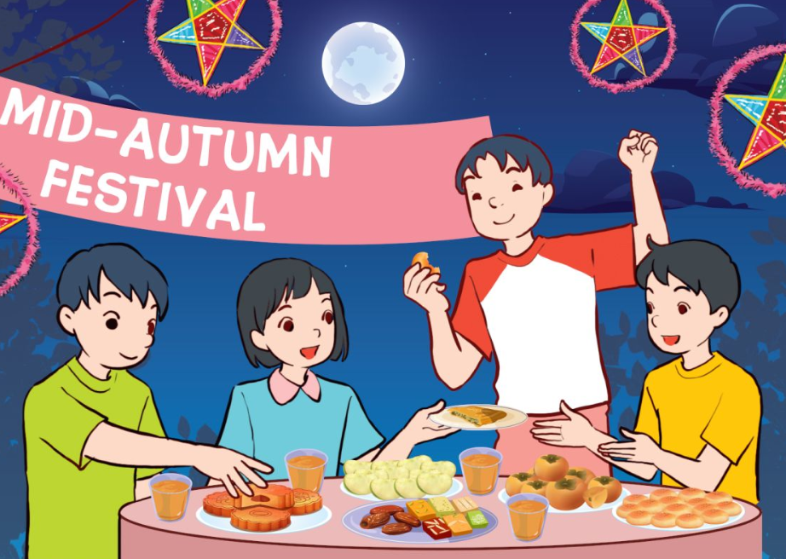
1
2
3
6/8
4
5
6
Bùi Liễu Powerpoint
0968142780
7
8
9
What will you do at Mid- Autumn Festival?
________________________________________
We’ll have a party.
_____________________
Check
Next

Slide 10
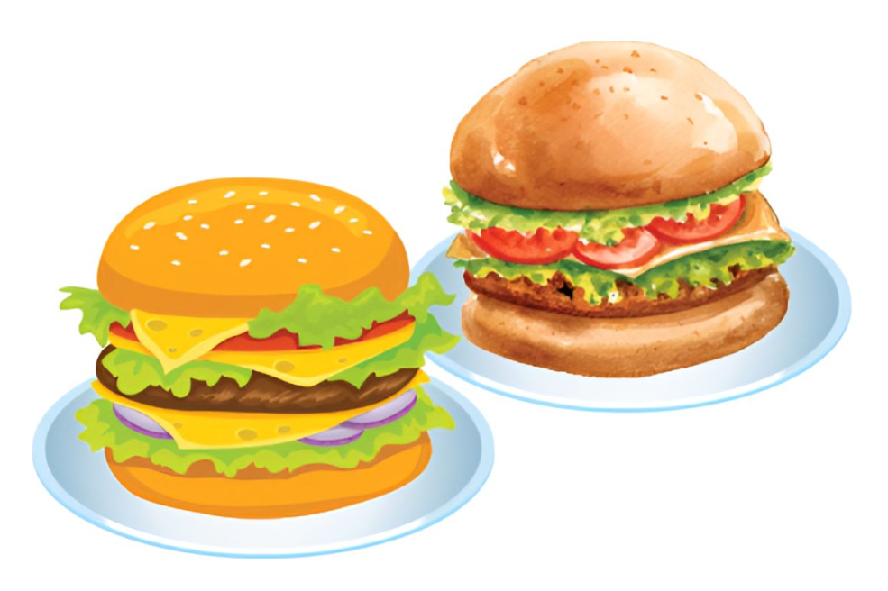
1
2
3
7/8
4
5
6
Bùi Liễu Powerpoint
0968142780
7
8
9
What food will you
have at the party?
_________________________________
_________________.
We’ll have burgers
Check
Next

Slide 11
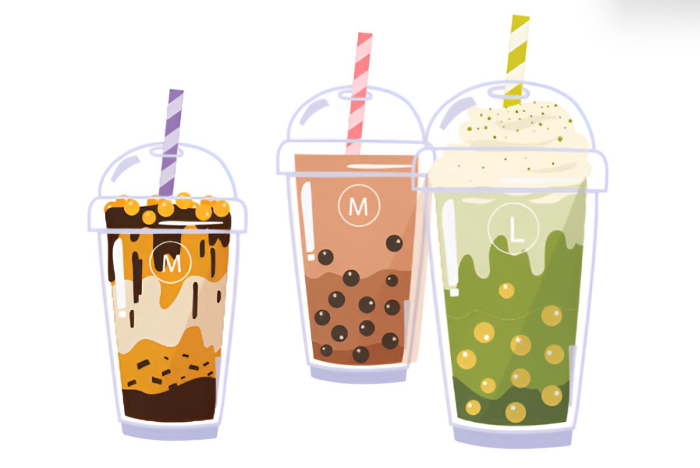
1
2
3
8/8
4
5
6
7
8
9
What drinks will you have at the party?
__________________________________
We’ll have milk tea
________________.
Check
End

Slide 12
Great job!
End

Slide 13
Contents
Read and answer.
Let’s write.
Project.

Slide 14
4. Read and answer.
Dear Linda,
How are you? It’s my birthday on Sunday. Will you come to my party? It’ll be at my home at 15 Quang Trung Street. We’ll have lots of food and drinks at the party. There’ll be pizza, burgers and chips. We’ll have lemonade, apple juice and milk tea, too. We’ll play some games such as Bingo, Tic-tac-toe or Charades. We’ll also listen to music and dance. It’ll be so much fun! I hope you’ll come.
Mai
1
2
1. When is Mai’s birthday?
Her birthday is on Sunday.
2. Where will her birthday party be?
Her birthday will be at her home at 15 Quang Trung Street.

Slide 15
4. Read and answer.
Dear Linda,
How are you? It’s my birthday on Sunday. Will you come to my party? It’ll be at my home at 15 Quang Trung Street. We’ll have lots of food and drinks at the party. There’ll be pizza, burgers and chips. We’ll have lemonade, apple juice and milk tea, too. We’ll play some games such as Bingo, Tic-tac-toe or Charades. We’ll also listen to music and dance. It’ll be so much fun! I hope you’ll come.
Mai
1
2
3
4
3. What food will they have?
They will have pizza, burgers and chips.
4. What drinks will they have?
They’ll have lemonade, apple juice and milk tea.

Slide 16
5. Let’s write.
My birthday is ______. At my birthday party, we’ll __________,
__________________________________________________________________________________________________________________________________.
in May
- When is your birthday?
- What food, drinks and fruits will you have at your birthday party?
- What will you do at the party?
have cakes
burgers and fruit.
We’ll have
water, lemonade and milk tea.
I’ll invite some friends to my party.
We’ll sing and dance.
We’ll have
a lot of fun.

Slide 17
6. Project.
Making a menu for your class party
Our class party will be _____.
We’ll have ____________.

Slide 18
Fun corner
& wrap - up

Slide 19
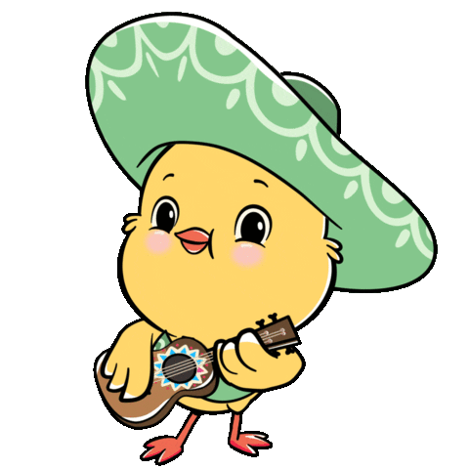
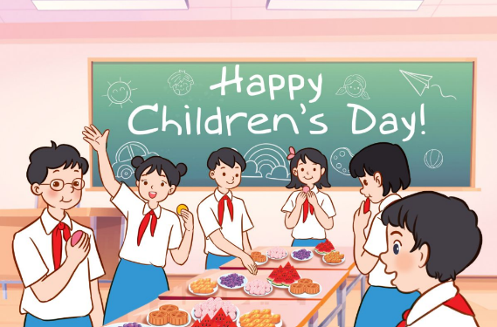
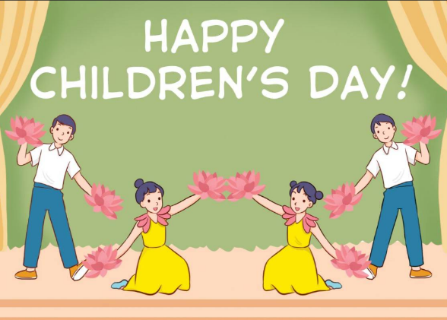
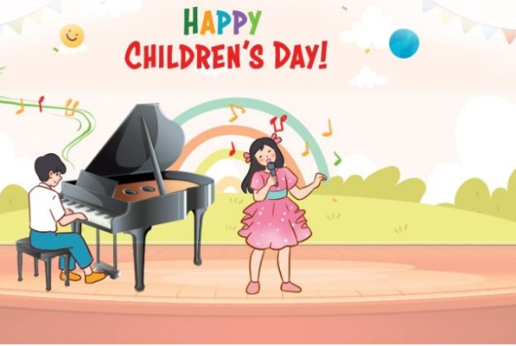
Listen and choose.
1/8
A
B
C

Slide 20
Listen and choose.
2/8
A
B
C

Slide 21
Listen and choose.
3/8
A
B
C

Slide 22
Listen and choose.
4/8
A
B
C

Slide 23
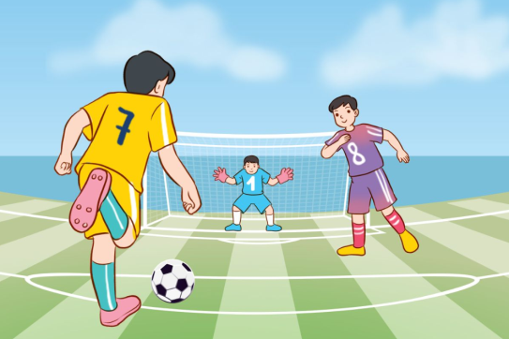
Listen and choose.
5/8
A
B
C

Slide 24
Listen and choose.
6/8
A
B
C

Slide 25
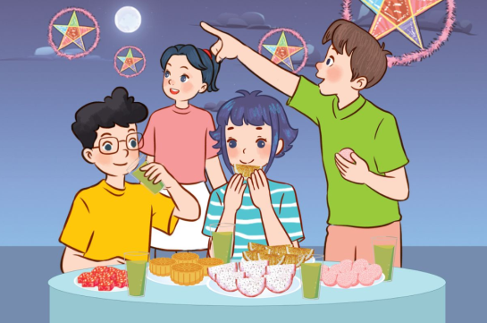
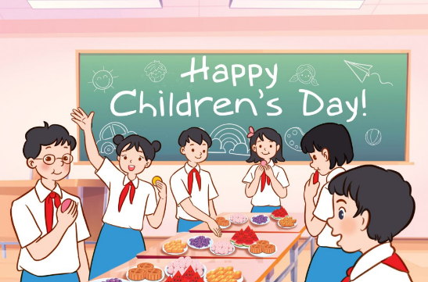
Listen and choose.
7/8
A
B
C

Slide 26
Listen and choose.
8/8
A
B
C

Slide 27
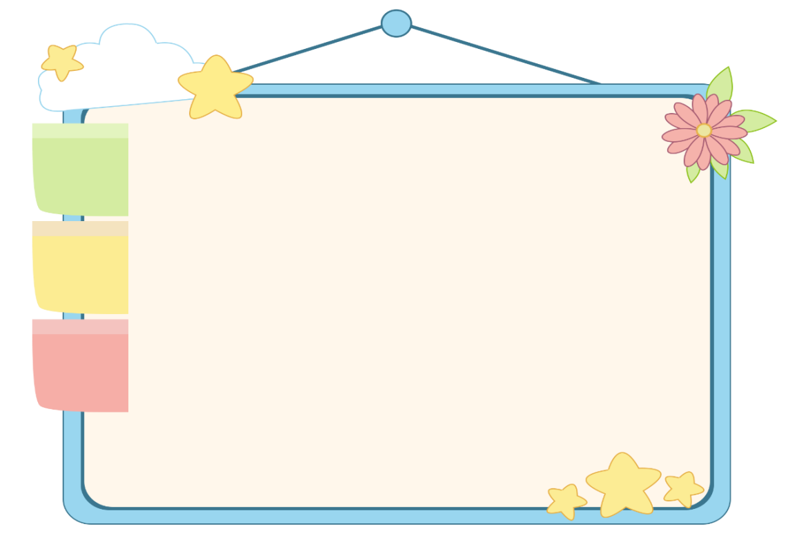
WELL DONE!

Slide 28
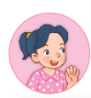
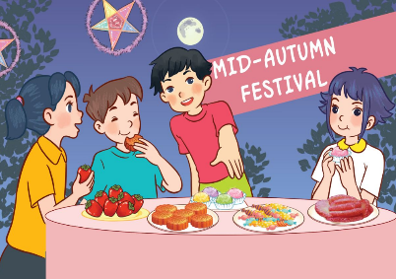
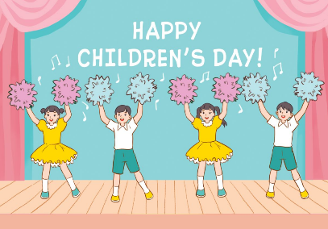
Unit 13 lesson 1
What will you do _____?
we’ll = we will
We’ll _____.
at Mid-Autumn Festival / have a party
on Sports Day / play badminton
on Children’s Day / dance
on Teachers’ Day / sing

Slide 29
Unit 13 lesson 2
What food / drinks will you have at the party?
We’ll have ______.
apple juice
milk tea
burgers
pizza

Slide 30
Homework
……………………………………… Prepare for lesson 3 (4+5+6).

Slide 31
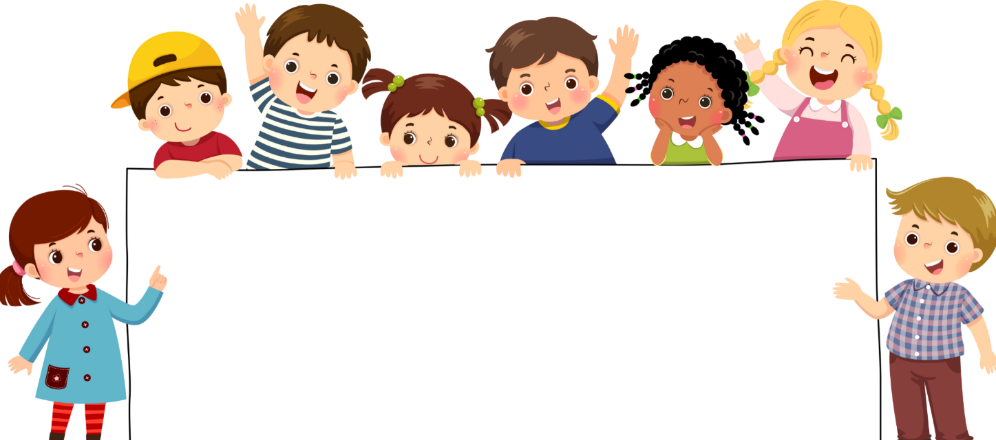
Goodbye!

