Slide 1
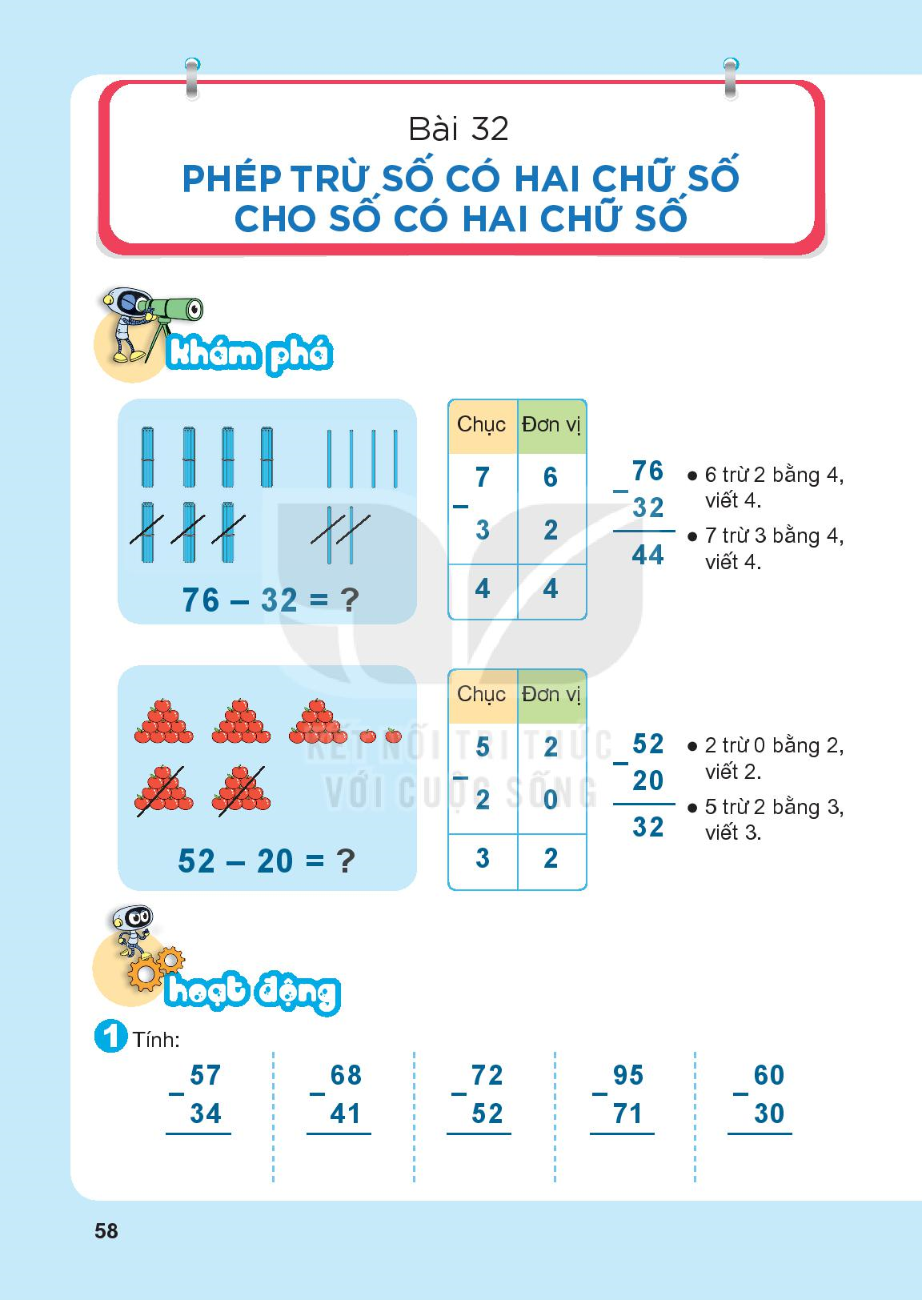

Slide 2
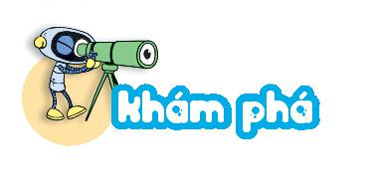

Slide 4
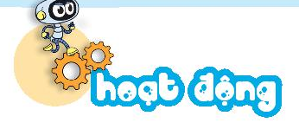
2
3
2
7
2
0
2
4
3
0

Slide 5
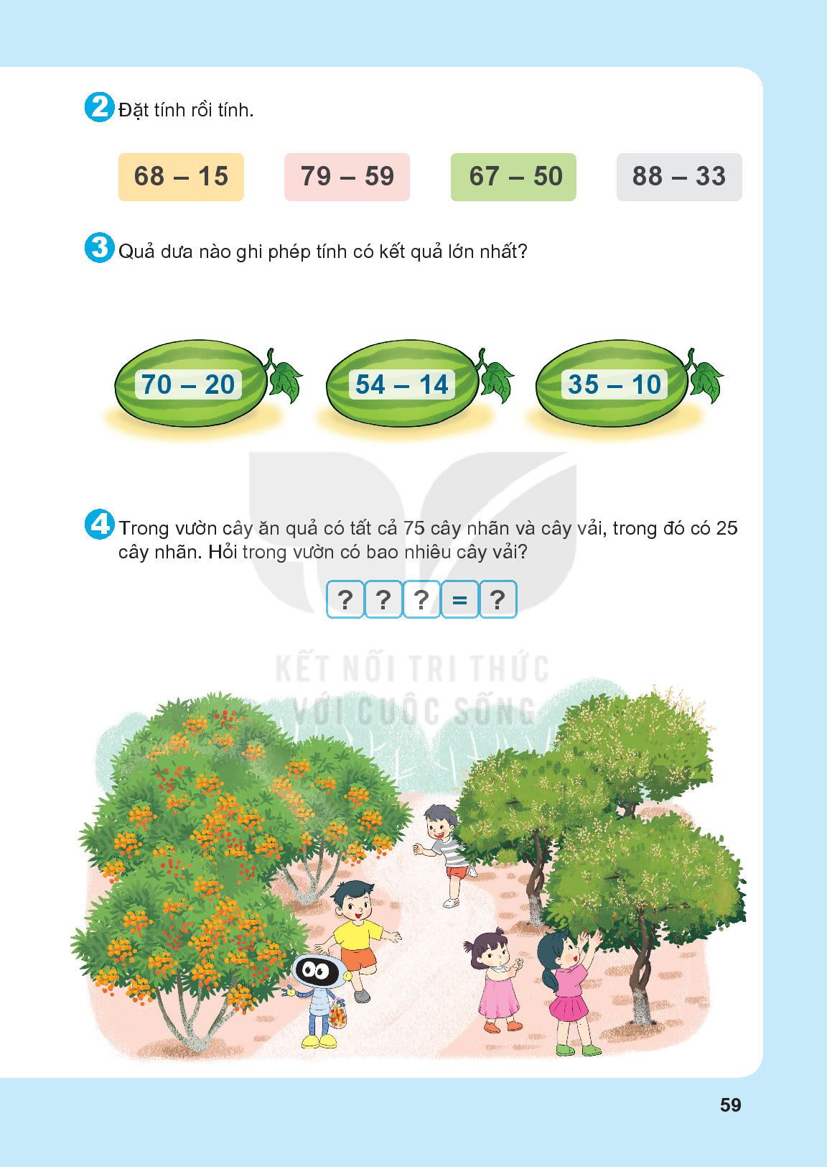

Slide 6
50
40
25

Slide 7
75
-
25
50

Slide 9
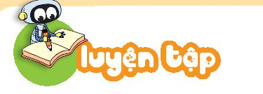
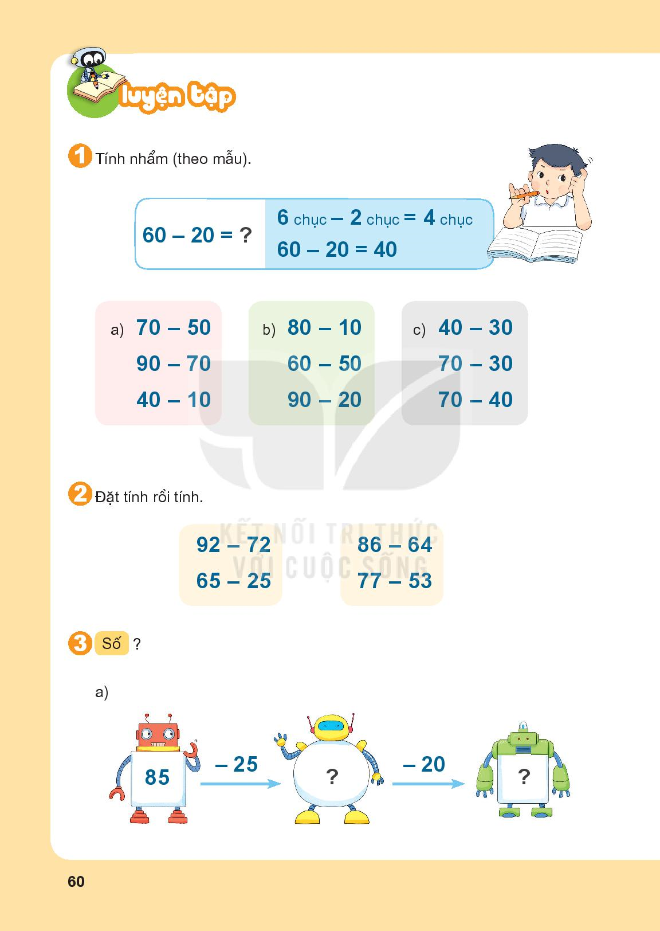
= 20
= 70
= 10
= 20
= 10
= 40
= 30
= 70
= 30

Slide 11
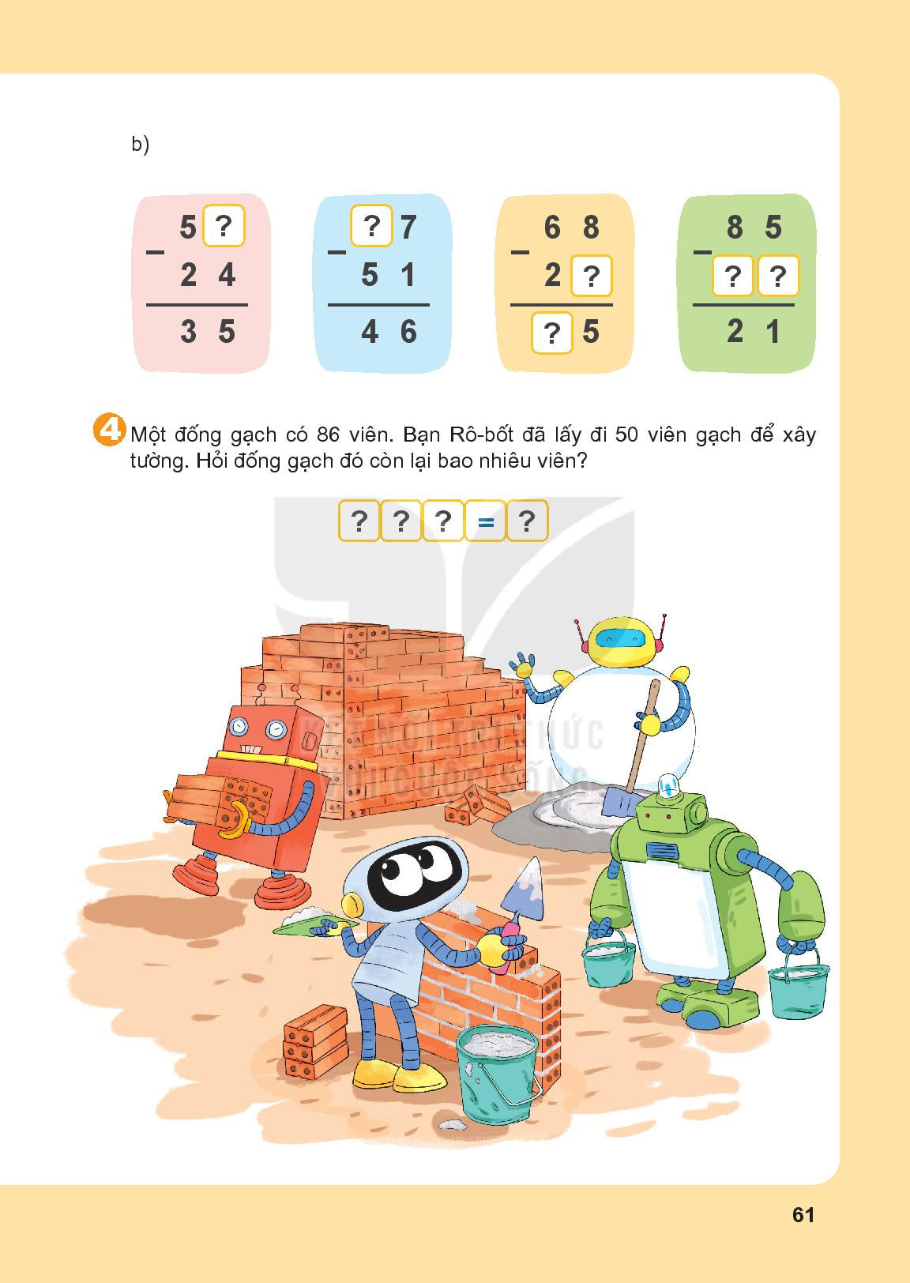
60
40
9
9
3
6
4
4

Slide 12
86
-
50
36

Slide 14
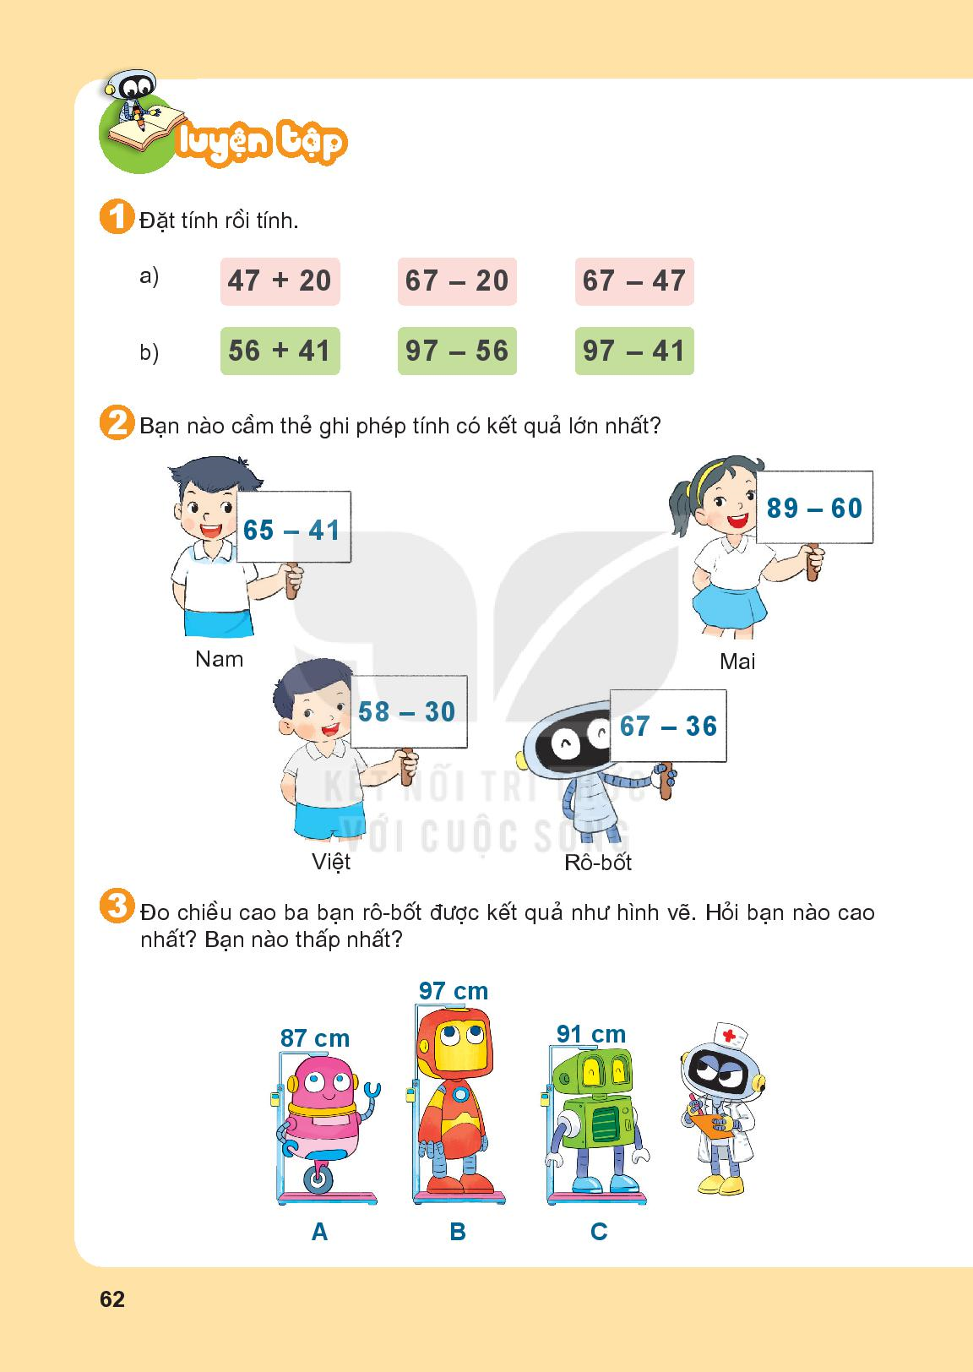

Slide 15
29
24
28
31

Slide 17
