Slide 2
* WARM-UP
E.g: I have a lot of bottles, dolls or stamps.
What is my hobby?
* Game:
Who’s faster?
COLLECTING

Slide 3
Unit
1
HOBBIES
LESSON 7: LOOKING BACK & PROJECT

Slide 4
* VOCABULARY REVIEW
1
Complete the sentences with appropriate hobbies.
1. I have a lot of coins from different countries. My hobby is ______________. 2. She loves judo and goes to the judo club every weekend. Her hobby is _________. 3. He loves making models of small cars and planes. His hobby is _______________. 4. My sister spends one hour in the garden every day. Her hobby is ______________. 5. Minh is a good footballer. He plays football with his friends every day.
His hobby is ________________.
Game: Who’s faster?

Slide 5
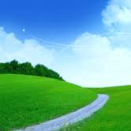
Who’s faster?
4
3
5
6
7
2
1

Slide 6
* VOCABULARY REVIEW
1
Complete the sentences with appropriate hobbies.
I have a lot of coins from different countries.
My hobby is ______________.
collecting coins

Slide 7
* VOCABULARY REVIEW
1
Complete the sentences with appropriate hobbies.
2. She loves judo and goes to the judo club every weekend.
Her hobby is _________.
doing judo

Slide 8
LUCKY apple!
YOU GET 1 POINT

Slide 9
LUCKY apple!
YOU GET 1 POINT

Slide 10
* VOCABULARY REVIEW
1
Complete the sentences with appropriate hobbies.
3. He loves making models of small cars and planes.
His hobby is _______________.
making models

Slide 11
* VOCABULARY REVIEW
1
Complete the sentences with appropriate hobbies.
4. My sister spends one hour in the garden every day.
Her hobby is ______________.
gardening

Slide 12
* VOCABULARY REVIEW
1
Complete the sentences with appropriate hobbies.
5. Minh is a good footballer. He plays football with his friends every day. His hobby is ________________.
playing football

Slide 13
* VOCABULARY REVIEW
1
Complete the sentences with appropriate hobbies.
1. I have a lot of coins from different countries. My hobby is ______________. 2. She loves judo and goes to the judo club every weekend. Her hobby is _________. 3. He loves making models of small cars and planes. His hobby is _______________. 4. My sister spends one hour in the garden every day. Her hobby is ______________. 5. Minh is a good footballer. He plays football with his friends every day.
His hobby is ________________.
collecting coins
doing judo
making models
gardening
playing football

Slide 14
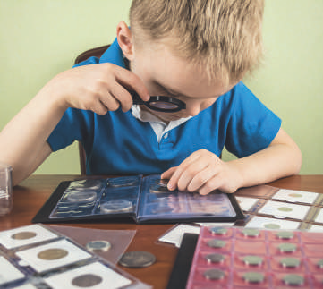
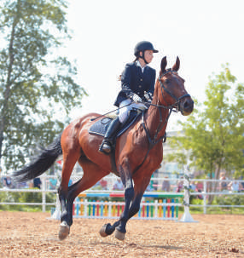
* VOCABULARY REVIEW
2
Write true sentences about you and your family members.
1. I like __________________. 2. My dad enjoys __________________. 3. My mum doesn’t like __________________. 4. My grandmother loves __________________. 5. My grandfather hates __________________.

Slide 15
* VOCABULARY REVIEW
2
Write true sentences about you and your family members.
1. I like playing volleyball.
2. My dad enjoys reading books
3. My mom doesn’t like gardening
4. My grandmother loves cooking
5. My grandfather hates making models

Slide 16
* GRAMMAR REVIEW
3
Use the present simple form of each verb to complete the passage.
Each of my best friends has his or her own hobby. Mi (1. love) __________ drawing. She can spend hours drawing pictures every day. Mark (2. have) _______ a different hobby. He (3. enjoy) __________ playing sport. I (4. not like) __________ playing sport. I like reading books because I can learn many things from them. However, there (5. be) ______ one hobby we share. It (6. be) ______ cooking. We all (7. go) _______ to the same cooking class. Our class (8. begin) __________ at 9 a.m. on Sundays.
loves
has
enjoys
don’t like
is
is
go
begins

Slide 17
* GRAMMAR REVIEW
4
Change the following sentences into questions and negative ones.
1. This river runs through my home town. _________________________________________________________________________________ _________________________________________________________________________________ 2. My drawing class starts at 8 a.m. every Sunday. _________________________________________________________________________________ _________________________________________________________________________________ 3. They enjoy collecting stamps. _________________________________________________________________________________ _________________________________________________________________________________
→ Does this river run through your home town?
→ This river doesn’t / does not run through my home town.
→Does your drawing class start at 8 a.m. every Sunday?
→My drawing class doesn’t / does not start at 8 a.m. every Sunday.
→ Do they enjoy collecting stamps?
→ They don’t / do not enjoy collecting stamps.

Slide 18
* GRAMMAR REVIEW
4
Change the following sentences into questions and negative ones.
4. I do judo every Tuesday. _________________________________________________ _________________________________________________ 5. My brother loves making model cars. _________________________________________________ _________________________________________________
Do you do judo every Tuesday?
I don’t / do not do judo every Tuesday.
Does your brother love making model cars?
My brother doesn’t / does not love making model cars.

Slide 19
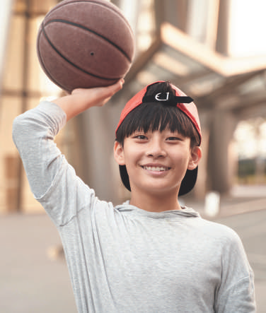
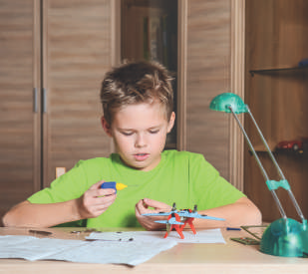
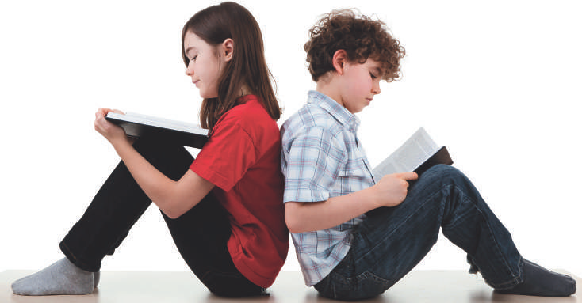
* PROJECT
Hobby posters
5
Work in groups.
1
Brainstorm some interesting and easy-to-do hobbies.
Choose a popular one among teens and discuss its benefits.
Create a poster about this hobby. Find suitable photos for it or draw your own pictures.
Present the hobby to the class. Try to persuade your classmates to take it up.

Slide 20
* CONSOLIDATION
1
WRAP-UP
Grammar
Words related to hobbies
The Present Simple Tense
Hobby Posters
Vocabulary
Project

Slide 21
homework
- Prepare for the next lesson:
- Prepare Unit 2: Lesson 1: Getting started

