Slide 2
WARM-UP
What will you mention when you talk about someone’s hobby?
Name of the hobby
The time he / she started the hobby
His / Her feeling about the hobby
His / Her future plan about the hobby

Slide 3
Unit
1
HOBBIES
LESSON 6: SKILL 2
LISTENING
WRITING

Slide 4
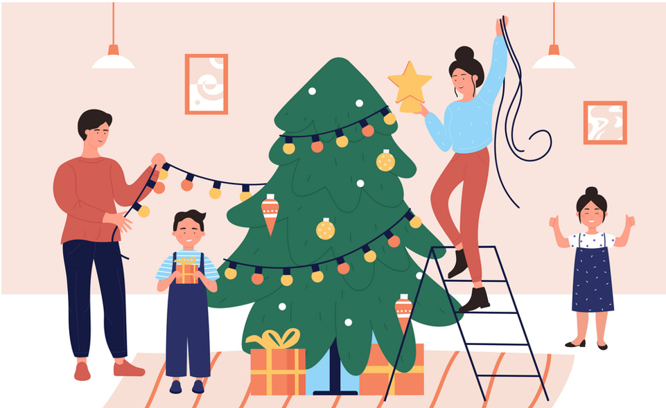
* Vocabulary
- decorate (v)
trang trí
/ˈdekəreɪt/:
- benefit (n)
/ˈbenɪfɪt/ :
lợi ích

Slide 5
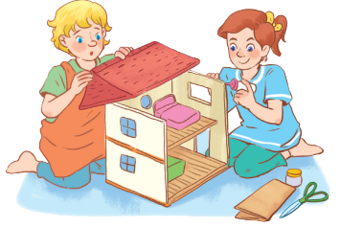
I. LISTENING
1
Look at the picture.
What hobby is it?
Do you think it is a good hobby? Why or why not?
In the picture, I can see two girls. They build a dollhouse. In my opinion, their hobby is building dollhouse
Because it develops your creativity. It also makes you more patient.

Slide 6
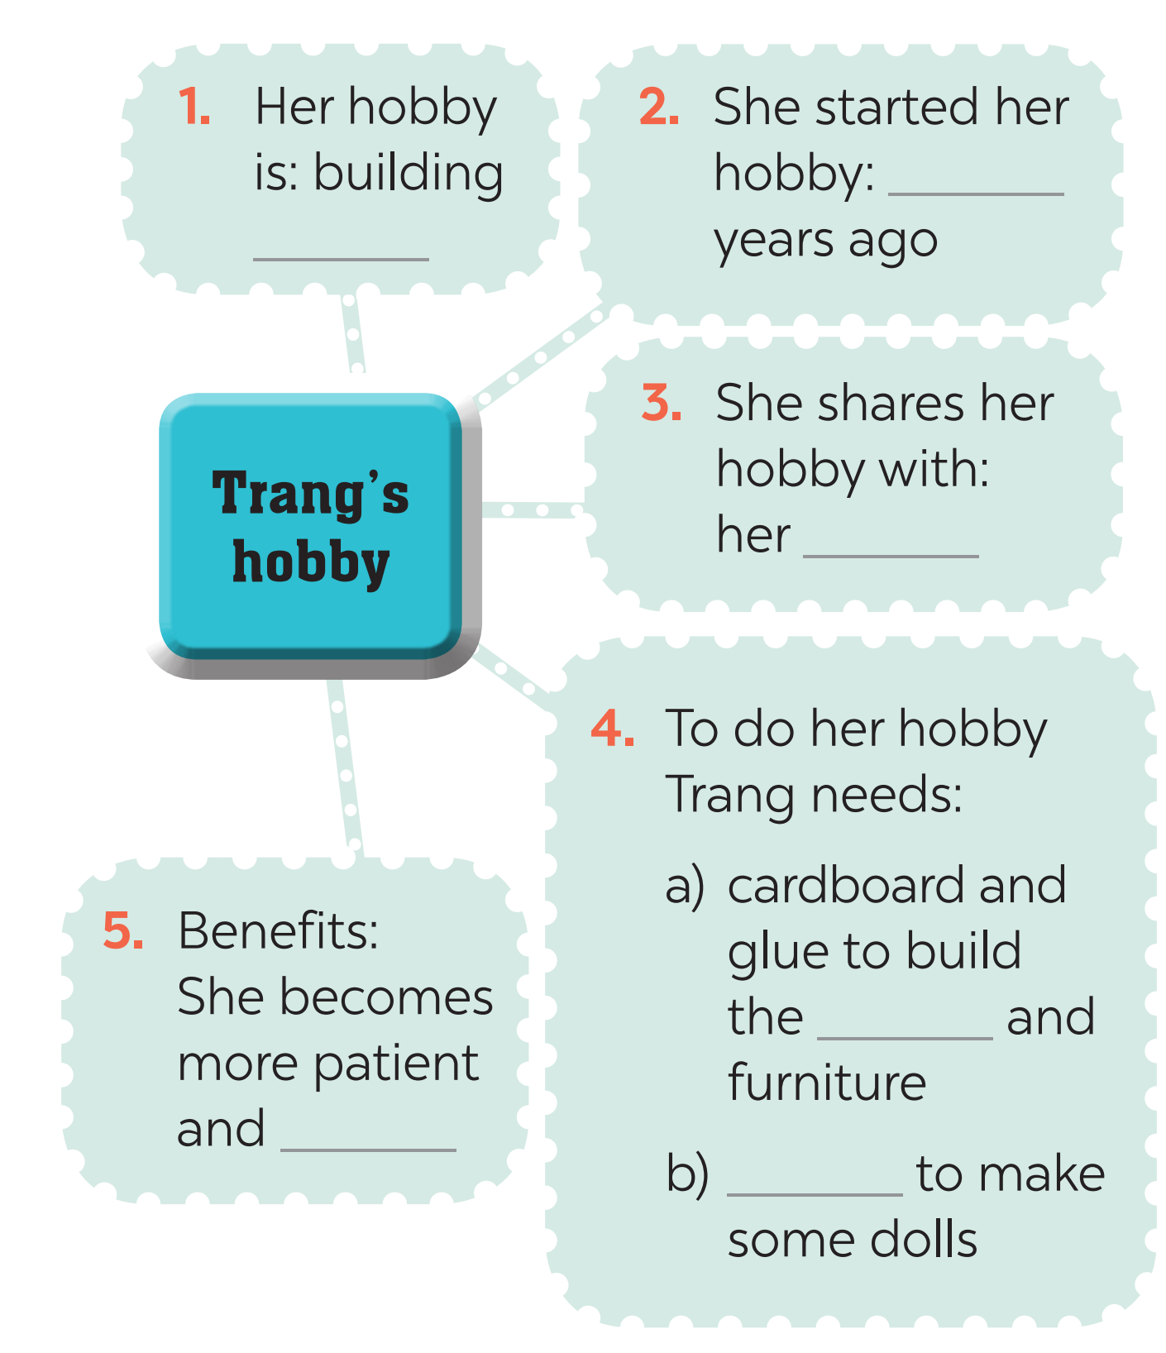
I. LISTENING
2
Listen to an interview about Trang’s hobby. Fill in each blank in the mind map with one word or number.
three
dollhouses
cousin
house
creative
cloth

Slide 7
Audio script
Lan: Today we’ll talk about hobbies. I know that your hobby is building dollhouses. It’s quite unusual, isn’t it?
Trang: Not really. A lot of girls like it.
Lan: When did you start doing this?
Trang: Three years ago. I read an article about building dollhouses. I loved the idea right away.
Lan: Do any of your friends or relatives build dollhouses too?
Trang: Yes, my cousin Mi loves building them too.
Lan: Is it hard to build a dollhouse?
Trang: No, it isn’t. I use cardboard and glue to build the house and make the furniture. Then I make the dolls from cloth. Finally, I decorate the house.
Lan: What are the benefits of the hobby?
Trang: Well, I’m more patient and creative now.

Slide 8
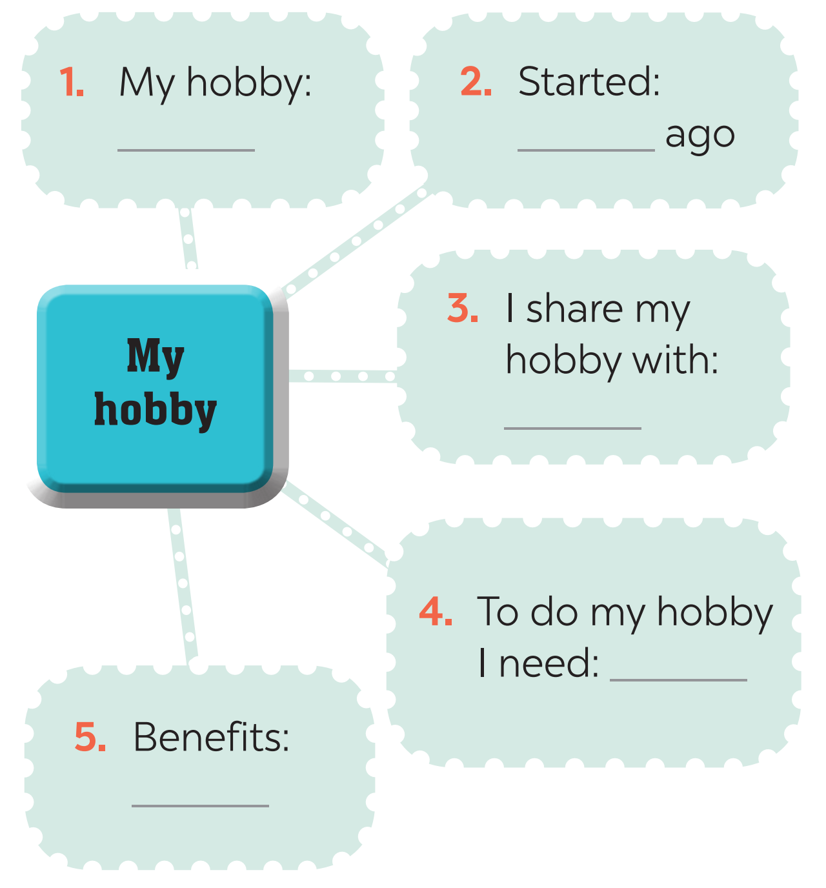
II. WRITING
3
What is your hobby? Fill in the blanks below.
Arranging flowers
3 years
my mom
flowers, vase, scissors
develop creativity, to be more patient.

Slide 9
II. WRITING
* Example:
1. My hobby: Arranging flowers
2. Started: 3 years ago
3. I share my hobby with: my mom
4. To do my hobby I need: flowers, vase, scissors
5. Benefits: develop creativity, to be more patient.

Slide 10
II. WRITING
4
Now write a paragraph of about 70 words about your hobby. Use the notes in Task 3. Start your paragraph as shown below.
My hobby is ___________________________________ ___________________________________________________ ___________________________________________________ ___________________________________________________ ___________________________________________________ ___________________________________________________ ___________________________________________________

Slide 11
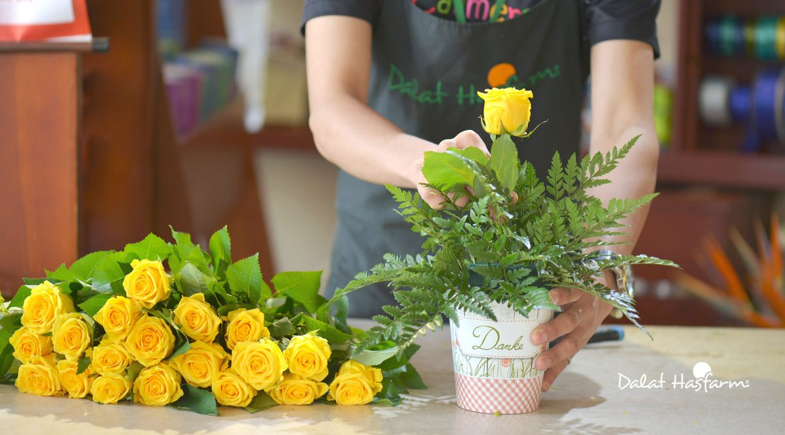
II. WRITING
4
Now write a paragraph of about 70 words about your hobby. Use the notes in Task 3. Start your paragraph as shown below.
4
My hobby is arranging flowers. I started this hobby 3 years ago. I share my hobby with my mom. We often arrange flowers at weekend. To arrange flowers, I need flowers, vase and scissors. When I arranging flowers, I feel happy. It helps me to develop my creativity and to be more patient.

Slide 12
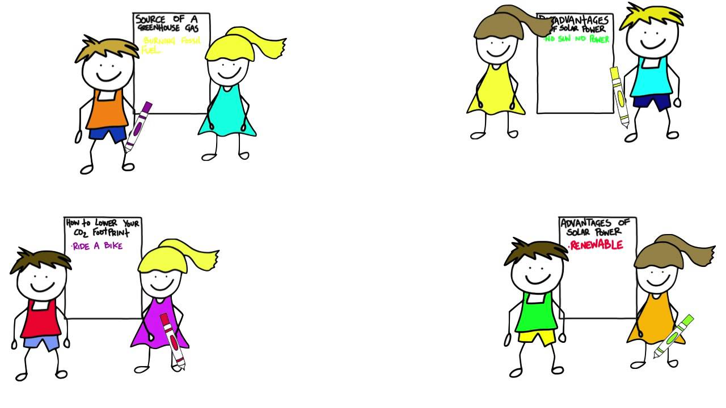
* PRODUCTION
CLASS GALLERY
Students can:
go and see others’ work
give comments to one another

Slide 13
* CONSOLIDATION
1
WRAP-UP
In this lesson, we have learnt to:
listen for specific information about Trang’s hobby
write a passage about her hobbies

Slide 14
* CONSOLIDATION
2
HOMEWORK
Prepare for the next lesson: Looking back & Project

Slide 15
