Slide 2


Unit
1
LOCAL COMMUNITY
LESSON 1: GETTING STARTED
I really love where I live now.
1

Slide 3
LESSON 1: GETTING STARTED
LESSON 1: GETTING STARTED
WARM-UP
Asking questions
PRESENTATION
Vocabulary
Task 1: Listen and read.
Task 2: Read the conversation again. Fill in each blank with no more than TWO words from the conversation.
Task 3: Match each word or phrase with its definition.
Task 4: Complete each sentence with a word or phrase from 3.
PRACTICE
PRODUCTION
Task 5: What is the place? Do the following quiz.
CONSOLIDATION
Wrap-up
Homework

Slide 4
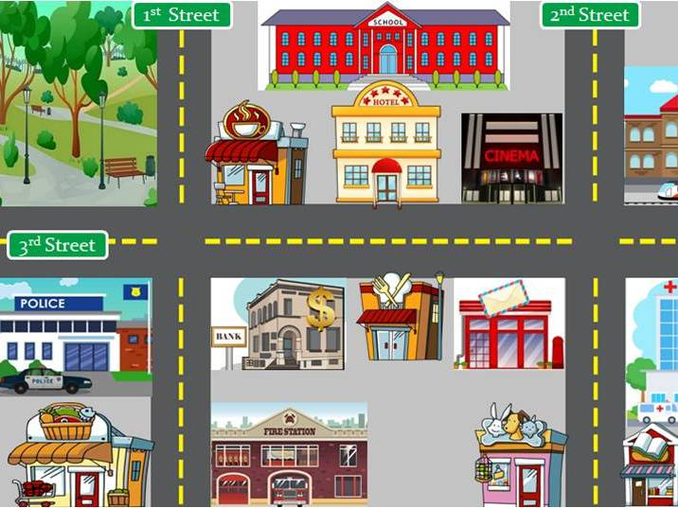
WARM-UP
What can you see in this photo?
BRAINSTORMING

Slide 5
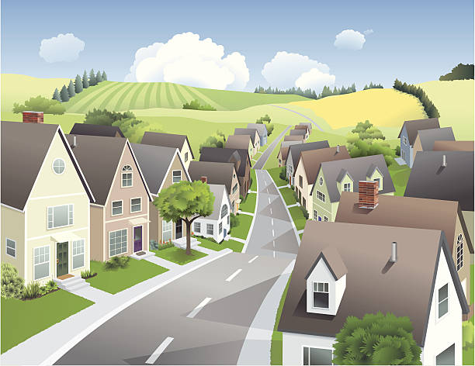

PRESENTATION
suburb (n)
/ˈsʌbɜːb/
vùng ngoại ô

Slide 6
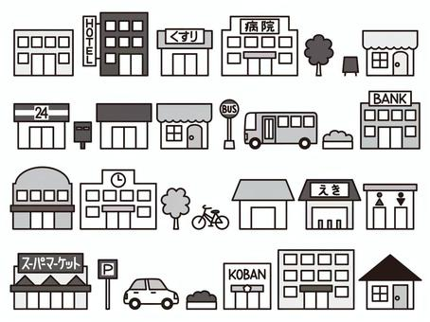
PRESENTATION
facilities (n)
/fəˈsɪlətiz/
cơ sở vật chất

Slide 7

PRESENTATION
community (n)
/kəˈmjuːnəti/
cộng đồng

Slide 8

PRESENTATION
get on with
/ɡet ɒn wɪð/
có quan hệ tốt với

Slide 9
PRESENTATION
New words | Pronunciation | Meaning
1. suburb (n) | /ˈsʌbɜːb/ | vùng ngoại ô
2. facilities (n) | /fəˈsɪlətiz/ | cơ sở vật chất
3. community (n) | /kəˈmjuːnəti/ | cộng đồng
4. get on with | /ɡet ɒn wɪð/ | có quan hệ tốt với

Slide 10
PRACTICE
1
Listen and read.
Ann: Hi, Mi. Long time no see. How’re you doing?
Mi: I’m fine, thanks. By the way, we moved to a new house in a suburb last month.
Ann: Oh, that’s why I haven’t seen you in the Reading Club very often.
Mi: Yes. We’re still busy moving in, you know.
Ann: How’s your new neighbourhood?
Mi: It’s much bigger than our old one. The streets are wider, and there are fewer people.
Ann: What about the facilities?
Mi: It has all the things we need: shopping malls, parks, and hospitals. And there’s a craft village near our house.
Ann: Great! How’re your new neighbours?
Mi: They’re nice. Last Sunday when I was looking for the way to the bus station, a lady came and showed me the way. I think we will get on with them.
Ann: That reminds me of the time our family moved to Viet Nam. We didn’t know where to buy stuff for our
house, and the new neighbours in the community gave us useful advice. I guess you like your new place.
Mi: Sure. I really love where I live now.

Slide 11
PRACTICE
2
Read the conversation again. Fill in each blank with no more than TWO words from the conversation.
last month
1. Mi’s family moved to a new house in a suburb __________.
2. Her new neighbourhood is bigger with wider streets and ____________.
3. There is a ___________ near Mi’s house.
4. Mi thinks she will get on with her new ___________.
5. People in Ann’s community gave her family _____________ on where to buy stuff.
fewer people
craft village
neighbours
useful advices

Slide 12
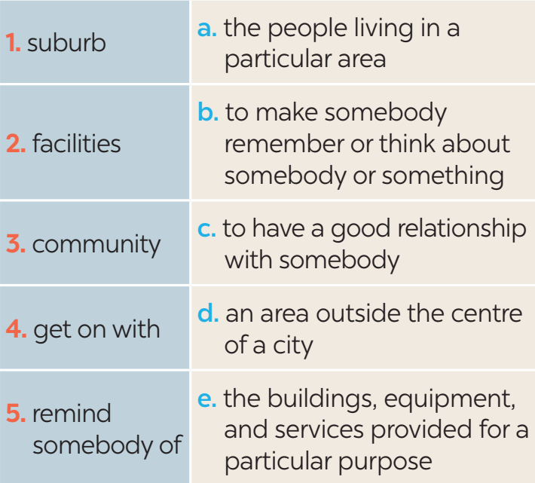
PRACTICE
3
Match each word or phrase with its definition.

Slide 13
PRACTICE
4
Complete each sentence with a word or phrase from 3.
1. They don’t live in the city centre but in a _______ of Ha Noi.
2. I love our new neighbourhood because we ____________ the people here.
3. There are enough sports _________ for people of all ages in our local park.
4. Souvenirs _________ people ______ a place, an occasion, or a holiday.
5. The local ____________ encourages us to protect the environment and keep our neighbourhood clean.
suburb
get on with
facilities
remind of
community

Slide 14


PRODUCTION
5
What is the place?
1. People watch sports such as football there.
=> stadium
2. People go there for health check-ups.
=> hospital
3. Parents take their children there so that they can have fun.
=> playground
4. Children learn to read and write there.
=> school
5. Visitors see objects from the past there.
=> museum

Slide 15

CONSOLIDATION
1
Wrap-up
What have we learnt in this lesson?
identify the topic of the unit
use lexical items related to local community
identify the language features that are covered in the unit

Slide 16

CONSOLIDATION
2
Homework
- Do exercises in the Workbook.
- Start preparing for the Project of the unit

Slide 17
Website: hoclieu.vn
Fanpage: facebook.com/www.tienganhglobalsuccess.vn/

