Slide 2




Unit
1
MY NEW SCHOOL
LESSON 5: SKILLS 1
READING
SPEAKING

Slide 3
LESSON 5: SKILLS 1
WARM-UP
Game: Lucky number
Task 1: Look at the picture and quickly read the passages. Match 1-3 with A - C.
Vocabulary teaching
Task 2: Read the passages again and complete the sentences.
Task 3: Answer the questions.
READING
Task 4: Which school in Task 1 would you like to go to? Why? Complete the table. Then discuss your choice with your friends.
SPEAKING
CONSOLIDATION
Wrap-up
Homework

Slide 4

WARM-UP
LUCKY NUMBER
1
2
3
2 teams
4
5
6
7

Slide 5
WARM-UP
1
How many classes are there in our school?
HOME

Slide 6
WARM-UP
2
Do students have to wear uniforms when they go to school?
HOME

Slide 7
WARM-UP
3
How many computer rooms does our school have?
HOME

Slide 8
WARM-UP
4
Name some clubs in our school.
HOME

Slide 9
WARM-UP
5
When was our school established?
HOME

Slide 10

WARM-UP
6
LUCKY NUMBER
HOME

Slide 11
WARM-UP
7
LUCKY NUMBER
HOME

Slide 12
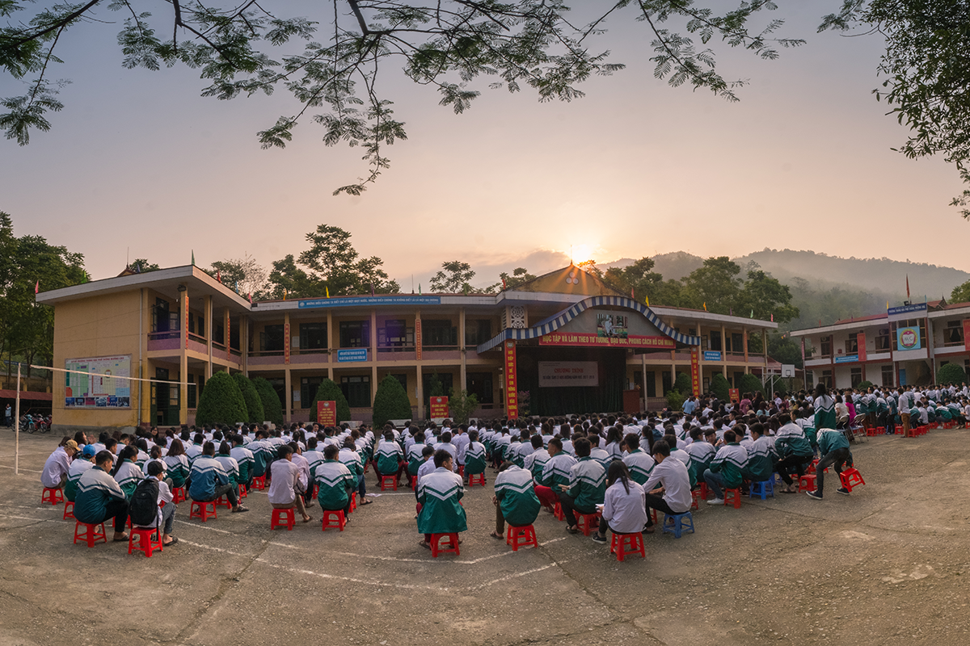
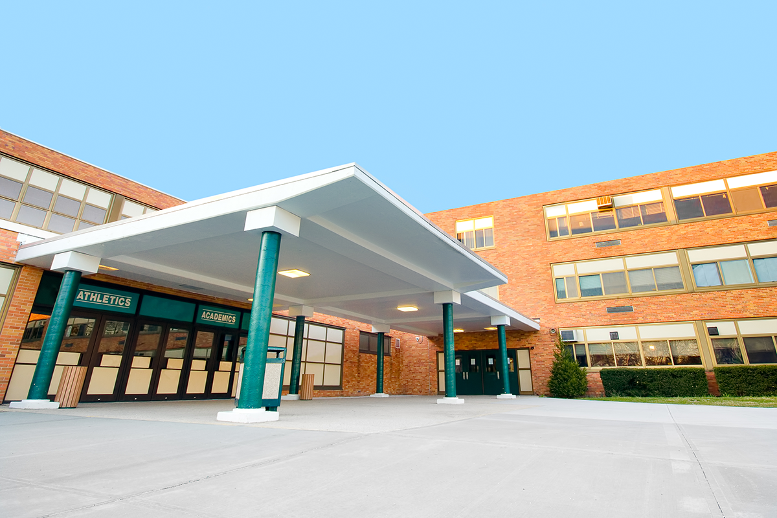

READING
1. What can you see in these pictures?
2. Are these schools in the same place?
3. Which school do you think is in Viet Nam?

Slide 13
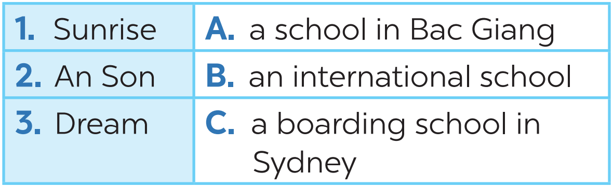
READING
1
Look at the picture and quickly read the passages. Match 1-3 with A-C.

Slide 14
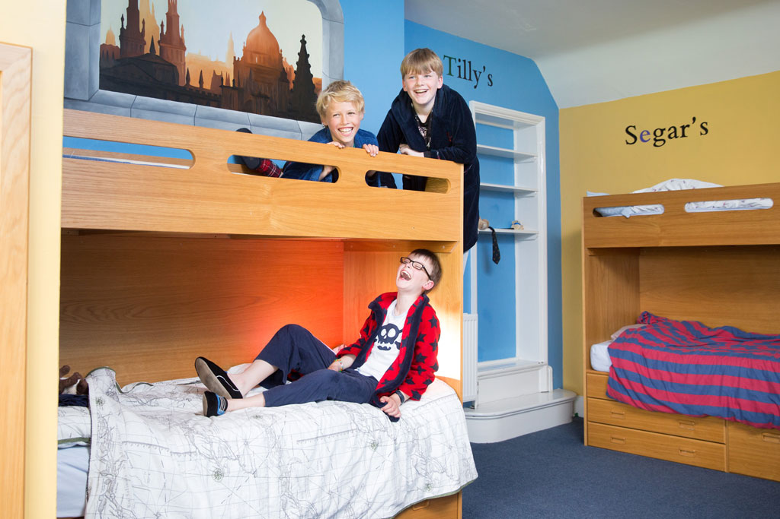

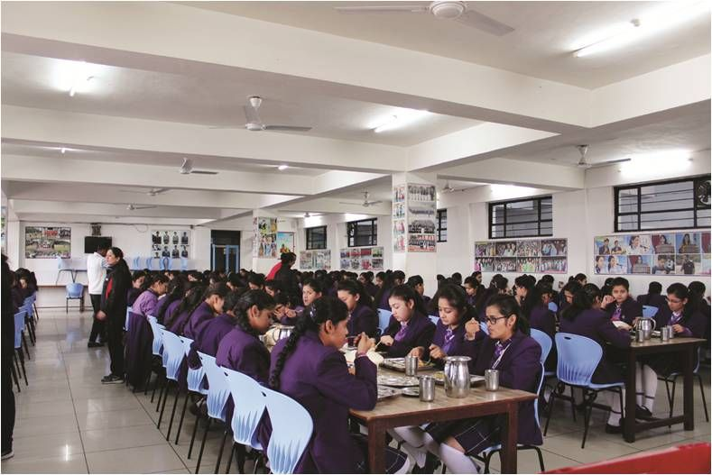
READING
boarding school (n)
A school where students live and study
/ˈbɔːdɪŋ ˌskuːl/
trường nội trú

Slide 15
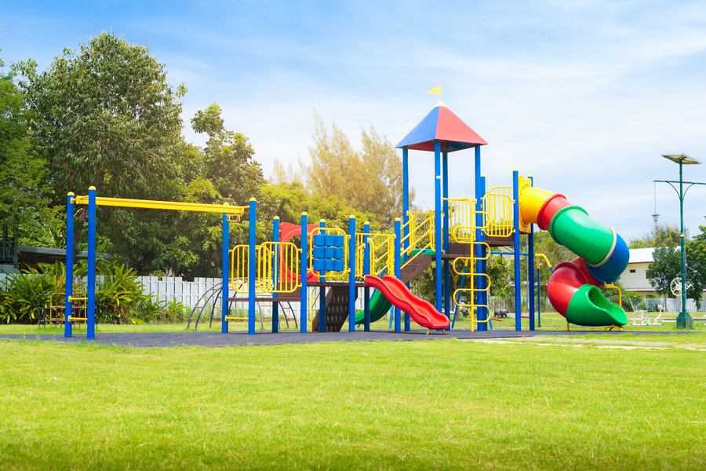
READING
playground (n)
/ˈpleɪɡraʊnd/
sân chơi

Slide 16

READING
international (adj)
/ˌɪntəˈnæʃənəl/
(mang tính)
quốc tế

Slide 17
READING
New words | Pronunciation | Meaning
1. boarding school (n) | /ˈbɔːdɪŋ ˌskuːl/ | trường nội trú
2. playground (n) | /ˈpleɪɡraʊnd/ | sân chơi
3. international (adj) | /ˌɪntəˈnæʃənəl/ | (mang tính) quốc tế

Slide 18
READING
2
Read the passages again and complete the sentences.
1. Students live and study in a ________ school. They only go home at weekends.
2. Sunrise is a school in _______.
3. There are ______________________ around An Son School.
4. ____________ has an art club.
5. At Dream School, students learn English with _______________________.
boarding
Sydney
mountains and green fields
Dream School
English-speaking teachers

Slide 19
READING
3
Answer the questions.
1. Which school is a boarding school?
→ Sunrise (is).
2. Where is An Son School?
→ It is in Bac Giang.
3. Is there a school garden in An Son School?
→ Yes, there is.
4. What do Dream School students do in the afternoon?
→ They join many interesting clubs.

Slide 20
SPEAKING
4
Which school in Exercise 1 would you like to go to? Why? Complete the table.
Name of school | Reasons you like it

Slide 21
SPEAKING
Discuss your choice with your friends.
Name of school | Reasons you like it
- Work in groups of 4.
- Share the answers.

Slide 22

CONSOLIDATION
1
Wrap-up
What have we learnt in this lesson?
Read about type of school
Speak about type of school you would like to go to

Slide 23

CONSOLIDATION
2
Homework
- Do exercises in the workbook.
- Write down your opinions about a school in your notebooks.

Slide 24






Website: hoclieu.vn
Fanpage: facebook.com/www.tienganhglobalsuccess.vn/

