Slide 2


Unit
1
MY NEW SCHOOL
LESSON 4: COMMUNICATION
1

Slide 3
LESSON 4: COMMUNICATION
LESSON 1: GETTING STARTED
WARM-UP
Game: Who knows more?
Task 1: Listen and read the dialogue.
Task 2: Work in groups. Practise introducing a friend to someone.
EVERYDAY ENGLISH
Task 3: Read and tick the questions you think are suitable to ask a new friend at school.
Task 4: Friendship quiz.
Task 5: Work in groups. Take turns to interview the others, use the questions above.
NEW FRIENDS AT SCHOOL
CONSOLIDATION
Wrap-up
Homework

Slide 4


WARM-UP
WHO KNOWS MORE???
Instructions
Pictures of some famous pairs of friends
2 teams
2 teams need to name them

Slide 5

WARM-UP
Tom and Jerry

Slide 6

WARM-UP
Woody and Buzz

Slide 7

WARM-UP
Lisa and Rose

Slide 8

WARM-UP
Spongebob and Patrick

Slide 9

WARM-UP
Harry Potter and Hermione Granger

Slide 10

WARM-UP
Leonardo DiCaprio
and Tobey Maguire

Slide 11


PRESENTATION
share (v)
/ʃeə(r)/
chia sẻ

Slide 12

PRESENTATION
classmate (n)
/ˈklɑːsmeɪt/
bạn cùng lớp

Slide 13
PRESENTATION
New words | Pronunciation | Meaning
1. share (v) | /ʃeə(r)/ | chia sẻ
2. classmate (n) | /ˈklɑːsmeɪt/ | bạn cùng lớp

Slide 14
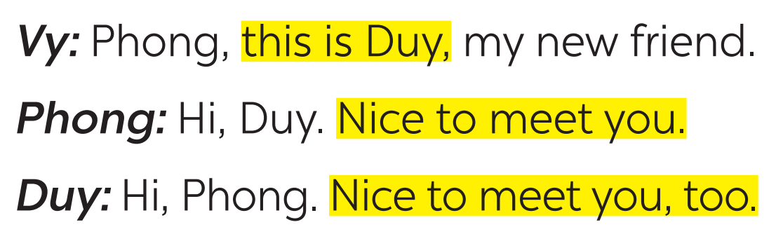
PRACTICE
1
Listen and read the dialogue. Pay attention to the highlighted parts.

Slide 15

PRACTICE
2
Work in groups. Practise introducing a friend to someone else.

Slide 16
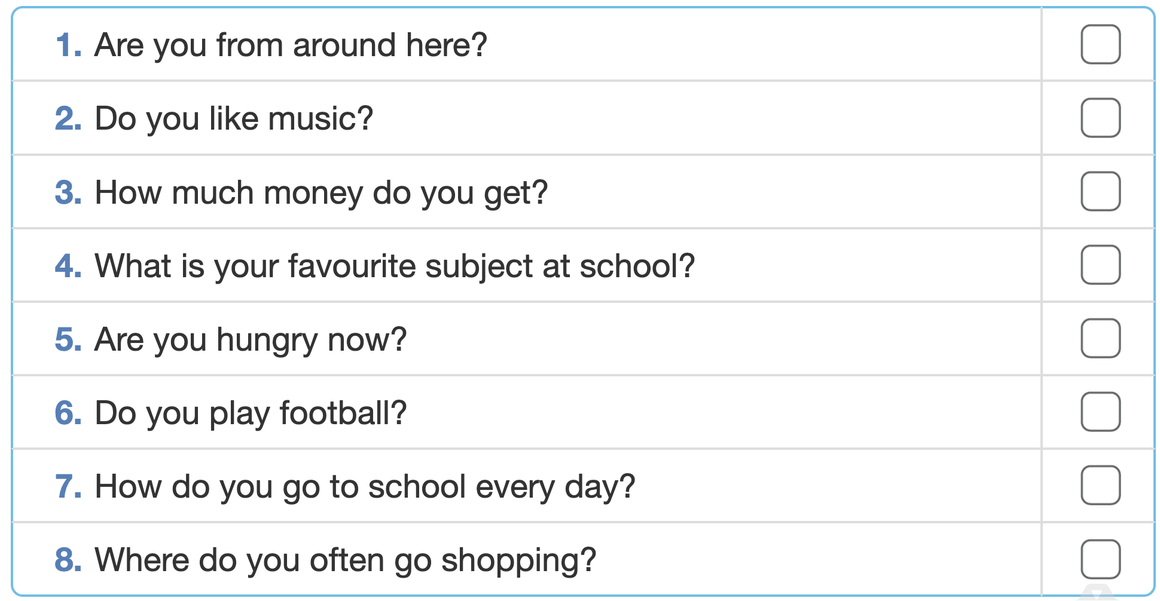

Can you add 2 more questions to the list?
PRACTICE
3
Read and tick the questions you think are suitable to ask a new friend at school.

Slide 17
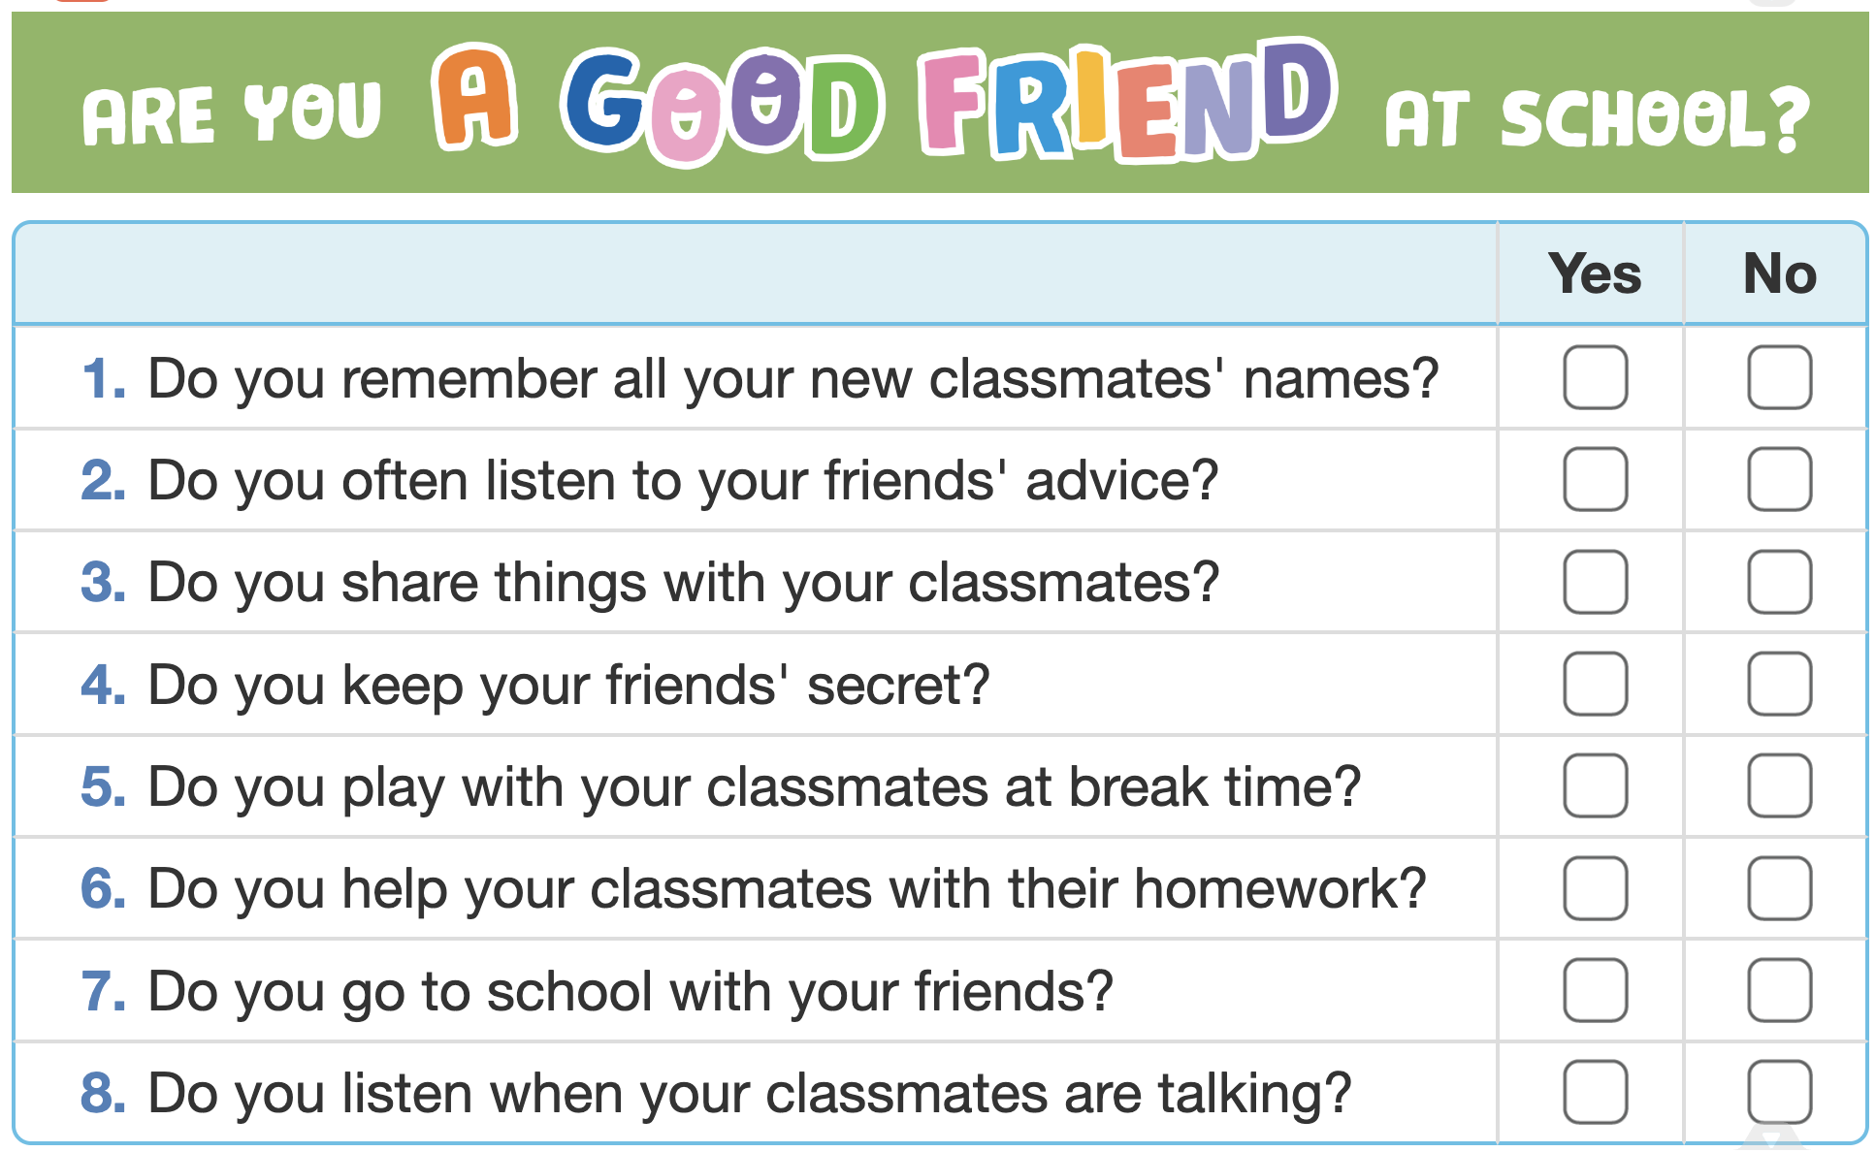
PRACTICE
4
There is a quiz for students in the new school newsletter. Answer the questions.

Slide 18

PRACTICE
5
Work in groups. Take turns to interview the others, use the questions above.

Slide 19

CONSOLIDATION
1
Wrap-up
What have we learnt in this lesson?
How to introduce someone
Questions when making friends at school
Good qualities a good friend should have

Slide 20

CONSOLIDATION
2
Homework
- Do exercises in the workbook.
- Write down the results and feedback of the interview.

Slide 21






Website: hoclieu.vn
Fanpage: facebook.com/www.tienganhglobalsuccess.vn/

