Slide 2


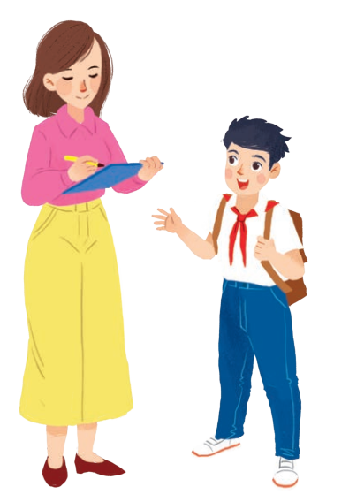
Unit
1
MY NEW SCHOOL
LESSON 3: A CLOSER LOOK 2
1

Slide 3
LESSON 3: A CLOSRE LOOK 2
LESSON 1: GETTING STARTED
WARM-UP
Game: Sentence puzzling
PRESENTATION
Present simple tense
Adverbs of frequency
Task 1: Choose the correct answer A, B, or C.
Task 2: Miss Nguyet is interviewing Duy for the school newsletter. Write the correct form of the verbs.
Task 3: Fill the blanks with usually, sometimes or never.
Task 4: Choose the correct answer A or B to complete each sentence.
Task 5: Work in pairs. Make questions, and then interview your partner.
PRACTICE
CONSOLIDATION
Wrap-up
Homework

Slide 4

WARM-UP
Sentence puzzling
Instructions
4 teams
a set of word cards
Create as many correct sentences from the word cards as possible

Slide 5
WARM-UP
1. Peter lives near his school.
2. We go to the same school.
3. They have new subjects.
4. We always look smart in our uniforms.

Slide 6
PRESENTATION
THE PRESENT SIMPLE

Slide 7
PRESENTATION
Positive | S + V(inf) / V(s/es) + …
Negative | S + don’t / doesn’t + V(inf) + …
Interrogative | Do / Does + S + V(inf) + … ?
Answer | Yes, S + do /does. No, S + don’t / doesn’t.
WH questions | WH + do /does + S + V(inf) + … ?
Notes | * Use do /don’t with: I, you, we, they and plural noun forms. * Use does/ doesn’t with: she, he, it and singular noun forms.

Slide 8
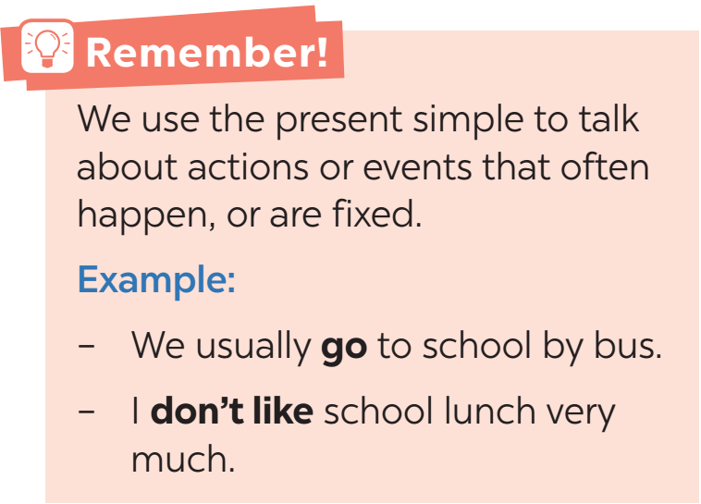
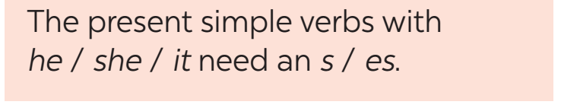
PRESENTATION

Slide 9
PRESENTATION
ADVERBS OF FREQUENCY

Slide 10
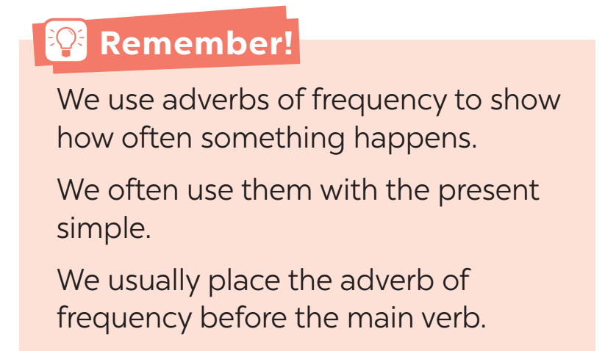
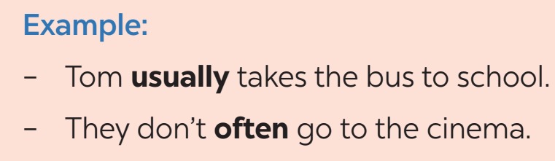
PRESENTATION

Slide 11
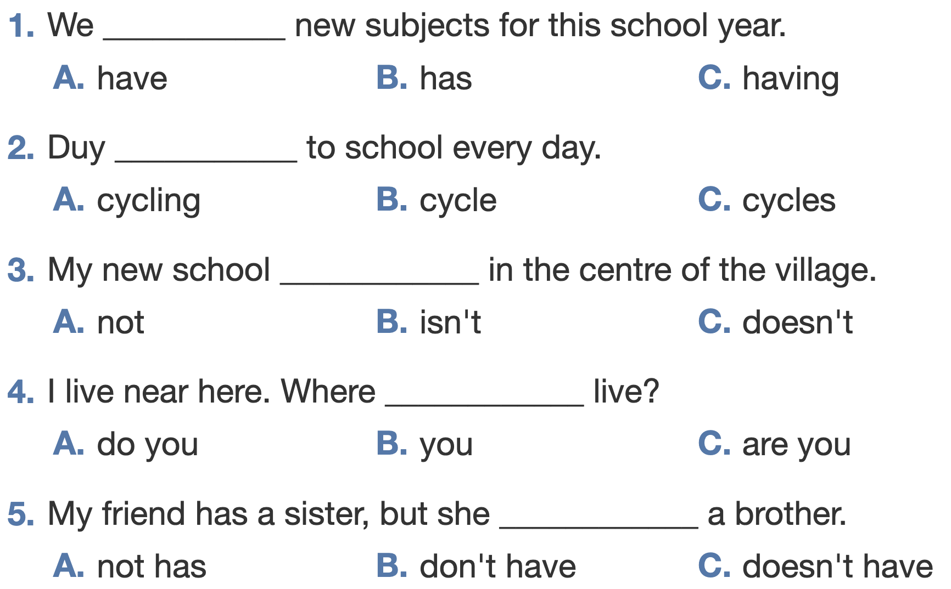
PRACTICE
1
Choose the correct answer A, B or C.

Slide 12
PRACTICE
1
Choose the correct answer A, B or C.

Slide 13
PRACTICE
2
Miss Nguyet is interviewing Duy for the school newsletter. Write the correct form of the verbs.
Miss Nguyet: Tell us about your new school, Duy.
Duy: Sure! My school (1. have) ______ a large playground.
Miss Nguyet: ____ you (2. have) _____ any new friends?
Duy: Yes. And I (3. like) _____ my new friends, Vy and Phong.
Miss Nguyet: ______ Vy (4. walk) ______ to school with you?
Duy: Well, we often (5. ride) _____ our bicycles to school.
Miss Nguyet: What time do you go home?
Duy: I (6. go) ____ home at 4 p.m. everyday.
Miss Nguyet: Thank you!
has
Do
have
like
Does
walk
ride
go

Slide 14
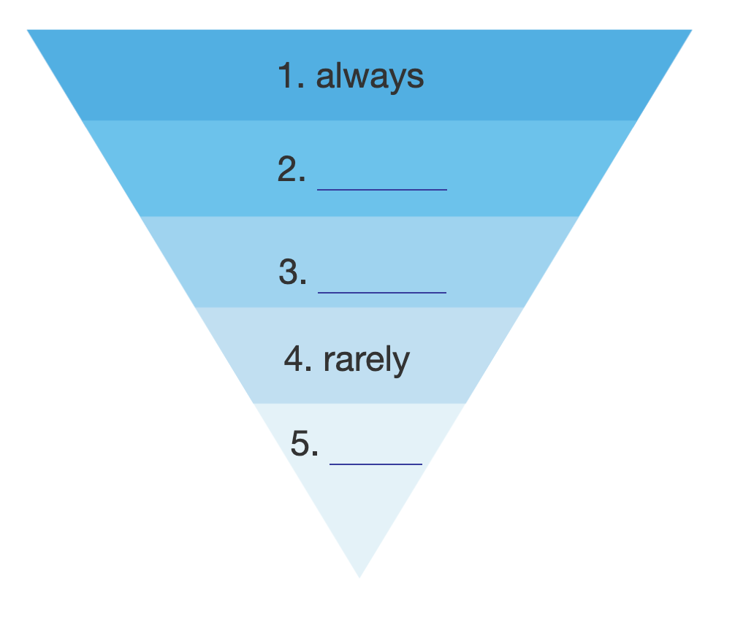
PRACTICE
- Work in groups of 4.
- Make 5 sentences using the 5 adverbs of frequency above.
3
Fill the blanks with sometimes, usually or never.
usually
sometimes
never

Slide 15
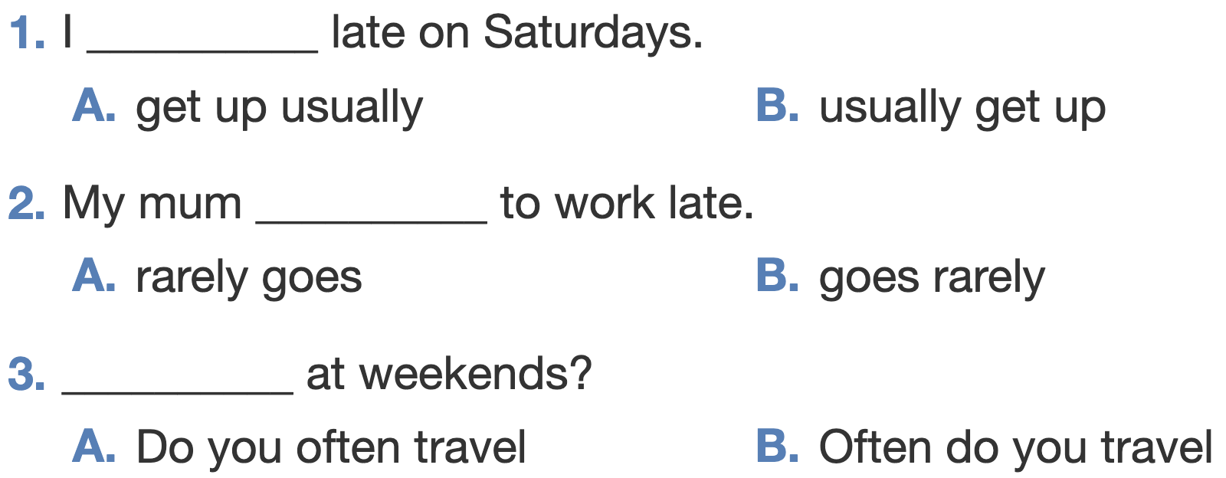
PRACTICE
4
Choose the correct answer A or B to complete each sentence.

Slide 16
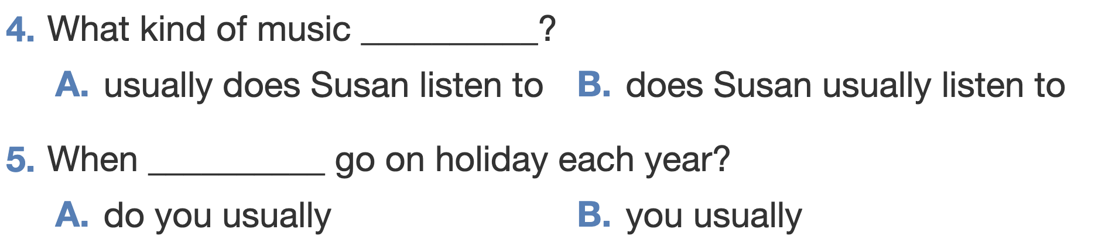
PRACTICE
4
Choose the correct answer A or B to complete each sentence.

Slide 17
PRACTICE
5
Work in pairs. Make questions then interview your partner.
1. you / often / ride your bicycle / to school
→ Do you like your new school?
2. you / sometimes / study / in the school library
→ Do you sometimes study in the school library?
3. your friends / always / go to school / with you
→ Do your friends usually go to school with you?
4. you / usually / do homework / after school
→ Do you usually do your homework after school?

Slide 18

CONSOLIDATION
1
Wrap-up
What have we learnt in this lesson?
The present simple tense
Adverbs of frequency

Slide 19

CONSOLIDATION
2
Homework
- Do exercises in the Workbook.
- Make 5 sentences in the present simple tense, using adverbs of frequency.

Slide 20






Website: hoclieu.vn
Fanpage: facebook.com/www.tienganhglobalsuccess.vn/

