Slide 2
Unit
12
ENGLISH-SPEAKING COUNTRIES
LESSON 4: COMMUNICATION
Unit

Slide 3
OBJECTIVES
By the end of the lesson, students will be able to:
express amazement
know interesting facts about English-speaking countries

Slide 4
LESSON 4: COMMUNICATION
WARM-UP
Guessing the remaining of the picture
Task 1: Listen and read the conversations, paying attention to the highlighted parts.
Task 2: Work in pairs. Make similar dialogues with the following situations, using expressions of amazement.
EVERYDAY ENGLISH
Task 3: Work in groups. Discuss and write the name of the country next to the fact.
Task 4: Work in pairs. Read some facts about English-speaking countries and tick the column true for you.
Task 5: Work in groups. Share with your group some interesting facts you know about English-speaking countries. The group takes notes and presents its findings to the class.
INTERESTING FACTS ABOUT ENGLISH-SPEAKING COUNTRIES
CONSOLIDATION
Wrap-up
Homework

Slide 5
WARM-UP

Slide 6
EVERYDAY ENGLISH
1
Listen and read the conversations, paying attention to the highlighted parts.
2 ways to express amazement:
Wow ... I didn’t know that!
Amazing!

Slide 7
EVERYDAY ENGLISH
2
Work in pairs. Make similar dialogues with the following situations, using expressions of amazement.
1. New Zealand has the cleanest and safest air on the planet. 2. There are no snakes in New Zealand. 3. More than half of all the lakes in the world are in Canada.

Slide 8
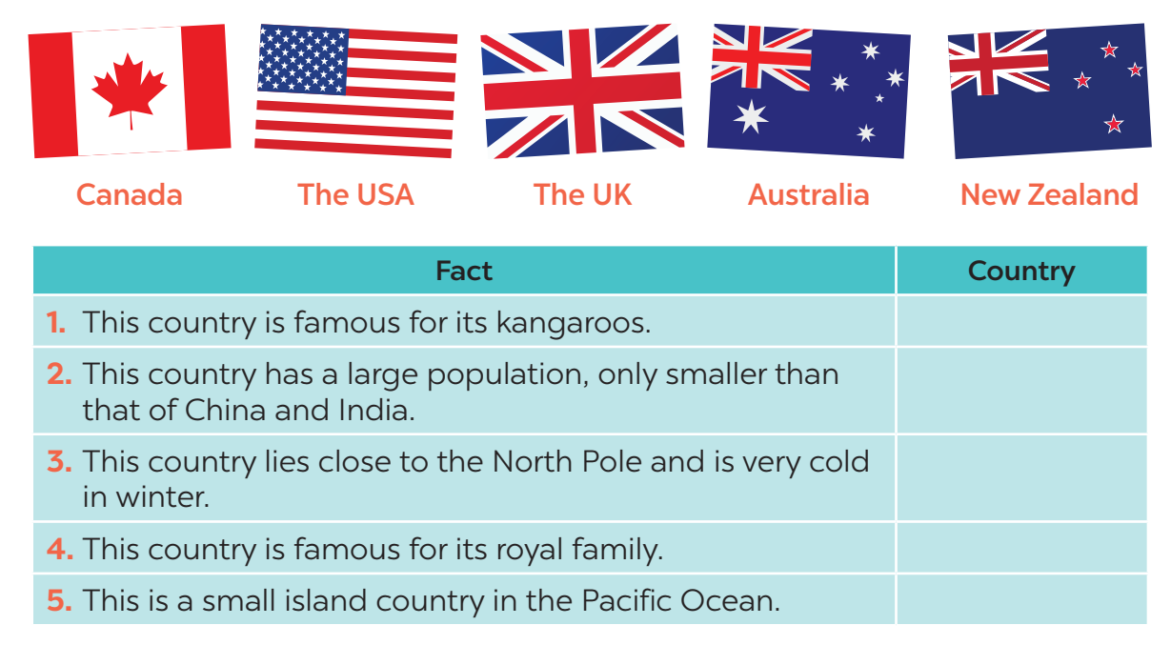
INTERESTING FACTS ABOUT ENGLISH-SPEAKING COUNTRIES
3
Work in groups. Discuss and write the name of the country next to the fact.
Australia
The USA
Canada
The UK
New Zealand

Slide 9
INTERESTING FACTS ABOUT ENGLISH-SPEAKING COUNTRIES
Work in pairs. Read some facts about English-speaking countries and tick the column true for you. Then role play by one person saying one statement aloud and the other responding to it.
4

Slide 10
INTERESTING FACTS ABOUT ENGLISH-SPEAKING COUNTRIES
Work in pairs. Read some facts about English-speaking countries and tick the column true for you. Then role play by one person saying one statement aloud and the other responding to it.
4
Example:
A: New York is the biggest city but not the capital of the USA.
B: I know this.
A: The state of Alaska in the USA has over 2,600 islands.
B: This is new to me.

Slide 11
INTERESTING FACTS ABOUT ENGLISH-SPEAKING COUNTRIES
5
Work in groups. Share with your group some interesting facts you know about English-speaking countries. The group takes notes and presents its findings to the class.

Slide 12
CONSOLIDATION
1
WRAP-UP
In this lesson, we have learn to:
express amazement
know interesting facts about English-speaking countries

Slide 13
CONSOLIDATION
2
HOMEWORK
Prepare some photos of your favourite English-speaking country.

Slide 14
Website: hoclieu.vn
Fanpage: facebook.com/www.tienganhglobalsuccess.vn/

