Slide 2
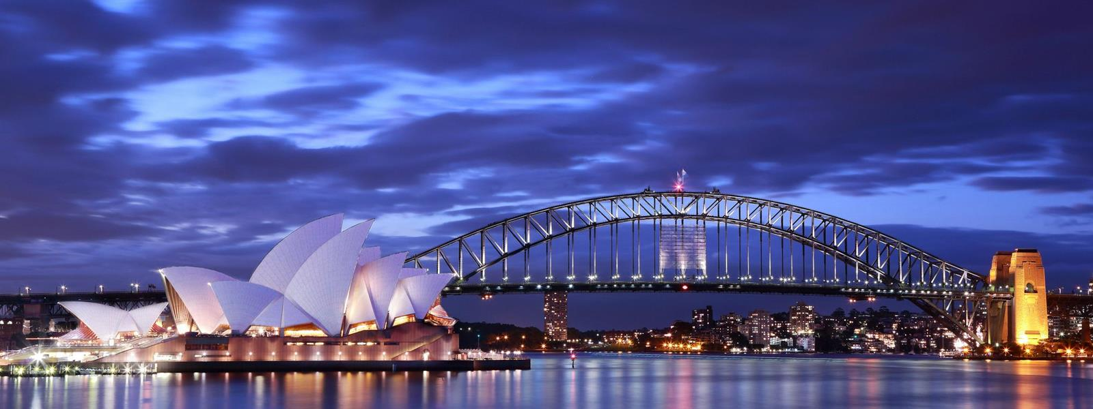
Unit
12
ENGLISH-SPEAKING COUNTRIES
LESSON 1: GETTING STARTED
A holiday in Australia

Slide 3
OBJECTIVES
By the end of the lesson, students will be able to gain:
an overview about the topic English-speaking countries
lexical items related to people and places in English-speaking countries
the language features that are covered in the unit

Slide 4
LESSON 1: GETTING STARTED
WARM-UP
Flags matching
PRESENTATION
Vocabulary
Task 1: Listen and read.
Task 2: What are Phong and Mark talking about?
Task 3: Read again and tick the information you can find in the conversation.
Task 4: Complete the sentences with the words and phrases from the box.
Task 5: Matching game: What’s its capital city?
PRACTICE
CONSOLIDATION
Wrap-up
Homework

Slide 5
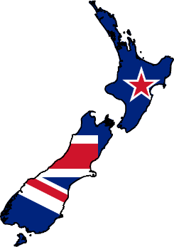
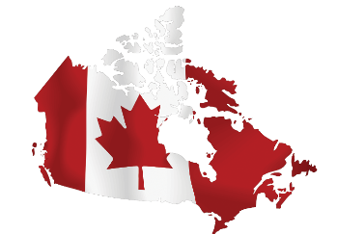
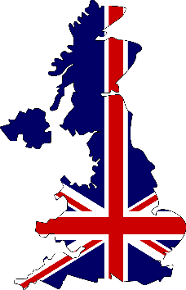
WARM-UP
FLAGS MATCHING
The USA
Canada
The UK
Australia
New Zealand

Slide 6
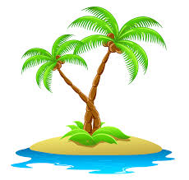
PRESENTATION
island (n)
/ˈaɪlənd/
hòn đảo

Slide 7
PRESENTATION
sunset (n)
/ˈsʌnset/
hoàng hôn

Slide 8
PRESENTATION
landscape (n)
/ˈlændskeɪp/
phong cảnh

Slide 9
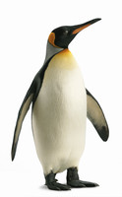
PRESENTATION
penguin (n)
/ˈpeŋɡwɪn/
chim cánh cụt

Slide 10
PRESENTATION
New words | Pronunciation | Meaning
island (n) | /ˈaɪlənd/ | hòn đảo
sunset (n) | /ˈsʌnset/ | hoàng hôn
landscape (n) | /ˈlændskeɪp/ | phong cảnh
penguin (n) | /ˈpeŋɡwɪn/ | chim cánh cụt

Slide 11
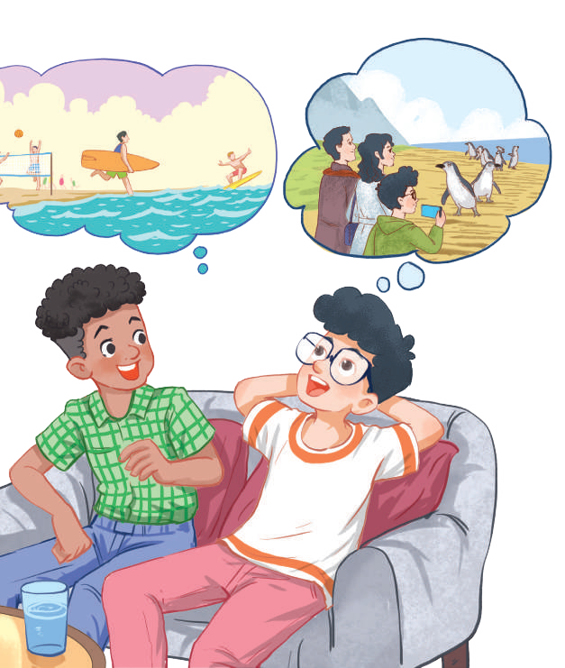
PRACTICE
1
Listen and read.
Mark: How was your holiday in Australia, Phong?
Phong: It was fantastic! I got to use my English in real life: asking for directions, reading maps, talking to local people, ...
Mark: Oh … Your English is much better.
Phong: Thanks.
Mark: Did you travel a lot?
Phong: Just around Melbourne, the city with four seasons in a day.
Mark: Wow ... I didn’t know that. How was it?
Phong: It was great! We took a tour to Phillip Island.
Mark: What did you see?
Phong: We went penguin watching.
Mark: It sounds pretty exciting.
Phong: It was. Australia has amazing landscapes.
Mark: Yes, and Australians love outdoor activities.
Phong: Right. There were plenty of people enjoying the parks and beaches.
Mark: I’m glad that you had a wonderful time there.
Phong: Thanks, Mark.

Slide 12
PRACTICE
2
What are Phong and Mark talking about?
A. Phong’s holiday in Australia B. English-speaking countries C. The tour to Phillip Island

Slide 13
PRACTICE
3
Read again and tick the information you can find in the conversation.
1. In Australia, Phong used English in real life. 2. Phong visited some museums. 3. Phillip Island is far from Melbourne. 4. Australia is beautiful. 5. Australians love outdoor activities.

Slide 14
PRACTICE
4
Complete the sentences with the words and phrases from the box.
island sunset landscape
Australians penguin watching
1. This is a picture of the ______________ in my village. 2. – Where did you go ___________________? – On the beach. 3. – Is Phu Quoc a(n) ____________? – Yes, it is. 4. We had dinner on the beach after ____________. 5. Most _____________ like outdoor sports and games.
landscape
penguin watching
island
sunset
Australians

Slide 15
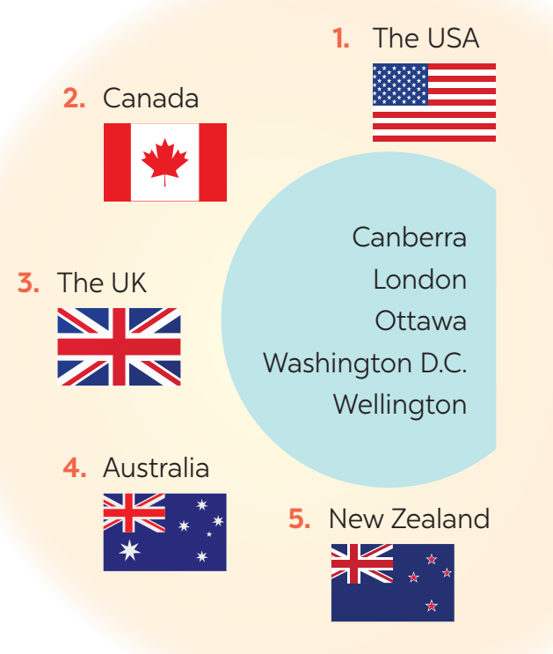
PRACTICE
5
Matching game: What’s its capital city?
1. Washington D.C.
2. Ottawa
3. London
4. Canberra
5. Wellington

Slide 16
PRACTICE
5
DISCUSSION
What do you know about the countries?

Slide 17
CONSOLIDATION
1
WRAP-UP
What have we learnt in this lesson?
identify the topic of the unit
lexical items related to people and places in English-speaking countries
identify the language features that are covered in the unit

Slide 18
CONSOLIDATION
2
HOMEWORK
Search for more English-speaking countries.
Prepare for the next lesson.
Prepare for the Unit’s project.

Slide 19
Website: hoclieu.vn
Fanpage: facebook.com/www.tienganhglobalsuccess.vn/

